Slide 1

OMEGA @ ME Grad Orientation
Discord: https://discord.gg/gyyGmftsx8
Website: purdueomega.com
Email: puomega@purdue.edu
Insta: puomega

Slide 2
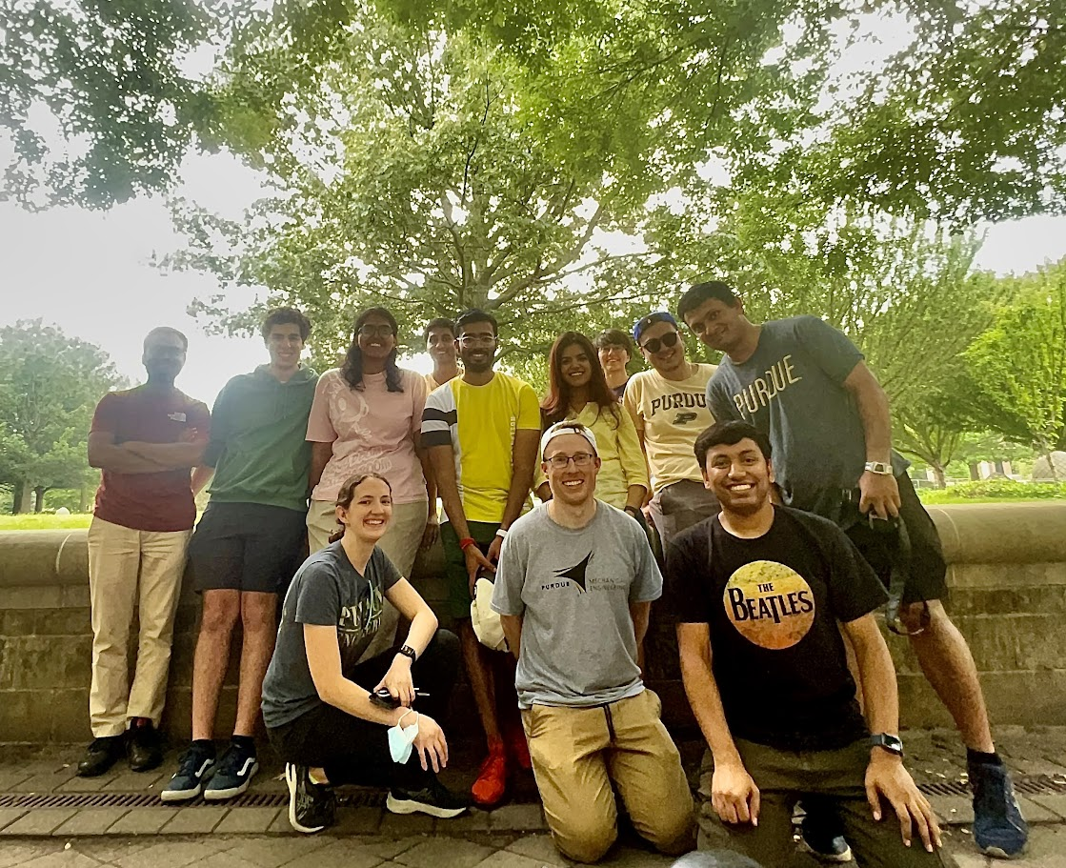
What is OMEGA?
The Official Mechanical Engineering Graduate Association, is a student organization that supports ME grad students through social, academic, and professional events
It automatically includes all ME grad students and represents their interests in university leadership settings
(23-24 Officers)

Slide 3
What does OMEGA do?
Building Social Connections: We organize social events, often in collaboration with other departments, to help ME grad students connect
Academic Enhancement: We support your academic success by hosting study groups and facilitating academic seminars
Mentoring Opportunities: We run mentoring activities that pair experienced grad students with newcomers to help them transition smoothly
Resource Guides: We provide useful links and resources on our website to assist with academic and personal challenges
Representing Students: We ensure your feedback is communicated to ME department and university leadership by actively representing you in leadership settings

Slide 4
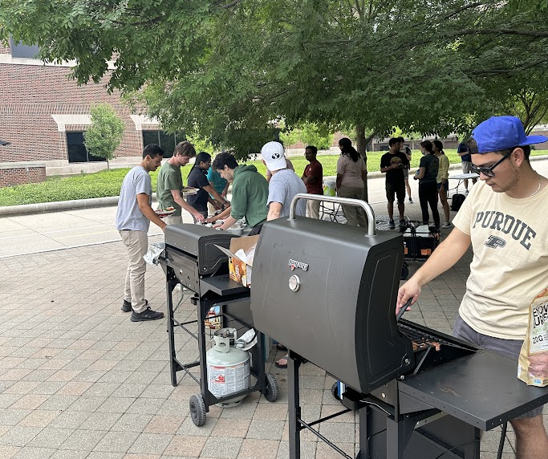
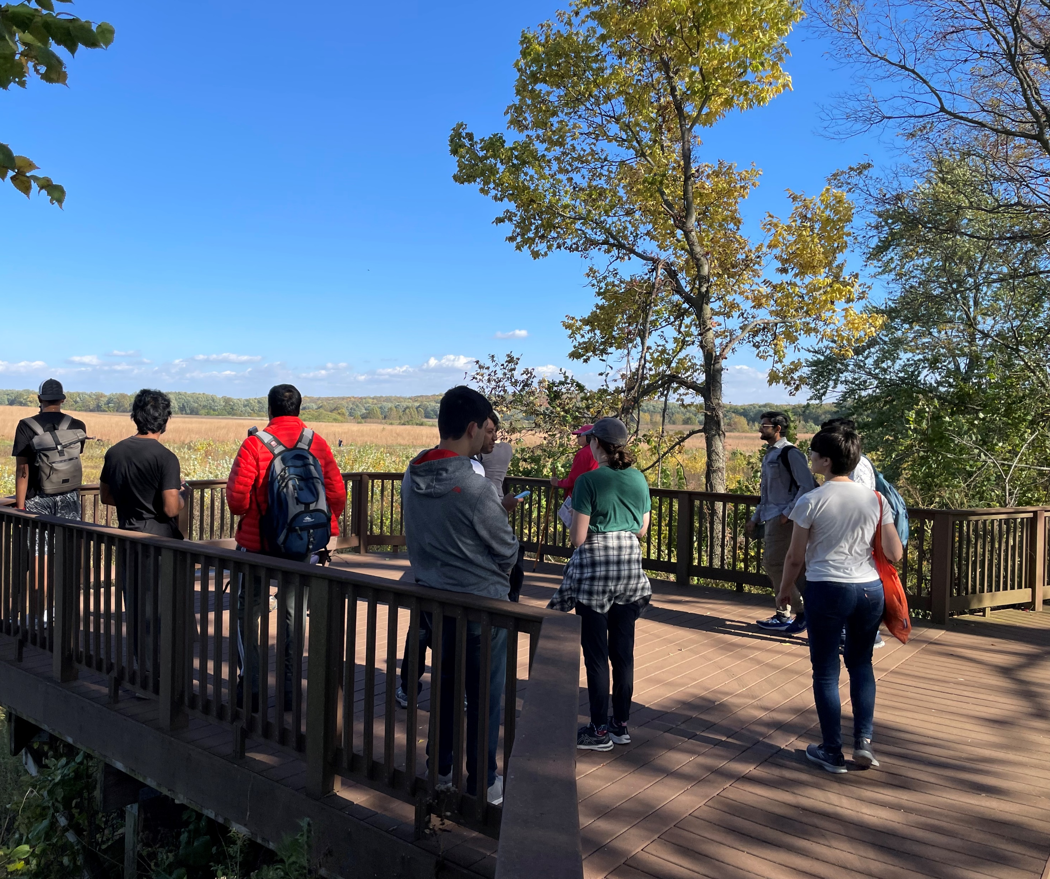
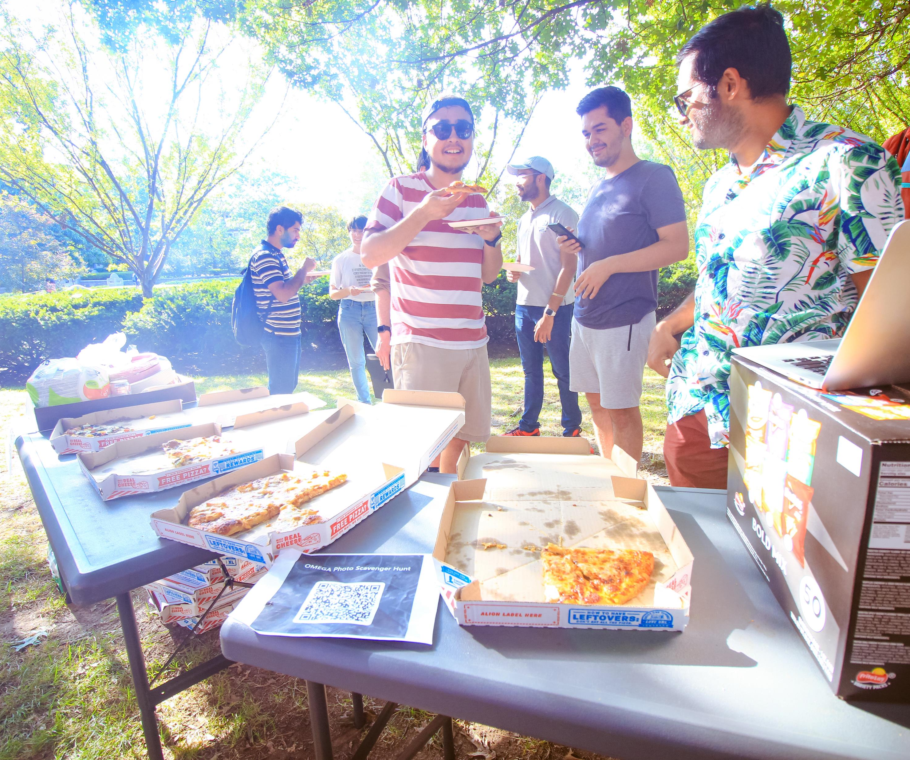
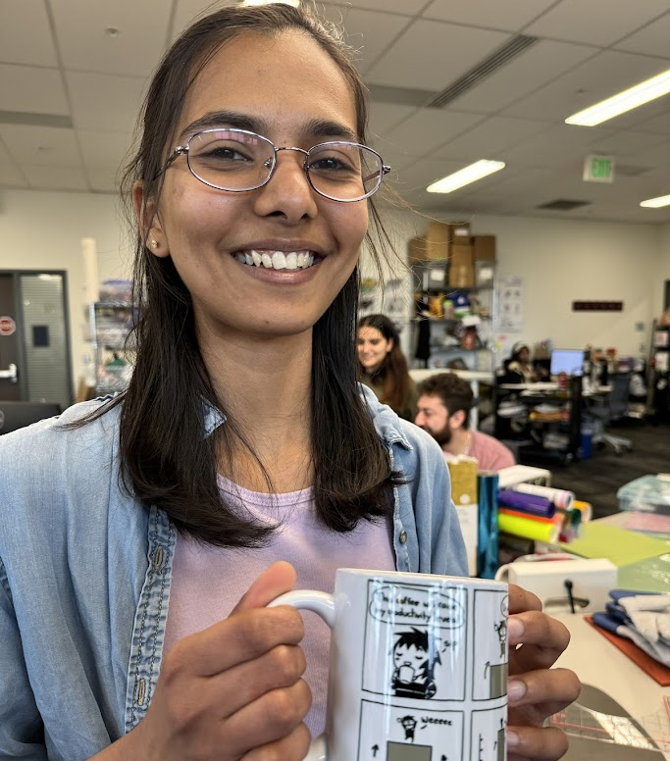
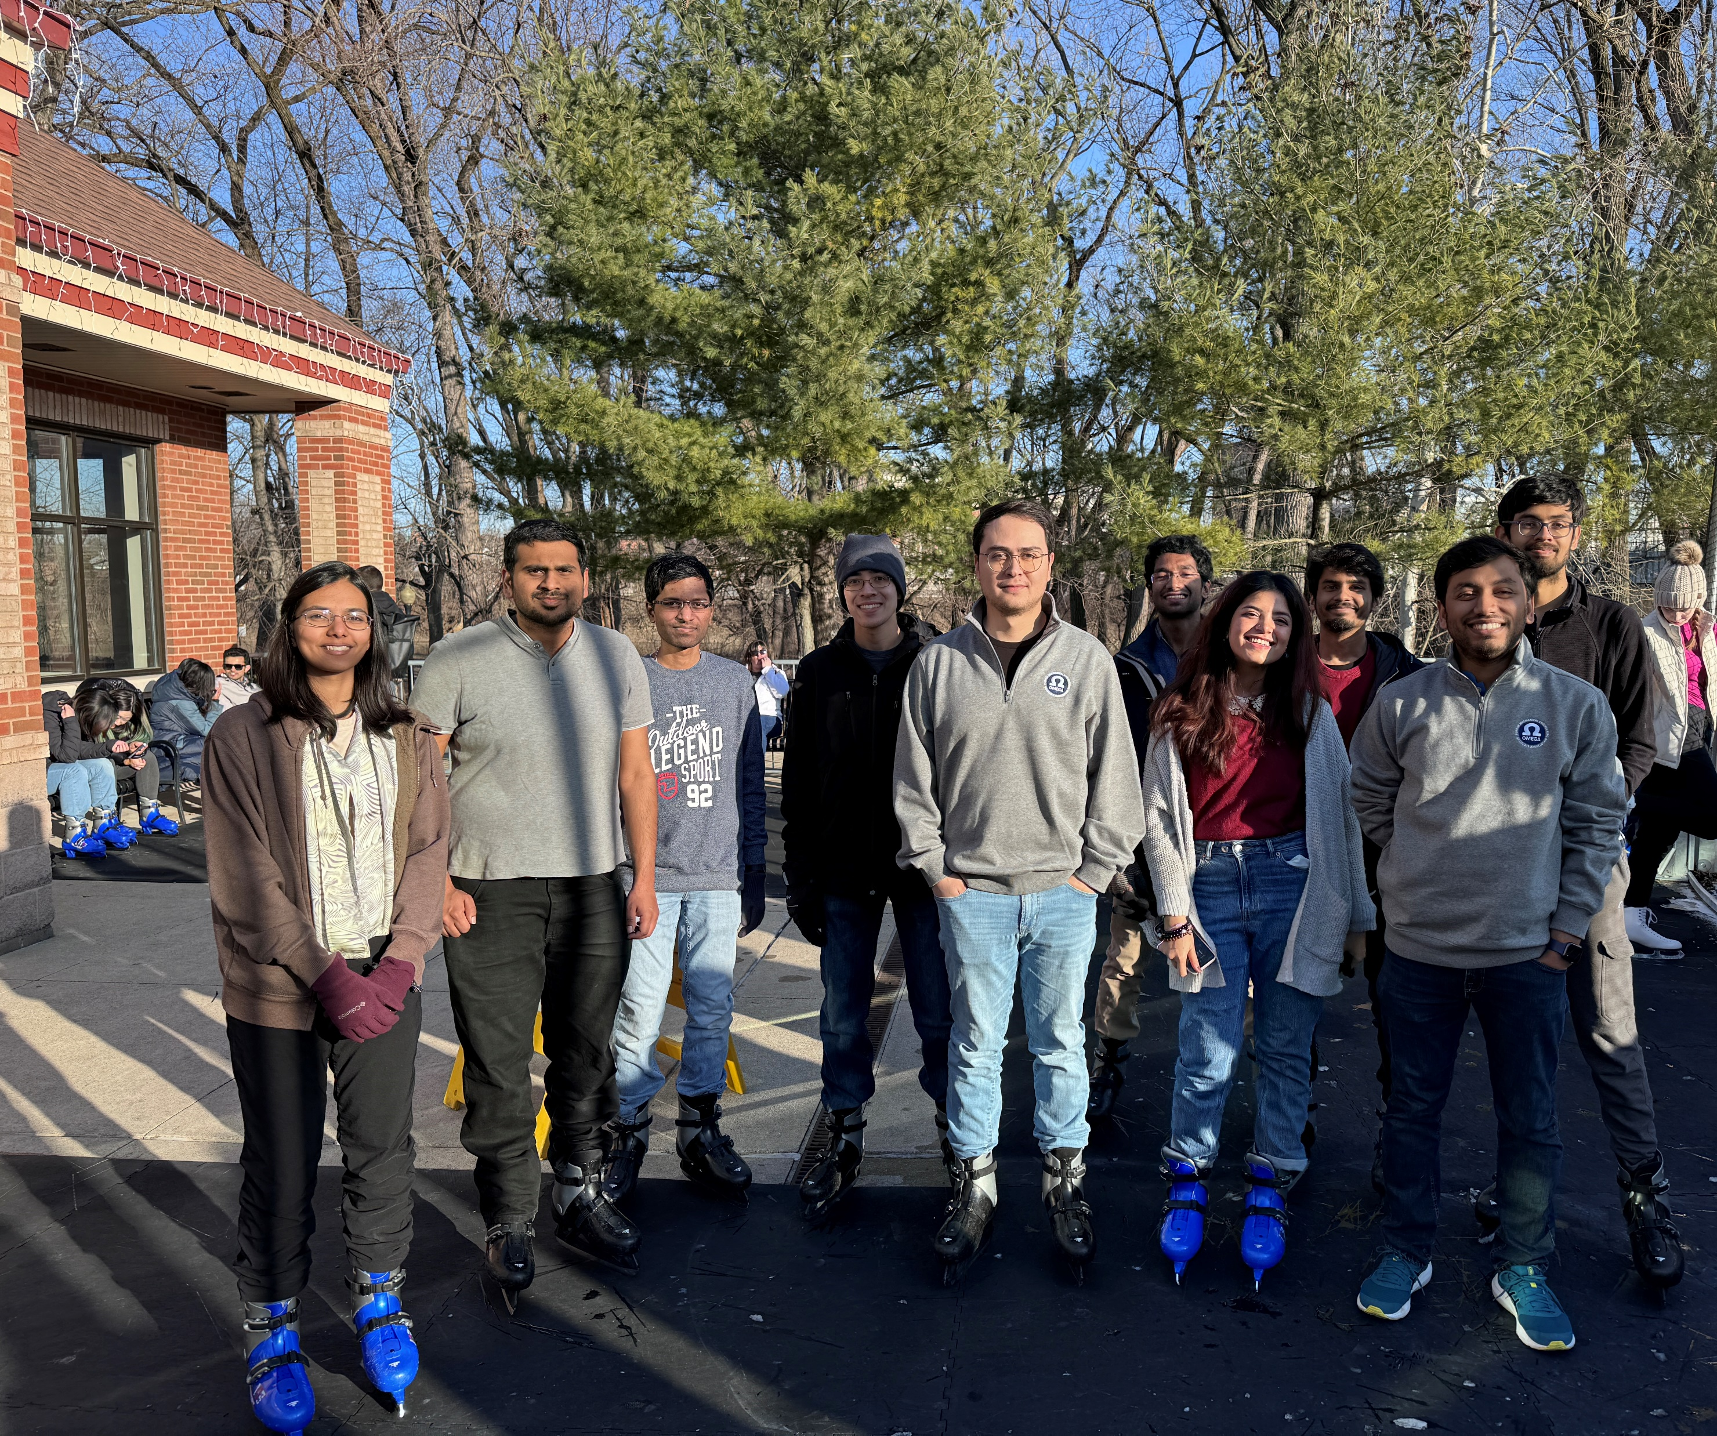
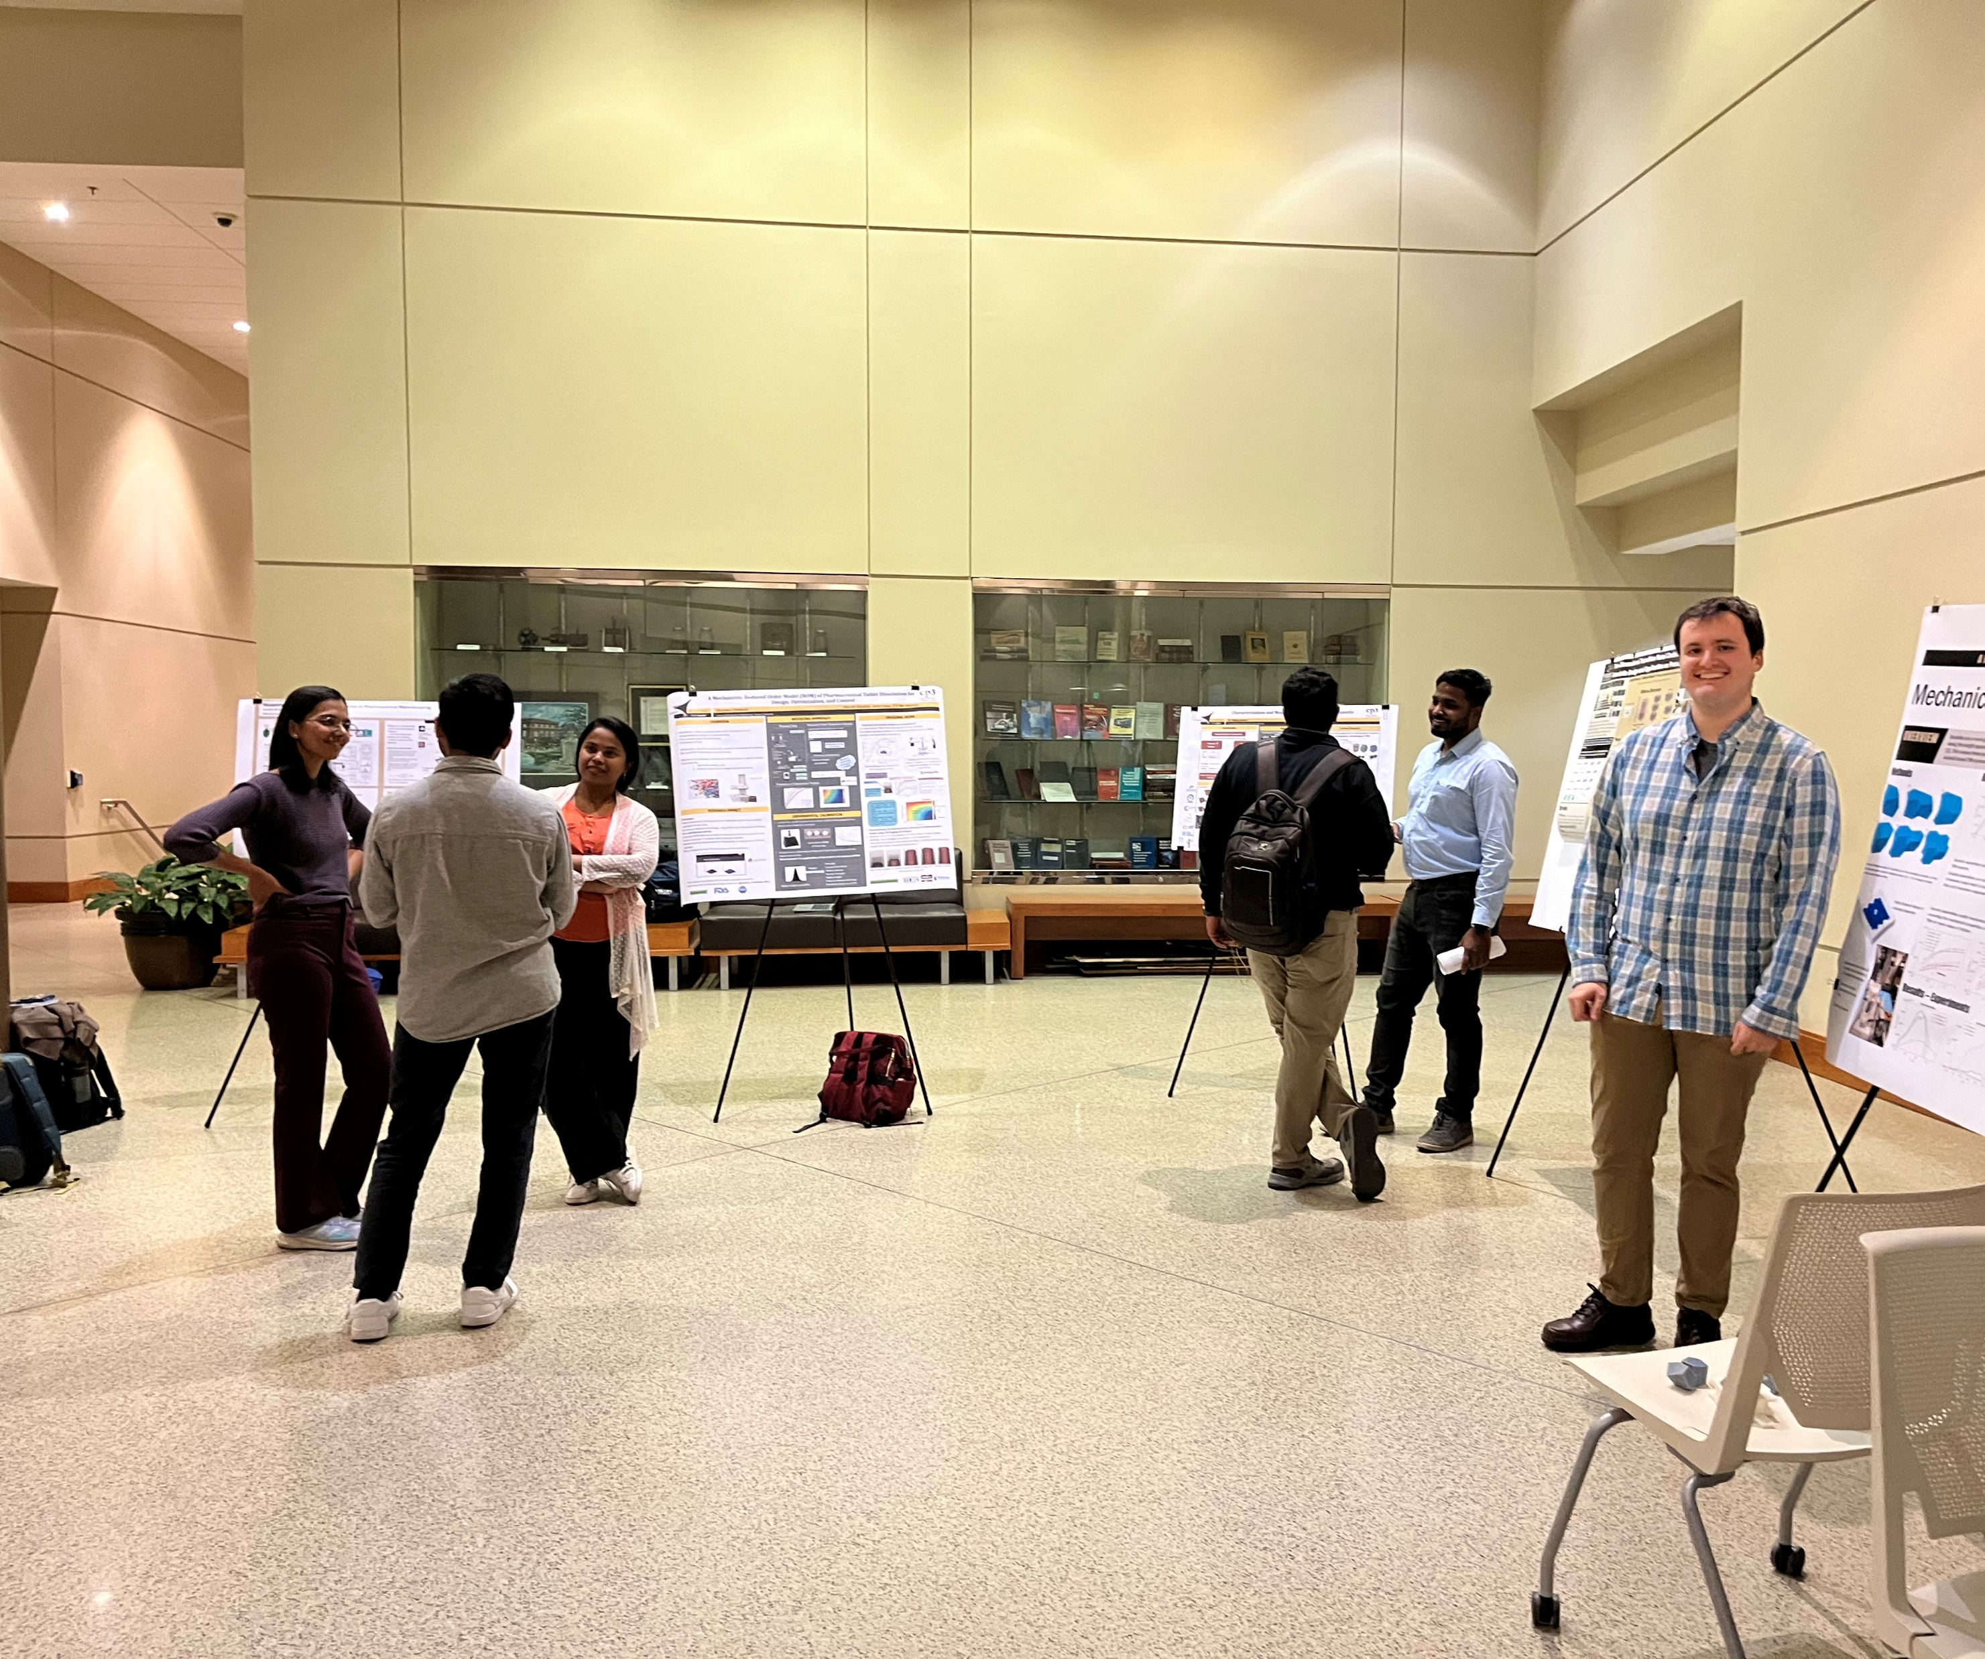
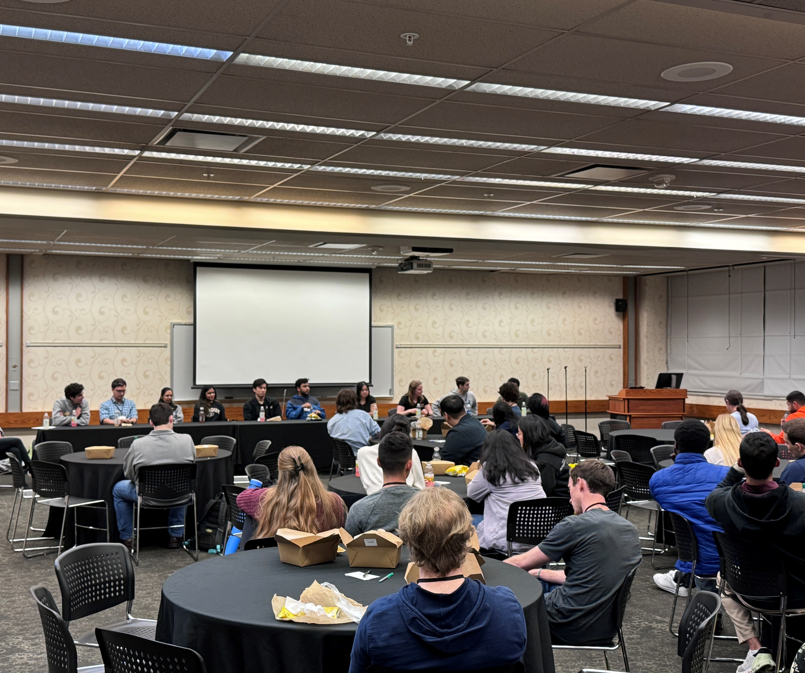

Summer Cookout
Jul 2023
Fall Hike
Oct 2023
Scavenger hunt
Aug 2023
Mug printing
Apr 2024
Ice skating social
Jan 2024
Reverse career fair Nov 2023
Grad Visitation Day
Feb 2024
Canoe Trip
Jun 2023

Slide 5
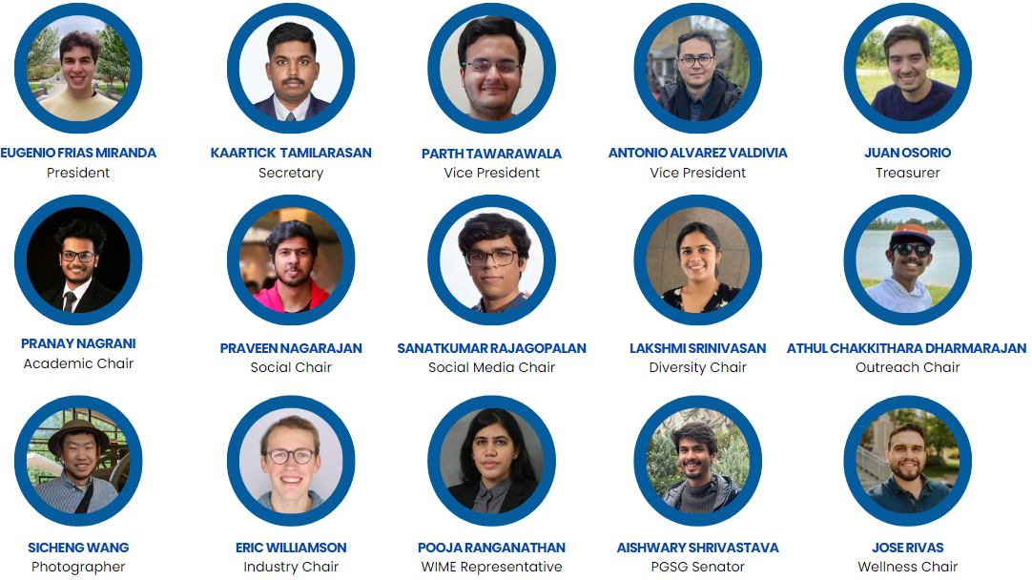
OMEGA Board 24-25

Slide 6
Committees
Academic - Aims to enhance the academic experience of ME grad students through educational events and resources
ME290 research tours, Prof/grad student panels to ugrads, Speaker series, mentoring programs, reverse career fair, industry tours
Social - Focuses on building a sense of community and connection among ME grad students through social events and activities
Socials/watch parties, hikes, IM teams, Cookouts

Slide 7
OMEGA Board - How to join?
Follow us on Instagram
Join OMEGA Discord
Attend events
Officer elections – end of spring semester
Volunteer
How to contact us?
Discord: https://discord.gg/gyyGmftsx8
Website: purdueomega.com
Email: puomega@purdue.edu
Insta: puomega

Slide 8
Thank you!
Discord: https://discord.gg/gyyGmftsx8
Website: purdueomega.com
Email: puomega@purdue.edu
Insta: puomega

