Slide 1
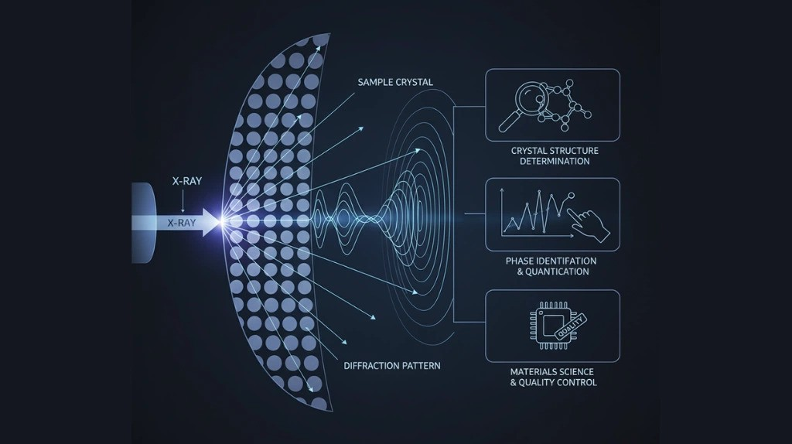
XRD
Arya Keni, ECE PhD (Spring 2026)
ECE 65800 Presentation
April 3
1
Notes:
Slide 1 — Title (~30s)
"Hi, I'm Arya Keni. Today I'll be covering X-ray diffraction — the physics behind it, what we extract from the measurements, and why it matters for nanotransistor engineering."

Slide 2
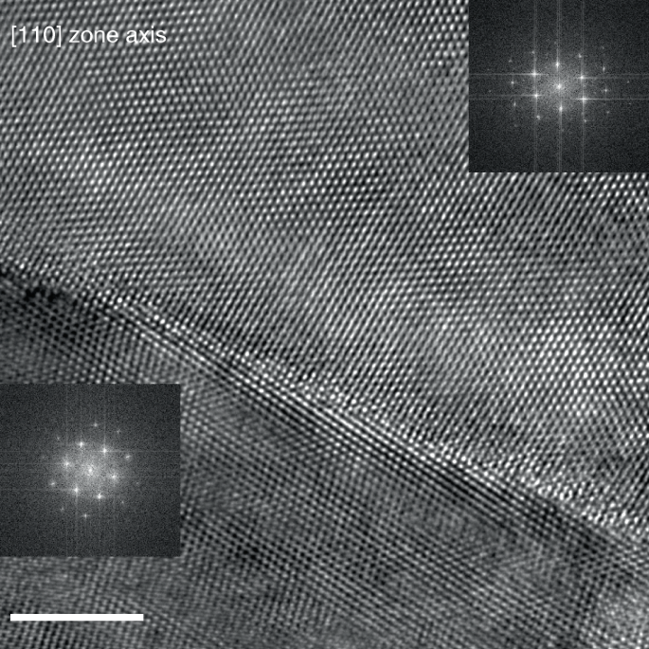
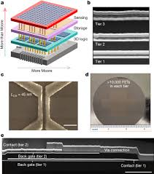
XRD for Nanotransistors
XRD tracks crystallinity, strain, and lattice changes in ultra-thin channels that govern carrier transport and device performance.
XRD also verifies phase purity, orientation, and structural stability to optimize advanced transistor materials and heterostructures.
2
Notes:
Slide 2 — XRD for Nanotransistors (~1.5 min)
As transistor channels shrink below 10 nm, the structural properties of your material — crystallinity, strain, preferred orientation, and phase purity — directly govern carrier transport and device performance.
XRD probes all of these non-destructively, making it essential for optimizing advanced materials and heterostructures, and for confirming the structural stability needed for reliable devices.
Point at images briefly: grain boundaries (left) scatter carriers and hurt mobility; 3D stacked architectures (right) introduce new interfaces where structural validation is critical.

Slide 3
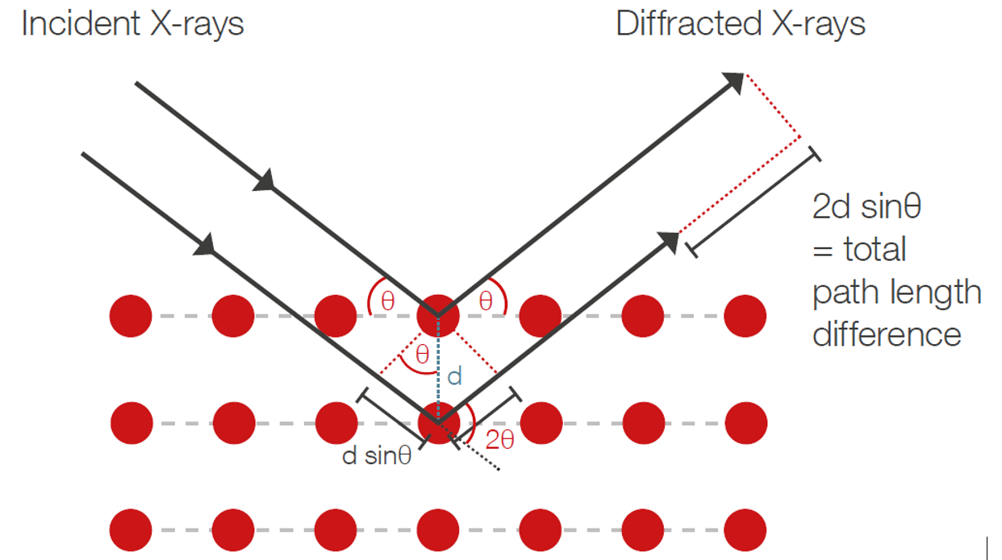
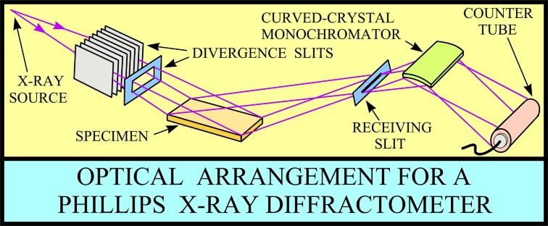
Basic Overview
XRD: Diffraction of X-rays from crystal lattice planes.
Bragg's law: peak positions in 2θ reveal lattice spacing parameters.
X-ray wavelengths are on the order of atomic spacings, making them ideal probes of crystal structure.
3
Notes:
Slide 3 — Basic Overview (~2 min)
XRD works because X-ray wavelengths — around 1 Å — are on the same scale as interatomic spacings, so crystal planes act as a natural diffraction grating.
Bragg's law: nλ = 2d sin θ. When the path length difference between rays reflecting off adjacent planes equals a whole number of wavelengths, you get constructive interference — a peak at that 2θ angle.
Walk through the diagram: point out the incoming beam, the lattice planes, the path difference, and the detector picking up the diffracted beam.
Slide 3: Spend an extra 30s actually writing out Bragg's law on the board or slowly walking through the geometry on the diagram. This is your most "teachable" slide and nobody will mind you taking time here.

Slide 4
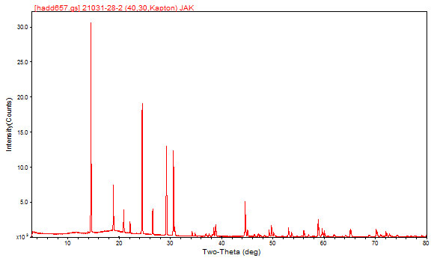
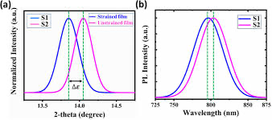
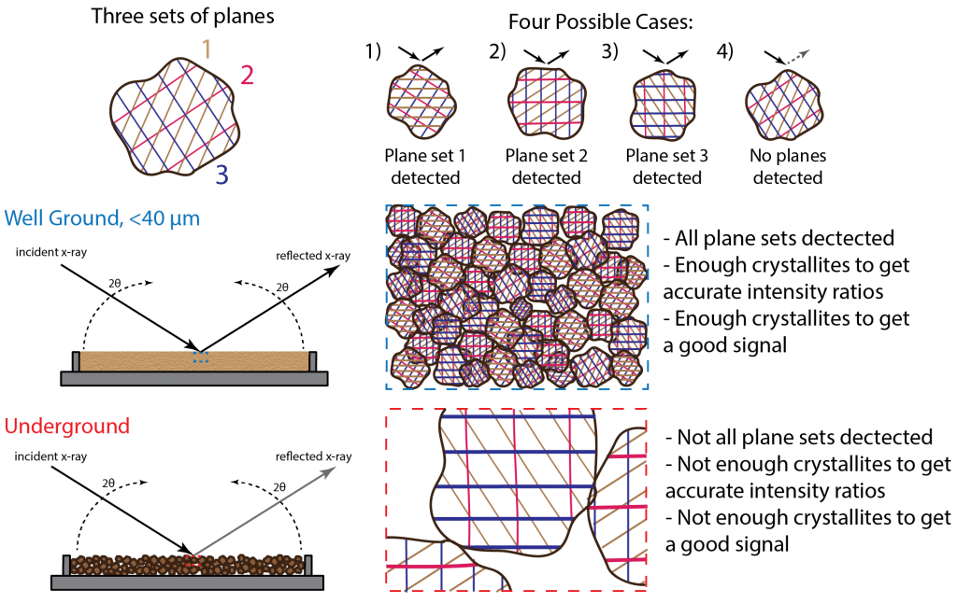
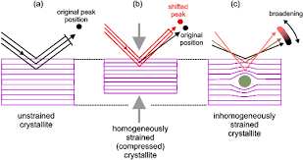
Measurements
Peak shifts → lattice parameters and strain
Pattern matching (ICDD database) → phase identification
Peak broadening and refinement → crystallite size and phase fractions
4
Notes:
Slide 4 — Measurements (~2 min)
You get three things from a diffractogram. Peak position — through Bragg's law, this gives you d-spacings and lattice parameters, and any shift from expected positions tells you about strain. Peak identity — you match your pattern against the ICDD database to confirm which phases are present. Peak width — broadening tells you crystallite size via the Scherrer equation, which basically says narrower peaks mean larger crystallites and vice versa.
For more complex films with multiple phases, you go beyond individual peaks and use Rietveld refinement — a full-pattern fitting method that lets you quantify phase fractions across the whole diffractogram.
Point at the spectrum, identify a couple peaks, show how you'd read position and relative intensity.
Scherrer Equation:
τ = Kλ / (β cos θ)
Where τ is the mean crystallite size, K is a shape factor (typically ~0.9 for spherical crystallites), λ is the X-ray wavelength, β is the full-width at half-maximum (FWHM) of the peak in radians (after subtracting instrumental broadening), and θ is the Bragg angle of that peak.
The intuition: smaller crystallites mean fewer planes contributing to diffraction, which relaxes the constructive interference condition and broadens the peak. So you measure how wide the peak is, plug it in, and get a size estimate. It's a quick-and-dirty number — works well for crystallites below ~100 nm, starts losing accuracy above that because the broadening becomes too small to distinguish from instrumental effects.
Rietveld Refinement:
Instead of analyzing individual peaks, you simulate the entire diffractogram from a structural model and minimize the residual:
S = Σᵢ wᵢ (yᵢ_obs − yᵢ_calc)²
Where yᵢ_obs is the observed intensity at each 2θ step, yᵢ_calc is the calculated intensity from your model (which includes crystal structure, lattice parameters, atomic positions, thermal factors, peak shape functions, background, and instrument parameters), and wᵢ = 1/yᵢ_obs is the statistical weight.
You iteratively adjust all those parameters via least-squares fitting until the calculated pattern matches the observed one. The output gives you refined lattice parameters, phase fractions (if multi-phase), crystallite sizes, and microstrain — all simultaneously from one dataset.
The goodness-of-fit is tracked with metrics like R_wp (weighted profile R-factor). Lower is better.

Slide 5
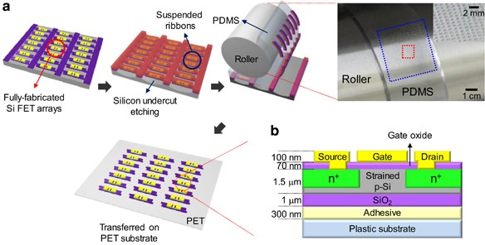
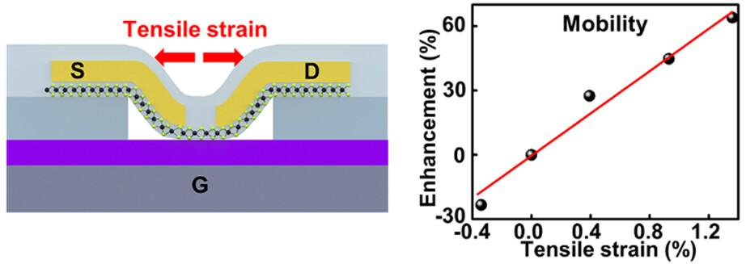
How it relates to device performance
XRD-measured strain indicates mobility enhancement in transistor channels.
Crystal quality and phase purity impact interface quality, leakage, and device stability.
5
Notes:
Slide 5 — Device Performance (~1.5 min)
This is the bridge slide — connecting structure to electrical behavior. Strain measured by XRD peak shifts maps directly to mobility enhancement. Tensile strain in Si boosts electron mobility; this is the foundation of strained-Si technology used in industry since the 90-nm node.
Beyond strain: crystal quality and phase purity affect interface quality, gate leakage, and long-term device stability. Poor crystallinity means more defects at the channel-oxide interface.
Reference the figure to anchor the point.

Slide 6
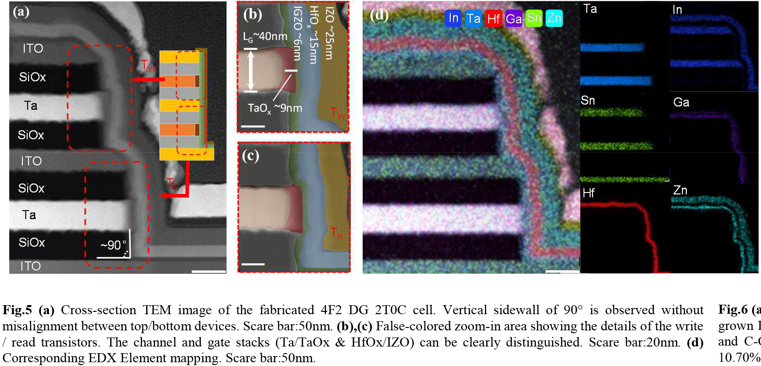
Applications with Devices
In strained Si/SiGe nanotransistors, XRD tracks channel strain that boosts carrier transport.
In thin-film transistor stacks, XRD verifies phase and crystal quality of active layers.
Limitations: limited thin-film sensitivity; complex incidence protocols for nanofilms.
6
Notes:
Slide 6 — Applications & Limitations (~1.5 min)
Two concrete applications: in strained Si/SiGe nanotransistors, XRD tracks the channel strain that boosts carrier transport. In thin-film transistor stacks, XRD verifies that your active layer has the right crystal phase and quality.
Honest limitations: conventional XRD has limited sensitivity for ultra-thin films — a few-nm channel barely diffracts. To get around this, you need grazing-incidence geometries or synchrotron sources, and those come with more complex incidence protocols and data interpretation.
EDX:
EDX (energy-dispersive X-ray spectroscopy) is an elemental analysis technique, usually attached to an SEM or TEM, that tells you which elements are present in a sample and gives an approximate composition. It works by hitting the sample with a high-energy electron beam, which knocks out inner-shell electrons from atoms; when higher-energy electrons fall down to fill those vacancies, they emit X-rays with element-specific energies. The detector measures the energies and counts of those emitted X-rays, producing a spectrum with peaks corresponding to different elements; peak height/area is then used for qualitative and semi-quantitative composition analysis. It is useful because it lets you map where elements are on the sample, identify contamination or unknown particles, compare regions of a device or film, and quickly confirm material composition with minimal extra sample preparation

Slide 7

Conclusion
XRD non-destructively links crystal structure, strain, and phase quality to device behavior and scalability.
Its role will grow in validating new channel materials, 3D architectures, and strain-engineered designs as transistors shrink further.
7
Notes:
Slide 7 — Conclusion (~15s)
"To summarize — XRD non-destructively links crystal structure, strain, and phase quality to device behavior and scalability. As transistors keep shrinking and we move to new channel materials, 3D architectures, and strain-engineered designs, its role in validation only grows. Thanks — happy to take questions."

Slide 8
References
Cullity & Stock, Elements of X-ray Diffraction, 3rd ed. (2001)
Jenkins & Snyder, Intro to X-ray Powder Diffractometry (1996)
Rietveld, J. Appl. Crystallogr. 2(2), 65–71 (1969)
Toby & Von Dreele, J. Appl. Crystallogr. 46(2), 544–549 (2013)
Birkholz, Thin Film Analysis by X-Ray Scattering, Wiley-VCH (2006)
Murray et al., Commun. Eng. 1, 11 (2022)
Kolahdouz et al., Nanoscale Res. Lett. 12, 108 (2017)
Li et al., Electron 2, e32 (2024)
8
Notes:
Slide 8 — References
Up on screen during Q&A. Don't narrate.

