Slide 1
X-ray Photoelectron Spectroscopy
ECE 60658
Andrew Robertson

Slide 2
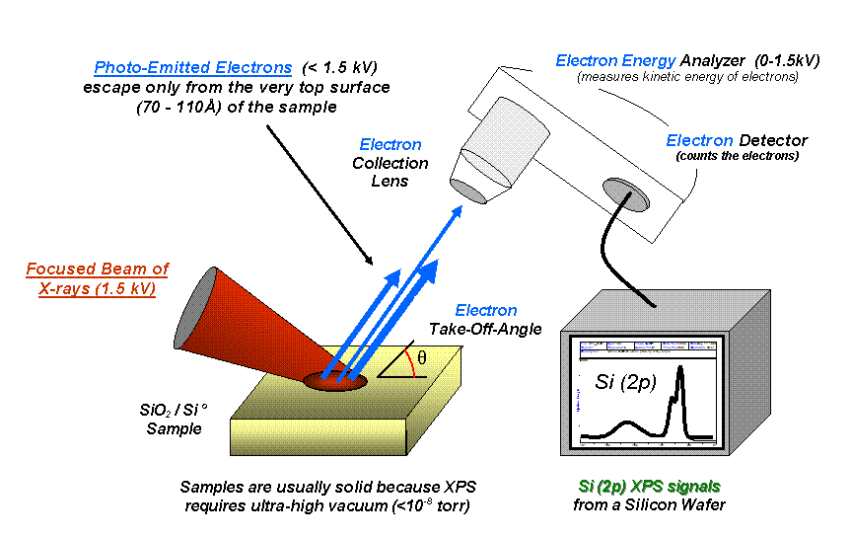
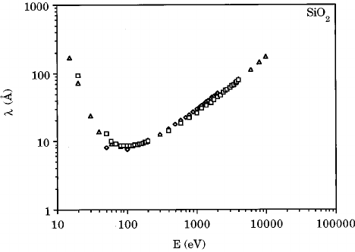

Theory of Operation
$$E_{B}=hv−E_{k}−φ_{spec}$$
Notes:
X-rays will penetrate a few microns, but the photons can only escape like 10 nm!
“Ineslastic free path”
Einstein nobel prize -> x-ray photo hits atom -> electon -> electron flies off into space as photo electron

Slide 3
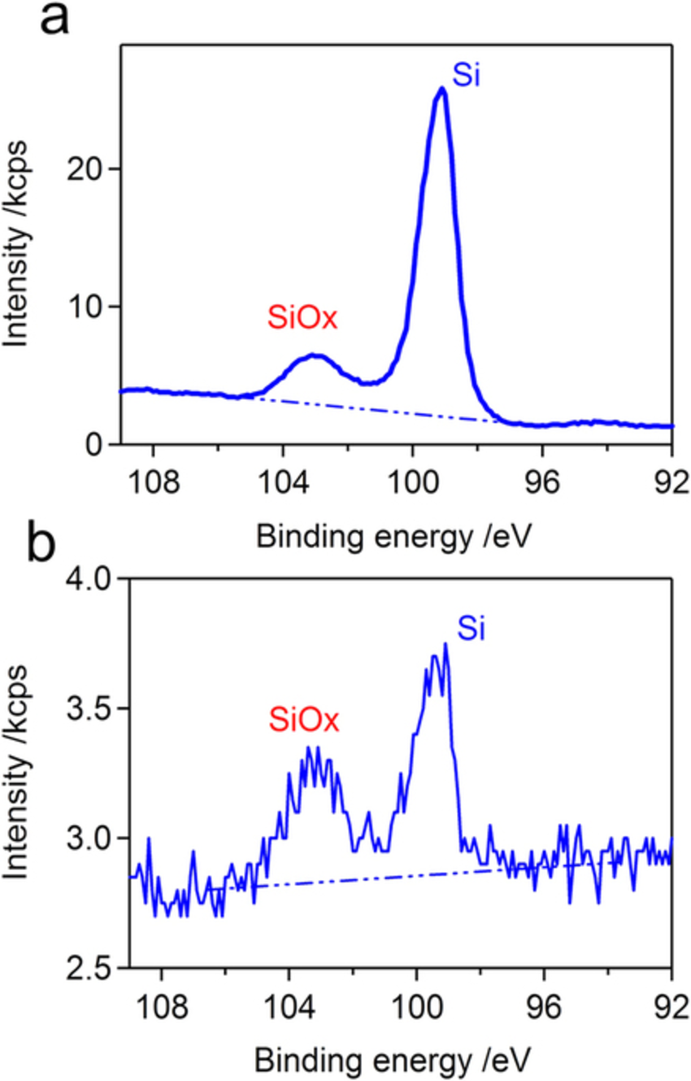
Electron Energy Results
Kawasaki, Mitsuo & Morita, Tatsuo & Tachibana, Kunihide. Facile Carbon Fixation to Performic Acids by Water-Sealed Dielectric Barrier Discharge
Notes:
Bulk silicon, thick layer with long aguisiton time. Clearly defined! You can see the difference between SiO2 and Si here. LONG measurement time.
Thin film. Lots of noise. Realistic for quick, line measurements. Thinner the film, the more surface oxidization you’re gonna have!
Generally, Si at 99 eV. SiO2 at like 103-102 eV.
Measured in Thousand counts per second

Slide 4
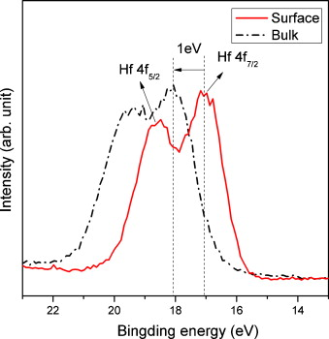
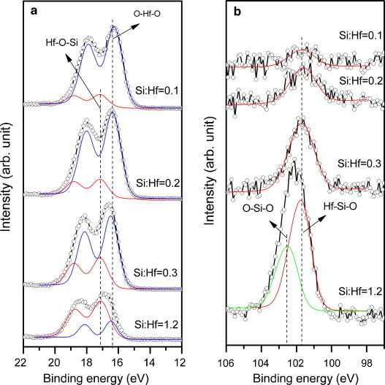
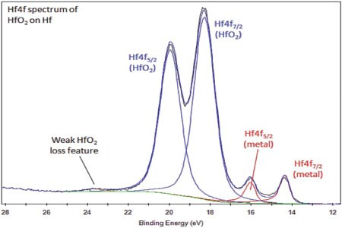
Case Study : HfO2
H. Wang, P. Wu, X.F. Li, S. Chen, S.P. Zhang, B.B. Song,
Study of reactions between HfO2 and Si in thin films with precise identification of chemical states by XPS
ThermoFisher Scientific
Notes:
Used physical vapor deposition to put on
Hf-si-o = hafnium silicate
Hafnium electron energy like 21-18 ev

Slide 5
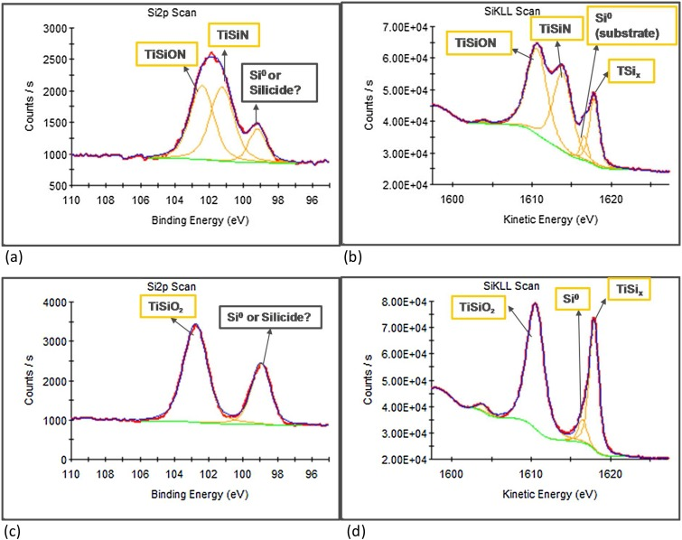
XPS Data Extraction
Element Ratios
Oxidization State
Film Thickness
Compare peak areas normalized by sensitivity.
Chemical shift tells you how many electrons it’s shared, a change in electronegativity changes the binding energy!
Si-Si = 99.4 eV
Si-O = 103.5 eV
(ThermoFisher Photoelectron Spectra)
Using the knowledge of how the IMFP is used and how the wafer looked prior, you can determine thickness without destroying sample.
Ghazal Saheli, Takashi Kuratomi, I-cheng Chen, Paul Mack, Christopher LaziK, Jeffrey Anthis, David M. Thompson, Christopher R. Brundle,
Use of Si KLL Auger shifts and the Auger parameter in XPS to distinguish Ti silicides from a Ti/Si mixture in thin films,
Notes:
cannot really tell the difference between hydrogen and helium samples.
Use “Relative Sensitivity Factors” to normalize (probability of photoionization, electrn transmission, etc.)

Slide 6
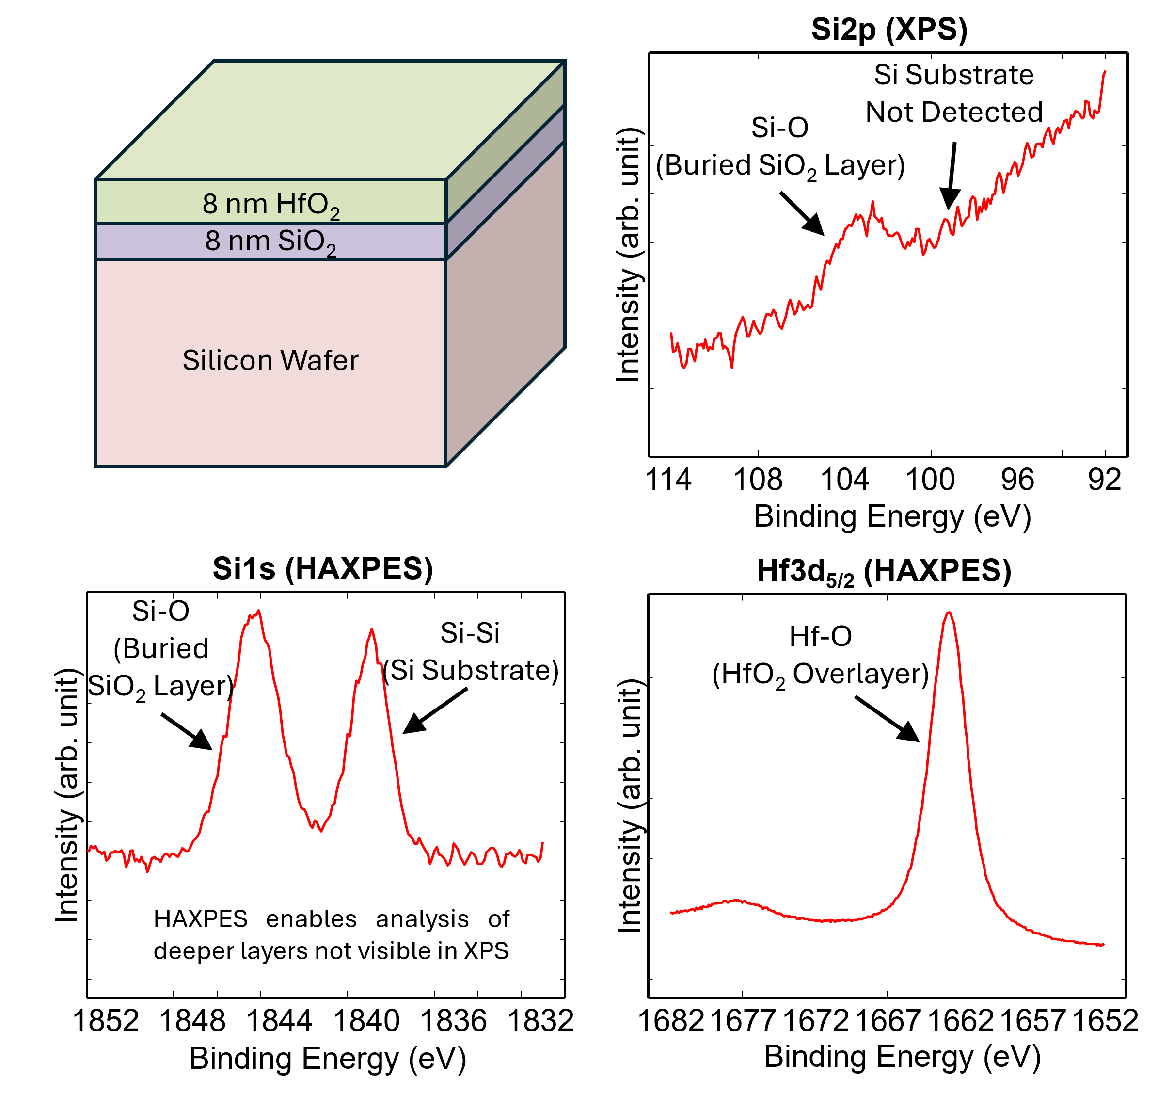
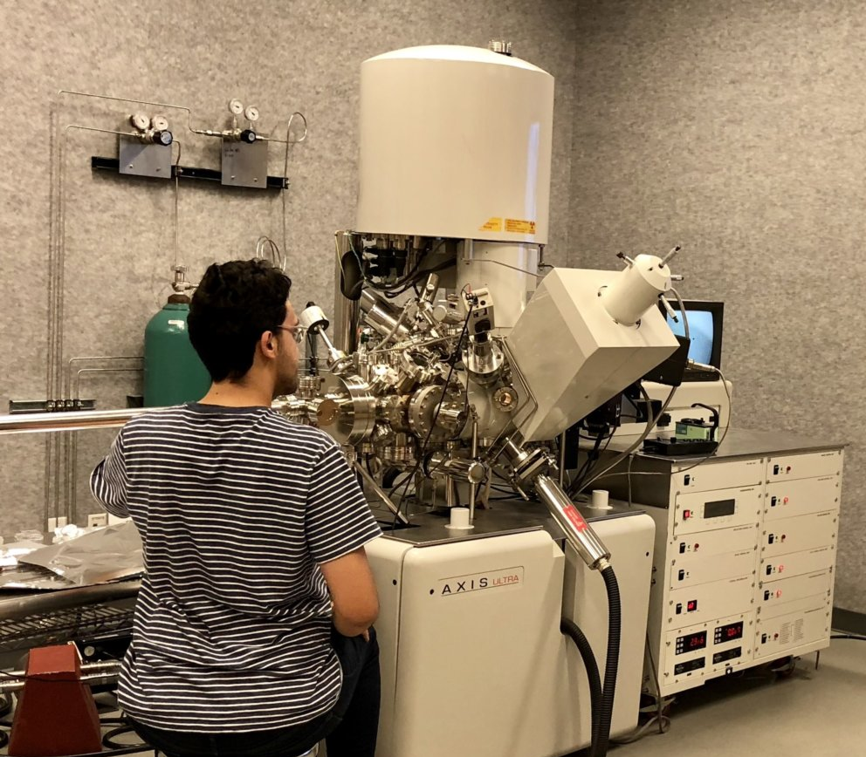
ARXPS & HAXPES
Angle Resolved X-Ray Photoelectron Spectroscopy
Hard X-Ray Photoelectron Spectroscopy
5-10 nm Probing Depth
Change the angle, determine exact depth with enough time
Medium surface damage
10-60 nm Probing Depth
Buried interfaces accessible!
Less surface damage
Physical electronics, XPS/HAXPES
Notes:
Hardxps-
2keV to 10keV, use a synchrotron typically
Increased IMFP (increased KE), 20-60 nm
Avoid ion sputtering
MUCH longer scan time, or borderline damaging high-flux x-rays
“Multilayer silicon wafer structure composed of an 8 nm HfO₂ overlayer and an 8 nm buried SiO₂ layer.
HAXPES spectrum reveals both the Si-O signal from the buried SiO₂ layer and the Si-Si signal from the underlying silicon substrateenhanced depth sensitivity. The bottom right HAXPES spectrum of Hf 3d_{5/2} confirms the presence of Hf-O in the HfO₂ layer.”

