Slide 1
Section 22
PN Diode Large Signal Response
Solid State Devices

Slide 2

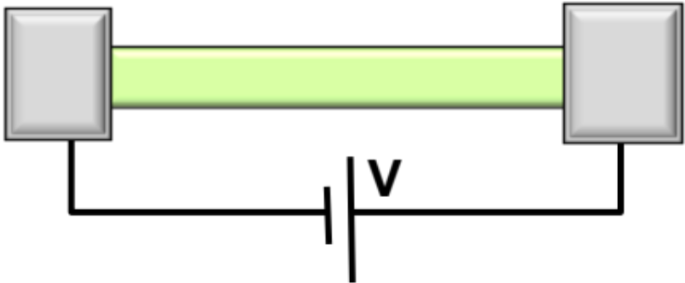
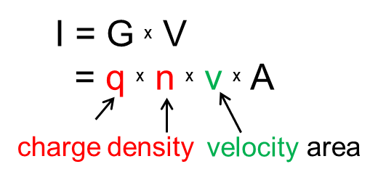
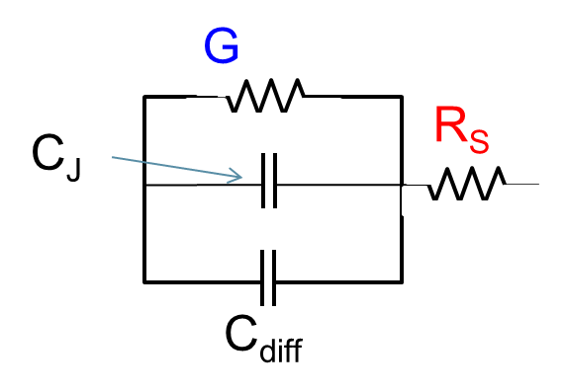
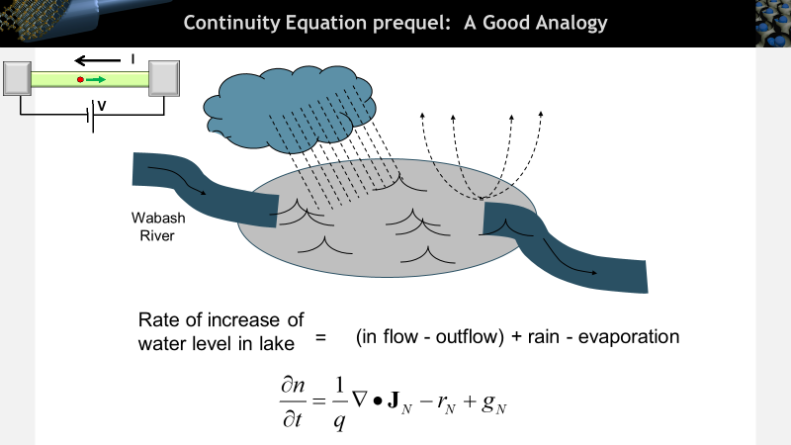
Section 22
PN Diode Large Signal Response
 | Equilibrium | DC | Small signal | Large Signal | Circuits
PN Diode
Diode in Non-Equilibrium
(External DC+AC voltage applied)
Schottky Diode
Digital Signals:
switch on and off
BJT/ HBT
MOS

Slide 3
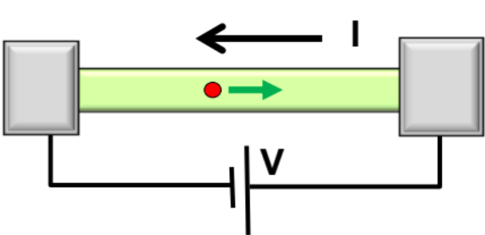
Section 22
PN Diode Large Signal Response
I = G ^{x} V
= q ^{x} n ^{x} v ^{x} A
charge
density
velocity
area
V
22.1 Charge control model
22.2 Turn-off and Turn-on characteristics
22.3 Steady-State expression from Charge Control
V
V

Slide 4
Digital, Large Signal Applications
‘1’:1V
A
ln(I)
V
‘0’:-2V
:If transition is slow,
every point is in quasi-equilibrium
→treat them like DC
‘0’ to ‘1’
‘1’ to ‘0’
-------:If transition is very fast
V
-2
1
------:Current flips “immediately”,
voltage changes slowly

Slide 5
A Closer Look to Fast Transition
V_{A}(t)
Before transition occur
constant voltage, current change from I_{F} to I_{R}
t
constant current, voltage change form 1V to 0V
ln(I)
‘1’:1V
V
A
‘0’:-2V
i(t)
‘1’ to ‘0’
I_{F}
-2
1
V
-0.1I_{R}
t_{r}
-IR
t_{s}
t_{rr}

Slide 6
Definitions
V_{A}(t)
t_{s} … Charge storage time
t_{r} … Recovery time
t_{rr} .. Reverse recovery time
t
i(t)
I_{F}
-0.1I_{R}
t_{r}
-IR
t_{s}
t_{rr}

Slide 7
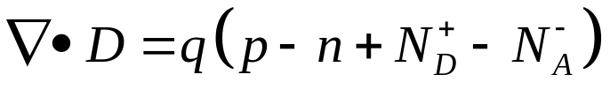
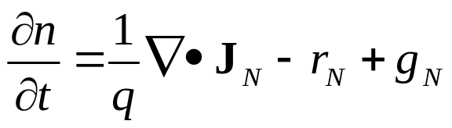
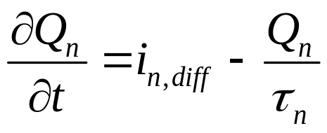
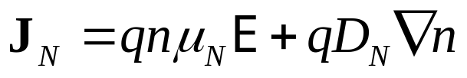
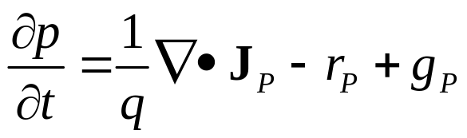
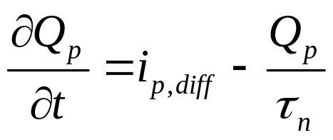
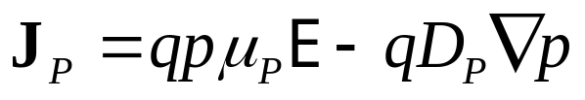
Continuity Equations
Full analytical solution impossible for large signal….
Charge control equations:
Approximation when you have
large transient response

Slide 8
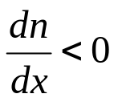
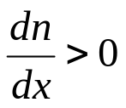
How Does Current Flip Without Voltage Flipping?
n(x,t)
forward bias,
minority carrier has been injected
n(x,t)
Where did the charge go?
Back to the left-hand side
Recombine with the trap and the majority carrier
Recombination→n(x,t) exponentially dying out
x
x
V_{DC}
When voltage starts to change,
=> n(x,t) suddenly bends downwards,
dn/dx changes sign
current flips from p→n to n→p
n(x,t)
x

Slide 9
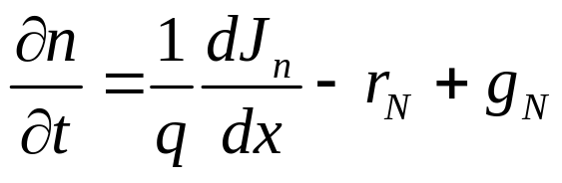
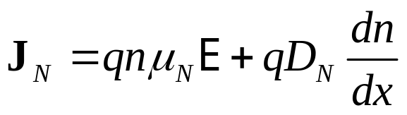
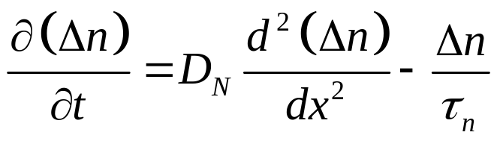
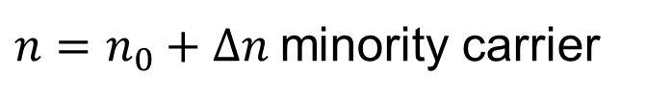
Large Signal Charge Control Model
n(x,t)
$n=n_{0}+Δn$minority carrier
x

Slide 10

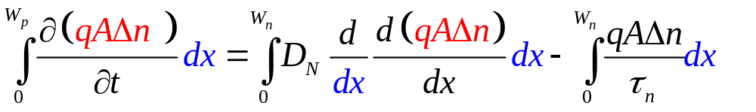
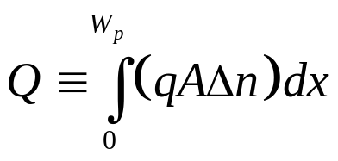
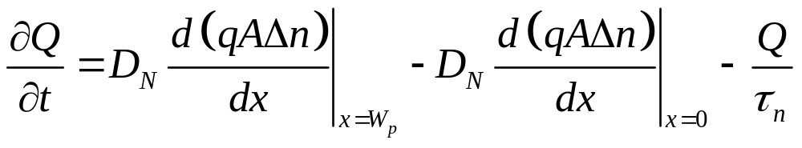
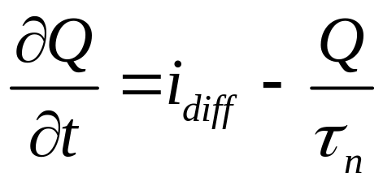
Large Signal Charge Control Model
n(x,t)
Area under the
curve @ given time
x(qA), integrate
x
W_{p}
Current going out
Current coming in
Recombination
(Total charge that is building in)=
(net electrons flowing in) – (recombination)
Notes:
Where are the approximations? Why it is used only for large transient response?

Slide 11
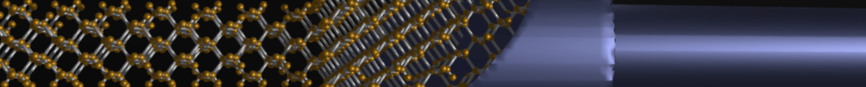
Section 22
PN Diode Large Signal Response
I = G ^{x} V
= q ^{x} n ^{x} v ^{x} A
charge
density
velocity
area
22.1 Charge control model
22.2 Turn-off and Turn-on characteristics
22.3 Steady-State expression from Charge Control
V
status
V
V
‘1’
A
V
‘0’

Slide 12
Section 22
PN Diode Large Signal Response
I = G ^{x} V
= q ^{x} n ^{x} v ^{x} A
charge
density
velocity
area
V
22.1 Charge control model
22.2 Turn-off and Turn-on characteristics
22.3 Steady-State expression from Charge Control
V
status
V
‘1’
A
V
‘0’

Slide 13
Section 22
PN Diode Large Signal Response
Solid State Devices
22.2 Turn-off and Turn-on characteristics

Slide 14
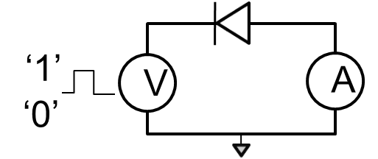
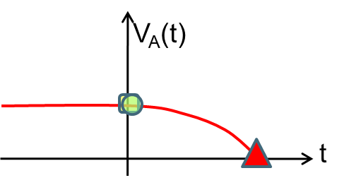

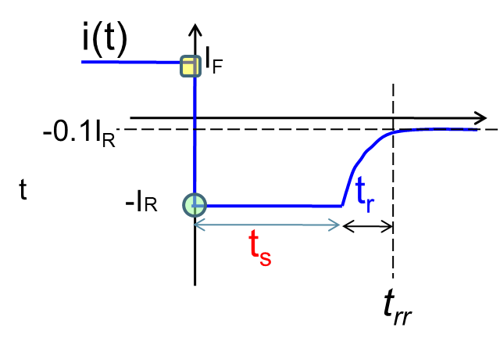
Section 22
PN Diode Large Signal Response
I = G ^{x} V
= q ^{x} n ^{x} v ^{x} A
charge
density
velocity
area
V
22.1 Charge control model
22.2 Turn-off and Turn-on characteristics
22.3 Steady-State expression from Charge Control
V
V
status

Slide 15
Turn-off Characteristics: Determine (t_{s})
S
R
IF
VF
+
VR
P
Vj
-
N
IR
Why does the voltage remain constant even for t>0?

Slide 16
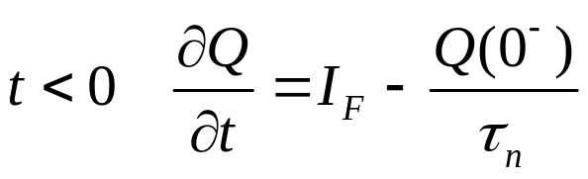

Boundary Condition
S
R
R
IF
VF
+
VR
P
Vj
-
N
IR
=0
For a capacitor, voltage can not change instantly.
So charge can not change instantly ….
Why does the voltage remain constant even for t>0?

Slide 17
Turn-off Current Transient
S
R
IF
VF
+
VR
P
Vj
-
N
IR
Why does the voltage remain constant even for t>0?

Slide 18
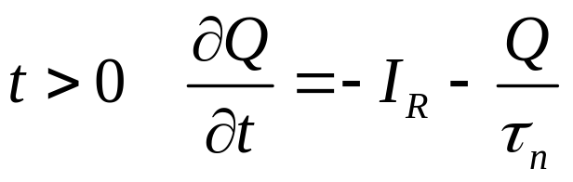
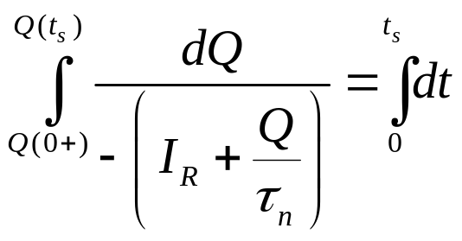
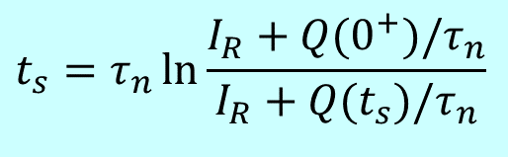
Turn-off Current Transient
R
n(x,t)
See how the slope change
S
n(x,t)
IF
VF
+
VR
P
Vj
x
x
-
N
IR
Approximately
constant!
$$t_{s}=τ_{n}\ln{\frac{I_{R}+Q(0^{+})/τ_{n}}{I_{R}+Q(t_{s})/τ_{n}}}$$

Slide 19

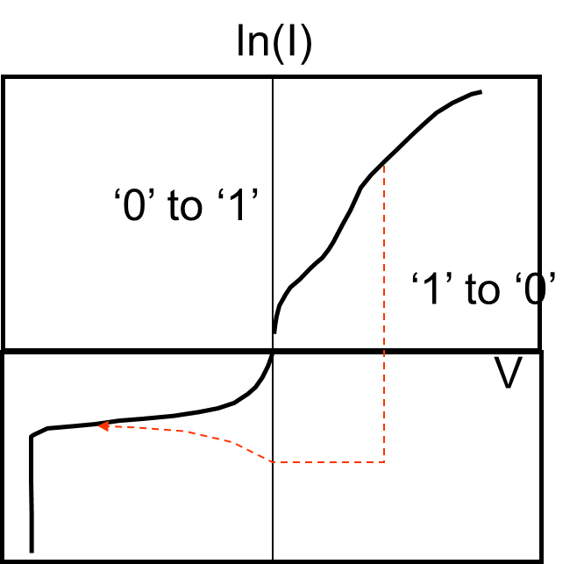
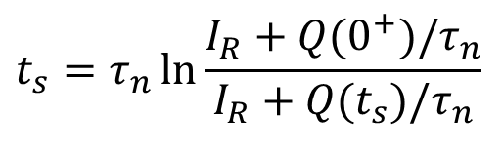
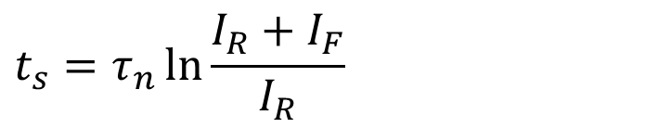
Storage Time
S
R
n(x,t)
IF
VF
+
VR
P
Q(t_{s})
Vj
x
-
N
IR
$$t_{s}=τ_{n}\ln{\frac{I_{R}+Q(0^{+})/τ_{n}}{I_{R}+Q(t_{s})/τ_{n}}}$$
$$t_{s}=τ_{n}\ln{\frac{I_{R}+I_{F}}{I_{R}}}$$
Want fast switching?
Shorten τ for fast response!
=> scattering can be good!

Slide 20
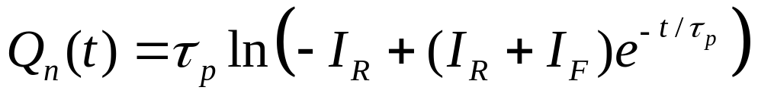
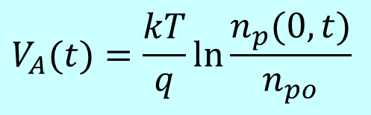
Turn-off Voltage Transient
S
R
IF
n(x,t)
+
Correction!
ln does not belong here
VF
P
VR
Vj
-
N
IR
x
Va (t)
t
ts
Allows easy calculation of n_{p}(0,t).
$$V_{A}(t)=\frac{kT}{q}\ln{\frac{n_{p}(0,t)}{n_{po}}}$$
Notes:
The ln() does not belong here!

Slide 21
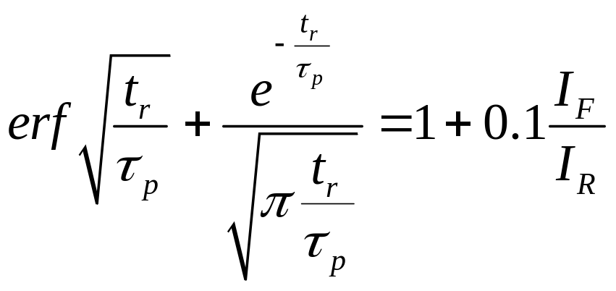
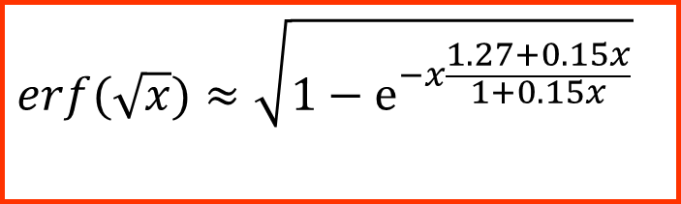
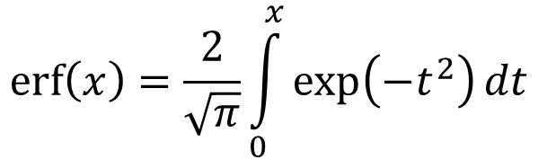
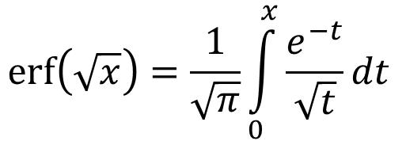
Recovery Time (not derived here)
ln(I)
‘0’ to ‘1’
‘1’ to ‘0’
V
$$erf\left(\sqrt{x}\right)=\frac{1}{\sqrt{π}}\int_{0}^{x}{\frac{e^{−t}}{\sqrt{t}}dt }$$
t_{r}
$$erf\left(x\right)=\frac{2}{\sqrt{π}}\int_{0}^{x}{\exp\left(−t^{2}\right)dt }$$
$$erf(\sqrt{x})≈\sqrt{1−e^{−x\frac{1.27+0.15x}{1+0.15x}}}$$
Useful formula …

Slide 22
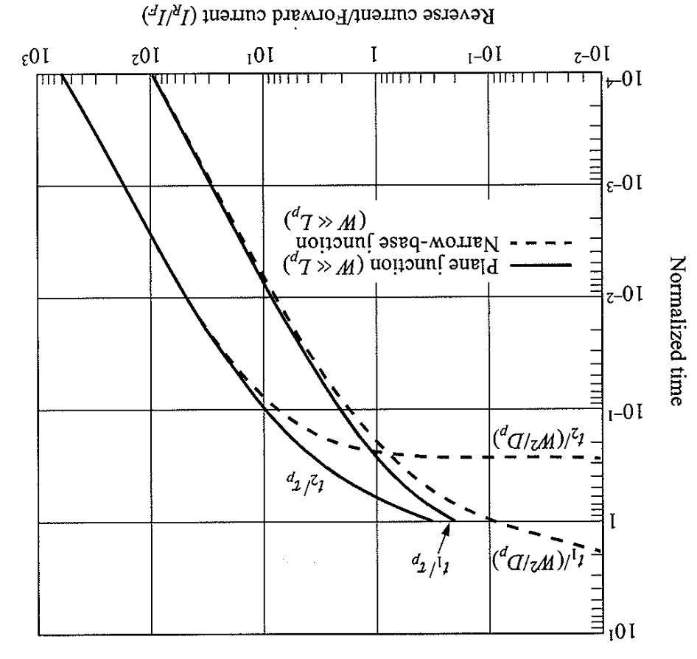
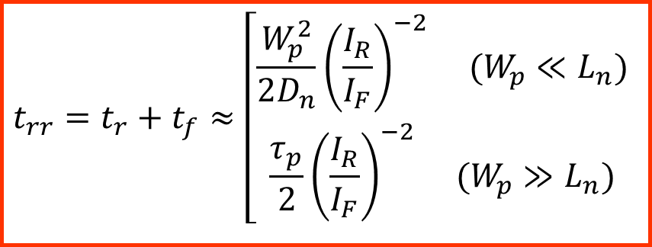
Recovery Time
ln(I)
Ref. Sze/Ng, p. 117
‘0’ to ‘1’
‘1’ to ‘0’
V
t_{r}
t_{s}
$$t_{rr}=t_{r}+t_{f}≈\left[\begin{matrix}\frac{W_{p}^{2}}{2D_{n}}{\left(\frac{I_{R}}{I_{F}}\right)}^{−2} (W_{p}≪L_{n}) \\ \frac{τ_{p}}{2}{\left(\frac{I_{R}}{I_{F}}\right)}^{−2} (W_{p}≫L_{n})\end{matrix}\right.$$

Slide 23
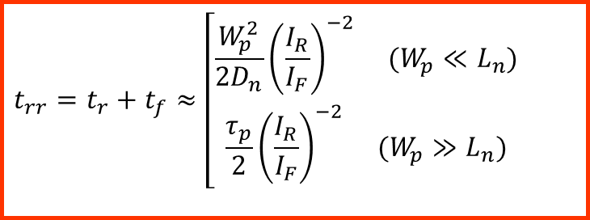
Section 22
PN Diode Large Signal Response
I = G ^{x} V
= q ^{x} n ^{x} v ^{x} A
charge
density
velocity
area
V
22.1 Charge control model
22.2 Turn-off and Turn-on characteristics
22.3 Steady-State expression from Charge Control
V
V
status
‘1’
A
V
‘0’
$$t_{rr}=t_{r}+t_{f}≈\left[\begin{matrix}\frac{W_{p}^{2}}{2D_{n}}{\left(\frac{I_{R}}{I_{F}}\right)}^{−2} (W_{p}≪L_{n}) \\ \frac{τ_{p}}{2}{\left(\frac{I_{R}}{I_{F}}\right)}^{−2} (W_{p}≫L_{n})\end{matrix}\right.$$

Slide 24
Section 22
PN Diode Large Signal Response
I = G ^{x} V
= q ^{x} n ^{x} v ^{x} A
charge
density
velocity
area
V
22.1 Charge control model
22.2 Turn-off and Turn-on characteristics
22.3 Steady-State expression from Charge Control
V
V
status
‘1’
A
V
‘0’
$$t_{rr}=t_{r}+t_{f}≈\left[\begin{matrix}\frac{W_{p}^{2}}{2D_{n}}{\left(\frac{I_{R}}{I_{F}}\right)}^{−2} (W_{p}≪L_{n}) \\ \frac{τ_{p}}{2}{\left(\frac{I_{R}}{I_{F}}\right)}^{−2} (W_{p}≫L_{n})\end{matrix}\right.$$

Slide 25
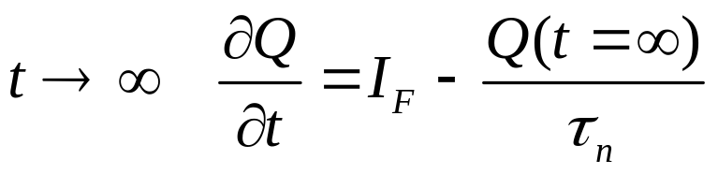
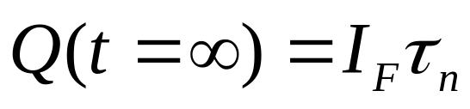
Turn-on Characteristics: Boundary Condition
S
R
IF
‘1’
V
A
VF
+
VR
P
‘0’
Vj
-
N
IR

Slide 26
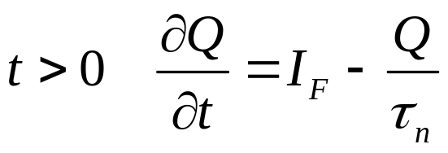
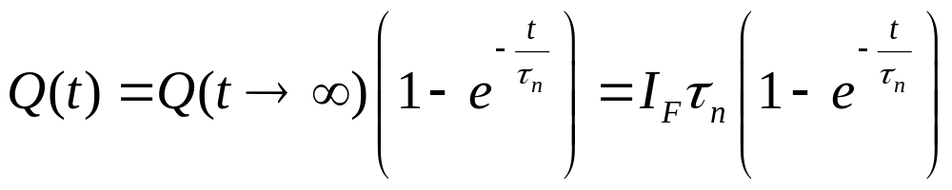
Turn-on Characteristics
S
R
IF
n_{p}(x,t)
time
VF
+
VR
P
Vj
-
N
IR
x
Check:
Q(t=0)=0
Q(t →∞)=I_{F} τ_{n}

Slide 27

Section 22
PN Diode Large Signal Response
I = G ^{x} V
= q ^{x} n ^{x} v ^{x} A
charge
density
velocity
area
V
22.1 Charge control model
22.2 Turn-off and Turn-on characteristics
22.3 Steady-State expression from Charge Control
V
V
status
‘1’
A
V
‘0’
$$t_{rr}=t_{r}+t_{f}≈\left[\begin{matrix}\frac{W_{p}^{2}}{2D_{n}}{\left(\frac{I_{R}}{I_{F}}\right)}^{−2} (W_{p}≪L_{n}) \\ \frac{τ_{p}}{2}{\left(\frac{I_{R}}{I_{F}}\right)}^{−2} (W_{p}≫L_{n})\end{matrix}\right.$$

Slide 28
Section 22
PN Diode Large Signal Response
I = G ^{x} V
= q ^{x} n ^{x} v ^{x} A
charge
density
velocity
area
V
22.1 Charge control model
22.2 Turn-off and Turn-on characteristics
22.3 Steady-State expression from Charge Control
V
V
‘1’
A
V
status
‘0’
$$t_{rr}=t_{r}+t_{f}≈\left[\begin{matrix}\frac{W_{p}^{2}}{2D_{n}}{\left(\frac{I_{R}}{I_{F}}\right)}^{−2} (W_{p}≪L_{n}) \\ \frac{τ_{p}}{2}{\left(\frac{I_{R}}{I_{F}}\right)}^{−2} (W_{p}≫L_{n})\end{matrix}\right.$$

Slide 29
Section 22
PN Diode Large Signal Response
Solid State Devices
22.3 Steady-State expression from Charge Control

Slide 30
Section 22
PN Diode Large Signal Response
I = G ^{x} V
= q ^{x} n ^{x} v ^{x} A
charge
density
velocity
area
V
22.1 Charge control model
22.2 Turn-off and Turn-on characteristics
22.3 Steady-State expression from Charge Control
V
V
‘1’
A
V
status
‘0’
$$t_{rr}=t_{r}+t_{f}≈\left[\begin{matrix}\frac{W_{p}^{2}}{2D_{n}}{\left(\frac{I_{R}}{I_{F}}\right)}^{−2} (W_{p}≪L_{n}) \\ \frac{τ_{p}}{2}{\left(\frac{I_{R}}{I_{F}}\right)}^{−2} (W_{p}≫L_{n})\end{matrix}\right.$$

Slide 31
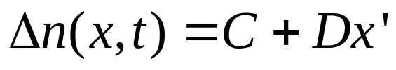
Minority Carrier Recombination or Diffusion
Electrons get scattered to the other side, the average time is…
Q(0⁺)
n_{p}(x,t)
recombination
No recombination
x
W_{p}

Slide 32
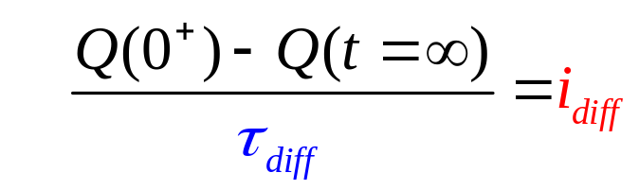
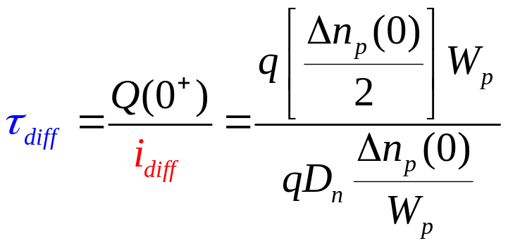
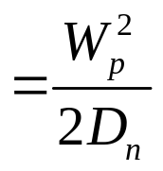

Diffusion Time
Electrons get scattered to the other side, the average time is…
Q(0⁺)
recombination
No recombination
x
W_{p}
Only half of them
goes to the right
Diffusion velocity

Slide 33




Two line derivation of Steady State Diode Current
Q(0⁺)
recombination
No recombination
x
W_{p}
Exact
Expression!

Slide 34
Large Signal pn-diode
Conclusion
Large signal response of devices of great importance for digital applications.
Analytical solution of partial differential equation often difficult (if not impossible),
=> approximate methods like Charge-control approximation often help simplify the solution and still provide a great deal of insight into the dynamics of switching operation.
Be careful in using the boundary condition which is often dictated by external circuit conditions.

Slide 35
Section 22
PN Diode Large Signal Response
I = G ^{x} V
= q ^{x} n ^{x} v ^{x} A
charge
density
velocity
area
V
22.1 Charge control model
22.2 Turn-off and Turn-on characteristics
22.3 Steady-State expression from Charge Control
V
V
‘1’
A
V
status
‘0’
$$t_{rr}=t_{r}+t_{f}≈\left[\begin{matrix}\frac{W_{p}^{2}}{2D_{n}}{\left(\frac{I_{R}}{I_{F}}\right)}^{−2} (W_{p}≪L_{n}) \\ \frac{τ_{p}}{2}{\left(\frac{I_{R}}{I_{F}}\right)}^{−2} (W_{p}≫L_{n})\end{matrix}\right.$$

