Slide 1
Section 21
PN Diode AC Response
Solid State Devices

Slide 2

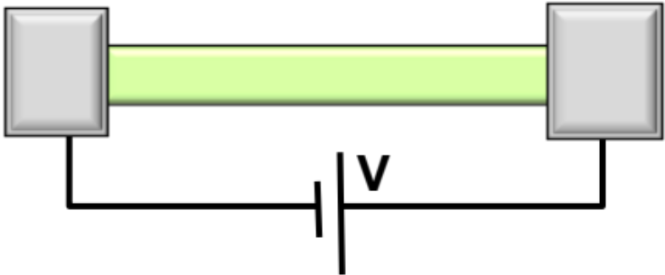
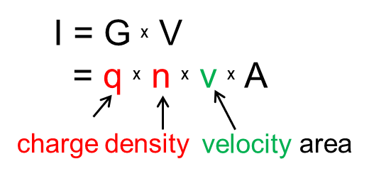
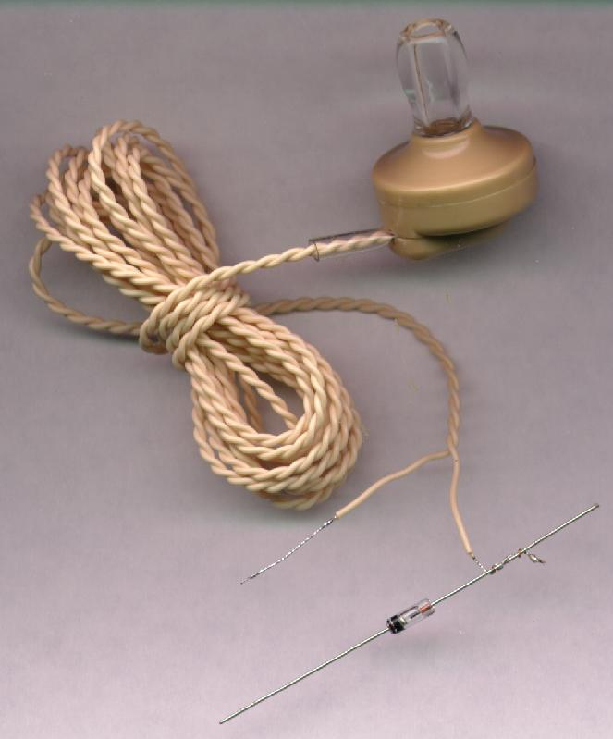
Section 21
PN Diode AC Response
 | Equilibrium | DC | Small signal | Large Signal | Circuits
PN Diode
Schottky Diode
Diode in Non-Equilibrium
(External DC+AC voltage applied)
BJT/ HBT
MOS

Slide 3
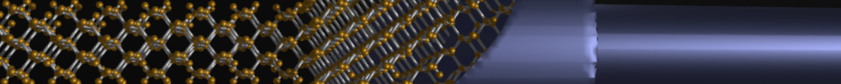
Section 21
PN Diode AC Response
status
V
21.1 Conductance and series resistance
21.2 Majority carrier junction capacitance
21.3 Minority carrier diffusion capacitance
V
V
G
R_{S}
C_{J}
C_{diff}

Slide 4
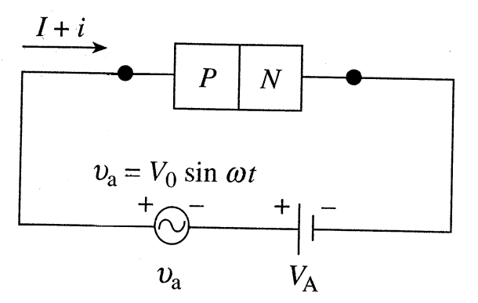




Why should we study AC Response?
Motivation
G
Conductance
Radio
R_{S}
C_{J}
Junction
Capacitance
www.sci-toy.com
Series Resistance
C_{diff}
Diffusion Capacitance

Slide 5
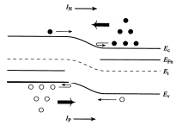
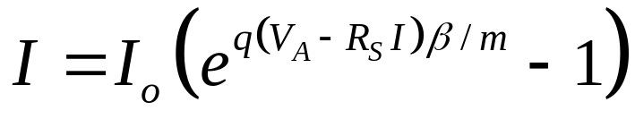
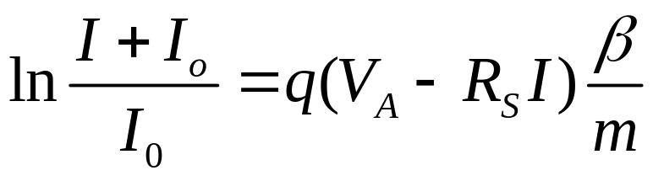
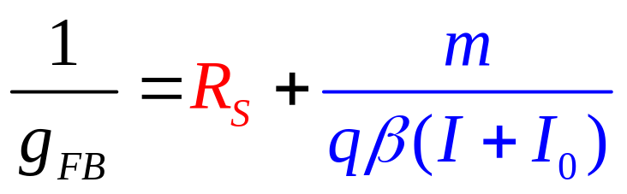
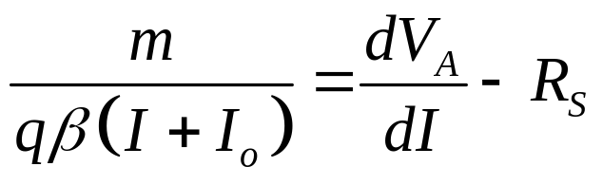
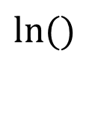
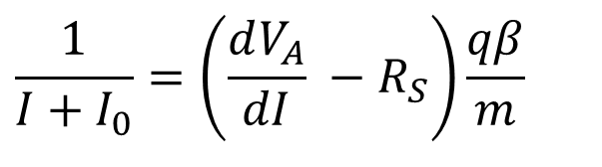
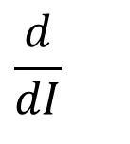
Forward Bias Conductance
ln(I)
3
2
1
6,7
V
$$ln⁡()$$
m = RG (2), diff (1), Ambipolar (2)
G
4
5
R_{S}
C_{J}
$$\frac{d}{dI}$$
$$\frac{1}{{I+I}_{0}}=\left(\frac{dV_{A}}{dI} −R_{S}\right)\frac{qβ}{m}$$
C_{diff}
Forward Bias Conductance

Slide 6
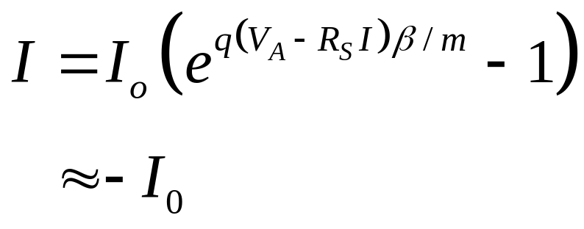
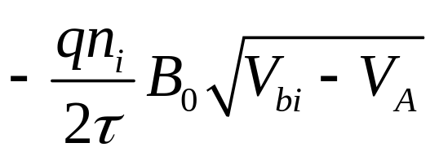
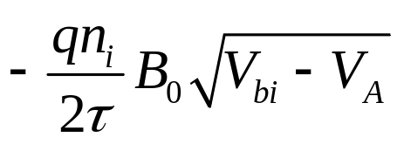
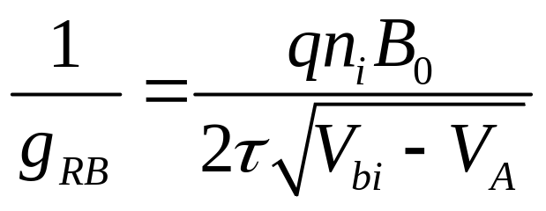
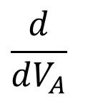
Reverse Bias Conductance
ln(I)
3
2
1
6,7
V
Recombination term
4
5
$$\frac{d}{dV_{A}}$$
G
R_{S}
C_{J}
Reverse Bias Conductance
C_{diff}

Slide 7
Section 21
PN Diode AC Response
G
R_{S}
C_{J}
21.1 Conductance and series resistance
21.2 Majority carrier junction capacitance
21.3 Minority carrier diffusion capacitance
V
status
V
V
C_{diff}

Slide 8
Section 21
PN Diode AC Response
G
R_{S}
C_{J}
V
21.1 Conductance and series resistance
21.2 Majority carrier junction capacitance
21.3 Minority carrier diffusion capacitance
V
status
V
C_{diff}

Slide 9
Section 21
PN Diode AC Response
Solid State Devices
21.2 Majority carrier junction capacitance

Slide 10
Section 21
PN Diode AC Response
G
R_{S}
C_{J}
V
21.1 Conductance and series resistance
21.2 Majority carrier junction capacitance
21.3 Minority carrier diffusion capacitance
V
status
V
C_{diff}

Slide 11
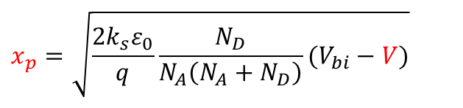
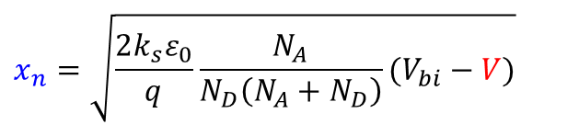
Fields and Depletion as a Function of Bias
VA=0
G
P
N
R_{S}
Charge
C_{J}
VA=0
VA=0
C_{diff}
Position
Electric Field
VA=0
$$x_{n}=\sqrt{\frac{2k_{s}ε_{0}}{q}\frac{N_{A}}{N_{D}\left(N_{A}+N_{D}\right)}(V_{bi}−V)}$$
Position
Potential
VA=0
Zero Bias
$$x_{p}=\sqrt{\frac{2k_{s}ε_{0}}{q}\frac{N_{D}}{N_{A}\left(N_{A}+N_{D}\right)}(V_{bi}−V)}$$
Position

Slide 12
Fields and Depletion as a Function of Bias
VA>0
VA=0
G
P
N
R_{S}
Charge
C_{J}
VA>0
VA>0
C_{diff}
Position
Electric Field
VA>0
$$x_{n}=\sqrt{\frac{2k_{s}ε_{0}}{q}\frac{N_{A}}{N_{D}\left(N_{A}+N_{D}\right)}(V_{bi}−V)}$$
Position
Potential
VA=0
DC + AC
$$x_{p}=\sqrt{\frac{2k_{s}ε_{0}}{q}\frac{N_{D}}{N_{A}\left(N_{A}+N_{D}\right)}(V_{bi}−V)}$$
VA>0
Position

Slide 13
Fields and Depletion as a Function of Bias
VA>0
VA=0
G
VA<0
P
N
R_{S}
Charge
C_{J}
VA<0
C_{diff}
Position
Electric Field
$$x_{n}=\sqrt{\frac{2k_{s}ε_{0}}{q}\frac{N_{A}}{N_{D}\left(N_{A}+N_{D}\right)}(V_{bi}−V)}$$
Position
Potential
VA<0
VA=0
DC - AC
$$x_{p}=\sqrt{\frac{2k_{s}ε_{0}}{q}\frac{N_{D}}{N_{A}\left(N_{A}+N_{D}\right)}(V_{bi}−V)}$$
VA>0
Position

Slide 14
Fields and Depletion as a Function of Bias
VA>0
VA=0
G
VA<0
P
N
R_{S}
Charge
C_{J}
VA<0
C_{diff}
Position
Electric Field
$$x_{n}=\sqrt{\frac{2k_{s}ε_{0}}{q}\frac{N_{A}}{N_{D}\left(N_{A}+N_{D}\right)}(V_{bi}−V)}$$
Position
Potential
VA<0
DC - AC
$$x_{p}=\sqrt{\frac{2k_{s}ε_{0}}{q}\frac{N_{D}}{N_{A}\left(N_{A}+N_{D}\right)}(V_{bi}−V)}$$
Position

Slide 15
Fields and Depletion as a Function of Bias
VA>0
VA=0
G
VA<0
P
N
R_{S}
Charge
C_{J}
VA=0
VA=0
VA>0
C_{diff}
Position
Electric Field
VA=0
$$x_{n}=\sqrt{\frac{2k_{s}ε_{0}}{q}\frac{N_{A}}{N_{D}\left(N_{A}+N_{D}\right)}(V_{bi}−V)}$$
Position
Potential
VA=0
DC
$$x_{p}=\sqrt{\frac{2k_{s}ε_{0}}{q}\frac{N_{D}}{N_{A}\left(N_{A}+N_{D}\right)}(V_{bi}−V)}$$
Position

Slide 16
Fields and Depletion as a Function of Bias
VA>0
VA=0
G
VA<0
P
N
R_{S}
Charge
C_{J}
VA>0
C_{diff}
Position
Electric Field
$$x_{n}=\sqrt{\frac{2k_{s}ε_{0}}{q}\frac{N_{A}}{N_{D}\left(N_{A}+N_{D}\right)}(V_{bi}−V)}$$
Position
Potential
DC + AC
$$x_{p}=\sqrt{\frac{2k_{s}ε_{0}}{q}\frac{N_{D}}{N_{A}\left(N_{A}+N_{D}\right)}(V_{bi}−V)}$$
VA>0
Position

Slide 17
Fields and Depletion as a Function of Bias
VA>0
VA=0
G
VA<0
P
N
R_{S}
Charge
C_{J}
VA=0
VA=0
VA>0
C_{diff}
Position
Electric Field
VA=0
$$x_{n}=\sqrt{\frac{2k_{s}ε_{0}}{q}\frac{N_{A}}{N_{D}\left(N_{A}+N_{D}\right)}(V_{bi}−V)}$$
Position
Potential
VA=0
DC
$$x_{p}=\sqrt{\frac{2k_{s}ε_{0}}{q}\frac{N_{D}}{N_{A}\left(N_{A}+N_{D}\right)}(V_{bi}−V)}$$
Position

Slide 18
Fields and Depletion as a Function of Bias
VA>0
VA=0
G
VA<0
P
N
R_{S}
Charge
C_{J}
VA<0
C_{diff}
Position
Electric Field
$$x_{n}=\sqrt{\frac{2k_{s}ε_{0}}{q}\frac{N_{A}}{N_{D}\left(N_{A}+N_{D}\right)}(V_{bi}−V)}$$
Position
Potential
VA<0
VA=0
DC - AC
$$x_{p}=\sqrt{\frac{2k_{s}ε_{0}}{q}\frac{N_{D}}{N_{A}\left(N_{A}+N_{D}\right)}(V_{bi}−V)}$$
VA>0
Position

Slide 19
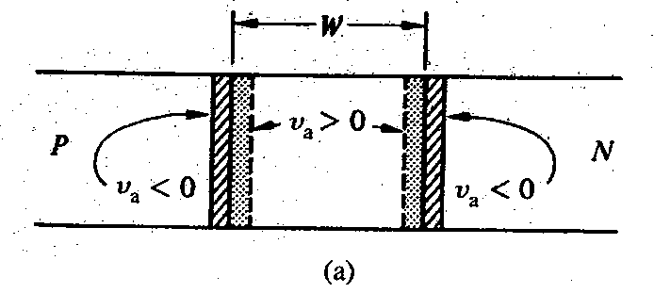
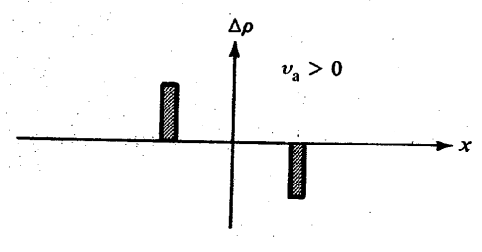
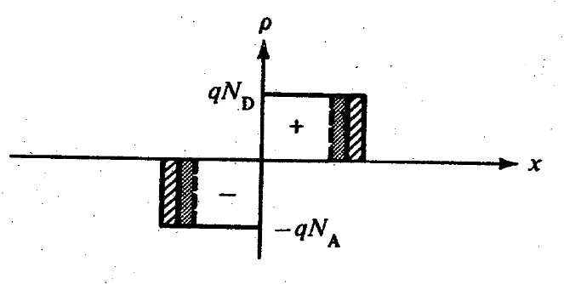
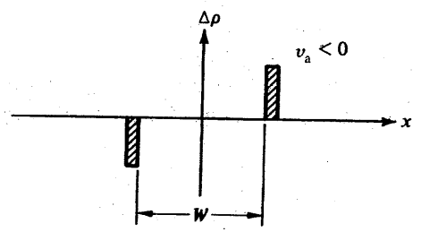
Junction Capacitance
G
Forward biased diode + AC signal
R_{S}
C_{J}
Junction
Capacitance
Fn
V_{DC}
Fp
C_{diff}
Depletion width modulation
V_{A}> 0
Majority carrier effect
Charge modulation
V_{A}< 0

Slide 20
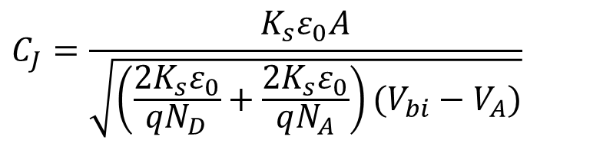
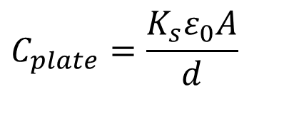
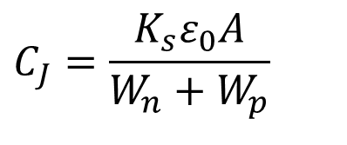
Majority Carrier Junction Capacitance
Conductance
Δρ
VA < 0
Series Resistance
Junction
Capacitance
x
Δρ
VA > 0
Diffusion Capacitance
$$C_{plate}=\frac{K_{s}ε_{0}A}{d}$$
x
measure
C_{J}
Majority Carrier Junction Capacitance
$$C_{J}=\frac{K_{s}ε_{0}A}{\sqrt{\left(\frac{2K_{s}ε_{0}}{qN_{D}}+\frac{2K_{s}ε_{0}}{qN_{A}}\right)(V_{bi}−V_{A})}}$$
$$C_{J}=\frac{K_{s}ε_{0}A}{W_{n}+W_{p}}$$
V_{A}

Slide 21
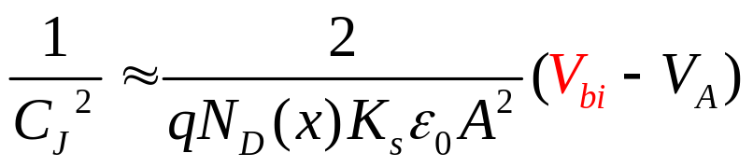
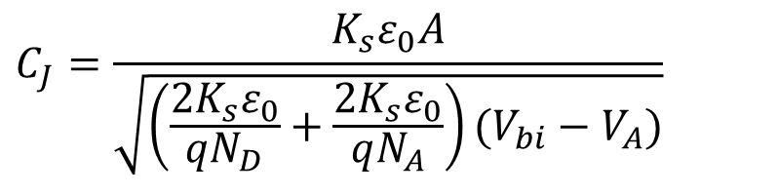
Measurement of Built-in Potential
$$C_{J}=\frac{K_{s}ε_{0}A}{\sqrt{\left(\frac{2K_{s}ε_{0}}{qN_{D}}+\frac{2K_{s}ε_{0}}{qN_{A}}\right)(V_{bi}−V_{A})}}$$
(Assume single sided p⁺-n junction)
Derive V_{bi} from C_{J} measurements
measure
plot
C_{J}⁻²
C_{J}
V_{A}
V_{A}
V_{bi}

Slide 22
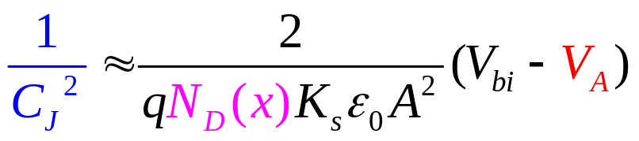
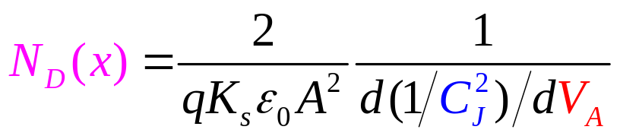
.. And Variable Doping – probe charge at depletionregion edge
measure
C_{J}
V_{A}
Measure doping concentration as a function of position
plot
C_{J}⁻²
Charge
VA<0
VA=0
VA>0
V_{A}

Slide 23
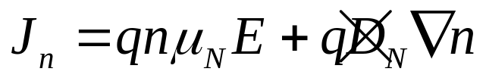
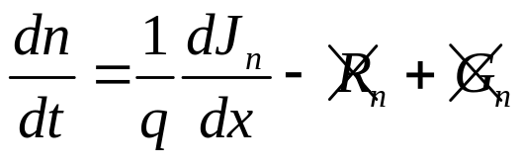
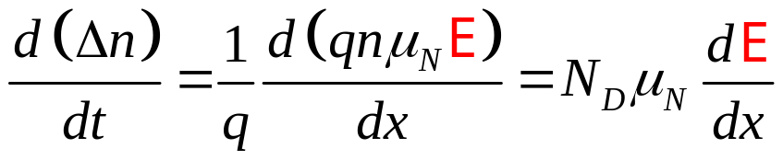
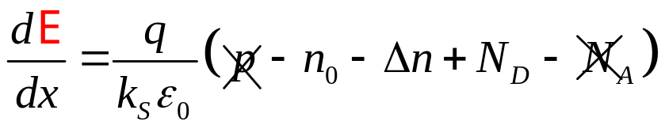
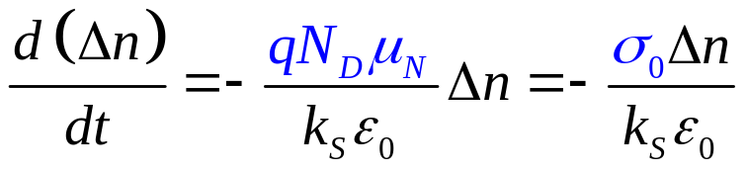
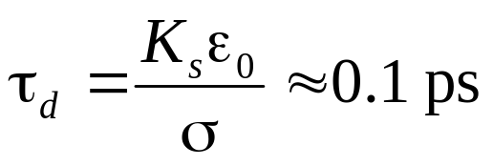
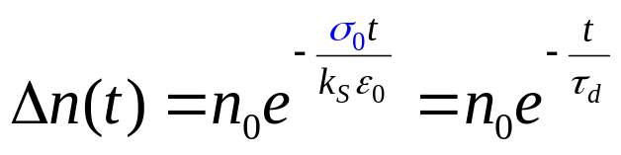
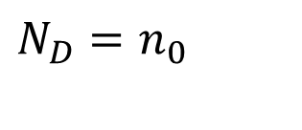
Dielectric Relaxation Time (majority side)
Majority side
Neglect
V_{DC}
N-side
$$N_{D}=n_{0}$$
How long does it take for the signal to cross the junction?
G
C_{J}
R_{S}
Very fast
C_{diff}
Overall electronic system responds => dielectric response

Slide 24
Section 21
PN Diode AC Response
G
R_{S}
C_{J}
V
21.1 Conductance and series resistance
21.2 Majority carrier junction capacitance
21.3 Minority carrier diffusion capacitance
V
status
V
C_{diff}

Slide 25
Section 21
PN Diode AC Response
G
R_{S}
C_{J}
V
21.1 Conductance and series resistance
21.2 Majority carrier junction capacitance
21.3 Minority carrier diffusion capacitance
V
V
status
C_{diff}

Slide 26
Section 21
PN Diode AC Response
Solid State Devices
21.3 Minority carrier diffusion capacitance

Slide 27
Section 21
PN Diode AC Response
G
R_{S}
C_{J}
V
21.1 Conductance and series resistance
21.2 Majority carrier junction capacitance
21.3 Minority carrier diffusion capacitance
V
V
status
C_{diff}

Slide 28
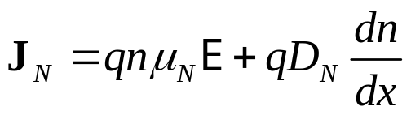
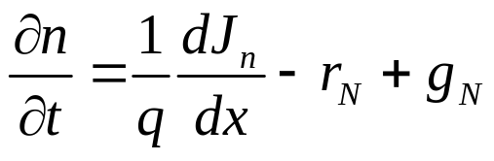
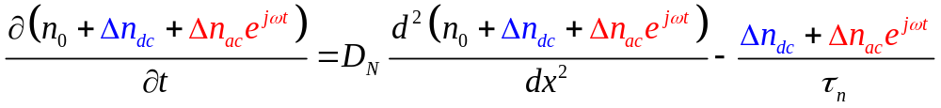
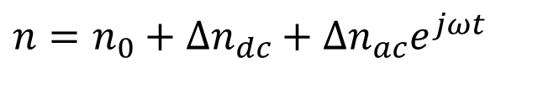
Diffusion Capacitance for Minority Carriers
G
Minority Carrier side
C_{J}
R_{S}
p
n
C_{diff}
AC
AC
x
DC
AC
$${n=n}_{0}+Δn_{dc}+Δn_{ac}e^{jωt}$$
V_{DC}

Slide 29
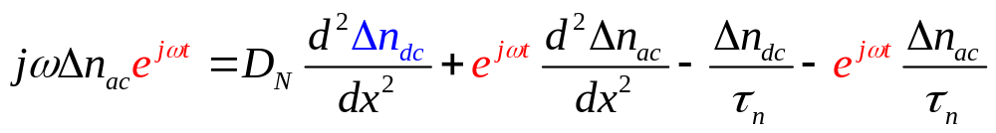
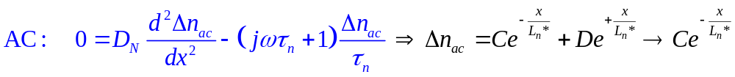
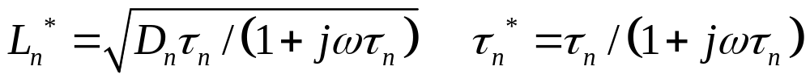
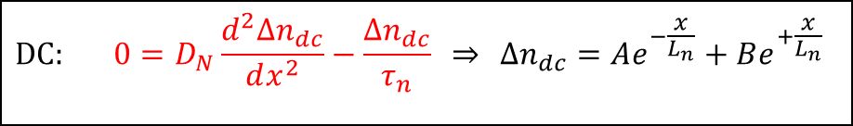

Diffusion Capacitance for Minority Carriers
n
x_{n}
$$\text{DC}: 0=D_{N}\frac{d^{2}Δn_{dc}}{dx^{2}}−\frac{Δn_{dc}}{τ_{n}} ⇒ Δn_{dc}=Ae^{−\frac{x}{L_{n}}}+Be^{+\frac{x}{L_{n}}}$$
$$⇒Ae^{−\frac{x}{L_{n}}} \text{with}{ L}_{n}= \sqrt{D_{n}τ_{n}}$$

Slide 30
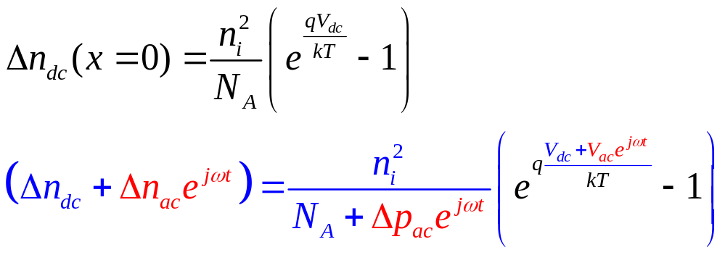
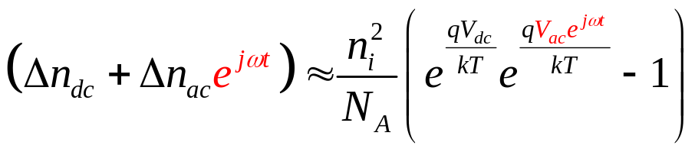
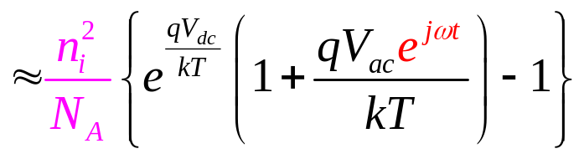

AC Boundary Conditions
n
x_{n}
Taylor expansion

Slide 31




AC Current and Impedance
n
Finally…
x_{n}
AC Current
AC Admittance

Slide 32





Diffusion Conductance and Capacitance
Separate in real &
imaginary parts …
Product of G_{D} and C_{D}
frequency-independent

Slide 33
Section 21
PN Diode AC Response
G
R_{S}
C_{J}
V
21.1 Conductance and series resistance
21.2 Majority carrier junction capacitance
21.3 Minority carrier diffusion capacitance
V
C_{diff}
V
status
Small signal response relevant for many analog applications.
Small signal parameters always refer to the DC operating conditions, as such the parameter changes with bias condition.
Important to distinguish between majority and minority carrier capacitance. Their relative importance depends on specific applications.

