Slide 1
Section 20
PN Diode I-V Characteristics
Solid State Devices

Slide 2

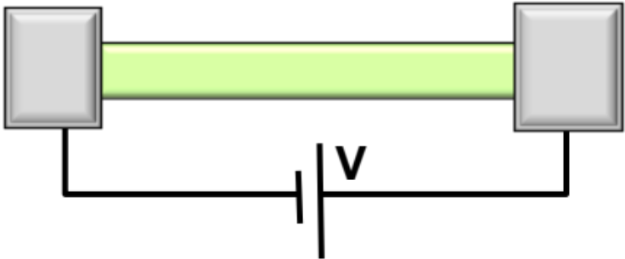
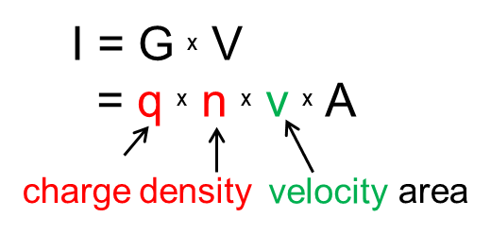
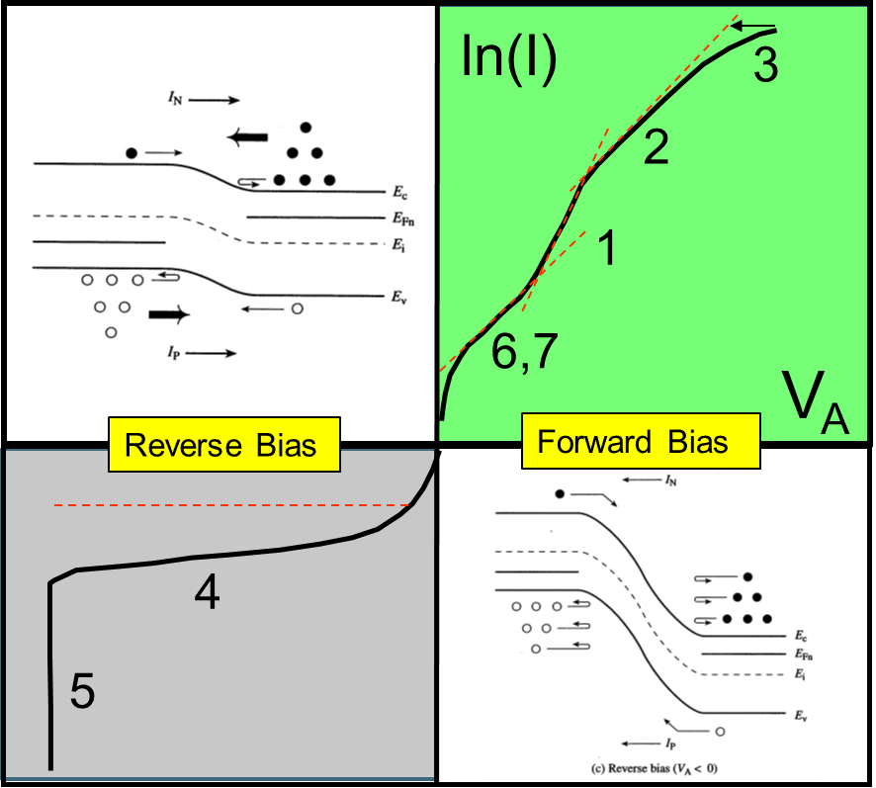
Section 20
PN Diode I-V Characteristics
 | Equilibrium | DC | Small signal | Large Signal | Circuits
PN Diode
Diode
in DC Bias
Schottky Diode
BJT/ HBT
MOS

Slide 3
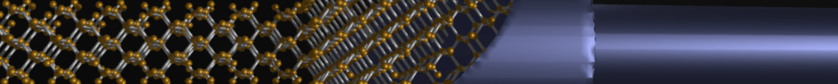
Section 20
PN Diode I-V Characteristics
status
V
20.1 Band diagram with applied bias
20.2 Derivation of the forward bias formula
20.3 Forward Bias - Non-linear Regime
  Resistive drop
  Ambipolar regime
20.4 Non-ideal effects:
  Junction recombination
  Tunneling
  Impact ionization
V
V
V

Slide 4
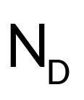
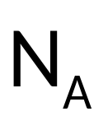
Forward and Reverse Bias
Current flows easily
Forward Bias
Current does not flow easily
Reverse Bias

Slide 5
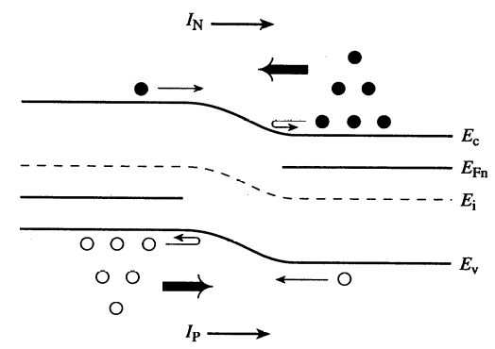
Applying Bias to p-n Junction
IV characteristics of a Diode
To be discussed in detail
ln(I)
3
Diffusion limited
Ambipolar transport
High injection
R-G in depletion
Breakdown
Trap-assisted R-G
Esaki Tunneling
2
1
6,7
V_{A}
Reverse Bias
Forward Bias
4
5

Slide 6
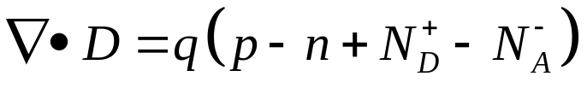
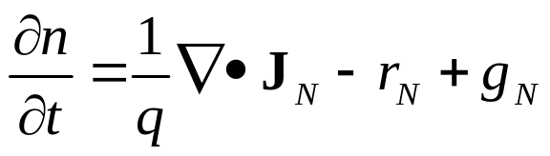
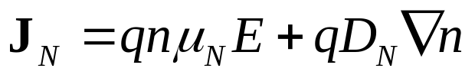
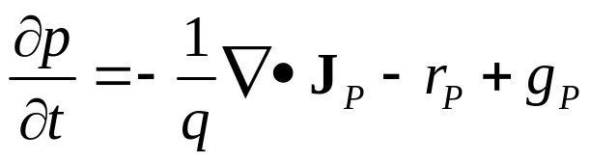
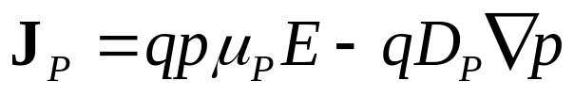
Band Diagram with Applied Bias…
Band diagram (this segment)
Next segment / lecture …

Slide 7
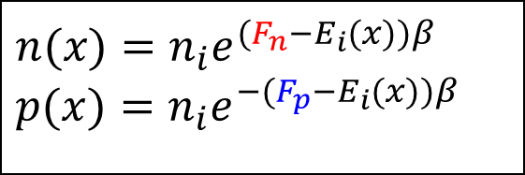
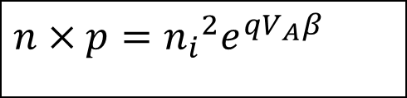

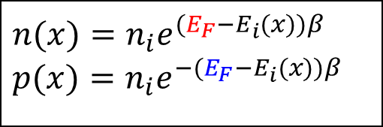
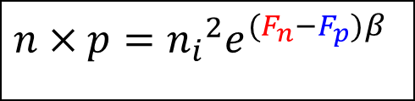
Applying a Bias: Poisson Equation
$$n(x)=n_{i}e^{(E_{F}−E_{i}(x))β} \\ p(x)=n_{i}e^{−(E_{F}−E_{i}(x))β}$$
No bias
qV_{bi}
$$n×p={n_{i}}^{2}$$
E_{C}-E_{F}
E_{F}-E_{V}
Question: Max value of V_{bi}?
Answer: for degenerate s.c.,
if E_{C}-E_{F}=0, E_{F}-E_{V}=0 → E_{g}
$$n(x)=n_{i}e^{(F_{n}−E_{i}(x))β} \\ p(x)=n_{i}e^{−(F_{p}−E_{i}(x))β}$$
Applied bias
q(V_{bi}-V)
E_{C}-F_{n}
-qV
$$n×p={n_{i}}^{2}e^{(F_{n}−F_{p})β}$$
F_{p}-E_{V}
$$n×p={n_{i}}^{2}e^{qV_{A}β}$$
P-side grounded
Notes:
Ec-Fn must remain the same. Fp-Ev must remain the same (Even under bias). Quasi-Fermilevel: Fermilevel in the presence of a bias.
Beta is 1/kt. In equilbrium Fn=Fp.

Slide 8
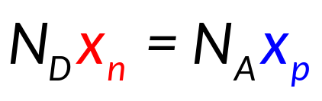
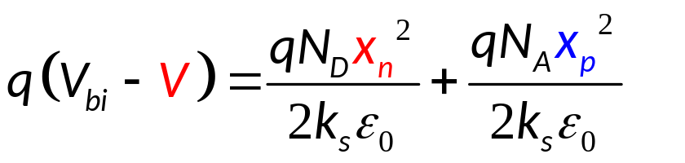
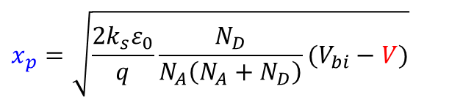
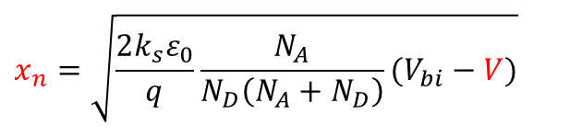
Depletion Widths
-V
GND
x_{n}
x_{p}
From previous lecture (homo-junction)
$$x_{n}=\sqrt{\frac{2k_{s}ε_{0}}{q}\frac{N_{A}}{N_{D}\left(N_{A}+N_{D}\right)}(V_{bi}−V)}$$
$$x_{p}=\sqrt{\frac{2k_{s}ε_{0}}{q}\frac{N_{D}}{N_{A}\left(N_{A}+N_{D}\right)}(V_{bi}−V)}$$
Applied bias

Slide 9
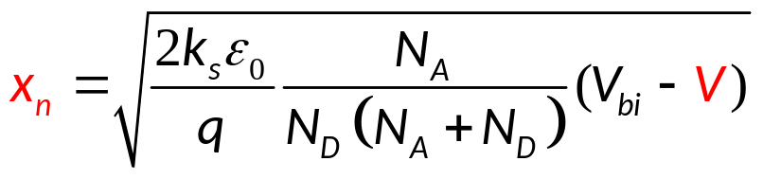
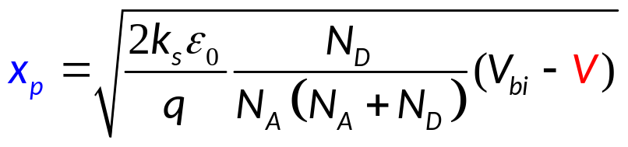
Depletion Widths
-V
P
N
GND
x_{n}
x_{p}
From previous lecture (homo-junction)
Applied bias

Slide 10
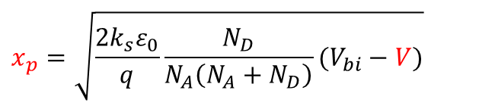
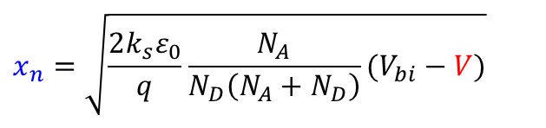
Fields and Depletion at Forward/Reverse Biases
VA=0
P
N
Charge
$$x_{n}=\sqrt{\frac{2k_{s}ε_{0}}{q}\frac{N_{A}}{N_{D}\left(N_{A}+N_{D}\right)}(V_{bi}−V)}$$
VA=0
VA=0
Position
Electric Field
$$x_{p}=\sqrt{\frac{2k_{s}ε_{0}}{q}\frac{N_{D}}{N_{A}\left(N_{A}+N_{D}\right)}(V_{bi}−V)}$$
VA=0
Position
Potential
VA=0
Zero Bias
Position

Slide 11
Fields and Depletion at Forward/Reverse Biases
VA>0
VA=0
P
N
Charge
$$x_{n}=\sqrt{\frac{2k_{s}ε_{0}}{q}\frac{N_{A}}{N_{D}\left(N_{A}+N_{D}\right)}(V_{bi}−V)}$$
VA>0
VA>0
Position
Electric Field
$$x_{p}=\sqrt{\frac{2k_{s}ε_{0}}{q}\frac{N_{D}}{N_{A}\left(N_{A}+N_{D}\right)}(V_{bi}−V)}$$
VA>0
Position
Potential
VA=0
Forward Bias
VA>0
Position

Slide 12
Fields and Depletion at Forward/Reverse Biases
VA>0
VA=0
VA<0
P
N
Charge
$$x_{n}=\sqrt{\frac{2k_{s}ε_{0}}{q}\frac{N_{A}}{N_{D}\left(N_{A}+N_{D}\right)}(V_{bi}−V)}$$
VA<0
Position
Electric Field
$$x_{p}=\sqrt{\frac{2k_{s}ε_{0}}{q}\frac{N_{D}}{N_{A}\left(N_{A}+N_{D}\right)}(V_{bi}−V)}$$
Position
Potential
VA<0
VA=0
Reverse Bias
VA>0
Position

Slide 13
Fields and Depletion at Forward/Reverse Biases
VA>0
VA=0
VA<0
P
N
Charge
$$x_{n}=\sqrt{\frac{2k_{s}ε_{0}}{q}\frac{N_{A}}{N_{D}\left(N_{A}+N_{D}\right)}(V_{bi}−V)}$$
VA<0
Position
Electric Field
$$x_{p}=\sqrt{\frac{2k_{s}ε_{0}}{q}\frac{N_{D}}{N_{A}\left(N_{A}+N_{D}\right)}(V_{bi}−V)}$$
Position
Potential
VA<0
Reverse Bias
Position

Slide 14
Fields and Depletion at Forward/Reverse Biases
VA>0
VA=0
VA<0
P
N
Charge
$$x_{n}=\sqrt{\frac{2k_{s}ε_{0}}{q}\frac{N_{A}}{N_{D}\left(N_{A}+N_{D}\right)}(V_{bi}−V)}$$
VA=0
VA=0
VA>0
Position
Electric Field
$$x_{p}=\sqrt{\frac{2k_{s}ε_{0}}{q}\frac{N_{D}}{N_{A}\left(N_{A}+N_{D}\right)}(V_{bi}−V)}$$
VA=0
Position
Potential
VA=0
Zero Bias
Position

Slide 15
Fields and Depletion at Forward/Reverse Biases
VA>0
VA=0
VA<0
P
N
Charge
$$x_{n}=\sqrt{\frac{2k_{s}ε_{0}}{q}\frac{N_{A}}{N_{D}\left(N_{A}+N_{D}\right)}(V_{bi}−V)}$$
VA>0
Position
Electric Field
$$x_{p}=\sqrt{\frac{2k_{s}ε_{0}}{q}\frac{N_{D}}{N_{A}\left(N_{A}+N_{D}\right)}(V_{bi}−V)}$$
Position
Potential
Forward Bias
VA>0
Position

Slide 16
Fields and Depletion at Forward/Reverse Biases
VA>0
VA=0
VA<0
P
N
Charge
$$x_{n}=\sqrt{\frac{2k_{s}ε_{0}}{q}\frac{N_{A}}{N_{D}\left(N_{A}+N_{D}\right)}(V_{bi}−V)}$$
VA=0
VA=0
VA>0
Position
Electric Field
$$x_{p}=\sqrt{\frac{2k_{s}ε_{0}}{q}\frac{N_{D}}{N_{A}\left(N_{A}+N_{D}\right)}(V_{bi}−V)}$$
VA=0
Barrier height is reduced at forward biases
Significant increase of peak field at reverse
bias
Position
Potential
VA=0
Zero Bias
Position

Slide 17
Section 20
PN Diode I-V Characteristics
status
V
20.1 Band diagram with applied bias
20.2 Derivation of the forward bias formula
20.3 Forward Bias - Non-linear Regime
  Resistive drop
  Ambipolar regime
20.4 Non-ideal effects:
  Junction recombination
  Tunneling
  Impact ionization
V
V
V

Slide 18
Section 20
PN Diode I-V Characteristics
V
20.1 Band diagram with applied bias
20.2 Derivation of the forward bias formula
20.3 Forward Bias - Non-linear Regime
  Resistive drop
  Ambipolar regime
20.4 Non-ideal effects:
  Junction recombination
  Impact ionization
  Tunneling
V
status
V
V

Slide 19
Section 20
PN Diode I-V Characteristics
Solid State Devices
20.2 Derivation of the forward bias formula

Slide 20
Section 20
PN Diode I-V Characteristics
V
20.1 Band diagram with applied bias
20.2 Derivation of the forward bias formula
20.3 Forward Bias - Non-linear Regime
  Resistive drop
  Ambipolar regime
20.4 Non-ideal effects:
  Junction recombination
  Impact ionization
  Tunneling
V
status
V
V

Slide 21
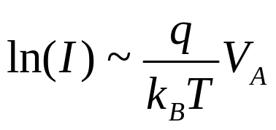
Various Regions of I-V Characteristics
ln(I)
3
Diffusion limited
Ambipolar transport
High injection
R-G in depletion
Breakdown
Trap-assisted R-G
Esaki Tunneling
1. Diffusion limited
2
1
6,7
V_{A}
1
4
5
Notes:
Asad: We should redraw the figure ….

Slide 22
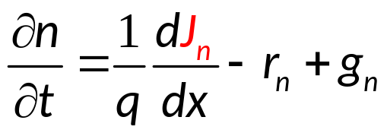
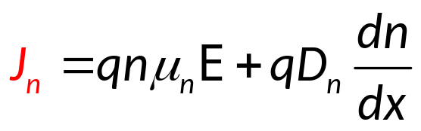
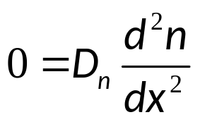
Recall: One Sided Minority Diffusion
Steady state
Acceptor doped
If current is continuous, one can calculate
for the current anywhere. Position doesn’t
matter! Calculate at “easiest” position.
Minority carrier current on p-side.
We know the solution from earlier
Assume steady state, no r_{n}, g_{n}
q(V_{bi}-V)
-V
F_{p}-E_{V}

Slide 23
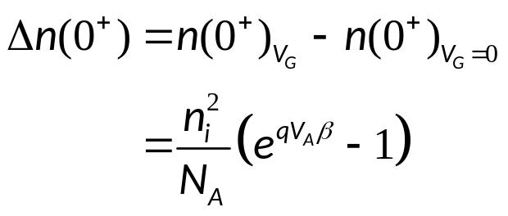
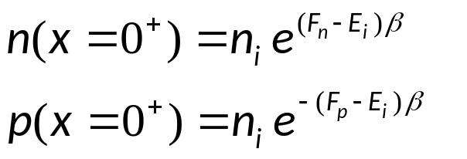
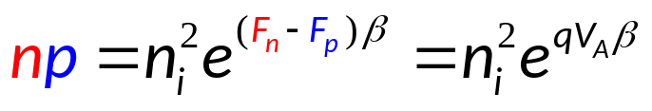
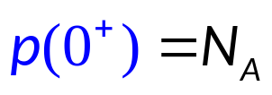
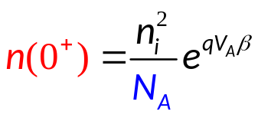
Boundary Conditions
Boundary Conditions
Solution profile
Difference of Quasi-Fermi-levels equals applied voltage
q(V_{bi}-V_{A})
-V_{A}
F_{n}
F_{p}
X=0⁺

Slide 24
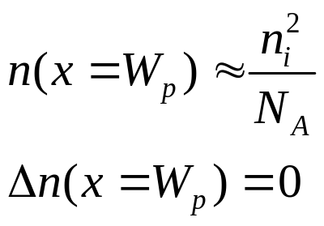
Right Boundary Condition
Infinite surface recombination velocity at metal → excess carrier concentration = 0
Solution profile
q(V_{bi}-V_{A})
-V_{A}
F_{n}
F_{p}
X=0⁺

Slide 25
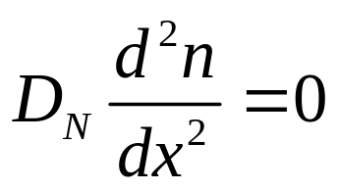

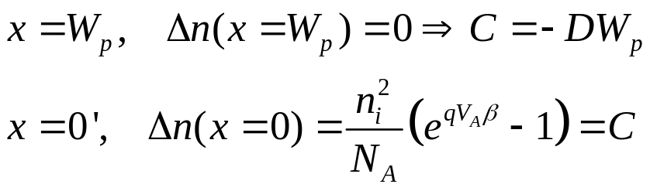
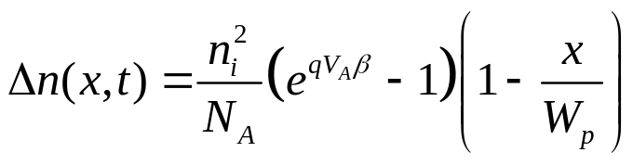
Example: One Sided Minority Diffusion
Ansatz
Solution profile
q(V_{bi}-V_{A})
Plug in B.C.
F_{n}
-V_{A}
F_{p}
X=0⁺
Final result: Excess electron carrier concentration (P-side) as function of position

Slide 26
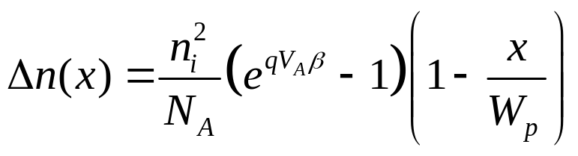
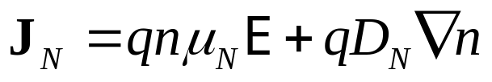
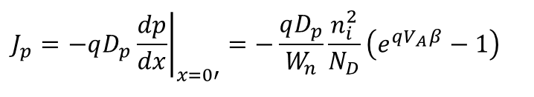
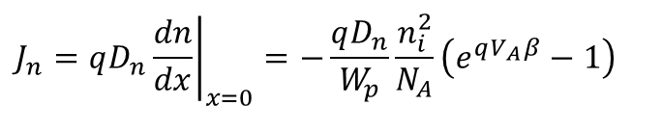
Electron & Hole Fluxes
Current (electrons)
Δn
$$J_{n}=qD_{n}{\left.\frac{dn}{dx}\right|}_{x=0}=−\frac{qD_{n}}{W_{p}}\frac{n_{i}^{2}}{N_{A}}\left(e^{qV_{A}β}−1\right)$$
F_{n}
F_{p}
Current (holes)
Δp
$$J_{p}=−qD_{p}{\left.\frac{dp}{dx}\right|}_{x=0′}=−\frac{qD_{p}}{W_{n}}\frac{n_{i}^{2}}{N_{D}}\left(e^{qV_{A}β}−1\right)$$

Slide 27
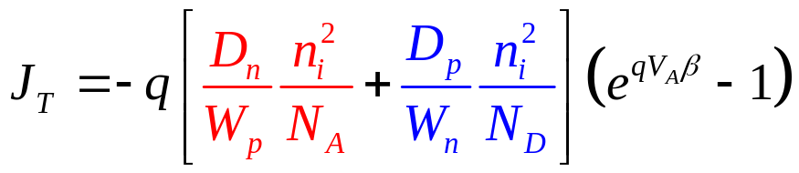
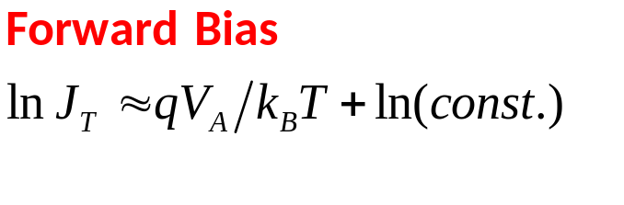
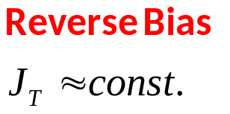
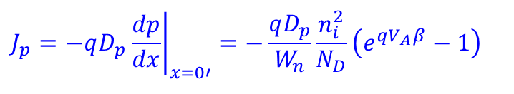
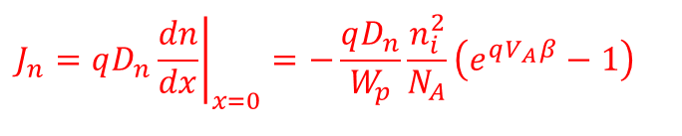


Total Current
Current (electrons)
To get total current, add electron and hole current values at identical x-points.
$$J_{n}=qD_{n}{\left.\frac{dn}{dx}\right|}_{x=0}=−\frac{qD_{n}}{W_{p}}\frac{n_{i}^{2}}{N_{A}}\left(e^{qV_{A}β}−1\right)$$
But we have only expressions at different x-points
If there is no R-G in junction,
=> then the diffusion currents will be continuous
Current (holes)
=> Add the 2 components
$$J_{p}=−qD_{p}{\left.\frac{dp}{dx}\right|}_{x=0′}=−\frac{qD_{p}}{W_{n}}\frac{n_{i}^{2}}{N_{D}}\left(e^{qV_{A}β}−1\right)$$
$$J_{n}$$
Δn
F_{n}
F_{p}
$$J_{p}$$
Δp
Diffusion current

Slide 28
Ideal pn-junction current
Slope = 1
1
Diffusion current
1

Slide 29
Section 20
PN Diode I-V Characteristics
V
20.1 Band diagram with applied bias
20.2 Derivation of the forward bias formula
20.3 Forward Bias - Non-linear Regime
  Resistive drop
  Ambipolar regime
20.4 Non-ideal effects:
  Junction recombination
  Impact ionization
  Tunneling
V
status
V
V

Slide 30
Section 20
PN Diode I-V Characteristics
V
20.1 Band diagram with applied bias
20.2 Derivation of the forward bias formula
20.3 Forward Bias - Non-linear Regime
  Resistive drop
  Ambipolar regime
20.4 Non-ideal effects:
  Junction recombination
  Impact ionization
  Tunneling
status
V
V
status
status
V

Slide 31
Section 20
PN Diode I-V Characteristics
Solid State Devices
20.2 Forward Bias - Non-linear Regime

Slide 32
Section 20
PN Diode I-V Characteristics
V
20.1 Band diagram with applied bias
20.2 Derivation of the forward bias formula
20.3 Forward Bias - Non-linear Regime
  Resistive drop
  Ambipolar regime
20.4 Non-ideal effects:
  Junction recombination
  Impact ionization
  Tunneling
status
V
V
status
status
V

Slide 33
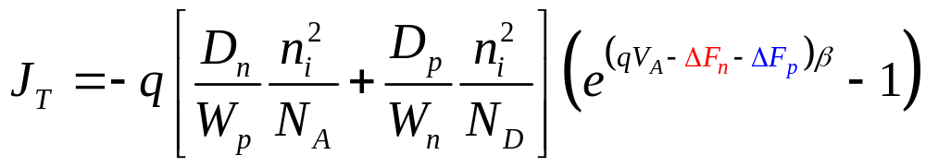
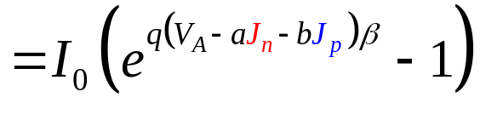
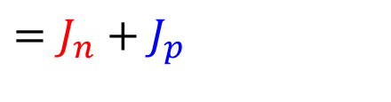
Nonlinear Regime (3) …
ln(I)
3
Assumption of flat Quasi-Fermi levels invalid here
2
Nonlinear Regime (2,3)
1
6,7
V_{A}
$$=J_{n}+J_{p}$$

Slide 34
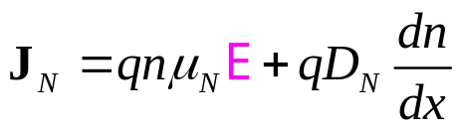













Flat Quasi-Fermi Level up to Junction ?
$$\overset{⃑}{ℇ}=−\frac{dV}{dx}=\frac{1}{q} \frac{dE_{i}}{dx}$$
Rewrite n into non-equilibrium form
$$n=n_{i}e^{β(F_{n}−E_{i})}$$
Ignore variation in temperature in x
$$E_{i}\left(x\right), F_{n}(x)$$
F_{n}
F_{p}
$$\frac{dn}{dx}=β\left[\frac{dF_{n}}{dx}−\frac{dE_{i}}{dx}\right]\left[n_{i}e^{β(F_{n}−E_{i})}\right]$$
$$=β\left[\frac{dF_{n}}{dx}−\frac{dE_{i}}{dx}\right]n$$
W_{n}
$$qD_{N}\frac{dn}{dx}=qD_{N}β\left[\frac{dF_{n}}{dx}−qℰ\right]n$$
$$\frac{D_{N}}{μ_{n}}=\frac{k_{B}T}{q}$$
$$D_{N}=μ_{n}\frac{1}{βq}$$
$$qD_{N}\frac{dn}{dx}=μ_{n}\left[\frac{dF_{n}}{dx}−qℰ\right]n$$
$$={nμ}_{n}\frac{dF_{n}}{dx}−qnμ_{n}ℰ$$
New diffusion component: Plug this into original J_{n} equation
$$J_{n}=nμ_{n}\frac{dF_{n}}{dx}$$
$$⇒ΔF_{n}=\frac{J_{n}W_{n}}{μ_{n}N_{D}}=\tilde{R}J_{n}$$
Drop of Quasi-Fermi level across the junction proportional to current!
$$\tilde{R}=\frac{W_{n}}{μ_{n}N_{D}}$$
resistivity

Slide 35





Forward Bias: Nonlinear Regime …
Δn
ΔF_{n}
V_{A}
ΔF_{p}
$$J_{n}=nμ_{n}\frac{dF_{n}}{dx}$$
Still diffusion dominated transport? Since Quasi-Fermi levels are not flat in nonlinear regime (drift), this approximation becomes worse.

Slide 36



Current and Fermi Level Drop – A general concept
$$J_{n}=nμ_{n}\frac{dF_{n}}{dx}$$
n can be derived from a complex quantum DOS
Journal of Computational Electronics 2: 177–182, 2003
Opportunity to link Classical and Quantum Transport

Slide 37
Section 20
PN Diode I-V Characteristics
V
20.1 Band diagram with applied bias
20.2 Derivation of the forward bias formula
20.3 Forward Bias - Non-linear Regime
  Resistive drop
  Ambipolar regime
20.4 Non-ideal effects:
  Junction recombination
  Impact ionization
  Tunneling
status
V
V
status
V

Slide 38
Section 20
PN Diode I-V Characteristics
V
20.1 Band diagram with applied bias
20.2 Derivation of the forward bias formula
20.3 Forward Bias - Non-linear Regime
  Resistive drop
  Ambipolar regime
20.4 Non-ideal effects:
  Junction recombination
  Impact ionization
  Tunneling
V
V
status
status
V

Slide 39

Region (2): Ambipolar Transport
Ambipolar Transport regime (2)
Question: Where does the 2 come from?
ln(I)
3
2
1
6,7
V_{A}

Slide 40





Nonlinear Regime: Ambipolar Transport
Previously considered: p-side: ${N_{A}=p}_{0}≫Δp$
Ambipolar: minority AND majority carrier distribution is modified!
Here not negligibly small. Ambipolar transport !
$$np=n_{i}^{2}e^{(F_{n}−F_{p})β} \\ (\frac{n_{i}^{2}}{N_{A}}+Δn)(N_{A}+Δp)=n_{i}^{2}\left(e^{\left(qV_{A}−ΔF_{n}−ΔF_{p}\right)β}−1\right)$$
Excess carrier concentrations $Δp≫p_{0}, N_{A}$Thus…
Currents
Note: junction never disappears, even for large forward bias!
Electric field is not really negligible, but we do it anyhow….

Slide 41
Region (2): Ambipolar Transport
Ambipolar Transport regime (2)
ln(I)
3
2
1
6,7
V_{A}

Slide 42
Section 20
PN Diode I-V Characteristics
V
20.1 Band diagram with applied bias
20.2 Derivation of the forward bias formula
20.3 Forward Bias - Non-linear Regime
  Resistive drop
  Ambipolar regime
20.4 Non-ideal effects:
  Junction recombination
  Tunneling
  Impact ionization
status
V
Video
status
status
V

Slide 43
Section 20
PN Diode I-V Characteristics
V
20.1 Band diagram with applied bias
20.2 Derivation of the forward bias formula
20.3 Forward Bias - Non-linear Regime
  Resistive drop
  Ambipolar regime
20.4 Non-ideal effects:
  Junction recombination
  Tunneling
  Impact ionization
V
Video
status
V

Slide 44
Section 20
PN Diode I-V Characteristics
Solid State Devices
20.3 Non-Ideal Effects

Slide 45
Section 20
PN Diode I-V Characteristics
V
20.1 Band diagram with applied bias
20.2 Derivation of the forward bias formula
20.3 Forward Bias - Non-linear Regime
  Resistive drop
  Ambipolar regime
20.4 Non-ideal effects:
  Junction recombination
  Tunneling
  Impact ionization
V
V
status
V

Slide 46
(4,6) Junction Recombination
Mass action in non-equilibrium

Slide 47






(4,6) Junction Recombination
What is the recombination current?
Shockley-Reed Hall
Follows from assuming midgap traps
Assume

Slide 48



Electron/Hole Concentrations at Junction
position

Slide 49






Junction Recombination

Slide 50




Junction Recombination in Forward Bias
Keep positive branch
Approximate electric field
as constant
E_{max}
ln(I)
3
2
1
6,7
V_{A}
Effective spatial width
of recombination
Excess Carrier at mid-junction
Factor ½ indicates
recombination / traps in junction
4
Traps hidden in τ
5

Slide 51

Junction Leakage in Practice
Insulating Layer
d
p
r_{j}
r_{j}
n
Junction Design Considerations
Electric field stronger at corners, sharp edges. → increased recombination!

Slide 52

Junction Recombination in Reverse Bias
W=x_{n}+x_{p}
Depletion width
Shockley-Reed Hall
Assume
Follows from assuming midgap traps
(Recombination in
depletion region
n=p=0)

Slide 53


Junction Recombination in Reverse Bias
W=x_{n}+x_{p}
Depletion width
(Recombination in
depletion region
n=p=0)
Integrate…
ln(I)
3
2
1
6,7
V_{A}
4
Ideally the flat – now it depends as a square root of voltage
=> another probe mechanism for traps in junction
5

Slide 54
Section 20
PN Diode I-V Characteristics
V
20.1 Band diagram with applied bias
20.2 Derivation of the forward bias formula
20.3 Forward Bias - Non-linear Regime
  Resistive drop
  Ambipolar regime
20.4 Non-ideal effects:
  Junction recombination
  Tunneling
  Impact ionization
V
V
status
V

Slide 55
Section 20
PN Diode I-V Characteristics
V
20.1 Band diagram with applied bias
20.2 Derivation of the forward bias formula
20.3 Forward Bias - Non-linear Regime
  Resistive drop
  Ambipolar regime
20.4 Non-ideal effects:
  Junction recombination
  Tunneling
  Impact ionization
V
V
V
status

Slide 56








Forward Bias Nonlinearity (7): Esaki Diode
Esaki-Diode: Heavily doped diode
ln(I)
3
2
F_{n}
F_{p}
1
6,7
V_{A}
empty
F_{n}
F_{p}
Heavy doping
I
1
X
No states!
Tunneling in diodes.
Nobel Prize (Esaki)
F_{n}
F_{p}
V_{A}

Slide 57



Reverse Bias (5): Zener Tunneling
Tunneling
(triangular barrier)
+V_{A}
Zener tunneling occurs in every diode. (reverse bias)
empty
F_{p}
F_{n}
4
5
empty
Remember: Tunneling through a triangular barrier

Slide 58
Various Regions of I-V Characteristics
ln(I)
3
Diffusion limited
Ambipolar transport
High injection
R-G in depletion
Breakdown
Trap-assisted R-G
Esaki Tunneling
2
1
6,7
V_{A}
4
5
Notes:
Asad: We should redraw the figure ….

Slide 59
Section 20
PN Diode I-V Characteristics
V
20.1 Band diagram with applied bias
20.2 Derivation of the forward bias formula
20.3 Forward Bias - Non-linear Regime
  Resistive drop
  Ambipolar regime
20.4 Non-ideal effects:
  Junction recombination
  Tunneling
  Impact ionization
V
V
V
status

Slide 60
Avalanche Breakdown
ln(I)
3
Diffusion limited
Ambipolar transport
High injection
R-G in depletion
Breakdown
Trap-assisted R-G
Esaki Tunneling
2
1
6,7
V_{A}
4
5
Notes:
Asad: We should redraw the figure ….

Slide 61
Nonlinearity due to Impact-Ionization
Reverse Bias

Slide 62
Nonlinearity due to Impact-Ionization
Reverse Bias

Slide 63
Nonlinearity due to Impact-Ionization
High Reverse Bias > bandgap (typically 3/2 bandgap)
Reverse Bias
Exponential current growth
(Impact Ionization or Inverse Auger process)

Slide 64
Nonlinearity due to Impact-Ionization
High Reverse Bias > bandgap (typically 3/2 bandgap)
Reverse Bias
Exponential current growth
(Impact Ionization or Inverse Auger process)

Slide 65




Impact-ionization and Flux Conservation
Impact Ionization probabilities
Steady state: Define
I_{T} = I_{N}+I_{P} (total current)
Constant in steady state
$$I_{p}=I_{T}−I_{n}(x)$$
$$\frac{dI_{n}(x)}{dx}=α_{p}\left[I_{T}−I_{n}(x)\right]+α_{n}I_{n}(x)$$
x
W
0
$$\frac{dI_{n}(x)}{dx}−\left(α_{n}−α_{p}\right)I_{n}(x)=α_{p}I_{T}$$
Differential equation

Slide 66




Impact-ionization and Flux Conservation
I_{n}(0)~0
$$\frac{dI_{n}(x)}{dx}−\left(α_{n}−α_{p}\right)I_{n}(x)=α_{p}I_{T}$$
Differential equation
$$y′−ay=b$$
$$y=\frac{1}{a}e^{ax+ca}−\frac{b}{a}$$
Solution form of differential equation
Reverse diffusion current
x
W
0
I_{p}(W)~0

Slide 67





Impact-ionization
I_{n}(0)~0
Solution form of differential equation
Reverse diffusion current
At x=W, I_{N} has grown exponentially, and I_{P} is now negligible.
Multiplication Factor
$$1=\frac{\int_{0}^{W}{α_{p}e^{−\int_{0}^{x}{\left(α_{n}−α_{p}\right)dx′}}dx+\frac{1}{M_{p}}}}{1+\int_{0}^{W}{\left(α_{p}−α_{n}\right)e^{−\int_{0}^{x}{\left(α_{n}−α_{p}\right)dx′}}dx}}$$
$$1+\int_{0}^{W}{\left(α_{p}−α_{n}\right)e^{−\int_{0}^{x}{\left(α_{n}−α_{p}\right)dx′}}dx}=\int_{0}^{W}{α_{p}e^{−\int_{0}^{x}{\left(α_{n}−α_{p}\right)dx′}}dx+\frac{1}{M_{p}}}$$
x
W
0
$$\int_{0}^{W}{α_{n}e^{−\int_{0}^{x}{\left(α_{n}−α_{p}\right)dx′}}dx}=\left(1−\frac{1}{M_{p}}\right)$$
I_{p}(W)~0
$$≈1$$

Slide 68








Impact-ionization
$$\int_{0}^{W}{α_{n}e^{−\int_{0}^{x}{\left(α_{n}−α_{p}\right)dx′}}dx}=\left(1−\frac{1}{M_{p}}\right)$$
$$≈1$$
Assume: $α_{n}=α_{p}$
this cannot be quite right…
n, p different masses etc
$$\int_{0}^{W}{α_{n}\left(x\right)dx}=1$$
Most avalanche happens spatially
at maximum electric field
Assume: $α_{n}(x)=α_{n}$
x
W
0
$$α_{n} W=1$$
Electric Field
from experiment and theory A and B material coeffients
VA<0
VA=0
VA>0
Breakdown-Field
Position

Slide 69

Impact-ionization: In Practice
Photon Detector
Good ….
Imagers
single photon can create an avalanche
Insulating Layer
d
High E-fields at junction corners → Breakdown
p
Bad….
rj
rj
n

Slide 70
Junction Engineering
Insulating Layer
d
p
rj
rj
i-region
n
Intrinsic region: E-field has to be constant, because there are no charges!
E
E
Lower E-field!
Reduced field for p-i-n junction, because V_{bi}
(area under the curve) must be the same.
High practical relevance for MOSFET scaling
Needed to reduce fields on the drain side….

Slide 71
Modern Considerations: Dead Space
Dead Space
Dead Space:
Space you need before an electron can impact ionize.
For very small (ballistic) junctions, electrons can cross the junction without inducing impact Ionization.
(Dead space too small)
W

Slide 72

Zener Breakdown vs. Impact Ionization
How do you differentiate between
Zener tunneling and
impact-ionization?
Can happen for smaller reverse bias ~1V
Need bias > bandgap
Very noisy – can be measured

Slide 73
Non-Ideal Effects:
Conclusion
Junction recombination is often used as a diagnostic tool for process maturity.
Defects in junction arises from misplaced donor impurities, not necessary from deep-trap impurities.
Impact ionization plays an important role in wide variety of devices (e.g. avalanche photo-diodes).

Slide 74
Section 20
PN Diode I-V Characteristics
V
20.1 Band diagram with applied bias
20.2 Derivation of the forward bias formula
20.3 Forward Bias - Non-linear Regime
  Resistive drop
  Ambipolar regime
20.4 Non-ideal effects:
  Junction recombination
  Tunneling
  Impact ionization
V
V
V
status

Slide 75
Section 20
PN Diode I-V Characteristics
V
20.1 Band diagram with applied bias
20.2 Derivation of the forward bias formula
20.3 Forward Bias - Non-linear Regime
  Resistive drop
  Ambipolar regime
20.4 Non-ideal effects:
  Junction recombination
  Tunneling
  Impact ionization
V
V
V

