Slide 1
Section 19
Introduction to PN Junctions
Solid State Devices

Slide 2
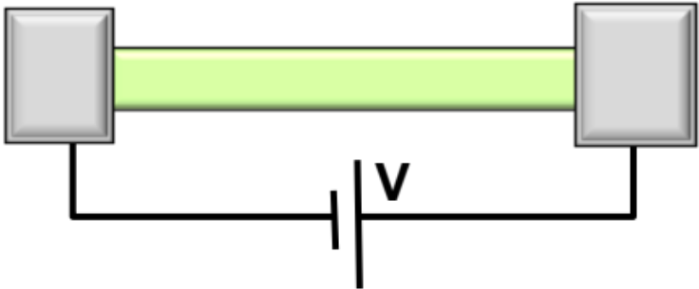
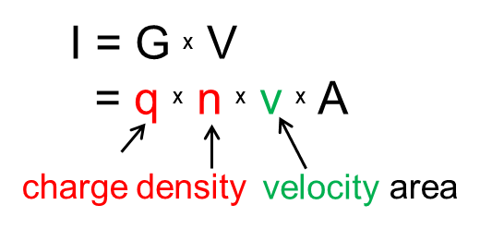

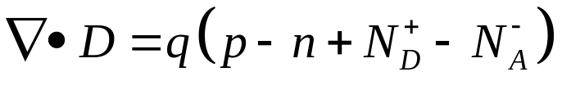
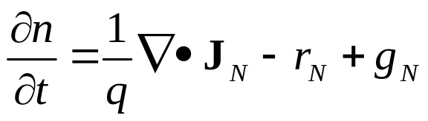
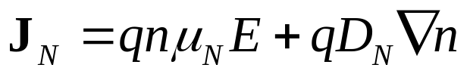
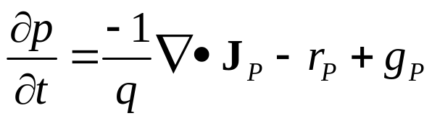
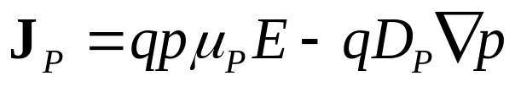
Current Flow
Through Semiconductors
Materials, composition, crystals
Tabulated for “known” bulk materials
At nm-scale properties change with geometry => theory
Quantum Mechanics Mechanics
Concepts of density of states and masses
Equilibrium Statistical Mechanics
Occupation factors
Transport with scattering, non-equil. Stat. Mech.
Drift-diffusion Eq. with recombination-generation
Understanding transport in concrete devices
PN Diode
Schottky Diode
BJT/ HBT
MOS

Slide 3

Topic Map
 | Equilibrium
PN Diode
Schottky Diode
BJT/ HBT
MOS

Slide 4
Topic Map
 | Equilibrium | DC
PN Diode
Schottky Diode
BJT/ HBT
MOS

Slide 5
Topic Map
 | Equilibrium | DC | Small signal | Large Signal | Circuits
PN Diode
Schottky Diode
BJT/ HBT
MOS

Slide 6
Section 19
Introduction to PN Junctions
 | Equilibrium | DC | Small signal | Large Signal | Circuits
PN Diode
Diode in Equilibrium.
(No external voltage applied)
Schottky Diode
BJT/ HBT
MOS

Slide 7

Section 19
Introduction to PN Junctions
Vid
19.1 Structure and Depletion Region
19.2 Drawing band-diagrams in equilibrium
Vid

Slide 8

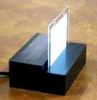


What is a Diode good for ….
solar cells
GaAs lasers
Organic LED
Avalanche Photodiode
GaN lasers
Notes:
28 slides … do not waste time …

Slide 9
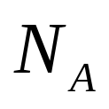
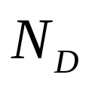
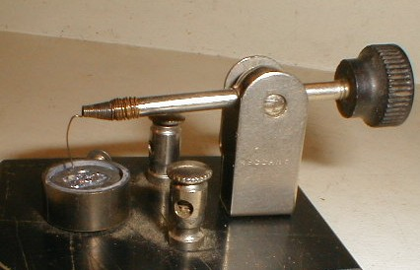
p-n Junction Devices …
Schematic of a p-n Diode
Symbol
Contact
P-doped pocket
N
P
N-doped
substrate
Point-contact diode
Contact
https://upload.wikimedia.org/wikipedia/commons/8/8c/CatWhisker.jpg

Slide 10
P and N doped Material Side by Side …
N-doped
P-doped
E
Vacuum level (determined by material)
Conduction Band
Conduction Band
Ec
EF
EF
EV
Valence Band
Valence Band
For P-doped
E_{F} close to E_{V}
-k
k

Slide 11
Forming a Junction
Space charge (fixed)
Mobile carriers
Donor-side (N-side)
Squares are fixed donor atoms.
Every donor atom has given away one electron (blue circle)
Acceptor-side (P-side)
Squares are fixed acceptor atoms.
Every acceptor atom has captured one electron (from the valence band).
Every acceptor atom leaves behind one hole in the valence band. (red circle)
Notes:
Nd-side: Squares are donor atoms fixed in space. The donor atoms have each given away one electron (blue circle). Every green square is matched with a blue circle.
Na-side: Squares are acceptor atoms. Each acceptor atom captures one electron from the valence band. This leaves behind a positive hole (red circle).

Slide 12
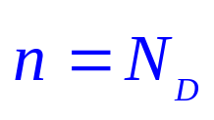
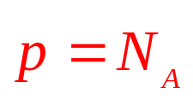

Forming a Junction
Space charge (fixed)
Mobile carriers
Before joining the p and the n side
Junction
x
Valid only in equilibrium
Notes:
Nd-side: Squares are donor atoms fixed in space. The donor atoms have each given away one electron (blue circle). Every green square is matched with a blue circle.
Na-side: Squares are acceptor atoms. Each acceptor atom captures one electron from the valence band. This leaves behind a positive hole (red circle).

Slide 13
Forming a Junction
Diffusion
E-field
Space charge (fixed)
Mobile carriers
Before joining the p and the n side
Junction
x
Depletion approximation
After joining the p and the n side
n
Actual Carrier Concentrations
p
ln(n),
ln(p)
n-side
p-side
n
p
Depletion approximation
Bulk Region
Depleted
Region
Bulk Region
x

Slide 14
Formation of a Junction
+
Net charge on N-side: qN_{D}
(subtract green from blue line)
Space charge region: fixed donor atoms
Neglect electrons in p-side
X_{n}: depletion region in N-side
Net charge on P-side: -qN_{A}
(subtract brown from red line)
Space charge region: fixed acceptor atoms
X_{p}: depletion region in P-side
red and blue are of equal size → charge balance
Depletion Region means depleted of “mobile” charges
ln(N_{D})
ln(n)
ln(N_{A})
ln(p)
Q=p-n+N_{D}-N_{A}
qN_{D}
Depleted Region
Bulk Region
Bulk Region
x_{n}
x_{p}
-qN_{A}
Notes:
Figure 3) Net charge is qNd on N-side depletion region. (Subtract green from blue line) qNd is a fixed space charge. Similar argument for P-side.
Blue and red area have to be the same; Charge balance.

Slide 15
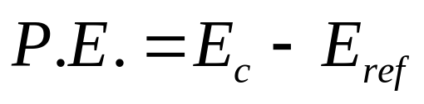
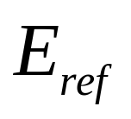
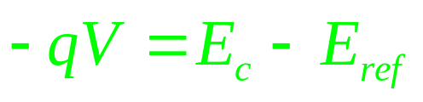
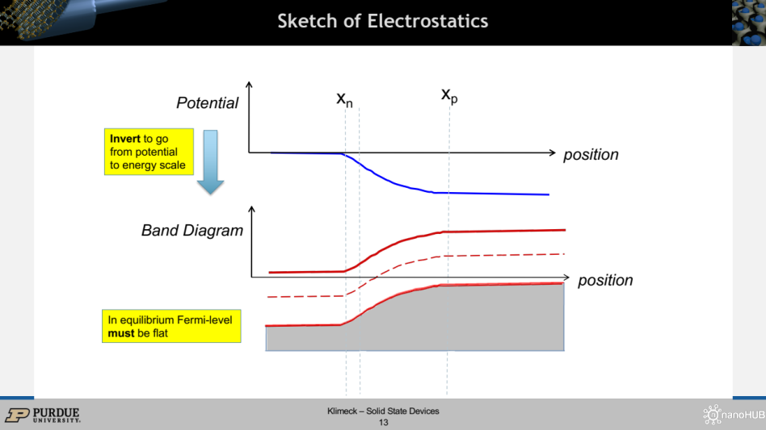
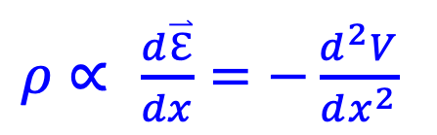
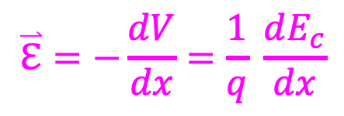
Potential, Field and Charge
From Section 13 – Band Diagrams
$$\overset{⃑}{ℇ}=−\frac{dV}{dx}=\frac{1}{q} \frac{dE_{c}}{dx}$$
$ρ$ $∝$ $\frac{d\overset{⃑}{ℇ}}{dx}=−\frac{d^{2}V}{dx^{2}}$
In most practical cases start from charge and derive potentials!
=> Useful to learn “graphical” integration

Slide 16

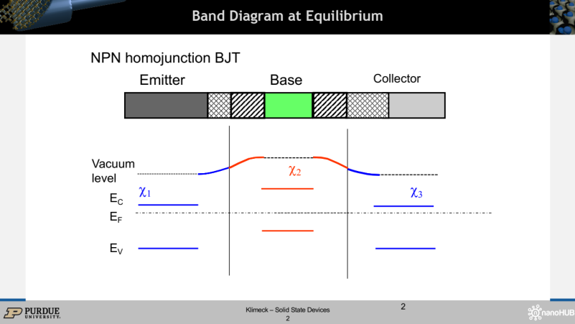
Potential, Field and Charge
From Section 13 – Band Diagrams
$$\overset{⃑}{ℇ}=−\frac{dV}{dx}=\frac{1}{q} \frac{dE_{c}}{dx}$$
$ρ$ $∝$ $\frac{d\overset{⃑}{ℇ}}{dx}=−\frac{d^{2}V}{dx^{2}}$
In most practical cases start from charge and derive potentials!
=> Useful to learn “graphical” integration

Slide 17
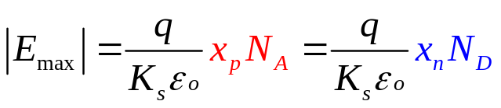
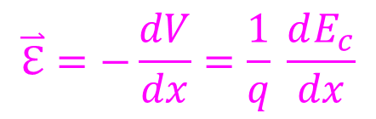
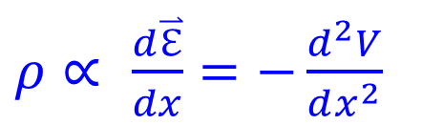
Sketch of Electrostatics
V_{bi}
Potential
position
Integrate
E-field
$$\overset{⃑}{ℇ}=−\frac{dV}{dx}=\frac{1}{q} \frac{dE_{c}}{dx}$$
position
Integrate
qN_{D}
p-n+ND-NA
Depleted
Region
$ρ$ $∝$ $\frac{d\overset{⃑}{ℇ}}{dx}=−\frac{d^{2}V}{dx^{2}}$
position
Bulk Region
x_{n}
x_{p}
Bulk Region
-qN_{A}

Slide 18
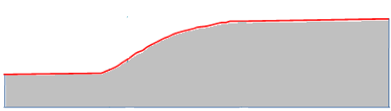
Sketch of Electrostatics
x_{n}
x_{p}
Potential
Invert to go from potential to energy scale
position
Band Diagram
position
In equilibrium Fermi-level must be flat

Slide 19
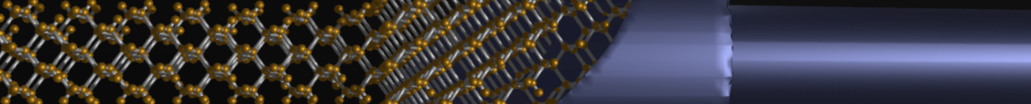
Section 19
Introduction to PN Junctions
19.1 Structure and Depletion Region
19.2 Drawing band-diagrams in equilibrium
Vi
status
Vid

Slide 20
Section 19
Introduction to PN Junctions
Vi
19.1 Structure and Depletion Region
19.2 Drawing band-diagrams in equilibrium
Vid
status

Slide 21
Section 19
Introduction to PN Junctions
Solid State Devices
19.2 Drawing band-diagrams in equilibrium

Slide 22
Section 19
Introduction to PN Junctions
Vid
19.1 Structure and Depletion Region
19.2 Drawing band-diagrams in equilibrium
Vid
status

Slide 23
Drawing Band Diagram in Equilibrium…
Previously constant in homogeneous semiconductors. But for pn diode: f(x) !!
Equilibrium
(Start here)
In equilibrium J=0 (no current flow).
But, Electric fields or diffusion might still be present. → Detailed balance
Non-Equilibrium (refine later)
DC dn/dt=0
Small signal dn/dt ~ jωt x n
Transient --- full solution

Slide 24
Short-cut to Band-diagram
Space Charge
Drawing Recipe
Start with EF
Ec/Ev in bulk n-side
Ec/Ev in bulk p-side
Vacuum level in N
Vacuum level in P
Join vacuum levels
“Transfer” vacuum slopes to join Ec/Ev
Neutral
Neutral
Vacuum level
χ₂
χ₁
E_{C}
E_{F}
E_{V}
… is equivalent to solving the Poisson equation

Slide 25


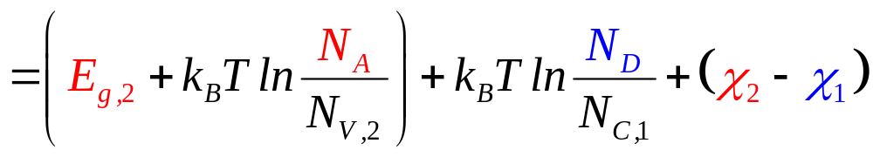
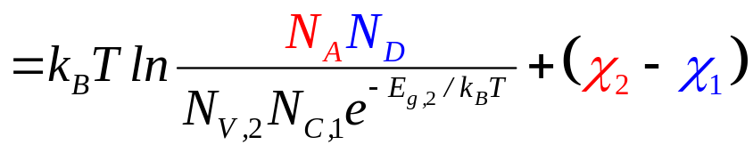
Built-in Potential: boundary conditions @infinity
Always true in equilibrium
qV_{bi}
χ₂
χ₁
Δ_{1,2} determined via doping concentrations
Δ₁
E_{g,2}
X_{1,2} material parameters
Δ₂
Built-in potential V_{bi} unknown!

Slide 26
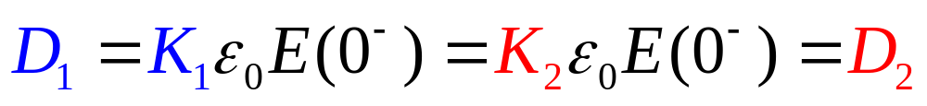
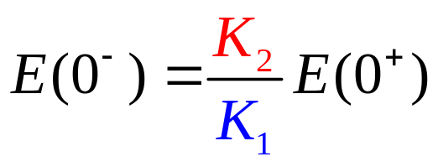
Interface Boundary Conditions
D
Homo - Junction
position
x_{n}
x_{p}
Hetero - Junction
E = (D/kεo)
Field not continuous across junction
position
x_{n}
x_{p}
Displacement is continuous across the interface, field need not be ..

Slide 27
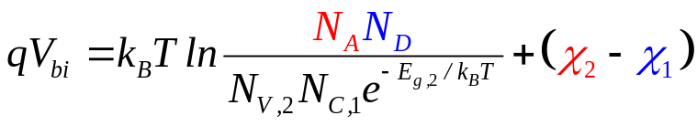
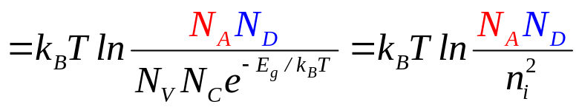
Built-in voltage for Homo-junctions
Space Charge
Neutral
Neutral
Drawing Recipe
Start with EF
Ec/Ev in bulk n-side
Ec/Ev in bulk p-side
Vacuum level in N
Vacuum level in P
Join vacuum levels
“Transfer” vacuum slopes to join Ec/Ev
qV_{bi}
χ₁
Vacuum level
χ₁
E_{C}
E_{F}
E_{V}
Zero for homo-junctions

Slide 28
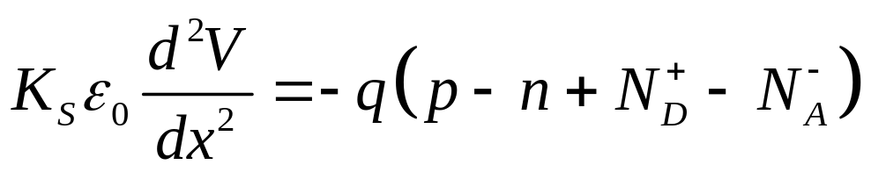
Analytical Solution of Poisson Equation
Depleted Region
qN_{D}
Q= p-n+N_{D}-N_{A}
-qN_{A}
position
xn
xp

Slide 29
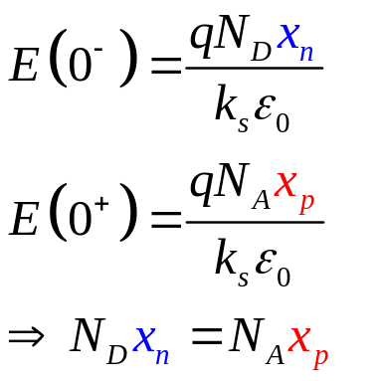
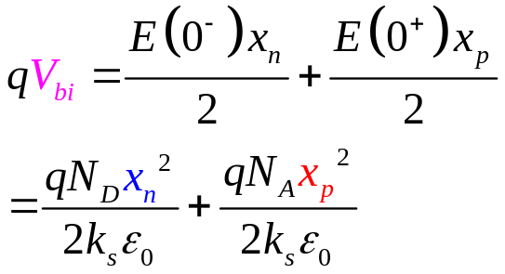
Analytical Solution for Homojunctions
(Charge)
p-n+ND-NA
qND
-qNA
E-field
position
Integrate
x_{n}
x_{p}
E-field
Integrate
position
Potential
Integrate
V_{bi}
Potential
position
Small !

Slide 30
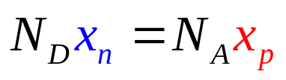
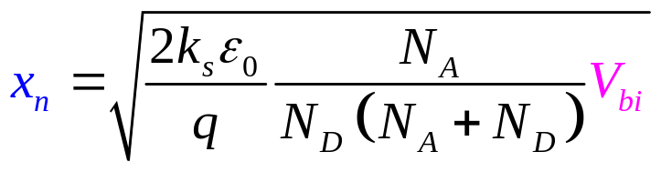
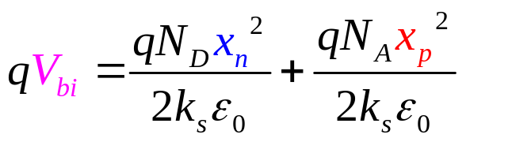
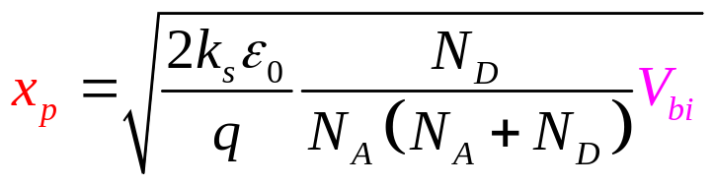
Depletion Regions in Homojunctions
Space Charge
Neutral
Neutral
x_{n}
x_{p}
Solve for x_{n}, x_{p}
Small Project: Solve the same problem for a hetero-junction

Slide 31


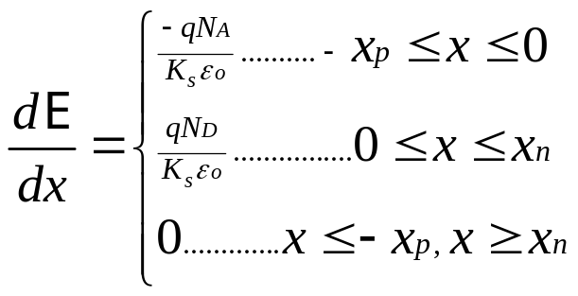
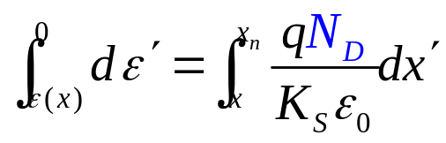
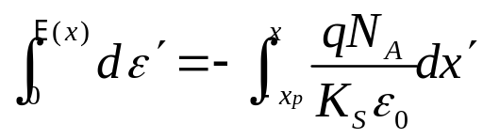
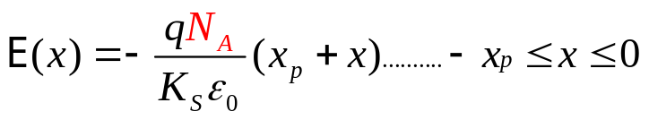
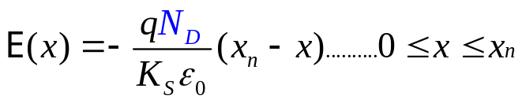
Complete Analytical Solution
N
P
x
-xp
0
xn
V
ρ
Integrate
E
Integrate
qND
-xp
-x_{p}
0
x_{n}
x
x
x
xn
-xp
xn
-qNA
If you need to calculate electric field at specific points…

Slide 32
Summary
PN-Junction Electrostatics
Drawing Recipe
Start with EF
Ec/Ev in bulk n-side
Ec/Ev in bulk p-side
Vacuum level in N
Vacuum level in P
Join vacuum levels
“Transfer” vacuum slopes to join Ec/Ev
Learning to draw band-diagrams is one of the most important topics you learn in this course. Band-diagrams are a graphical way of quickly solving the Poisson equation.
If you consistently follow the rules of drawing band-diagrams, you will always get correct results. Try to follow the rules, not guess the final result.

Slide 33
Section 19
Introduction to PN Junctions
Vid
19.1 Structure and Depletion Region
19.2 Drawing band-diagrams in equilibrium
Vid
Learning to draw band-diagrams is one of the most important topics you learn in this course.
Band-diagrams are a graphical way of quickly solving the Poisson equation.
If you consistently follow the rules of drawing band-diagrams, you will always get correct results.
Try to follow the rules, not guess the final result.
Drawing Recipe
Start with EF
Ec/Ev in bulk n-side
Ec/Ev in bulk p-side
Vacuum level in N
Vacuum level in P
Join vacuum levels
“Transfer” vacuum slopes to join Ec/Ev

