Slide 1
Section 18
Semiconductor Equations
Solid State Devices

Slide 2
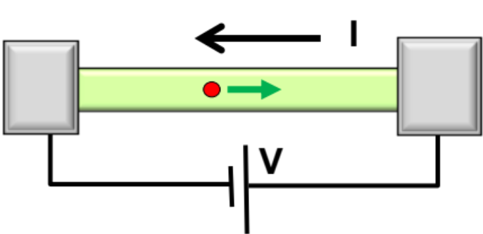
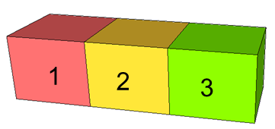
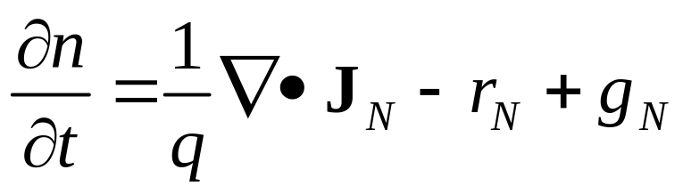
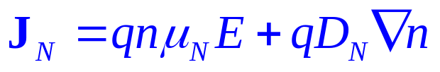
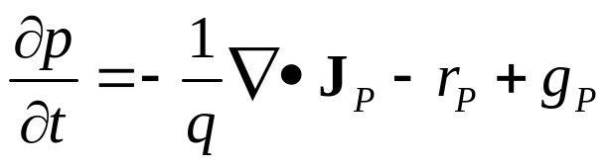
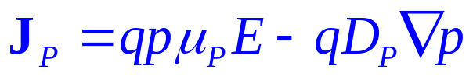
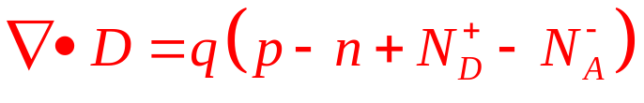
Section 18
Continuity Equations
I = G ^{x} V
= q ^{x} n ^{x} v ^{x} A
charge
density
velocity
area
Vid
18.1 Continuity Equations
18.2 Analytical Solutions (Strategy & Examples)
18.3 Numerical Solutions
  Basic Transport Equations
  Gridding and finite differences
  Discretizing equations and boundary conditions
  Iterative Solution Approach
Vid
Vid

Slide 3
Now the Continuity Equations …
Continuity eqn. for electrons
Continuity eqn. for holes
Poisson equation
These equations have been state of the art in device modeling until ‘recently’ (20 years ago…)
Nano-scaled Devices – Non-Equilibrium Green Functions (NEGF)
Theory for Electrical Engineers: Supriyo Datta (Purdue)
NEGF Simulation Tools for atomistic devices: NEMO - Klimeck

Slide 4
Some critical remarks about these equations
Continuity equations are always valid (regardless of the detailed physical model describing the device) because they describe a conservation law.
Poisson equation as given does not account for explicit electron-electron repulsion. Might need to be modified for strongly correlated systems.
Drift and Diffusion equations get modified when devices are so small that essentially no scattering takes place within the device.

Slide 5
Continuity Equation prequel: A Good Analogy
Wabash
River
Rate of increase of
water level in lake
=
(in flow - outflow) + rain - evaporation

Slide 6

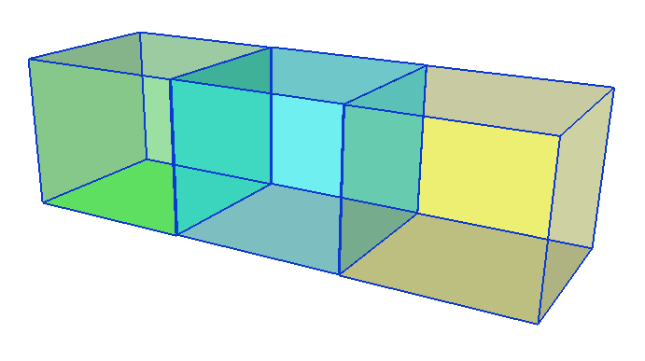



Now the Continuity Equations for electrons…
Consider an arbitrarily shaped semiconductor with contacts that pump in current.
Divide this arbitrary semiconductor into small cubic boxes of cross sectional area ‘A’ and length Δx.
Boxes are large enough that concepts like effective mass, mobility etc. are valid inside these boxes.
Electrons coming in are given by J(x), going out➔ J(x+Δx)
Total number of electrons per cm³ ➔n
Δx
A=1
n

Slide 7
Now the Continuity Equations …
g_{N}-> generation rate in (per cm³ per sec) from external processes such as light.
r_{N}-> recombination rate in (per cm³ per sec) in the central box.
Δx
A=1
n
We wish to relate all of these factors that affect the concentration of carriers in the central box.
Our strategy (remember the analogy)– The rate of change of number of electrons INSIDE the central box should be equal to
  No. of electrons coming in MINUS No. of electrons going out per sec (governed by current density J(x) and J(x+Δx)) PLUS
  No. of electrons getting generated from external processes per sec (governed by generation rate g_{N}) MINUS
  No. of electrons lost by recombination per sec (governed by recombination rate r_{N})

Slide 8
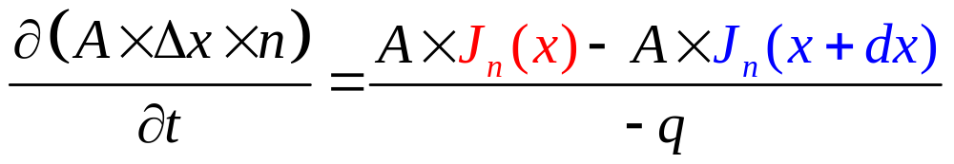

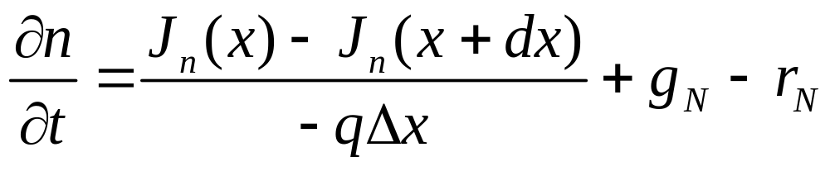
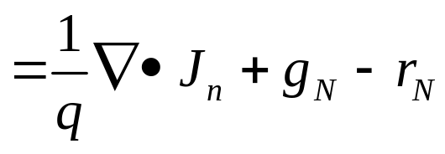
Let’s just write the equations down…
Δx
A=1
n

Slide 9

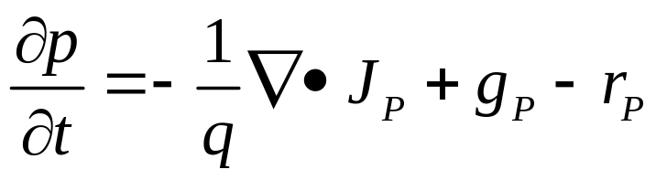

Continuity Equations for Electron/Holes
Δx
A=1
n
Usually generation and recombination rates for electrons and holes are the same since the same processes create/destroy an electron/hole
rp
p
gp

Slide 10
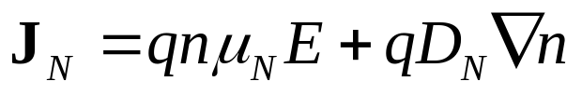
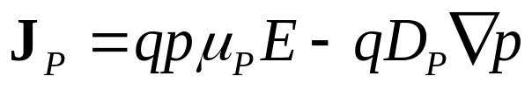

Equations in place, learning to solve them…
Two methods of solution:
Numerical and Analytical
$$∇•D=q\left(p−n+N_{D}^{+}−N_{A}^{−}\right)$$

Slide 11
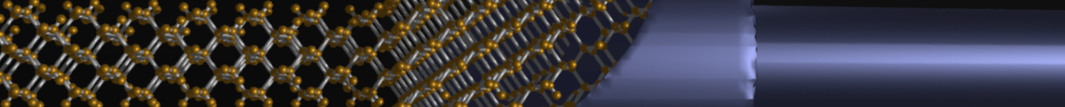

Section 18
Continuity Equations
I = G ^{x} V
= q ^{x} n ^{x} v ^{x} A
charge
density
velocity
area
status
Vi
18.1 Continuity Equations
18.2 Analytical Solutions (Strategy & Examples)
18.3 Numerical Solutions
  Basic Transport Equations
  Gridding and finite differences
  Discretizing equations and boundary conditions
  Iterative Solution Approach
Vid
Vid
$$∇•D=q\left(p−n+N_{D}^{+}−N_{A}^{−}\right)$$

Slide 12
Section 18
Continuity Equations
I = G ^{x} V
= q ^{x} n ^{x} v ^{x} A
charge
density
velocity
area
Vi
18.1 Continuity Equations
18.2 Analytical Solutions (Strategy & Examples)
18.3 Numerical Solutions
  Basic Transport Equations
  Gridding and finite differences
  Discretizing equations and boundary conditions
  Iterative Solution Approach
Vid
status
Vid
$$∇•D=q\left(p−n+N_{D}^{+}−N_{A}^{−}\right)$$

Slide 13
Section 18
Semiconductor Equations
Solid State Devices
18.2 Analytical Solutions (Strategy & Examples)

Slide 14
Section 18
Continuity Equations
I = G ^{x} V
= q ^{x} n ^{x} v ^{x} A
charge
density
velocity
area
Vid
18.1 Continuity Equations
18.2 Analytical Solutions (Strategy & Examples)
18.3 Numerical Solutions
  Basic Transport Equations
  Gridding and finite differences
  Discretizing equations and boundary conditions
  Iterative Solution Approach
Vid
status
Vid
$$∇•D=q\left(p−n+N_{D}^{+}−N_{A}^{−}\right)$$

Slide 15
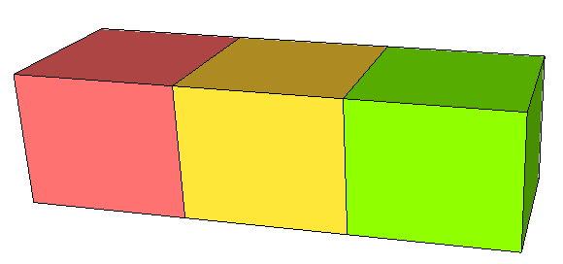

Analytical Solutions
Diffusion approximation,
Minority carrier transport,
Ambipolar transport
$$∇•D=q\left(p−n+N_{D}^{+}−N_{A}^{−}\right)$$
Band-diagram
x
1
2
3

Slide 16
Consider a complicated real device example
Metal contact
Metal contact
x
1
2
3
Acceptor doped
Light turned on in the middle section.
The right region is full of mid-gap traps
because of dangling bonds due to unpassivated surface.
Interface traps at the end of the right region
(That’s where the dangling bonds are…)
The left region is trap free.
The left/right regions contacted by metal electrode.

Slide 17
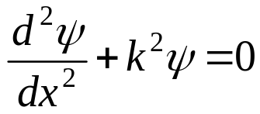
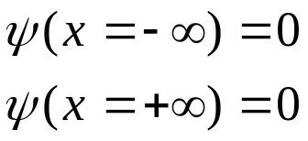
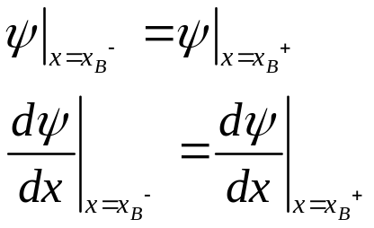
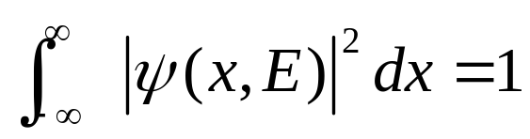
Recall: Analytical Solution of
Schrodinger Equation
2N unknowns
for N regions
1
2
3
1)
2)
Reduces 2 unknowns
3)
Set 2N-2 equations for
2N-2 unknowns (for continuous U)
4)
Det(coefficient matix)=0
And find E by graphical
or numerical solution
5)
for wave function

Slide 18



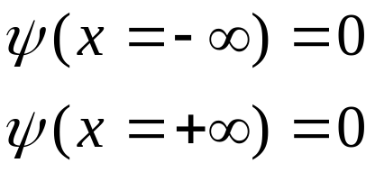
Recall: Bound-levels in Finite well
E
1
2
3
U(x)
1)
2) Boundary Conditions …
0
a

Slide 19
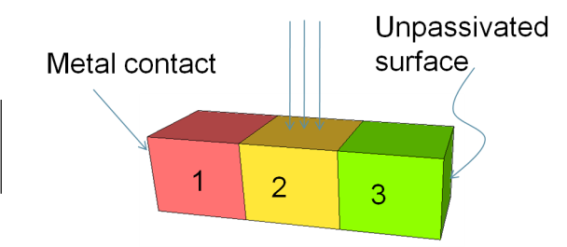
Analogously, we solve for our device
Solve the equations in different regions independently.
Bring them together by applying boundary conditions.
1
2
3

Slide 20
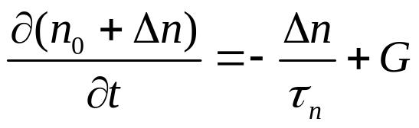
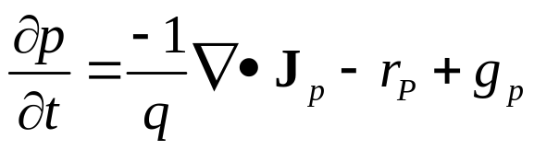

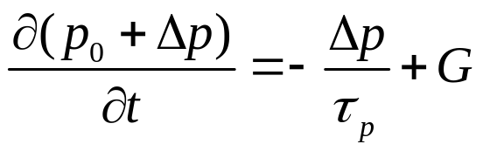
Region 2: Transient, Uniform Illumination, Uniform doping
(uniform)
Recall Shockley-Read-Hall
2
Acceptor doped
(uniform)
Majority carrier
Electric field still zero because new carriers balance
$$∇•D=q\left(p−n+N_{D}^{+}−N_{A}^{−}\right)=q\left(p_{0}+Δp−n_{0}−Δn+N_{D}^{+}−N_{A}^{−}\right)=0$$

Slide 21
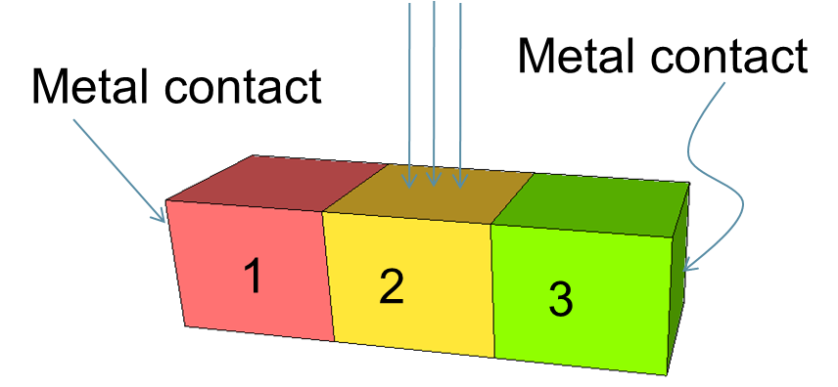
Region 2: Transient, Uniform Illumination, Uniform doping
(uniform)
Recall Shockley-Read-Hall
2
Acceptor doped
(uniform)
Electric field still zero because new carriers balance
$$∇•D=q\left(p−n+N_{D}^{+}−N_{A}^{−}\right)=q\left(p_{0}+Δp−n_{0}−Δn+N_{D}^{+}−N_{A}^{−}\right)=0$$

Slide 22
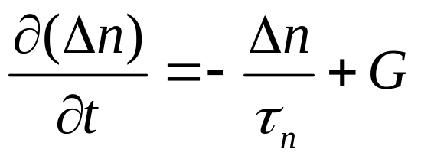
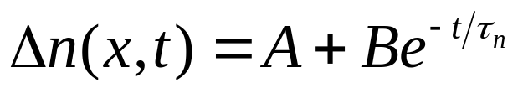
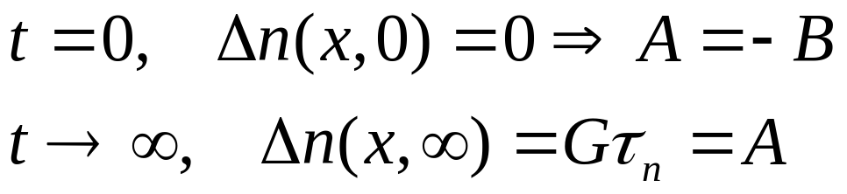
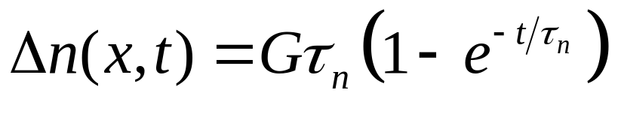
Example: Transient, Uniform Illumination,
Uniform doping, No applied electric field
2
Acceptor doped
No carriers yet generated…
Steady state, no change
in carriers with time…
time

Slide 23
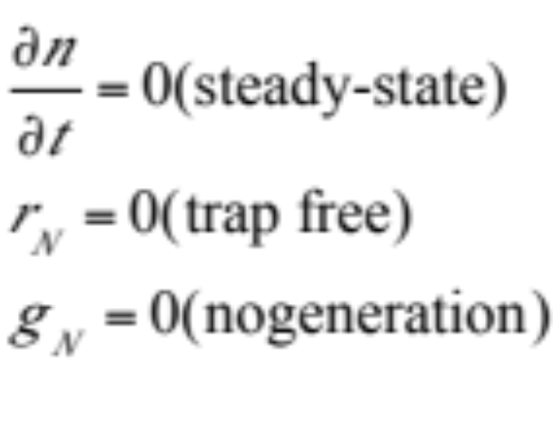
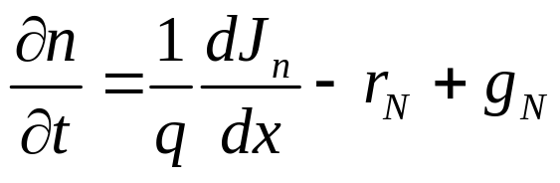
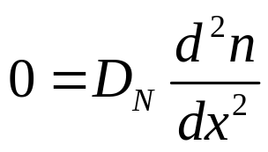
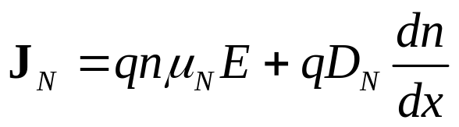
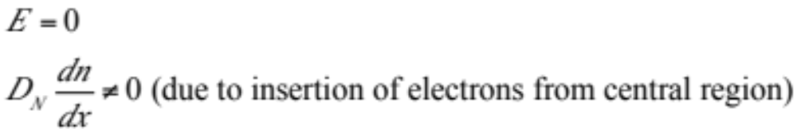
Region 1:
One sided Minority Diffusion at steady state
Steady state
Acceptor doped
1
Trap-free

Slide 24

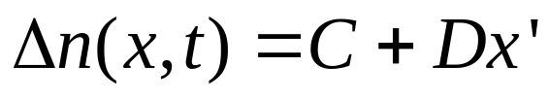
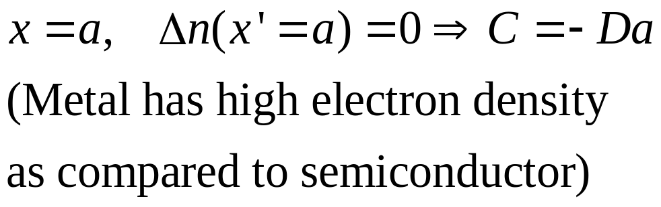
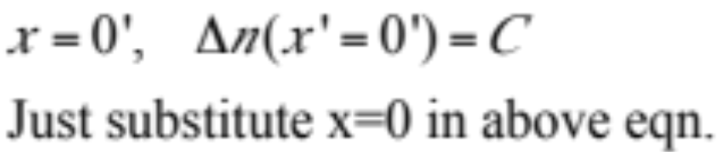
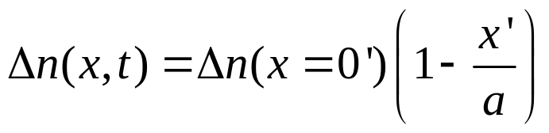
Example: One sided Minority Diffusion
Metal contact
x’
a
0
x’

Slide 25
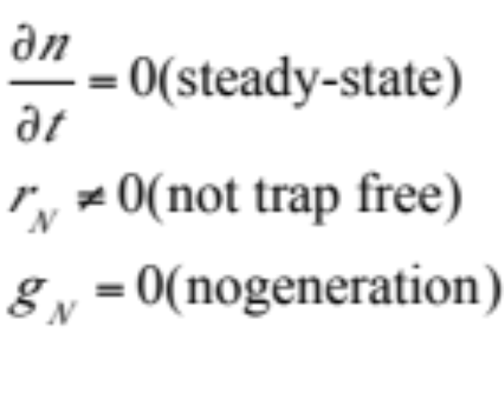
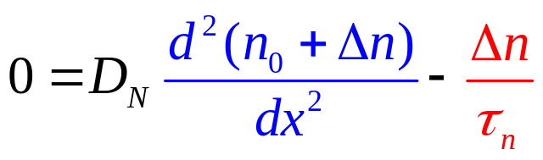
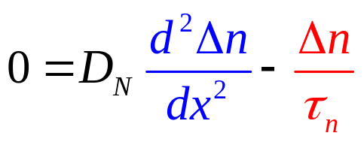
Region 3: Steady state Minority Diffusion with recombination
Steady state
Acceptor doped
Flux
3
Trap-filled

Slide 26
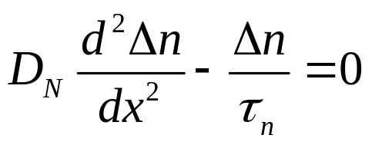
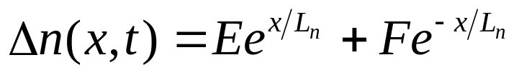


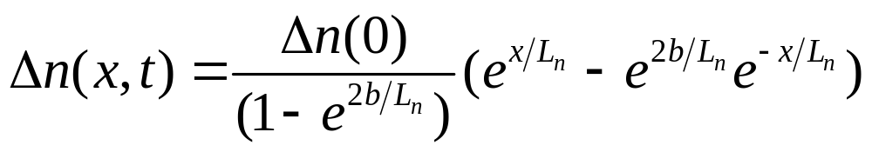

Diffusion with Recombination …
Metal contact
Functionally similar to Schrodinger eqn.
b
$$L_{n}=\sqrt{D_{n}τ_{n}}$$
3
X
0
Δn
x

Slide 27
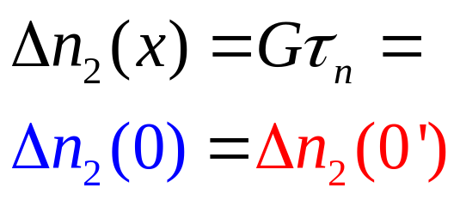
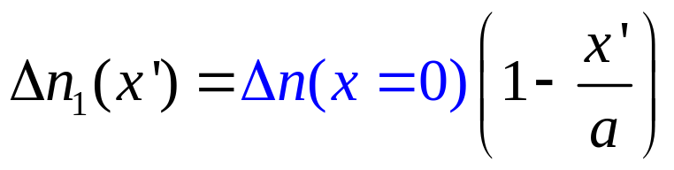
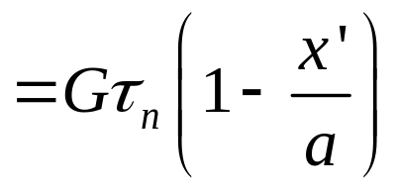
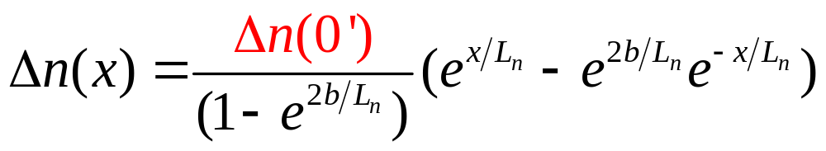
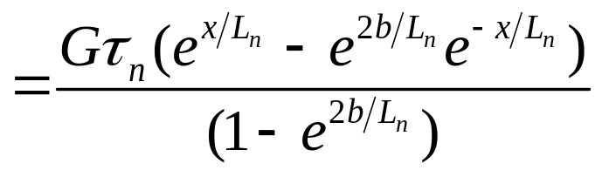
Combining them all ….
Δn
x’
0
0’
b
1
2
3
Match boundary condition
Calculating current

Slide 28

Analytical Solutions Summary
Continuity Equations form the basis of analysis of all the devices we will study in this course.
Full numerical solution of the equations are possible and many commercial software are available to do so.
Analytical solutions however provide a great deal of insight into the key physical mechanism involved in the operation of a device.
$$∇•D=q\left(p−n+N_{D}^{+}−N_{A}^{−}\right)$$

Slide 29
Section 18
Continuity Equations
I = G ^{x} V
= q ^{x} n ^{x} v ^{x} A
charge
density
velocity
area
Vid
18.1 Continuity Equations
18.2 Analytical Solutions (Strategy & Examples)
18.3 Numerical Solutions
  Basic Transport Equations
  Gridding and finite differences
  Discretizing equations and boundary conditions
  Iterative Solution Approach
Vid
status
Vid
$$∇•D=q\left(p−n+N_{D}^{+}−N_{A}^{−}\right)$$

Slide 30
Section 18
Continuity Equations
I = G ^{x} V
= q ^{x} n ^{x} v ^{x} A
charge
density
velocity
area
Vid
18.1 Continuity Equations
18.2 Analytical Solutions (Strategy & Examples)
18.3 Numerical Solutions
  Basic Transport Equations
  Gridding and finite differences
  Discretizing equations and boundary conditions
  Iterative Solution Approach
Vid
Vid
status
$$∇•D=q\left(p−n+N_{D}^{+}−N_{A}^{−}\right)$$

Slide 31
Section 18
Semiconductor Equations
Solid State Devices
18.3 Numerical Solutions

Slide 32
Section 18
Semiconductor Equations
I = G ^{x} V
= q ^{x} n ^{x} v ^{x} A
charge
density
velocity
area
Vid
18.1 Continuity Equations
18.2 Analytical Solutions (Strategy & Examples)
18.3 Numerical Solutions
  Basic Transport Equations
  Gridding and finite differences
  Discretizing equations and boundary conditions
  Iterative Solution Approach
Vid
Vid
status
$$∇•D=q\left(p−n+N_{D}^{+}−N_{A}^{−}\right)$$

Slide 33
Preface
The 5 equations we derived the past few lectures have been used for the longest time in the industry and in academia to understand carrier transport in devices.
It is useful to know the essentials of how these equations are implemented on a modern computer so that one understands some of the finer details involved in creating tools that simulate thee phenomena.
Understanding some of these details helps one become a ‘power user’ of the simulation tools that implement the physics. One also understands the limitations re. numerical issues and applicability ranges of results.
$$∇•D=q\left(p−n+N_{D}^{+}−N_{A}^{−}\right)$$

Slide 34

Equations to be solved
Band-diagram
$$∇•D=q\left(p−n+N_{D}^{+}−N_{A}^{−}\right)$$
Diffusion approximation,
Minority carrier transport,
Ambipolar transport

Slide 35






1) The Semiconductor Equations
Constitutive relations: specific to problem at hand – reflect physics of the problem
Conservation Laws: not specific to a particular problem - Universal
$$∇•D=q\left(p−n+N_{D}^{+}−N_{A}^{−}\right)$$
(steady-state)

Slide 36


1) The Mathematical Problem
The “Semiconductor Equations”
3 coupled, nonlinear,
second order PDE’s
for the 3 unknowns:
Why are these equations coupled?
Potential→Field→current→changes potential→changes field and so on…
Conservations laws: exact
Transport eqs. (drift-diffusion): approximate

Slide 37
Section 18
Semiconductor Equations
I = G ^{x} V
= q ^{x} n ^{x} v ^{x} A
charge
density
velocity
area
Vid
18.1 Continuity Equations
18.2 Analytical Solutions (Strategy & Examples)
18.3 Numerical Solutions
  Basic Transport Equations
  Gridding and finite differences
  Discretizing equations and boundary conditions
  Iterative Solution Approach
Vid
Vid
status
$$∇•D=q\left(p−n+N_{D}^{+}−N_{A}^{−}\right)$$

Slide 38
Section 18
Semiconductor Equations
I = G ^{x} V
= q ^{x} n ^{x} v ^{x} A
charge
density
velocity
area
Vid
18.1 Continuity Equations
18.2 Analytical Solutions (Strategy & Examples)
18.3 Numerical Solutions
  Basic Transport Equations
  Gridding and finite differences
  Discretizing equations and boundary conditions
  Iterative Solution Approach
Vid
Vid
status
$$∇•D=q\left(p−n+N_{D}^{+}−N_{A}^{−}\right)$$

Slide 39


2) The Grid
(ii) “exact” numerical solutions
N nodes
3N unknowns
a
‘Gridding‘– total length divided into ‘N’ parts
- equal (uniform gridding) , or
- unequal (adaptive and non-uniform gridding)
Variables described at each point ‘i’.
V_{o} and V_{n+1} is known because these are voltages at source and drain.
=?

Slide 40




Finite Difference Expression for Derivative
f(x)
a
x_{i-1}
x_{i}
x_{i+1}
x
“centered difference”
=?

Slide 41




The Second Derivative …
=?
3 point formula, could be extended to N points depending on the number of derivatives we carry in our expansion

Slide 42
Section 18
Semiconductor Equations
I = G ^{x} V
= q ^{x} n ^{x} v ^{x} A
charge
density
velocity
area
Vid
18.1 Continuity Equations
18.2 Analytical Solutions (Strategy & Examples)
18.3 Numerical Solutions
  Basic Transport Equations
  Gridding and finite differences
  Discretizing equations and boundary conditions
  Iterative Solution Approach
Vid
Vid
status
$$∇•D=q\left(p−n+N_{D}^{+}−N_{A}^{−}\right)$$

Slide 43
Section 18
Semiconductor Equations
I = G ^{x} V
= q ^{x} n ^{x} v ^{x} A
charge
density
velocity
area
Vid
18.1 Continuity Equation
18.2 Analytical Solutions (Strategy & Examples)
18.3 Numerical Solutions
  Basic Transport Equations
  Gridding and finite differences
  Discretizing equations and boundary conditions
  Iterative Solution Approach
Vid
Vid
status
$$∇•D=q\left(p−n+N_{D}^{+}−N_{A}^{−}\right)$$

Slide 44

2) Control Volume
3 unknowns at each node:
x
(i -1)
(i)
(i +1)
Need 3 equations
at each node
“control volume”

Slide 45




Discretizing Poisson’s Equation
Since V_{o} and V₋₁ are known, as are carrier concentration on doping (or lack thereof) in contacts, we find V₁ and iterate from this point to solve for potential.
(i -1)
(i)
(i +1)
D_{L}
D_{R}
Once this potential is found, solve continuity equation to obtain new carrier concentrations

Slide 46




Discretizing Continuity Equations
(i -1)
(i)
(i +1)
J_{nL}
The simplest approach…..

Slide 47

Three Discretized Equations
x
(i -1)
(i)
(i +1, j)
3 unknowns at each node
N nodes
3N unknowns and 3N equations (coupled to each other)

Slide 48



Numerical Solution – Poisson Equation Only
x
(i -1)
(i)
(i +1, j)
3 unknowns at each node
N nodes
3N unknowns and 3N equations (coupled to each other)
linear if n_{i} and p_{i} are known
[A]:

Slide 49




Boundary conditions
Contacts are assumed large and in equilibrium
→ detailed balance and law of mass-action apply!!
Dopant density
a
One could have unequal materials on the two contact sides, one must be careful to use the right intrinsic concentration <-> material.

Slide 50
Section 18
Semiconductor Equations
I = G ^{x} V
= q ^{x} n ^{x} v ^{x} A
charge
density
velocity
area
Vid
18.1 Continuity Equations
18.2 Analytical Solutions (Strategy & Examples)
18.3 Numerical Solutions
  Basic Transport Equations
  Gridding and finite differences
  Discretizing equations and boundary conditions
  Iterative Solution Approach
Vid
Vid
status
$$∇•D=q\left(p−n+N_{D}^{+}−N_{A}^{−}\right)$$

Slide 51
Section 18
Semiconductor Equations
I = G ^{x} V
= q ^{x} n ^{x} v ^{x} A
charge
density
velocity
area
Vid
18.1 Continuity Equations
18.2 Analytical Solutions (Strategy & Examples)
18.3 Numerical Solutions
  Basic Transport Equations
  Gridding and finite differences
  Discretizing equations and boundary conditions
  Iterative Solution Approach
Vid
Vid
status
$$∇•D=q\left(p−n+N_{D}^{+}−N_{A}^{−}\right)$$

Slide 52

Numerical Solution…
n-continuity
p-continuity
Poisson
V=>n
V=>p
n=>Q
p=>Q
Off-diagonal terms are Poisson-Continuity equations talking to each other. Recombination-generation terms also feed into continuity equations.

Slide 53

3) Uncoupled Numerical Solution
The semiconductor equations are nonlinear!
(but they are linear individually)
Guess V,n,p
Uncoupled solution procedure
Solve Poisson
for new V
Solve electron
cont for new n
Solve hole
cont for new p

Slide 54
Summary
Two methods to solve drift-diffusion equation consistently – analytical and numerical.
Analytical solution provides great insight and the solution methodology is similar to that of Schrodinger equations.
Numerical solution is more versatile.
  One begins with a set of equations and boundary conditions,
  discretize the equations on a grid with N nodes to obtain 3N nonlinear equations in 3N unknowns, and
  solve the system of nonlinear equations by iteration.

Slide 55
Section 18
Semiconductor Equations
I = G ^{x} V
= q ^{x} n ^{x} v ^{x} A
charge
density
velocity
area
Vid
18.1 Continuity Equations
18.2 Analytical Solutions (Strategy & Examples)
18.3 Numerical Solutions
  Basic Transport Equations
  Gridding and finite differences
  Discretizing equations and boundary conditions
  Iterative Solution Approach
Vid
Vid
status
$$∇•D=q\left(p−n+N_{D}^{+}−N_{A}^{−}\right)$$

