Slide 1
Section 7
Bandstructure in 1D Periodic Potentials
Solid State Devices

Slide 2
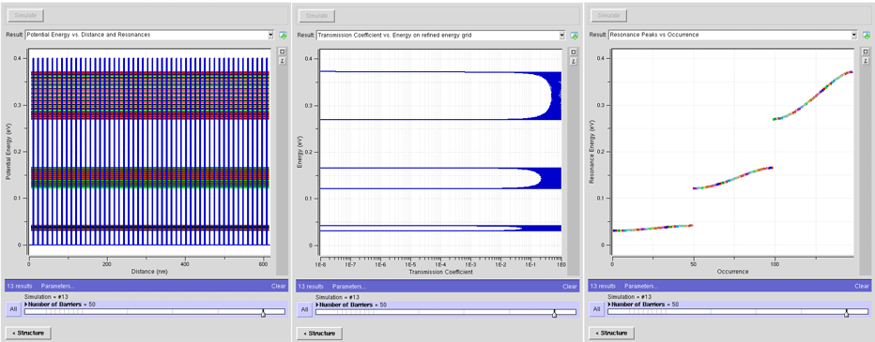

Section 7
Bandstructure – in 1D Periodic Potentials
Original
Problem
Periodic
Structure
E
U
Tunneling
through finite
open systems
Goal: Representation of “Infinite Systems”
7.1 Bandstructure - Problem Formulation
7.2 Bandstructure - Solutions
7.3 Band Properties
Reference: Vol. 6, Ch. 3
Daniel Mejia, Gerhard Klimeck (2019), "Periodic Potential Lab - Kronig Penney Model,
" https://nanohub.org/resources/kronigpenneylab. (DOI: 10.21981/TT2Y-A185).

Slide 3
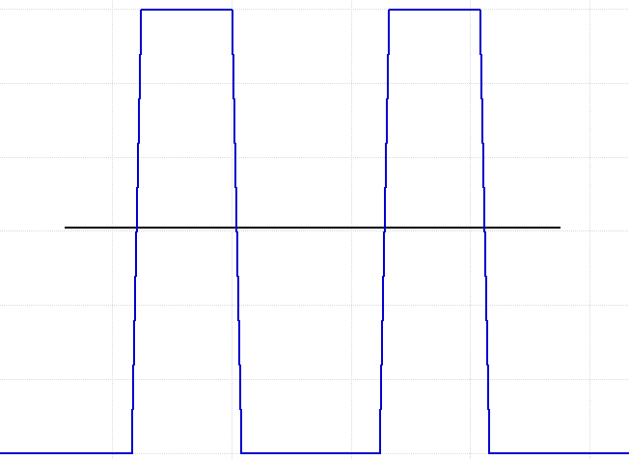
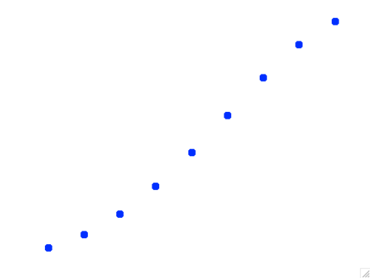
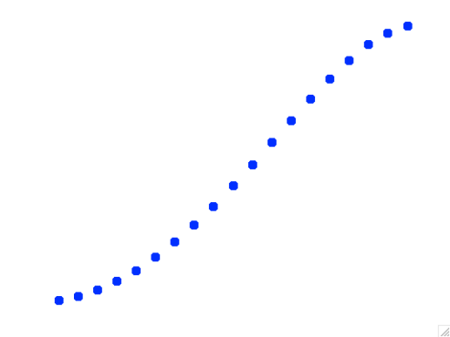
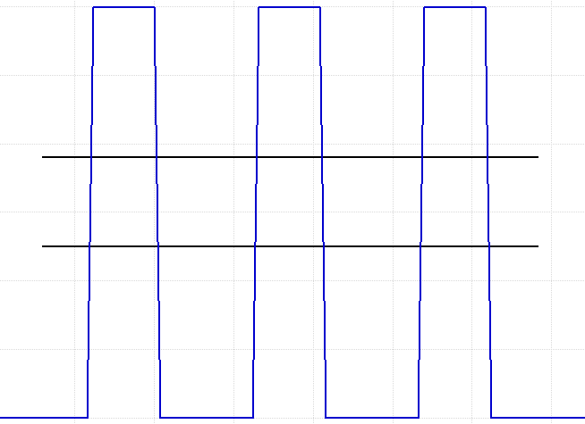
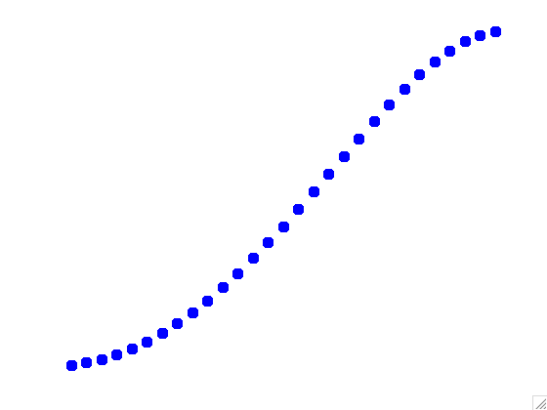
Reminder
Transmission through Repeated Wells
10 barriers
As the number of barriers are increased more and more energy resonances begin to appear and energy bands are formed.
2 barriers =>1 resonance
20 barriers
What if the number of wells is infinite?
30 barriers
3 barriers =>2 resonance
n barriers =>n-1 resonance

Slide 4
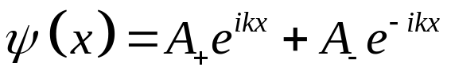
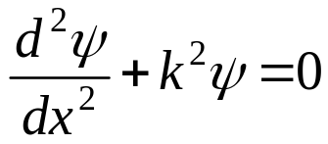
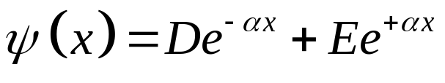
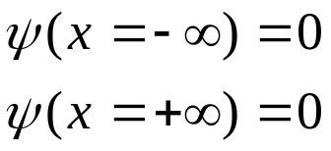
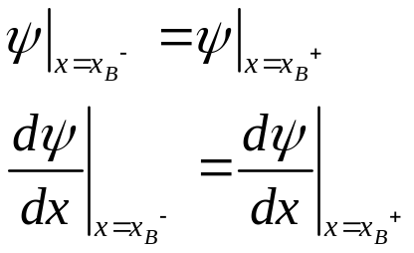
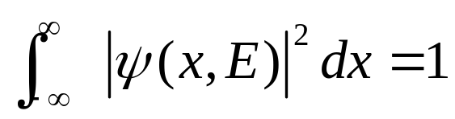
Reminder:
Five Steps for Closed System Analytical Solution
Open
Solution Ansatz
2N unknowns
for N regions
1)
2)
Boundary Conditions at the edge
Reduces 2 unknowns
Open
3)
Boundary Condition at each interface:
Set 2N-2 equations for
2N-2 unknowns (for continuous U)
4)
Det (coefficient matrix)=0
And find E by graphical
or numerical solution
5)
Normalization of unity probability
for wave function

Slide 5
Reminder:
Five Steps for Closed System Analytical Solution
Open
Periodic
Solution Ansatz
2N unknowns
for N regions
1)
Bloch Theorem
Edge => huge number of cells
2)
Boundary Conditions at the edge
Reduces 2 unknowns
Open
Periodic
3)
Boundary Condition at each interface:
Set 2N-2 equations for
2N-2 unknowns (for continuous U)
Interface => interfaces in periodic cell
4)
Det (coefficient matrix)=0
And find E by graphical
or numerical solution
5)
Normalization of unity probability
for wave function

Slide 6
Reminder:
Five Steps for Closed System Analytical Solution
Open
Periodic
Solution Ansatz
2N unknowns
for N regions
1)
Bloch Theorem
Edge => huge number of cells
2)
Boundary Conditions at the edge
Reduces 2 unknowns
Open
Periodic
3)
Boundary Condition at each interface:
Set 2N-2 equations for
2N-2 unknowns (for continuous U)
Interface => interfaces in periodic cell
4)
Det (coefficient matrix)=0
And find E by graphical
or numerical solution
5)
Normalization of unity probability
for wave function

Slide 7
Periodic Potential Concept
e
Repeated indefinitely
-∞
∞
e
Finite barriers
As the number of barriers is increased the electrons see no difference between the actual structure and a structure that is simply modeled as being repeated indefinitely (Periodic).

Slide 8
Choosing the Smallest Unit Cell
e
Repeated indefinitely
-∞
∞
e
As the number of barriers is increased the electrons see no difference between the actual structure and a structure that is simply modeled as being repeated indefinitely (Periodic).
Choose the smallest cell to reduce computational work load

Slide 9


Solution Ansatz
Choose the Simplest Basis Set
Propagation above barriers
e
Decays in barriers
e
As the number of barriers is increased the electrons see no difference between the actual structure and a structure that is simply modeled as being repeated indefinitely (Periodic).
Choose the smallest cell to reduce computational work load

Slide 10
Finally an (almost) Real Problem …
E
U(x)
a
b
L=a+b
But N atoms have two 2N unknown constants to find ….
For large N, isn’t there a better way ?

Slide 11
Reminder:
Five Steps for Closed System Analytical Solution
Periodic
Solution Ansatz
2N unknowns
for N regions
1)
Bloch Theorem
Edge => huge number of cells
2)
Boundary Conditions at the edge
Reduces 2 unknowns
Periodic
3)
Boundary Condition at each interface:
Set 2N-2 equations for
2N-2 unknowns (for continuous U)
Interface => interfaces in periodic cell
4)
Det (coefficient matrix)=0
And find E by graphical
or numerical solution
5)
Normalization of unity probability
for wave function

Slide 12
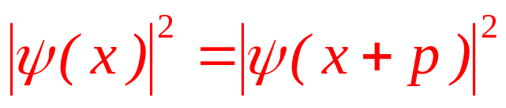
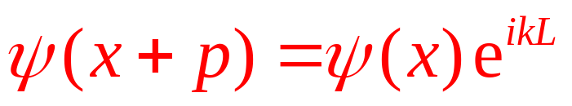
Periodic U(x) and Bloch’s Theorem Periodic U(x) and Bloch’s Theorem
E
U(x)=U(x+a+b)=U(x+L)
U(x)
a
b
p =some period length
not our old (k)

Slide 13
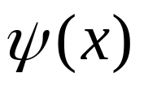
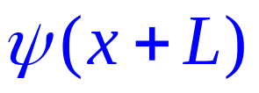
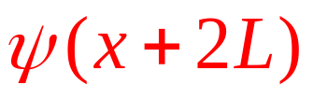
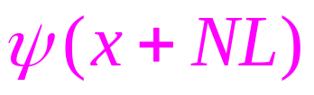
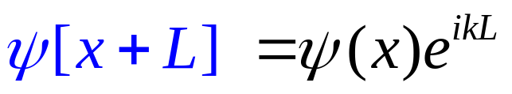
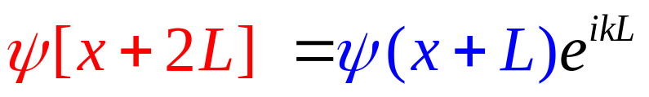
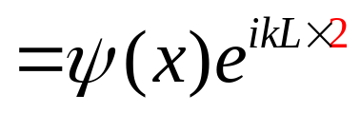
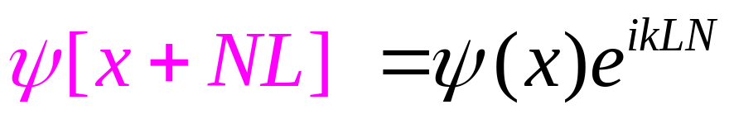
Phase-factor for N-cells
E
U(x)
N
1
2
3

Slide 14
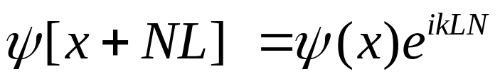
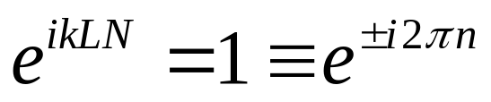
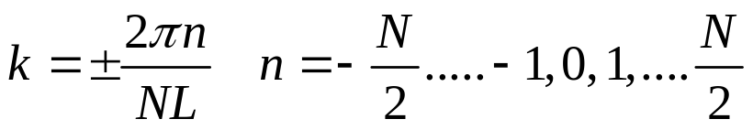
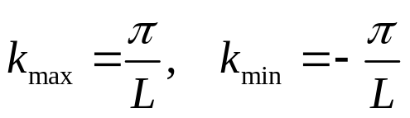
Step 2: Periodic Boundary Condition
E
U(x)
N-1
1
2
3
3
2
1
N-1

Slide 15
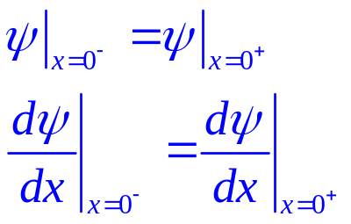

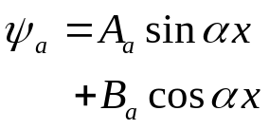
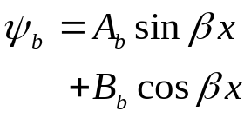
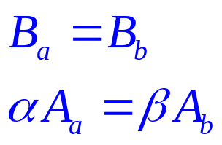
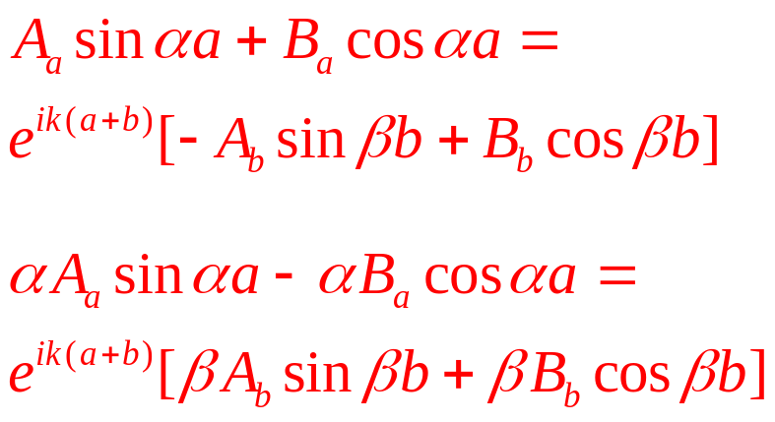
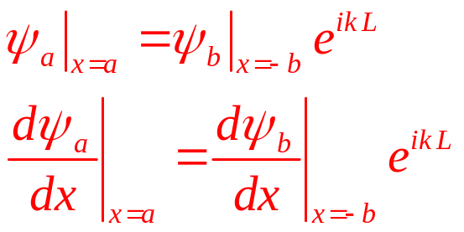
Step 3: Boundary Conditions
-b
0
a

Slide 16
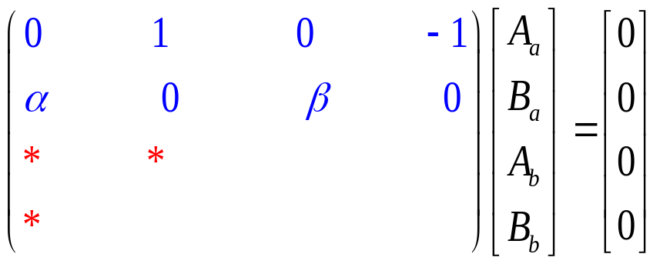
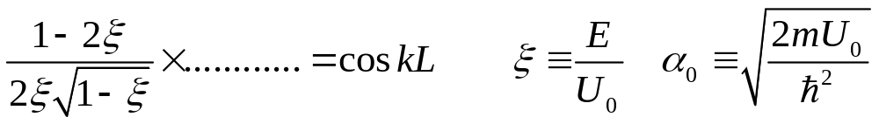
Step 4: Det(matrix)=0 for Energy-levels
-b
0
a
4)

Slide 17
Reminder:
Five Steps for Closed System Analytical Solution
Periodic
Solution Ansatz
2N unknowns
for N regions
1)
Bloch Theorem
Edge => huge number of cells
2)
Boundary Conditions at the edge
Reduces 2 unknowns
Periodic
3)
Boundary Condition at each interface:
Set 2N-2 equations for
2N-2 unknowns (for continuous U)
Interface => interfaces in periodic cell
4)
Det (coefficient matrix)=0
And find E by graphical
or numerical solution
5)
Normalization of unity probability
for wave function

Slide 18
Five Steps for Periodic System Analytical Solution
Solution Ansatz
4 unknowns
for 1 periodic cell
1)
2)
Periodic Boundary Conditions
Imposes symmetry
Bloch Theorem
3)
Boundary Condition in periodic cell:
Set 4 equations for 4 unknowns
4)
Det (coefficient matrix)=0
And find E by graphical
or numerical solution
5)
Normalization of unity probability
for wave function

Slide 19
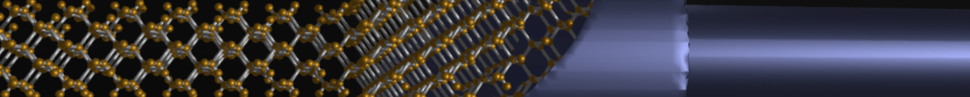
Section 7
Bandstructure – in 1D Periodic Potentials
7.1 Bandstructure - Problem Formulation
  Kronig-Penney Model setup
  Bloch theorem
  Analytical solution process
7.2 Bandstructure - Solutions
  Bandgaps
  Comparison to finite system model
7.3 Band Properties
  Wave packets
  Effective mass
  Electrons and Holes
One Video Segment
status
One Video Segment
One Video Segment
Reference: Vol. 6, Ch. 3
Daniel Mejia, Gerhard Klimeck (2019), "Periodic Potential Lab - Kronig Penney Model,
" https://nanohub.org/resources/kronigpenneylab. (DOI: 10.21981/TT2Y-A185).

Slide 20
Section 7
Bandstructure – in 1D Periodic Potentials
7.1 Bandstructure - Problem Formulation
  Kronig-Penney Model setup
  Bloch theorem
  Analytical solution process
7.2 Bandstructure - Solutions
  Bandgaps
  Comparison to finite system model
7.3 Band Properties
  Wave packets
  Effective mass
  Electrons and Holes
One Video Segment
status
One Video Segment
One Video Segment
Reference: Vol. 6, Ch. 3
Daniel Mejia, Gerhard Klimeck (2019), "Periodic Potential Lab - Kronig Penney Model,
" https://nanohub.org/resources/kronigpenneylab. (DOI: 10.21981/TT2Y-A185).

Slide 21
Section 7
Bandstructure in 1D Periodic Potentials
7.2 Bandstructure - Solutions
Solid State Devices

Slide 22
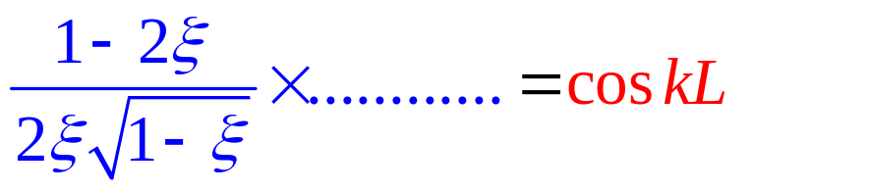
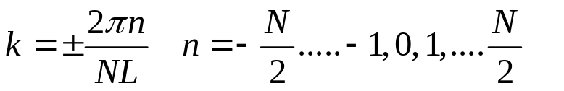
Section 7
Bandstructure – in 1D Periodic Potentials
7.1 Bandstructure - Problem Formulation
  Kronig-Penney Model setup
  Bloch theorem
  Analytical solution process
7.2 Bandstructure - Solutions
  Bandgaps
  Comparison to finite system model
7.3 Band Properties
  Wave packets
  Effective mass
  Electrons and Holes
One Video Segment
status
One Video Segment
One Video Segment
Reference: Vol. 6, Ch. 3
Daniel Mejia, Gerhard Klimeck (2019), "Periodic Potential Lab - Kronig Penney Model,
" https://nanohub.org/resources/kronigpenneylab. (DOI: 10.21981/TT2Y-A185).

Slide 23
Graphical solution to Energy Levels
kL=2πn/N
k=0
1
ζ=E/U
-1
Right Hand side is a set of N flat lines between -1 and 1
Left Hand side is an ocillatory function with damping

Slide 24
Energy Band Diagram
ζ=E/U
k=2π/NL
k=0
ζ=E/U
0
k

Slide 25
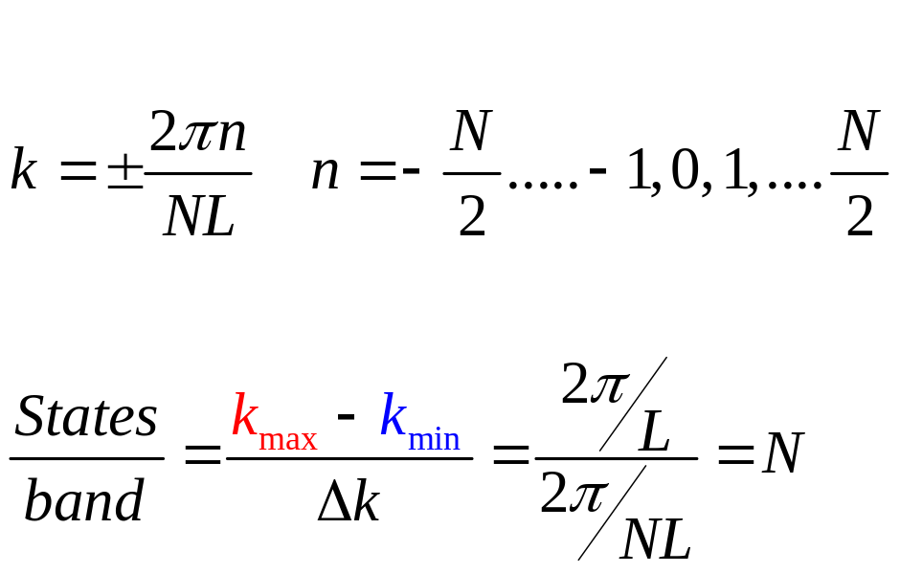
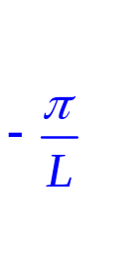

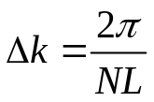
Brillouin Zone and Number of States
E
k
4 states per atom, N atoms
=> 4 bands, N states in each band

Slide 26
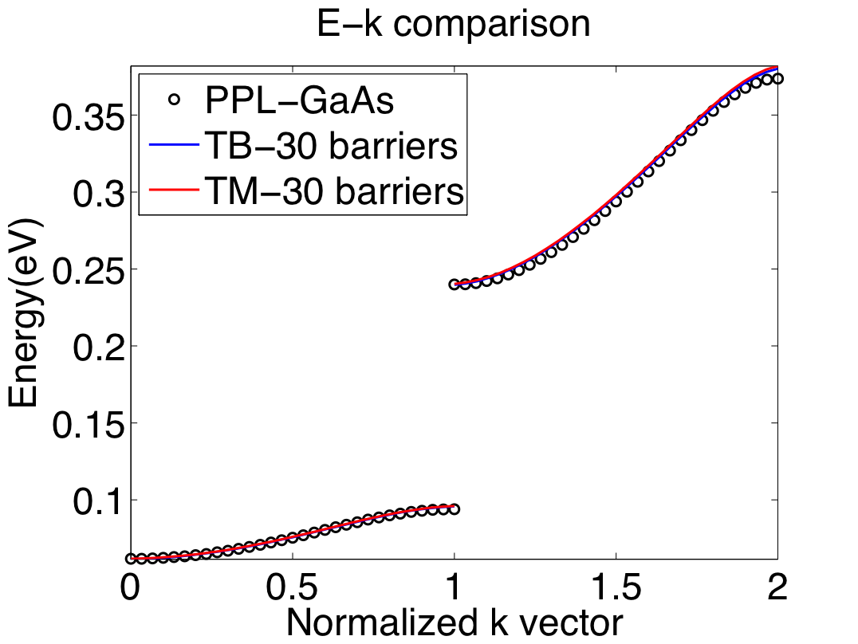
GaAs Well Comparison – 30 Barriers
A GaAs structure with 6nm wells, 2nm barriers and 0.4eV barrier height is modeled as follows,
PPL-Periodic structure repeated indefinitely.
TB: 30 barriers using tight-binding.
TM: 30 barriers using transfer matrices.
It can be seen that the results of these three approaches agree well.

Slide 27
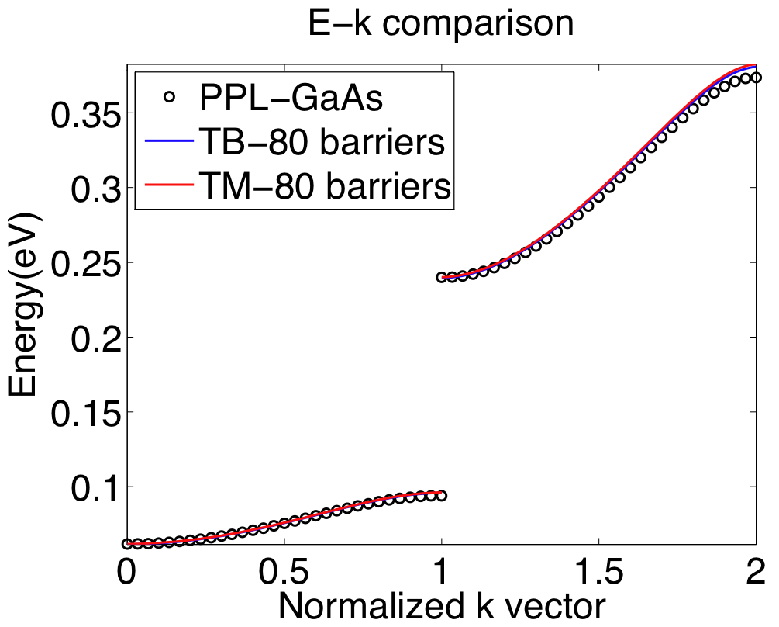
GaAs Well Comparison – 80 Barriers
A GaAs structure with 6nm wells, 2nm barriers and 0.4eV barrier height is modeled as follows,
PPL-Periodic structure repeated indefinitely.
TB: 80 barriers using tight-binding.
TM: 80 barriers using transfer matrices.
It can be seen that the results of these three approaches agree well.

Slide 28
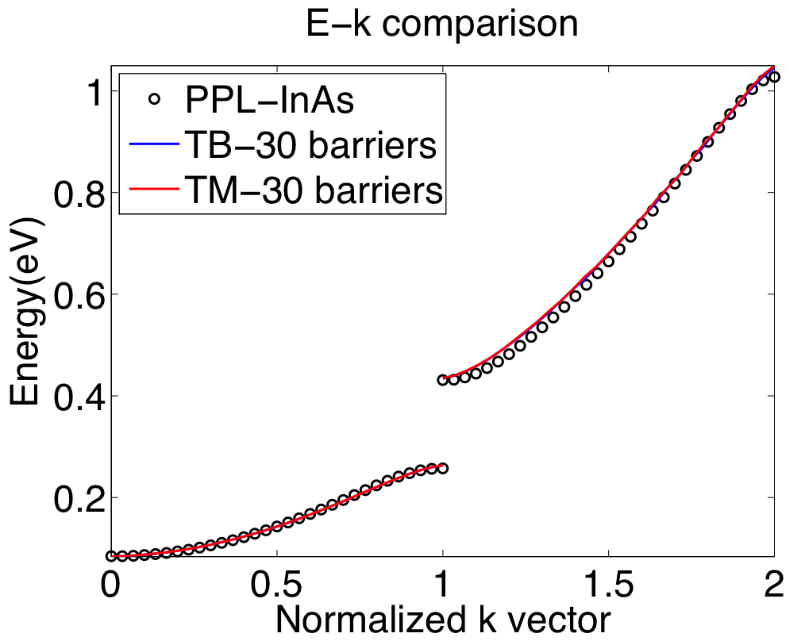
InAs Well Comparison – 30 Barriers
An InAs structure with 6nm wells, 2nm barriers and 0.4eV barrier height is modeled as follows,
PPL-Periodic structure repeated indefinitely.
TB: 30 barriers using tight-binding.
TM: 30 barriers using transfer matrices.
It can be seen that the results of these three approaches agree well.

Slide 29
Key Summary
Finite superlattice with large number of repeated cells approaches the periodic potential model

Slide 30
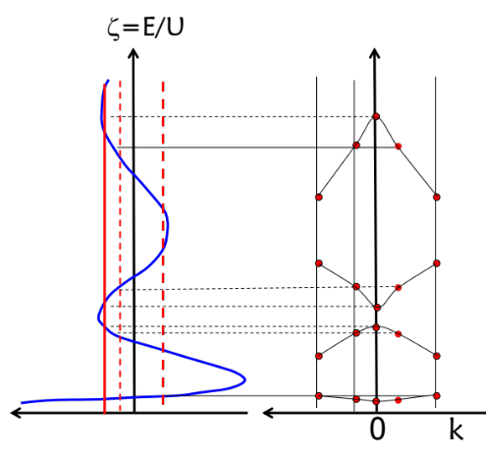
Section 7
Bandstructure – in 1D Periodic Potentials
7.1 Bandstructure - Problem Formulation
  Kronig-Penney Model setup
  Bloch theorem
  Analytical solution process
7.2 Bandstructure - Solutions
  Bandgaps
  Comparison to finite system model
7.3 Band Properties
  Wave packets
  Effective mass
  Electrons and Holes
One Video Segment
One Video Segment
status
One Video Segment
Reference: Vol. 6, Ch. 3
Daniel Mejia, Gerhard Klimeck (2019), "Periodic Potential Lab - Kronig Penney Model,
" https://nanohub.org/resources/kronigpenneylab. (DOI: 10.21981/TT2Y-A185).

Slide 31
Section 7
Bandstructure – in 1D Periodic Potentials
7.1 Bandstructure - Problem Formulation
  Kronig-Penney Model setup
  Bloch theorem
  Analytical solution process
7.2 Bandstructure - Solutions
  Bandgaps
  Comparison to finite system model
7.3 Band Properties
  Wave packets
  Effective mass
  Electrons and Holes
One Video Segment
One Video Segment
status
One Video Segment
Reference: Vol. 6, Ch. 3
Daniel Mejia, Gerhard Klimeck (2019), "Periodic Potential Lab - Kronig Penney Model,
" https://nanohub.org/resources/kronigpenneylab. (DOI: 10.21981/TT2Y-A185).

Slide 32
Section 7
Bandstructure in 1D Periodic Potentials
7.3 Band Properties
Solid State Devices

Slide 33
Section 7
Bandstructure – in 1D Periodic Potentials
7.1 Bandstructure - Problem Formulation
  Kronig-Penney Model setup
  Bloch theorem
  Analytical solution process
7.2 Bandstructure - Solutions
  Bandgaps
  Comparison to finite system model
7.3 Band Properties
  Wave packets
  Effective mass
  Electrons and Holes
One Video Segment
One Video Segment
status
One Video Segment
Reference: Vol. 6, Ch. 3
Daniel Mejia, Gerhard Klimeck (2019), "Periodic Potential Lab - Kronig Penney Model,
" https://nanohub.org/resources/kronigpenneylab. (DOI: 10.21981/TT2Y-A185).

Slide 34
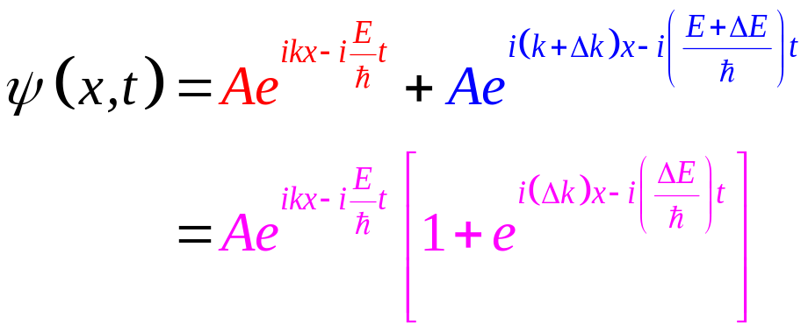
Wave Packet and Group Velocity
t₁
t₂
k

Slide 35
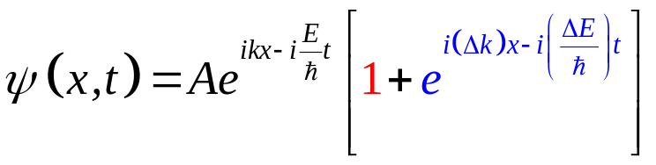
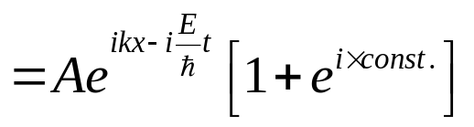

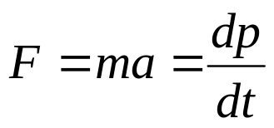
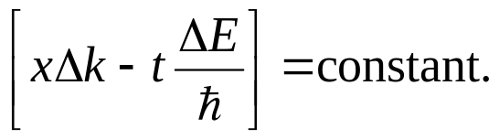
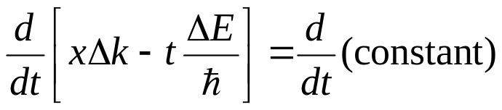









Group Velocity for a Given Band
momentum
force
t₁
t₂

Slide 36


Effective Mass for a Given Band
E
v
1/m*
k
k
mass for each band
mass changes throughout the band

Slide 37




Effective Mass is not Essential …
E
v
1/m*
??
k
k
k
Mass appears to be ill-defined
Integral description of the momentum and position change of wavepackets
Do not need effective mass
=> Effective mass is not a critical physical property!
=> Graphene is a material with such linear dispersion!

Slide 38




Electron and Hole fluxes: Filled/Empty Bands
E
Need
inversion symmetry
(number of states in +/-k identical)
Pauli exclusion principle
E_{F}
Empty bands carry no current
Full bands carry no current
-k
k

Slide 39
Partially filled bands
E
Partial filling can be achieved by:
Optical excitation
Thermal excitation
Doping + a little thermal excitation
3
Empty bands carry no current
2
Full bands carry no current
Let’s imagine there is a way to get some electrons from the valence band into the conduction band!
1
k

Slide 40






Electron and Hole Fluxes: Partially Filled Bands
E
3
2
-v_{e} charge moving with –v_{e} mass
+v_{e} charge moving with +v_{e} mass
1
k
Shockley example – top view of parking lot

Slide 41
Interpretation of the effective mass ?
m* not free mass
m* function of k
negative and positive
(in the same band!)
But for Transport:
Some bands are more important than others
Some are always full
Some are always empty
Minimizing energy:
Electrons “fall” to the bottom
Holes “float” to the top
“Constant” Masses at:
Bottom conduction band
Top valence band
E
1/m*
k
-k
k

Slide 42


Conclusions
Solution of Schrodinger equation is relatively easy for systems with well-defined periodicity.
Kronig-Penney model is analytically solvable. Real band-structures are solved numerically. Such solutions are relatively easy – we will do HW problems on nanohub.org on this topic.
Electrons can only sit in-specific energy bands.
Effective masses and band gaps summarize information about possible electronic states.
Effective mass is not a fundamental concept. There are systems for which effective mass can not be defined.
Of all the possible bands, only a few contribute to conduction. These are often called conduction and valence bands.

Slide 43
Section 7
Bandstructure – in 1D Periodic Potentials
7.1 Bandstructure - Problem Formulation
  Kronig-Penney Model setup
  Bloch theorem
  Analytical solution process
7.2 Bandstructure - Solutions
  Bandgaps
  Comparison to finite system model
7.3 Band Properties
  Wave packets
  Effective mass
  Electrons and Holes
One Video Segment
One Video Segment
One Video Segment
Reference: Vol. 6, Ch. 3
Daniel Mejia, Gerhard Klimeck (2019), "Periodic Potential Lab - ….,
" https://nanohub.org/resources/kronigpenneylab. (DOI: 10.21981/TT2Y-A185).

