Slide 1
Section 3
Crystals
Solid State Devices
Gerhard Klimeck
gekco@purdue.edu

Slide 2
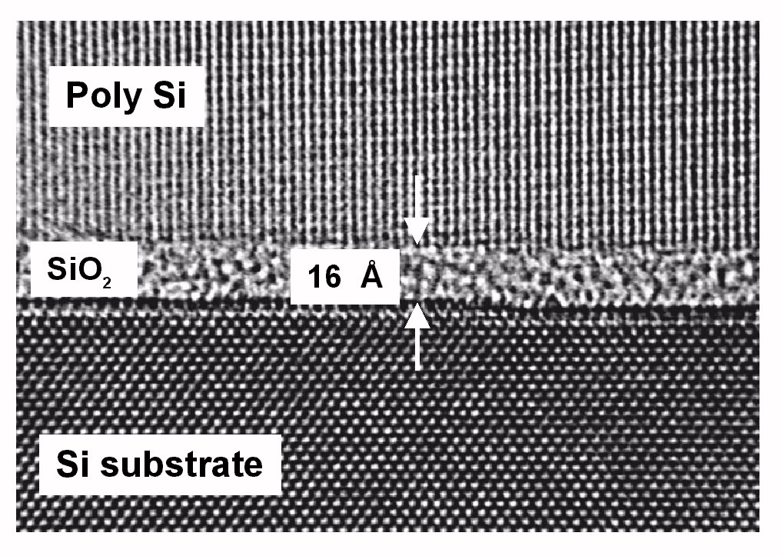
Section 3
Crystals
3.1 Crystal definitions
  One-dimensional Crystals – simple primitive cell
  Unit cells of a Periodic 2D Lattice
  Bravais lattice
  Bravais lattice with a basis
  Non-periodic repeated cells
  Definition of ONE Primitive Cell – Wigner-Seitz Cell
3.2 Tables of Bravais Lattices
  Bravais Lattices in 2D (5 types)
  Bravais Lattices in 3D (14 types)
  3 Dominant Bravais Lattices in Nature
3.3 Density Definitions and Applications to Common Materials
  Number, Packing, and Areal Density
  Common Crystals – Non-Primitive Unit Cells (NaCl, GaAs, CdS)
3.4 Surfaces, Miller Index
Reference: Vol. 6, Ch. 1, ABACUS tool at nanohub.org/tools/abacus and
"Crystal Viewer Lab, https://nanohub.org/resources/crystalviewer
One Video Segment
One Video Segment
One Video Segment
One Video Segment

Slide 3
Section 3
Crystals
3.1 Crystal definitions
  One-dimensional Crystals – simple primitive cell
  Unit cells of a Periodic 2D Lattice
  Bravais lattice
  Bravais lattice with a basis
  Non-periodic repeated cells
  Definition of ONE Primitive Cell – Wigner-Seitz Cell
3.2 Tables of Bravais Lattices
  Bravais Lattices in 2D (5 types)
  Bravais Lattices in 3D (14 types)
  3 Dominant Bravais Lattices in Nature
3.3 Density Definitions and Applications to Common Materials
  Number, Packing, and Areal Density
  Common Crystals – Non-Primitive Unit Cells (NaCl, GaAs, CdS)
3.4 Surfaces, Miller Index
Reference: Vol. 6, Ch. 1, ABACUS tool at nanohub.org/tools/abacus and
"Crystal Viewer Lab, https://nanohub.org/resources/crystalviewer
One Video Segment
One Video Segment
One Video Segment
One Video Segment

Slide 4
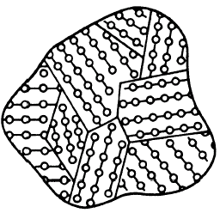
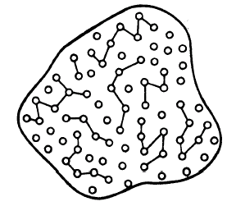
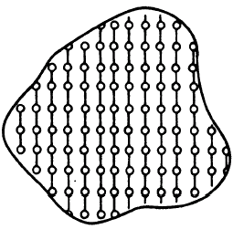

Crystals form the Core Device Material
Poly-Crystalline
Cross section of a MOSFET
Conductive
Electron transport
Hold charge
Conductor
Poly-Si / metal
Gate
Amorphous
Oxides
Dielectric
Non-Conductive
“NO” transport
Semiconductor
Device
solid crystals
Crystalline
Highly conductive
Electron transport
Device is a perfectly
arranged crystal
Modern solid state devices use all forms these forms of materials
Focus on Crystals first – start with 1D => 2D => 3D
Transfer concepts of electronic behavior in crystals to other materials
specific position
specific orientation

Slide 5

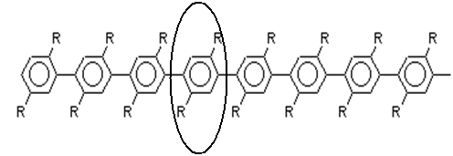
One-dimensional Crystals
There is exactly ONE primitive unit cell in a 1D system
No realistic system is truly 1-D, but ….
1D properties dominate behavior in some material and devices
  Materials: e.g polymers,
  Biology: e.g. DNA
  Devices: e.g. 1D heterostructures (lasers, RTDs)
Can often be solved analytically, many properties have 2D/3D analogs
Polyacetylene
PPP

Slide 6
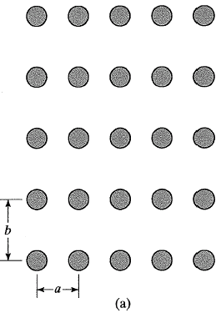
Unit cells of a Periodic 2D Lattice
“Infinitely” extended
2D shown
3D same concepts
N_{A}=6 x 10²³/mol
Can NEVER solve this, even on the largest computer
Simplify to a repeated (small) cell
b₃
b₄
a₃
a₄
b₁
b₂
a₁
a₂
Unit cells are not unique
Unit cells can be Primitive or Non-primitive
Property of ONE CELL defines the property of the solid
Address every point in the lattice by integer translation of unit vectors

Slide 7
Bravais Lattice
b₃
b₄
a₃
a₄
b₁
b₂
a₁
a₂
Property of ONE CELL defines the property of the solid
Address every point in the lattice by integer translation of unit vectors
every point has the same environment as every other point
(same number of neighbors, next neighbors, …)

Slide 8
Bravais Lattice with a Basis
Non-Bravais lattice
b₃
b₄
a₃
a₄
Bravais lattice
with a basis
b₁
b₂
a₁
a₂
Property of ONE CELL defines the property of the solid
Address every point in the lattice by integer translation of unit vectors
every point has the same environment as every other point
(same number of neighbors, next neighbors, …)

Slide 9
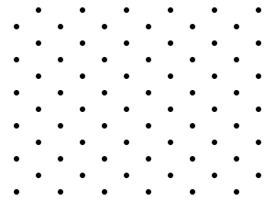
Graphene - Bravais Lattice with a Basis
A and B do not have
identical environments
Non-Bravais lattice
Bravais lattice
with a basis
A
B
This is a Graphene sheet which has “recently” been
isolated from Graphite by adhesive tape stamping.
2005 - Novoselov, Geim, et al. Nature, 438, 197.
2010 – Nobel Prize in Physics
Conversion into a Bravais lattice:
Combine A and B into a single basis
Obtain a rhombic Bravais lattice
Original image from: http://en.wikipedia.org/wiki/File:Rhombic_Lattice.svg
Property of ONE CELL defines the property of the solid
Address every point in the lattice by integer translation of unit vectors
every point has the same environment as every other point
(same number of neighbors, next neighbors, …)

Slide 10
Bravais Lattice with a Basis
Non-Bravais lattice
b₃
b₄
a₃
a₄
Bravais lattice
with a basis
b₁
b₂
Conversion into a Bravais lattice:
Combine complex components into a single repeated basis
Establish basis vectors
a₁
a₂
Unit cells are not unique
Unit cells can be Primitive or Non-primitive
Property of ONE CELL defines the property of the solid
Address every point in the lattice by integer translation of unit vectors
every point has the same environment as every other point
(same number of neighbors, next neighbors, …)

Slide 11
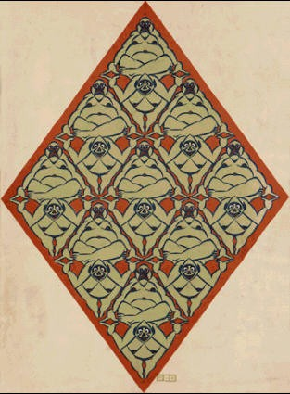
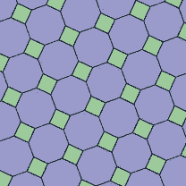
Bravais Lattice with a Basis – in Art
Non-Bravais lattice
b₃
b₄
a₃
a₄
Bravais lattice
with a basis
b₁
b₂
Conversion into a Bravais lattice:
Combine complex components into a single repeated basis
Establish basis vectors
a₁
a₂
Unit cells are not unique
Unit cells can be Primitive or Non-primitive
Escher
Tiling
Kepler
Tiling
Property of ONE CELL defines the property of the solid
Address every point in the lattice by integer translation of unit vectors
every point has the same environment as every other point
(same number of neighbors, next neighbors, …)

Slide 12
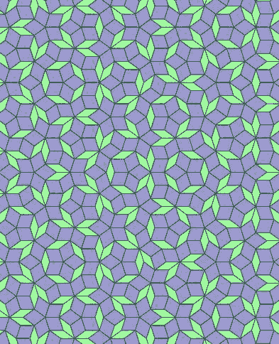
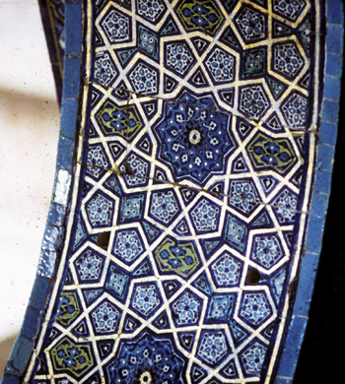
Non-Periodic Repeated Cells
NOT a Bravais Lattice
Non-Bravais lattice
Bravais lattice
with a basis
b₃
b₄
Penrose Tiles
Ancient Tiles
a₃
a₄
Conversion into a Bravais lattice:
Combine complex components into a single repeated basis
Establish basis vectors
b₁
b₂
a₁
a₂
Unit cells are not unique
Unit cells can be Primitive or Non-primitive
… these CANNOT be transformed to Bravais lattice
ex. Aluminum-Manganese compounds, non-sticky coats
A Bravais Lattice must contain long-range order!
Two different unit cells in random order
Property of ONE CELL defines the property of the solid
Address every point in the lattice by integer translation of unit vectors
every point has the same environment as every other point
(same number of neighbors, next neighbors, …)

Slide 13
How to define ONE primitive cell?
Wigner-Seitz Primitive Cell
Non-Bravais lattice
b₃
b₄
a₃
a₄
Bravais lattice
with a basis
b₁
b₂
a₁
a₂
Conversion into a Bravais lattice:
Combine A and B int a single basis
Obtain a rhombic Bravais lattice
Unit cells are not unique
Unit cells can be Primitive or Non-primitive
Property of ONE CELL defines the property of the solid
Address every point in the lattice by integer translation of unit vectors
every point has the same environment as every other point
(same number of neighbors, next neighbors, …)

Slide 14
How to define ONE primitive cell?
Wigner-Seitz Primitive Cell
b₃
b₄
a₃
a₄
b₁
b₂
a₁
a₂
Eg.: oblique
Unit cells are not unique
Unit cells can be Primitive or Non-primitive
Property of ONE CELL defines the property of the solid
Address every point in the lattice by integer translation of unit vectors
every point has the same environment as every other point
(same number of neighbors, next neighbors, …)

Slide 15
How to define ONE primitive cell?
Wigner-Seitz Primitive Cell
Choose a reference atom
Connect to all its neighbors
by straight lines
Draw lines (in 2D) or planes
(in 3D) normal to and at the
midpoints of connecting lines
Smallest area/volume enclosed
is the Wigner-Seitz primitive cell
Non-Bravais lattice
Bravais lattice
with a basis
Conversion into a Bravais lattice:
Combine A and B int a single basis
Obtain a rhombic Bravais lattice
Need work on cell
Unit cells are not unique
Unit cells can be Primitive or Non-primitive
Wigner-Seitz cell is ONE definition of a Unit Cell that always works
There are other ways of construction!
Property of ONE CELL defines the property of the solid
Address every point in the lattice by integer translation of unit vectors
every point has the same environment as every other point
(same number of neighbors, next neighbors, …)

Slide 16
How to define ONE primitive cell?
Wigner-Seitz Primitive Cell
Choose a reference atom
Connect to all its neighbors
by straight lines
Draw lines (in 2D) or planes
(in 3D) normal to and at the
midpoints of connecting lines
Smallest area/volume enclosed
is the Wigner-Seitz primitive cell
Non-Bravais lattice
Bravais lattice
with a basis
Conversion into a Bravais lattice:
Combine A and B int a single basis
Obtain a rhombic Bravais lattice
Unit cells are not unique
Unit cells can be Primitive or Non-primitive
Wigner-Seitz cell is ONE definition of a Unit Cell that always works
There are other ways of construction!
Property of ONE CELL defines the property of the solid
Address every point in the lattice by integer translation of unit vectors
every point has the same environment as every other point
(same number of neighbors, next neighbors, …)

Slide 17
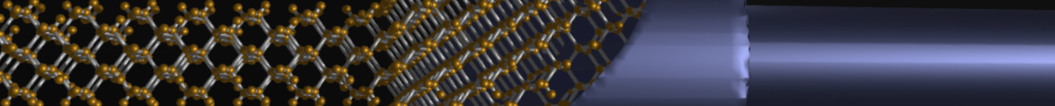
Section 3
Crystals
3.1 Crystal definitions
  One-dimensional Crystals – simple primitive cell
  Unit cells of a Periodic 2D Lattice
  Bravais lattice
  Bravais lattice with a basis
  Non-periodic repeated cells
  Definition of ONE Primitive Cell – Wigner-Seitz Cell
3.2 Tables of Bravais Lattices
  Bravais Lattices in 2D (5 types)
  Bravais Lattices in 3D (14 types)
  3 Dominant Bravais Lattices in Nature
3.3 Density Definitions and Applications to Common Materials
  Number, Packing, and Areal Density
  Common Crystals – Non-Primitive Unit Cells (NaCl, GaAs, CdS)
3.4 Surfaces, Miller Index
Reference: Vol. 6, Ch. 1, ABACUS tool at nanohub.org/tools/abacus and
"Crystal Viewer Lab, https://nanohub.org/resources/crystalviewer
One Video Segment
status
One Video Segment
One Video Segment
One Video Segment

Slide 18
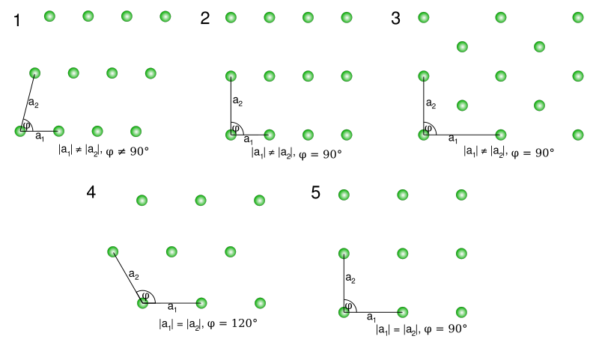
Section 3
Crystals
3.1 Crystal definitions
  One-dimensional Crystals – simple primitive cell
  Unit cells of a Periodic 2D Lattice
  Bravais lattice
  Bravais lattice with a basis
  Non-periodic repeated cells
  Definition of ONE Primitive Cell – Wigner-Seitz Cell
3.2 Tables of Bravais Lattices
  Bravais Lattices in 2D (5 types)
  Bravais Lattices in 3D (14 types)
  3 Dominant Bravais Lattices in Nature
3.3 Density Definitions and Applications to Common Materials
  Number, Packing, and Areal Density
  Common Crystals – Non-Primitive Unit Cells (NaCl, GaAs, CdS)
3.4 Surfaces, Miller Index
Reference: Vol. 6, Ch. 1, ABACUS tool at nanohub.org/tools/abacus and
"Crystal Viewer Lab, https://nanohub.org/resources/crystalviewer
One Video Segment
status
One Video Segment
One Video Segment
One Video Segment

Slide 19
Section 3 – Crystals
3.2 Tables of Bravais Lattices
Solid State Devices
Gerhard Klimeck
gekco@purdue.edu

Slide 20
Section 3
Crystals
3.1 Crystal definitions
  One-dimensional Crystals – simple primitive cell
  Unit cells of a Periodic 2D Lattice
  Bravais lattice
  Bravais lattice with a basis
  Non-periodic repeated cells
  Definition of ONE Primitive Cell – Wigner-Seitz Cell
3.2 Tables of Bravais Lattices
  Bravais Lattices in 2D (5 types)
  Bravais Lattices in 3D (14 types)
  3 Dominant Bravais Lattices in Nature
3.3 Density Definitions and Applications to Common Materials
  Number, Packing, and Areal Density
  Common Crystals – Non-Primitive Unit Cells (NaCl, GaAs, CdS)
3.4 Surfaces, Miller Index
Reference: Vol. 6, Ch. 1, ABACUS tool at nanohub.org/tools/abacus and
"Crystal Viewer Lab, https://nanohub.org/resources/crystalviewer
One Video Segment
status
One Video Segment
One Video Segment
One Video Segment

Slide 21
Bravais Lattices in 2D (5-types)
rectangular
Centered rectangular
or rhombic or triangular
2 atoms per unit cell!
Parallelogrammic or
oblique
hexagonal
square
Original image from: http://upload.wikimedia.org/wikipedia/commons/e/ee/2d-bravais.svg
Notes:
corrections

Slide 22
Bravais Lattices in 2D (5-types)
rectangular
Centered rectangular
or rhombic or triangular
2 atoms per unit cell!
Parallelogrammic or
oblique
hexagonal
Can construct all periodic 2D lattices from these basis sets
square
Original image from: http://upload.wikimedia.org/wikipedia/commons/e/ee/2d-bravais.svg
Notes:
corrections

Slide 23

Section 3
Crystals
3.1 Crystal definitions
  One-dimensional Crystals – simple primitive cell
  Unit cells of a Periodic 2D Lattice
  Bravais lattice
  Bravais lattice with a basis
  Non-periodic repeated cells
  Definition of ONE Primitive Cell – Wigner-Seitz Cell
3.2 Tables of Bravais Lattices
  Bravais Lattices in 2D (5 types)
  Bravais Lattices in 3D (14 types)
  3 Dominant Bravais Lattices in Nature
3.3 Density Definitions and Applications to Common Materials
  Number, Packing, and Areal Density
  Common Crystals – Non-Primitive Unit Cells (NaCl, GaAs, CdS)
3.4 Surfaces, Miller Index
Reference: Vol. 6, Ch. 1, ABACUS tool at nanohub.org/tools/abacus and
"Crystal Viewer Lab, https://nanohub.org/resources/crystalviewer
One Video Segment
One Video Segment
status
One Video Segment
One Video Segment

Slide 24

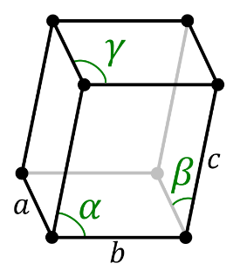












Bravais lattice in 3D (14-types)
Rotation
 | Triclinic | Cubic | Tetragonal | Orthorobmic | Rhombohedral | Hexagonal | Monoclinic
P
I
F
C
points
primitve
Body centered
Face centered
Single face centered

Slide 25
Bravais lattice in 3D (14-types)
Rotation
 | Triclinic | Cubic | Tetragonal | Orthorobmic | Rhombohedral | Hexagonal | Monoclinic
P
I
F
C
points
primitve
Body centered
A
C
Face centered
Single face centered

Slide 26
Duplicated Bravais Lattice
Unlucky Frankenheim (1842)
counted 15 unit cells!
Bravais pointed out that
2 cells were duplicated
Tetragonal face centered
Tetragonal body centered
A
A
A
C
c
c
c
Tetragonal FC = Tetragonal BC

Slide 27
Bravais lattice in 3D (14-types)
A
C

Slide 28
3 Dominant Bravais Lattices in Nature
Cubic conceptionally simple,
but experimentally very unusual
Polonium84
70-75% of all natural
crystalline materials

Slide 29
Section 3
Crystals
3.1 Crystal definitions
  One-dimensional Crystals – simple primitive cell
  Unit cells of a Periodic 2D Lattice
  Bravais lattice
  Bravais lattice with a basis
  Non-periodic repeated cells
  Definition of ONE Primitive Cell – Wigner-Seitz Cell
3.2 Tables of Bravais Lattices
  Bravais Lattices in 2D (5 types)
  Bravais Lattices in 3D (14 types)
  3 Dominant Bravais Lattices in Nature
3.3 Density Definitions and Applications to Common Materials
  Number, Packing, and Areal Density
  Common Crystals – Non-Primitive Unit Cells (NaCl, GaAs, CdS)
3.4 Surfaces, Miller Index
Reference: Vol. 6, Ch. 1, ABACUS tool at nanohub.org/tools/abacus and
"Crystal Viewer Lab, https://nanohub.org/resources/crystalviewer
One Video Segment
One Video Segment
status
One Video Segment
One Video Segment

Slide 30
Section 3
Crystals
3.1 Crystal definitions
  One-dimensional Crystals – simple primitive cell
  Unit cells of a Periodic 2D Lattice
  Bravais lattice
  Bravais lattice with a basis
  Non-periodic repeated cells
  Definition of ONE Primitive Cell – Wigner-Seitz Cell
3.2 Tables of Bravais Lattices
  Bravais Lattices in 2D (5 types)
  Bravais Lattices in 3D (14 types)
  3 Dominant Bravais Lattices in Nature
3.3 Density Definitions and Applications to Common Materials
  Number, Packing, and Areal Density
  Common Crystals – Non-Primitive Unit Cells (NaCl, GaAs, CdS)
3.4 Surfaces, Miller Index
Reference: Vol. 6, Ch. 1, ABACUS tool at nanohub.org/tools/abacus and
"Crystal Viewer Lab, https://nanohub.org/resources/crystalviewer
One Video Segment
One Video Segment
status
One Video Segment
One Video Segment

Slide 31
Section 3 – Crystals
3.3 Density Definitions and Applications to Common Materials
Solid State Devices
Gerhard Klimeck
gekco@purdue.edu

Slide 32
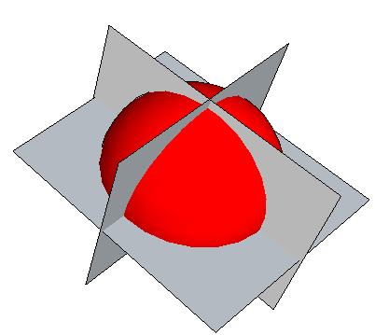
Section 3
Crystals
3.1 Crystal definitions
  One-dimensional Crystals – simple primitive cell
  Unit cells of a Periodic 2D Lattice
  Bravais lattice
  Bravais lattice with a basis
  Non-periodic repeated cells
  Definition of ONE Primitive Cell – Wigner-Seitz Cell
3.2 Tables of Bravais Lattices
  Bravais Lattices in 2D (5 types)
  Bravais Lattices in 3D (14 types)
  3 Dominant Bravais Lattices in Nature
3.3 Density Definitions and Applications to Common Materials
  Number, Packing, and Areal Density
  Common Crystals – Non-Primitive Unit Cells (NaCl, GaAs, CdS)
3.4 Surfaces, Miller Index
Reference: Vol. 6, Ch. 1, ABACUS tool at nanohub.org/tools/abacus and
"Crystal Viewer Lab, https://nanohub.org/resources/crystalviewer
One Video Segment
One Video Segment
status
One Video Segment
One Video Segment

Slide 33
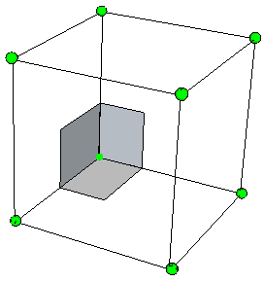
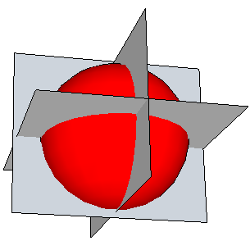
Simple Cubic Cubic Lattice:
Number of atoms
Points per cell
=1/8 points/corner x 8 corners
=1 Point/cell
(depends on definition of cell)
a
Number density
= (1/a³) points/cm³
(does not depend on cell definition)

Slide 34
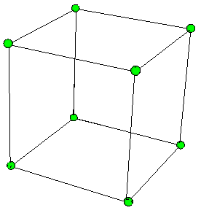
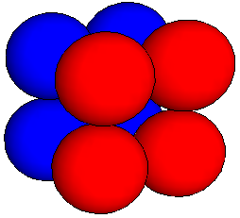
Simple Cubic Cubic Lattice:
Packing Density
Packing density
=volume filled/total volume
R=a/2 maximum radius
V=(4/3)πR³ Volume of a sphere
P= (1/8)x(4/3)πR³ x (8 corners) /a³
=π/6
~52%
(about HALF of the volume is EMPTY)
Typical for crystals and amorphous materials
(does not depend on cell definition)
a
R
a

Slide 35
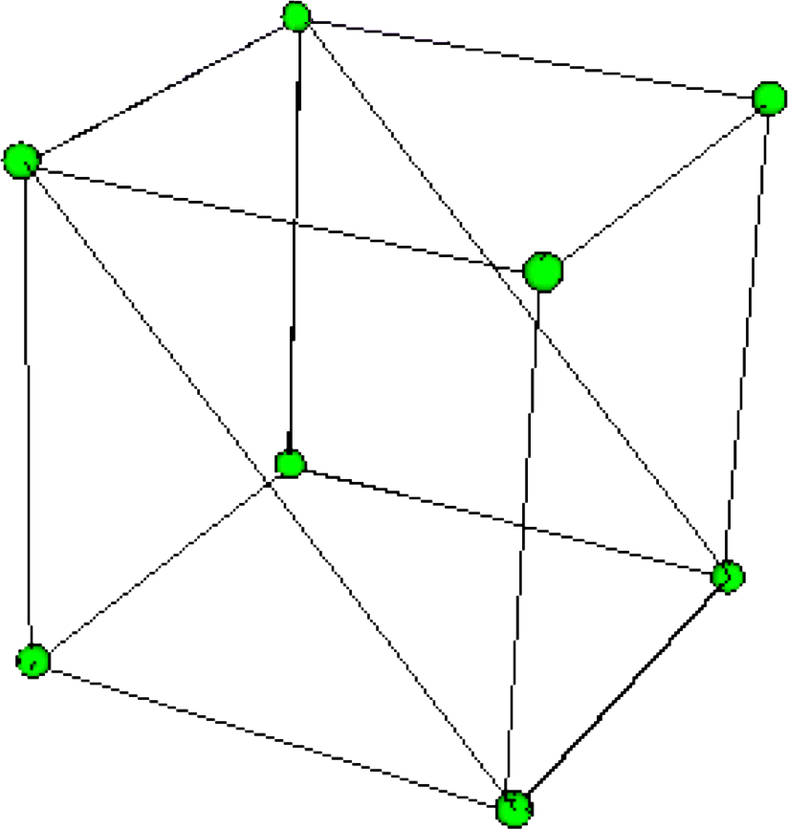
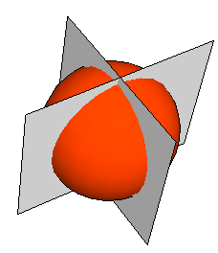
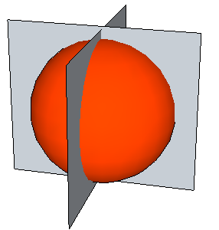
Simple Cubic Cubic Lattice:
Areal Density
Surfaces are critical in semiconductors:
Vertical stacking of materials
=> misalignment => dangling bonds => loose electrons
=> Different surface chemistry
Areal Density
=(1/4 per corner) x (4 corners)/a²
=1/a² cm⁻²
Areal density (face diagonal)
= (1/4 points/corner) x (4 corners)/2a² cm⁻²
~0.7/a² cm⁻²
Notes:
Typo on the exponent (-3)

Slide 36
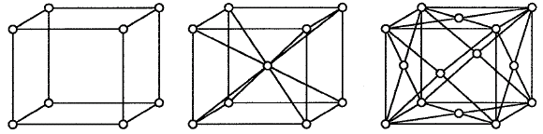
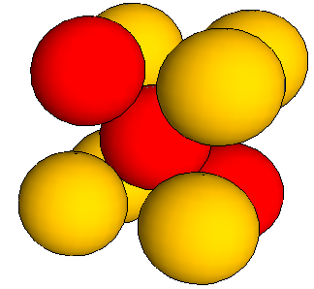
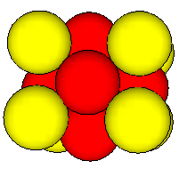
Points per Cell Examples
BCC
Points per cell
= 1/8 x 8 @corners
+ 1 @inside
=2
FCC
Points per cell
= 1/8 x 8 @corners
+ 1/2 x 6 @faces
=4

Slide 37
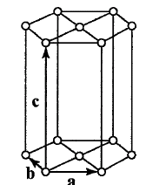
Hexagonal Closed-Packed
Points per cell
1/2 x 2 @faces =1
1/2x1/3 x 12 @corners =2
top/bottom
neigbors
3 points/cell

Slide 38
Section 3
Crystals
3.1 Crystal definitions
  One-dimensional Crystals – simple primitive cell
  Unit cells of a Periodic 2D Lattice
  Bravais lattice
  Bravais lattice with a basis
  Non-periodic repeated cells
  Definition of ONE Primitive Cell – Wigner-Seitz Cell
3.2 Tables of Bravais Lattices
  Bravais Lattices in 2D (5 types)
  Bravais Lattices in 3D (14 types)
  3 Dominant Bravais Lattices in Nature
3.3 Density Definitions and Applications to Common Materials
  Number, Packing, and Areal Density
  Common Crystals – Non-Primitive Unit Cells (NaCl, GaAs, CdS)
3.4 Surfaces, Miller Index
Reference: Vol. 6, Ch. 1, ABACUS tool at nanohub.org/tools/abacus and
"Crystal Viewer Lab, https://nanohub.org/resources/crystalviewer
One Video Segment
One Video Segment
One Video Segment
status
One Video Segment

Slide 39
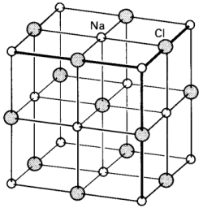
Section 3
Crystals
3.1 Crystal definitions
  One-dimensional Crystals – simple primitive cell
  Unit cells of a Periodic 2D Lattice
  Bravais lattice
  Bravais lattice with a basis
  Non-periodic repeated cells
  Definition of ONE Primitive Cell – Wigner-Seitz Cell
3.2 Tables of Bravais Lattices
  Bravais Lattices in 2D (5 types)
  Bravais Lattices in 3D (14 types)
  3 Dominant Bravais Lattices in Nature
3.3 Density Definitions and Applications to Common Materials
  Number, Packing, and Areal Density
  Common Crystals – Non-Primitive Unit Cells (NaCl, GaAs, CdS)
3.4 Surfaces, Miller Index
Reference: Vol. 6, Ch. 1, ABACUS tool at nanohub.org/tools/abacus and
"Crystal Viewer Lab, https://nanohub.org/resources/crystalviewer
One Video Segment
One Video Segment
One Video Segment
status
One Video Segment

Slide 40
Bravais Lattice with a Basis
Graphene
Non-Bravais lattice
b₃
b₄
a₃
a₄
Bravais lattice
with a basis
Bravais lattice
with a basis
NaCl
Rocksalt
b₁
b₂
Conversion into a Bravais lattice:
Combine complex components into a single repeated basis
Establish basis vectors
a₁
a₂
Unit cells are not unique
Unit cells can be Primitive or Non-primitive
Property of ONE CELL defines the property of the solid
Address every point in the lattice by integer translation of unit vectors
every point has the same environment as every other point
(same number of neighbors, next neighbors, …)

Slide 41
Rock-Salt as FCC lattice
NaCl is normal household cooking salt
We see the crystals every day – what is the crystal structure?
At first glance it looks like a simple cubic cell
one atom on each corner
But they are different => not a Bravais lattice
=
a basis
of 2 atoms
arranged in
FCC
For more discussion, see Kittel and Ashcroft/Mermin

Slide 42
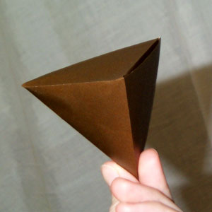
Zinc-Blende Lattice for GaAs
Atoms/cell=(1/8)x8 + (1/2)x6 + 4=8
Tetrahedral structure
Need work on animation

Slide 43
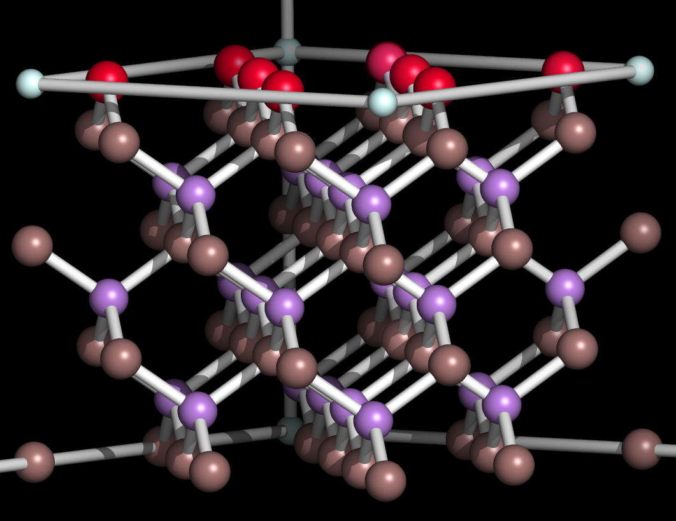
GaAs Crystal Plotted in Crystal Viewer

Slide 44
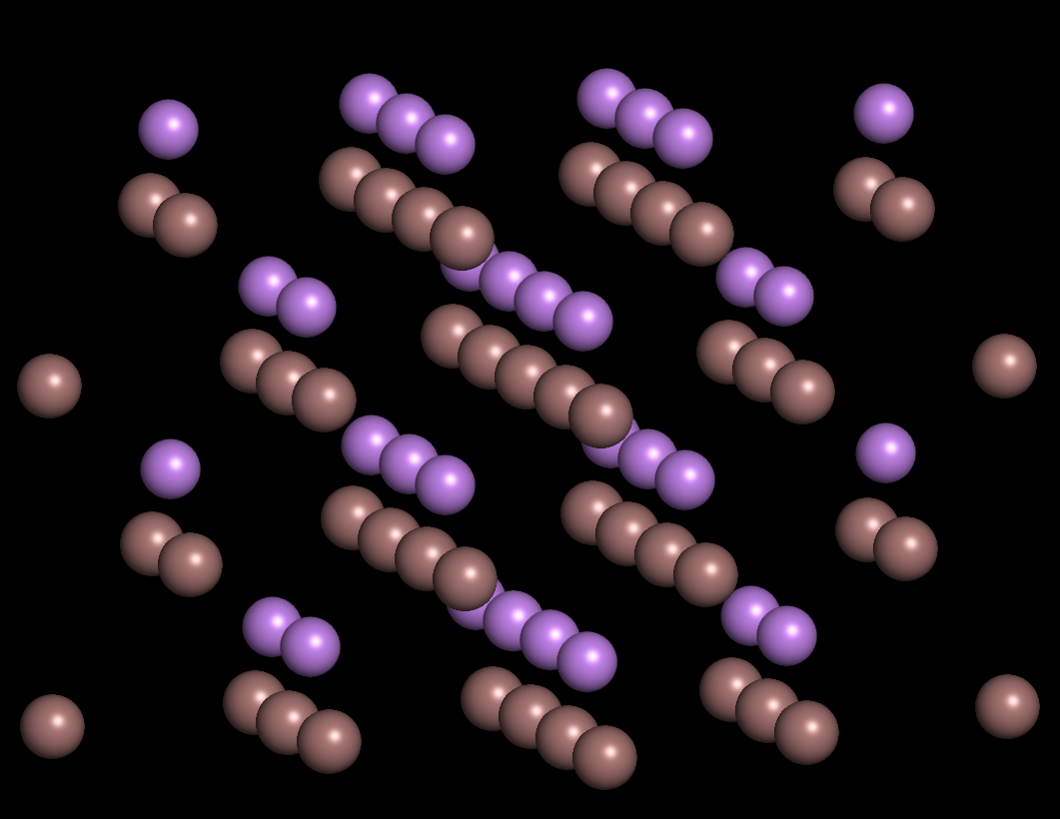
GaAs Crystal Without Bonds

Slide 45
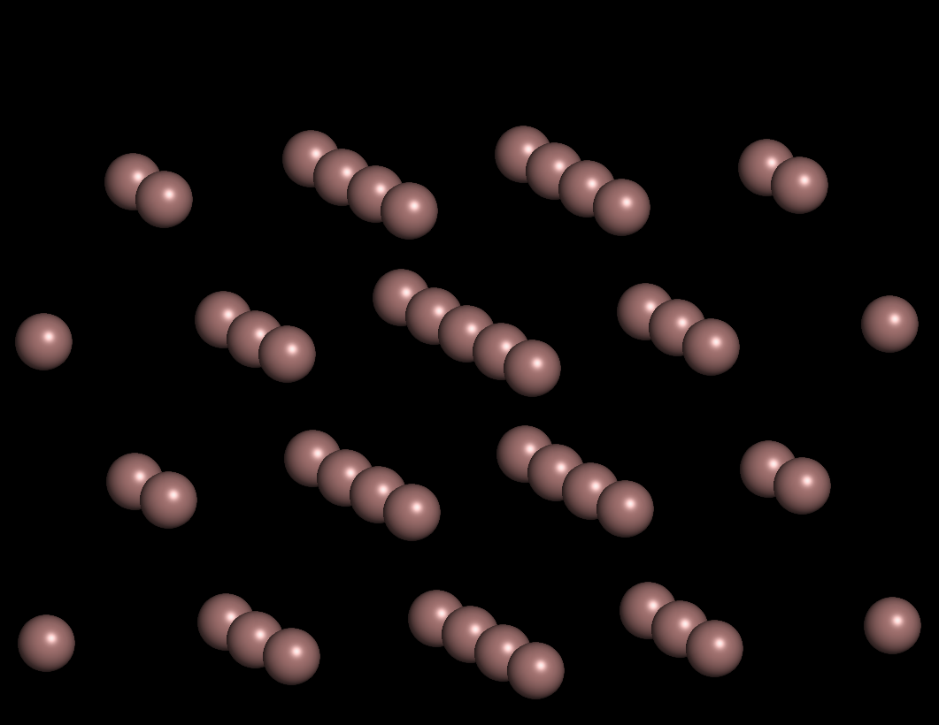
GaAs Crystal Just One Species

Slide 46
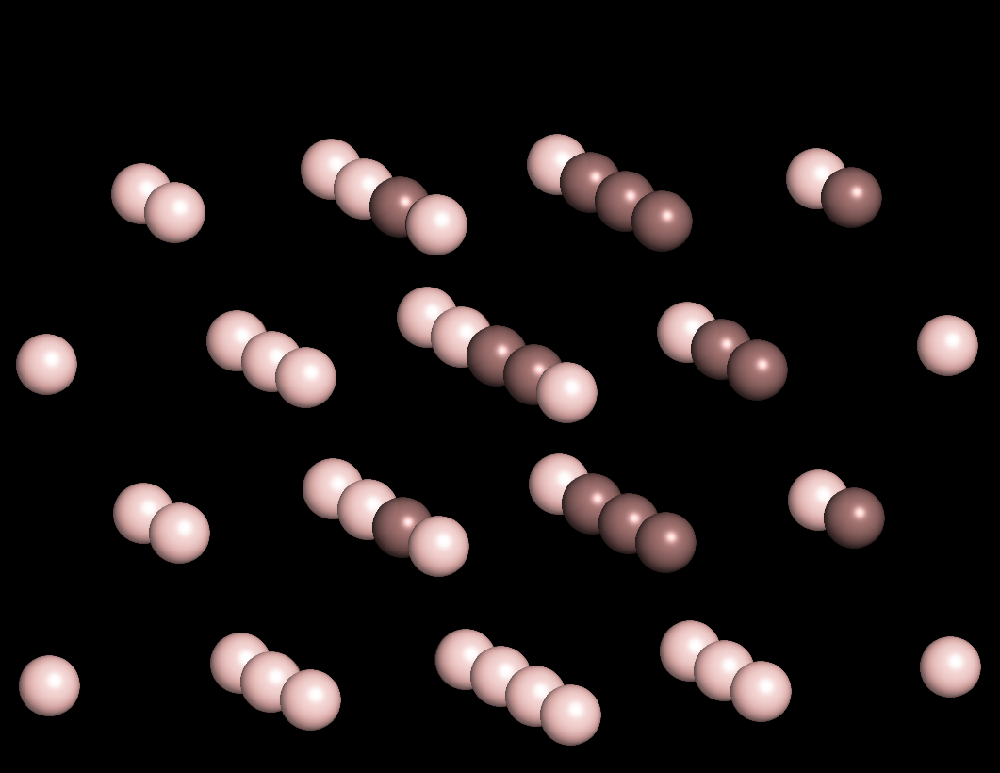
GaAs Crystal Just One Species
Focus on Few

Slide 47
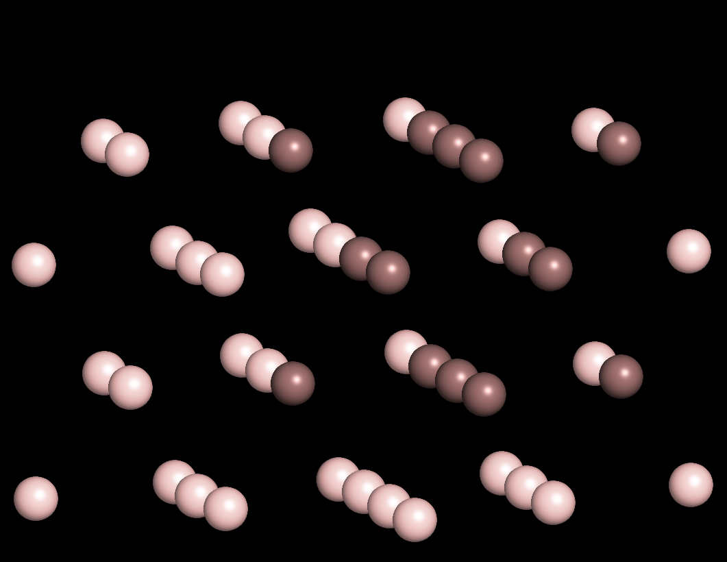
GaAs Crystal Just One Species
Focus on Few – Take out a Few

Slide 48
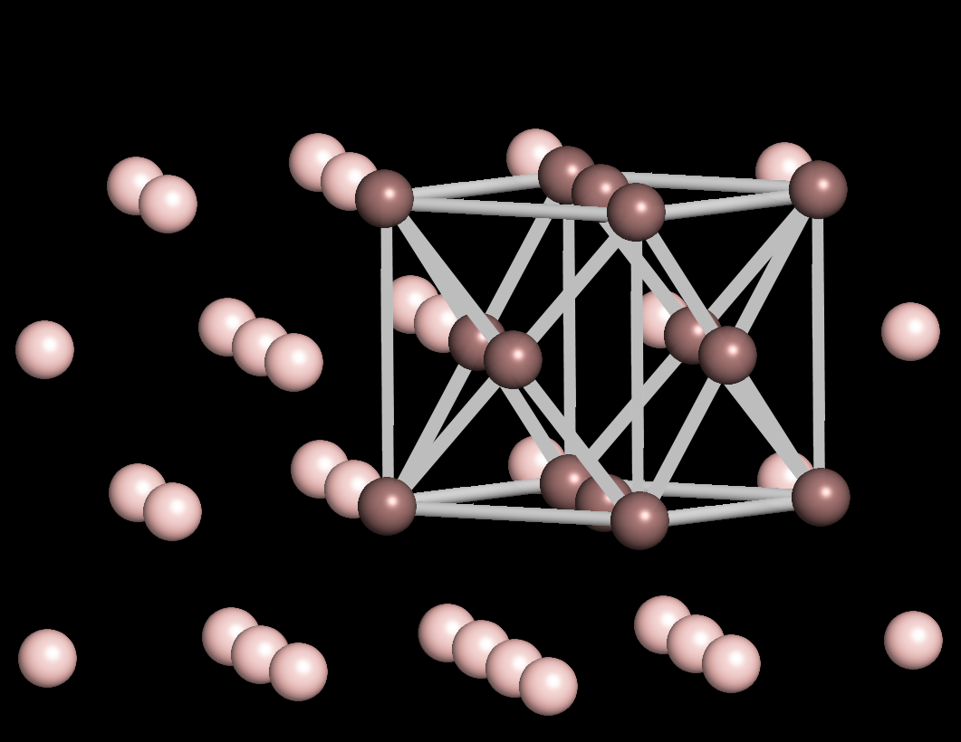
GaAs Crystal Just One Species
A FCC Cell!
FCC cell – Atoms/cell = (1/8)x8 + (1/2)x6 = 4

Slide 49
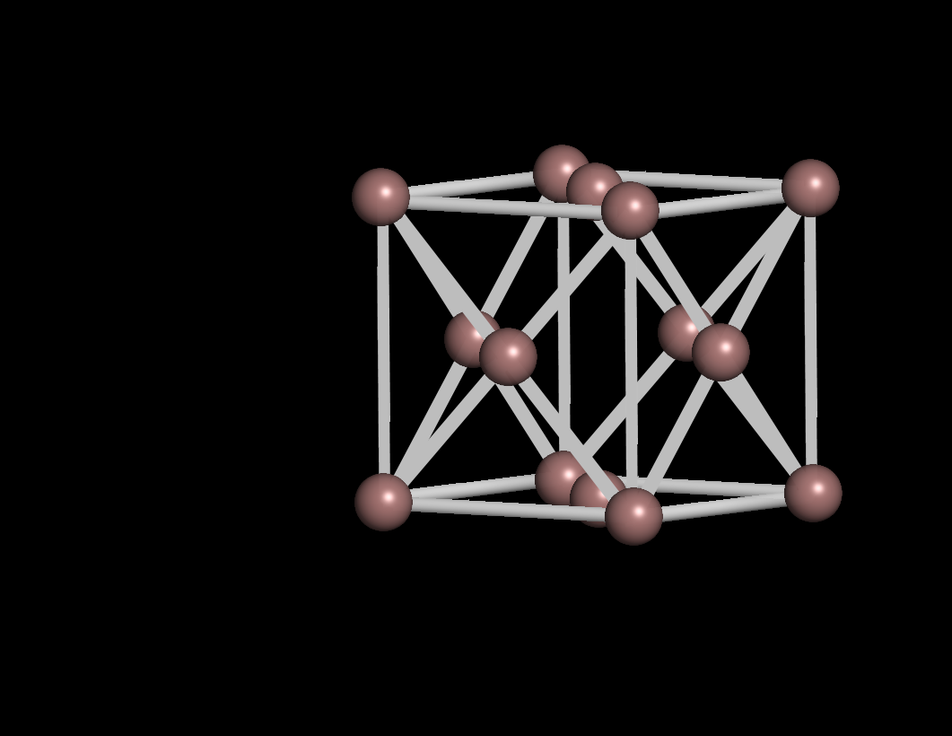
GaAs Crystal Just One Species
A FCC Cell!
FCC cell – 4 atoms per unit cell

Slide 50
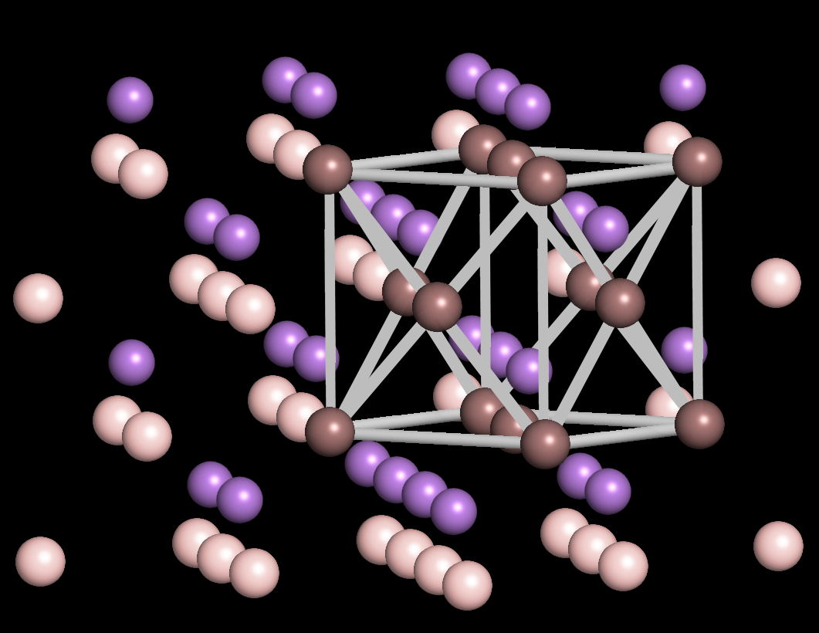
GaAs Crystal Both Species
FCC cell – 4 atoms per unit cell – brown species

Slide 51
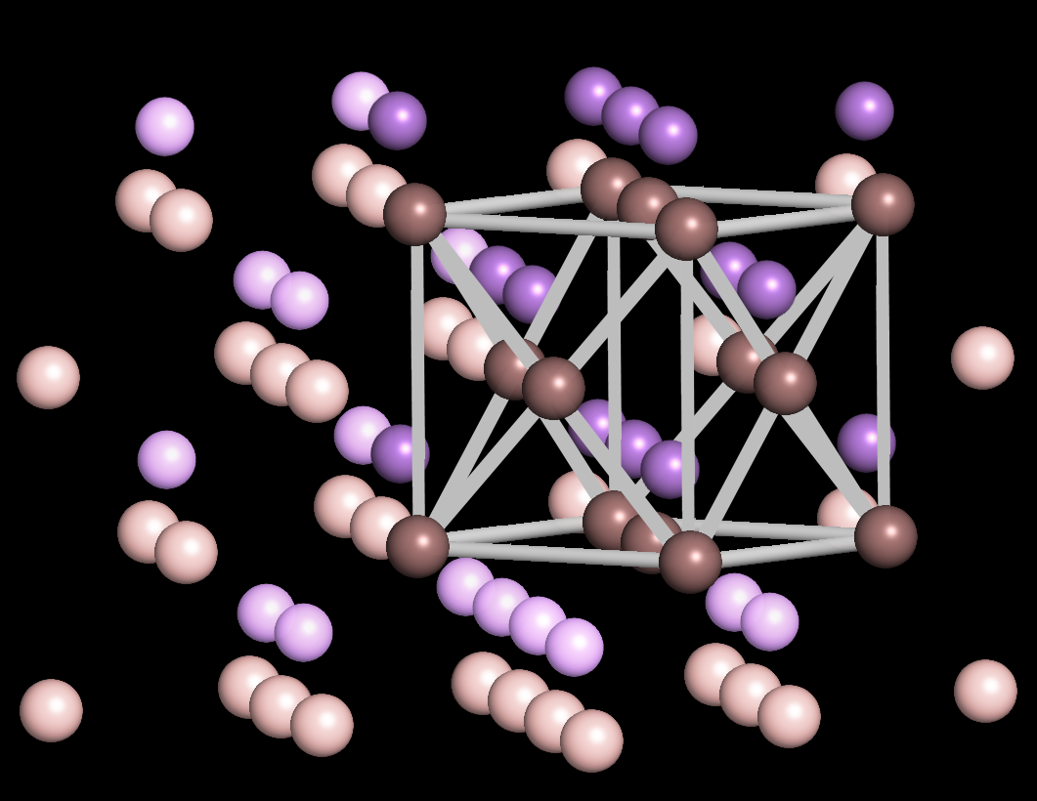
GaAs Crystal Both Species
FCC cell – 4 atoms per unit cell – brown species
Focus on a few of the “blue species”

Slide 52
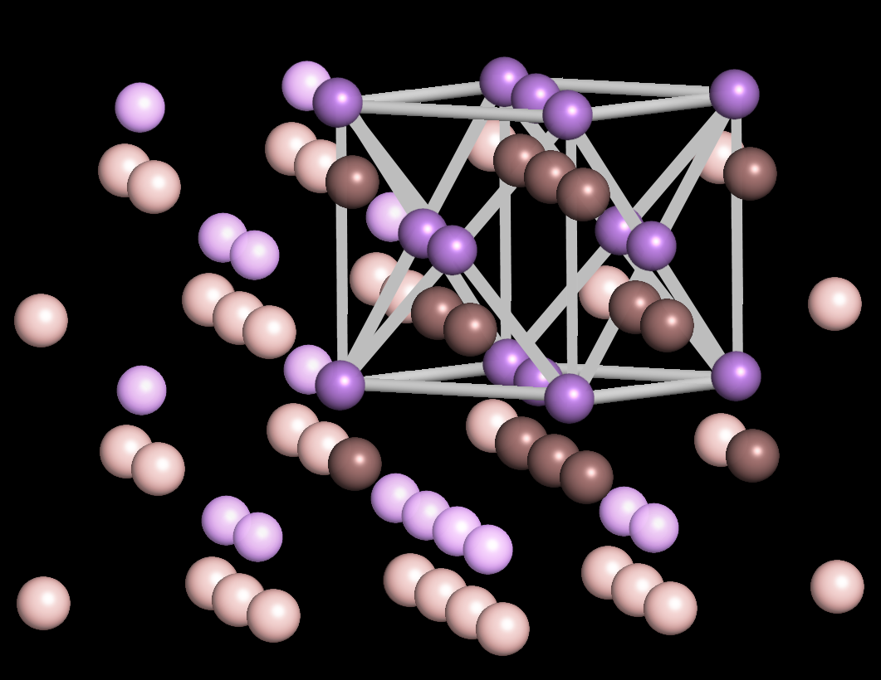
GaAs Crystal Both Species
FCC cell – 4 atoms per unit cell – brown species
FCC cell – 4 atoms per unit cell – purple species

Slide 53
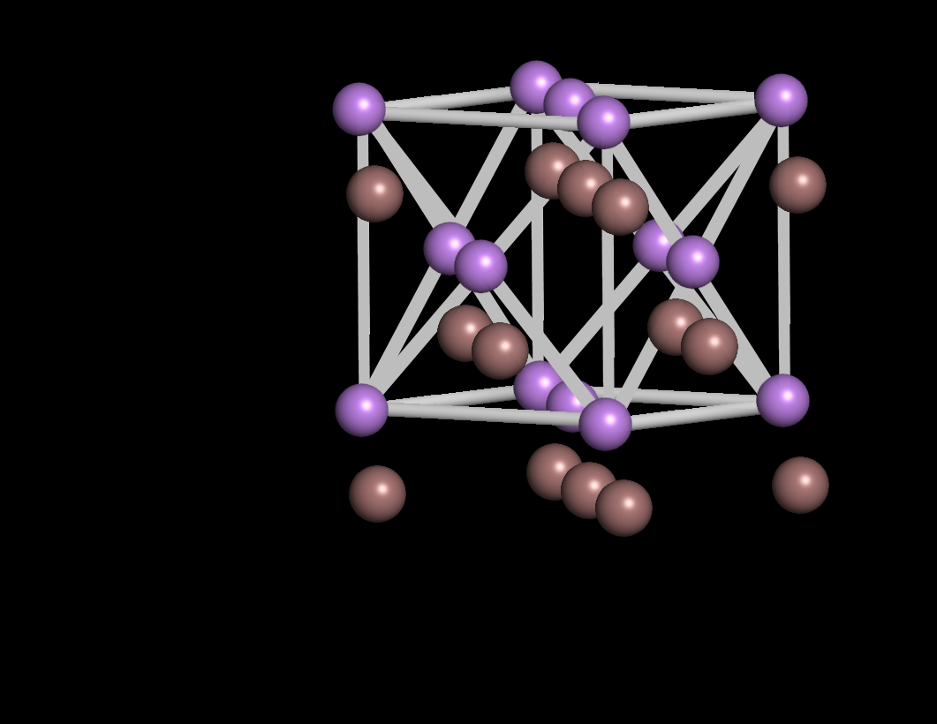
GaAs Crystal Both Species
FCC cell – 4 atoms per unit cell – brown species
FCC cell – 4 atoms per unit cell – purple species

Slide 54
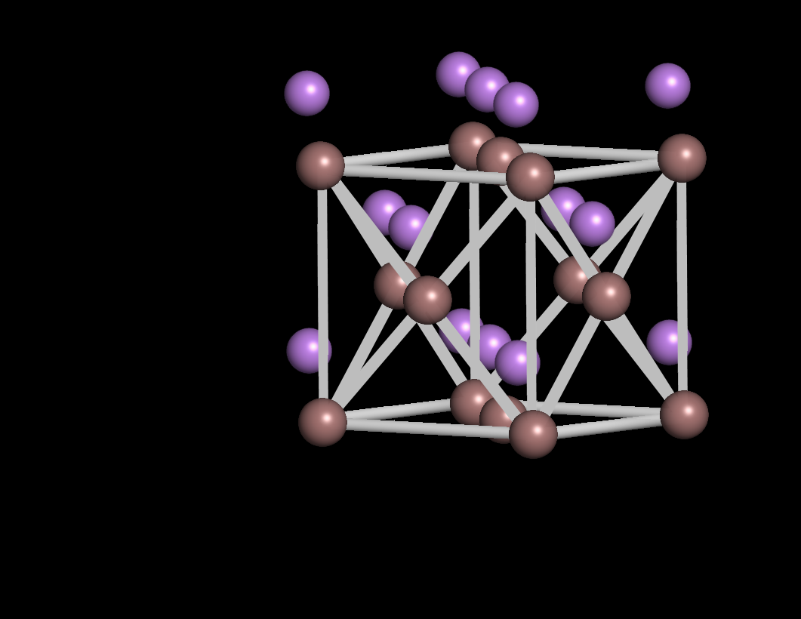
GaAs Crystal Both Species
FCC cell – 4 atoms per unit cell – brown species
FCC cell – 4 atoms per unit cell – purple species

Slide 55
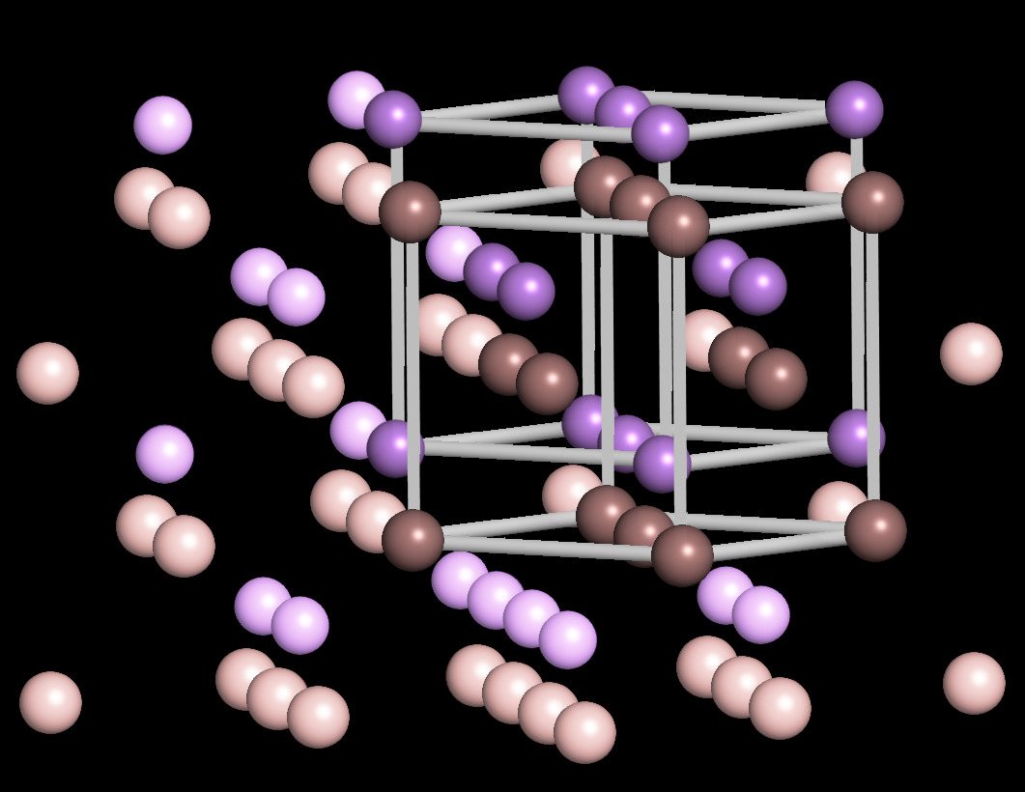
GaAs Crystal – 2 FCC
Zincblende – 2 FCC bases – separated by [¼ ¼ ¼]

Slide 56
Diamond FCC Lattice for GaAs and Silicon
Zincblende – GaAs - 2 FCC bases – separated by [¼ ¼ ¼]
Diamond – Si - 2 FCC bases – separated by [¼ ¼ ¼]

Slide 57
Hexagonal Closed-Packed for CdS
Focus on (Cd) …
(Cd) atoms/cell=
(1/6)x12 + (1/2)x2 + 3=6

Slide 58
Section 3
Crystals
3.1 Crystal definitions
  One-dimensional Crystals – simple primitive cell
  Unit cells of a Periodic 2D Lattice
  Bravais lattice
  Bravais lattice with a basis
  Non-periodic repeated cells
  Definition of ONE Primitive Cell – Wigner-Seitz Cell
3.2 Tables of Bravais Lattices
  Bravais Lattices in 2D (5 types)
  Bravais Lattices in 3D (14 types)
  3 Dominant Bravais Lattices in Nature
3.3 Density Definitions and Applications to Common Materials
  Number, Packing, and Areal Density
  Common Crystals – Non-Primitive Unit Cells (NaCl, GaAs, CdS)
3.4 Surfaces, Miller Index
Reference: Vol. 6, Ch. 1, ABACUS tool at nanohub.org/tools/abacus and
"Crystal Viewer Lab, https://nanohub.org/resources/crystalviewer
One Video Segment
One Video Segment
One Video Segment
status
One Video Segment

Slide 59
Section 3
Crystals
3.1 Crystal definitions
  One-dimensional Crystals – simple primitive cell
  Unit cells of a Periodic 2D Lattice
  Bravais lattice
  Bravais lattice with a basis
  Non-periodic repeated cells
  Definition of ONE Primitive Cell – Wigner-Seitz Cell
3.2 Tables of Bravais Lattices
  Bravais Lattices in 2D (5 types)
  Bravais Lattices in 3D (14 types)
  3 Dominant Bravais Lattices in Nature
3.3 Density Definitions and Applications to Common Materials
  Number, Packing, and Areal Density
  Common Crystals – Non-Primitive Unit Cells (NaCl, GaAs, CdS)
3.4 Surfaces, Miller Index
Reference: Vol. 6, Ch. 1, ABACUS tool at nanohub.org/tools/abacus and
"Crystal Viewer Lab, https://nanohub.org/resources/crystalviewer
One Video Segment
One Video Segment
One Video Segment
status
One Video Segment

Slide 60
Section 3 – Crystals
3.4 Surfaces, Miller Index
Solid State Devices
Gerhard Klimeck
gekco@purdue.edu

Slide 61
Section 3
Crystals
3.1 Crystal definitions
  One-dimensional Crystals – simple primitive cell
  Unit cells of a Periodic 2D Lattice
  Bravais lattice
  Bravais lattice with a basis
  Non-periodic repeated cells
  Definition of ONE Primitive Cell – Wigner-Seitz Cell
3.2 Tables of Bravais Lattices
  Bravais Lattices in 2D (5 types)
  Bravais Lattices in 3D (14 types)
  3 Dominant Bravais Lattices in Nature
3.3 Density Definitions and Applications to Common Materials
  Number, Packing, and Areal Density
  Common Crystals – Non-Primitive Unit Cells (NaCl, GaAs, CdS)
3.4 Surfaces, Miller Index
Reference: Vol. 6, Ch. 1, ABACUS tool at nanohub.org/tools/abacus and
"Crystal Viewer Lab, https://nanohub.org/resources/crystalviewer
One Video Segment
One Video Segment
One Video Segment
status
One Video Segment

Slide 62
Surface Reconstruction

Slide 63
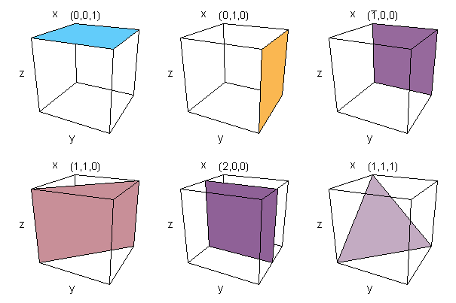
Miller-Indices and Definition of Planes

Slide 64
Miller Indices: Simple Construction Process
z
Set up axes along the edges of unit cell
Normalize intercepts …. 2, 3, 1
y
Invert/rationalize intercepts … 1/2, 1/3, 1
3/6, 2/6, 6/6
x
4. Enclose the numbers in curvilinear brackets
(326)

Slide 65
Miller Indices: Additional Cases
Negative Intercept
Intercept at infinity
z
z
y
y
x
x
2, 3, -2
1/2, 1/3, -1/2
3, 2, -3
_
(3 2 3)
2, 3, ∝
1/2, 1/3, 0
3, 2, 0
(3 2 0)

Slide 66
Miller Indices and Vector Algebra
Miller indices: (326)
z,c
R₁= 1c – 2a
Normal to the surface and R₁,R₂
R₂xR₁= = 3a + 2b + 6c
y,b
x,a
R₂ = 3b – 2a
Vector indices same as Miller indices !
(326) vs. [326]
Specification of vectors normal to a particular plane!

Slide 67
Angle between Two Planes
Angle between two vectors
Dot product / inner product between two vectors
z
y
x
z
y
x
Typo on equation

Slide 68
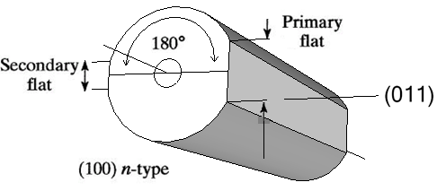
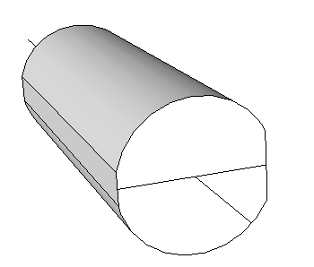
Examples …
z
y
x
cos(θ)=(1x0+0x1+0x1)/(1x2) = 0
so θ=90 degrees
(011) surface is normal to (100) surface

Slide 69
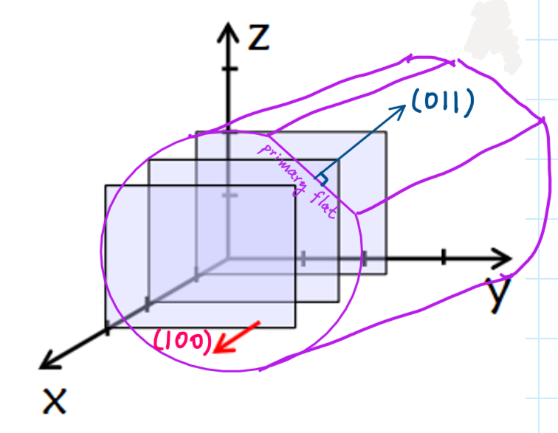
Examples … Ingot rotated in the coordinate system
cos(θ)=(1x0+0x1+0x1)/(1x2) = 0
so θ=90 degrees
(011) surface is normal to (100) surface

Slide 70
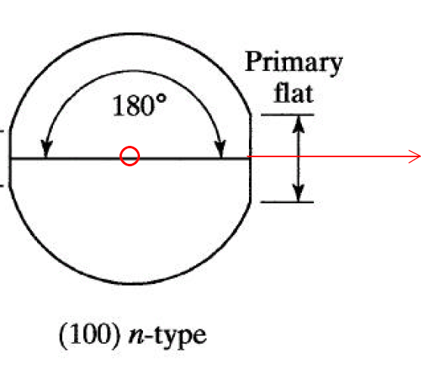
Example: Find the [021] direction
[021]
[100]
[011]
θ₁
[021]
θ₂
[011]
N₁•T =cos(θ₁)=(1x0+0x2+0x1)/(1x5) = 0, so θ=90 degrees
[021] vector lies on (100) plane.
N₂•T =cos(θ₂)=(0x0+2x1+1x1)/(5 2) = 3/ 10, so θ=18.43 degrees
with respect to [011] direction.
Notes:
Typo on formula on the bottom

Slide 71
Bravais-Miller Indices
z
∝, 1, -1, ∝
0, 1, -1, 0
0, 1, -1, 0
(0 1 1 0)
a₃
a₂
a₁
First three indices sum to zero.

Slide 72
Crystals form the Core Device Material
Poly-Crystalline
Cross section of a MOSFET
Conductive
Electron transport
Hold charge
Conductor
Poly-Si / metal
Gate
Amorphous
Oxides
Dielectric
Non-Conductive
“NO” transport
Semiconductor
Device
solid crystals
Crystalline
Highly conductive
Electron transport
Device is a perfectly
arranged crystal
specific position
specific orientation
Modern solid state devices use all forms these forms of materials
Focus on Crystals first – start with 1D => 2D => 3D
Transfer concepts of electronic behavior in crystals to other materials

Slide 73
Summary
Crystalline material can be built by repeating the basic building blocks. This simplifies the quantum solution of the material, which will allow us to compute n and v for these systems easily.
Silicon, GaAs, PbS do not have simple Bravais lattice; but they have Bravais lattice with a basis.
Often we need to calculate the direction of crystal planes because material properties differ along different planes. Miller indices are one useful way of characterizing crystal planes. It is useful to review some identities of vector calculus to such calculations involving crystal planes.

Slide 74
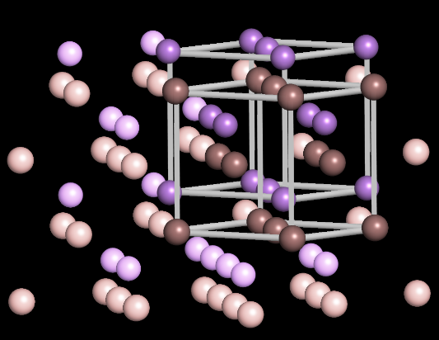
Section 3
Crystals
3.1 Crystal definitions
  One-dimensional Crystals – simple primitive cell
  Unit cells of a Periodic 2D Lattice
  Bravais lattice
  Bravais lattice with a basis
  Non-periodic repeated cells
  Definition of ONE Primitive Cell – Wigner-Seitz Cell
3.2 Tables of Bravais Lattices
  Bravais Lattices in 2D (5 types)
  Bravais Lattices in 3D (14 types)
  3 Dominant Bravais Lattices in Nature
3.3 Density Definitions and Applications to Common Materials
  Number, Packing, and Areal Density
  Common Crystals – Non-Primitive Unit Cells (NaCl, GaAs, CdS)
3.4 Surfaces, Miller Index
Reference: Vol. 6, Ch. 1, ABACUS tool at nanohub.org/tools/abacus and
"Crystal Viewer Lab, https://nanohub.org/resources/crystalviewer
One Video Segment
One Video Segment
One Video Segment
One Video Segment

