Slide 1
Section 2
Materials
Solid State Devices
Gerhard Klimeck
gekco@purdue.edu
Notes:
In..

Slide 2
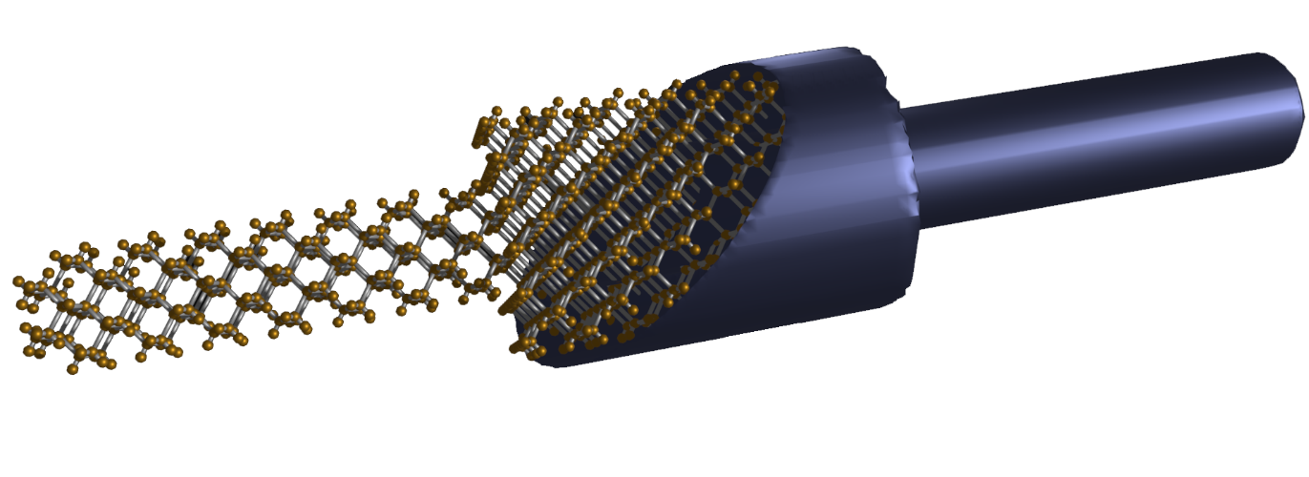
Section 2
Materials
I
2.1 Typical Semiconducting Materials
  Current flow in semiconductors (reminder)
  Elemental semiconductors in the periodic table
  Bonding for half-filled shells, column IV, III-V, and II-VI
2.2 Typical applications of elemental and compound semiconductors
2.3 Atomic Positions and Bond Orientations
  Solid State vs. other crystals
  Typical Atomic Arrangements in MOSFETS
Reference: Vol. 6, Ch. 1
One Video Segment
V
One Video Segment
One Video Segment
2

Slide 3
Section 2
Typical Semiconducting Materials
I
I = G ^{x} V
= q ^{x} n ^{x} v ^{x} A
V
charge
density
velocity
area
Materials, composition, crystals
Tabulated for “known” bulk materials
At nm-scale properties change with geometry => theory
Quantum Mechanics + Equilibrium Statistical Mechanics
Concepts of effective masses and occupation factors
Transport with scattering, non-equilibrium Statistical Mechanics
Drift-diffusion equation with recombination-generation
Understanding transport in concrete devices
Diodes, BJT/HBT, MOS

Slide 4
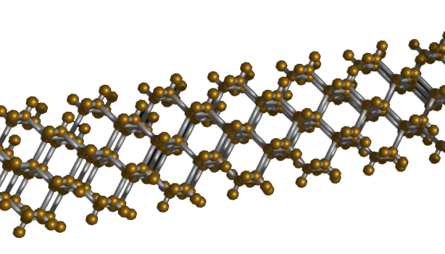
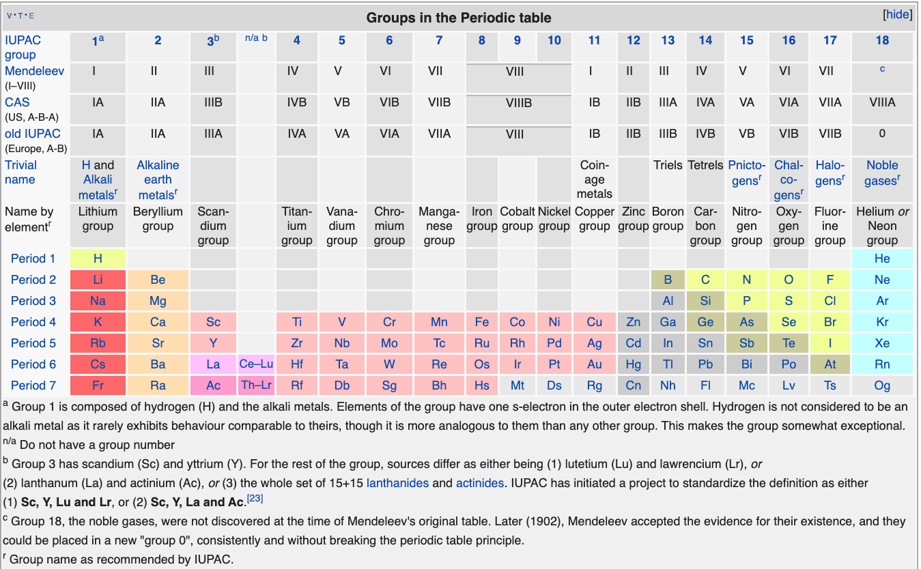
Section 2
Typical Semiconducting Materials
Materials, composition, crystals
Tabulated for “known” bulk materials
At nm-scale properties change with geometry => theory
Quantum Mechanics + Equilibrium Statistical Mechanics
Concepts of effective masses and occupation factors
Transport with scattering, non-equilibrium Statistical Mechanics
Drift-diffusion equation with recombination-generation
Atomic composition
- number of electrons per atom
Arrangement of atoms
- not all electrons are available for conduction
Understanding transport in concrete devices
Diodes, BJT/HBT, MOS

Slide 5
Elemental Semiconductors in the Periodic Table
Filling of electron shells
Increasing weight & size
Adding electron shells
Increasing weight & size
Atomic composition
- number of electrons per atom
Arrangement of atoms
- not all electrons are available for conduction
IV =4
s&p shells
half-filled
VIII =8
shells
full
Si & Ge
Elemental semiconductors
1) https://en.wikipedia.org/wiki/Periodic_table

Slide 6
s & p Orbital Shell Filling
Filling of electron shells
Increasing weight & size
Adding electron shells
Increasing weight & size
II =2
s&p shell
filling
II =2
s&p shell
filling
IV =4
s&p shells
half-filled
VIII =8
shells
full
Si & Ge
Elemental semiconductors
1) https://en.wikipedia.org/wiki/Periodic_table

Slide 7
Focus on Columns II – VI in Periodic Table
Filling of electron shells
Increasing weight & size
Adding electron shells
Increasing weight & size
II =2
s&p shell
filling
II =2
s&p shell
filling
IV =4
s&p shells
half-filled
VIII =8
shells
full
Si & Ge
Elemental semiconductors
1) https://en.wikipedia.org/wiki/Periodic_table

Slide 8
Focus on Columns II – VI in Periodic Table
Filling of electron shells
Increasing weight & size
Adding electron shells
Increasing weight & size
II =2
s&p shell
filling
IV =4
s&p shells
half-filled
Si & Ge
Elemental semiconductors
1) https://en.wikipedia.org/wiki/Periodic_table

Slide 9
Focus on Columns II – VI in Periodic Table
Filling of electron shells
Increasing weight & size
Adding electron shells
Increasing weight & size
II =2
s&p shell
filling
IV =4
s&p shells
half-filled
Si & Ge
Elemental semiconductors
1) https://en.wikipedia.org/wiki/Periodic_table

Slide 10
Focus on Columns II – VI in Periodic Table
Filling of electron shells
Adding electron shells
Increasing weight & size
II =2
s&p shell
filling
IV =4
s&p shells
half-filled
Si & Ge
Elemental semiconductors
1) https://en.wikipedia.org/wiki/Periodic_table

Slide 11
Bonding for Half-Filled Shells – IV, III-V, II-VI
Filling of electron shells
Adding electron shells
Increasing weight & size
II=4-2
III=4-1
IV =4
s&p shells
half-filled
V=4+1
VI=4+2
Compound semiconductors
III-V
II-VI
Si & Ge
Elemental semiconductors
1) https://en.wikipedia.org/wiki/Periodic_table

Slide 12




Section 2
Materials
solid crystals
2.1 Typical Semiconducting Materials
  Current flow in semiconductors (reminder)
  Elemental semiconductors in the periodic table
  Bonding for half-filled shells, column IV, III-V, and II-VI
2.2 Typical applications of elemental and compound semiconductors
2.3 Atomic Positions and Bond Orientations
  Solid State vs. other crystals
  Typical Atomic Arrangements in MOSFETS
Reference: Vol. 6, Ch. 1
One Video Segment
plastic crystals
specific position
random orientation
One Video Segment
specific position
specific orientation
One Video Segment

Slide 13
Section 2
Materials
solid crystals
2.1 Typical Semiconducting Materials
  Current flow in semiconductors (reminder)
  Elemental semiconductors in the periodic table
  Bonding for half-filled shells, column IV, III-V, and II-VI
2.2 Typical applications of elemental and compound semiconductors
2.3 Atomic Positions and Bond Orientations
  Solid State vs. other crystals
  Typical Atomic Arrangements in MOSFETS
Reference: Vol. 6, Ch. 1
One Video Segment
plastic crystals
specific position
random orientation
One Video Segment
specific position
specific orientation
One Video Segment

Slide 14
Section 2 Materials
2.2 Typical applications of elemental and compound semiconductors
Solid State Devices
Gerhard Klimeck
gekco@purdue.edu
Notes:
In..

Slide 15
Section 2
Materials
solid crystals
2.1 Typical Semiconducting Materials
  Current flow in semiconductors (reminder)
  Elemental semiconductors in the periodic table
  Bonding for half-filled shells, column IV, III-V, and II-VI
2.2 Typical applications of elemental and compound semiconductors
2.3 Atomic Positions and Bond Orientations
  Solid State vs. other crystals
  Typical Atomic Arrangements in MOSFETS
Reference: Vol. 6, Ch. 1
One Video Segment
plastic crystals
specific position
random orientation
One Video Segment
specific position
specific orientation
One Video Segment

Slide 16
Applications of Elemental Semiconductors
Elemental (e.g., Si, Ge, C)
Si: Transistors - $260billion industry
1)
1) "Crystal Viewer Lab (New Interactive Front End), https://nanohub.org/resources/crystalviewer
2) © Gerhard Klimeck
3) https://commons.wikimedia.org/wiki/File:Microprocessore_silicio_germano.jpg
4) https://commons.wikimedia.org/wiki/File:Interband_optical_transition.svg
5) https://commons.wikimedia.org/wiki/File:Hgcdte_bandgap_x_t.png
6) https://en.wikipedia.org/wiki/Lead(II)_sulfide https://en.wikipedia.org/wiki/File:Sulfid_olovnat%C3%BD.PNG

Slide 17
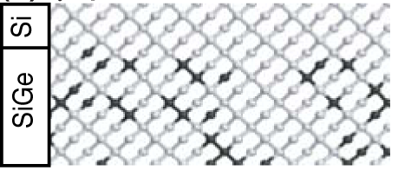
Applications of
Elemental Semiconductors Compounds
Elemental (e.g., Si, Ge, C)
Si: Transistors - $260billion industry
Compound
IV-IV: Si-Ge, Si-C
1)
2)
Adding electron shells
Increasing weight & size
SiGe is a random alloy!
No long-range order
Interfaces are NOT atomically flat
NOT a uniform bond length
1) "Crystal Viewer Lab (New Interactive Front End), https://nanohub.org/resources/crystalviewer
2) © Gerhard Klimeck
3) https://commons.wikimedia.org/wiki/File:Microprocessore_silicio_germano.jpg
4) https://commons.wikimedia.org/wiki/File:Interband_optical_transition.svg
5) https://commons.wikimedia.org/wiki/File:Hgcdte_bandgap_x_t.png
6) https://en.wikipedia.org/wiki/Lead(II)_sulfide https://en.wikipedia.org/wiki/File:Sulfid_olovnat%C3%BD.PNG

Slide 18
Applications of
Elemental Semiconductors Compounds
Elemental (e.g., Si, Ge, C)
Si: Transistors - $260billion industry
Compound
IV-IV: Si-Ge, Si-C
1)
SiGe: stressors
SiC: radiation
Adding electron shells
Increasing weight & size
2)
Top layer has a different natural lattice constant
=> get strained to fit!
Strained bonds => modified “electron sharing”
=> modified electronic properties
3)
=> Bandgaps, effective masses, mobility….
1) "Crystal Viewer Lab (New Interactive Front End), https://nanohub.org/resources/crystalviewer
2) © Gerhard Klimeck
3) https://commons.wikimedia.org/wiki/File:Microprocessore_silicio_germano.jpg
4) https://commons.wikimedia.org/wiki/File:Interband_optical_transition.svg
5) https://commons.wikimedia.org/wiki/File:Hgcdte_bandgap_x_t.png
6) https://en.wikipedia.org/wiki/Lead(II)_sulfide https://en.wikipedia.org/wiki/File:Sulfid_olovnat%C3%BD.PNG

Slide 19
Applications of III-V Compound Semiconductors
Elemental (e.g., Si, Ge, C)
Si: Transistors - $260billion industry
Compound
IV-IV: Si-Ge, Si-C
1)
2)
SiGe: stressors
SiC: radiation
3)
III-V: InP, GaAs, (In_{x}Ga _{1-x})(As_{y}P _{1-y})
Light Emitting Diodes, Lasers, Detectors
expensive
4)
Different bandgaps
=> Heterostructure engineering
=> Artificial atoms with custom designed wavelengths
1) "Crystal Viewer Lab (New Interactive Front End), https://nanohub.org/resources/crystalviewer
2) © Gerhard Klimeck
3) https://commons.wikimedia.org/wiki/File:Microprocessore_silicio_germano.jpg
4) https://commons.wikimedia.org/wiki/File:Interband_optical_transition.svg
5) https://commons.wikimedia.org/wiki/File:Hgcdte_bandgap_x_t.png
6) https://en.wikipedia.org/wiki/Lead(II)_sulfide https://en.wikipedia.org/wiki/File:Sulfid_olovnat%C3%BD.PNG

Slide 20
Applications of II-VI Compound Semiconductors
Elemental (e.g., Si, Ge, C)
Si: Transistors - $260billion industry
Compound
IV-IV: Si-Ge, Si-C
1)
2)
SiGe: stressors
SiC: radiation
3)
III-V: InP, GaAs, (In_{x}Ga _{1-x})(As_{y}P _{1-y})
4)
Light Emitting Diodes, Lasers, Detectors
expensive
5)
II-VI: Hg_{1-x}Cd_{x}Te
Far IR detectors
Soft and difficult
Temperature (K)
Bandgap (eV)
1) "Crystal Viewer Lab (New Interactive Front End), https://nanohub.org/resources/crystalviewer
2) © Gerhard Klimeck
3) https://commons.wikimedia.org/wiki/File:Microprocessore_silicio_germano.jpg
4) https://commons.wikimedia.org/wiki/File:Interband_optical_transition.svg
5) https://commons.wikimedia.org/wiki/File:Hgcdte_bandgap_x_t.png
6) https://en.wikipedia.org/wiki/Lead(II)_sulfide https://en.wikipedia.org/wiki/File:Sulfid_olovnat%C3%BD.PNG
Composition x

Slide 21
Lead Sulfide – PbS – is different!
Elemental (e.g., Si, Ge, C)
Si: Transistors - $260billion industry
Compound
IV-IV: Si-Ge, Si-C
1)
2)
SiGe: stressors
SiC: radiation
3)
III-V: InP, GaAs, (In_{x}Ga _{1-x})(As_{y}P _{1-y})
Light Emitting Diodes, Lasers, Detectors
expensive
5)
4)
II-VI: Hg_{1-x}Cd_{x}Te
Far IR detectors
Soft and difficult
IV-VI: PbS
Outlier from the column IV balance!
First semiconductor diodes
Very soft and difficult
1) "Crystal Viewer Lab (New Interactive Front End), https://nanohub.org/resources/crystalviewer
2) © Gerhard Klimeck
3) https://commons.wikimedia.org/wiki/File:Microprocessore_silicio_germano.jpg
4) https://commons.wikimedia.org/wiki/File:Interband_optical_transition.svg
5) https://commons.wikimedia.org/wiki/File:Hgcdte_bandgap_x_t.png
6) https://en.wikipedia.org/wiki/Lead(II)_sulfide https://en.wikipedia.org/wiki/File:Sulfid_olovnat%C3%BD.PNG
6)

Slide 22
Applications of Semiconductors
Elemental (e.g., Si, Ge, C)
Si: Transistors - $260billion industry
Compound
IV-IV: Si-Ge, Si-C
1)
2)
SiGe: stressors
SiC: radiation
3)
III-V: InP, GaAs, (In_{x}Ga _{1-x})(As_{y}P _{1-y})
Light Emitting Diodes, Lasers, Detectors
expensive
5)
4)
II-VI: Hg_{1-x}Cd_{x}Te
Far IR detectors
Soft and difficult
IV-VI: PbS
First semiconductor diodes
Very soft and difficult
1) "Crystal Viewer Lab (New Interactive Front End), https://nanohub.org/resources/crystalviewer
2) © Gerhard Klimeck
3) https://commons.wikimedia.org/wiki/File:Microprocessore_silicio_germano.jpg
4) https://commons.wikimedia.org/wiki/File:Interband_optical_transition.svg
5) https://commons.wikimedia.org/wiki/File:Hgcdte_bandgap_x_t.png
6) https://en.wikipedia.org/wiki/Lead(II)_sulfide https://en.wikipedia.org/wiki/File:Sulfid_olovnat%C3%BD.PNG
6)

Slide 23
Materials are the Toolbox for Devices
solid crystals
Elemental (e.g., Si, Ge, C)
Si: Transistors - $260billion industry
Compound
IV-IV: Si-Ge, Si-C
1)
3)
2)
plastic crystals
III-V: InP, GaAs, (In_{x}Ga _{1-x})(As_{y}P _{1-y})
SiGe: stressors
SiC: radiation
specific position
random orientation
II-VI: Hg_{1-x}Cd_{x}Te
5)
4)
IV-VI: PbS
6)
Light Emitting Diodes, Lasers, Detectors
expensive
specific position
specific orientation
Columns II-VI build a “Lego-like” tool box for semiconductor Devices
Chemical differences lead to different bandgaps
Physical lattice mismatch leads to strain
  Can be design feature or a physical instability
Not all combinations possible:
  lattice mismatch, room temperature instability
Far IR detectors
Soft and difficult
First semiconductor diodes
Very soft and difficult
1) "Crystal Viewer Lab (New Interactive Front End), https://nanohub.org/resources/crystalviewer
2) © Gerhard Klimeck
3) https://commons.wikimedia.org/wiki/File:Microprocessore_silicio_germano.jpg
4) https://commons.wikimedia.org/wiki/File:Interband_optical_transition.svg
5) https://commons.wikimedia.org/wiki/File:Hgcdte_bandgap_x_t.png
6) https://en.wikipedia.org/wiki/Lead(II)_sulfide https://en.wikipedia.org/wiki/File:Sulfid_olovnat%C3%BD.PNG

Slide 24
Section 2
Materials
solid crystals
2.1 Typical Semiconducting Materials
  Current flow in semiconductors (reminder)
  Elemental semiconductors in the periodic table
  Bonding for half-filled shells, column IV, III-V, and II-VI
2.2 Typical applications of elemental and compound semiconductors
2.3 Atomic Positions and Bond Orientations
  Solid State vs. other crystals
  Typical Atomic Arrangements in MOSFETS
Reference: Vol. 6, Ch. 1
One Video Segment
plastic crystals
specific position
random orientation
One Video Segment
Elemental (e.g., Si, Ge, C)
Si: Transistors - $260billion industry
Compound
IV-IV: Si-Ge, Si-C
1)
specific position
specific orientation
3)
2)
One Video Segment
III-V: InP, GaAs, (In_{x}Ga _{1-x})(As_{y}P _{1-y})
SiGe: stressors
SiC: radiation
II-VI: Hg_{1-x}Cd_{x}Te
5)
4)
IV-VI: PbS
6)
Light Emitting Diodes, Lasers, Detectors
expensive

Slide 25
Section 2
Materials
solid crystals
2.1 Typical Semiconducting Materials
  Current flow in semiconductors (reminder)
  Elemental semiconductors in the periodic table
  Bonding for half-filled shells, column IV, III-V, and II-VI
2.2 Typical applications of elemental and compound semiconductors
2.3 Atomic Positions and Bond Orientations
  Solid State vs. other crystals
  Typical Atomic Arrangements in MOSFETS
Reference: Vol. 6, Ch. 1
One Video Segment
plastic crystals
specific position
random orientation
One Video Segment
Elemental (e.g., Si, Ge, C)
Si: Transistors - $260billion industry
Compound
IV-IV: Si-Ge, Si-C
1)
specific position
specific orientation
3)
2)
One Video Segment
III-V: InP, GaAs, (In_{x}Ga _{1-x})(As_{y}P _{1-y})
SiGe: stressors
SiC: radiation
II-VI: Hg_{1-x}Cd_{x}Te
5)
4)
IV-VI: PbS
6)
Light Emitting Diodes, Lasers, Detectors
expensive

Slide 26
Section 2 Materials
2.3 Atomic Positions and Bond Orientations
Solid State Devices
Gerhard Klimeck
gekco@purdue.edu
Notes:
In..

Slide 27
Section 2
Materials
solid crystals
2.1 Typical Semiconducting Materials
  Current flow in semiconductors (reminder)
  Elemental semiconductors in the periodic table
  Bonding for half-filled shells, column IV, III-V, and II-VI
2.2 Typical applications of elemental and compound semiconductors
2.3 Atomic Positions and Bond Orientations
  Solid State vs. other crystals
  Typical Atomic Arrangements in MOSFETS
Reference: Vol. 6, Ch. 1
One Video Segment
plastic crystals
specific position
random orientation
One Video Segment
Elemental (e.g., Si, Ge, C)
Si: Transistors - $260billion industry
Compound
IV-IV: Si-Ge, Si-C
1)
specific position
specific orientation
3)
2)
One Video Segment
III-V: InP, GaAs, (In_{x}Ga _{1-x})(As_{y}P _{1-y})
SiGe: stressors
SiC: radiation
II-VI: Hg_{1-x}Cd_{x}Te
5)
4)
IV-VI: PbS
6)
Light Emitting Diodes, Lasers, Detectors
expensive

Slide 28
Spatial Atomic Arrangements
Position and Bond Orientation
solid crystals
Elemental (e.g., Si, Ge, C)
Si: Transistors - $260billion industry
Compound
IV-IV: Si-Ge, Si-C
1)
3)
2)
plastic crystals
III-V: InP, GaAs, (In_{x}Ga _{1-x})(As_{y}P _{1-y})
SiGe: stressors
SiC: radiation
specific position
random orientation
II-VI: Hg_{1-x}Cd_{x}Te
5)
4)
IV-VI: PbS
Light Emitting Diodes, Lasers, Detectors
expensive
6)
specific position
specific orientation
Far IR detectors
Soft and difficult
Columns II-VI build a “Lego-like” tool box for semiconductor Devices
Chemical differences lead to different bandgaps
Physical lattice mismatch leads to strain
  Can be design feature or a physical instability
Not all combinations possible:
  lattice mismatch, room temperature instability
First semiconductor diodes
Very soft and difficult
1) "Crystal Viewer Lab (New Interactive Front End), https://nanohub.org/resources/crystalviewer
2) © Gerhard Klimeck
3) https://commons.wikimedia.org/wiki/File:Microprocessore_silicio_germano.jpg
4) https://commons.wikimedia.org/wiki/File:Interband_optical_transition.svg
5) https://commons.wikimedia.org/wiki/File:Hgcdte_bandgap_x_t.png
6) https://en.wikipedia.org/wiki/Lead(II)_sulfide https://en.wikipedia.org/wiki/File:Sulfid_olovnat%C3%BD.PNG

Slide 29





Spatial Atomic Arrangements
Position and Bond Orientation
solid crystals
Elemental (e.g., Si, Ge, C)
plastic crystals
Si: Transistors - $260billion industry
Compound
IV-IV: Si-Ge, Si-C
1)
3)
2)
specific position
specific orientation
specific position
random orientation
III-V: InP, GaAs, (In_{x}Ga _{1-x})(As_{y}P _{1-y})
SiGe: stressors
SiC: radiation
II-VI: Hg_{1-x}Cd_{x}Te
5)
4)
IV-VI: PbS
Light Emitting Diodes, Lasers, Detectors
expensive
6)
liquid crystals
liquid
Far IR detectors
Soft and difficult
Columns II-VI build a “Lego-like” tool box for semiconductor Devices
Chemical differences lead to different bandgaps
Physical lattice mismatch leads to strain
  Can be design feature or a physical instability
Not all combinations possible:
  lattice mismatch, room temperature instability
random position
specific orientation
random position
random orientation
First semiconductor diodes
Very soft and difficult

Slide 30
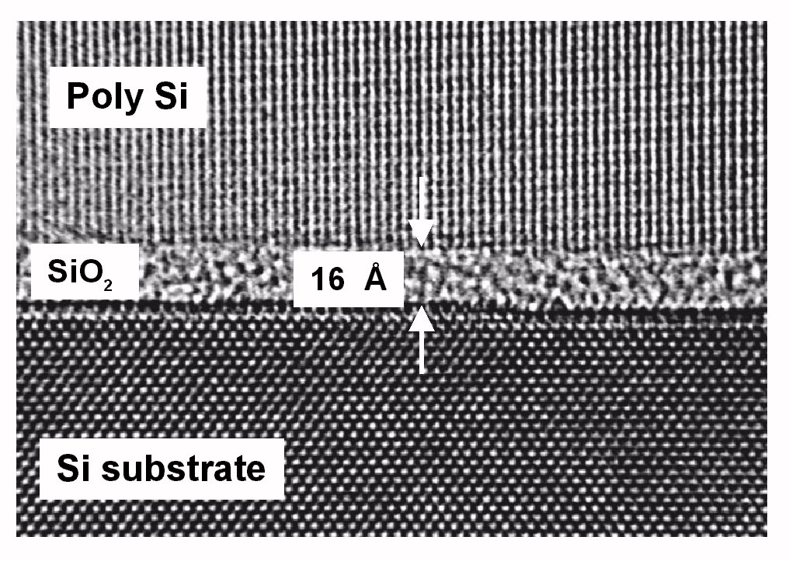
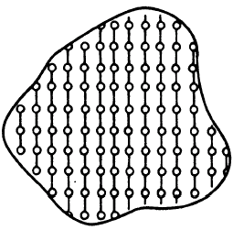
Spatial Atomic Arrangements
Position and Bond Orientation
Cross section of a MOSFET
solid crystals
plastic crystals
specific position
specific orientation
specific position
random orientation
Crystalline
Course will focus on solid materials with stable bonds:
“Solid State”
liquid crystals
liquid
random position
specific orientation
random position
random orientation

Slide 31
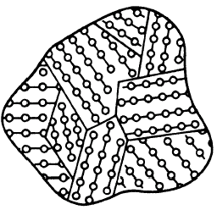
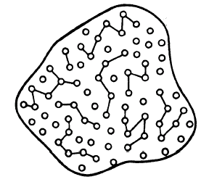
Solid State Atomic Arrangements in MOSFETS
Poly-Crystalline
Cross section of a MOSFET
Amorphous
Oxides
solid crystals
Crystalline
Substrate is a perfectly
arranged Si crystal
specific position
specific orientation

Slide 32
Functional Layers in MOSFETS
Poly-Crystalline
Cross section of a MOSFET
Conductive
Electron transport
Hold charge
Conductor
Poly-Si / metal
Gate
Amorphous
Oxides
Dielectric
Non-Conductive
“NO” transport
Semiconductor
Device
solid crystals
Crystalline
Highly conductive
Electron transport
Substrate is a perfectly
arranged Si crystal
Device is a perfectly
arranged crystal
specific position
specific orientation

Slide 33
Functional Layers in MOSFETS
Poly-Crystalline
Cross section of a MOSFET
Conductive
Electron transport
Hold charge
Conductor
Poly-Si / metal
Gate
Amorphous
Oxides
Dielectric
Non-Conductive
“NO” transport
Semiconductor
Device
solid crystals
Crystalline
Highly conductive
Electron transport
Device is a perfectly
arranged crystal
Modern solid state devices use all forms these forms of materials
Focus on Crystals first – start with 1D => 2D => 3D
Transfer concepts of electronic behavior in crystals to other materials
specific position
specific orientation

Slide 34
Section 2
Materials
2.1 Typical Semiconducting Materials
  Current flow in semiconductors (reminder)
  Elemental semiconductors in the periodic table
  Bonding for half-filled shells, column IV, III-V, and II-VI
2.2 Typical applications of elemental and compound semiconductors
2.3 Atomic Positions and Bond Orientations
  Solid State vs. other crystals
  Typical Atomic Arrangements in MOSFETS
Reference: Vol. 6, Ch. 1
One Video Segment
One Video Segment
One Video Segment
34

Slide 36
Computing Carrier-Density and Velocity
Atomic composition
- number of electrons per atom
Arrangement of atoms
- not all electrons are available for conduction
For Periodic Arrays
- simplification for computation
• Concept of Unit Cells
• Simple 3-D Unit Cells

