Slide 1
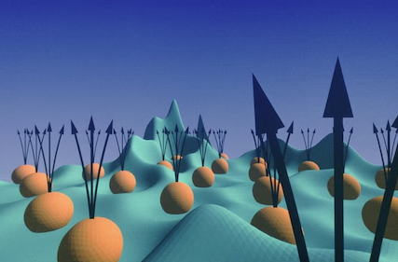

Fractional Quantum Hall Effect
Mir Md Fahimul Islam
Course: ECE 658
Instructor: Professor Peide D. Ye

Slide 2
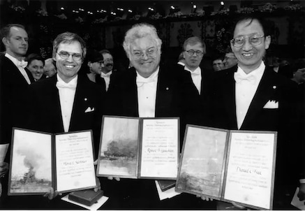
History
The 1998 Nobel Prize in Physics was shared by Bell Labs physicist Horst Störmer and two former Bell Labs researchers, Daniel Tsui and Robert Laughlin, “for their discovery of a new form of quantum fluid with fractionally charged excitations,” known to physicists as the fractional quantum Hall effect.

Slide 3
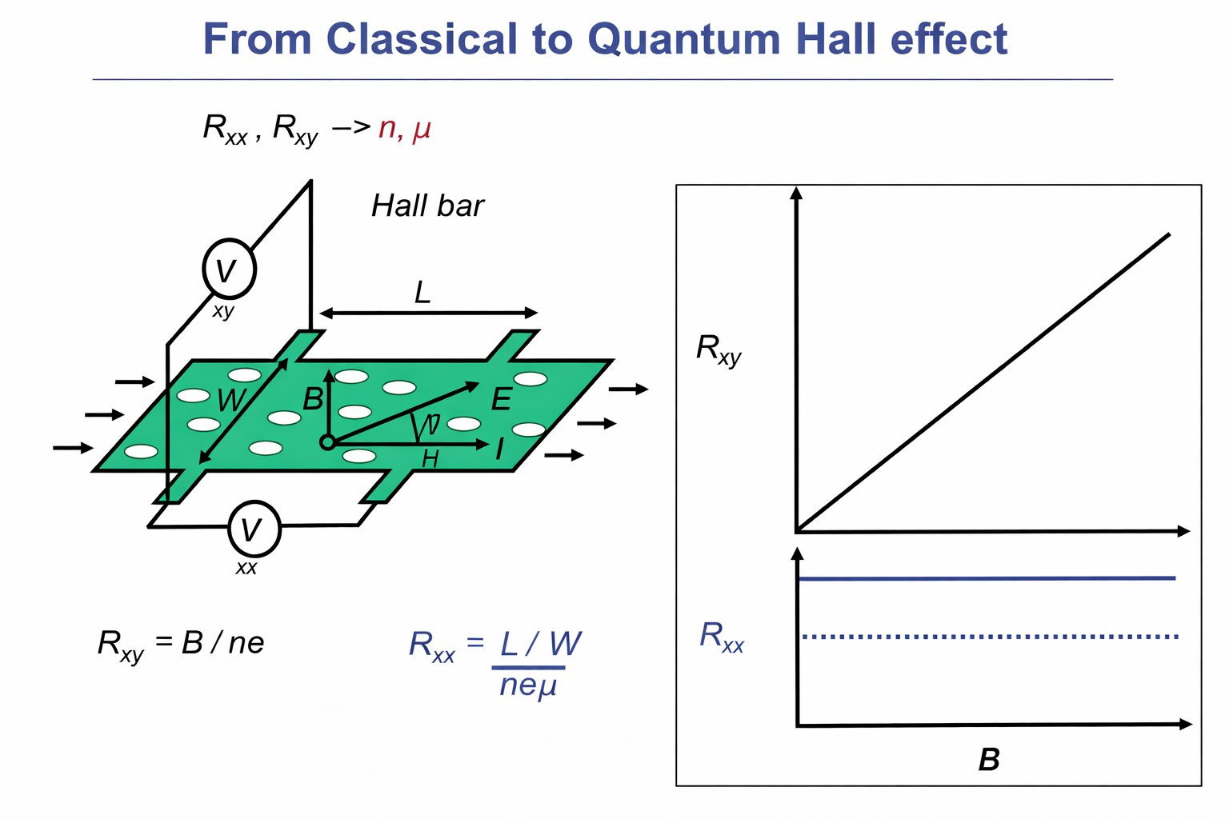
Classical Hall Effect
Classical Hall effect: linear, dissipative, single-particle physics

Slide 4
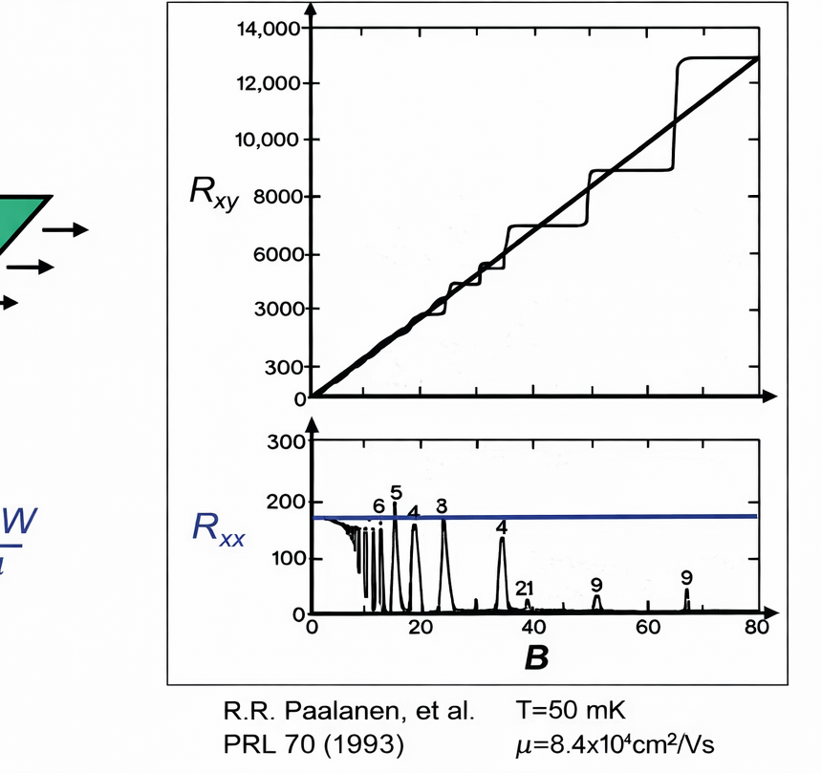
From Classical to Quantum Hall Effect
High B-field: transition from classical transport to quantized, and eventually strongly correlated, quantum states of matter.

Slide 5
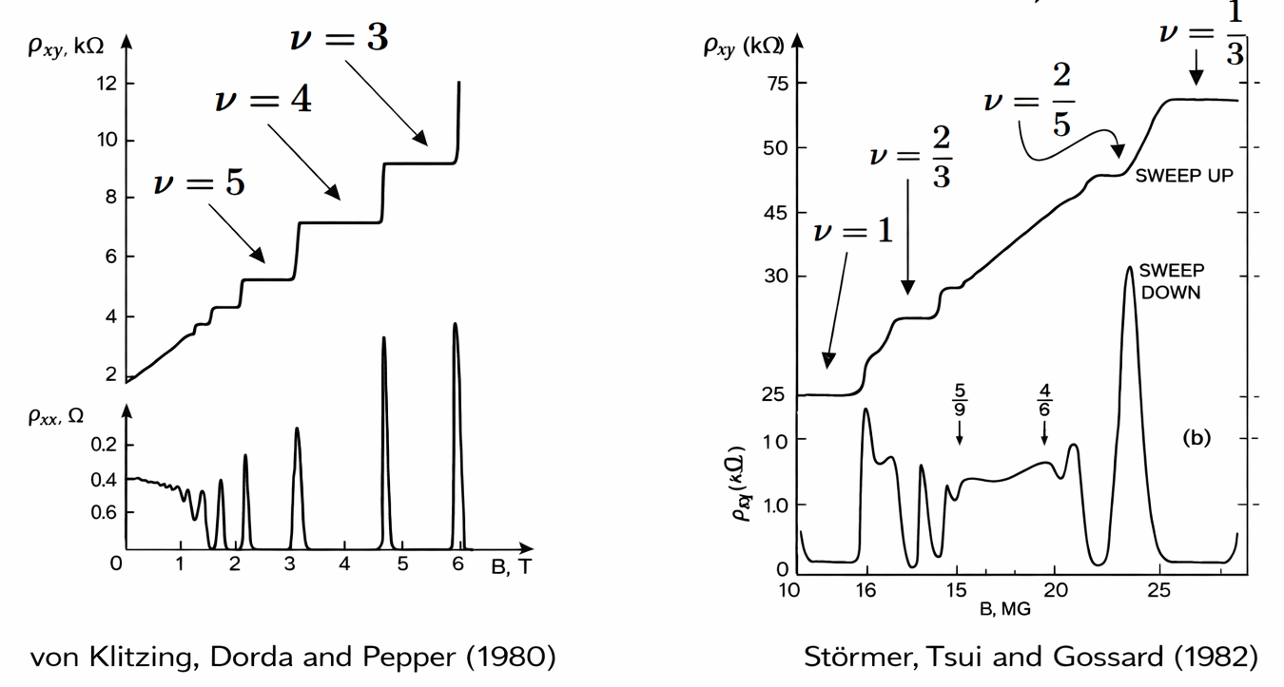


Puzzle!
Integer $ν$
Fractional $ν$
The same experiment that confirms single-particle physics also reveals entirely new many-body quantum states

Slide 6
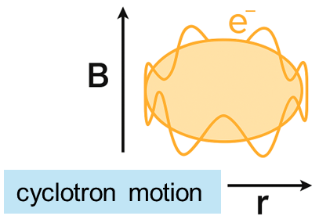
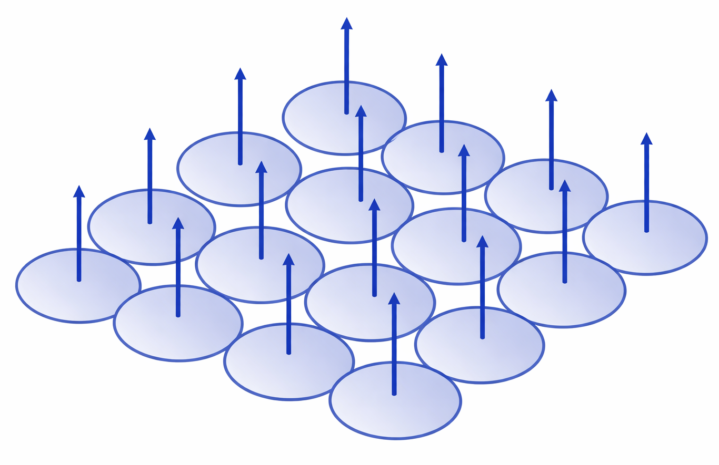
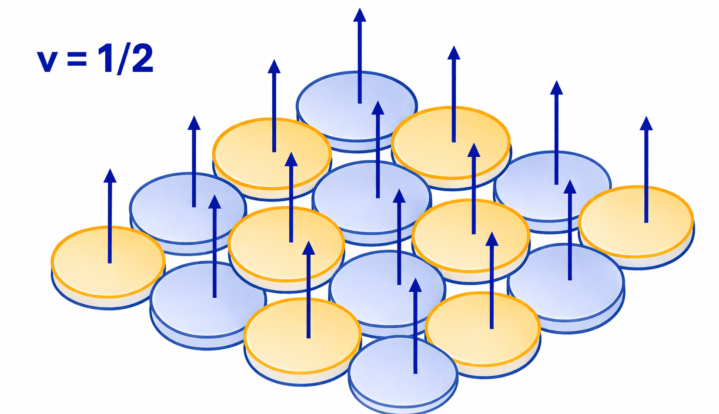
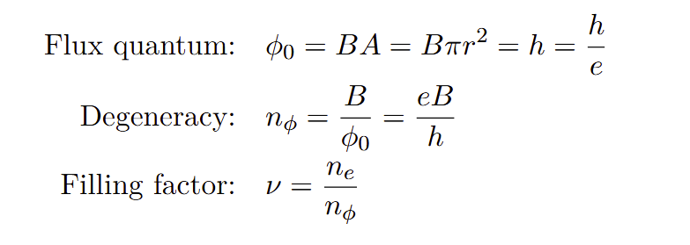

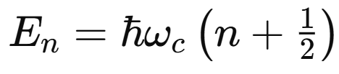
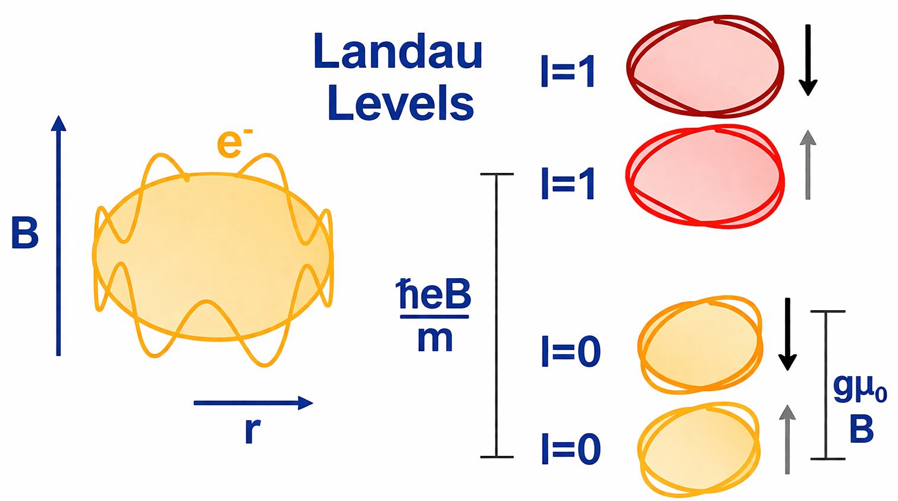
Energy Splitting and Landau Levels
(a)
(b)
(c)
Flux Quantum
Filling Factor
(d)
Electron motion: discrete
Energy: highly degenerate Landau levels

Slide 7
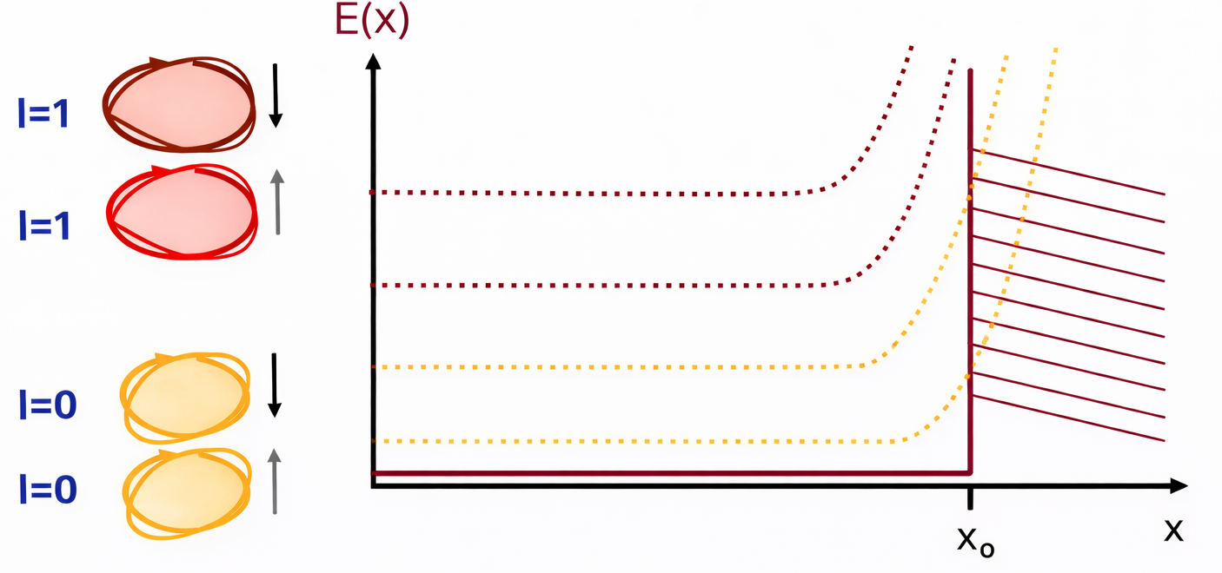
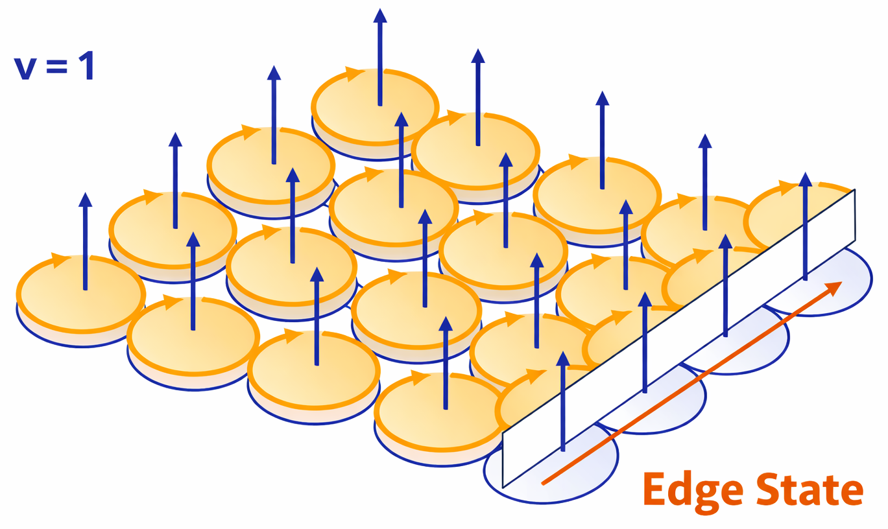
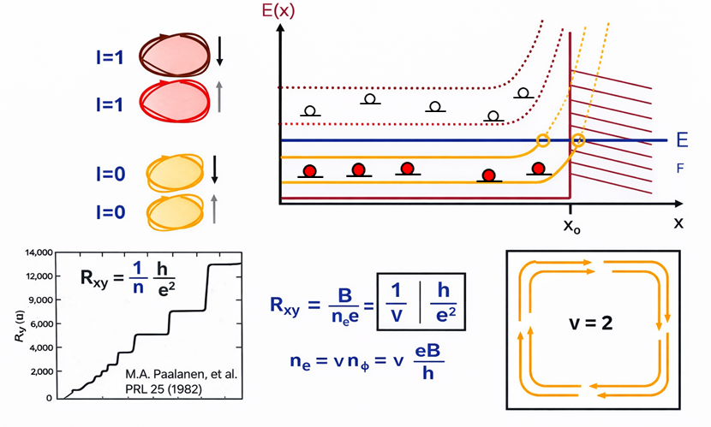
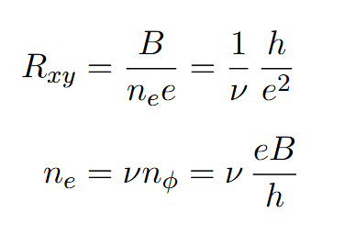
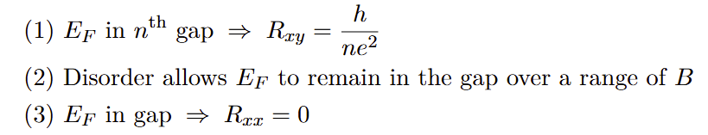
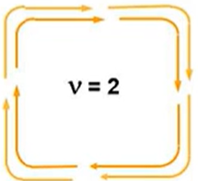
Energy Gap, Edge States, Role of Disorder
(a)
(b)
(c)

Slide 8
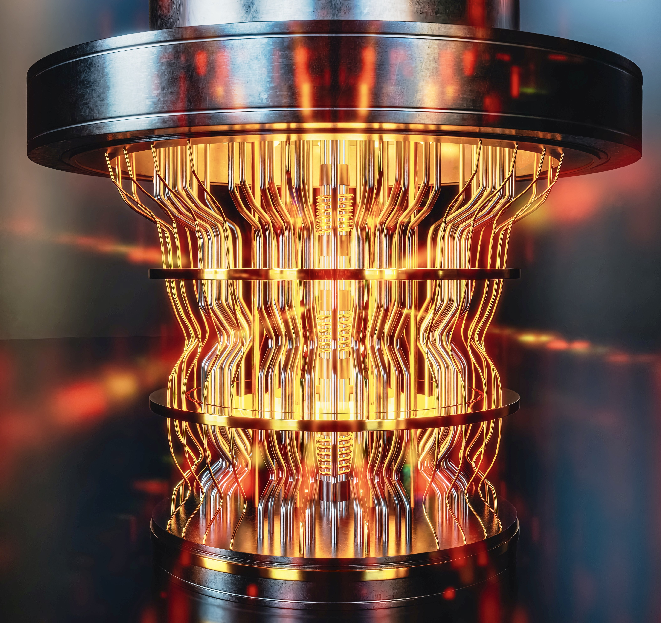
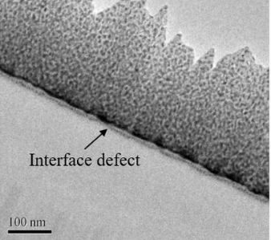
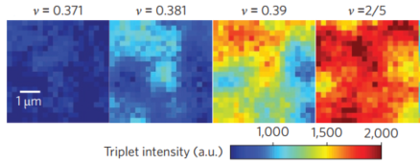
Applications:
Fault-tolerant quantum computers
Ultra-clean semiconductor devices
Incompressible quantum liquid
Error-resistant qubits
braiding operations are immune to local perturbations
Low defect
R_{xx} ​≈ 0 in incompressible states No scattering → no energy loss

