Slide 1
Scanning Electron Microscopy (SEM)
Ryan Bailey
ECE 658
Dr. Peide Ye
4/8/2026

Slide 2
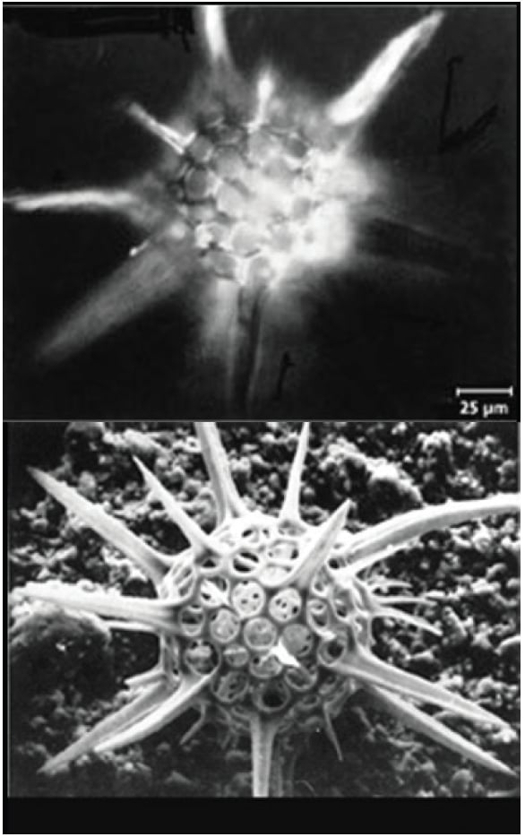
Why SEM for Semiconductor Devices
Scaling trends cause need for nanometer-scale visualization
Common semiconductor structures requiring SEM
  Trenches, vias, sidewalls, dopant contrast, failure analysis
Benefits vs. Optical Microscopy:
  Higher resolution
  Larger depth of Field
  Material Contrast
Light Microscope Image
SEM Image
Source: Donna Guarrera / American Laboratory (2016)

Slide 3
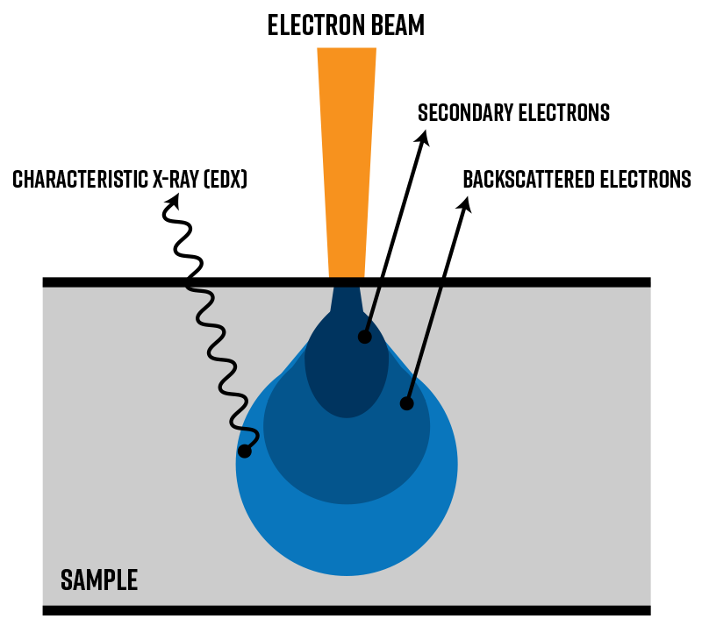
Fundamentals of SEM
Electron-Sample Interactions
  Primary electron beam interacts in interaction volume
  Signal Types:
    Secondary electrons (SE) sensitive to surface morphology
    Backscattered Electrons (BSE) show atomic number contrast
    Characteristic X-rays enable EDS/EDX for composition
Resolution limits determined by:
  Spot Size
  Beam Energy
  Working Distance
Typically ~1-10nm
Nanoscience Instruments, “Struck by an Electron Beam: Interactions at the Surface in SEM,” 2024

Slide 4
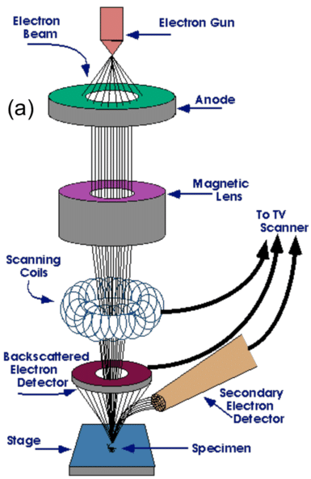
SEM Instrumentation
Key Components:
  Electron gun (thermionic, Schottky, Field Emission)
  Condenser Lenses
  Scanning coils
  Detectors (SE, BSE, EDS)
Operating Parameters:
  Accelerating voltage
    Low kV allows for better surface detail, less charging
    High kV allows for deeper penetration, more BSE
  Working distance
  Apertures/beam current
Walock, Nanocomposite Coatings Based on Quaternary Metal‑Nitrogen and Nanocarbon Systems, 2012

Slide 5
SEM for Semiconductor Characterization
Surface Topography & Morphology
  Trench depth, profile, sidewall angle
  Roughness Evaluation
Failure Analysis & Process Monitoring
  Line edge roughness
  Void detection in interconnects
  Defect inspection (Particles, Residues)
Material Identification (BSE, EDS)
  Contrast between Si, SiO₂, metals
  Elemental Mapping for doped regions
  Limitations: Interaction volume causes poor lateral resolution for EDX
Charging & Conductivity Issues in Semiconductors
  Strategies:
    Low Voltage
    Conductive Coatings
    Charge Neutralizers

Slide 6
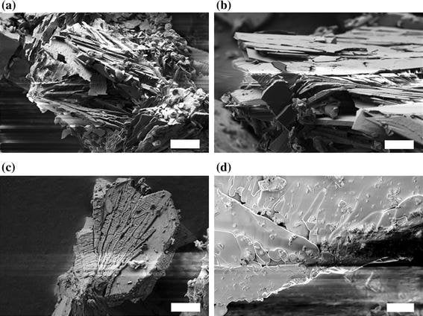
Limitations & Practical Considerations
Sample prep: mounting, coating, cleaving
Charging and beam damage in semiconductors
Not suitable for:
  Subsurface imaging
  Ultra-thick samples
Spatial Resolution limits vs. TEM/AFM
Source: Anstoetz et al., “Resolving Topology of an Electron Beam‑Sensitive OPA‑MOF,” Journal of Materials Science

Slide 7
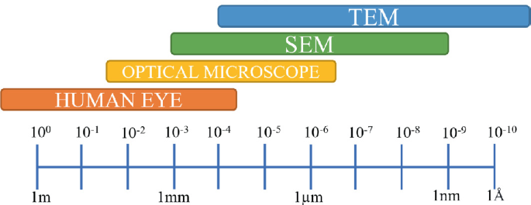
Conclusion
SEM Provides nanometer-scale visualization essential for semiconductor device fabrication
Versatile signal modes for morphology, composition, structure
Pant, Jaipuria & Gupta, “Spectroscopic and Microscopic Techniques: Tools for Characterizing Nanoscale MOFs,” 2022.

Slide 8
References
Anstoetz, M., Clark, M., & Yee, L. (2016). Resolving topology of an electron beam‑sensitive oxalate‑phosphate‑amine metal–organic framework (OPA‑MOF). Journal of Materials Science, 51(3), 1562–1571. https://doi.org/10.1007/s10853-015-9478-y
Guarrera, D. (2016, February 10). SEMs provide deep insight into materials. American Laboratory. https://www.americanlaboratory.com/914-Application-Notes/182491-SEMs-Provide-Deep-Insight-Into-Materials/
Nanoscience Instruments. (2024). Struck by an electron beam: Interactions at the surface in SEM. https://www.nanoscience.com/blogs/struck-by-an-electron-beam-interactions-at-the-surface-in-sem
Pant, P., Jaipuria, A., & Gupta, C. (2022). Spectroscopic and microscopic techniques: Tools for characterizing nanoscale metal–organic frameworks (NMOFs). In S. Gulati (Ed.), Metal‑Organic Frameworks (MOFs) as Catalysts (pp. 127–164). Springer, Singapore. https://doi.org/10.1007/978-981-16-7959-9_5
Trice, R., Marinero, E., & Anasori, B. (2025). MSE 230 [PowerPoint slides]. Brightspace.
Walock, M. J. (2012). Nanocomposite coatings based on quaternary metal‑nitrogen and nanocarbon systems (Doctoral dissertation, A&M ParisTech; PhD, UAB). https://www.researchgate.net/publication/281184428_Nanocomposite_coatings_based_on_quaternary_metal-nitrogen_and_nanocarbon_systems

Slide 9
Thank You!

