Slide 1
Antiferroelectricity
Aidan Broy

Slide 2

Dipole Review
Regular Dielectric (w/ internal dipole)
3 main types of polarization: orientational, ionic, and electronic
Dipole reaction to an electric field
Regular dielectric: Statistical bias to align to field
Ferroelectric: Full alignment past coercive field
Antiferroelectric: Anti-parallel alignment
Ferroelectric
Antiferroelectric

Slide 3
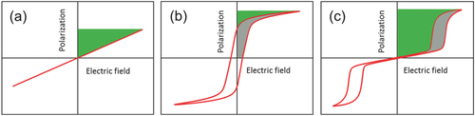
Polarization Density Comparison
Linear: Dielectric without internal dipole only experiences electronic polarization
Ferroelectric: Leap near E=0 because of orientational polarization
Antiferroelectric: Leaps after electric field reaches critical field
[1]

Slide 4
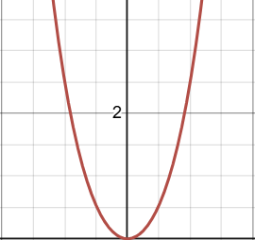
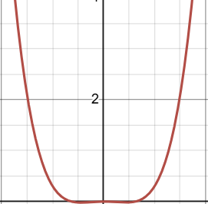
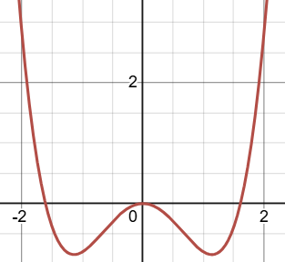
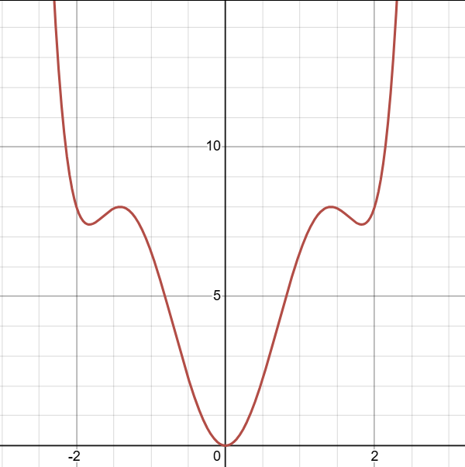
What Causes AFE?
E = aP² +bP⁴ +cP⁶
Visualize with Landau-Ginzburg-Devonshire Formula
AFE materials have structural coupling that can be modeled as a P⁶ term
Phonon’s frequency can “soften” to 0 and induce new structure.
Reduced influence from x² leads to two valleys
Coupling energies force neighboring molecules into opposite valleys
Cooled
Free Energy
Polarization Density
FE structural coupling
AFE structural coupling

Slide 5
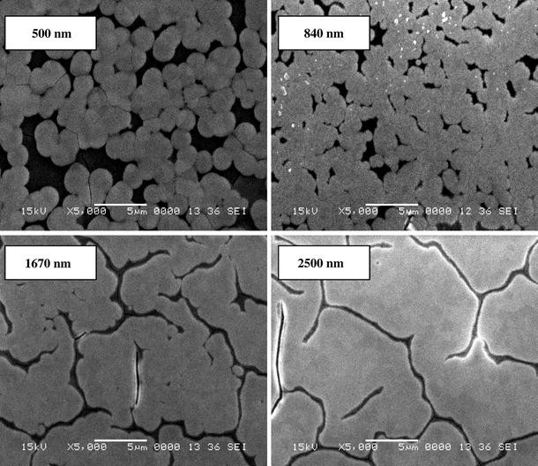
AFE Materials
Ideal AFE material:
Low transition field
Safe to use
High dielectric constant
Examples:
BaTiO₃’s transition field causes dielectric breakdown if undoped [2]
PbZrO₃ has lead, so not suitable for some applications [3]
Surface SEM pictures of PLZT antiferroelectric films with different thickness [3]

Slide 6
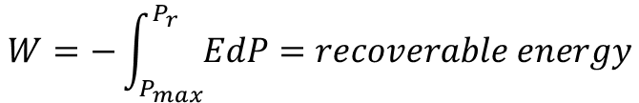
Applications - Capacitor
$$W=−\int_{P_{max}}^{P_{r}}{EdP}=recoverable energy$$
Capacitors have higher output than batteries, but traditionally lower capacity
AFE material often has the most recoverable energy
Not much total energy stored in linear material
Not all energy recoverable from FE material
All from [1]

Slide 7
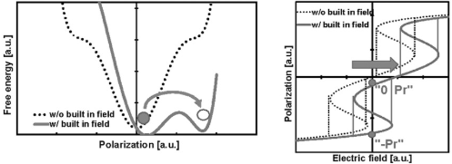
Applications - Memory
RuO_{x} (W=5.3eV)
ZrO₂
By introducing an internal bias, we can make the AFE act like a FE
Chemical potential gradient leads to charge build up on interfaces
Only works for thin films
AFE materials can function for more cycles than FE materials
TiN (W=4.5eV)
TiN-ZrO2-TiN (dotted) and RuO_{x}-ZrO2-TiN (solid) polarization vs voltage and energy [4]

Slide 8
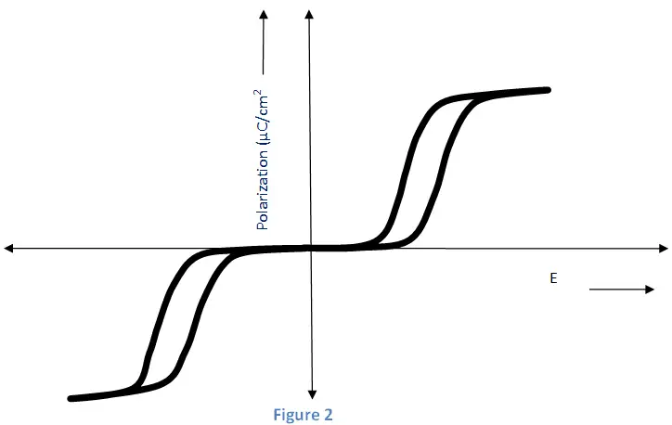
AFE Modes
High Electric Field (1, 3)
1
2
3
1
3
Free Energy
Low Electric Field (2)
2
Polarization Density
AFE hysteresis loop [6]

Slide 9
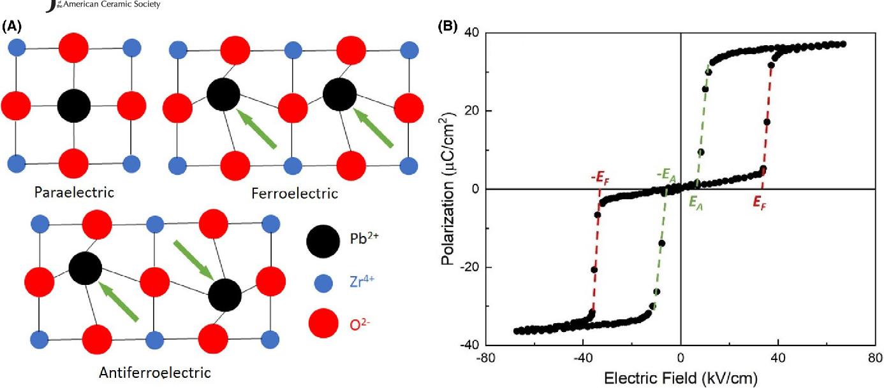
Conclusion
AFEs are a group of materials with antiparallel dipole orientation
Applications: energy storage, memory, and more
Future work: finding suitable, synthesizable materials
[5]

Slide 10
Bibliography
[1] Z. Liu, T. Lu, J. Ye, G. Wang, X. Dong, R. Withers, and Y. Liu, "Antiferroelectrics for energy storage applications: A review," Advanced Materials Technologies, vol. 3, no. 9, p. 1800111, Sep. 2018. doi: 10.1002/admt.201800111.
[2] A. Jain et al., "Antiferroelectric materials review," Journal of Alloys and Compounds, vol. 909, 2022. doi: 10.1016/j.jallcom.2021.163165.
[3] X. Hao, J. Zhai, F. Zhou, X. Song, and S. An, "Thickness and frequency dependence of electric-field-induced strains of sol-gel derived (Pb0.97La0.02)(Zr0.95Ti0.05)O3 antiferroelectric films," Journal of Sol-Gel Science and Technology, vol. 53, pp. 366–371, Feb. 2010. doi: 10.1007/s10971-009-2104-1.
[4] M. Pešić, M. Hoffmann, C. Richter, T. Mikolajick, and U. Schroeder, "Nonvolatile random access memory and energy storage based on antiferroelectric like hysteresis in ZrO2," Advanced Functional Materials, vol. 26, no. 41, pp. 7486–7494, 2016. doi: 10.1002/adfm.201603182.
[5] C. A. Randall, Z. Fan, I. Reaney, L.-Q. Chen, and S. Trolier-McKinstry, "Antiferroelectrics: History, fundamentals, crystal chemistry, crystal structures, size effects, and applications," Journal of the American Ceramic Society, vol. 104, no. 8, pp. 3775–3810, 2021. doi: 10.1111/jace.17834.
[6] IEEE:Electrical4U, "Antiferroelectricity," Electrical4U, May 15, 2024. [Online]. Available: https://www.electrical4u.com/antiferroelectricity/.

