Slide 1
From Program Verification to Program Synthesis
Saurabh Srivastava *
Sumit Gulwani ♯
Jeffrey S. Foster *
* University of Maryland, College Park
♯ Microsoft Research, Redmond

Slide 2
Program Synthesis
Goal: Automatically generate program
Important benefits of program synthesis
  Reduced programmer burden
  Potential to generate novel algorithms
  Objective: Automatic program synthesis, given
  Pre/post condition (functional specification)
  Some hints about the form of the program
Ideally: program is automatically proved correct
  Synthesized programs can be complicated
scaffold

Slide 3
Proof-theoretic synthesis
Our approach:
Synthesize program and proof simultaneously
Benefits:
View synthesis as generalized verification
  Reuse existing verification tools and technology
Tool synthesizes: linear arithmetic programs, sorting, dynamic programming programs

Slide 4
Discrete Line Drawing
Input
(X,Y)
0<Y≤X
(12,7)
(10,6)
(11,6)
(8,5)
(9,5)
(6,4)
(7,4)
(5,3)
Output values
(3,2)
(4,2)
|y-(Y/X)x| ≤ 1/2
(0,0)
(0,0)
(1,1)
(2,1)
Using only linear operations:
Bresenham’s line drawing algorithm

Slide 5
Synthesis Scaffold and Task
The synthesis problem is described using a scaffold of the form
  <F,D,R>
  F: Functional Specification
  D: Domain Constraints
  R: Resource Constrains

Slide 6
Scaffold(1): Functional Specification
Fuctional specification: (F_{pre,} F_{post})
Precondition F_{pre}
  Formal specification of possible valid inputs
  E.g., 0<Y≤X
Output Postcondition F_{post}
  Formal specification that outputs need to meet
  E.g., |y-(Y/X)x| ≤ 1/2

Slide 7
Scaffold(2): Domain Constraints
The domain specification: (D_{exp,} D_{grd,} D_{prf})
Domains for program elements
  Expressions D_{exp}
  Guards D_{grd}
  E.g.
    linear or quadratic expression over program variables
    predicates with array lookups
Domain for invariants D_{prf}
  Choice of solver
  E.g., linear arithmetic
    Invariant form: ⋀_{i} a_{i}x+b_{i}y+c_{i} ≥ 0
    Linear arithmetic fixed-point computation tool, i.e., verifier

Slide 8
Scaffold(3): Resource Constraints
Hints about the form of the desired program
  (R _{loop,} R _{stack,} R _{comp})
Looping structure R _{loop}
  Acyclic fragments (*), loops (•), sequencing (;)
  Grammar: L ::= •| *(L) | L;L
  E.g., R _{loop} = *;•(*)
    Acyclic fragment followed by a loop with an acyclic fragment inside
Stack R _{stack}
  Maximum number of local variables permitted
  E.g., R _{stack} = 1
    Only one extra local variable is available
Hints about the form of the desired program
Looping structure R _{loop}
  Acyclic fragmentecs n•), sequing (;)
  Grammar: L ::= * | •(L) | L;L(*), loops (
    E.g.,
    Acyclic fragment followed by a loop with an acyclic fragment inside
Stack R _{stack}
  Maximum number of local variables permitted
  E.g., R _{stack} =int, 1
    Only one extra local variable is available
•
*
•

Slide 9
Synthesis Task
Given a scaffold, the executable program valid if it meet the following conditions:
  input terminates: the program with invariants and ranking functions providing the proof
  Program loop corresponds to loop annotation in flowgraph template
  Program contains statements:
    S :: = skip | S;S | x := e | if g then S else S
  Element operation as many as R_{comp}
  Program uses many local variable R_{stack}

Slide 10
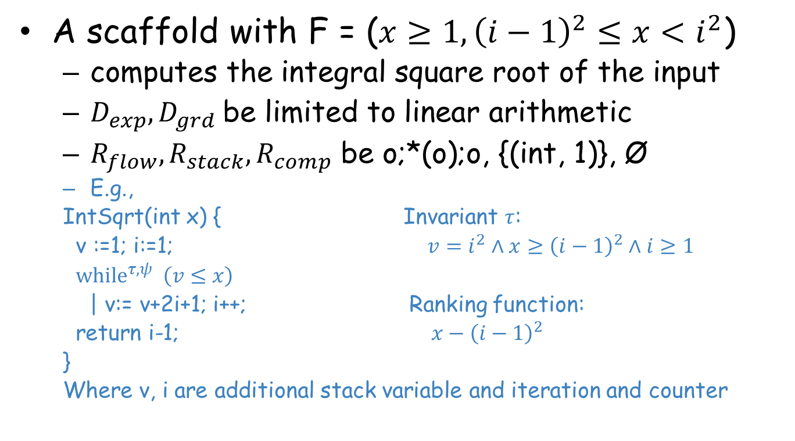
Example: Integral Square root
A scaffold with F = ($x≥1, {\left(i−1\right)}^{2}≤x<i^{2}$)
  computes the integral square root of the input
  $D_{exp}, D_{grd}$be limited to linear arithmetic
  $R_{flow}, R_{stack}, R_{comp}$ be o;*(o);o, {(int, 1)}, Ø
  E.g.,
  IntSqrt(int x) { Invariant $τ$:
  v :=1; i:=1; $v=i^{2}∧x≥{\left(i−1\right)}^{2}∧i≥1$
  ${while}^{τ, ψ} \left(v≤x\right)$
  | v:= v+2i+1; i++; Ranking function:
  return i-1; $x−{\left(i−1\right)}^{2}$
  }
  Where v, i are additional stack variable and iteration and counter

Slide 11
Outline
Input: Scaffold
Approach: Synthesis conditions
Experiments

Slide 12


Modeling Basic Blocks as Transitions
Task:
Model statements in a manner that a solver can reason about
State update and ordering problematic
Basic Block as input->output transition
inputs: v,x,Y
v := v + 2Y; x++;
outputs: v’,x’
transition : ⋀_{i} (output var_{i} = fn(input vars))
S_{body} :
v’ = v + 2Y ⋀ x’ = x + 1;
Example: {$φ_{pre}$} $x≔e_{x};y≔e_{y}${$φ_{post}$}
{$φ_{pre}$} <x’,y’>=<$e_{x}, e_{y}$> {${φ′}_{post}$}
Verification condition: $φ_{pre}∧x^{′}=e_{x}∧y^{′}=e_{y}⇒{φ′}_{post}$

Slide 13
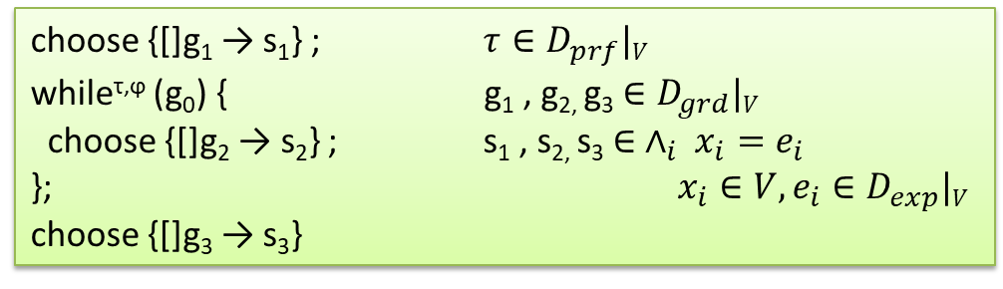
Synthesis Task
Transition System Language:
p ::= choose {[]$g_{i}→s_{i}\}$ | $while^{\text{τ}\text{,}\text{ϕ}}$ (g) do {p} | p;p
Example: (Integral square root computation)
•; *(•); •
expand
choose {[]g₁ → s₁} ; $τ∈D_{prf}|V$
while^{τ,ϕ} (g₀) { g₁ , g_{2,} g₃ $∈D_{grd}|V$
choose {[]g₂ → s₂} ; s₁ , s_{2,} s₃ $∈ ∧_{i} x_{i}=e_{i}$
}; $x_{i}∈V, e_{i}∈D_{exp}|V$
choose {[]g₃ → s₃}

Slide 14
VC - Safety Constraints
Verification condition (VC)
entry:
0<Y≤X ⋀ S_{init} ⇒ I’
output:
I ⋀ G_{loop} ⇒ |y-(Y/X)x| ≤ 1/2
I ⋀ G_{cond1} ⋀ S_{body1} ⇒ I’
0<Y≤X
S_{init}
while ( G_{loop} ) {
|y-(Y/X)x| ≤ 1/2
[]G_{cond1} → S_{body1}
[]G_{cond2} → S_{body2}
}
induct:
output
I ⋀ G_{cond2} ⋀ S_{body2} ⇒ I’
entry
I
induct

Slide 15
Fixed point solutions, i.e., invariants
Verification condition (VC)
entry:
0<Y≤X ⋀ S_{init} ⇒ I’
output:
I ⋀ G_{loop} ⇒ |y-(Y/X)x| ≤ 1/2
verifier
I ⋀ G_{cond1} ⋀ S_{body1} ⇒ I’
induct:
I ⋀ G_{cond2} ⋀ S_{body2} ⇒ I’
i_{k}, i.e., invariant I
Assume a form for I, e.g.,
i₁x+i₂y+i₃≥0 for I (given the domains)
SAT solver
boolean clauses
Domain specific reducer
G_{cond2}
S_{body2}
i₁x+i₂y+i₃≥0 ⋀ g₁x+g₂y+g₃≥0 ⋀ x’=s₁x+s₂y+s₃ ⋀ y’=… ⇒ i₁x’+i₂y’+i₃≥0
linear arithmetic
Linear arithmetic tricks
linear arithmetic [PLDI’08]
∃i_{k}:
integer SAT instance
predicate abstraction [PLDI’09]

Slide 16
Fixed point solutions, i.e., invariants
Verification condition (VC)
entry:
0<Y≤X ⋀ S_{init} ⇒ I’
output:
I ⋀ G_{loop} ⇒ |y-(Y/X)x| ≤ 1/2
verifier
I ⋀ G_{cond1} ⋀ S_{body1} ⇒ I’
induct:
I ⋀ G_{cond2} ⋀ S_{body2} ⇒ I’
i_{k}, i.e., invariant I
Assume a form for I, e.g.,
i₁x+i₂y+i₃≥0 for I (given the domains)
SAT solver
boolean clauses
Domain specific reducer
G_{cond2}
S_{body2}
i₁x+i₂y+i₃≥0 ⋀ g₁x+g₂y+g₃≥0 ⋀ x’=s₁x+s₂y+s₃ ⋀ y’=… ⇒ i₁x’+i₂y’+i₃≥0
linear arithmetic
Linear arithmetic tricks
linear arithmetic [PLDI’08]
∃i_{k}:
integer SAT instance
predicate abstraction [PLDI’09]

Slide 17
Unknown statements and guards
Synthesize statements and guards!
Verification condition (VC)
entry:
0<Y≤X ⋀ S_{init} ⇒ I’
output:
I ⋀ G_{loop} ⇒ |y-(Y/X)x| ≤ 1/2
verifier
I ⋀ G_{cond1} ⋀ S_{body1} ⇒ I’
induct:
I ⋀ G_{cond2} ⋀ S_{body2} ⇒ I’
i_{k}, i.e., invariant I
Assume a form for I, G_{cond2},S_{body2}, e.g.,
i₁x+i₂y+i₃≥0 for I (given the domains)
SAT solver
boolean clauses
Domain specific reducer
g_{k} and s_{k}
i₁x+i₂y+i₃≥0 ⋀ g₁x+g₂y+g₃≥0 ⋀ x’=s₁x+s₂y+s₃ ⋀ y’=… ⇒ i₁x’+i₂y’+i₃≥0
guards/
statements
linear arithmetic
Linear arithmetic tricks
linear arithmetic [PLDI’08]
∃i_{k},g_{k},s_{k}:
integer SAT instance
predicate abstraction [PLDI’09]

Slide 18
Additional Constraints
Outputs reachable/termination constraints:
Exists ranking function r
r bounded from below
r decreases in each iteration
0<Y≤X ⋀ S_{init} ⇒ I’
Safety
I ⋀ G_{loop} ⇒ |y-(Y/X)x| ≤ 1/2
I ⋀ G_{cond1} ⋀ S_{body1} ⇒ I’
I ⋀ G_{cond2} ⋀ S_{body2} ⇒ I’
Termination
Issue: Termination constraints
Issue: Well-formedness not ensured
Statements
Conditional Guards
Well-formedness
Well-formedness constraints
Conditional guards form tautologies
Infer I and S_{init},S_{body1},S_{body2},G_{loop},G_{cond}

Slide 19
Additional Constraints
Synthesis
Conditions
User input: Program
User input: Scaffold
0<Y≤X ⋀ S_{init} ⇒ I’
Safety
VCGen
SCGen
I ⋀ G_{loop} ⇒ |y-(Y/X)x| ≤ 1/2
I ⋀ G_{cond1} ⋀ S_{body1} ⇒ I’
Verification Conditions
Synthesis Conditions
I ⋀ G_{cond2} ⋀ S_{body2} ⇒ I’
Fixed-pt Solver
Fixed-pt Solver
Termination
Well-formedness
Verified Program + Proof
Synthesized Program+ Proof
Verification
(Invariant inference)
Synthesis
(Invariant + Program inference)
Infer I and S_{init},S_{body1},S_{body2},G_{loop},G_{cond}
Solving synthesis conditions does yield valid programs
Notes:
Compare the two different approaches..

Slide 20
Outline
Input: Scaffold
Approach: Synthesis conditions
Experiments
Notes:
First, easy to specify but tricky arithmetic programs; second, sorting programs, which all have the same specification but yield different sorting strategies depending on the resource constraints; third, dynamic programming programs for which naive solutions yield exponential runtimes, but which can be computed in polytime by suitable memoization.

Slide 21
Experiments: Linear Arithmetic
LIA verifier from previous work [PLDI’08]
Benchmarks
  Strassen’s 2x2 matrix multiplication
    R _{loop} = * and R _{stack} = 7 --- for holding the seven intermediate results
  Swapping two integers without a temporary
    R _{loop} = * and R _{stack} = 0
  Computing the integral square root
    Linear search
      R _{loop} = *;•(*) and R _{stack} = 1
    Binary search
      R _{loop} = *;•(*) and R _{stack} = 2
  Discrete line drawing
    R _{loop} = *;•(*) and R _{stack} = 1

Slide 22
Experiments: Predicate Abstraction
Predicate abstraction verifier from previous work [PLDI’09]
Benchmarks: Sorting
  Requires quantified specification and invariants
  E.g., All major sorting programs
    Specification: sortedness
    Vary resource constraints
      Nested loop, 0 extra variables: bubble sort, insertion sort
      Nested loop, 1 extra variable: selection sort
      Recursive, 0 extra variables: merge sort
      Recursive, 1 extra variable: quick sort
Benchmarks: Dynamic Programming
  Iterative program from its recursive specification
  E.g., Fibonacci
    Specification f(0)=1, f(1)=1, ∀k>2: f(k)=f(k-1)+f(k-2)
    R _{loop} = *;•(*) and R _{stack} = 2
    Generated program maintains sliding window (of size 2) and computes f(n)

Slide 23
Experiments: Synthesis times
1 around 10,000 seconds
8 under 1000 seconds
seconds (log scale)
8 under 10 seconds
0.1
0.01
0.001
Sorting Prg 1
Sorting Prg 2
Sorting Prg 5
Sorting Prg 4
Sorting Prg 3
All pairs SP (loop)
All pairs SP (body)
LIA verifier
Predicate abstraction verifier

Slide 24
Summary: Proof-theoretic synthesis
Proof-theoretic synthesis
  Synthesize programs and proof simultaneously
  Treat synthesis as generalized verification
    Principled approach to solving for programs using verification
User input: scaffold
  Functional specification
  Space of desired program
    Domains of guards and statements
    Resource constraints
Approach: One-shot synthesis, i.e., no iteration
  Constraints, synthesis conditions, encode the desired program
    Safety, termination, and well-formedness
  Solve using existing constraint-based verifiers
  Possible to synthesize wide variety of programs

