Slide 1



Parallel Programming Solutions for Accelerators
Christopher Wright
March 21, 2018

Slide 2
Papers Material Presented From
Mint: Realizing CUDA performance in 3D stencil methods with annotated C (ICS 2011)
APTCC: Auto Parallelizing Translator From C To CUDA (ICCS 2011)
Pagoda: Fine-grained GPU Virtualization for Narrow Tasks (PPoPP 2017)

Slide 3
Presentation Blueprint
Background (GPUs, Parallelism, CUDA, OpenMP)
Massive parallelism solutions
  Mint
  APTCC
Task-based parallelism
  Pagoda
Conclusion

Slide 4
What do we want and why do we care?
Programmer Production: Can we make it easy enough for any programmer to utilize GPU power
Parallel programming can be hard, even when we only use pthreads with maybe 10s of threads.
GPUs typically use > 10,000 threads for one function/kernel call
GPUs are usually more energy efficient than CPUs, throughput oriented

Slide 5
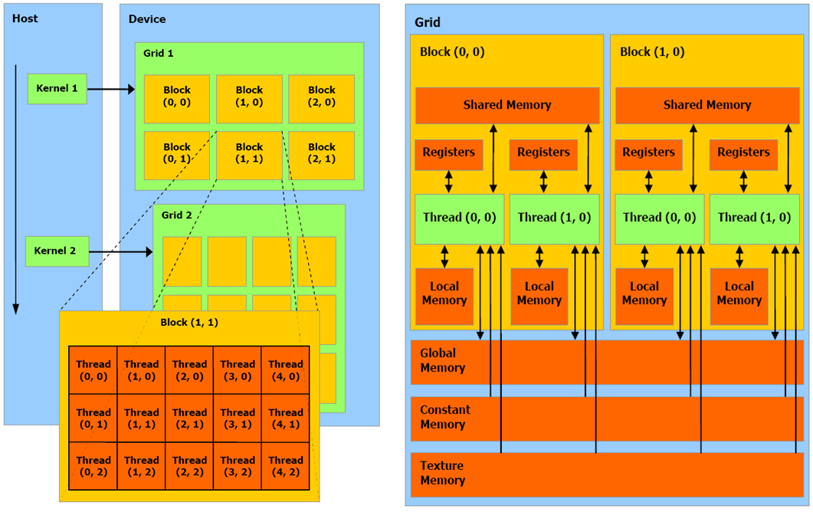
Accelerator Hierarchy Review

Slide 6
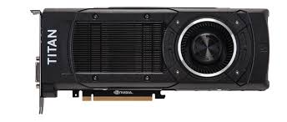
GPUs
Massive parallelism
  Exploited with kernels that use a high degree of parallelism (i.e. contain thousands of threads)
Kernel with > 10000 threads
Kernel with > 10000 threads
Kernel with > 10000 threads
Narrow tasks :
Kernel with < 500
threads
Several applications do not exhibit such bulk-synchronous, massively parallel behavior
Task-based parallelism
  Irregular applications – parallel work is dynamically created
  Real-time scenarios – network packet processing, processing images/signals coming through several sources
  Multi-programmed environments
  Degree of parallelism in each individual task is low (<500 threads) ➔ Narrow tasks
Can applications with high narrow task counts efficiently exploit GPUs? No!

Slide 7
CUDA
Parallel computing platform and API
Used for programming NVIDIA GPUs
C like constructs to invoke GPU
Compiler generates intermediate code (PTX)
GPU takes the PTX and converts/runs that code
  PTX is not consistent between CUDA versions
  API is consistent
Copy data to and from GPU is explicit

Slide 8
OpenMP
API for multiprocessing (C, C++, Fortran)
Uses #pragma directives
Different versions
  Newest version(4.5) can be used for GPU using special pragmas that map to GPU
Pros/Cons?

Slide 9
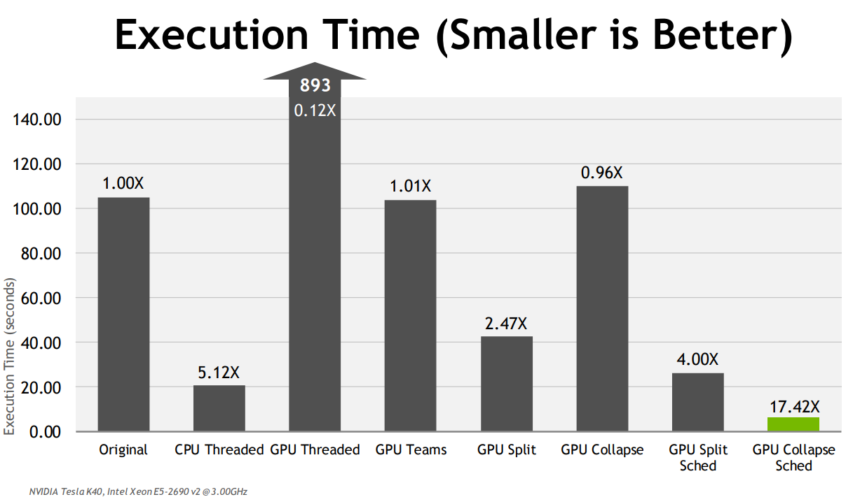
OpenMP with CUDA (4.0+)
For Jacobi Iteration Program:

Slide 10
Presentation Blueprint
Background (GPUs, Parallelism, CUDA, OpenMP)
Massive parallelism solutions
  Mint
  APTCC
Task-based parallelism
  Pagoda
Conclusion

Slide 11
Mint
Uses pragmas for programmer annotations
  Only 5 pragmas (with more options)
Source-to-source translator
Targets 3D stencil methods
Realized 76% of performance obtained from aggressively hand optimized CUDA

Slide 12
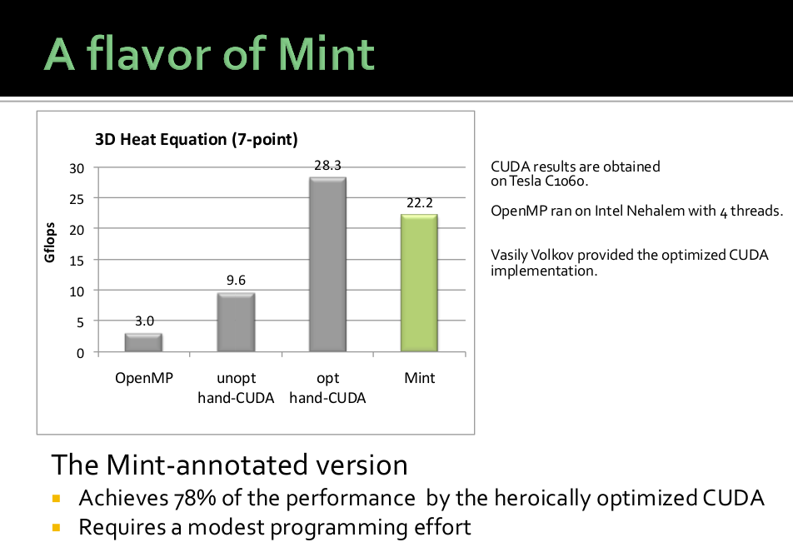

Slide 13
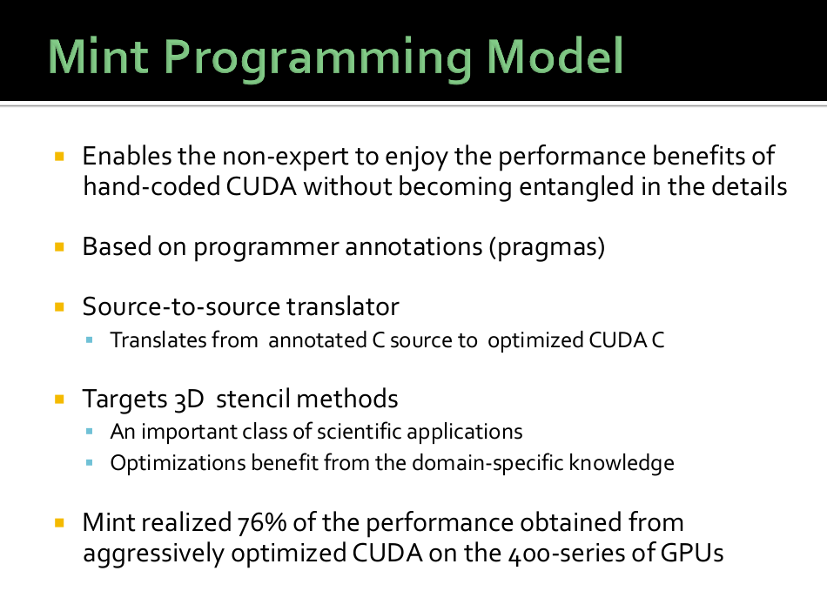

Slide 14
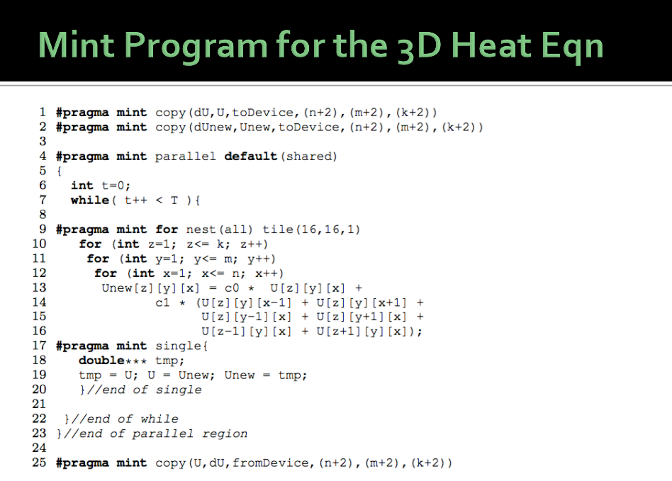

Slide 15
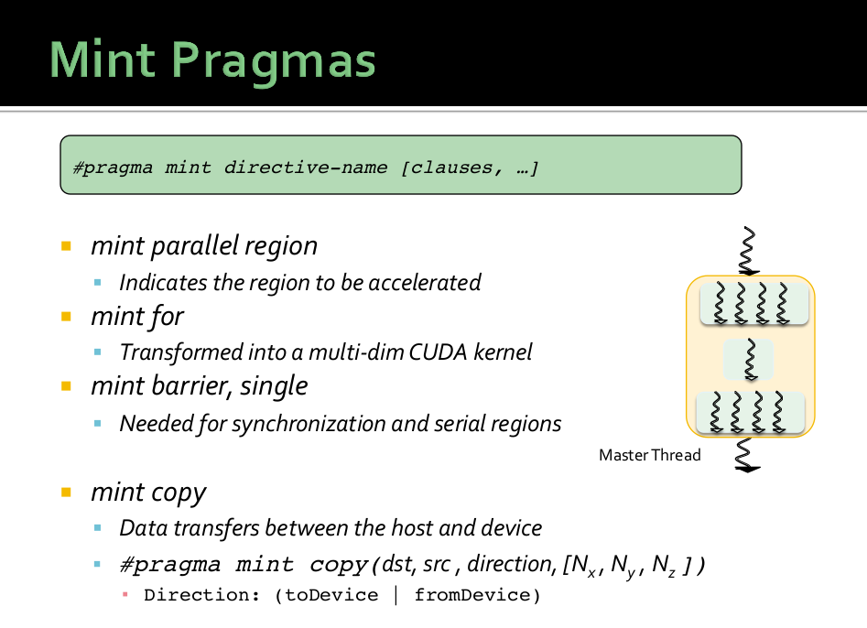

Slide 16
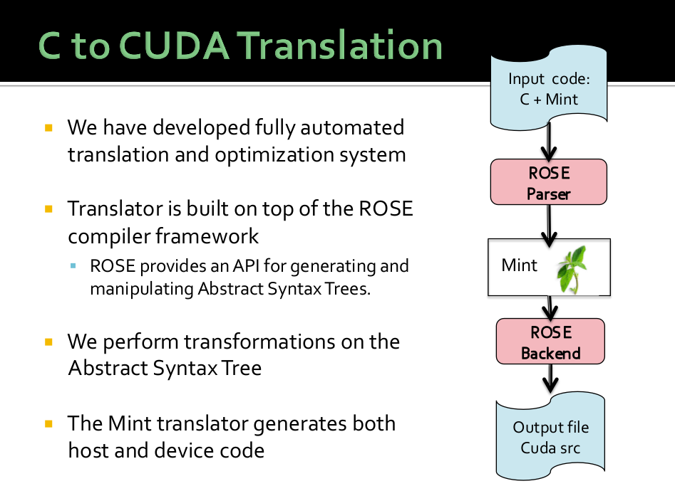

Slide 17
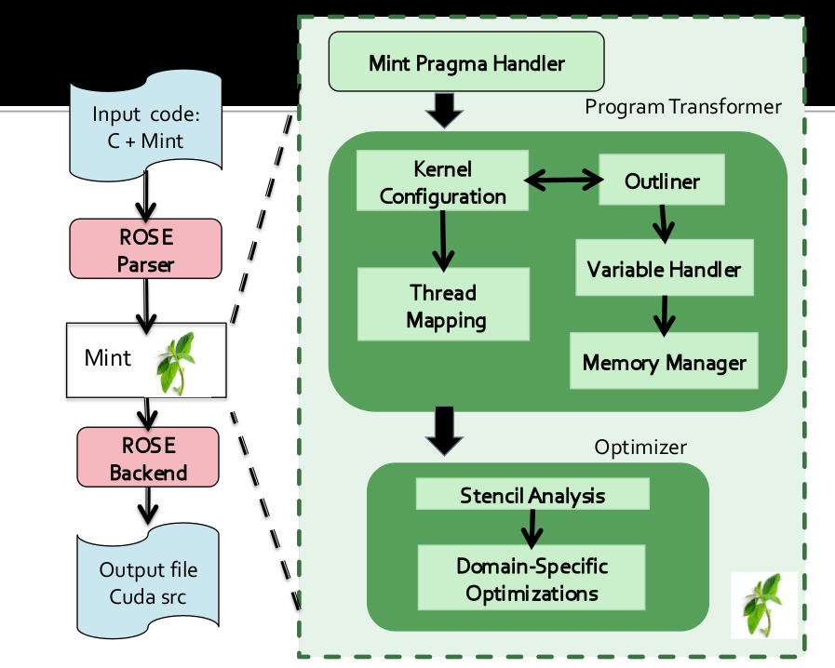

Slide 18
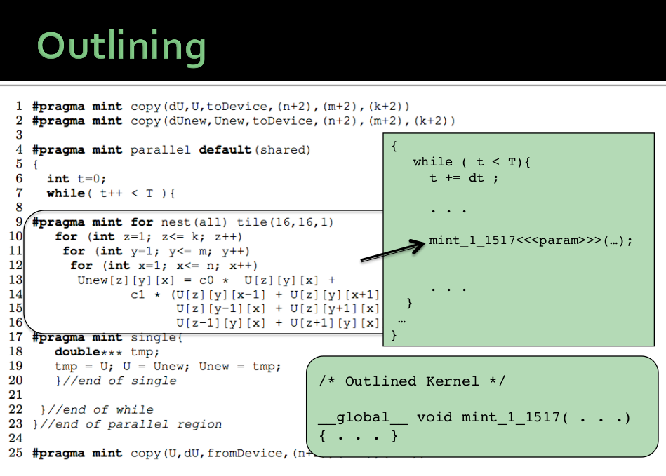

Slide 19
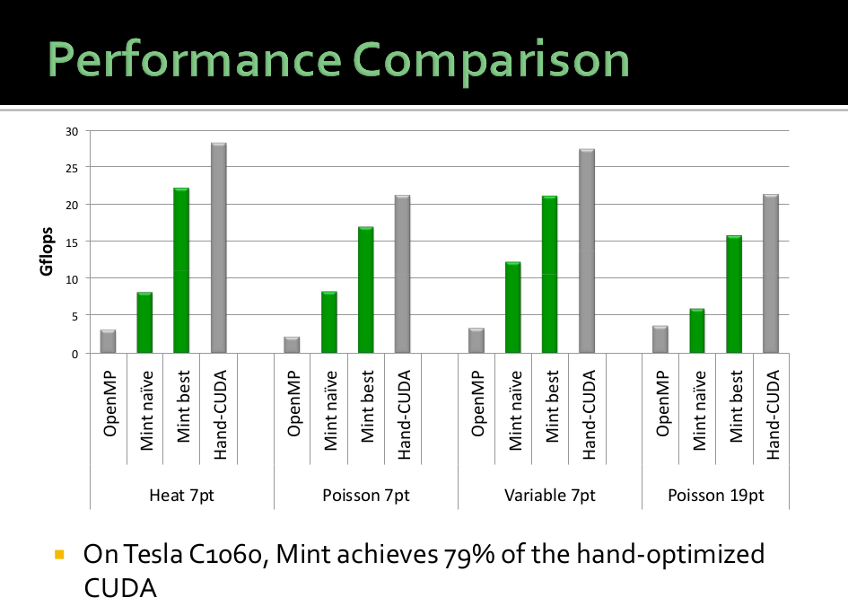

Slide 20
Presentation Blueprint
Background (GPUs, Parallelism, CUDA, OpenMP)
Massive parallelism solutions
  Mint
  APTCC
Task-based parallelism
  Pagoda
Conclusion

Slide 21
APTCC: Auto Parallelizing Translator From C To CUDA
Idea is to give normal C code and have it translate it to CUDA, no pragmas or directives
Pros/Cons
  It only works for simple for loops
  Has its own parser and grammar, not compliant with any standard
  Must give code that is already legal and good for CUDA implementation, analysis is not automatic over a whole program

Slide 22
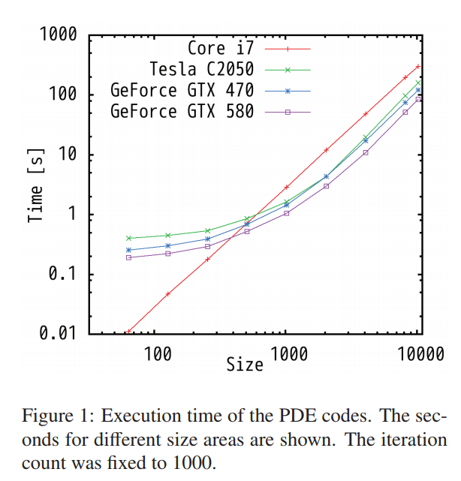
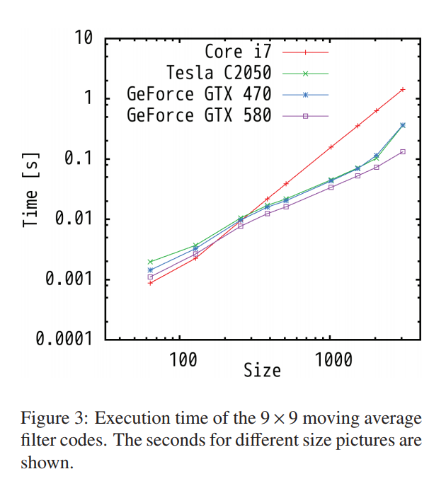
APTCC Results

Slide 23
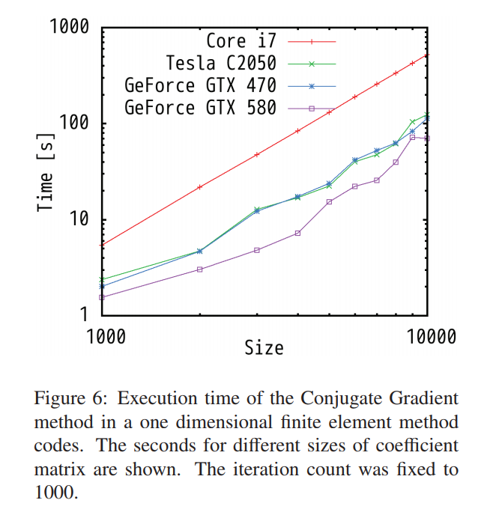
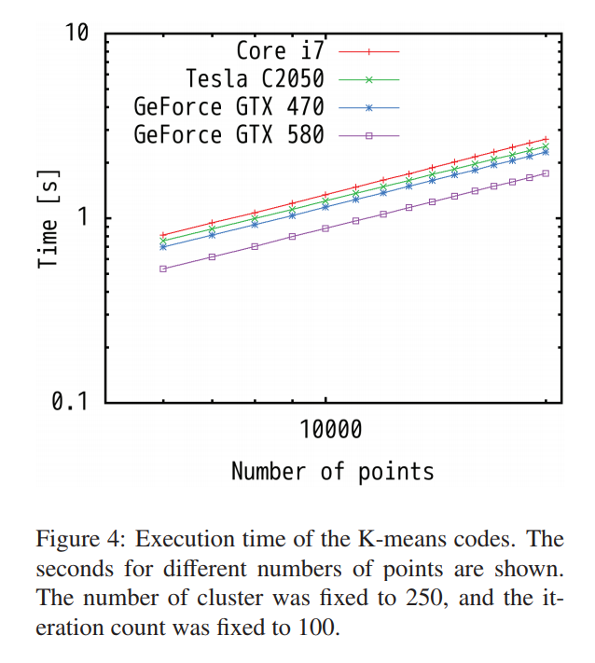
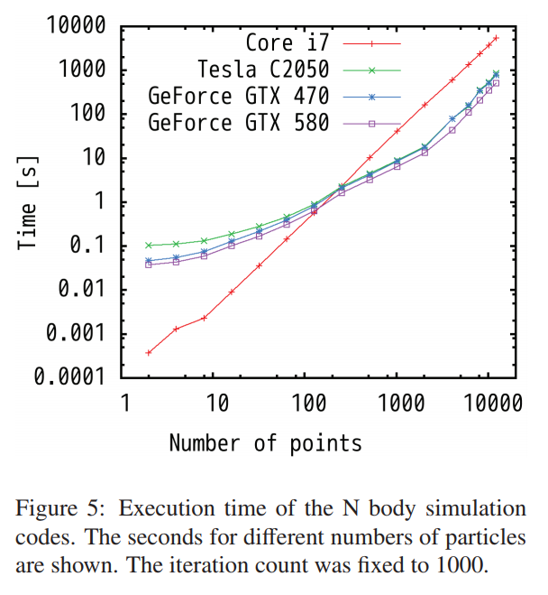
APTCC Results(2)

Slide 24
Presentation Blueprint
Background (GPUs, Parallelism, CUDA, OpenMP)
Massive parallelism solutions
  Mint
  APTCC
Task-based parallelism
  Pagoda
Conclusion

Slide 25
GPU utilization for narrow tasks
Occupancy = resident threads / maximum total threads
SMM 0
SMM P
Threadblock T
Threadblock T
Threadblock 0
Threadblock 0
Warp 0
Warp N
Warp 0
Warp N
Registers
Shared Memory
Registers
Shared Memory
Limiting factors:
  #threads per threadblock, #threadblocks per SMM → Unsuitable for narrow tasks
  #registers per thread
  Shared memory requirement per block
GPUs restrict concurrent kernel count (CUDA HyperQ : 32)
  Tasks with 256 threads each → Occupancy 16.67% (on Maxwell Titan X) → Severe Underutilization
Notes:
Mention that the concurrent kernel count has been growing across GPU generations.
Say why occupancy is important – overlaps memory latency

Slide 26
Alternatives
Static approaches : Kernel fusion [Wang et. al 2010, Gregg et. al 2012]
  Manual
  Higher average latency
  Each task gets same resources → wastage
Static fusion + runtime monitoring [Ravi et. al 2011, Pai et. al 2013]
  Concurrent kernels + dynamic mapping
Dynamic approaches
  Default – CUDA HyperQ
  GeMTC [Krieder et. al 2014]:
    Send tasks in “batches” – latency issue mitigated, not solved
    Each task = one threadblock. Underutilization still possible
Notes:
Batch : tasks are launched one-by-one, until batch threshold is reached

Slide 27
Pagoda: GPU-runtime system to overcome underutilization for narrow tasks
Key ideas:
MasterKernel, an OS-like daemon, dynamically
allocates resources to spawned tasks → virtualization
GPU scheduling at warp granularity
Challenges:
Reducing CPU-GPU handshaking
Efficient GPU scheduling of tasks onto HW resources
  Parallel scheduling on the GPU
  Overlap scheduling and spawning
Supporting key CUDA features – shared memory allocation and threadblock-level synchronizations
Task Spawn
GPU
CPU
MasterKernel (runs persistently)
PCI
Task Return
Notes:
Say that the CPU can launch tasks asynchronously

Slide 28
Programming with Pagoda – Filterbank Example
#pragma omp parallel num_threads(2) { //create 2 CPU threads
__global__ gpufilter(float *r , …) {
int tid = threadIdx.x;
if (tid < N_sim) //convolve H
for (int k = 0; k < N_col; k++)
if ((tid - k) > 0 )
Vect_H[tid] += r[tid-k]*H[k];
__syncthreads();
//Down sampling
if (tid < (N_sim/N_samp))
up[tid] = dn[tid];
__syncthreads();
//Up Sampling
.
.
}
__device__
while ( taskReady() ) { //keep polling to fetch new tasks
int tid = getTid();
#pragma omp task {
cudaMalloc(in_dev); cudaMalloc(op_dev); //allocate GPU data
Stream str = streamArray[taskNum % 32];
cudaMemcpyAsync(in_dev, in, HostToDevice, str); //copy input
gpufilter<<< BLOCKS, THREADS_PER_BLOCK, str >>> (in_dev, out_dev);
cudaMemcpy(in_dev, in, hostToDevice); //copy input
int taskId = taskSpawn( THREADS_PER_BLOCK , BLOCKS ,
SHARED_MEM_SIZE , SYNC_ON , &gpufilter, in_dev...);
syncBlock();
cudaMemcpyAsync(op, op_dev, DeviceToHost, str); //copy output data
cudaStreamSynchronize(str);
cudaFree(in_dev); cudaFree(op_dev); //free GPU data
wait(taskId);
cudaMemcpy(op, op_dev, DeviceToHost); //copy output data
cudaFree(in_dev); cudaFree(op_dev); //free GPU data
#pragma omp task { //nested task runs asynchronously
syncBlock();
}
Few changes compared to CUDA
Opens avenues for non-traditional applications on GPUs
}
}
}
#pragma omp barrier //ensure all tasks are done

Slide 29
TaskTable Operation
CPU can’t spawn anymore!
Memcpy single task entry over PCI
Task Entry 0
Task Entry 0
Task Entry 0
Task Entry 0
CPU Spawner
Threads
Task Entry 1
Task Entry 1
PCI
Bus
Task Entry 1
Task Entry 1
Task Entry 30
Task Entry 30
Task Entry 30
Task Entry 30
Task Entry 31
Task Entry 31
Task Entry 31
Task Entry 31
Column 0
Column 47
Column 0
Column 47
CPU TaskTable
GPU TaskTable – Placed in the Device Memory
Copyback the whole table
Lazy aggregate copy – better PCI BW, lower handshaking
Simultaneous CPU and GPU edits
Challenges
  Consistency – CPU must correctly see GPU task finish notifications
  Memory copies occur while MasterKernel in flight
  PCI bus packet delivery mechanism

Slide 30
Evaluation Setup
Benchmark | Task Type | Description
FilterBank (FB) | Regular | Signal processing algorithm – apply sets of filters/decide reception and transmission direction on different input signals
BeamFormer (BF) | Regular
Image Convolution (CONV) | Regular | Convolve/ perform discrete cosine transform on images coming through different streams
DCT8x8 (DCT) | Regular
Matrix Multiply (MM) | Regular | Several MPI processes generate tasks
Sparse LU Decomposition (SLUD) | Irregular | Every CPU iteration creates different number of tasks
MandelBrot (MB) | Irregular | Each task works on image pixel, each task performs different amount of work
3DES | Irregular | Network packet encryption – packets vary in sizes
Multi-programmed Environment (MPE) | Irregular | Combination of tasks from MB, 3DES, FB, MM
GPU : NVIDIA Maxwell Titan X, 12 GB RAM
CPU : 2 x Intel Xeon E5-2660, 32 GB RAM
Notes:
Iso-power

Slide 31
Overall performance comparison
Fixed #tasks (32K, except SLUD 273K), #threads/task = 128
Pagoda performs significantly better (1.51x over CUDA-HyperQ, 5.7x over Pthreads, 1.69x over GeMTC
DCT – significant time is spent in data transfers
GeMTC performs worse than HyperQ in MB, 3DES where tasks are irregular
Notes:
* CPU approaches: OpenMP with data parallelism, OS-based task scheduling, Python based thread pooling

Slide 32
Comparison against static fusion
Start-together end-together behavior lowers static fusion performance
Average latency per task increases linearly in fusion, while stays the same in Pagoda

Slide 33
Conclusion
Translate C to OpenMP?
Translate C to Pagoda?
Translate C to CUDA/Pagoda hybrid with multi-GPUs?

