Slide 1
Ringer: Web Automation by Demonstration
Shaon Barman, Sarah Chasins, Ras Bodik, Sumit Gulwani

Slide 2
Web Automation
The functionality of a website may not meet the needs of its users
Automation helps users complete many tedious interactions, such as scraping data, completing forms or transferring data between websites.
Web automation scripts are typically written by programmer

Slide 3
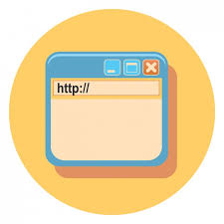
Record and Replay
Interact with page
User
Browser
DOM Event
HTTP Request
Recordings

Slide 4
Challenges

Slide 5
Interactivity
Website use AJAX and custom JavaScript handlers to respond to user actions
Some updates may be delayed by the network or server, the replayer may need to wait before replaying a user action

Slide 6
a) Page of black camera

Slide 7
Server
JavaScript
DOM
User
a
Hover
JS handler
Picture
update
b
a) Page of black camera
Sequence of events

Slide 8
b) Hover on silver button

Slide 9
Server
JavaScript
DOM
User
a
Hover
JS handler
Picture
update
b
JS handler
Click
Request
c
b) Hover on silver button
Sequence of events

Slide 10
c) After click (grayed page).

Slide 11
Server
JavaScript
DOM
User
a
Hover
JS handler
Picture
update
b
JS handler
Click
Request
c
Response
Price
update
d
c) After click (grayed page).
Sequence of events

Slide 12
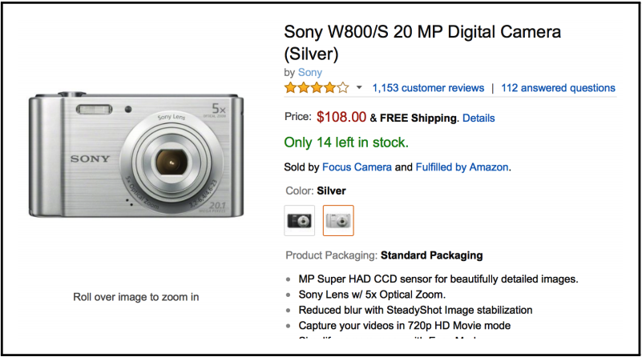
d) Page of silver camera.

Slide 13
Server
JavaScript
DOM
User
a
Hover
JS handler
Picture
update
b
JS handler
Click
Request
c
Response
Price
update
d
Scrape
price
d) Page of silver camera.
Sequence of events

Slide 14
Page structure
Websites often roll out new layouts making it difficult to identify the page’s elements across accesses.
Even small changes on the page can lead the replayer to click a different button or type into a different text box than the one the user intended.

Slide 15
a new "Recent Searches" pull-down menu appears after the first search

Slide 16
Ringer’s Approach
Wait until trigger:
then dispatch action on element
Action: What does the user or program do?
Element: On what GUI Component does the agent do an action?
Trigger: When does the agent do an action?

Slide 17
Action: What instruction do they use?
Past approach:
type “sony”
Ringer’s approach:
Keydown s
Keypress s
TextInput s
Input s
Keydown o
Keypress o
….

Slide 18
Element: Which node should we choose?
Past approach:
Text surrounding the element
XPath: Path from root element to the element iteself
Ringer’s approach:

Slide 19
Trigger: how to handle asynchrony?
Human use visual cues as trigger
To replay correctly, replayed must identify trigger too.
Trigger synthesis:
Triggers are server responses.
hostname == ‘amazon.com' &&
path ==‘ajaxv2’ &&
params.id == ‘bar’

Slide 20
Record Phase
User
Listen to DOM events
Store feature of elements
create a simple trace
Browser
Page level Javascript

Slide 21
Running Example
User
Browser
Click
mousedown
Page level Javascript
mouse up
click

Slide 22
Running Example
User
Recorded script is sample
Knows what action to perform but not when to perform them
Browser
Page level Javascript

Slide 23
Trigger Inference
Run simple script multiple times
identify HTTP responses across executions
infer causeality between responses and actions

Slide 24
Evaluation
End to end vs. CoScripter
Longitudinal study of Ringer scripts

Slide 25
Experimental setup
Choose 34 Websites
pick interaction that was a core site task
To automate experiment, give a correctness criterion
Example: www.southwest.com
Interaction: Purchase ticket from SFO to HOU
Check: Scrape text “San Francisco, CA to Houston, TX”

Slide 26
Comparison vs. CoScripter
Ringer
Replayed 25/34
Failure
5 complete/ 4 partial
Failure reason:
not identify node
website use flash
CoScripter
Replayed 6/34
Failure
5 complete/ 4 partial
Failure reason:
node identification: 8
interaction UI component:21

Slide 27
Longitudinal study of Ringer scripts
Ran each benchmark 9 times over 24 days
Results
24 benchmarks succeeded on the first run
15 benchmarks succeeded every time
6 experienced exactly one failure during 3 weeks
3 experienced multiple failure

Slide 28
Limitation
Recording high frequency events can make pages slow to respond.
The Ringer approach was designed for interactions that satisfy some trigger assumptions. Ringer fails when these do not hold.
Example: games, Google Map

Slide 29
Thanks

