Slide 1
A Parallelization Framework for Recursive Tree Programs by Paul Feautrier
Kirshanthan Sundararajah
School of Electrical and Computer Engineering

Slide 2
Regular Vs Irregular Programs
Arrays Vs Pointers
Iteration space, data space, execution order, dependence
Finding parallelism depends on our ability to answer questions about the associated Z-polytopes.
Is it possible to construct such a framework for irregular programs?

Slide 3
Polytope Model
Iteration Vector
Bounds
Scanning a Polytope
for(i=0; i < N; ++i)
for(j=0; j < i; ++j)
S;

Slide 4
Definition of Dependence
“Two operations are dependent if they access the same memory cell, one at least of the two accesses being a write.”

Slide 5
Contributions
Control Domain of Tree Programs
Locations and Function From Location to Values
Address Functions

Slide 6
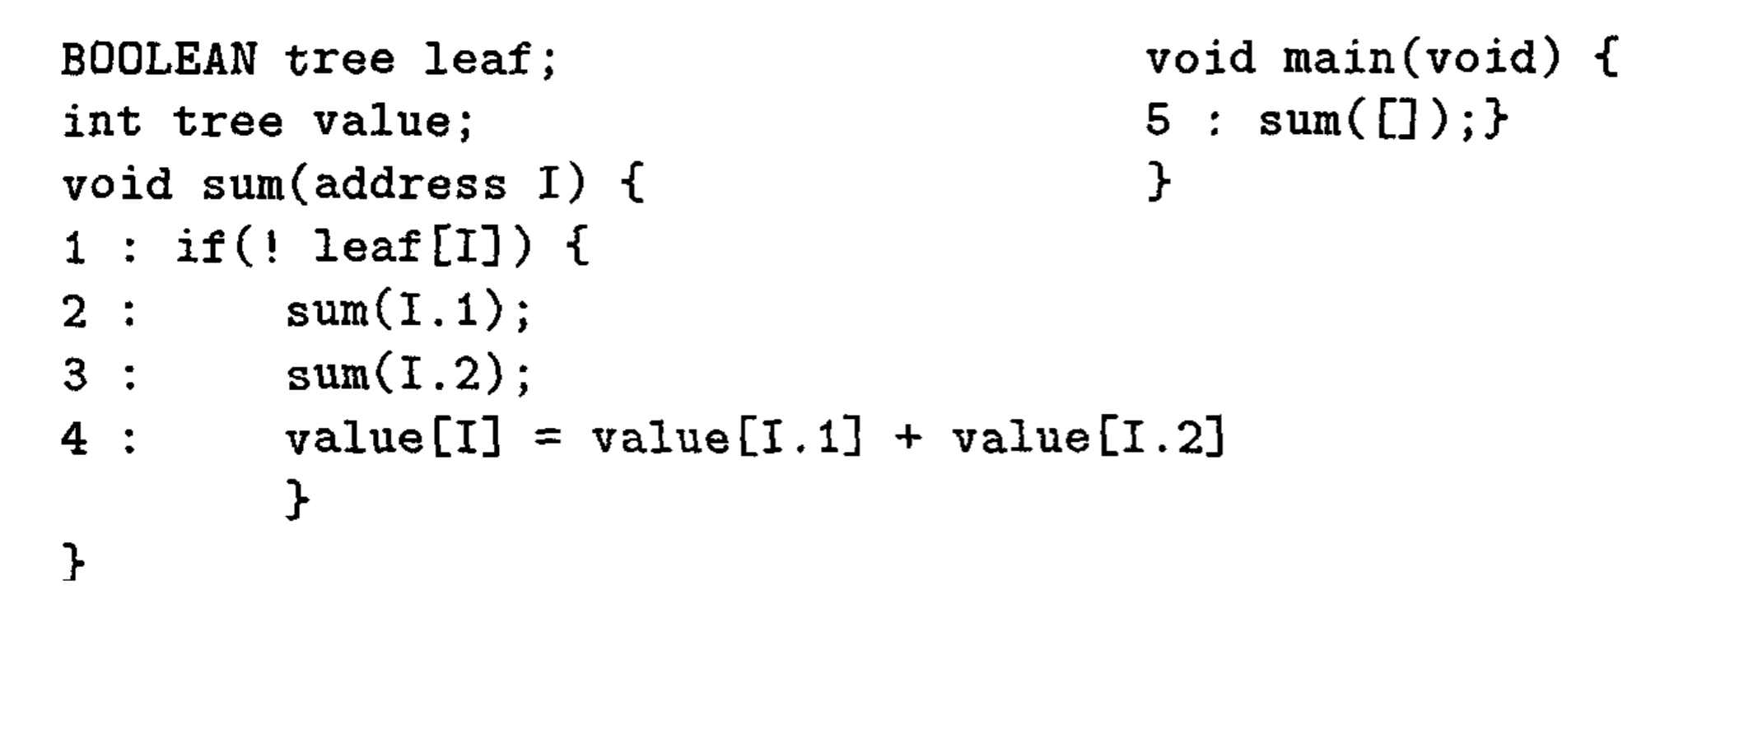
Control Domain
Notes:
The required call strings can be generated by a control automaton whose states are the functions names and the basic statements of the program. The state associated to main is initial and the states associated to basic statements are terminal.

Slide 7
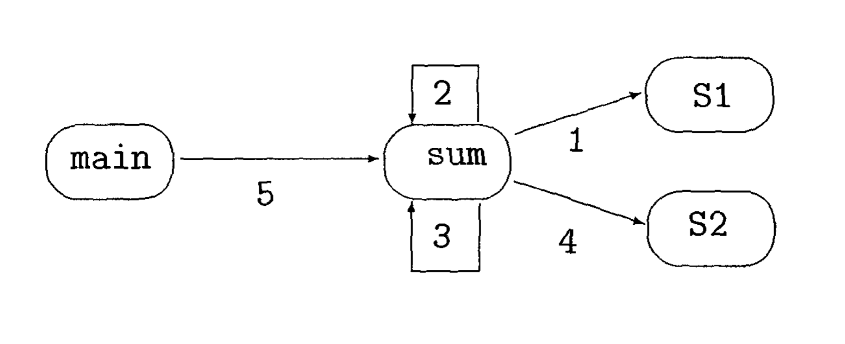
Control Automaton

Slide 8
Address Function (Rational Transduction)
Notes:
Tree Addressing Method

Slide 9
Toy Language Tau
No pointers are allowed. They are replaced by addresses.
The only data structures are scalars and trees.
Trees are always global.
No function returns an address.
The only control structures are conditionals function calls

Slide 10
Dependence Analysis in Tau
Parallelization Model:
Control Parallelism and Data Parallelism

Slide 11
Synthetic Dependence Graph
Consider a function foo and the statements {S1, S2 .., Sn} of its body.
There is a dependence edge from Si to Sj, i < j iff there exists three iteration words u, v, w such that,
u is an iteration of foo.
Both u.i.v and u.j.w are iterations of some terminal statements Sk and Sl.
u.i.v and u.j.w are in dependence.

Slide 12
Synthetic Dependence Graph
Parallelization: Topological Sorting of SDG
The Dependence Test (Algorithm D)

Slide 13
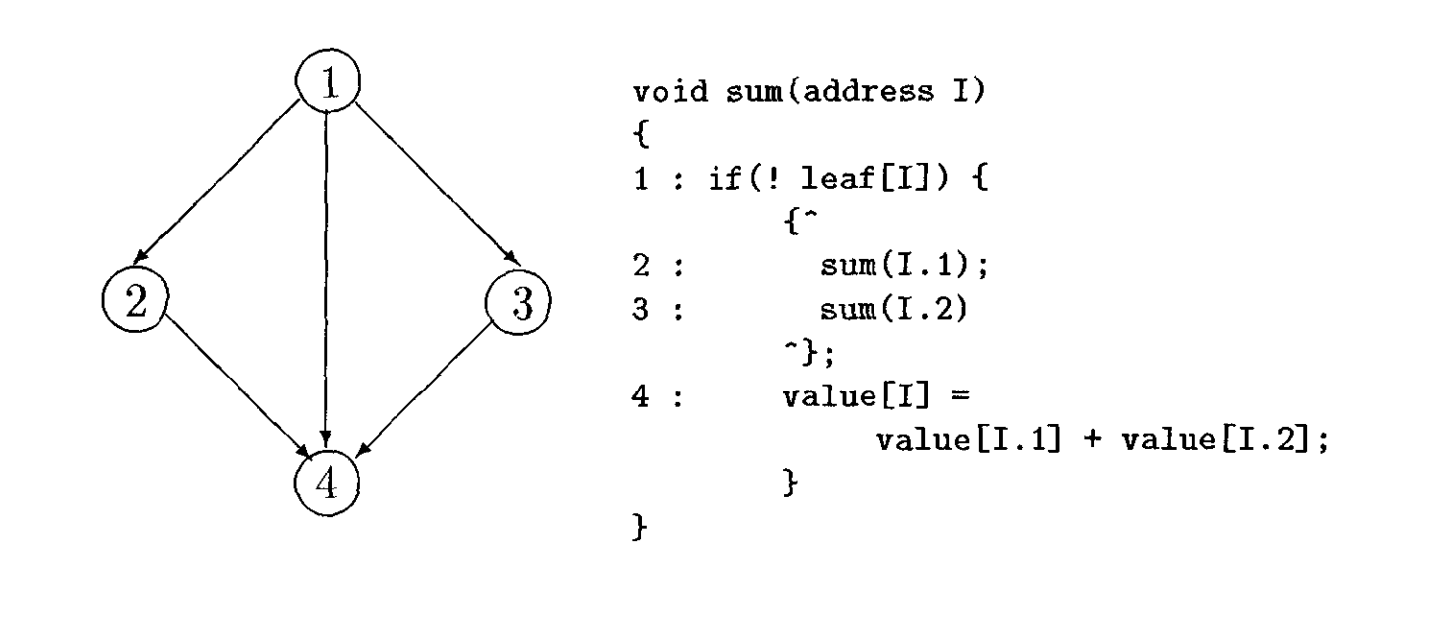
Parallelization of Sum

Slide 14
Conclusion and Future Work
Data Structures are restricted to trees
Operations on the addresses are limited to postfixing
The analysis is operation oriented, meaning that addresses are associated to operations, not to statements. This allows to get more precise results when computing dependences.

Slide 15
Conclusion and Future Work
Trees of arrays extension for multigrid method
Extending to DAGs and Cyclic Graphs by prefix operator.

Slide 16
A Parallelization Framework for Recursive Tree Programs by Paul Feautrier
Kirshanthan Sundararajah
School of Electrical and Computer Engineering

