Slide 1
ECE 663 Paper Presentation
Code Completion with Statistical Language Models
Veselin Raychev et al
Presented by: Nouraldin Jaber

Slide 2
Why Code Completion
Lots of APIs and libraries
  Not usually well-documented
Help the programmer complete code
  Code search!
But..
  Simple sequences
  Semantics are not considered

Slide 3
Proposed Approach
Synthesis with statistical language models
Key Insight
And we already know how to “complete” a sentence in a natural language!
Regularities in code is similar to regularities in natural languages

Slide 4
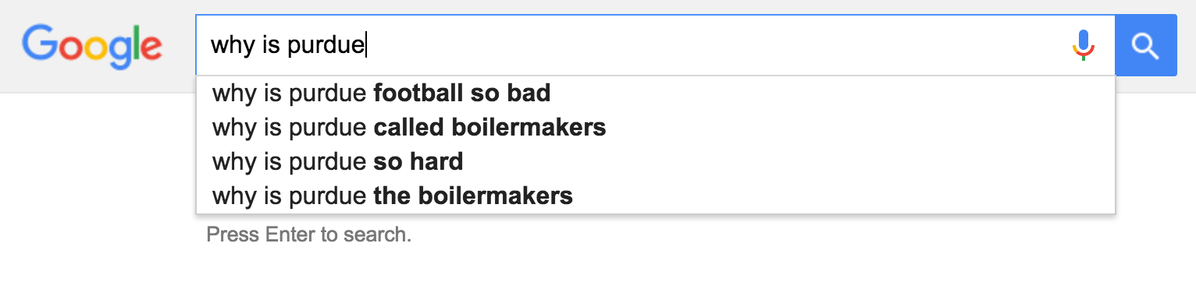
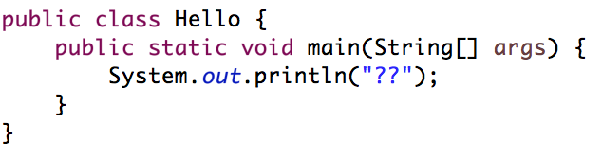
Proposed Approach

Slide 5
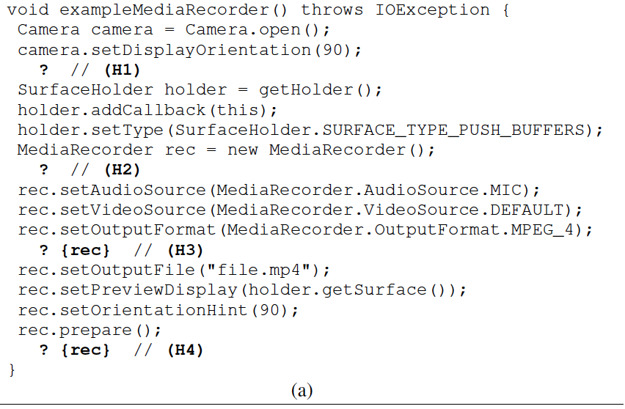




Proposed Approach

Slide 6



System Overview
Partial program
Complete program
4
constraints
1
2
3
Statistical Language Model

Slide 7
System Overview
To make this work we need to
  Model the system
  Map code completion to natural language
Understand How language models work
  Look at a Full example

Slide 8
Language Models
Based on words and sentences
Conditional Probability of sentences: P(word| previous words)
  P(why is Purdue football bad) =
  P(why)
  * P(is | why)
  * P(Purdue | why is)
  * P(football | why is Purdue)
  * P(bad | why is Purdue football)
How to calculate such probabilities?
  Since the “given” part can be very long

Slide 9
Language Models
N-gram models
  P(word| previous N-1 words)
  The paper uses 2- and 3-grams
Recurrent Neural Networks
  Capture longer distance relationship between words

Slide 10
Recurrent Neural Networks
Input: v^{i}
Output: y^{i} = g(c^{i})
0
0
1
0
00
000
Context c^{i} = f(v^{i},c^{i-1})
y(w _{i+1}) = possible probabilities for next word
W_{i}
Context c^{i-1}
S = w₁ . w₂ … w_{m} what is w_{m+1}?
Input w₁, calcuate c¹, calculate y¹
Input w₂, calcuate c², calculate y²
Input w_{m}, calcuate c^{m}, calculate y^{m}
y^{m} is used to give words with probabilities estimation

Slide 11
Language Models
Predict holes in natural sentences
Works as a scoring mechanism
S = “the quick brown ? jumped”
  Try all words in the Dictionary and get highest P(S)
Issues?

Slide 12
Language Models
Predict holes in natural sentences
Works as a scoring mechanism
S = “the quick brown ? jumped”
  Alternatively, Consult a bigram model for likely completions based only on previous the word
    fox or dog? Ask the language model!
    P(the quick brown fox jumped) > P(the quick brown dog jumped)

Slide 13
Language Models: Takeaway
Given a sentence,
  Returns probability
Given a set of words,
  Returns the highest probable next word

Slide 14
System Model
How to model the system as sentences
  So we can complete it
Concrete VS Abstract semantics

Slide 15

Concrete Semantics
Program state = ⟨L*,$ρ$*,$π$*⟩
  L* Set of all allocated objects
  $ρ$* Environment mapping local variables to objects
  $π$* objects’ fields to values
Basically all possible objects in the program
new Foo();
x = new Foo();
x.bar = 5;

Slide 16
Concrete Semantics
WORDS
Object Event
  API method invocation involving that object
    As a receiver door.open();
    As one of the arguments person.close(door);
    As a return value door = company.makeDoor();
Object History
  The set of all events on a concrete object
  Changed by method invocations, or object creations
SENTENCES

Slide 17
Abstract Semantics
It is impractical to track all possible object creations and full histories
Abstraction
  Abstract Object
    The set of all aliased concrete objects
  Abstract History
    Containing all concrete histories of aliased objects

Slide 18
Example
void home(){
Cat cat = new Cat();
Dog dog = new Dog();
cat.beSilly();
dog.hide();
If(a good day){
cat.play();
}
dog.enter();
cat.fight(dog);
}
History for abstract object cat
beSilly play fight
beSilly fight
History for abstract object dog
hide, enter, fight^{param}
Potential blowup?

Slide 19
System Model: Takeaway
Frame the program as a set of sentences
Method calls == words
History == sentences
Hence, we can use language models in this context too!

Slide 20
A Complete Example
SmsManager smsMgr = SmsManager.getDefault();
int length = message.length();
if (length > MAX_SMS_MESSAGE_LENGTH) {
ArrayList<String> msgList =
smsMgr.divideMsg(message);
? {smsMgr, msgList} // (H1)
} else {
? {smsMgr, message} // (H2)
}
smsMgr = getDefault . H2
getDefault . divideMsg . H1
message = length . length . H2
msgList = divideMsg. H1

Slide 21
A Complete Example
getDefault. sendTextMessage getDefault. sendMultipartTextMessage | 1 2 | length. length length. sendTextMessage length.sendMultipartTextMessage | 1 2 3
getDefault. sendTextMessage getDefault. sendMultipartTextMessage | 1 2 | length. length length. sendTextMessage length.sendMultipartTextMessage | 1 3
getDefault . H2
getDefault . divideMsg . H1
length . length . H2
divideMsg. H1
getDefault. divideMsg. sendMultipartTextMessage getDefault. divideMsg. sendTextMessage | 1 2 | divideMsg. sendMultipartTextMessage | 1

Slide 22
General Comments
Only works for code with similar patterns
  API calls but not a complex application
There is no verification component
  It is up to the programmer to verify
Training data needs to be carefully chosen
  Common mistakes could also be learnt!

Slide 23
Potential Improvements
Automatic type check for completions
Semantic final check?
  Did the synthesized code use respect the dataflow?
  Did the synthesized code override a variable not used yet?
Joint probability?
  Calls on two objects are one event instead of two

Slide 24
Demo

Slide 25
Thank You!

