Slide 1
Lecture 5
Floyd-Hoare Style Verification
Xiaokang Qiu

Slide 2
Motivation
z = 0;
i = x;
while (i) {
z = z + y;
i = i – 1;
}
Consider the following program:

Slide 3
Motivation
The techniques we learned in 573 are insufficient.
  Easy to argue that a given input will produce a given output.
  Easy to argue that a property always holds at a single program point
  Also easy to argue that all constructs in the language will preserve some property (like when we proved type soundness).
  Much harder to prove general properties of the behavior of a program on all inputs.
Notes:
Types allow us to design custom checkers to verify specific properties.
Very good at reasoning about properties of the data pointed at by particular variables.

Slide 4
Axiomatic Semantics
(AKA program logics)
A system for proving properties about programs
Key idea:
  We can define the semantics of a construct by describing its effect on assertions about the program state.
Two components
  A language for stating assertions (“the assertion logic”)
  Can be First-Order Logic (FOL), a specialized logic such as separation logic, or Higher-Order Logic (HOL), which can encode the others.
  Many specialized languages developed over the years:
    Z, Larch, JML, Spec#
  Deductive rules (“the program logic”) for establishing the truth of such assertions

Slide 5
A little history
Early years: Unbridled optimism
  Heavily endorsed by the likes of Hoare and Dijkstra
  If you can prove programs correct, bugs will be a thing of the past.
  You won’t even have to test your programs!
The middle ages
  1979 paper by DeMillo, Lipton and Perlis
  “Proofs in math only work because there is a social process in place to get people to argue them and internalize them.”
  “Program proofs are too boring for social process to form around them.”
  “Programs change too fast and proofs are too brittle.”
The renaissance
  New generation of automated reasoning tools
  A handful of success stories
  Better appreciation of costs, benefits and limitations?

Slide 6
The basics
{A} stmt {B}
Precondition
Postcondition
Hoare triple
  If the precondition holds before stmt and stmt terminates, postcondition will hold afterward.
This is a partial correctness assertion.
  We sometimes use the notation
to denote a total correctness assertion
  which means you also have to prove termination.
[A] stmt [B]

Slide 7


What do assertions mean?
We first need to introduce a language.
For today we will be using Winskel’s IMP:
e := n | x | e1 + e2 | e1 - e2
c:= x := e | c1; c2 | if e then c1 else c2 | while e do c
Big Step Semantics have two kinds of judgments:
expressions result in values; commands change the state

Slide 8




Semantics of IMP
Commands mutate the state:
What about loops?

Slide 9



Semantics of IMP
The definition for loops must be recursive.

Slide 10
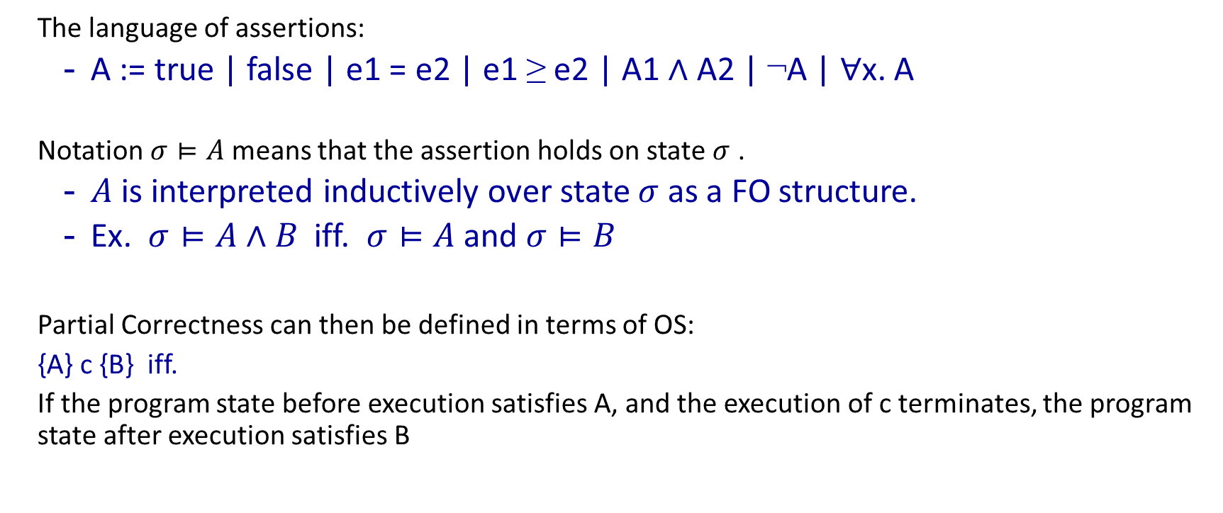
What do assertions mean?
The language of assertions:
  A := true | false | e1 = e2 | e1 ≥ e2 | A1 ∧ A2 | ¬A | ∀x. A
Notation $σ⊨A$ means that the assertion holds on state $σ$ .
  $A$ is interpreted inductively over state $σ$ as a FO structure.
  Ex. $σ⊨A∧B$ iff. $σ⊨A$ and $σ⊨B$
Partial Correctness can then be defined in terms of OS:
{A} c {B} iff.
If the program state before execution satisfies A, and the execution of c terminates, the program state after execution satisfies B

Slide 11

Defining axiomatic semantics
Establishing the truth of a Hoare triple in terms of the operational semantics is impractical.
The real power of AS is the ability to establish the validity of a Hoare triple by using deduction rules.
  means we can deduce the triple from a set of basic axioms.

Slide 12





Derivation Rules
Derivation rules for each language construct
Can be combined together with the rule of consequence

Slide 13
Example
The following program purports to compute the square of a given integer n (not necessarily positive).
int i, j;
i := 1;
j := 1;
while (j != n) {
i := i + 2*j + 1;
j := j+1;
}
return i;

Slide 14
Example
{true}
int i, j;
i := 1;
j := 1;
while (j != n) {
i := i + 2*j + 1;
j := j+1;
}
return i;
{i = n*n}

Slide 15
Example
{true}
int i, j;
{??}
i := 1;
{??}
j := 1;
{??}
while (j != n) {
i := i + 2*j + 1;
j := j+1;
}
{??}
return i;
{i = n*n}

Slide 16
Example
{true}
int i, j;
{true} //strongest postcondition
i := 1;
{i=1} //strongest postcondition
j := 1;
{i=1 ∧ j=1} //strongest postcondition
{??} //loop invariant
while (j != n) {
i := i + 2*j + 1;
j := j+1;
}
{i = n*n} //weakest postcondition
return i;
{i = n*n}

Slide 17
Example
{true}
int i, j;
{true} //strongest postcondition
i := 1;
{i=1} //strongest postcondition
j := 1;
{i=1 ∧ j=1} //strongest postcondition
{i = j*j} //loop invariant
while (j != n) {
i := i + 2*j + 1;
j := j+1;
}
{i = n*n} //weakest postcondition
return i;
{i = n*n}

Slide 18
Example
{true}
int i, j;
{true} //strongest postcondition
i := 1;
{i=1} //strongest postcondition
j := 1;
{i=1 ∧ j=1} //strongest postcondition
{i = j*j} //loop invariant
while (j != n) {
{i = j*j ∧ j != n}
i := i + 2*j + 1;
{i = (j+1)*(j+1) ∧ j != n}
j := j+1;
{i = j*j ∧ j-1 != n}
}
{i = n*n} //weakest postcondition
return i;
{i = n*n}

Slide 19
Soundness and Completeness
What does it mean for our deduction rules to be sound?
What does it mean for them to be complete?
So are they complete?
  {true} x:=x {p}
  {true} c {false}
Relative Completeness in the sense of Cook (1974)
  Expressible enough to express intermediate assertions, e.g., loop invariants

Slide 20

Total Correctness
Definition: a well-ordered set is a set $S$ with with a total order $>$ such that every non-empty subset of $S$ has a least element.
E.g., $\left(ℕ,>\right)$ is a w.o. set, $\left(ℤ,>\right)$ is not
$\left(ℕ^{2},>\right)$ where $\left(a,b\right)>\left(a^{′},b^{′}\right)$ if $a>a′$, or $a=a′$ and $b>b′$

Slide 21
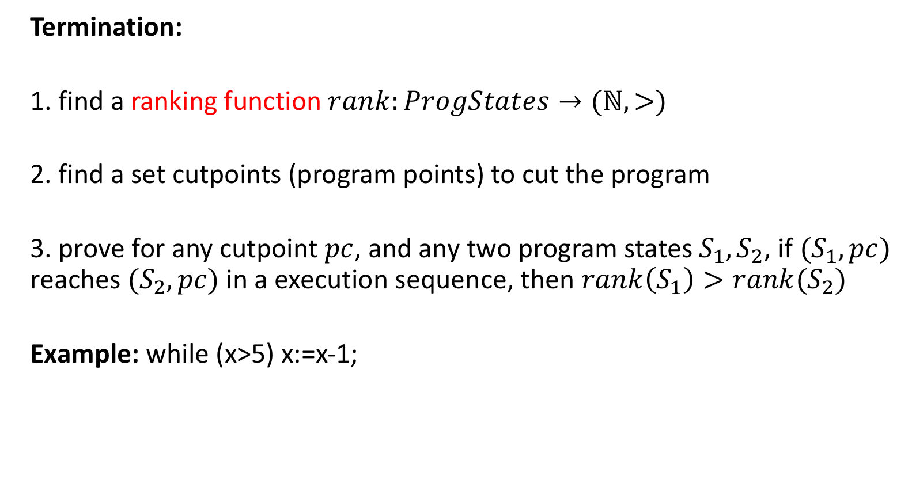
Total Correctness
Termination:
1. find a ranking function $rank:ProgStates→(ℕ,>)$
2. find a set cutpoints (program points) to cut the program
3. prove for any cutpoint $pc$, and any two program states $S_{1},S_{2}$, if $(S_{1},pc)$ reaches $(S_{2},pc)$ in a execution sequence, then $rank\left(S_{1}\right)>rank(S_{2})$
Example: while (x>5) x:=x-1;

Slide 22
Total Correctness
Example:
int i, j;
i := 1;
j := 1;
while (j != n) {
i := i + 2*j + 1;
j := j+1;
}
return i;

