Slide 1
Lecture 2 Propositional Logic
Xiaokang Qiu

Slide 2
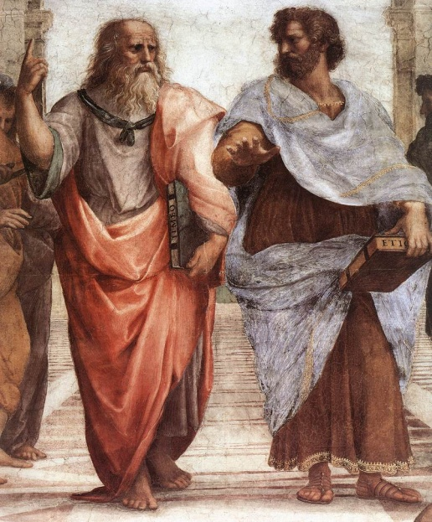
A brief history of logic
Beginnings
Aristotle (~300 B CE)
Earliest formal study of logic
Rhetoric, syllogism, philosophy, geometry
Furthered by Islamic logicians
Logic in India
Nyaya and Vaisheshika (2 CE)
Ontology; obtaining valid knowledge
Logic in China
Mozi school (~400 B CE)

Slide 3
A brief history of logic
Syllogism
Major premise: Every man is mortal
Minor premise: Socrates is a man
Conclusion: Socrates is mortal
“man”, “mortal”, “Socrates” – not important
Every M is D
S is an M
Conclude: S is D
$$∀x. M\left(x\right)→D\left(x\right)$$
$$M(S)$$
So, $D(S)$.

Slide 4
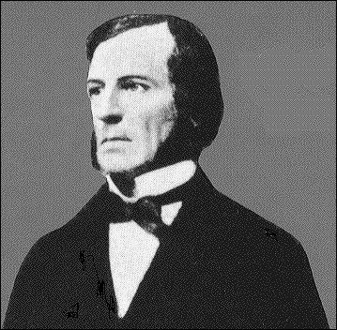
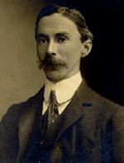
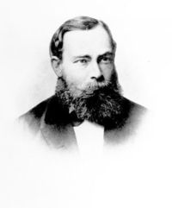
A brief history of logic
The algebraic school
George Boole and others (end of 19th century)
Algebraic structure of formulas; Boolean algebra
The logicist school
(Russel, Wittgenstein, Frege)
Frege: book of “Begriffsschrift” developed an elaborate formal language
Quantifiers, “predicate calculus”, number-theory -> logic
Russel’s paradox
Book of “Principia Mathematica” (Russel-Whitehead, 1910-1913)

Slide 5
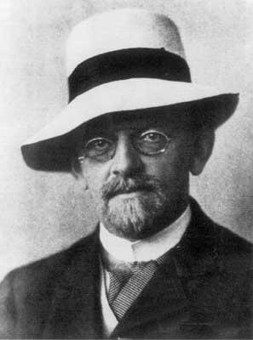
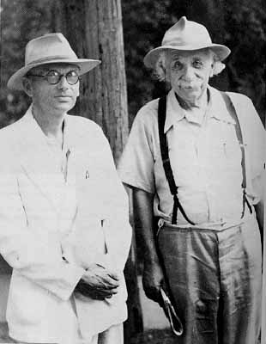
A brief history of logic
The mathematical school (early 20th century)
Dedekind, Peano, Hilbert, Heyton, Zermelo, Tarski
Axiomatize branches of math (geometry, arithmetic, set-theory)
Zermelo: Axiomatization of set-theory
The Hilbert program: formalization of all of mathematics in axiomatic
form, with a proof of consistency using “finitary” methods.
Godel’s theorems:
PhD: Every F O sentence can be deduced in common deductive systems.
Godel’s completeness theorem
Any axiomatization that includes arithmetic must either be unsound or incomplete (i.e. there is a sentence neither provable nor disprovable)
Godel’s incompleteness theorem.

Slide 6
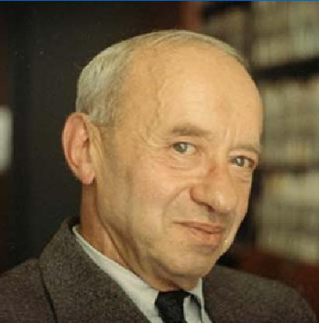
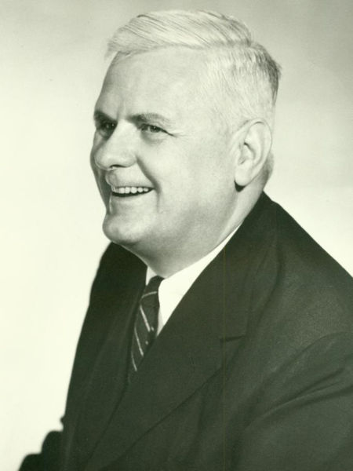
A brief history of logic
The mathematical school (20th century)
Tarski: Logician extraoradinaire ( ~ 2500 pages!)
Completeness, truth, definability, decidability
Alonzo Church, and students Kleene and Henkin
Church’s thesis of computability
First-order logic is undecidable

Slide 7
Post WW-II
model theory
Study of mathematical structures (groups, etc.) using logic
proof theory
Study of axiom systems, inference systems, proofs
computability theory
Relationship of logic to computability/complexity
set theory
foundations of mathematics, axiomatic set theory
Cohen: independence of continuum hypo and independence of axiom of choice from ZF axioms.
constructivism
applications of logic in computer science
applied logic to AI, databases, verification, aided by tools like automated and semi-automated theorem provers

Slide 8
Propositional Logic

Slide 9
Propositional Logic: Syntax
Propositions
Sentences that can be determined as true or false
p = “Tomorrow is raining.”
q = “U.S. has 50 states.”
$P$: a countably infinite set of propositions $\left\{p_{1},p_{2},…\right\}$
Well Formed Formulae ($WFF$) is the smallest set that satisfies:
$⊤,⊥∈WFF, p∈WFF$ for any $p∈P$
If $α∈WFF$, then $\left(¬α\right)∈WFF$
If $α_{1},α_{2}∈WFF$, then $\left(α_{1}∼α_{2}\right)∈WFF$
$∼$ is a connective, e.g., $∧, ∨, →$

Slide 10
Propositional Logic: Syntax
Precedence:
$¬$ takes precedence over $∧$
$∧$ takes precedence over $∨$
E.g., $¬p∧q∨r$
Alternative Syntax
$α→β≡¬α∨β$
$α∧β≡¬(¬α∨¬β)$

Slide 11
Propositional Logic: Semantics
A model/valuation/interpretation is a function
$v:P→\{T,F\}$
$v$ can be extended to $\hat{v}$, mapping every formula to $\{T,F\}$:
$\hat{v}\left(p\right)=v(p)$
$\hat{v}\left(¬α\right)=\left\{\begin{aligned}T if \hat{v}\left(α\right)=F \\ F if \hat{v}\left(α\right)=T\end{aligned}\right.$
$\hat{v}\left(α_{1}∧α_{2}\right)=\left\{\begin{aligned}T if \hat{v}\left(α_{1}\right)=T and \hat{v}\left(α_{2}\right)=T \\ F otherwise\end{aligned}\right.$
$\hat{v}\left(α_{1}∨α_{2}\right)=\left\{\begin{aligned}T if \hat{v}\left(α_{1}\right)=T or \hat{v}\left(α_{2}\right)=T \\ F otherwise\end{aligned}\right.$

Slide 12
Propositional Logic: Semantics
$\hat{v}\left(α\right)=T$ is also denoted as $v⊨α$
A wff $α$ is a tautology if $\hat{v}\left(α\right)=T$ for every model $v$,
denoted as $⊨α$
E.g., $p→p$
A wff $α$ is satisfiable if $\hat{v}\left(α\right)=T$ for some model $v$
E.g., $p∧¬q$
Theorem: $α$ is a tautology iff. $¬α$ is unsatisfiable.

Slide 13
Propositional Logic: Inference
How to check if $α$ is a tautology (or $¬α$ is satisfiable) ?
Many procedures have been developed:
Hilbert System
Tableaux
Resolution
DPLL
Natural Deduction
Sequent Calculus

Slide 14
Normal Forms
Negation Normal Form (NNF)
Every negation is used only on propositions
E.g., $¬p∨¬q$
Atomic $p$ or $¬p$ is called a literal
Conjunctive Normal Form (CNF)
$\bigwedge_{i=1}^{m}{(\bigvee_{j=1}^{n}{l_{i,j}})}$
E.g., $\left(p_{1}∨p_{2}∨¬p_{3}\right)∧\left(¬p_{1}∨p_{2}∨p_{3}\right)$
Disjunctive Normal Form (DNF)
$\bigvee_{i=1}^{m}{\left(\bigwedge_{j=1}^{n}{l_{i,j}}\right)}$

Slide 15
Normal Forms
Theorem: there is no polynomial blow-up translation from wff to CNF/DNF.
Theorem: SAT can be reduced to CNF-SAT in polynomial time.
Idea: introduce a fresh variable for each subformula
Cook’s Theorem: CNF-SAT is NP-complete.

Slide 16
Resolution
Is $α$ a tautology? ➔ Is $¬α$ unsatisfiable?
➔ Is the equivalent $D_{1}∧D_{2}∧…∧D_{k}$ unsatisfiable?
Resolution: $\frac{D∨p D^{′}∨¬p}{D∨D^{′}}$
$D∨D^{′}$ is added as a new disjunction
Repeat until no more resolution can be done
Resolution is closed if the empty clause is contained
Unsatisfiable iff. Closed
Example: $\left(p∨q\right)∧\left(¬p∨r\right)∧\left(¬q∨r\right)∧(¬r)$

Slide 17
Resolution
Theorem: resolution is sound.
If the resolution is closed, $α$ is unsat.
Easy to prove.

Slide 18
Resolution
Theorem: resolution is complete.
If $α$ is unsat, show the resolution will be closed.
Resolution will continue if there are both $p$ and $¬p$ in $Γ$, and preserves the satisfiability.
$Γ=Γ_{1}∧Γ_{2}∧Γ_{3}$
$Γ_{1}$ are conjuncts containing $p$; $Γ_{2}$ are conjuncts containing $¬p$; $Γ_{3}$ are conjuncts containing neither.
$Γ_{1}=\bigwedge_{i=1}^{m}{\left(D_{i}∨p\right)}$ $Γ_{2}=\bigwedge_{j=1}^{n}{\left(E_{j}∨¬p\right)}$
$Γ_{1}×Γ_{2}=\bigwedge_{i,j=1,1}^{m,n}{\left(D_{i}∨E_{j}\right)}$
Let $Γ^{′}=Γ_{1}×Γ_{2}∧Γ_{3}$. if $Γ$ is satisfiable, so is $Γ^{′}$
Let $v⊨Γ$. If $v\left(p\right)=T$, all $E_{i}$ are satisfiable. So $v⊨Γ_{1}×Γ_{2}$
Similarly if $v\left(p\right)=F$

Slide 19
DPLL Procedure
Backtracking based search
Assign a value to a variable to simplify the CNF
Stop if all variables are assigned
Backtrack if unsatisfiable
Variables are chosen heuristically
Most efficient SAT solving procedure since 1960s
Implementations: zChaff, Minisat, etc.

Slide 20
Compactness Theorem
Theorem: An infinite set of formulas $Γ$ is satisfiable iff. every finite subset of $Γ$ is satisfiable.
Proof: skipped.

Slide 21
Application: Four-Color Theorem
https://en.wikipedia.org/wiki/Four_color_theorem

