Slide 1


PRECISION:
Efficient Measurement on Programmable Switches Using Probabilistic Recirculation
Ran Ben Basat, Xiaoqi Chen,
Gil Einziger, Ori Rottenstreich

Slide 2
Outline
Programmable switches?
Heavy-hitter detection, prior solutions
Adapting to Programmable switches
Evaluation

Slide 3
Network Measurement?
Collect statistics of network traffic, for...
  Security
  Performance diagnostics
  Capacity planning
Notes:
Why we need network measurement?
Slow down.
1. Measurement can help security: detect DDoS attack.
2. Improve performance: find bottlenecks (For example, microburst, paper by Danfeng presented on the first day mentioned we need to know heavy flows “beforehand” to better handle queuing.)
3. Help Predict future demand, e.g. building new links? Know traffic characteristic before new NFV deployment?

Slide 4
Measurement in the Data Plane?
Opportunity: programmable switches!
  Only report result to controller, upon demand
  Immediate per-packet action in the data plane
Challenges
  Restrictive programming model
  Limited state (memory)
Our solution: Probabilistic Recirculation
(PRECISION)
Notes:
Traditionally people uses sampling to catch up with line rate. With today’s switch having Terabytes aggregated throughput, even sending 1/1000 is quite a lot (needs a lot bandwidth, lower sampling rate, hurts accuracy).
Recently, we can embed measurement algorithms directly in the network data plane, at line rate,
as commodity programmable switch becomes available.
This provides us opportunity
More accurate, no sampling;
Immediate per-pkt action, based on measurement
However, also challenges: restrictive programming model, simple operation, limited state (need sketch)
Our solution is to use prob. recirc.

Slide 5
PISA Programmable Switch
(Protocol Independent Switching Architecture)
Stateful Memory
01011010…
1 | 2 | 3 | 4
1 | 0 | 1 | 0
1 | 2 | 3 | 4
1 | 2 | 3 | 4
1
K₁ | V₁
K₂ | V₂
K₃ | V’
K₄ | V”
K₅ | V”
K₁ | V₁
K₂ | V₂
K₃ | V₃
01011010…
Parser
Match-Action pipeline
Deparser
Notes:
A brief overview of PISA switch…
Pipe goes one way. Once next stage, can’t go back. If you want to go back, may recirculate, but need to do again.
-> what is recirculation? Bring back… visit every stage a second time. Obviously it’s very expensive to do this for many packets, hurts throughput.
Recirculation: what we focus on today
PISA switch is real, “practical”, on the market, already widely used today in data centers (for quick iteration / deployment of new network functionality)
Barefoot Tofino.

Slide 6
Challenges of Running Algorithms on PISA
Constrained memory access:
  Partitioned between stages
  Can only R/W one address per stage
Computation: only basic arithmetic
Limited memory size, limited #stages
Recirculation helps, but hurts throughput
Notes:
Recirculation can help a lot (simplified operation in each pass), but hurts throughput
Switch may have a small reserved capacity for recirc. No penalty.

Slide 7


The Heavy-Hitter Detection Problem
A few “Heavy-Hitters”, a.k.a. elephant flows, send most of the packets.
To catch these elephants, we:
  Report top-k flows
  Estimate flow size for each flow
Metrics:
  Recall
  On-arrival MSE
Flow size
All flows
Notes:
Motivate
Elephant vs Mice
Why directly in data-plane is important
Immediate action on elephant flows
Reroute? Load-balance? Drop?
Flow size is defined as #packets.
Two Formulation (two evaluation metrics):
Catch top-128
On-arrival MSE / some called it “AAR”

Slide 8







The Space-Saving Algorithm
(Metwally et al.)
When queried for an element that has a counter, we return its value.
  Query( ) returns 3
When queried for unmonitored element, return the value of the minimal counter.
  Query ( ) returns 2
For a N-sized stream, when allocated with m counters, Space Saving guarantees:
$$f_{x}≤Query\left(x\right)≤f_{x}+\frac{N}{m}$$
Keep a set of m counters.
  Each counter keeps the ID of the associated item.
If an element that had a counter arrives, increase its value by one.
If an element without a counter arrive, allocate it with the minimal counter and increment.
For top-k, simply return the IDs of the largest counters (e.g., guess the most frequent element to be ).
For achieving an $Nε$approximation, $⌈1/ε⌉$ counters are needed.
Value
ID
2
0
1
3
Fix animation here
2
0
1
Metwally, et al. Efficient computation of frequent and top-k elements in data streams. ICDT 2005.

Slide 9




The Space-Saving Algorithm
(Metwally et al.)
Metwally, et al. Efficient computation of frequent and top-k elements in data streams. ICDT 2005.

Slide 10
The Space-Saving Algorithm
Widely used, easy to implement
Performance suffers when there are too many small flows
Flow size
Too many!
All flows
What we care
Notes:
SS suffers when too many small flows.
Unfortunately, Network traffic has too many small flows

Slide 11
Randomized Admission Policy (RAP)
(Ben Basat et al.)
What if we don’t always replace the minimum?
When minimum counter is c_{min}, replace it with a small probability
“Increment 1 in expectation”: P=1/(c_{min}+1)
Ben Basat, et al. Randomized admission policy for efficient top-k and frequency estimation. INFOCOM 2017

Slide 12


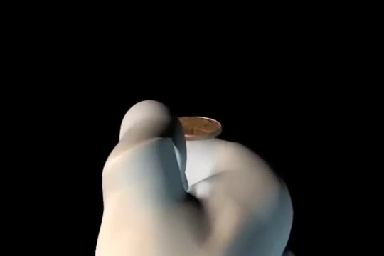

Randomized Admission Policy (RAP)
(Ben Basat et al.)
P=1/4 (c_{min}=3)
P=1/2 (c_{min}=1)
P=1/4 (c_{min}=3)
P=1/3 (c_{min}=2)

Slide 13
Adapting RAP to Programmable Switches
Space-Saving and RAP are for software!
Constraints of programmable switches:
Cannot know the global minimum counter
Partitioned memory – too late to update
How to flip coin?
Recirculation hurts throughput

Slide 14
Adapting to Data Plane:
Cannot Find Minimum
What if you can only R/W a few memory addresses?
Can’t find global minimum c_{min}
Find approximate minimum c’_{min}, by randomly querying 4 addresses (based on flow ID)
Count-Min Sketch (Cormode and Muthukrishnan),
HashPipe (Sivaraman et al.)
Flow ID: x
h₁(x)=0 h₂(x)=2 h₃(x)=0 h₄(x)=3
h₁ |  | h₂ |  | h₃ |  | h₄
Flow ID: y
h₁(y)=3 h₂(y)=2 h₃(y)=3 h₄(y)=1
Sivaraman et al. Heavy-hitter detection entirely in the data plane. SOSR 2017
Graham Cormode and Shan Muthukrishnan. An improved data stream summary: the count-min sketch and its applications. Journal of Algorithms 55.1 (2005): 58-75.

Slide 15
Adapting to Data Plane:
Too Late to Update
We know the approximate minimum count c’_{min} at the end of pipeline. Too late to update!
Solution: use a little recirculation
If coin flip succeeded, recirculate with (Flow ID, minimum stage #)
h₁ |  | h₂ |  | h₃ |  | h₄
5 |  |  |  | 7
 |  | 3
 |  |  |  |  |  | 4
4
Flow ID=x
Stage#=2, c’_{min}=3
Sivaraman et al. Heavy-hitter detection entirely in the data plane. SOSR 2017
Notes:
HashPipe choose to never recirc. The authors considered recirculation, but dismissed it as being impractical; hurts too much throughput.
We choose to recirc only a little bit…

Slide 16

Adapting to Data Plane:
How to flip coin?
P | P’ | How many binary coins?
1/2 | 1/2
1/3 | 1/4
1/4 | 1/4
1/5 | 1/8
1/7 | 1/8
1/8 | 1/8
1/9 | 1/16
We need to flip coin w.p. P=1/(c’_{min}+1)
No arbitrary flip! Only binary flips
Naïve solution:
  Find 2^{-N} ≥ P > 2^{-(N+1)}
  Flip N binary coins, get P’=2^{-N}
(2-approximation of probability P)
Better solution: use Match-Action Table
(1.125-approx., see paper)
Notes:
But how do I get the right probability?
We can’t do aribtrary probabilty like RAP in software.

Slide 17
Adapting to Data Plane:
Recirculation Hurts Throughput
Avoid packet reordering
  Send original (preserve ordering)
  Copy the packet, then recirc+drop
Upper-bound recirc. to a small percentage, e.g., 1%
  By initializing counters to 100
  Switch may have reserved capacity for recirc; no performance penalty.
h₁ |  |  | h₂ |  |  | h₃
_{ID} | # |  | _{ID} | # |  | _{ID} | #
N/A | 100 |  | N/A | 100 |  | N/A | 100
a | 101 |  | N/A | 100 |  | N/A | 100
c | 103 |  | f | 105 |  | N/A | 100
N/A | 100 |  | N/A | 100 |  | N/A | 100
c’_{min}≥ 100, P<1%

Slide 18
PRECISION Algorithm
h₁ |  |  | h₂ |  |  | h₃
_{ID} | # |  | _{ID} | # |  | _{ID} | #
a | 106 |  | N/A | 100 |  | N/A | 100
b | 103 |  | g | 102 |  | N/A | 100
c | 105 |  | f | 130 |  | k | 160
d | 104 |  | N/A | 100 |  | l | 180
Visit d=3 random entries, one per stage
  If ID matched, add 1!
  Otherwise, find out c’_{min}
Flip coin, P=1/(c’_{min}+1)
If coin is head:
  copy and recirculate
  update minimum counter
Pkt
ID=z
z
103
S#=2
ID=z
c’_{min}=102
Coin flip: P=1/103
Notes:
Process: we first…
Benefit: for each stage, we perform two very simple operations.
Check ID equal?
If this stage is minimum, remember this stage.
Know min, flip coin
Send original out (no latency/reordering), copy and recirc
update
At the end: Is it make sense for everyone?

Slide 19
Evaluation Highlight
Problems of recirculation:
Impact throughput?
    Bound probability to 1%!
    No accuracy loss
Delayed update?
    No accuracy loss
Other potential problems:
Approximated coin flip?
    2-approx. is good
    1.125-approx. is great
Limited stages?
    2 stages are good
    4 are great

Slide 20
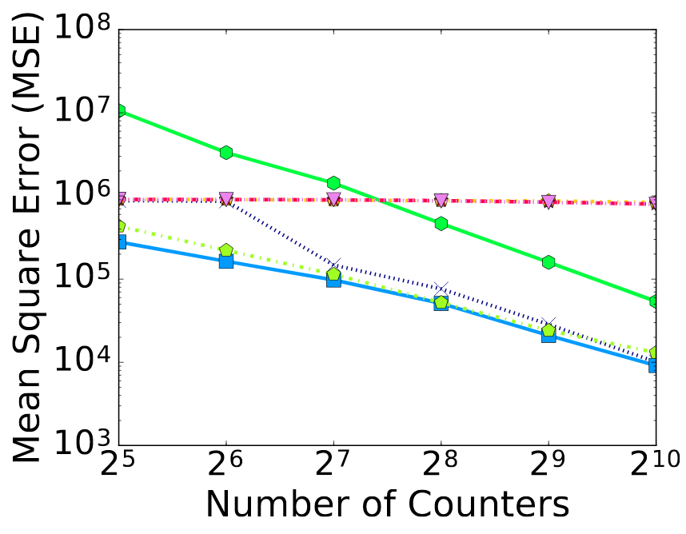







Evaluation: Mean-Square Error, CAIDA
Space-Saving:
HashPipe:
2-stage 4-stage 8-stage
PRECISION (2-stage):
2-approx. coin flip
1.125-approx. coin flip
ideal flip (RAP)
Notes:
We use CAIDA trace, collected from internet backbone. 2 million packets.
Say CAIDA is heavy-tailed, many small flows.
RAP, the best we can be. (remind: on software; PRECISION runs precision).

Slide 21
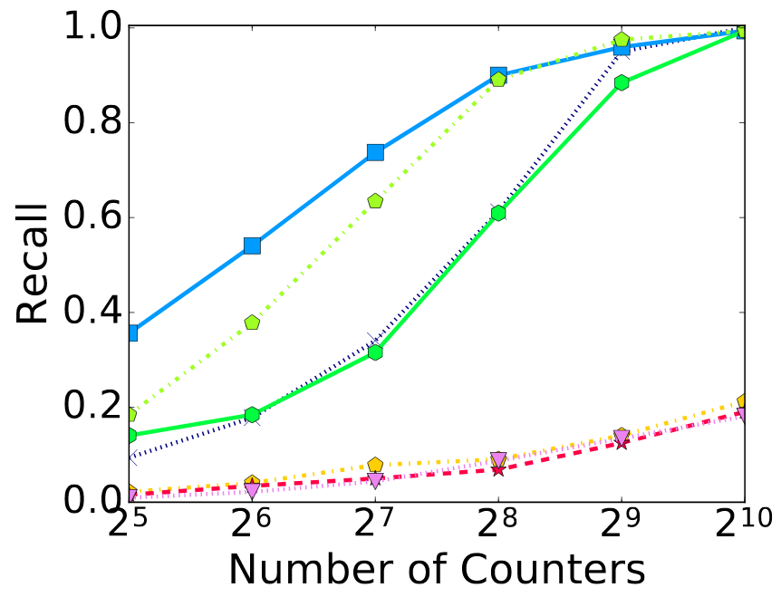
Evaluation: top-32 flows, CAIDA
Space-Saving:
HashPipe:
2-stage 4-stage 8-stage
PRECISION (2-stage):
2-approx. coin flip
1.125-approx. coin flip
ideal flip (RAP)

Slide 22
Summary
PRECISION:
an accurate, hardware-friendly algorithm for heavy-hitter detection on programmable switches.
Takeaway: approximate probabilistic recirculation!
Hardware Friendly.
Little Impact on throughput.
Better Accuracy.
Notes:
We successfully compiled it to Barefoot Tofino.

Slide 23

Any Questions
Notes:
Someone told me:
The worst thing to do in a conference is to keep hungry listeners from going to lunch.
Let me conclude here and answer some questions, before we enjoy the lunch break.
Thanks!

Slide 24
Backup Slides

Slide 25
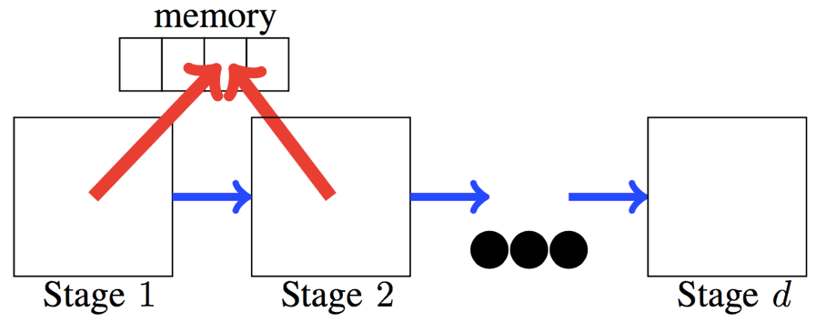
No Memory Access Across Stages
Packets are processed in parallel (one in each stage).
To avoid memory hazard, each memory address is only accessible from a single stage.

Slide 26
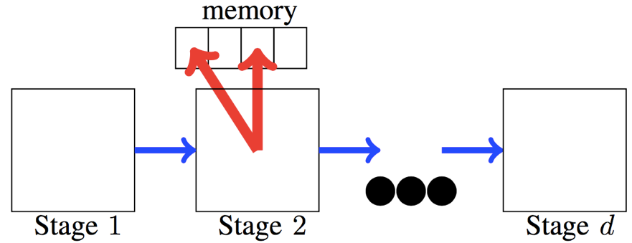
Read One Location Per Stage
Can only specify one SRAM address, then read or write.
Cannot access multiple locations.
The limitation is aimed at keeping per stage complexity low, resulting in high throughput.

Slide 27
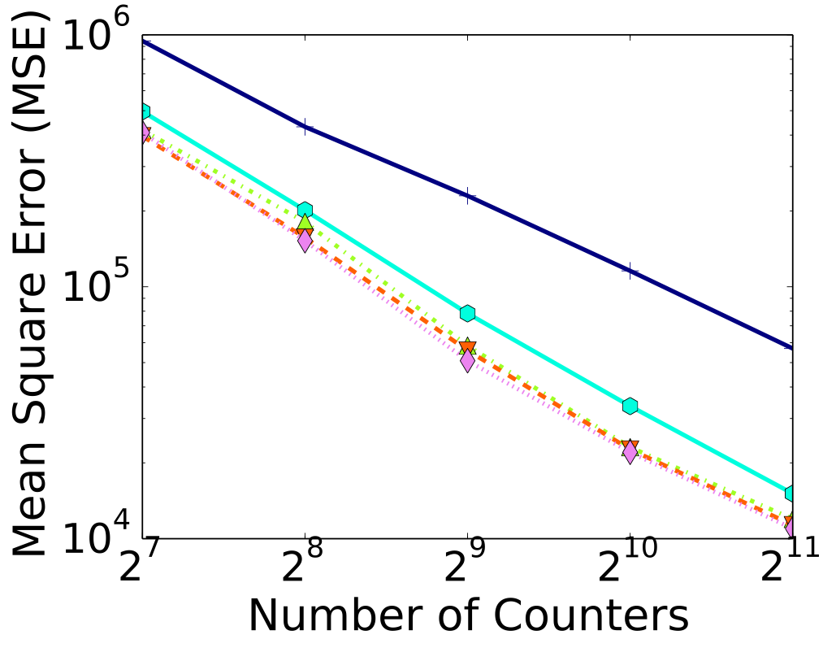
Eval 1: How many stages?
2-way associativity is sufficiently accurate

Slide 28
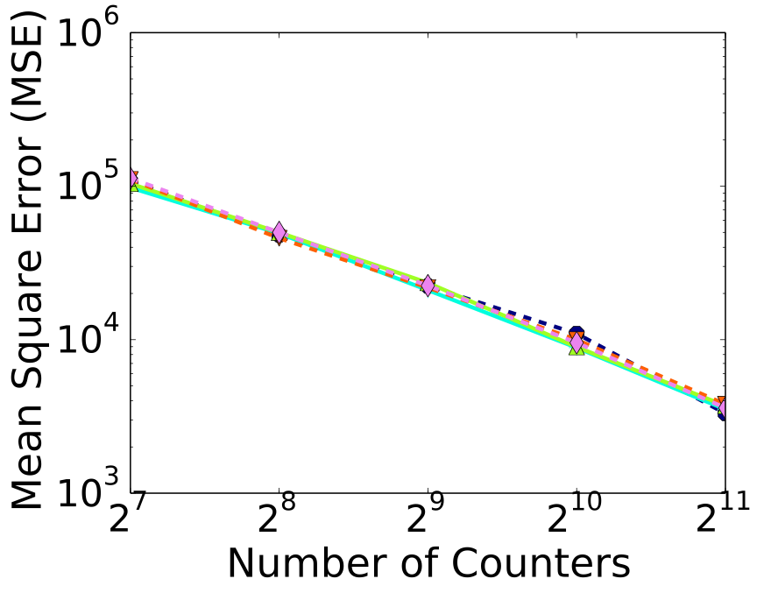
Eval 2: delayed by recirculation?
Recirculation delay (pipeline length) does not affect accuracy

Slide 29
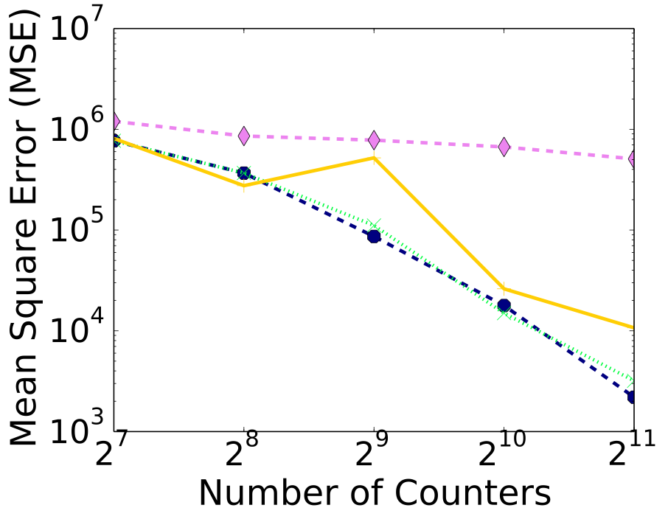
Eval 3: Bounded recirculation?
Bounding recirculation to 1% does not affect accuracy

Slide 30
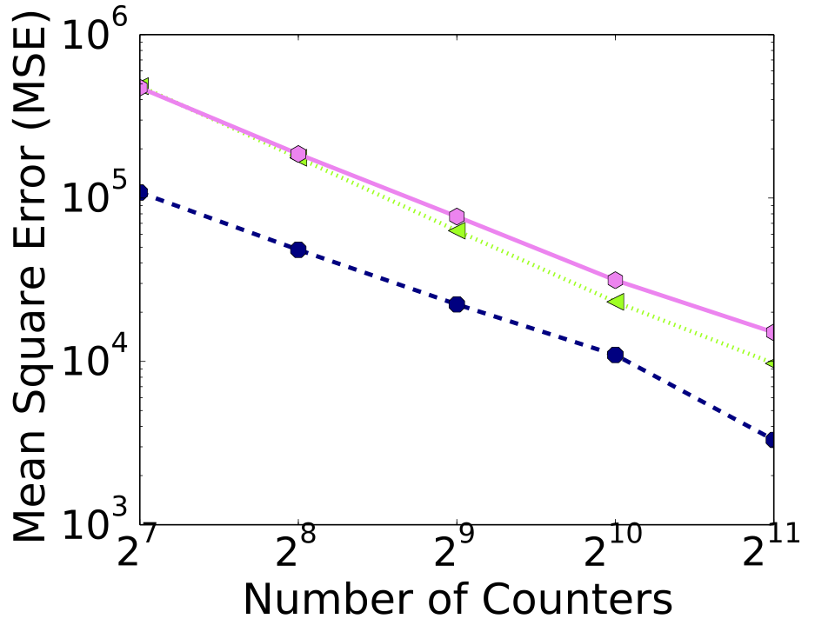
Eval 4: approximate probability?
Approximate 1/x probability does not affect accuracy.
(Figure not ready yet…)

Slide 31
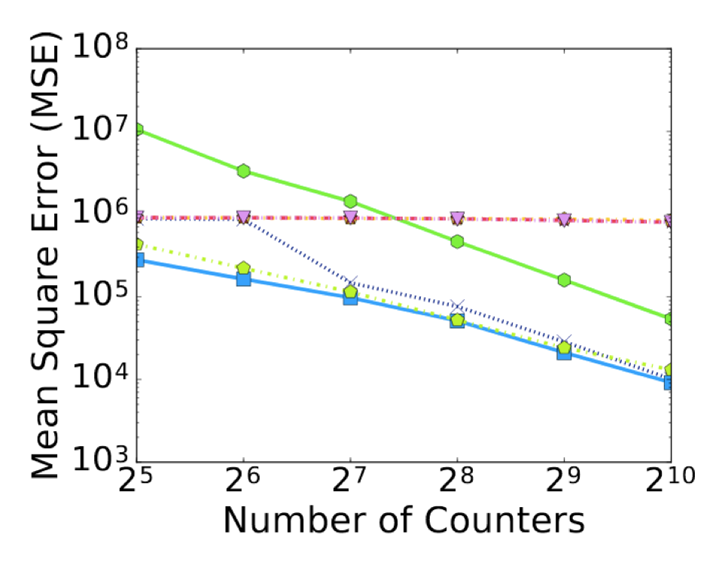




Comparison evaluation
PRECISION (d=2):
PRECISION is almost as accurate as Space-Saving

