Slide 1



ConQuest: Queue Analysis in the Data Plane
Xiaoqi Chen, Shir Landau Feibish, Yaron Koral, Jennifer Rexford, Ori Rottenstreich, Steven A Monetti, Tzuu-Yi Wang

Slide 2
Everyone hates…

Slide 3
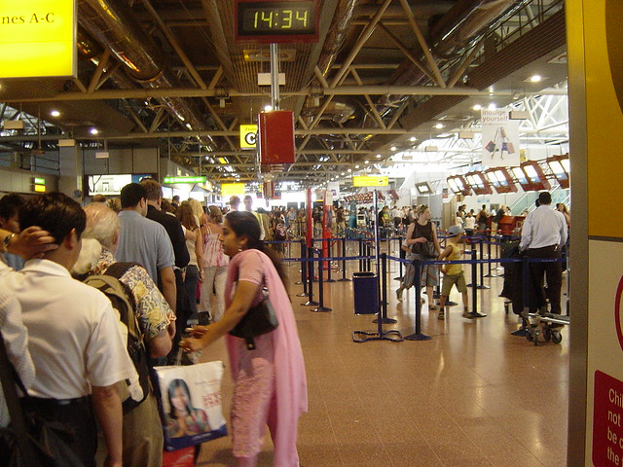
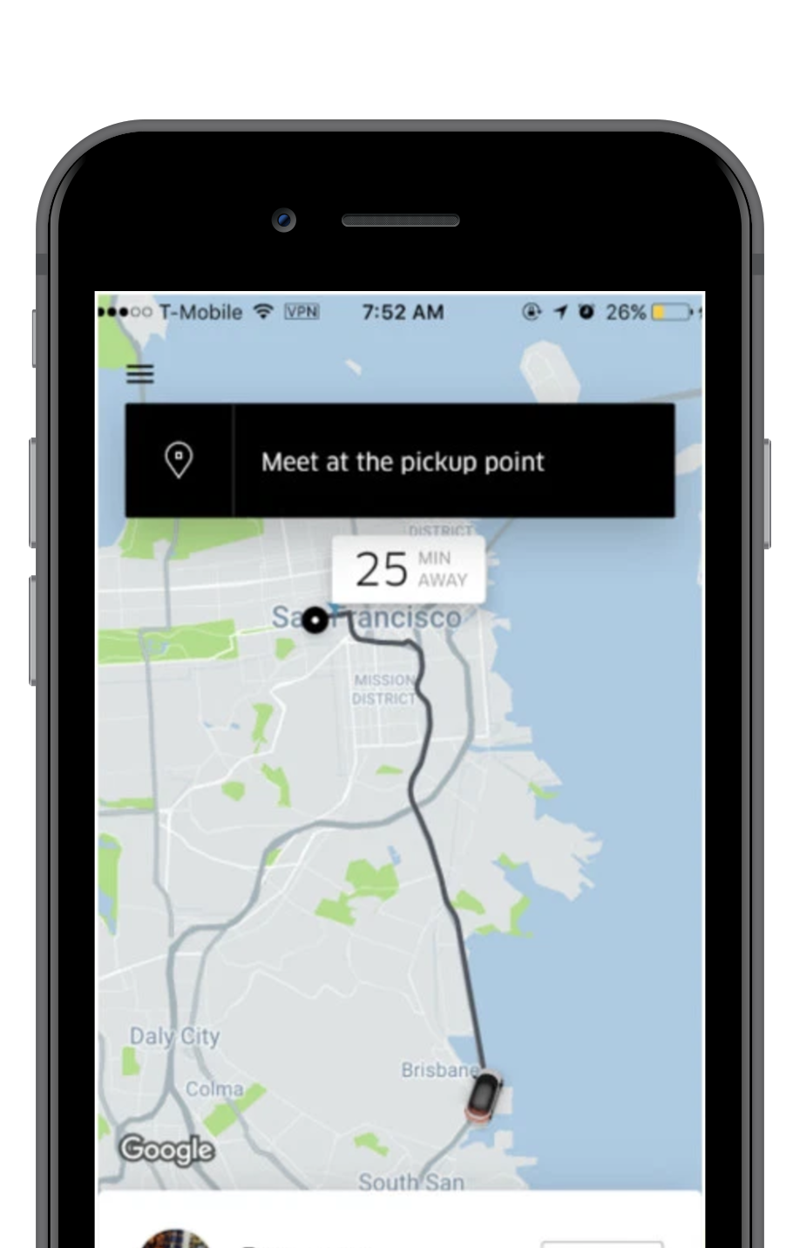
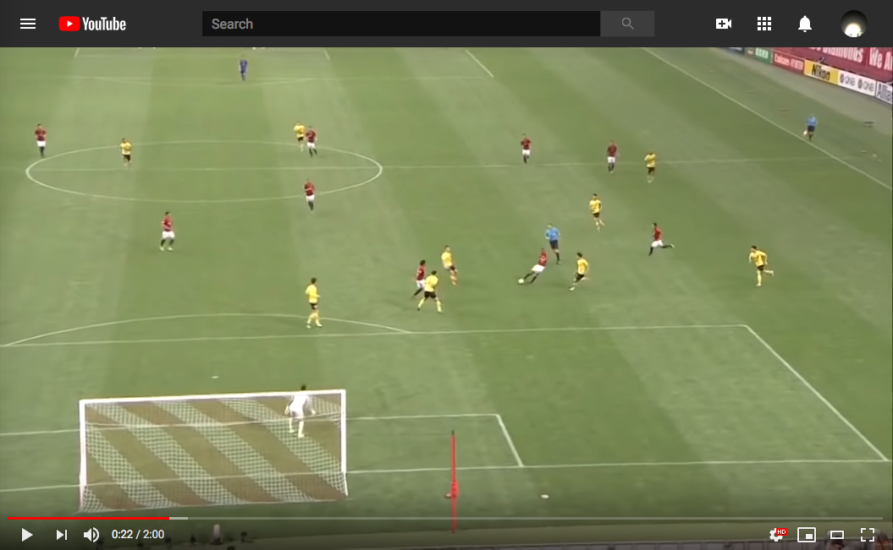

Everyone hates long queues… -

Slide 4
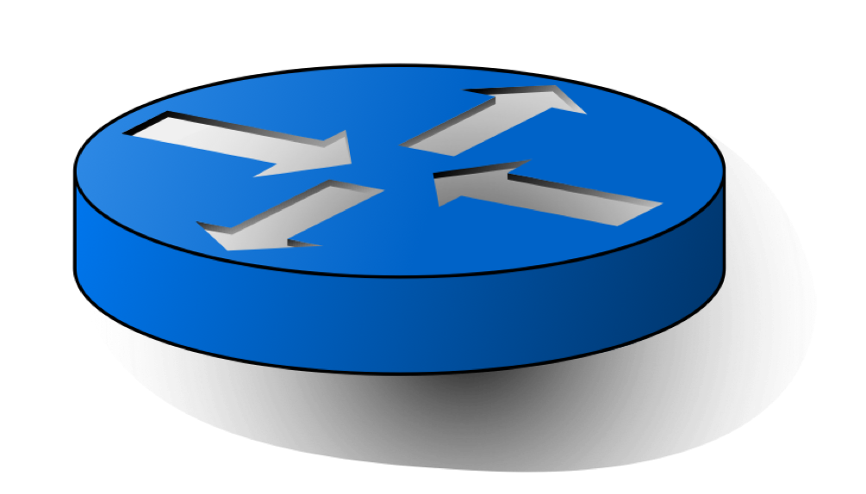
Queuing in routers
Ingress
Egress
Routing
Crossbar
Queue
Ingress
Egress
Routing
Queue
Ingress
Egress
Routing
Queue

Slide 5
Queuing in routers
Ingress
Egress
Routing
Crossbar
Queue
Ingress
Egress
Packet
Routing
Queue
Ingress
Egress
Packet
Routing
Queue

Slide 6
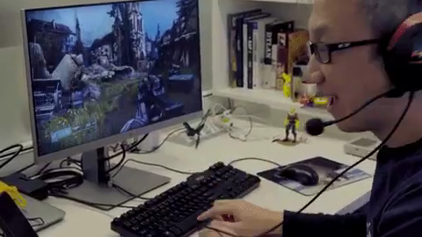
Long queues?
Ingress
Egress
Packet
Routing
Crossbar
Queue
Ingress
Egress
Packet
Routing
Queue
Packet
Ingress
Egress
Packet
Routing
Queue

Slide 7
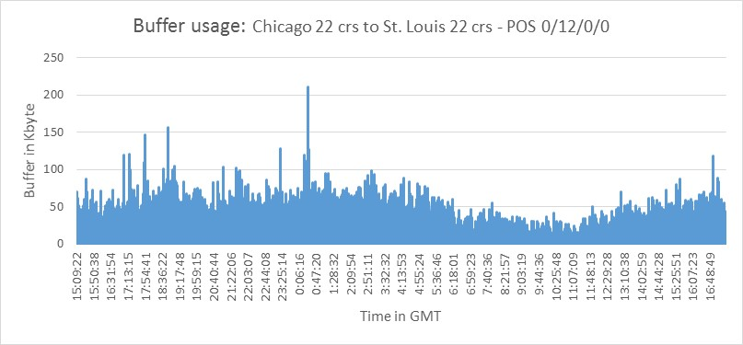
Long queues? Delay and jitter!
Bad for interactive applications
Microburst: sub-millisecond queuing
In data center networks (e.g., incast)
In carrier networks (unknown reason)
  Can’t use hosts to monitor/mitigate
5x
Microbursts
3x
Queue Length
1x
16:00:00
0:00:00
8:00:00
16:00:00
Time in day (24h)

Slide 8
Programmable switch to the rescue
Traditional routers:
limited visibility, coarse-grained stats
By the time you see microbursts,
the harm is already done…
P4-enabled programmable switch allows real-time, fine-grained queue analysis
5x
Microbursts
3x
Queue Length
1x
16:00:00
0:00:00
8:00:00
16:00:00
Time in day (24h)

Slide 9

Why am I waiting?
Which flow has many packets in the queue?
Flow ID: A
{SrcIP: XXX, DstIP: YYY}
Why am I waiting?
Egress
Queue
E
B
B
B
D
C
B
B
A
Why am I waiting?
It’s because
the NBA game!
It’s because flow B!

Slide 10
ConQuest: why am I waiting?

Slide 11
A strawman solution
Maintain a “flow size in the queue” table
Increment when packet arrives
Subtracts when packet exits
Egress
Queue
C
C
B
A
Flow | Count
1
A
0
B
1
Memory access
Memory access
2
C
1

Slide 12

Challenge: memory partitioned!
100 Gbps = one packet per 6.7 nanoseconds
Concurrent access is hard to implement
  Need to prevent memory hazard
Memory partitioned before and after queuing
Egress
Packet
Queue
Write
Write
Shared Memory

Slide 13
Solution: snapshots
Slice traffic into time windows
Each snapshot records T=4 packets
Why am I waiting?
Egress
Queue
B
B
E
C
B
B
C
A
D
B
B
D
A
B
I enqueued at t=5
I dequeued at t=14
Historical Departures
Flow | ~Count
 | 1
 | 5
 | 1
 | 1
?
S1 | S2 | S3 | S4 | …
A
Memory access
B
C
D

Slide 14

So far so good? Gotta reuse them
Each snapshot records
a time window T of traffic
(using sketch)
Write into one snapshot
Read recent snapshots
# snapshots to read =
(max queuing delay)/T
Need cleaning every T ≤ 1ms
Control plane is too slow!

Slide 15

Solution: round-robin snapshots
Clean and Reuse the snapshots in the data plane!
Read
Read
Write
Clean
Read
Read
Read

Slide 16
The ConQuest data structure
Slice traffic into time windows
For each packet dequeued:
  Write into the latest snapshot
  Read some recent snapshots
  Clean the oldest snapshot

Slide 17
Evaluation

Slide 18
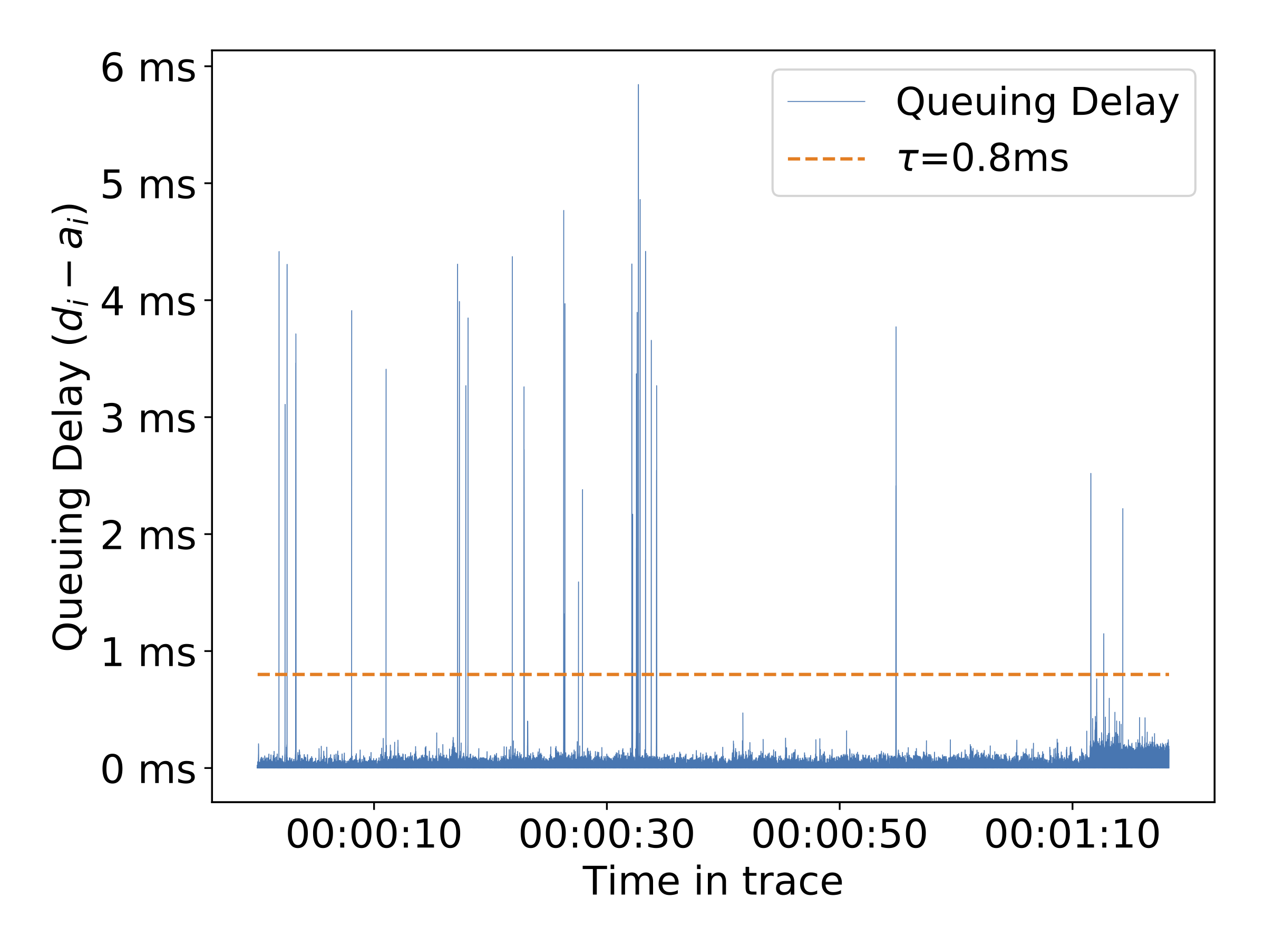
Evaluation 1: is ConQuest accurate?
Python-based Simulator
Trace: UWISC IMC’10 data center
Find flows occupying >α queue
Metric: Precision & Recall, for finding large flows in queue during congestion
Result: >90% Precision & Recall

Slide 19

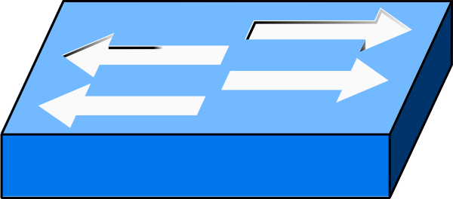

Evaluation 2: mitigate bursty flows?
Testbed with P4-enabled Barefoot Tofino, 4 snapshots
Test: flow-based ECN, when “a flow is causing others to wait”
  Baseline: ECN all packets, when queue is long
Send 1M TCP flows
+ synthetic bursts
100G
10G
Sender
Receiver

Slide 20
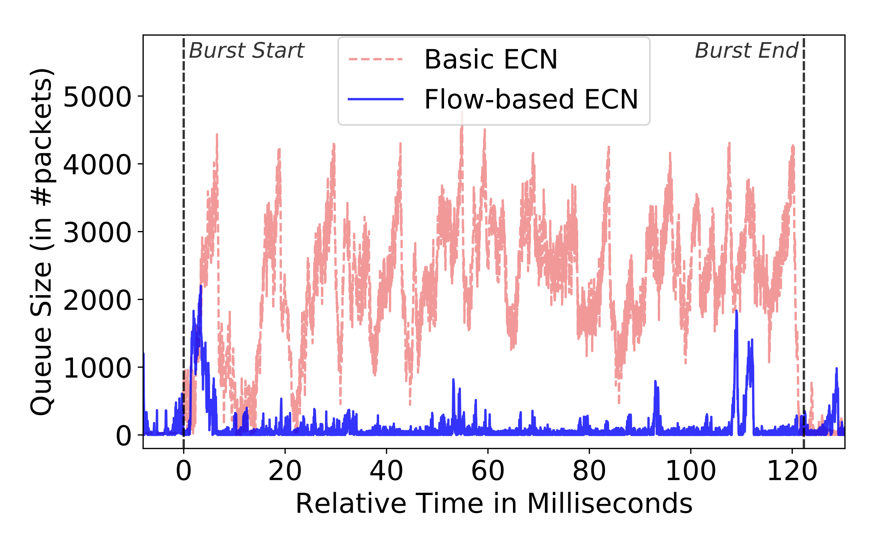
Evaluation 2: mitigate bursty flows?
Flow-based ECN reduces Flow Completion Time
Queue remains short, bursty flow effectively suppressed
11%

Slide 21

Legacy network device not programmable
Not all network devices are programmable yet …
We need queuing analytics now!
Y U no ?

Slide 22
Legacy network device
P
Egress
Ingress
Not all network devices are programmable yet…
We need queuing analytics now!
Tap ingress + egress links
Record a packet’s appearances, analyze queuing delay
P
Ingress
P
Egress
P
Ingress
Ingress
Ingress
Packet P, flow ID F
Enqueued at t=20
Packet P, flow ID F
Dequeued at t=28

Slide 23
Evaluation 3: analyze legacy devices
Measured delay matches coarse-grained report
Result: >90% Precision & Recall
Deployed for queues in the wild
  Princeton P4Campus
  AT&T Labs

Slide 24
Image Credits
Uber waiting screenshot: techcrunch, mockuphone
Airport: flickr.com/photos/heathershacienda/199507247/ CC-BY 2.0
Smurfs:
  pngimg.com/download/47420 CC-BY-NC 4.0
  clipartmag.com/smurf-drawing#smurf-drawing-10.jpg CC-BY-NC 4.0
  imgur.com/gallery/cdvqgwa imgur.com/a/KcmQhj6 Imgur tos UGC NC
High latency Stadia gaming: washingtonpost
Soccer video: youtu.be/J0dICCF7B6A

Slide 25
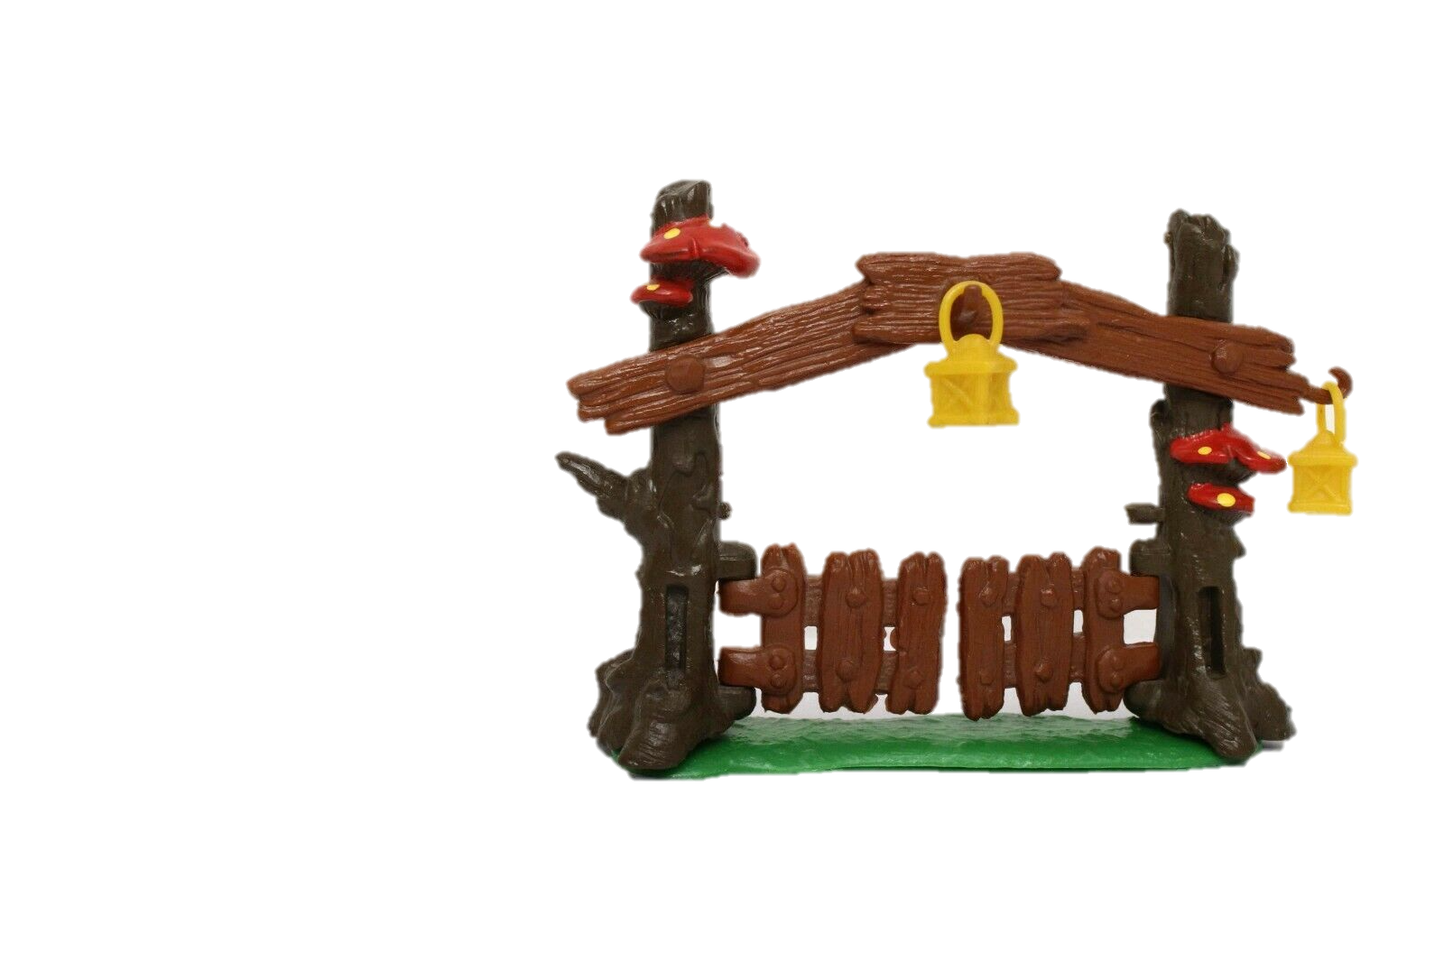
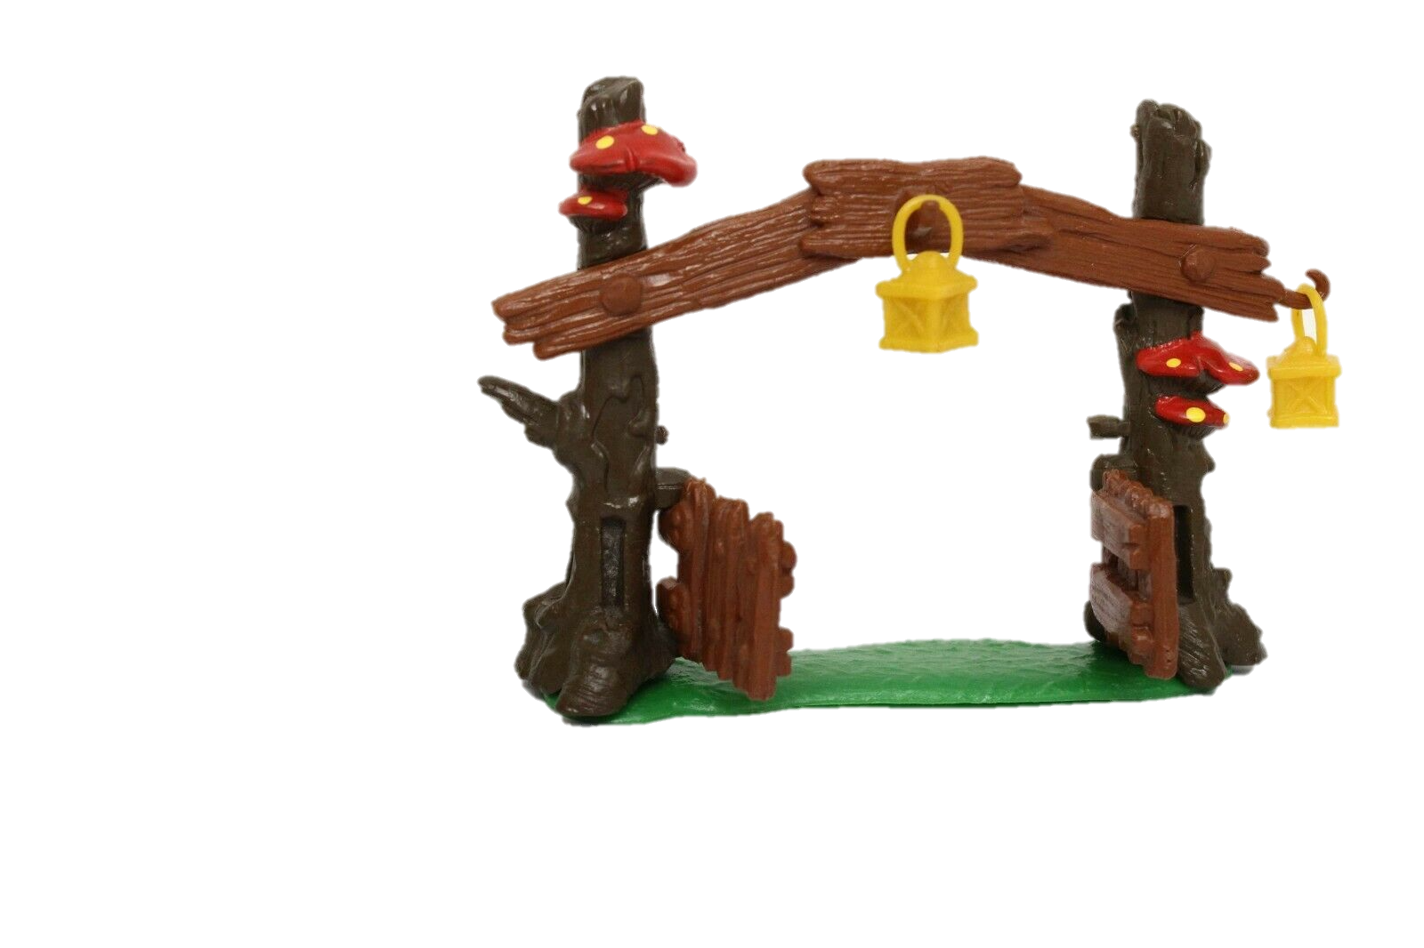

Summary, Q&A
ConQuest : round-robin snapshots in the data plane
Identify flows contributing to long queuing delay in real time
Reduce Flow Completion Time by up to 11% given bursty flows
Why am I waiting?
Egress

Slide 26
Backup slides

Slide 27
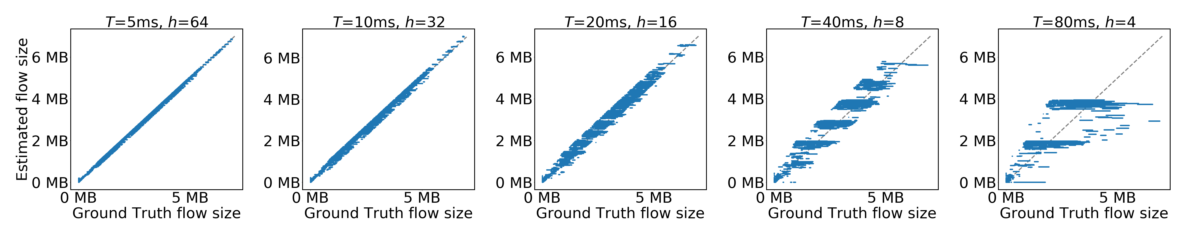
Estimated / Real flow size

Slide 28
Number of snapshots: 4 or 8

Slide 29
Per-snapshot memory size

Slide 30
Precision/Recall curve
Simulator
Testbed

Slide 31
Hash Collision / Rounding

