Slide 1


Scalable Real-Time Bandwidth Fairness in Programmable Switches
Robert MacDavid, Xiaoqi Chen, Jennifer Rexford
INFOCOM 2023
May 17th,2023
Notes:
Jen‘s feedback on AHAB talk slides. For INFOCOM
I do think the talk errs too much on the side of summarizing the paper, rather than on advertising the paper. Granted, for the Pronto audience, they’ll have already bought into the challenges of PISA data places and the motivation. But, for INFOCOM, you’ll probably want to focus more on motivation and less on being complete.
you have a lot of graphs and results. you may want to — particularly for the infocom talk — have fewer graphs.

Slide 2
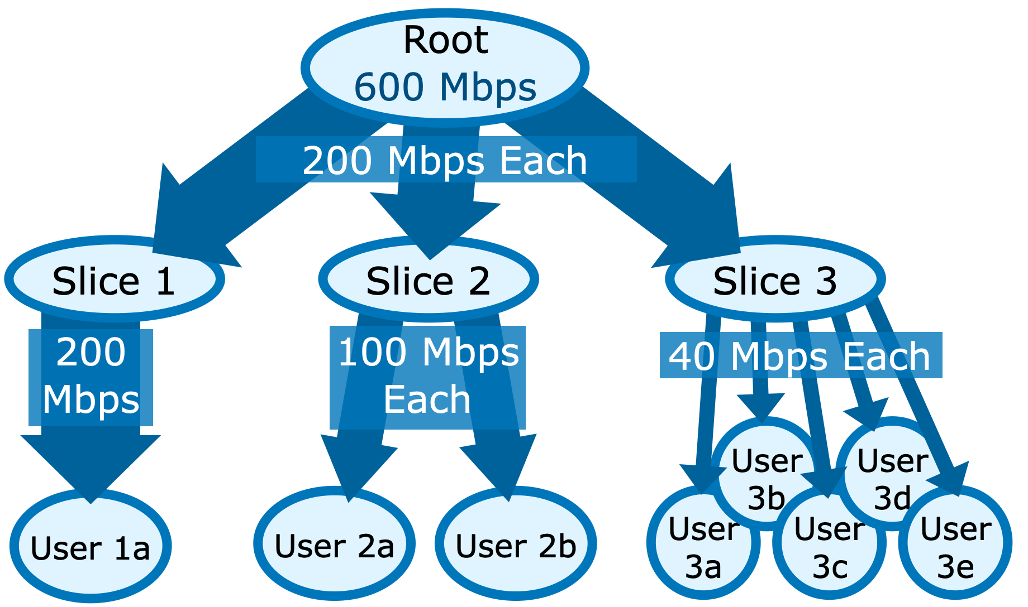
Network Slicing and Bandwidth Fairness
Each slice / user gets a fair share of bandwidth
* For simplicity, all slices and users have equal weight.
Trivial to add weighted case.

Slide 3
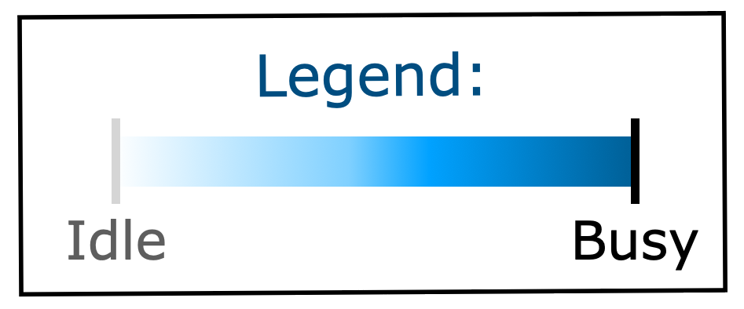
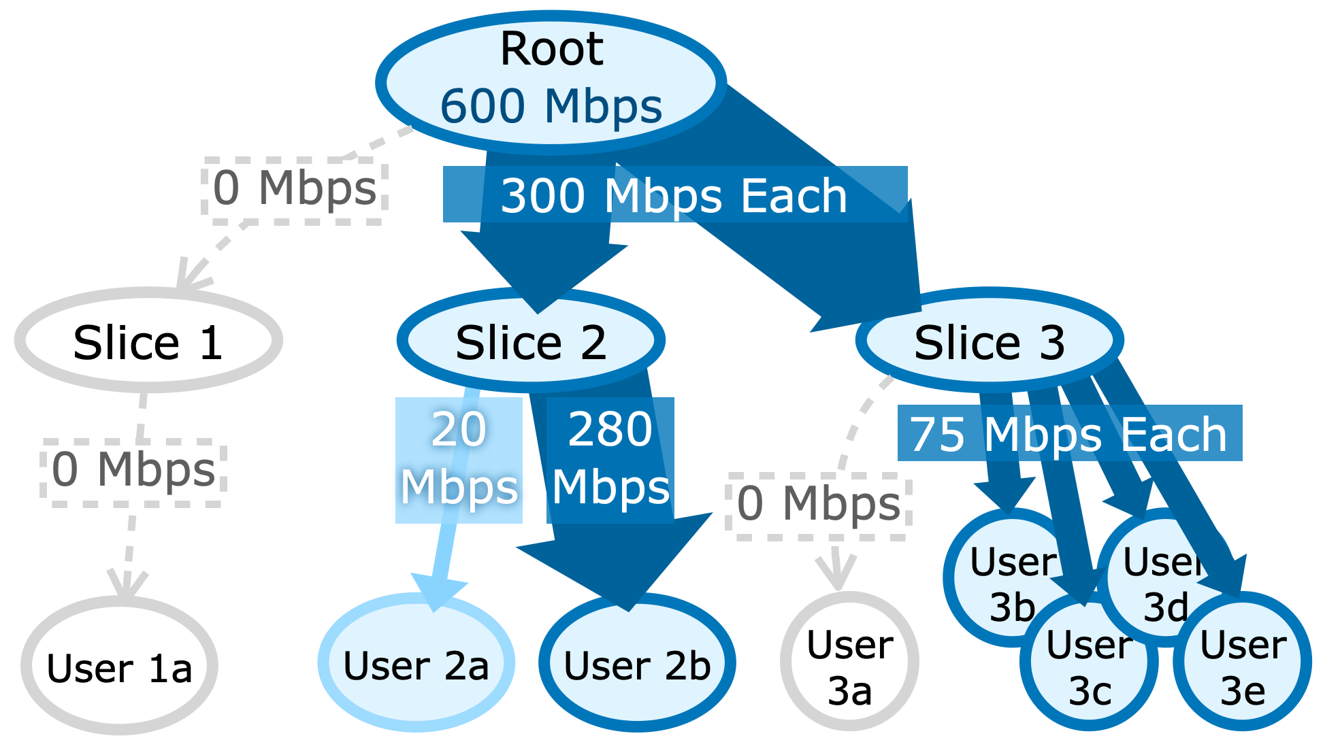
Network Slicing and Bandwidth Fairness
Each slice / user gets a fair share of bandwidth
If some user or slice is underutilized, fairly re-allocate the surplus
User 1a, 3a go offline
User 2a needs only 20

Slide 4



AHAB: Scalable hierarchical bandwidth fairness
Goal: Support thousands of slices, millions of users
CPU-based Software switch? High latency
Programmable switch? Hardware constraints
  8-32 hardware queues per port
  Limited arithmetic
  Small memory

Slide 5
AHAB: Scalable hierarchical bandwidth fairness
Challenge 1: can’t easily calculate the per-user fair rate limit
Solution: guess a limit, closed-loop iterative update
Challenge 2: can’t use per-user memory to track sending rate
Solution: CMS-LPF sketch, approximate per-user rate

Slide 6
Outline
Problem definition & challenge
Finding bandwidth limit using closed-loop iterative update
Avoiding per-user memory using CMS-LPF sketch
Implementation on Tofino
Evaluation: Fast, Accurate, and Scalable

Slide 7


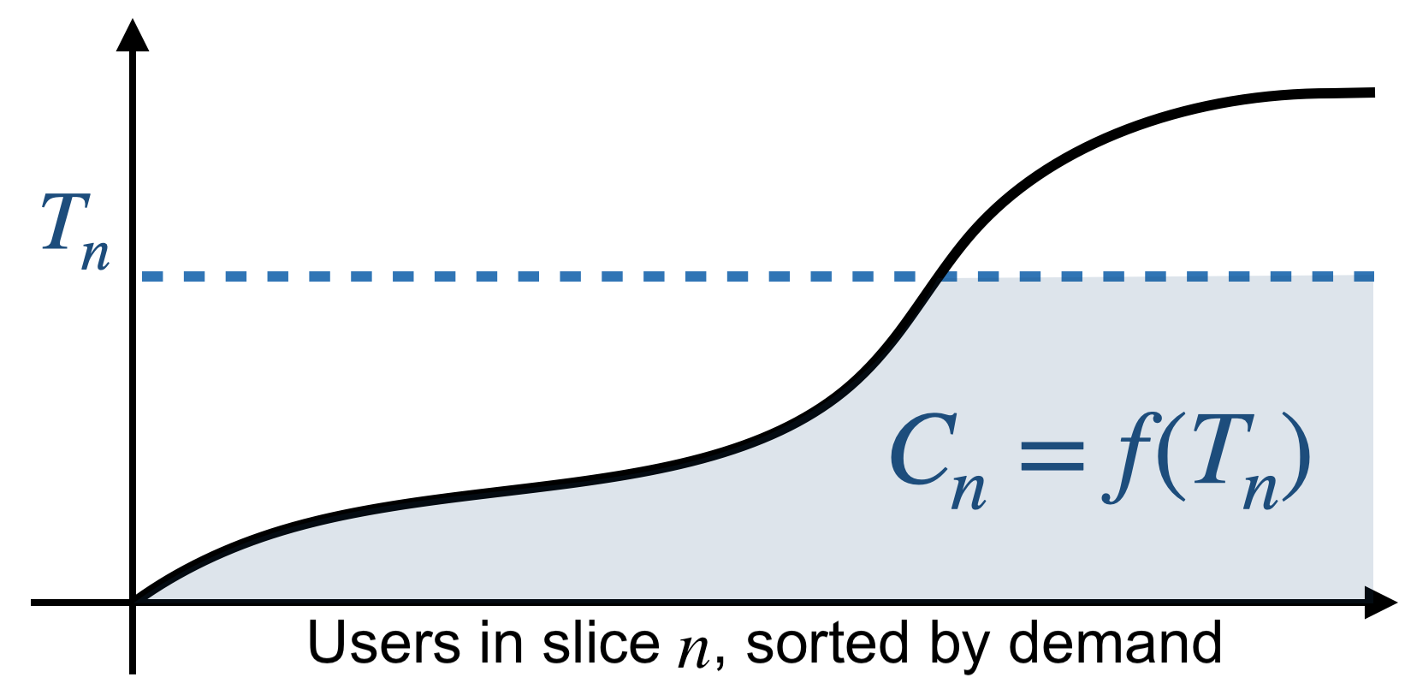
Challenge 1: Finding fair per-user rate limit
Demand: 20Mbps
Demand: 180Mbps
Limited to: 110Mbps
Sort and plot all user’s bandwidth demand
Apply limit T_{n}
Total bandwidth used is shaded area f(T_{n})
T_{n}
110Mbps

Slide 8
Challenge 1: Finding fair per-user rate limit
The ”right” limit means total usage equals capacity:
C_{n} =f(T_{n})
But how do we find T_{n}?
Just guess and refine!
Demand: 20Mbps
Demand: 180Mbps
Limited to: 110Mbps
T_{n}
110Mbps

Slide 9
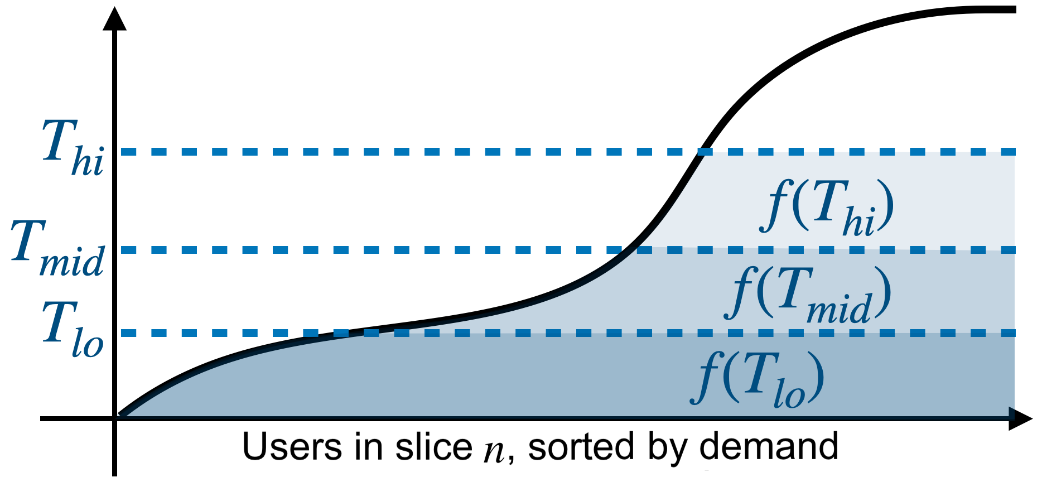
Fair rate limit via closed-loop refinement
Adjust T : pick 3 candidates, track 3 hypothetical demands

Slide 10
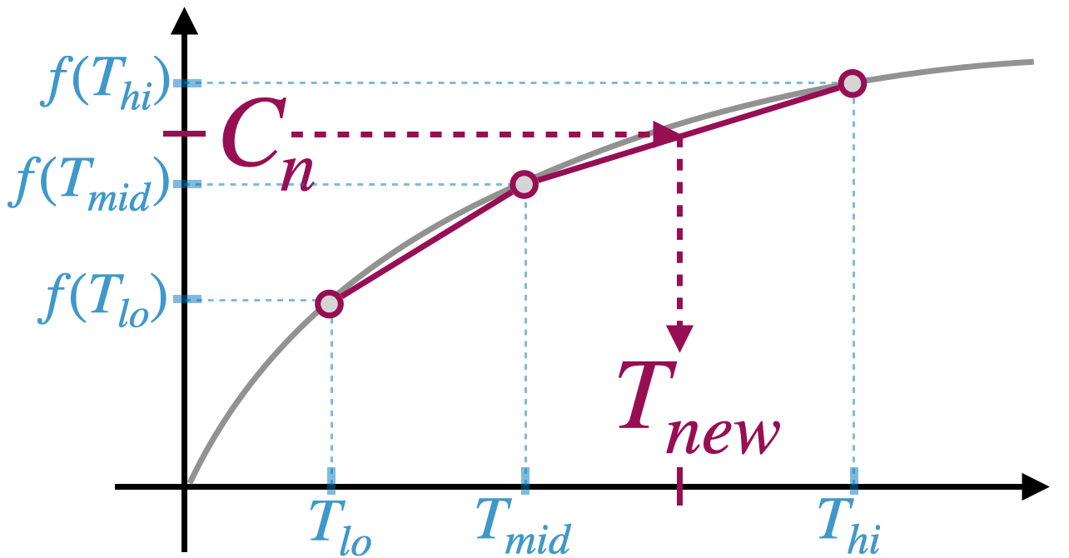
Fair rate limit via closed-loop refinement
Plot f(T ) on Y-axis. X-axis is different T limits
We can then map C_{n} into T_{new} , via linear interpolation
Repeat every epoch, until convergence

Slide 11
Challenge 2: Tracking per-user sending rate
Rate limit T can be enforced via probabilistic drop*:
p= (1-T/R)
But this requires knowing sending rate R
How to get per-user sending rate, without per-user memory?
Idea: we only care about heavy users… Use sketch!
* Disclaimers:
Only when R >T
This is for UDP. For TCP needs something fancier (see paper)

Slide 12

Solving scalability challenge: CMS-LPF sketch
Count-Min Sketch: approximate data structure for heavy-hitter flows
CMS-LPF: approximate
per-user sending rate
h₁(id)
h₂(id)
h₃(id)
0 | +1 | 0 | 0 | 2
14 | 0 | +1 | 5 | 0
7 | 0 | 23 | 0 | +1
Pkt
Flow id
min
Estimate
flow size
h₁(id)
h₂(id)
h₃(id)
Σ
Σ
Σ
Σ
Σ
T, uid,
size
Pkt
Σ
Σ
Σ
Σ
Σ
Low-Pass Filter:
self-decaying counter for
exponential moving average
Σ
Σ
Σ
Σ
Σ
min
Estimate
per-user sending rate
Pkt
Time,
Pkt size
Σ
Average total sending rate

Slide 13
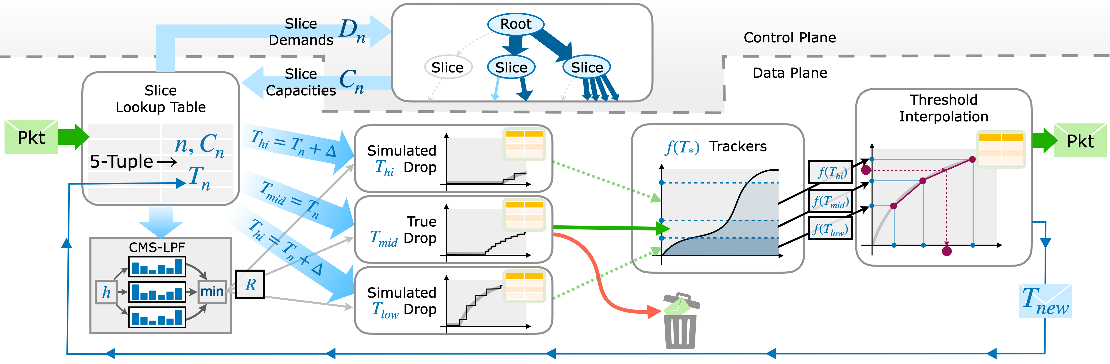
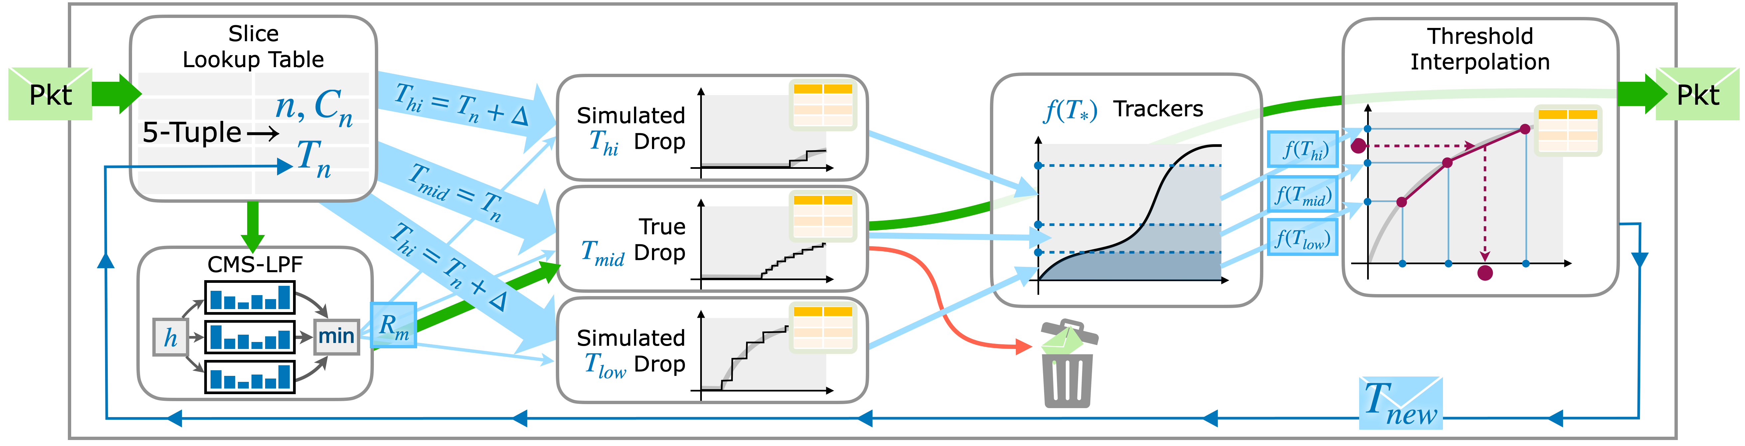
AHAB’s Hardware implementation on Tofino
First, look up slice id n and its current per-user rate limit T_{n} ;
Also, use CMS-LPF to get estimated per-user sending rate R .
Approximated probabilistic dropping (using match-action rules).
Linear interpolation for new rate limit T_{new} ; update using messenger packets.

Slide 14
Evaluation overview
1. How fast can AHAB converge to the right limit?
✓ 3.1ms, 13x faster than state-of-the-art
2. How fair (accurate)?
✓ Throughput within 4%-6% of ideal fair rate
3. Can AHAB scale?
✓ Millions of users

Slide 15
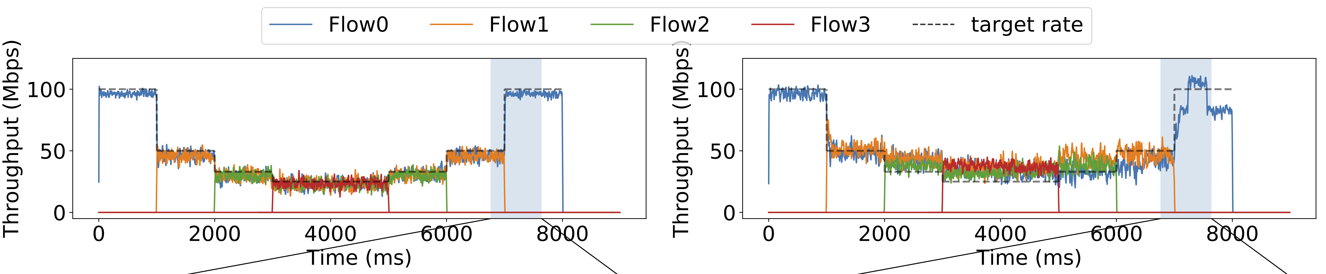
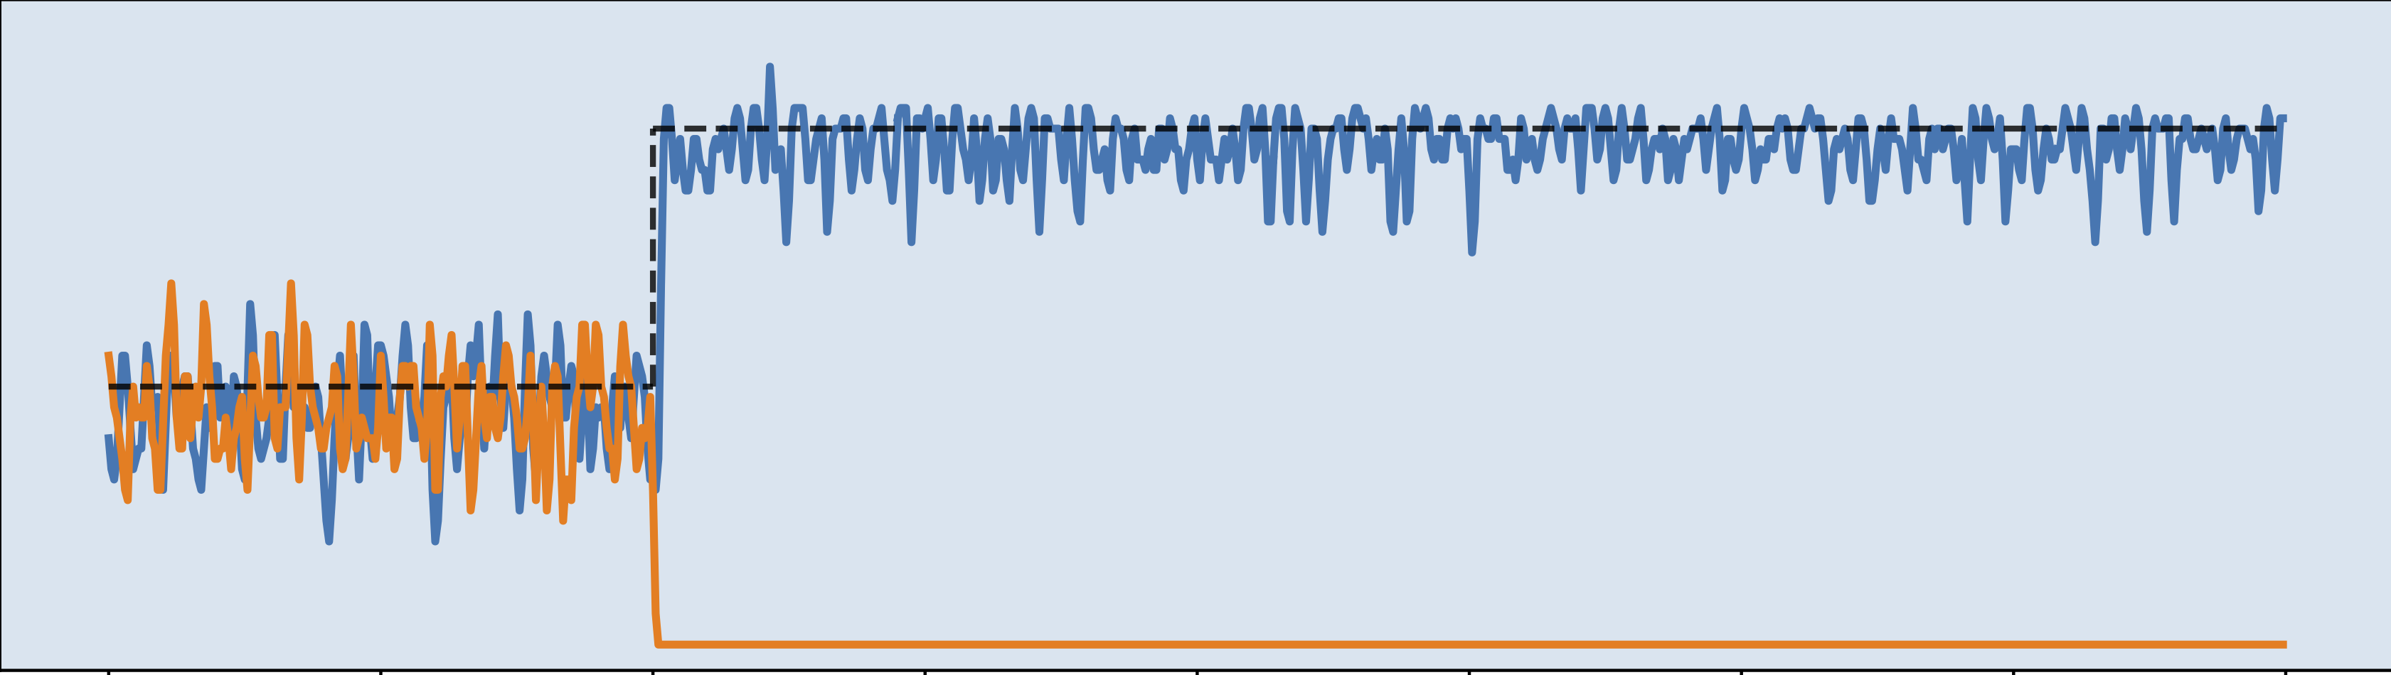
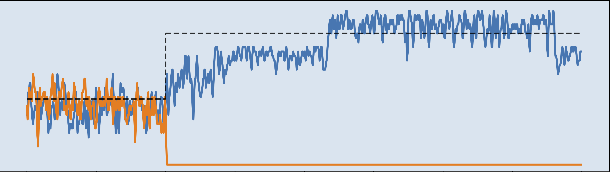
Eval 1: Fast convergence
Setup: 1 to 4 flows sharing a slice (fixed 100Mbps capacity)
Compare AHAB with prior state-of-the-art, HCSFQ

Slide 16
Eval 1: Fast convergence to fairness
AHAB’s iterative update converges in 3.1ms
Instead, HCSFQ needs 42ms to converge (13x)

Slide 17
Eval 2: Accuracy
Flows with different demands: 10Mbps, 20Mbps, 30Mbps…160Mbps
Enforced to within 4%-6% of fair bandwidth limit.

Slide 18
Eval 3: Scalability
Simulate CMS-LPF errors for a very large number of users,
using local ISP trace (6M users) and CAIDA (7.3M users)
# of Users | CMS-LPF size needed | SRAM utilization
3 millions | 2048x3 (24KB) | 1.56%
6 millions | 4096x3 (48KB) | 2.60%
24 millions (est.) | 16384x3 (768KB) | 8.85%
Other hardware resource metrics
HW Resource | Instr. Words | Hash Unit | TCAM | Stages
Utilization | 28.6% | 37.5% | 5.2% | 12+9

Slide 19

Summary, Q&A
AHAB: scalable bandwidth fairness, with slicing/hierarchy
using closed-loop iterative refinement to find rate limits,
and CMS-LPF sketch for estimating per-user sending rate.
Runs on today’s switches
Converges in milliseconds
Supports millions of users
https://github.com/
Princeton-Cabernet/AHAB

