Slide 1
Campus network as a P4 Lab
Xiaoqi Chen, Princeton University
https://p4campus.cs.princeton.edu

Slide 2
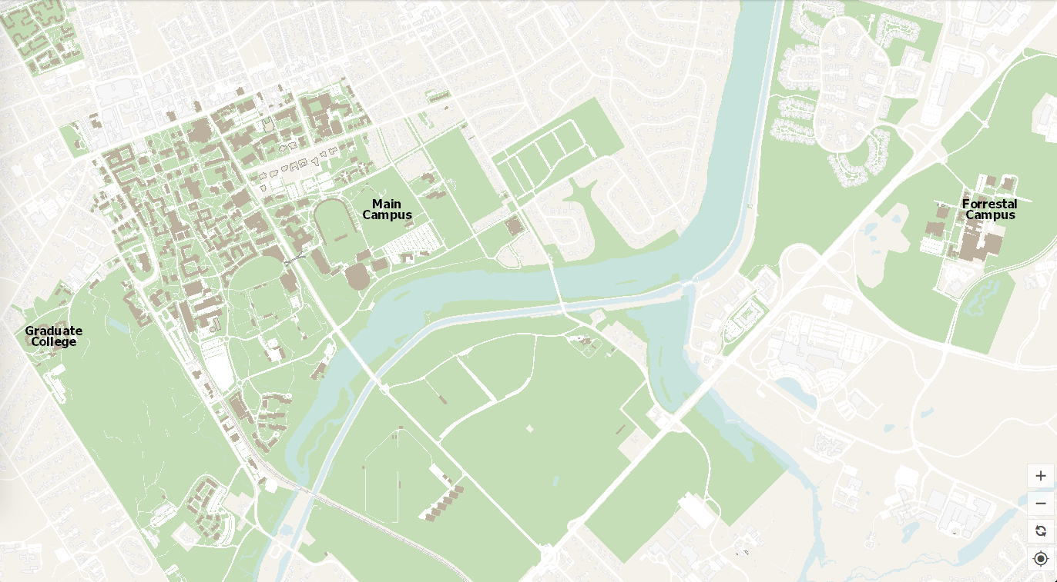
Why deploy in campus?
A tangible first step
before carrier / data center networks
Iterate faster
“local” collaboration / approval
Benefits the community
students enjoy faster network

Slide 3
Campus network as a testbed!
A representative enterprise network
  Internet peering, many routers, firewall, different user roles
Same problems as all networks
  Congestion, drops, failures, attacks
An open and dynamic network
  BYOD, a lot of experimental stuff, less restrictive access

Slide 4
P4 Apps for campus network
Security
  OS fingerprint analysis
  Intrusion detection offload
  Honeypot / Deception
Privacy
  Trace anonymization
  Surveillance protection
Performance
  Heavy hitter detection
  Queue and microburst analysis
  RTT statistics
  DNS cache

Slide 5
P4 Apps for campus network
Security
  OS fingerprint analysis
  Intrusion detection offload
  Honeypot / Deception
Privacy
  Trace anonymization
  Surveillance protection
Performance
  Heavy hitter detection
  Queue and microburst analysis
  RTT statistics
  DNS cache
Green: already deployed
Yellow: developing P4 program

Slide 6
Our workflow
Establish collaboration with campus network operator
  Find collaborator, point of contact
  Identify potential use cases of P4
Administrative approval
  data management scheme & anonymization
Develop and deploy individual P4 ”apps”

Slide 7
Lifecycle of each “P4 app”
Concept
Develop ideas
BMV2 prototype
Trace test
Simulation
Tofino prototype
Paper writing
Deploy & Iterate
Trace test
Debug with live traffic
Write non-P4 components

Slide 8
CS Dept cluster
P4 switch
Internet
P4 switch
I2
CS Dept gateway
Peering with local ISPs
ESNet
Peering with
ESNet
Peering with
Internet2
OIT core switch
P4 switch
OIT router
OIT core switch
Forrestal campus supercomputing center
P4 switch
Other clusters
CS Dept gateway
P4 switch
CS colo

Slide 9
Case study 1: PRECISION
Goal: Monitor heavy hitter flows in the network.
Challenge:
  Border link speed is 10/100Gbps, can’t capture & analyze on CPU
  Sampling captures the largest flows, but miss medium-sized flows
Use a heavy-hitter detection P4 program
  Maintain & update a list of heavy flows in data plane
See our ICNP’18 paper for more detail
Efficient Measurement on Programmable Switches Using Probabilistic Recirculation.
Ran Ben-Basat, Xiaoqi Chen, Gil Einziger, Ori Rottenstreich

Slide 10
Findings
10Gbps mirrored traffic from border router
Top-1 host is an open source mirror site
mirror.math.princeton.edu

Slide 11

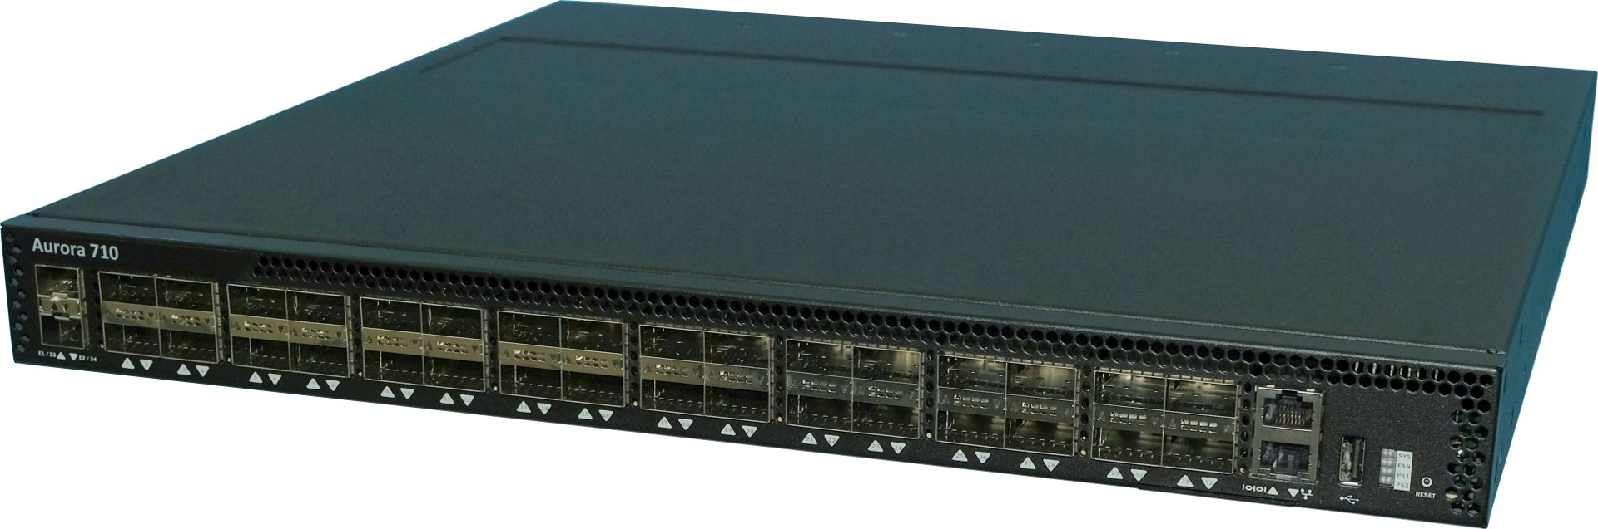
Case study 2: Snappy
Internet2
Issue: a link with high packet drop and low average link utilization
  Microburst?
  Which flows caused the drop?
Challenge:
  Bursts happen at short timescale
  Legacy routers do not support reporting queuing statistics
Use an off-path queuing analytics P4 program
See our CoNEXT’19 paper for more detail
Fine-Grained Queue Measurement in the Data Plane. Xiaoqi Chen, Shir Landau Feibish, Yaron Koral, Jennifer Rexford, Ori Rottenstreich, Steven A Monetti, Tzuu-Yi Wang
100G
Border router
100G
Target router
10G
10G
10G
10G, lossy
P4 Programmable switch

Slide 12
Findings
For each high loss event, there are bursts of packets from PerfSonar servers from Internet2
  Maybe: simultaneous throughput tests?
  Claim: they’ll be scheduled “exclusively”?
For other high queue utilization events without loss, there are only one throughput testing flow

Slide 13
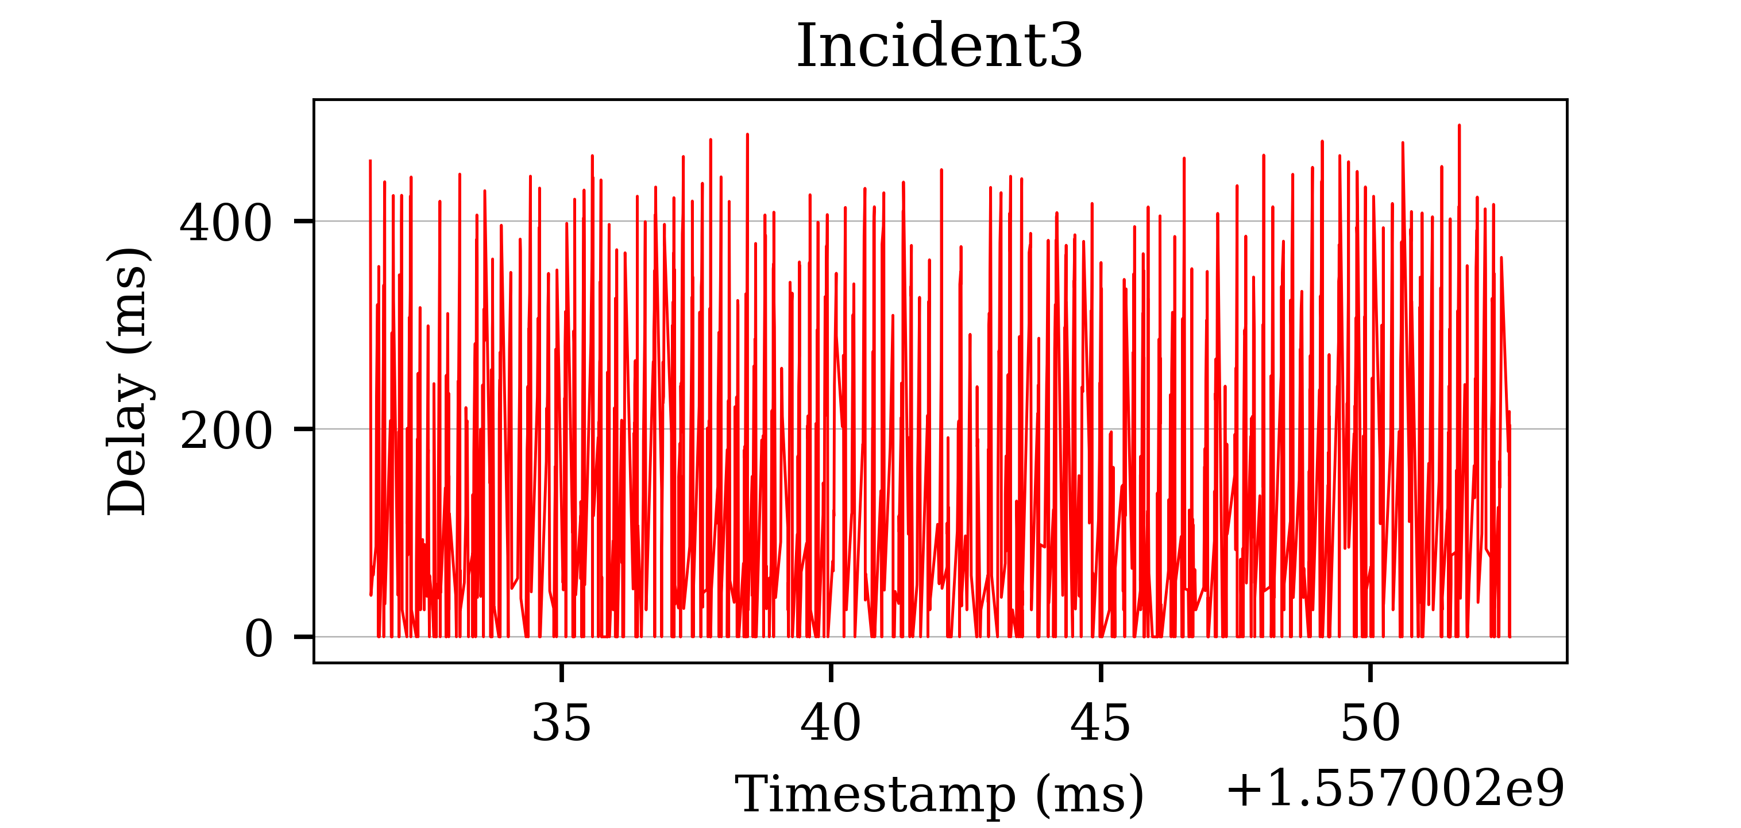
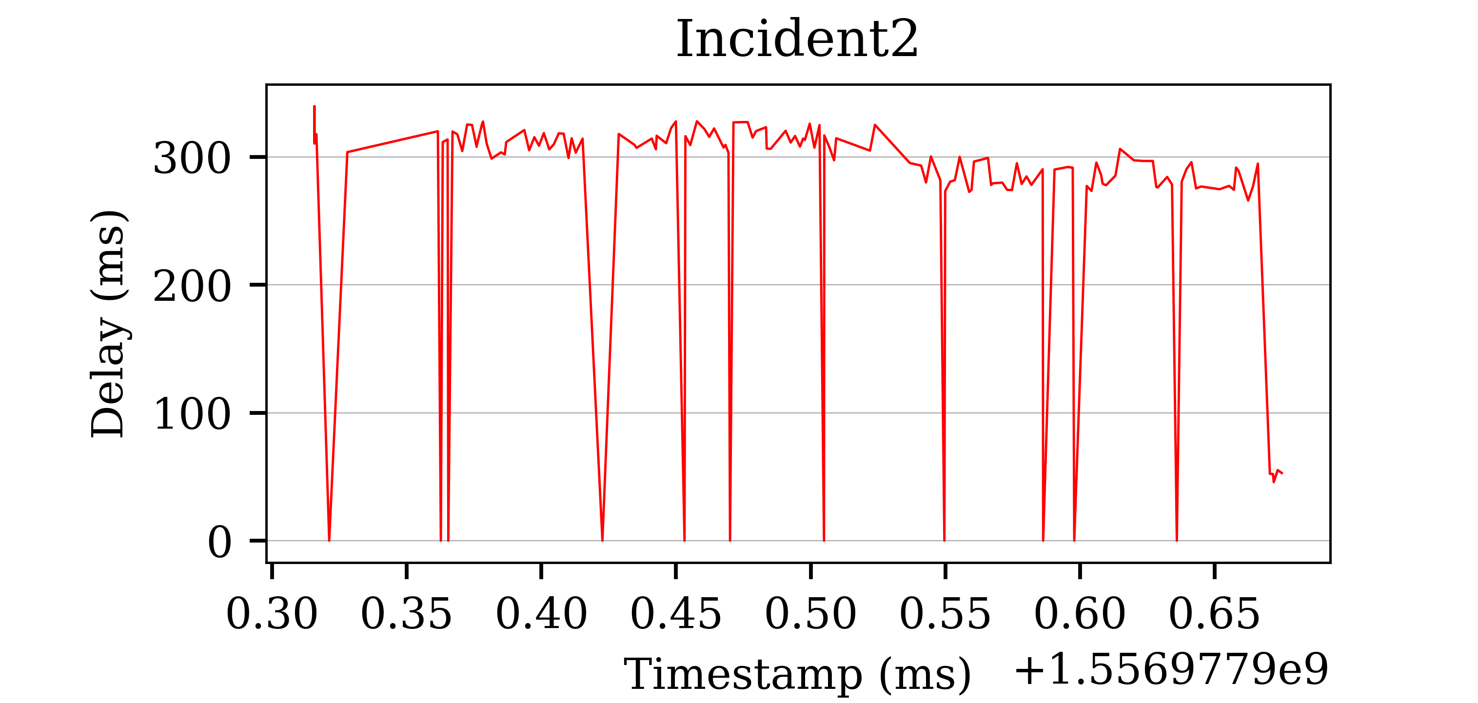
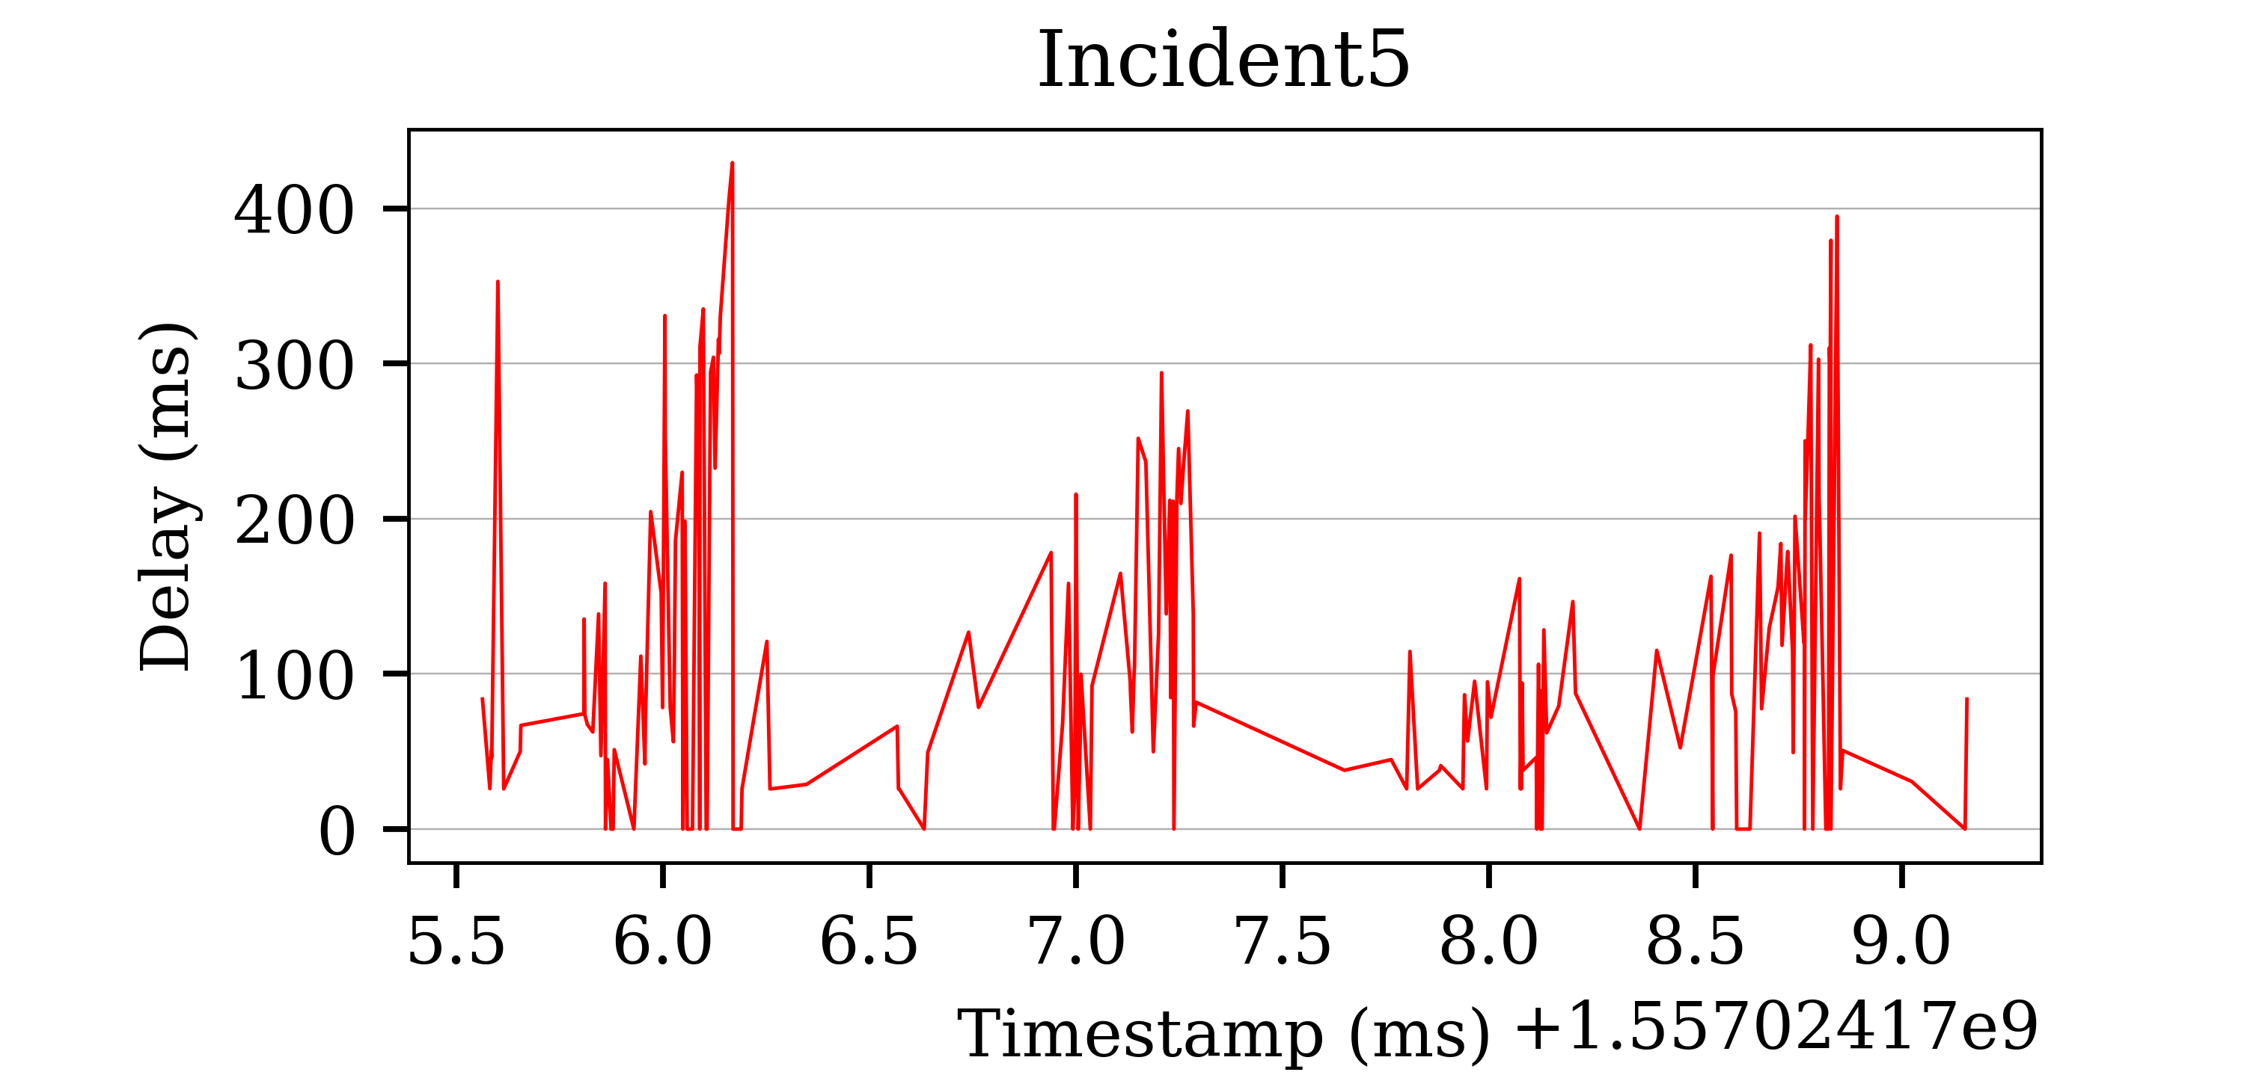
Findings
Only one incoming throughput test
Simultaneous tests
Congestion control working well
Very few packet drops
Congestion Control failing

Slide 14
Lesson learned
From BMV2+Mininet to Tofino+Campus Net
  Fitting and adapting P4
    Think about hardware while designing algorithm
  Debugging back and forth unavoidable, need fast iteration
Can provide value for campus network
  Even small improvement / innovation can be useful for operators!

Slide 15
Share our apps, share our methodology
Contact us for code sharing
  Build a collection of apps!
Work with campus network operators everywhere!
  Deploy P4 into many academic networks
  Start administrative approval process early
Reach out to us: p4campus@princeton.edu
Learn more: https://p4campus.cs.princeton.edu
Notes:
If you have a switch, you can also run our code (via Barefoot’s FASTER program). Reach out to us if you need any help

