Slide 1
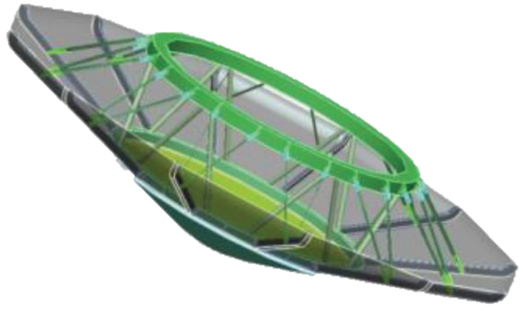


OPTIMAL ENTRY TRAJECTORIES AT VENUS USING MECHANICALLY DEPLOYED DECELERATORS
May 19, 2014.
Sarag J. Saikia
sarag@purdue.edu
Harish Saranathan, Michael J. Grant, James M. Longuski
School of Aeronautics and Astronautics, Purdue University
Workshop on Venus Exploration Targets
May 19–21, 2014, Lunar and Planetary Institute, Houston, TX.

Slide 2

Why Venus?
The 2013 Planetary Science Decadal Survey recommends the Venus In Situ Explorer mission as highest-priority within New Frontiers class.
Venus In Situ Explorer Science Goals
Understand chemistry, mineralogy, weathering of the Venus’ crust
Understand history and properties of Venus atmosphere and the role of water
Understand key drivers of atmospheric dynamics and climate
Understand planetary-scale evidence of past hydrological cycles

Slide 3

Requirements of Venus In Situ Mission
Achieving a majority of the above goals represents a New Frontiers class mission
Measurements of deep atmospheric gas compositions and surface mineralogy require an in situ mission
Venus Intrepid Tessera Lander (VITaL) concept was evaluated for the 2013 Decadal Survey
Magellan radar data

Slide 4
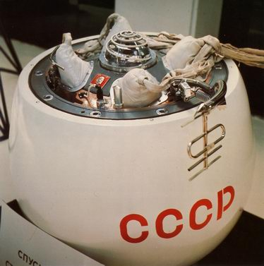
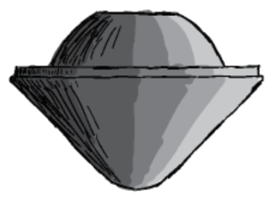
EDL Challenges on Venus
Venera (Russia) and Pioneer-Venus (US): successful missions to survive harsh Venus entry conditions
Employed traditional rigid aeroshell technology (high ballistic coefficient), Carbon Phenolic (CP) thermal protection system (only with flight heritage)
CP: high density and high thermal conductivity
    Requirement: Increase heat flux, and lower heat load (shorten duration)
For “ballistic” entry, steep entry flight path angle is selected
    High deceleration loading (150-500 g’s)
    High heat fluxes (3–17 kW/cm2)
Carbon Phenolic is in short supply!
Venera 7
Pioneer-Venus

Slide 5
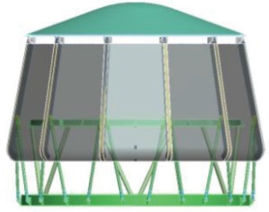
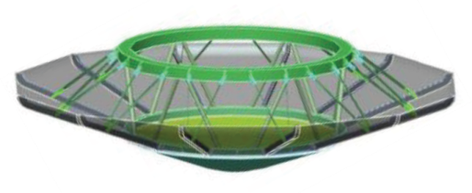
Low Ballistic Coefficient Entry Systems
Shallower entry flight angles possible using low ballistic coefficient (<30 kg/m²) entry system
To overcome limits of rigid aeroshells due to launch vehicle fairing diameter: in-space deployment of a decelerator system to increase drag-area
  Low ballistic coefficient
Adaptive Deployable Entry and Placement Technology (ADEPT) is a viable mechanically deployed decelerator entry system being developed by NASA
ADEPT
Stowed and Deployed

Slide 6
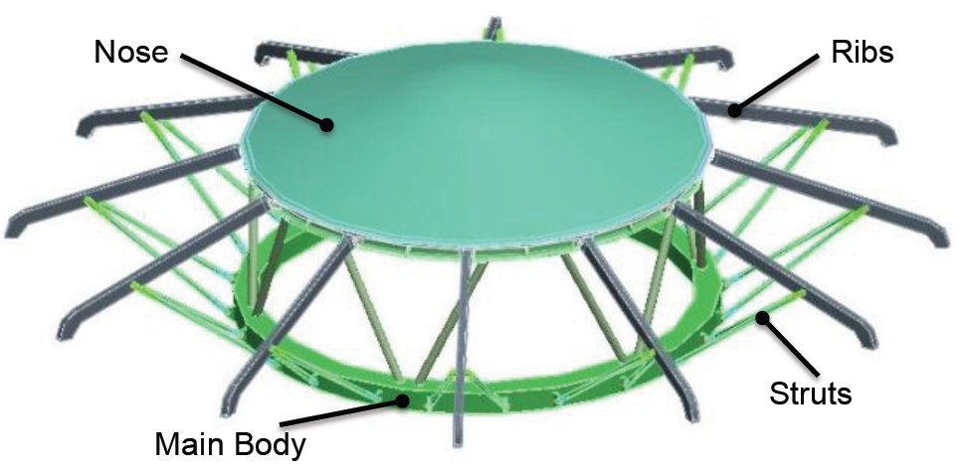
ADEPT
ADEPT achieves low ballistic coefficient by mechanically deploying a decelerator surface
Has four primary subsystems: main body, nose cap, ribs, and struts
Nose cap is a traditional 70° sphere-cone aeroshell with a base diameter of 3 m
Ribs provide support to the tensioned 3D-woven carbon cloth (thermal protection system) and a pair of struts in turn support each rib: against aerodynamic loads
Maximum diameter for the ADEPT is 6m and preserves the 70° sphere-cone geometry when fully deployed
ADEPT Structure

Slide 7
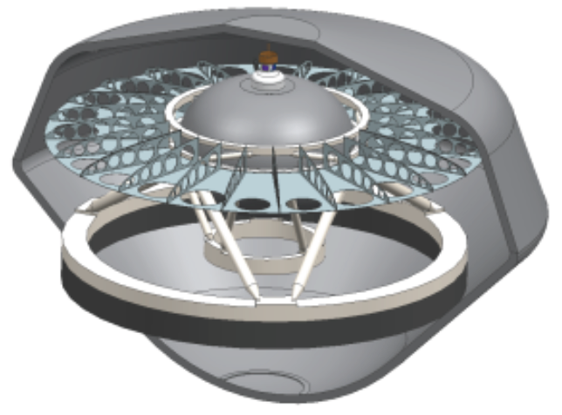
Baseline Mission Concept
VITaL repackaged from rigid aeroshell in to ADEPT Decelerator
Lander mass of 1050 kg, instruments carried inside a pressurized vessel
Thermal management system supports 3 hours of operation
Entry mass of 1602 kg: carries the payload from entry interface to subsonic (Mach 0.8 ) parachute deployment at around ~75 km
Parachute extracts the lander from ADEPT Decelerator
Lander lands in a Tessera region (study baseline is Ovda Regio, 3.7°E longitude, and , 25.4°S latitude) carries same instruments as VITaL
Fulfill the same scientific objectives as ViTaL

Slide 8

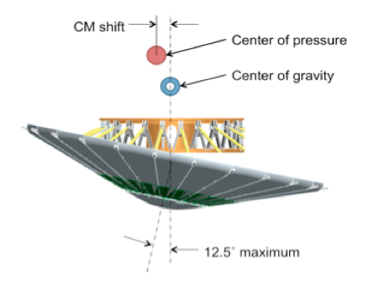
ADEPT CONTROL STRATEGIES
Bank Angle Control: The vehicle is trimmed at 12.5º angle-of-attack. The vertical component of lift vector is controlled by varying the bank angle.
Drag Control: The ADEPT vehicle is trimmed at 0º angle-of-attack. The drag coefficient is varied by controlling the level of deployment of the decelerator system.
Angle-of-Attack and Bank Angle Control: The aero-surface is suitably gimbaled to orient the lift vector in the desired direction. This results in to a unique combination of angle-of-attack and bank angle.
Angle-of-Attack, Drag, and Bank Angle Control: In addition to gimbaling the aero-surface, the drag skirt deployment angle is also controlled.
Drag Control
Angle-of-Attack and Bank Angle Control

Slide 9
CONTROL STRATEGIES: COMPARISONS
Five control strategies (including combinations) are compared:
Ballistic entry (no control)
Drag (Ballistic Coefficient) control
Bank angle control
Angle-of-Attack (AoA), and Bank Angle Control
AoA, Bank Angle, and Drag Control

Slide 10
TRAJECTORY OPTIMIZATION
Trajectory optimization was performed using GPOPS, for each control strategy. The trajectory was optimized for minimum stagnation-point heat-load.
Initial conditions:
Entry velocity = 10.8 km/s
Entry flight path angle = free
Entry altitude = 200 km
Entry downrange = 0 km
Final conditions:
Velocity = free
Flight path angle = free
Altitude = free
Downrange = free
g-load Path constraint: The minimum peak g-load was found in each case which outputs a feasible solution.

Slide 11
ALTITUDE VS. VELOCITY
The plot for bank angle control and AoA-drag-bank angle control closely match that of AoA-bank angle control.

Slide 12
g-LOAD VS. ALTITUDE
Guided entry has the capability to reduce g-load to ~3 g’s, as opposed to ADEPT ballistic entry (~30 g’s).
The minimum peak g-load was found in each case which outputs a feasible solution.

Slide 13
HEAT-RATE VS. g-LOAD
Guided entry has the capability to reduce the stagnation-point heat-rate to ~160 W/cm², as opposed to ADEPT ballistic entry (~300 W/cm²).
Only convective stagnation point heating is considered. Radiative heating for the assumed entry speed if very small compared to convective.

Slide 14
HEAT-LOAD VS. TIME
Integrated stagnation-point heat-load is higher for guided entry because of increase in time of flight.
Additional TPS material can be added to counter the increased heat-load, at the expense of slight increase in entry mass. Further analysis needs to be done because the additional TPS mass will alter trajectory.

Slide 15
ALTITUDE VS. DOWNRANGE
Downrange information of the spacecraft for different control methods

Slide 16
1. CONTROL HISTORY: DRAG CONTROL ONLY
The vehicle flies with the drag skirt fully deployed up to 100 s, after which it is partially retracted and redeployed to stay on the g-load constraint (6 g). This is done again after ~225 s.

Slide 17
2. CONTROL HISTORY: BANK ANGLE CONTROL
The artifacts in control history are likely due to the use of Venus-GRAM. They can be reduced by tightening the error tolerance(s) in the optimizer.

Slide 18
3. CONTROL HISTORY: ANGLE-OF-ATTACK AND BANK ANGLE CONTROL
The artifacts in AoA control history are likely due to the use of Venus-GRAM. They can be reduced by tightening the error tolerance in the optimizer.

Slide 19
CONTROL HISTORY: AoA, DRAG, AND BANK ANGLE CONTROL
This control methodology will result in the slacking of drag skirt when partially deployed. This results in turbulent flow, which can increase heat-rate by a factor of 3. The calculated aerodynamic coefficients using modified Newtonian flow assumption can have higher error because of slackened drag-skirt.

Slide 20
SUMMARY AND CONCLUSIONS
Low-β ADEPT lifting and guided entry (in contrast to ballistic entry) leads to
  further reduction in peak deceleration loads (3–6 g) Vs. 30 g for ADEPT ballistic entry
  reduction in convective heat-flux (~160 W/cm²) Vs. ~300 W/cm² for ADEPT ballistic entry
Integrated stagnation-point heat-load increases because of increase in time of flight
Drag control (β), angle-of-attack (α), and bank angle (σ) and combination thereof used as control strategies. β-α-σ control strategy results in least peak g-load
Mechanism for gimbaling the decelerator system involves minimal additional structural elements
Introduction of β-control will require additional control elements (increase in mass)
Order of magnitude decrease in peak deceleration: significant mass savings
Precision delivery of scientific payloads is possible when control is used

