Slide 1
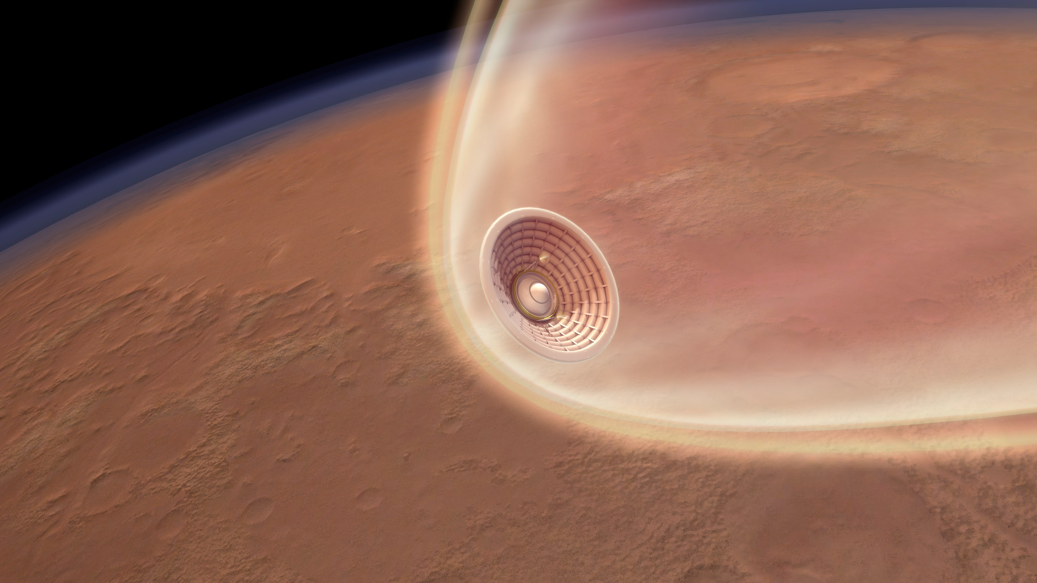
Numerical Optimal Control Methods
Applied to Mars EDL
Max Fagin
Rapid Design of Systems Lab
Purdue University
17th Annual Mars Society Convention
League City, TX, Aug 7, 2014

Slide 2
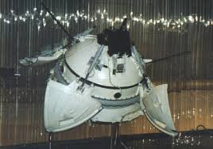
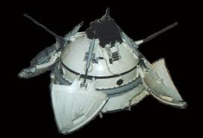
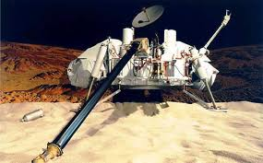
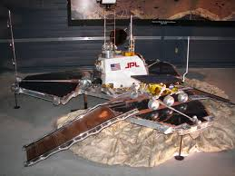
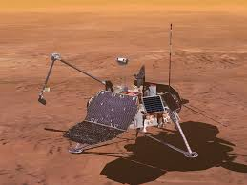
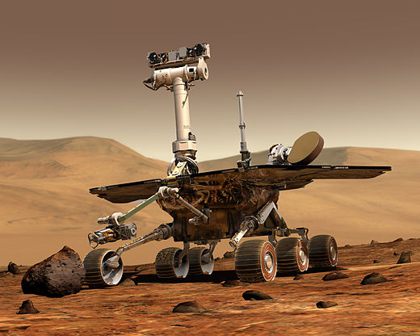
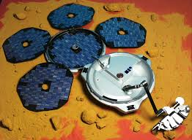
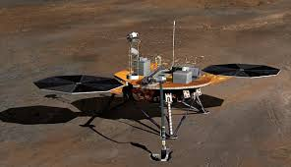
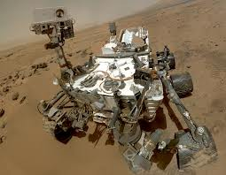
Entry Descent and Landing: A Brief History
Since the 1960s, 13 spacecraft have made it to the top of Mars’ atmosphere…
…and 5 of them were destroyed trying to get to the surface.
Notes:
Statistically, EDL as hazardous as launch

Slide 3
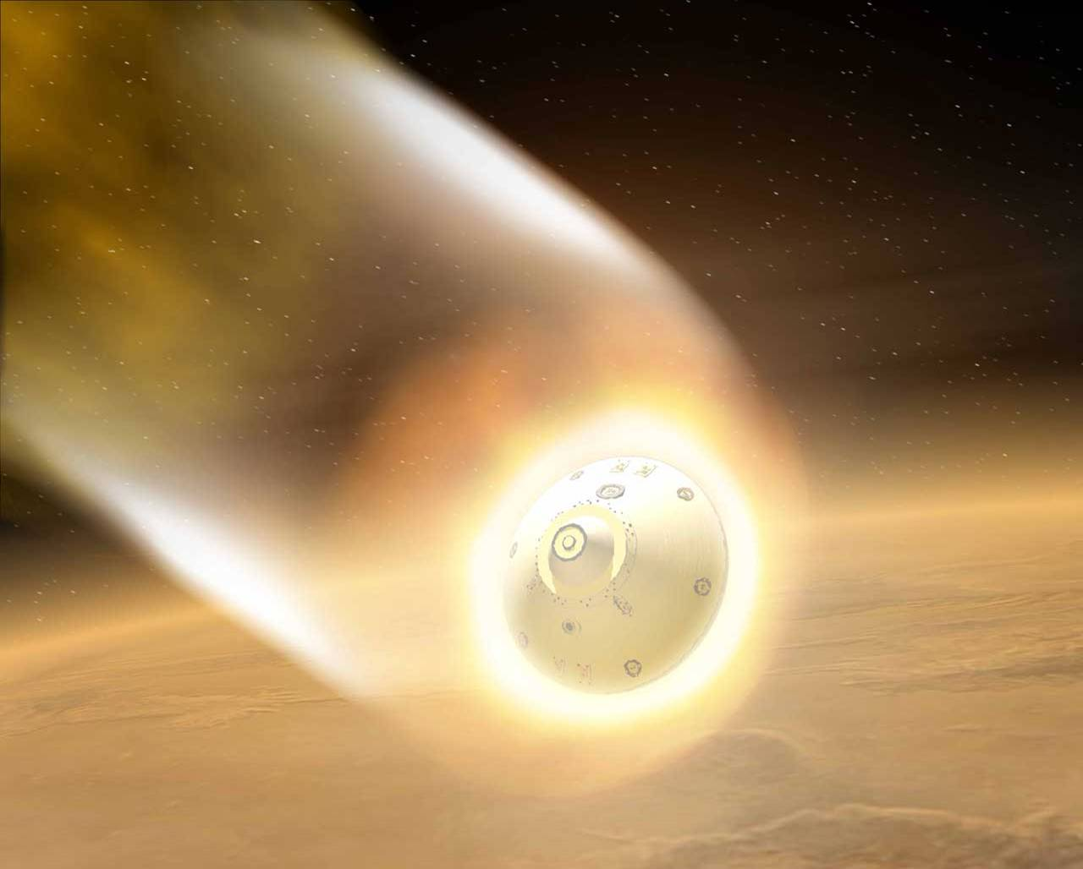
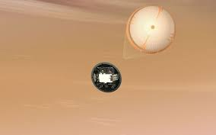
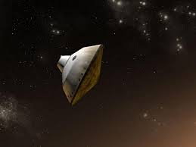
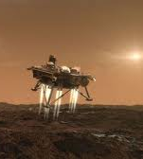
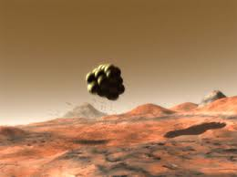
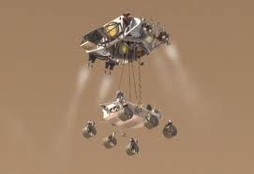
Entry Descent and Landing: A Brief History
Hypersonic Phase:
Sub/Trans-sonic Phase:
Terminal/Landing:
Notes:
Can divide EDL into three major phases and identify the dangers that can cause loss of vehicle.
MSL first significant innovation above the 3rd tier. Can optimize all three phases however.

Slide 4
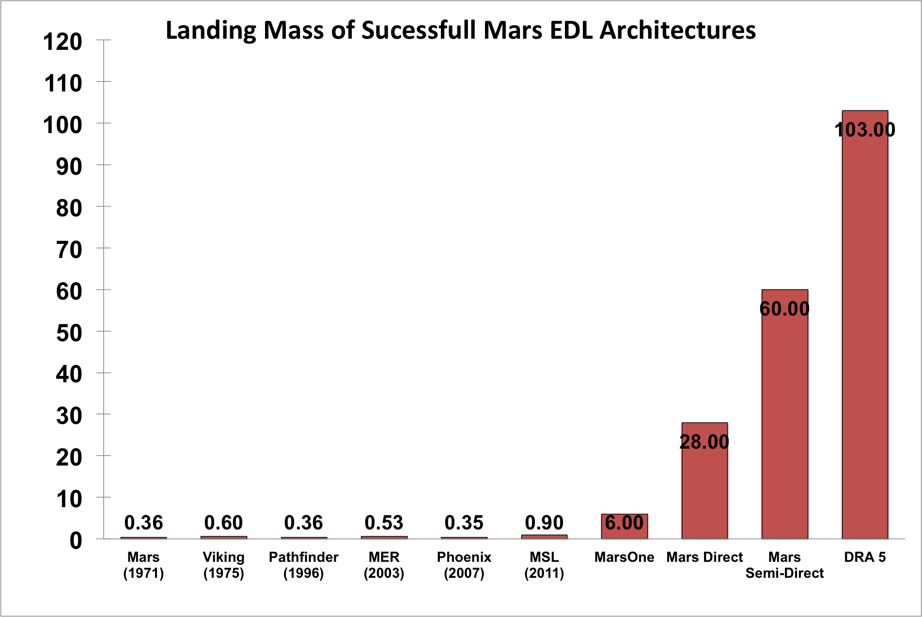
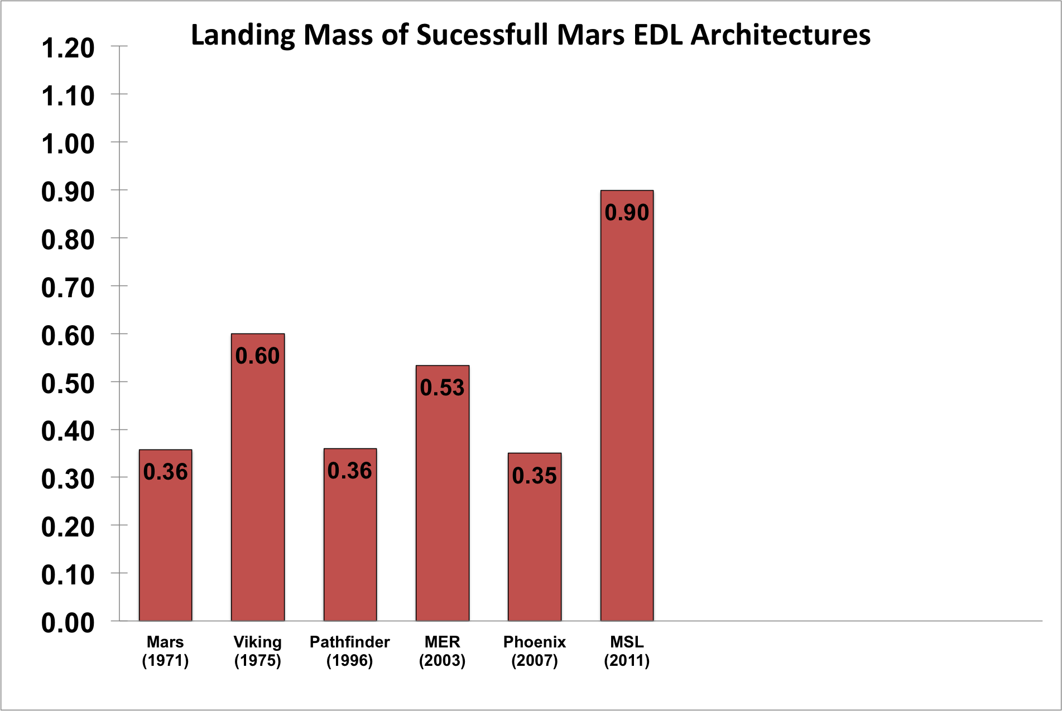
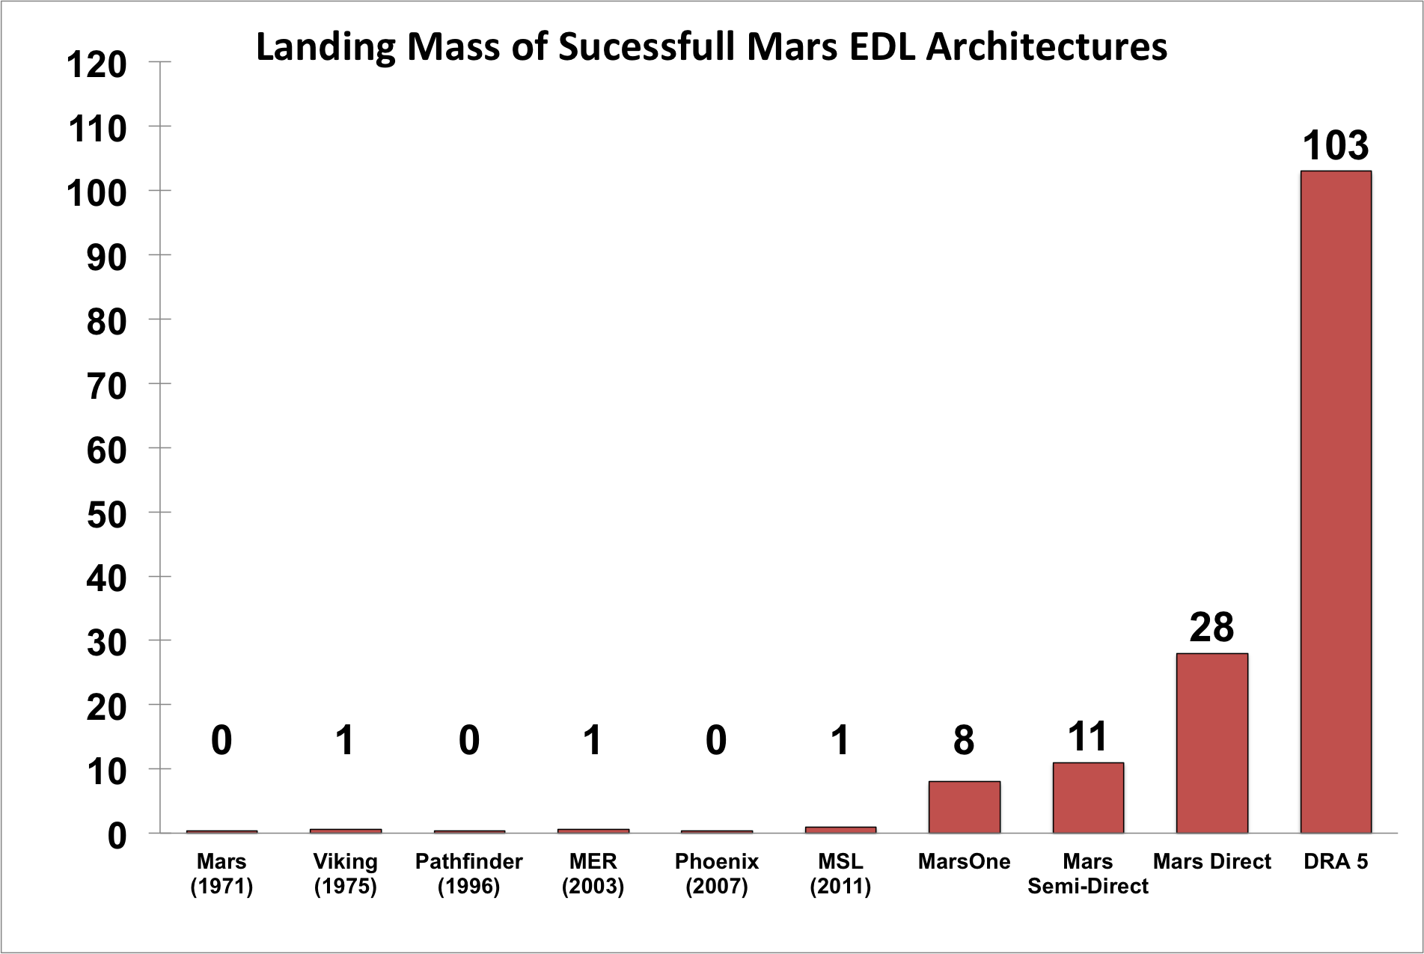
Tonnes Landed
“No credible architecture has been put forward that can place a
>2 mT payload at high elevations on the surface of Mars.”
-Braun and Manning, 2007
Notes:
Four decades of work in EDL has increased our landing mass by only a factor of 3.
Blow up graph by two order of magnitude to see mass required by human architectures.
Side note: This is where some of the agitation for “Phobos First” has come from.

Slide 5
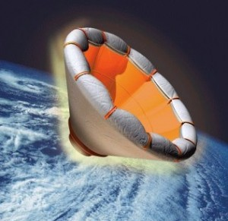
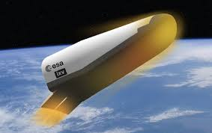
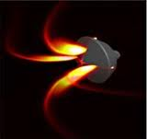
Entry Descent and Landing: The Near Future
INFLATABLES
LIFTING BODIES
SUPERSONIC RETROPROPULSION
RIGID DEPLOYABLES
Notes:
NASA JPL: LDSD Low Density Supersonic Decelerator
NASA AMES: Rigid Deployable with the AREST concept
SpaceX: SRP with Dragon

Slide 6
Entry Descent and Landing: The Near Future
These EDL Architectures are hard to implement because they are:
1) Impossible to test in an operational environment without sending to Mars.
2) Physics isn’t amenable to analytical modeling (hypersonics, ablation, aeroelastics, shock/plume interactions). Crude approximations required.
3) Have small margins for error and a large design space for trajectory selection.
Given an EDL architecture, how do we identify the best trajectory to fly and how do we implement that trajectory in a robust way?
Notes:
In theory, yes, these methods are able to land 20-40 tonnes on Mars, but require crude approximations in the modeling.
Crude approximation is fine, provided your system is robust. And these aren’t.

Slide 7
Optimal Control Theory
Lets us derive, from first principles and physics, analytical solution to
path and trajectory problems which are provably the best solution
possible by a given set of criteria.
R(s)
C(s)
G(s)
T(s)
Classical Control Theory asks:
What steering inputs will give the desired trajectory?
Optimal Control Theory asks:
What is the desired trajectory?

Slide 8
Optimal Control Theory
A two slide primer
There exists some scalar H (the Hamiltonian), which is a function of the state
of the state vector of the system (x) some control parameters (u) and time (t)
IF a control history U(t) can be found that satisfies the three conditions:
“The Euler-Lagrange Theorem”:
“The Minimum Principle / Legendre-Clebsch Necessary Condition”:
“The Transversality Condition”:
THEN it is U(t) must be the control history that produces the minimum value of H.
Notes:
Obligatory math which no one will follow because this is a 20 minute presentation.

Slide 9
Optimal Control Theory
A two slide primer
Find u(t) to minimize H.
H can be thermal load, time of flight, g-loading, landing velocity etc.
“A reader meeting [this subject] for the first time is likely to feel at this stage that a great many things are not completely clear. This is normal. To feel otherwise is either a mark of genius or indication of real trouble…”
Take Away:
Optimal control problems are boundary value problems, and can be solved as such.
Notes:
Optimal control problems unlike classical control problems are not solved with Laplace
transformations and transfer functions. They are boundary value problems, where the
equations of motion (expressed through the Hamiltonian) are the equation to solve.

Slide 10
Advantage: Perturbation Tolerance
On all previous EDL methods from Apollo to MSL:
Preset Trajectory
Classical Method
Perturbation
Optimal Method
Notes:
What does this do that classical control methods does not?
Classical control has been implemented on every EDL, both terrestrial and Martian. The desire trajectory is calculated in advance, vehicle steers to the pre-programed trajectory.
What happens if the spacecraft is perturbed?
What if the perturbation is big? Optimal control allows the spacecraft to roll with the punches, be more robust.

Slide 11
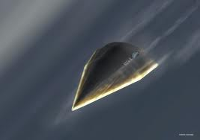
Advantage: Rapid Computation
(Example Provided by Thomas Antony, Purdue RDSL)
PGS: Prompt Global Strike
“Deliver a cruise missile to anywhere on the planet in 1 hour”
Minimum amount of time to target, reroute
in flight, subject to constraints
(thermal, geographic, g-loads etc.)
Trajectories can be computed on board in seconds
Notes:
Prompt Global Strike. This is the same problem, with different boundary conditions!
Evasive maneuvers vs. Atmospheric Perturbations
Comm Jamming vs. Comm Delay
We are just solving a boundary value problem, we aren’t doing any 3D meshing or CFD. Optimal trajectories can be produced in seconds on a small on board GPU, rather than minutes to hours on a computer cluster.

Slide 12
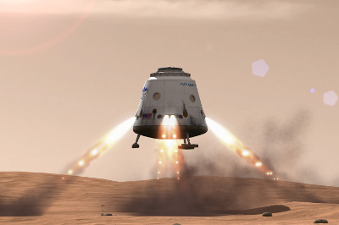
Application: Supersonic Retropropulsion
The spacecraft has the ability to decelerate propulsively with a
“thrust coefficient”, analogous to a drag of lift coefficient:
(Korzun and Braun, 2009)
Notes:
What if we want to do this at high altitudes when the vehicle is still moving supersonically?

Slide 13
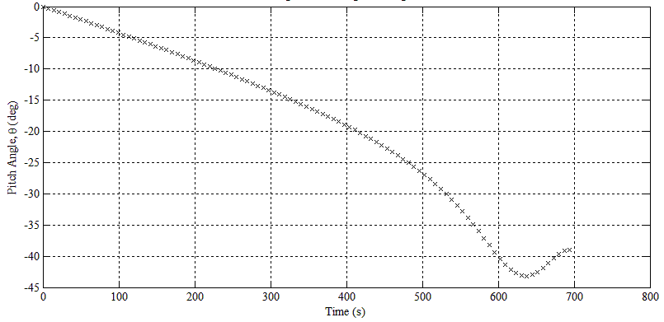
Application: Supersonic Retropropulsion
Convergence on a regular PC in ~10 seconds
Fast enough for new trajectories to be computed on
the spacecraft in real time during EDL

Slide 14
Application: Lofting Maneuvers w. a Lifting Body
(Example provided by Kshitij Mall)
Control pitch of a lifting body to optimize different components at different times:
Hypersonic Phase: Pitch for thermal limit of spacecraft TPS
Sub/Transonic Phase: Pitch for g-load limit of crew
Deceleration Phase: Pitch for level flight while bleeding off velocity
Notes:
Implement multiple constraints at different sections of the trajectory

Slide 15
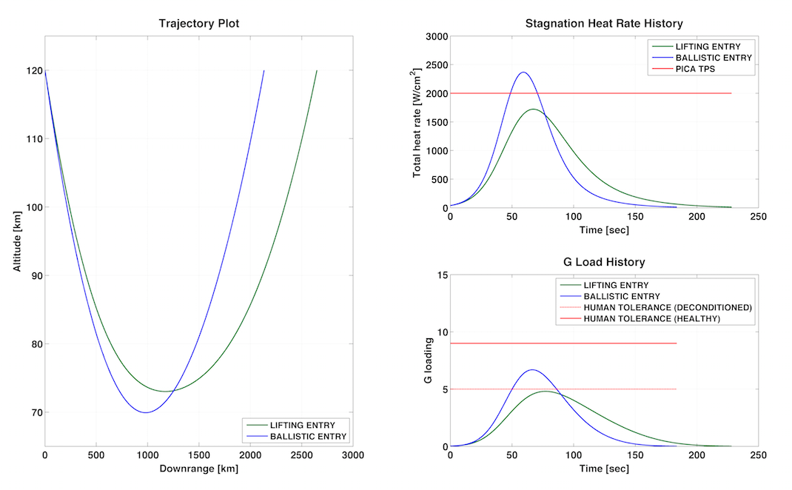
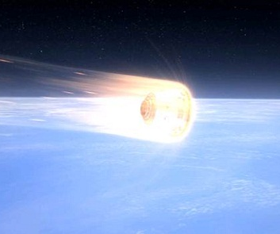
Application: Aerocapture with a Dragon
(Example provided by Kshitij Mall)
Use of directed lift on a Dragon capsule to enable reentry from interplanetary space.
For more details, come to Inspiration Mars architecture presentation on Saturday, 5:30.
Notes:
Maximize time of flight

Slide 16
Conclusions
1) Existing EDL architectures cannot land payloads with mass >1 mT.
2) Proposed human exploration architectures require a mass of 6-28 mT.
3) New EDL methods must be developed, incremental improvements are not sufficient.
4) EDL methods still use classical control based code and techniques. They work,
but they are based on Apollo concepts, are not robust, and are not demonstrably
the best answer.
5) Optimal control offers several advantages to conventional numerical methods
- Real time trajectory computation in seconds
- Solve trajectory problems as boundary value problems
- Robustness to perturbations
- Precision landing site selection
Stand by! More to come…
Notes:
Conclusions about the state of EDL in general
Conclusions about optimal control’s application to EDL specifically

Slide 17
Thanks to:
Kshitij Mall, Thomas Antony, Michael Grant
Questions?

