Slide 1
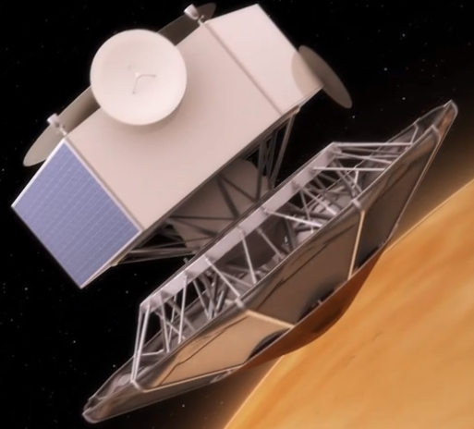



Trajectory optimization with adaptive deployable entry and placement technology architecture
Harish Saranathan
hsaranat@purdue.edu
Sarag J. Saikia, Michael J. Grant, James M. Longuski
School of Aeronautics and Astronautics, Purdue University
11th International Planetary Probe Workshop
Caltech, Pasadena, CA., June 16–20, 2014

Slide 2

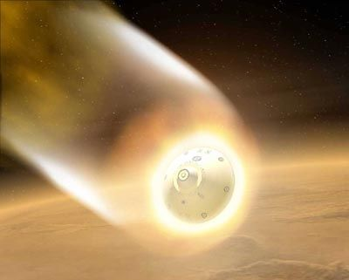
Heavy Mass EDL Challenges on Mars
Human missions require ~50 metric tons delivered payload
Thin atmosphere
  Not enough aerodynamic drag
  Significant heating
Size (~40 m) of rigid aeroshell is prohibitive
Current architecture cannot land at higher elevations
Promising technology: mechanically deployed aerodynamic decelerator

Slide 3
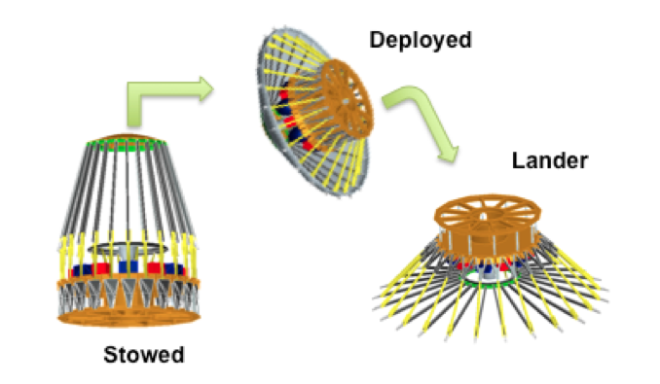
What is ADEPT?
Adaptive Deployable Entry and Placement Technology (ADEPT)
Venkatapathy et al.

Slide 4
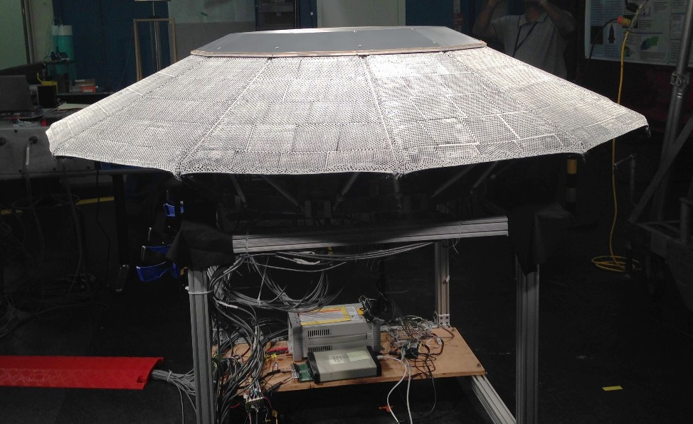
The Real Look: ADEPT Deployment Test
NASA Office of the Chief Technologist

Slide 5

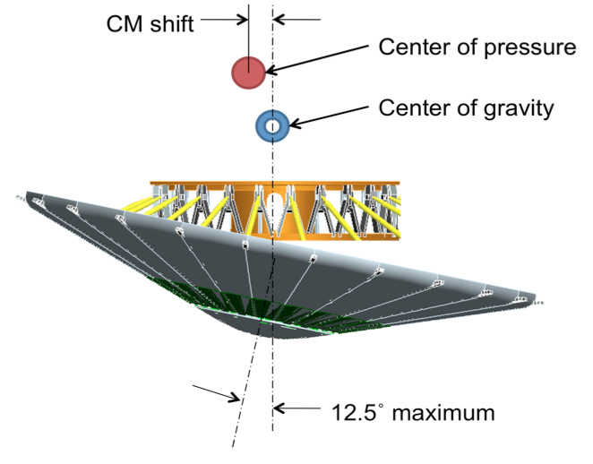
Control Strategies
Angle-of-attack and bank angle
via gimbaling aeroshell
2. Drag modulation

Slide 6
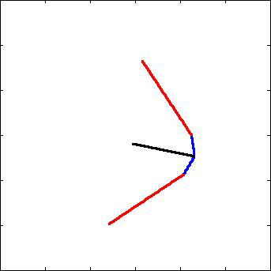
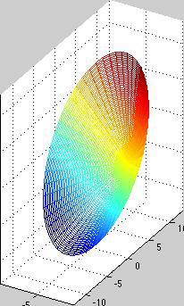
Control Strategies
Modified Drag Control
Angle-of-attack, bank angle, and decelerator angle control

Slide 7
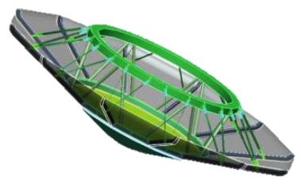
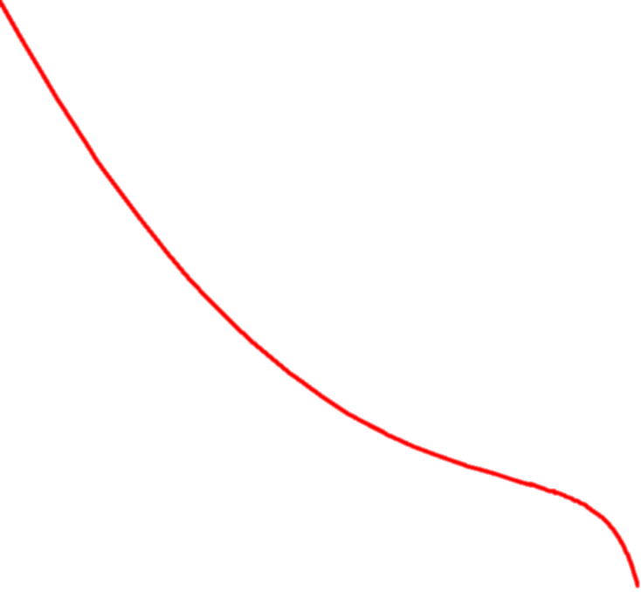
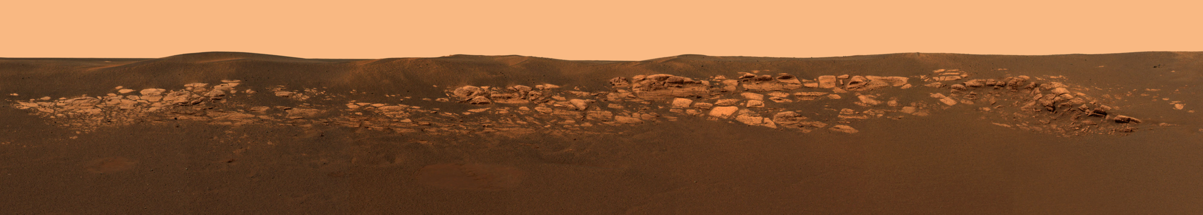
Problem Schematic
V_{e} = 5.6 km/s
h_{e} = 120 km
Minimize: Stagnation-Point Heat Load
Constraint: Peak g-load
~Mach 1.5
Notes:
Think about title

Slide 8
Deceleration
Notes:
For g-load, mention about Apollo g-load

Slide 9
Stagnation-Point Heat Rate
Notes:
For g-load, mention about Apollo g-load

Slide 10
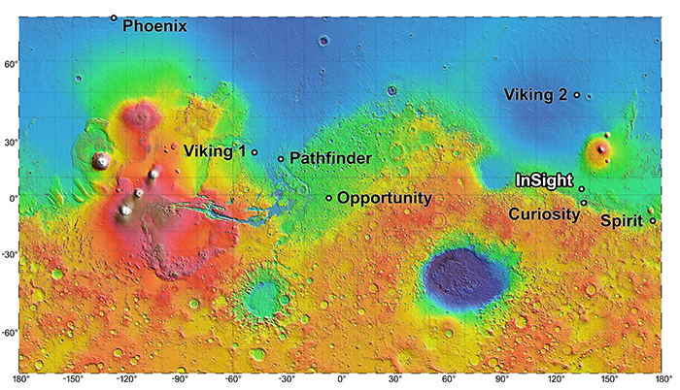
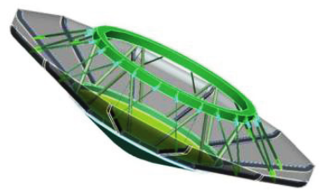
Summary
ADEPT can land heavy mass on Mars
Four different control strategies are assessed
g-load constraint enforced
AoA-bank angle control strategy is attractive
3-control strategy is highly complex
Guidance issue for precision landing is yet to be addressed

Slide 11
Backup

Slide 12
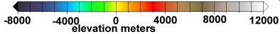
Heavy Mass EDL Challenges on Mars
Current architecture cannot land at high MOLA altitudes
Notes:
Provide reference

Slide 13
Stagnation-Point Heat-Load
Stagnation-Point Heat-Load
Notes:
Check heat load for MSL and Phoenix and mention (add dashed line in graph)

Slide 14
Downrange

Slide 15
Altitude-Velocity

Slide 16
Control History: AoA-Bank Angle Control

Slide 17
Drag Modulation

Slide 18
Modified Drag Modulation

Slide 19
AoA-Bank-Decelerator Angle Control

Slide 20
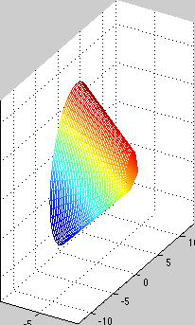
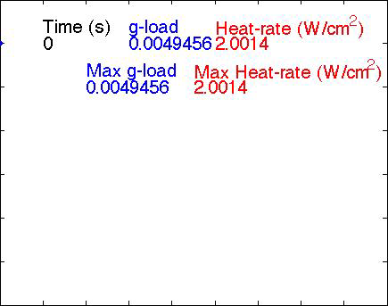

AoA-Bank-Decelerator Angle Control
120
y dimensions (km)
0
Downrange (km)
900
Vehicle
Notes:
Mask dashed line on axis in the bottom video

Slide 21
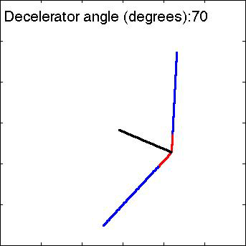

Modified Drag Modulation
Vehicle cross-section
30
120
y dimensions (m)
Altitude (km)
0
0
Downrange (km)
900
x dimensions (m)
30

