Slide 1
Detecting Parallelism
in C Programs with
Recursive Data Structures
Rakesh Ghiya, L J. Hendren, Y Zhu
Presented By Hao Lin
April. 5th, 2010

Slide 2
Overview
Parallel Patterns
Function-call parallelism
Forall loop parallelism
Foreach loop parallelism
Dependence Test Framework for Function-Call Parallelism
Loop Parallelism
Experimental Results
Notes:
Here is the today’s agenda. First, talk about. Next, paper present. Finally comes.

Slide 3
Overview
Key Techniques
Points-to Analysis
Connection Analysis
Shape Analysis
Notes:
Get involved are. We will not focus on these techniques, although we might have an emphasis on shape analysis, but what the paper is mainly about is how to use such analysis to detect the parallel.

Slide 4
Overview
Parallel Patterns
Function-call parallelism
Forall loop parallelism
Foreach loop parallelism
Dependence Test Framework for Function-Call Parallelism
Loop Parallel
Experimental Results
Notes:
First, let’s go over the parallel patterns

Slide 5
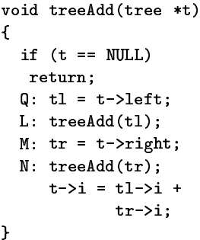
Parallel Patterns
Function-call parallelism:
2 calls to the function treeAdd
Left and rigth sub-trees by pointer t
Could be executed in parallel as accessing disjoint regions
Notes:
We call it. In the sample code, there are 2 calls to the same function with different arguments. Two pointers represents left and right sub-trees by pointer t. As sub-trees are disjoint, two function calls access disjoint regions of the heap, which can run in parallel.

Slide 6
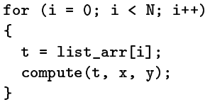
Parallel Patterns
Forall parallelism:
List_arr: Array of pointers
Fully parallelized as each pointer pointing to disjoint heap data structure
Notes:
It is easy to understand. It is an array-based loop. Fully parallelized.

Slide 7
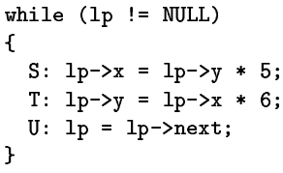
Parallel Patterns
Foreach parallelism:
Computation part: S, T
Navigation part: U
Loop-carried dependence
Notes:
Consist of 2 parts: first one does the computation, while the second performs navigation. The pointer used to navigate through the list, like lp in the program. Because it has a LCD due to the navigator. The navigator for the next iteration is obtained via the navigator for the current iteration.

Slide 8
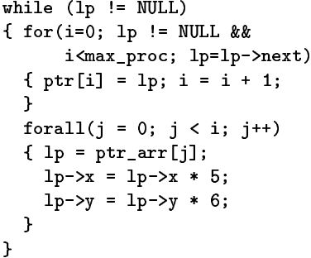
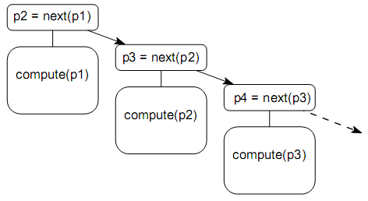
Parallel Patterns
Foreach loop converted into forall loop
max_proc: the number of processors being used
Note: stable computation part
Notes:
Converted into a forall-like loop. First, navigator for the next iteration is obtained sequentially. Then the computation part can run in parallel. Given the variable of the number of processors being used, we can first assign the navigator for each iteration to the pointer array. Then do the computation through the array list.

Slide 9
Overview
Parallel Patterns
Function-call parallelism
Forall loop parallelism
Foreach loop parallelism
Dependence Test Framework for Function-Call Parallelism
Loop Parallel
Experimental Results
Notes:
After we have figure all three patterns, lets first take a look at the function calls.

Slide 10
Function-call Parallelism
Overall Algorithms
No intervening irregular control flow constructs: break, continue, return, exit, abort…
fun depTest (stmtS, stmtT, depType)=
if (stackTest (stmtS, stmtT, depType)==NoDep)
return NoDep;
else if (stackTest (stmtS, stmtT, depType)==OnlyHeap)
if(connectionTest (stmtS, stmtT, depType)==NoDep)
return NoDep;
if (shapeTest (stmtS, stmtT, depType)==NoDep)
return NoDep;
return Dep;
else return Dep;
Notes:
Here is an overall algorithm called dependence test. If we can prove no dependence between 2 stmt then they can run in parallel. It is still conservative detection, which means if we can’t disprove dependence, we assume dependence. First, the paper assumes that no irregular control flow constructs like…in the same nest level with the two stmt. So we make sure that there will be a runtime path from S to T. the parameter of depType specifies the dependence type we want to detect like anti- output- or flow- dep. First, do stackTest, if cannot be disproved, check if dep is only due to heap. If so, heap analysis is used. 2 heap analysis will be potentially used: connectionTest, if test succeeds, report independence. Otherwise, more accurate test---shape analysis is invoked.

Slide 11
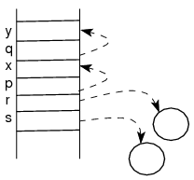
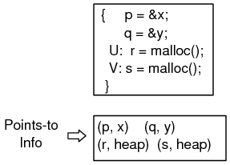
Pointer Analysis
Stack-directed Pointer: p, q
Pointing to statically-allocated memory objects, which has compile-time names
Heap-directed Pointer: r, s
Pointing to dynamically allocated in the heap, which are anonymous (dereference)
Variable themselves are stack-resident
Notes:
Before we go in detail, lets first go over a little bit about types of pointers. What paper deals with are two types of pointers: in the examples, we say p and q are sdp because they are pointing to …

Slide 12
Pointer Analysis
Stack-directed Pointer:
Points-to analysis
Computing Read/Write sets
Heap-directed Pointer:
Connection analysis: connectionTest
Shape analysis: shapeTest
fun depTest (stmtS, stmtT, depType)=
if (stackTest (stmtS, stmtT, depType)==NoDep)
return NoDep;
else if (stackTest (stmtS, stmtT, depType)==OnlyHeap)
if(connectionTest (stmtS, stmtT, depType)==NoDep)
return NoDep;
if (shapeTest (stmtS, stmtT, depType)==NoDep)
return NoDep;
return Dep;
else return Dep;
Notes:
Lets go back to the algorithm. The purpose of stackTest is to analyze sdp by using points-to analysis and computing R/W sets. As for Hdp, we have connection analysis which is implemented in connectionTest and shape analysis which is in shapeTest.

Slide 13
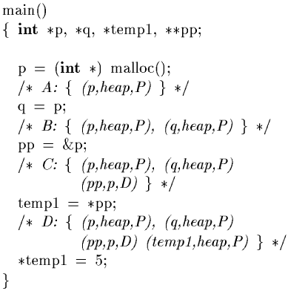
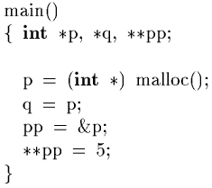
Points-to Analysis
Notes:
Lets first see an example of points-to analysis. Won’t go in detail because we have discussed this in Aurengzeb’s presentation.

Slide 14
Computing Stack R/W Sets
SIMPLE Statements: 15
Only involves scalars: x = a binop b
Involves indirections: *p = *q
{(p, x, D), (q, b, P), (q, heap, P)}
Read() = {p, q, b, heap}
Write() = {x}
Notes:
Once we have the points-to information, we can compute the stack-based R/W sets. Paper announce any C program can be broken down to 15 types of Simple stmt. All these simple stmt can be divided into 2 groups: those only involves scalars and those involves indirection. For those only involving scalars, it is quite straightforward. Rhs can be included in R set, and lhs in W set. Next Lets take a look at an example of stmt that has indirections. Reads p and q, according to points-to pairs, it also reads b and heap, writes x.

Slide 15
Function-call Parallelism
stackTest:
Using Points-to based stack R/W sets
Whether need to call heap analysis
fun stackTest (stmtS, stmtT, depType) =
if (depType == FlowDep)
ISet = Write (stmtS) Read (stmtT);
else if (depType == AntiDep)
ISet = Read (stmtS) Write (stmtT);
else // Output Dep
ISet = Write (stmtS) Write(stmtT)
if (ISet == Empty)
return NoDep;
else if (ISet == OnlyHeap)
return OnlyHeap;
else return Dep;
Notes:
Once we have this technique, we can do the stackTest. First, we compute the points-to based stack R/W sets, and then according to different depType, we have different strategies. If we want a flowdep, compute the intersection.. Similarly…

Slide 16
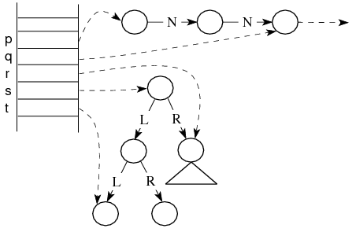
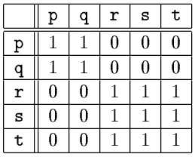
Heap Analysis
Handles:
Access to any node of the data on the heap
Resident on stack
Finite in number
Matrix of Handles:
Connection matrix
Notes:
After we finished dealing with the stack-directed pointers, lets go over heap analysis. As we know, there are potentially infinite number of objects on the heap, but we know they can be always accessed from hdp on the stack by using access-path. Introduce another term of heapdp, called handle. In finite number, less expensive to deal with.

Slide 17
Heap Analysis
fun depTest (stmtS, stmtT, depType)=
if (stackTest (stmtS, stmtT, depType)==NoDep)
return NoDep;
else if (stackTest (stmtS, stmtT, depType)==OnlyHeap)
if(connectionTest (stmtS, stmtT, depType)==NoDep)
return NoDep;
if (shapeTest (stmtS, stmtT, depType)==NoDep)
return NoDep;
return Dep;
else return Dep;
Connection Analysis:
Whether 2 handles point to nodes in the same data structure using connection matrix
Shape Analysis:
Access path
Interference matrix
Shape of data structure from handle
Notes:
Go back to the depTest. If the stackTest turned out to be OnlyHeap, next thing we are gonna do is connection analysis. Purpose of CA is to decide whether 2 …

Slide 18
Connection Analysis
Connection Matrix:
View heap as undirected graph
C[p,q] = 1: p, q possibly point to heap objects in the same data structure
C[p,q] = 0: heap objects pointed by p and q definitely in different structure
C[r,t] = 1: only data structure level
Notes:
Lets go over CA. symmetrical. Caution data structure level

Slide 19
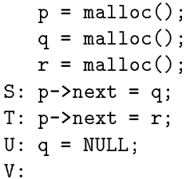
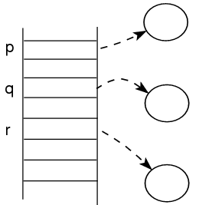
Connection Analysis
Examples:
Statement S: p, q, r point to disjoint data structures
Connect(S) = {}

Slide 20
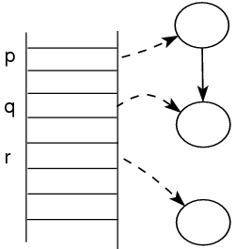
Connection Analysis
Examples:
Statement T: p, q have been connected after S
Connect(T) = {(p,q)}

Slide 21
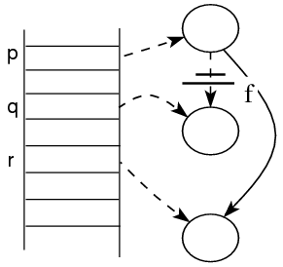
Connection Analysis
Examples:
Statement U: (p, q) cannot be safely killed though field next has been disconnected
Connect(U) = {(p,q), (p,r), (q,r)}
Notes:
We don’t know how p and q are connected before T. not sufficient information

Slide 22
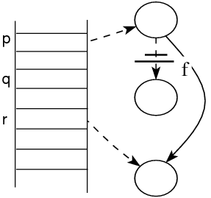
Connection Analysis
Overall algorithm:
Statement V: (p, q), (q,r) are safely because stack-based pointer q is updated
Connect(V) = {(p,r)}
Details in R G, L H. Connection analysis: A practical interprocedual heap analysis for C. 1996

Slide 23
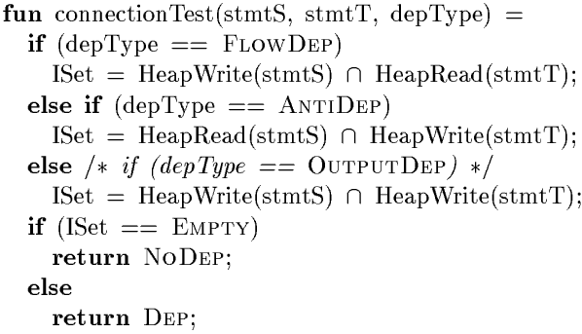
Function-call Parallelism
ConnectionTest:
Similar to stackTest, but with HeapSet
Notes:
After basically understand how it works, we can look at the algorithm of CT. difference. We know the concept of R/W sets. Here we are using Heap-based the sets because we are dealing the hdp.

Slide 24
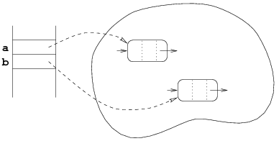
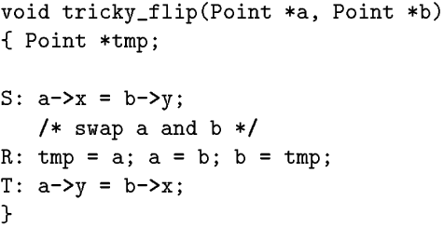
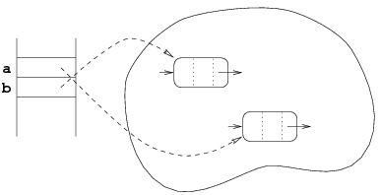
Connection-based R/W Sets
Difficulties in computing these sets:
Notes:
We know that stack-based R/W gives very conservative approximation for stmt involving indirect references. Need sharper information for the heap references. When we do CA, at stmtS connection set is empty, at stmtT, still empty, no dep. In fact, there is flow dep. Problem is that not enough name. existing names not reliable. need new name for pointers that doesn’t change.

Slide 25
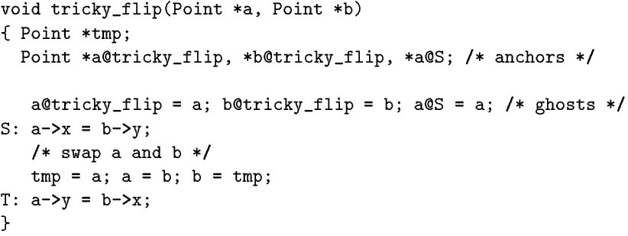
Connection-based R/W Sets
New version with anchor handles:
Notes:
These pointers with new name are called anchor handles. Introduce anchors for the parameters. Another anchor for a in stmtS. Ghost copy stmt. These anchors will not change through the its scope.

Slide 26
Connection-based R/W Sets
New version with anchor handles:

Slide 27
Connection-based R/W Sets
New version with anchor handles:
HeapW(S) = {a@tricky_flip->x, a@S->x}
HeapR(T) = {a@tricky_flip->x, a@S->x}
Notes:
Won’t go deep into the naming strategy, but use that later in the further examples.

Slide 28
Function-call Parallelism
StackTest
Output from L to M:
W(L) = {y}, W(M) = {x} ➔ ISet = Empty
Flow from M to N:
W(M) = {x}, R(N) = {x} ➔ ISet = {x}
Notes:
We might want some examples to go further. First lets do stackTest. If we want to examine the output dep from L to M, we need w sets.

Slide 29
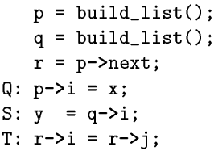
Function-call Parallelism
Flow from Q to S:
W(Q) = {heap}, R(S) = {q, heap} ➔ ISet = {heap}
HeapW(Q) = {p@Q->i}, HeapR(S) = {q@S->i} ➔ ISet = Empty
Flow from Q to T:
HeapR(T) = {p@Q->j, r@S->j}, HeapW(Q) = {p@Q->i}, ➔ ISet = Empty
Output from Q to T:
HeapW(Q) = {p@Q->i}, HeapW(T) = {p@Q->i, r@S->i} ➔ ISet = {p@Q->i}

Slide 30
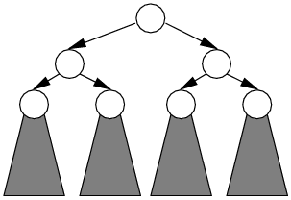
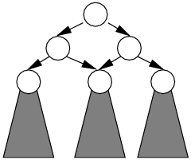
Shape Analysis
Goal:
Estimate the shape of the structure accessible from a given heap-directed pointer
Tree-like? Including linked lists
DAG-like?
Cycle?
Direction Matrix:
D[p,q] = 1: access path exists from p to q
Interference Matrix:
I[p,q] = 1: common object accessed from p and q

Slide 31
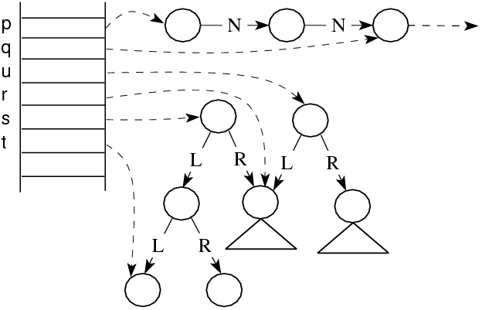
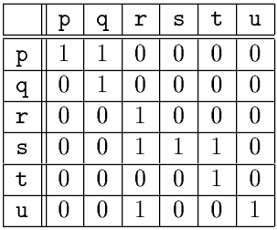
Shape Analysis
Examples:
Direction Matrix

Slide 32
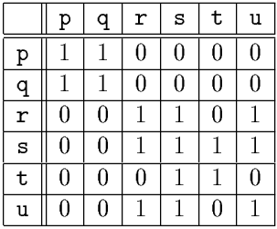
Shape Analysis
Examples:
Interference Matrix

Slide 33
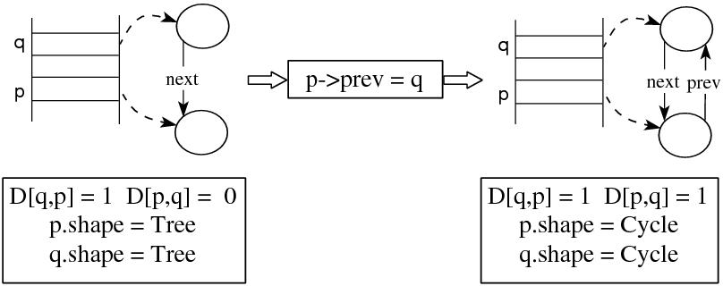
Shape Analysis
Examples:
How matrix information used to decide shape attribute
Notes:
First initialized to be tree-like

Slide 34
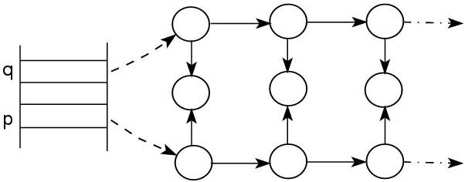
Shape Analysis
Examples:
p.shape only abstract the shape of structure accessible from p but not the overall shape of the structure pointed to by p (p.shape = q.shape =Tree)
Notes:
Here is a note.

Slide 35
Function-call Parallelism
shapeTest:
Based on shape of the structure being traversed and the access paths
Access path computed with respect to a node pointed to by the anchor pointer
Anchor pointer: pointer pointing to a fixed node
Checking whether paths can lead to the same node starting from the anchor to decide dependence
Notes:
shapeTest relies on the shape of the data structure being traversed and the access path used to reach particular node. What we need is compare different access path. How to compare. First find a pointer to fixed node called anchor pointer.

Slide 36
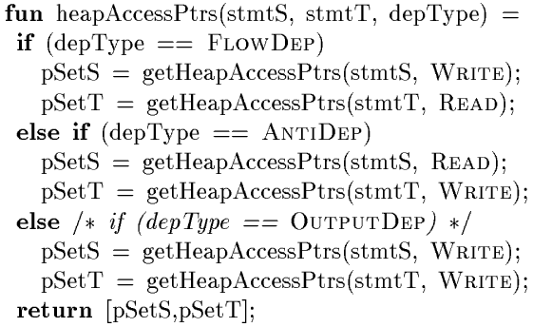
Shape Dependence Test
1. collect the sets of pointers access the heap:
Notes:
Separated into several steps.

Slide 37
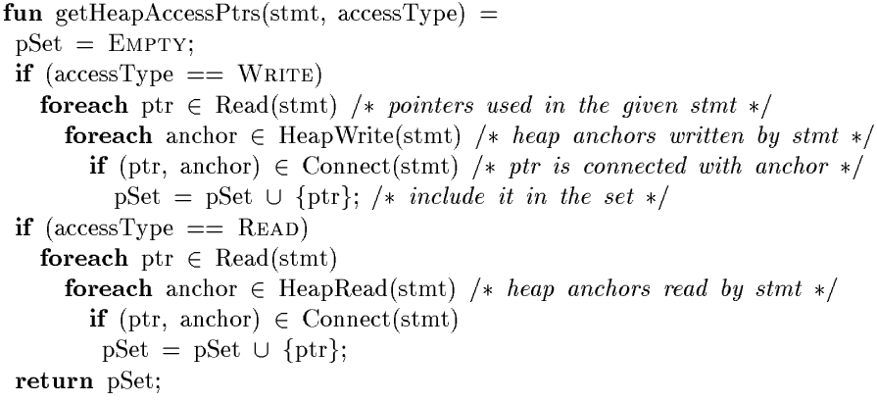
Shape Dependence Test
1. collect the sets of pointers:
Notes:
Using anchor connection information

Slide 38
Shape Dependence Test
2. for each pair (ptrS, ptrT) in the sets, test for cycles:
Any pointer attribute found to be cycle, dependence is reported and test terminates
Notes:
Check each pair of pointers in sets for dependence. First thing we are gonna do check cycles.

Slide 39
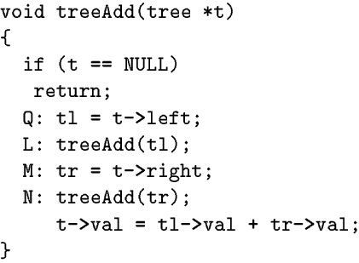
Shape Dependence Test
3. for each pair (ptrS, ptrT) in the sets, anchor-based access paths are constructed
1) computing the definition chains
Traversal stops when:
Reach the function header
More than one reaching def
Control flow
Notes:
Next, still for each pair. Check the access path constructed. expensive comparing path

Slide 40
Shape Dependence Test
3. for each pair (ptrS, ptrT) in the sets, anchor-based access paths are constructed
2) find a common anchor, with which both pointers can be defined
tl and tr can be defined in terms of t, which can be the anchor

Slide 41
Shape Dependence Test
3. for each pair (ptrS, ptrT) in the sets, anchor-based access paths are constructed
3) get access paths from the anchor, like t->left, t->right
Now shapeTest may terminates if
Anchor is not found, so no path constructed
anchor.shape is cycle
Fields used in the paths are updated between anchor definition and statement
Notes:
In the third case, the shape of the data structure being traversed can change in between, and the access path cannot be safely used.

Slide 42
Shape Dependence Test
4. for each pair (ptrS, ptrT) in the sets with anchor-based access paths, compare the paths for dependence detection
Different actions according whether the statement is a call statement or simple statement
Statement L: access all nodes in the left sub-tree via tl
Last statement: only access a field of the specific node pointed to by tl
Notes:
The last step is to compare.
Function calls: it can pass the pointer as a parameter and the callee function can access fields of all nodes accessible from the pointer.

Slide 43
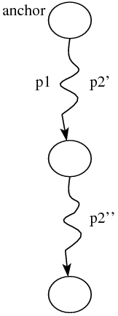
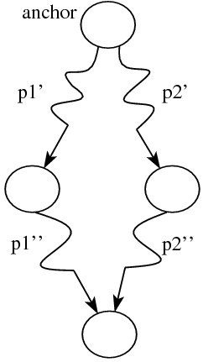
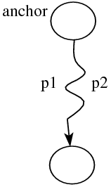
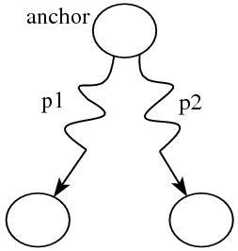
Operation to Compare Paths
equivPaths(pathS, pathT)
subPath(pathS, pathT)
disjointPaths(pathS, pathT)
Notes:
Before comparing, need
Subpath: pathS contains some field accesses less than pathT, and will be equivalent to the path by removing last k field accesses from pathT.
Disjoint: 1. not equiv 2.not subpath to each other.

Slide 44
Shape Dependence Test
4. for each pair (ptrS, ptrT) in the sets with anchor-based access paths, compare the paths for dependence detection
Both statements are call statements
stmtS is a call and stmtT is simple
stmtT is a call and stmtS is simple
Both statements are simple

Slide 45
Shape Dependence Test
4. for each pair (ptrS, ptrT) in the sets with anchor-based access paths, compare the paths for dependence detection
Both statements are call statements
In the example: t->left, t->right
t.shape = Tree
Disjoint path
Notes:
Call stmt can access whole sub-pieces of a data structure. For 2 calls to be independent, the 2 access path should lead to disjoint sub-pieces of data structure. This requires that the 2 path are disjoint and the shape attribute of the anchor is Tree.
We have finished the function call part.

Slide 46
Overview
Parallel Patterns
Function-call parallelism
Forall loop parallelism
Foreach loop parallelism
Dependence Test Framework for Function-Call Parallelism
Loop Parallelism
Experimental Results

Slide 47
Loop Parallelism
Additionally detect the presence of loop-carried dependence (LCD)
Forall loops should not have any LCD
In foreach loops, the only LCD present is induced by statement that advances the navigator

Slide 48
Loop Parallelism
Detect the forall and foreach loops
Good loop detection: if traversing a recursive heap structure in a regular fashion
Detecting heap-based LCDs: detecting presence of LCDs with respect to heap access
Detecting stack- and array-based LCDs (foreach)

Slide 49
Loop Parallelism
Identifying forall Loops---difference form foreach loops
Similar to the strategy for detecting foreach loops, but several difference
Navigator pointer ➔ interger
Heap-based LCD detecting ➔ comparing array expressions (subscript tests)

Slide 50
Loop Parallelism
Good Loop Detection
Loop body involves read/write access to heap locations:
Loop body is free from irregular control flow constructs like exit, abort, break, return…
A navigator can be identified for the loop: navigates in a regular fashion
Notes:
Ensure it is heap-based.
Ensure the correctness of parallelizing transformations.
In a regular fashion

Slide 51
Loop Parallelism
Good Loop Detection
Identifying the Navigator
Find variables in the loop condition test (testVar)
Definition chain construction for testVar in the loop
Terminates if:
No loop-resident def found
More than 1 def found
Conditionally reaches
Recurrent def found
Check recurrence flag
Access path constructed and find the base variable
Notes:
Loop conditions: checks whether next iteration could be executed. LHS and RHS
Definition chain computing is similar to what used in shape analysis. All def stmt in the loop.
Goal is to find recurrent def, which means the presence of a variable in the loop whose value for the next iter is defined in terms of current value. The access path is called test expression; base variable in the path is navigator.

Slide 52
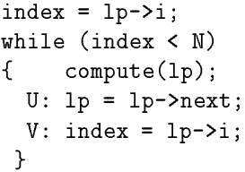
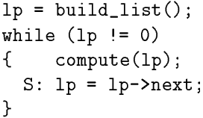
Loop Parallelism
Good Loop Detection
Identifying the Navigator
Def stmt: lp = lp->next;
Access path: lp->next
Navigator: lp
Navigation Expr: lp->next
Def stmt: lp = lp->next;
Access path: lp->next->i
Navigator: lp
Navigation Expr: lp->next
Notes:
Navigation expr: the component of the access path, contributed by the definition involved in the recurrence

Slide 53
Loop Parallelism
Good Loop Detection
Verifying the Navigator: check if navigator visits a distinct node in the data structure in each iteration
Shape of attribute of navigator is Tree or DAG: cannot revisit a node
Shape of attribute of navigator is Cycle: Assuming not an infinite loop

Slide 54
Loop Parallelism
Detecting heap-based LCDs
Invoked after stackTest returns OnlyHeap and connectionTest returns Dep
First collects sets of pointers that 2 statements use to access heap
For each pair of pointers in the sets, constructs the access paths (NAP) with respect to the navigator. Similar to shapeTest
Compares paths to detect an LCD

Slide 55
Loop Parallelism
Heap-based LCD arises when
Navigator fields of the navigator nodes are accessed:
lp->next->i = lp->i
Two or more iterations access the same node:
lp->hdr->num++
At least one pointer fields of the navigator involved
Different shape attribute of navigator
Notes:
Navigator node: e.g. nodes other than the one being currently visited by the navigator

Slide 56
Loop Parallelism
Comparing paths to detect an LCD
Shape attribute of navigator is Tree and NAPs do not use navigator fields and do not update pointer fields ➔ do not induce LCDs
Shape attribute of navigator is DAG or Cycle, but loop is acyclic, and NAPs do not use pointer fields ➔ no LCDs
None of above: LCDs reported, and non-foreach loop

Slide 57
Loop Parallelism
Detecting stack and array-based LCDs
If use (read) of a stack location at stmtS in loop is reached by a def from stmtT in loop, and stmtT lexically succeds stmtS, potentially induce an LCD.
Exclude LCDs with symbolic stack location heap
Also exclude LCDs induced by navigator
Loop
Good Loop
heap foreach loop
foreach loop
Good loop detection
Heap-based LCD detection
Stack-based LCD detection

Slide 58
Questions?

Slide 59
Thank you!

