Slide 1
Commutativity Analysis: A New Analysis Technique for Parallelizing Compilers Martin C. Rinard Pedro C. Diniz
April 7th, 2010
Youngjoon Jo

Slide 2
Layout
Introduction
Motivating Example
Framework
Running Example
Experimental Results
Takeaway

Slide 3
Introduction
Data dependence analysis is inadequate for computations that manipulate dynamic pointer-based data structures
Independent operations: two operations are independent if neither accesses data that the other writes
Commuting operations: operations that generate the same final result regardless of the order in which they execute

Slide 4
Introduction
4 of 6 parallel applications in SPLASH(’92) and 3 of 4 parallel applications in SAM(’94) benchmarks rely on commuting operations to expose concurrency and generate correct parallel execution
We would like to exploit commuting operations automatically!

Slide 5
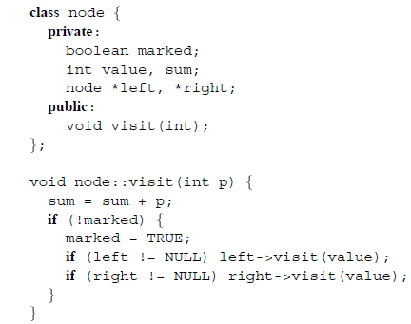
Motivating Example

Slide 6
Motivating Example
Parallelize by executing the two recursive invocations of node::visit in parallel

Slide 7
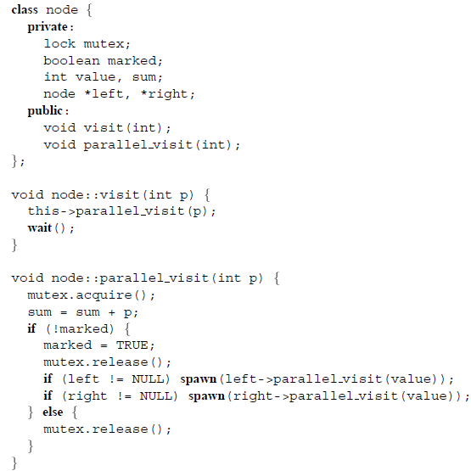
Motivating Example

Slide 8
Motivating Example
In parallel execution, order of node::parallel_visit could change.
Is this a problem?

Slide 9
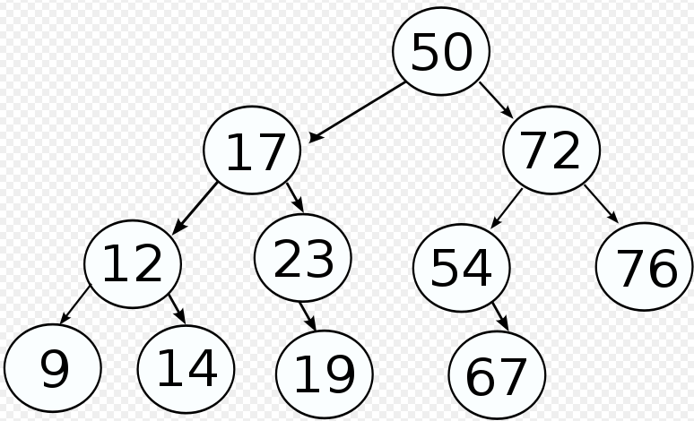
Motivating Example
In parallel execution, order of node::parallel_visit could change.
Is this a problem?
In serial execution the order will be
50, 17, 12, 9, 14, 23, 19, 72, 54, 67, 76
In parallel execution we can ensure that
50, 17, 12 will execute before 9
But we don’t know which of 12, 13 or 9, 14, 19 will execute first
What conditions are necessary to ensure that parallel execution will be correct?

Slide 10
Commutativity Conditions
Instance Variables:
The new value of each instance variable of the receiver objects of A and B must be the same after the execution of the object section of A followed by the object section of B as after the execution of the object section of B followed by the object section of A
Invoked Operations:
The multiset of operations directly invoked by either A or B under the execution order A followed by B must be the same as the multiset of operations directly invoked by either A or B under the execution order B followed by A.

Slide 11
Motivating Example
Instance variables condition
node::parallel_visit operations can
execute in any order
(sum + p1) + p2 = (sum + p2) + p1
2) Invoked operations condition
node::parallel_visit will be called on
same set of nodes as serial execution

Slide 12
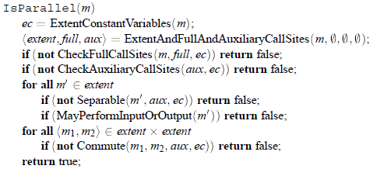
Framework
Concepts:
Extent
Extent constants
Auxiliary methods
Main algorithm

Slide 13
Extents
The compiler analyzes one computation for each method in the program
The extent of a method is the set of methods that could be invoked directly or indirectly during the execution of the method
If the compiler can verify that all pairs of operations in the extent commute, it marks the method as parallel

Slide 14
Extent Constants
In certain cases the compiler may be able to prove that two values are equal without representing the values precisely in closed form
If the operation reads a variable that none of the operations in the computation write, the variable will have the same value regardless of when the operation executes relative to all of the other operations
We call such a variable an extent constant variable

Slide 15
Auxiliary Methods
For modularity purposes, programmer often encapsulate the computation of values inside methods. We call these methods auxiliary methods
Integrating auxiliary methods into their callers for analysis coarsens the granularity of the analysis reducing the number of pairs that the algorithm tests
Divide functions into full methods and auxiliary methods
Auxiliary methods
Do not write instance variables or read instance variables that other methods in the extent may write
Call only auxiliary methods
Auxiliary methods are not visible outside callers, hence we can check only full methods for commutativity

Slide 16
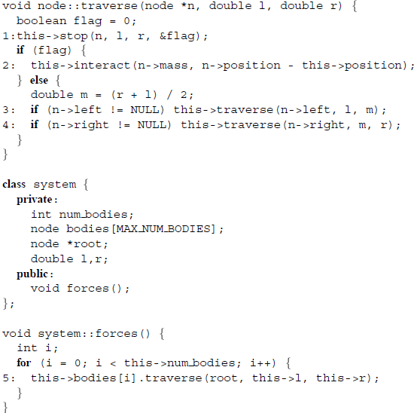
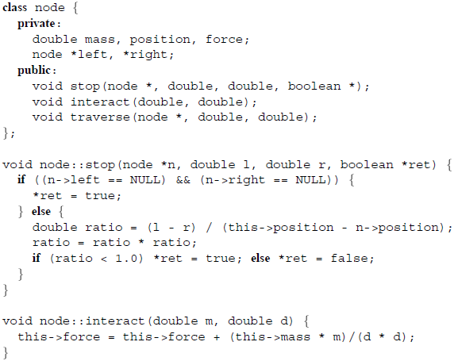
Running Example

Slide 17
Running Example
Find IsParallel(system::forces)

Slide 18
Running Example

Slide 19
Read/Write Sets & Call Sites

Slide 20
Read/Write Sets & Call Sites

Slide 21
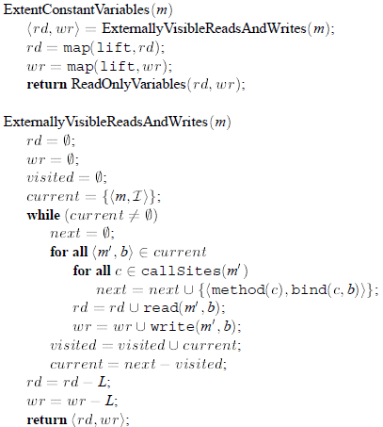
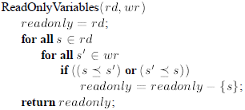
Extent Constant Variables
Combines the read/write sets of all invoked methods

Slide 22
Extent Constant Variables

Slide 23
Extent Constant Variables

Slide 24
Extent Constant Variables

Slide 25
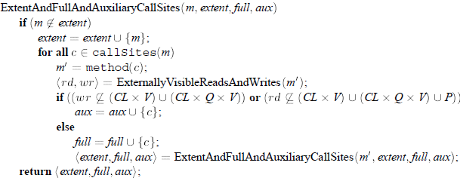
Extent And Full And Auxiliary CallSites
If method writes to only instance variables and reads from only instance variables and reference parameters, this is a full method.
Else method is an auxiliary method
This is just a way of classifying the methods. Additional correctness conditions will be enforced later.

Slide 26
Extent And Full And Auxiliary CallSites
Because node::stop writes to a reference parameter, it is classified as an auxiliary method
The other methods node::interact, node::traverse, system::forces writes to only instance variables and reads from only instance variables and reference parameters, and are classified as full methods
Only full methods are included in the extent (and checked for commutativity analysis)

Slide 27
Check Full Call Sites
Checks each full call site to ensure that the caller writes only extent constant values into variables that are passed by reference into full methods
Also checks that method m is a full method

Slide 28
Check Full Call Sites

Slide 29
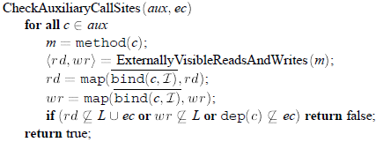
Check Auxiliary Call Sites
Auxiliary method writes only local variables
Auxiliary method reads only local variables, extent constant variables and reference parameters
Reference parameters of auxiliary methods must contain extent constant values
These conditions ensure that auxiliary methods are not visible outside callers, hence we can check only full methods for commutativity

Slide 30
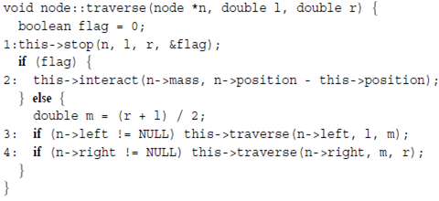
Check Auxiliary Call Sites

Slide 31
Separability
Execution should be decomposed into:
Object section: performs all accesses to the object
Invocation section: invokes methods and does not access the object
Parallelized code atomically executes the object section, and invokes the invocation section in parallel.
Separability test checks each method to ensure that it never accesses a non extent constant instance variable after it invokes a full method

Slide 32
May Perform Input Or Output
Parallelizing computations that may perform input or output may change the order of the I/O operations, which may violate the semantics of the original serial program

Slide 33
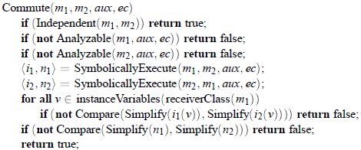
Commutativity Testing
Check commutativity for each pair in the extent

Slide 34
Commutativity Testing
Independence analysis is same as in data dependence analysis
Independent methods commute by definition
Unstructured control flow such as ‘goto’ may prohibit the precise extraction of expression values
We conservatively assume that unanalyzable methods do not commute

Slide 35
Commutativity Testing
Examine all methods in extent
node::traverse and system::forces commute with all methods in extent because:
they compute only extent constant values (ensured in full call site check)
they do not write instance variables

Slide 36
Commutativity Testing
The compiler is left to check that node::interact commutes with itself

Slide 37
Commutativity Testing
After expression simplification, the compiler compares corresponding expressions for equality. Hence system::forces is a parallel method!

Slide 38
Code Generation
Every method is either a serial or parallel method
Operations executed by a serial method executes sequentially
The object section of a parallel method is executed atomically (via locks)
The invocation section of a parallel method is invoked in parallel (via spawn)

Slide 39
Experimental Results
Compiler used to automatically parallelize 3 applications
the Barnes-Hut hierarchial N-body solver
the Water simulation code
the String seismic code

Slide 40
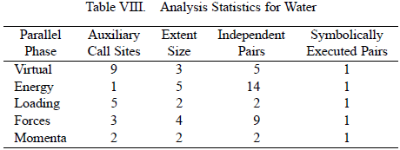
Experimental Results
All of the parallel phases have a significant number of auxiliary call sites
Most of the pairs of invoked methods are independent, hence the compiler executes relatively few pairs symbolically

Slide 41
Experimental Results
Parallelism coverage is the percentage of time spent in parallelized sections
It can be seen that commutativity analysis parallelizes a significant portion of the benchmarks

Slide 42
Takeaway
Commuting operations play an important role in parallel computing
This framework can exploit commuting operations and automatically parallelize dynamic, pointer based programs
This framework ensures that the internal state of objects are identical, regardless of the order of execution

Slide 43
Takeaway
Future work (which we will see soon!) relaxes this and ensures that the external state of objects are consistent, even though the internal state may be different

