Slide 1
The Ant and The Grasshopper Fast and Accurate Pointer Analysis for Millions of Lines of Code
Ben Hardekopf and Calvin Lin
PLDI 2007
(Best Paper & Best Presentation Award)

Slide 2
Contributions of the Paper
Identify current state-of-the-art
Compare 3 well-known algorithms
Fastest takes ½ hour to analyze 1M lines of C
Advance the state-of-the-art
Two techniques(The Ant and The Grasshopper) for inclusion-based analysis
Over 3x faster, same precision
Will be incorporated into GCC

Slide 3
The Agenda
Background
Lazy Cycle Detection
Hybrid Cycle Detection
Evaluation
Q & A

Slide 4
Why Pointer Analysis ?
Pointer information - vital for most program analyses like program verification and program understanding.
Precise pointer analysis is NP hard.
The most precise analyses are flow sensitive and context sensitive, but do not scale to large programs.

Slide 5
Pointer Analysis - Simplified
Flow-sensitive analysis computes a different graph at each program point. But this can be quite expensive.
Solution: Flow-insensitive analysis - compute a points-to relation which is the least upper bound of all the points-to relations computed by the flow-sensitive analysis
Compute a SINGLE points-to relation that holds regardless of the order in which assignment statements are actually executed
“consider all the assignment statements together, replacing strong updates in dataflow equations with weak updates”
Lets see some equations!

Slide 6
Dataflow Equations – Flow-Sensitive
G
G
x := &y
x := *y
G’ = G with pt’(x) ← {y}
G’ = G with pt’(x) ← U pt(a)
for all a in pt(y)
G
G
x := y
*x := y
G’ = G with pt’(x) ← pt(y)
G’ = G with pt’(a) U← pt(y)
for all a in pt(x)
strong updates
weak update

Slide 7
Dataflow Equations – Flow-Insensitive
Statements
weak updates only
G
G
x := &y
x := *y
G = G with pt(x) U← {y}
G = G with pt(x) U← pt(a)
for all a in pt(y)
G
G
x := y
*x := y
G = G with pt(x) U← pt(y)
G = G with pt(a) U← pt(y)
for all a in pt(x)

Slide 8
Set Constraints
Statements
Base
Simple
x := &y
x := *y
Complex1
Complex2
x := y
*x := y

Slide 9
Background: Inclusion-based Analysis
Generate constraints from the code
Build a constraint graph
Nodes: variables
Edges: inclusion constraints
Add indirect constraints
Pointer dereference
Recursively compute transitive closure of the graph

Slide 10
Background: Inclusion-based Analysis
c = &f;
e = &c;
g = &a;
a = d;
b = a;
d = *e;
*e = b;
*g = e;

Slide 11
Background: Inclusion-based Analysis
c = &f;
e = &c;
g = &a;
a = d;
b = a;
d = *e;
*e = b;
*g = e;
c  {f}
e  {c}
g  {a}
a  d
b  a
d  *e
*e  b
*g  e

Slide 12
Background: Inclusion-based Analysis
c = &f;
e = &c;
g = &a;
a = d;
b = a;
d = *e;
*e = b;
*g = e;
c  {f}
e  {c}
g  {a}
a  d
b  a
d  *e
*e  b
*g  e

Slide 13
Background: Inclusion-based Analysis
c = &f;
e = &c;
g = &a;
a = d;
b = a;
d = *e;
*e = b;
*g = e;
c  {f}
e  {c}
g  {a}
a  d
b  a
d  *e
*e  b
*g  e

Slide 14
Background: Inclusion-based Analysis
c = &f;
e = &c;
g = &a;
a = d;
b = a;
d = *e;
*e = b;
*g = e;
c  {f}
e  {c}
g  {a}
a  d
b  a
d  *e
*e  b
*g  e

Slide 15
Background: Inclusion-based Analysis
c  {f}
e  {c}
g  {a}
a  d
b  a
d  *e
*e  b
*g  e

Slide 16
Background: Inclusion-based Analysis
e
a
c  {f}
e  {c}
g  {a}
a  d
b  a
d  *e
*e  b
*g  e
g
d
b
f
c
Constraint Graph

Slide 17
Background: Inclusion-based Analysis
e
a
c  {f}
e  {c}
g  {a}
a  d
b  a
d  *e
*e  b
*g  e
g
d
b
f
c
f
Constraint Graph

Slide 18
Background: Inclusion-based Analysis
e
c
a
c  {f}
e  {c}
g  {a}
a  d
b  a
d  *e
*e  b
*g  e
g
a
d
b
f
c
f
Constraint Graph

Slide 19
Background: Inclusion-based Analysis
e
c
a
c  {f}
e  {c}
g  {a}
a  d
b  a
d  *e
*e  b
*g  e
g
a
d
b
f
c
f
Constraint Graph

Slide 20
Background: Inclusion-based Analysis
e
c
a
c  {f}
e  {c}
g  {a}
a  d
b  a
d  *e
*e  b
*g  e
g
a
d
b
f
c
f
Constraint Graph

Slide 21
Background: Inclusion-based Analysis
e
c
a
c  {f}
e  {c}
g  {a}
a  d
b  a
d  *e
*e  b
*g  e
g
a
d
b
f
c
f
Constraint Graph

Slide 22
Background: Inclusion-based Analysis
e
c
a
c  {f}
e  {c}
g  {a}
a  d
b  a
d  *e
*e  b
*g  e
g
a
d
b
f
c
f
Constraint Graph

Slide 23
Background: Inclusion-based Analysis
e
c
a
c  {f}
e  {c}
g  {a}
a  d
b  a
d  *e
*e  b
*g  e
g
a
d
b
f
c
f
Constraint Graph

Slide 24
Background: Inclusion-based Analysis
e
c
a
c  {f}
e  {c}
g  {a}
a  d
b  a
d  *e
*e  b
*g  e
g
a
d
b
f
c
f
Constraint Graph

Slide 25
Background: Inclusion-based Analysis
e
c
a
c  {f}
e  {c}
g  {a}
a  d
b  a
d  *e
*e  b
*g  e
g
a
d
b
f
c
f
Constraint Graph

Slide 26
Background: Inclusion-based Analysis
e
c
a
c  {f}
e  {c}
g  {a}
a  d
b  a
d  *e
*e  b
*g  e
g
a
d
f
b
f
c
f
Constraint Graph

Slide 27
Background: Inclusion-based Analysis
e
c
a
f
c  {f}
e  {c}
g  {a}
a  d
b  a
d  *e
*e  b
*g  e
g
a
d
f
b
f
c
f
Constraint Graph

Slide 28
Background: Inclusion-based Analysis
e
c
a
f
c  {f}
e  {c}
g  {a}
a  d
b  a
d  *e
*e  b
*g  e
g
a
d
f
b
f
f
c
f
Constraint Graph

Slide 29
Background: Inclusion-based Analysis
e
c
a
f
c  {f}
e  {c}
g  {a}
a  d
b  a
d  *e
*e  b
*g  e
g
a
d
f
b
f
f
c
f
Constraint Graph

Slide 30
Background: Inclusion-based Analysis
e
c
a
f
c  {f}
e  {c}
g  {a}
a  d
b  a
d  *e
*e  b
*g  e
g
a
d
f
b
f
f
c
f
Constraint Graph

Slide 31
Background: Inclusion-based Analysis
e
c
a
f
c  {f}
e  {c}
g  {a}
a  d
b  a
d  *e
*e  b
*g  e
g
a
d
f
b
f
f
c
f
Constraint Graph

Slide 32
Background: Inclusion-based Analysis
e
c
a
f
c  {f}
e  {c}
g  {a}
a  d
b  a
d  *e
*e  b
*g  e
g
a
d
f
b
f
f
c
f
Constraint Graph

Slide 33
Background: Inclusion-based Analysis
e
c
a
f
c  {f}
e  {c}
g  {a}
a  d
b  a
d  *e
*e  b
*g  e
g
a
d
f
b
f
f
c
f
Constraint Graph

Slide 34
Background: Inclusion-based Analysis
e
c
a
f
c  {f}
e  {c}
g  {a}
a  d
b  a
d  *e
*e  b
*g  e
g
a
d
f
b
f
f
c
f
Constraint Graph

Slide 35
Background: Inclusion-based Analysis
e
c
a
f
c  {f}
e  {c}
g  {a}
a  d
b  a
d  *e
*e  b
*g  e
g
a
d
f
b
f
f
c
f
Constraint Graph

Slide 36
Background: Inclusion-based Analysis
e
c
a
f
c  {f}
e  {c}
g  {a}
a  d
b  a
d  *e
*e  b
*g  e
g
a
d
f
b
f
f
c
f
Constraint Graph

Slide 37
Background: Inclusion-based Analysis
e
c
a
f,c
c  {f}
e  {c}
g  {a}
a  d
b  a
d  *e
*e  b
*g  e
g
a
d
f
b
f
f
c
f
Constraint Graph

Slide 38
Background: Inclusion-based Analysis
e
c
a
f,c
c  {f}
e  {c}
g  {a}
a  d
b  a
d  *e
*e  b
*g  e
g
a
d
f
b
f,c
f
c
f
Constraint Graph

Slide 39
Background: Inclusion-based Analysis
e
c
a
f,c
c  {f}
e  {c}
g  {a}
a  d
b  a
d  *e
*e  b
*g  e
g
a
d
f
b
f,c
f
c
f,c
Constraint Graph

Slide 40
Background: Inclusion-based Analysis
e
c
a
f,c
c  {f}
e  {c}
g  {a}
a  d
b  a
d  *e
*e  b
*g  e
g
a
d
f,c
b
f,c
f
c
f,c
Constraint Graph

Slide 41
Background: Inclusion-based Analysis
e
c
a
f,c
c  {f}
e  {c}
g  {a}
a  d
b  a
d  *e
*e  b
*g  e
g
a
d
f,c
b
f,c
f
c
f,c
Constraint Graph

Slide 42
Background: Online Cycle Detection
Inclusion-based analysis is O(n³)
Optimize with online cycle detection
All nodes in the same cycle will have identical points-to sets
Most cycles appear during the analysis as new edges are added

Slide 43
Background: Online Cycle Detection
Cycle detection mechanism will largely determine performance of analysis
Must carefully balance aggression versus overhead
Too aggressive → too much graph traversal
Too conservative → cycles found too late

Slide 44
Contributions
Two new techniques for cycle detection
Lazy Cycle Detection
Hybrid Cycle Detection
Techniques are complementary
Hybrid Cycle Detection can be composed with any other cycle detection technique

Slide 45
Contributions
Two new techniques for cycle detection
Lazy Cycle Detection
Hybrid Cycle Detection
Techniques are complementary
Hybrid Cycle Detection can be composed with any other cycle detection technique

Slide 46
Lazy Cycle Detection
Well-known fact:
A cycle forces nodes to have identical points-to sets
Key Insight:
Nodes with identical points-to sets indicate possible cycles
Balance aggression and overhead by waiting for the effect of the cycle (identical points-to sets) to become obvious

Slide 47
Lazy Cycle Detection
e
c
a
c  {f}
e  {c}
g  {a}
a  d
b  a
d  *e
*e  b
*g  e
g
a
d
b
f
c
f
Constraint Graph

Slide 48
Lazy Cycle Detection
e
c
a
c  {f}
e  {c}
g  {a}
a  d
b  a
d  *e
*e  b
*g  e
g
a
d
b
f
c
f
Constraint Graph

Slide 49
Lazy Cycle Detection
e
c
a
c  {f}
e  {c}
g  {a}
a  d
b  a
d  *e
*e  b
*g  e
g
a
d
b
f
c
f
Constraint Graph

Slide 50
Lazy Cycle Detection
e
c
a
c  {f}
e  {c}
g  {a}
a  d
b  a
d  *e
*e  b
*g  e
g
a
d
b
f
c
f
Constraint Graph

Slide 51
Lazy Cycle Detection
e
c
a
c  {f}
e  {c}
g  {a}
a  d
b  a
d  *e
*e  b
*g  e
g
a
d
f
b
f
c
f
Constraint Graph

Slide 52
Lazy Cycle Detection
e
c
a
f
c  {f}
e  {c}
g  {a}
a  d
b  a
d  *e
*e  b
*g  e
g
a
d
f
b
f
c
f
Constraint Graph

Slide 53
Lazy Cycle Detection
e
c
a
f
c  {f}
e  {c}
g  {a}
a  d
b  a
d  *e
*e  b
*g  e
g
a
d
f
b
f
f
c
f
Constraint Graph

Slide 54
Lazy Cycle Detection
e
c
a
f
c  {f}
e  {c}
g  {a}
a  d
b  a
d  *e
*e  b
*g  e
g
a
d
f
b
f
f
c
f
Constraint Graph

Slide 55
Lazy Cycle Detection
e
c
a
f
c  {f}
e  {c}
g  {a}
a  d
b  a
d  *e
*e  b
*g  e
g
a
d
f
b
f
f
c
f
Constraint Graph

Slide 56
Lazy Cycle Detection
e
c
a
f
c  {f}
e  {c}
g  {a}
a  d
b  a
d  *e
*e  b
*g  e
g
a
d
f
b
f
f
c
f
Constraint Graph

Slide 57
Lazy Cycle Detection
e
c
a
f
c  {f}
e  {c}
g  {a}
a  d
b  a
d  *e
*e  b
*g  e
g
a
d
f
b
f
f
c
f
Constraint Graph

Slide 58
Lazy Cycle Detection
e
c
a
f
c  {f}
e  {c}
g  {a}
a  d
b  a
d  *e
*e  b
*g  e
g
a
d
f
b
f
f
c
f
Constraint Graph

Slide 59
Lazy Cycle Detection
e
c
a
f
c  {f}
e  {c}
g  {a}
a  d
b  a
d  *e
*e  b
*g  e
g
a
d
f
b
f
f
c
f
Constraint Graph

Slide 60
Lazy Cycle Detection
e
c
a
f
c  {f}
e  {c}
g  {a}
a  d
b  a
d  *e
*e  b
*g  e
g
a
d
f
b
f
f
c
f
Constraint Graph

Slide 61
Lazy Cycle Detection
e
c
a/b/c/d
f
c  {f}
e  {c}
g  {a}
a  d
b  a
d  *e
*e  b
*g  e
g
a
f
Constraint Graph

Slide 62
Lazy Cycle Detection
e
c
a/b/c/d
f
c  {f}
e  {c}
g  {a}
a  d
b  a
d  *e
*e  b
*g  e
g
a
f
Constraint Graph

Slide 63
Lazy Cycle Detection
e
c
a/b/c/d
f
c  {f}
e  {c}
g  {a}
a  d
b  a
d  *e
*e  b
*g  e
g
a
f
Constraint Graph

Slide 64
Lazy Cycle Detection
e
c
a/b/c/d
f
c  {f}
e  {c}
g  {a}
a  d
b  a
d  *e
*e  b
*g  e
g
a
f
Constraint Graph

Slide 65
Lazy Cycle Detection
e
c
a/b/c/d
f,c
c  {f}
e  {c}
g  {a}
a  d
b  a
d  *e
*e  b
*g  e
g
a
f
Constraint Graph

Slide 66
Lazy Cycle Detection
e
c
a/b/c/d
f,c
c  {f}
e  {c}
g  {a}
a  d
b  a
d  *e
*e  b
*g  e
g
a
f
Constraint Graph

Slide 67
Lazy Cycle Detection
IS LAZY because cycles are detected only while propagating constraints to them (well after they are created)
Nodes with identical points-to sets MAY NOT be part of a cycle
An Additional heuristic is needed to stop this wasteful search : Don’t trigger cycles detection on the same edge twice
=> Cycle detection is not guaranteed to find all cycles

Slide 68
Contributions
Two new techniques for cycle detection
Lazy Cycle Detection
Hybrid Cycle Detection
Techniques are complementary
Hybrid Cycle Detection can be composed with any other cycle detection technique

Slide 69
Hybrid Cycle Detection
finds few cycles
finds many cycles
cheap
Offline
Cycle Detection
expensive
Rountev and Chandra, Off-line Variable Substitution for Scaling Points-to
Analysis, in PLDI 2000.

Slide 70
Hybrid Cycle Detection
finds few cycles
finds many cycles
cheap
Offline
Cycle Detection
expensive
Online
Cycle Detection
Fähndrich et al, Partial Online Cycle Elimination in Inclusion Constraint
Graphs, in PLDI 1998.

Slide 71
Hybrid Cycle Detection
finds few cycles
finds many cycles
cheap
Offline
Cycle Detection
Hybrid
Cycle Detection
expensive
Online
Cycle Detection
Key Insight: combining offline and online techniques can give us the best of both worlds
PS: Offline – before actual constraint graph traversal

Slide 72
Hybrid Cycle Detection
Eagerly finds cycles without traversing constraint graph
Not guaranteed to find all cycles
46‒74% in these benchmarks
Can be combined with other cycle detection techniques

Slide 73
Hybrid Cycle Detection
Offline component
Online component

Slide 74
Hybrid Cycle Detection ‒ Offline
Linear time static analysis prior to actual pointer analysis.
Uses a simpler offline constraint graph
a node for each variable
a ref node for variable dereference
an edge for each simple, complex constr.
ignore base constraints
Detect cycles in this graph using Tarjan’s Algorithm
Key: No need to perform transitive closure here!

Slide 75
Hybrid Cycle Detection ‒ Offline
c  {f}
e  {c}
g  {a}
a  d
b  a
d  *e
*e  b
*g  e

Slide 76
Hybrid Cycle Detection ‒ Offline
c  {f}
e  {c}
g  {a}
a  d
b  a
d  *e
*e  b
*g  e
Ignore Base Constraints!

Slide 77
Hybrid Cycle Detection ‒ Offline
c  {f}
e  {c}
g  {a}
a  d
b  a
d  *e
*e  b
*g  e

Slide 78
Hybrid Cycle Detection ‒ Offline
e
a
c  {f}
e  {c}
g  {a}
a  d
b  a
d  *e
*e  b
*g  e
*g
d
b
*e
Offline Constraint Graph

Slide 79
Hybrid Cycle Detection ‒ Offline
e
a
c  {f}
e  {c}
g  {a}
a  d
b  a
d  *e
*e  b
*g  e
*g
d
b
*e
Offline Constraint Graph

Slide 80
Hybrid Cycle Detection ‒ Offline
e
a
c  {f}
e  {c}
g  {a}
a  d
b  a
d  *e
*e  b
*g  e
*g
d
b
*e
Offline Constraint Graph

Slide 81
Hybrid Cycle Detection ‒ Offline
e
a
c  {f}
e  {c}
g  {a}
a  d
b  a
d  *e
*e  b
*g  e
*g
d
b
*e
Offline Constraint Graph

Slide 82
Hybrid Cycle Detection ‒ Offline
e
a
c  {f}
e  {c}
g  {a}
a  d
b  a
d  *e
*e  b
*g  e
*g
d
b
*e
Offline Constraint Graph

Slide 83
Hybrid Cycle Detection ‒ Offline
e
a
e → {a,b,d}
c  {f}
e  {c}
g  {a}
a  d
b  a
d  *e
*e  b
*g  e
*g
d
b
*e
Offline Constraint Graph

Slide 84
Hybrid Cycle Detection
Offline component
Online component

Slide 85
Hybrid Cycle Detection ‒ Online
e
c
a
e → {a,b,d}
c  {f}
e  {c}
g  {a}
a  d
b  a
d  *e
*e  b
*g  e
g
a
d
b
f
c
f
Constraint Graph

Slide 86
Hybrid Cycle Detection ‒ Online
e
c
a
e → {a,b,d}
c  {f}
e  {c}
g  {a}
a  d
b  a
d  *e
*e  b
*g  e
g
a
d
b
f
c
f
Constraint Graph

Slide 87
Hybrid Cycle Detection ‒ Online
e
c
a
e → {a,b,d}
c  {f}
e  {c}
g  {a}
a  d
b  a
d  *e
*e  b
*g  e
g
a
d
b
f
c
f
Constraint Graph

Slide 88
Hybrid Cycle Detection ‒ Online
e
c
a/b/c/d
f
e → {a,b,d}
c  {f}
e  {c}
g  {a}
a  d
b  a
d  *e
*e  b
*g  e
g
a
f
Constraint Graph

Slide 89
Hybrid Cycle Detection ‒ Online
e
c
a/b/c/d
f
e → {a,b,d}
c  {f}
e  {c}
g  {a}
a  d
b  a
d  *e
*e  b
*g  e
g
a
f
Constraint Graph

Slide 90
Hybrid Cycle Detection ‒ Online
e
c
a/b/c/d
f
e → {a,b,d}
c  {f}
e  {c}
g  {a}
a  d
b  a
d  *e
*e  b
*g  e
g
a
f
Constraint Graph

Slide 91
Hybrid Cycle Detection ‒ Online
e
c
a/b/c/d
f
e → {a,b,d}
c  {f}
e  {c}
g  {a}
a  d
b  a
d  *e
*e  b
*g  e
g
a
f
Constraint Graph

Slide 92
Hybrid Cycle Detection ‒ Online
e
c
a/b/c/d
f
e → {a,b,d}
c  {f}
e  {c}
g  {a}
a  d
b  a
d  *e
*e  b
*g  e
g
a
f
Constraint Graph

Slide 93
Hybrid Cycle Detection ‒ Online
e
c
a/b/c/d
f
e → {a,b,d}
c  {f}
e  {c}
g  {a}
a  d
b  a
d  *e
*e  b
*g  e
g
a
f
Constraint Graph

Slide 94
Hybrid Cycle Detection ‒ Online
e
c
a/b/c/d
f
e → {a,b,d}
c  {f}
e  {c}
g  {a}
a  d
b  a
d  *e
*e  b
*g  e
g
a
f
Constraint Graph

Slide 95
Hybrid Cycle Detection ‒ Online
e
c
a/b/c/d
f
e → {a,b,d}
c  {f}
e  {c}
g  {a}
a  d
b  a
d  *e
*e  b
*g  e
g
a
f
Constraint Graph

Slide 96
Hybrid Cycle Detection ‒ Online
e
c
a/b/c/d
f
e → {a,b,d}
c  {f}
e  {c}
g  {a}
a  d
b  a
d  *e
*e  b
*g  e
g
a
f
Constraint Graph

Slide 97
Hybrid Cycle Detection ‒ Online
e
c
a/b/c/d
f
e → {a,b,d}
c  {f}
e  {c}
g  {a}
a  d
b  a
d  *e
*e  b
*g  e
g
a
f
Constraint Graph

Slide 98
Hybrid Cycle Detection ‒ Online
e
c
a/b/c/d
f,c
e → {a,b,d}
c  {f}
e  {c}
g  {a}
a  d
b  a
d  *e
*e  b
*g  e
g
a
f
Constraint Graph

Slide 99
Hybrid Cycle Detection ‒ Online
e
c
a/b/c/d
f,c
e → {a,b,d}
c  {f}
e  {c}
g  {a}
a  d
b  a
d  *e
*e  b
*g  e
g
a
f
Constraint Graph

Slide 100
Evaluation
Compare against 3 well-known algorithms
Heintze and Tardieu [PLDI'01]
Pearce et al [PASTE'04]
Berndl et al [PLDI'03]
All algorithms compute the exact same solution
Six benchmarks: 100K—2M LOC
Emacs, Ghostscript, Gimp, Insight, Wine, Linux Kernel

Slide 101
Performance Comparison
59

Slide 102
Performance Comparison
59

Slide 103
Concluding Remarks
20x faster than Berndl et al, 6x faster than Pearce et al and 3x faster than Heintze et al
The paper also looks at different data structures to efficiently represent points-to sets
Sparse-bitmap (used in GCC)
Binary Decision Trees (BDD)
BDD implementation is 2x slower on average, but used 5.5X less memory
Question: They DO NOT compare with IDEAL. Is there further opportunity here ?

Slide 104
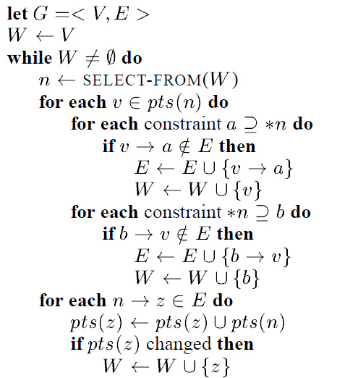
Backup: Transitive Closure Algorithm

Slide 105
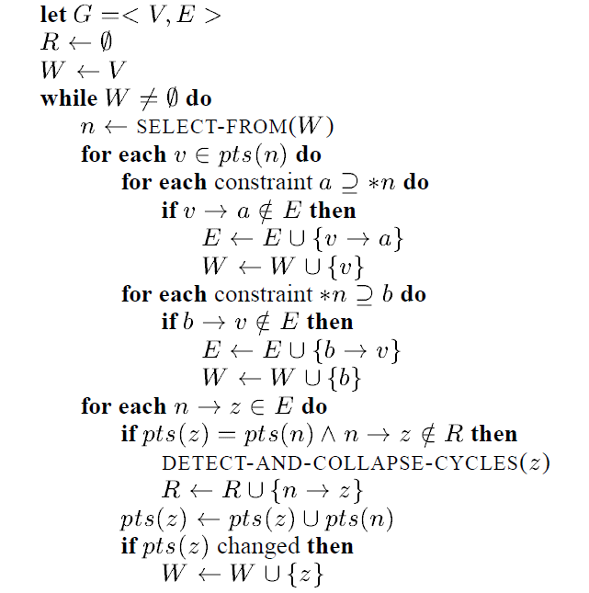
Lazy Cycle Detection Algorithm

Slide 106
Heintze and Tardieu [PLDI'01]
Online algorithm
During construction, as new inclusion edges are added to the graph, the transitive edges are NOT added
During analysis, indirect constraints are resolved through REACHABILITY queries.
=> lots of redundant queries
In their paper, they reported results for field based implementation. When fields are expanded, the algorithm is dramatically slow.

Slide 107
Pearce et al [PASTE'04]
Two variants
First:
Maintain topological order of the graph
A newly inserted edge that violates this ordering COULD create a cycle, so check whenever this happens.
Second
Periodic sweep of the constraint graph to detect and collapse cycles.

Slide 108
Berndl et al [PLDI'03]
Field sensitive inclusion-based pointer analysis for JAVA programs
Uses BDDs to represent graph and points-to sets
This paper extends this algorithm by
Making it field insensitive
Handle indirect function calls

Slide 109
Benchmarks
Constraints reduced using offline variable substitution
(60-77%)

Slide 110
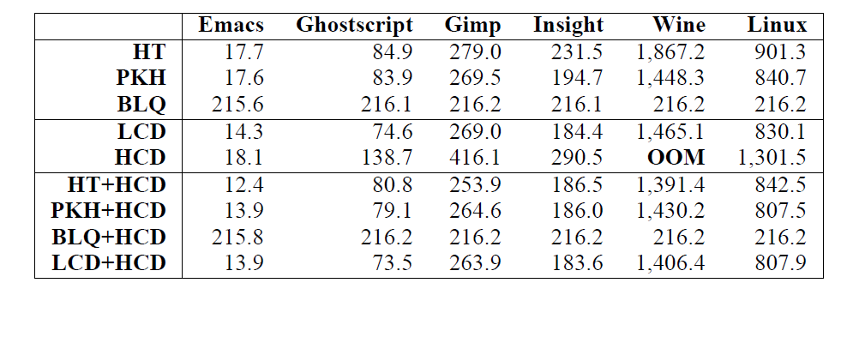
Memory Consumption

Slide 111
Observations
Number of nodes collapsed
Reduces nodes and edges in graph
Number of nodes searched in DFS
Overhead due to cycle detection
Number of points-to info propogation
Expensive operation

