Slide 1
A fresh look at pickett’s charge
2021-11-16
Jonathan Poggie, Sorin Matei, and Robert Kirchubel
FORCES Initiative, Purdue University

Slide 2
Battle Flow: Alternative Perspective on Battles and Crises
Conventional models: game pieces
Discrete units: arbitrary aggregation
Continuous flow may provide
More realistically portray troop motion
Intuitive understanding of momentum of conflict
Tool for training and decision making
Rigid, Discrete
Game Counter
Continuous Density
Battle Flow Unit

Slide 3
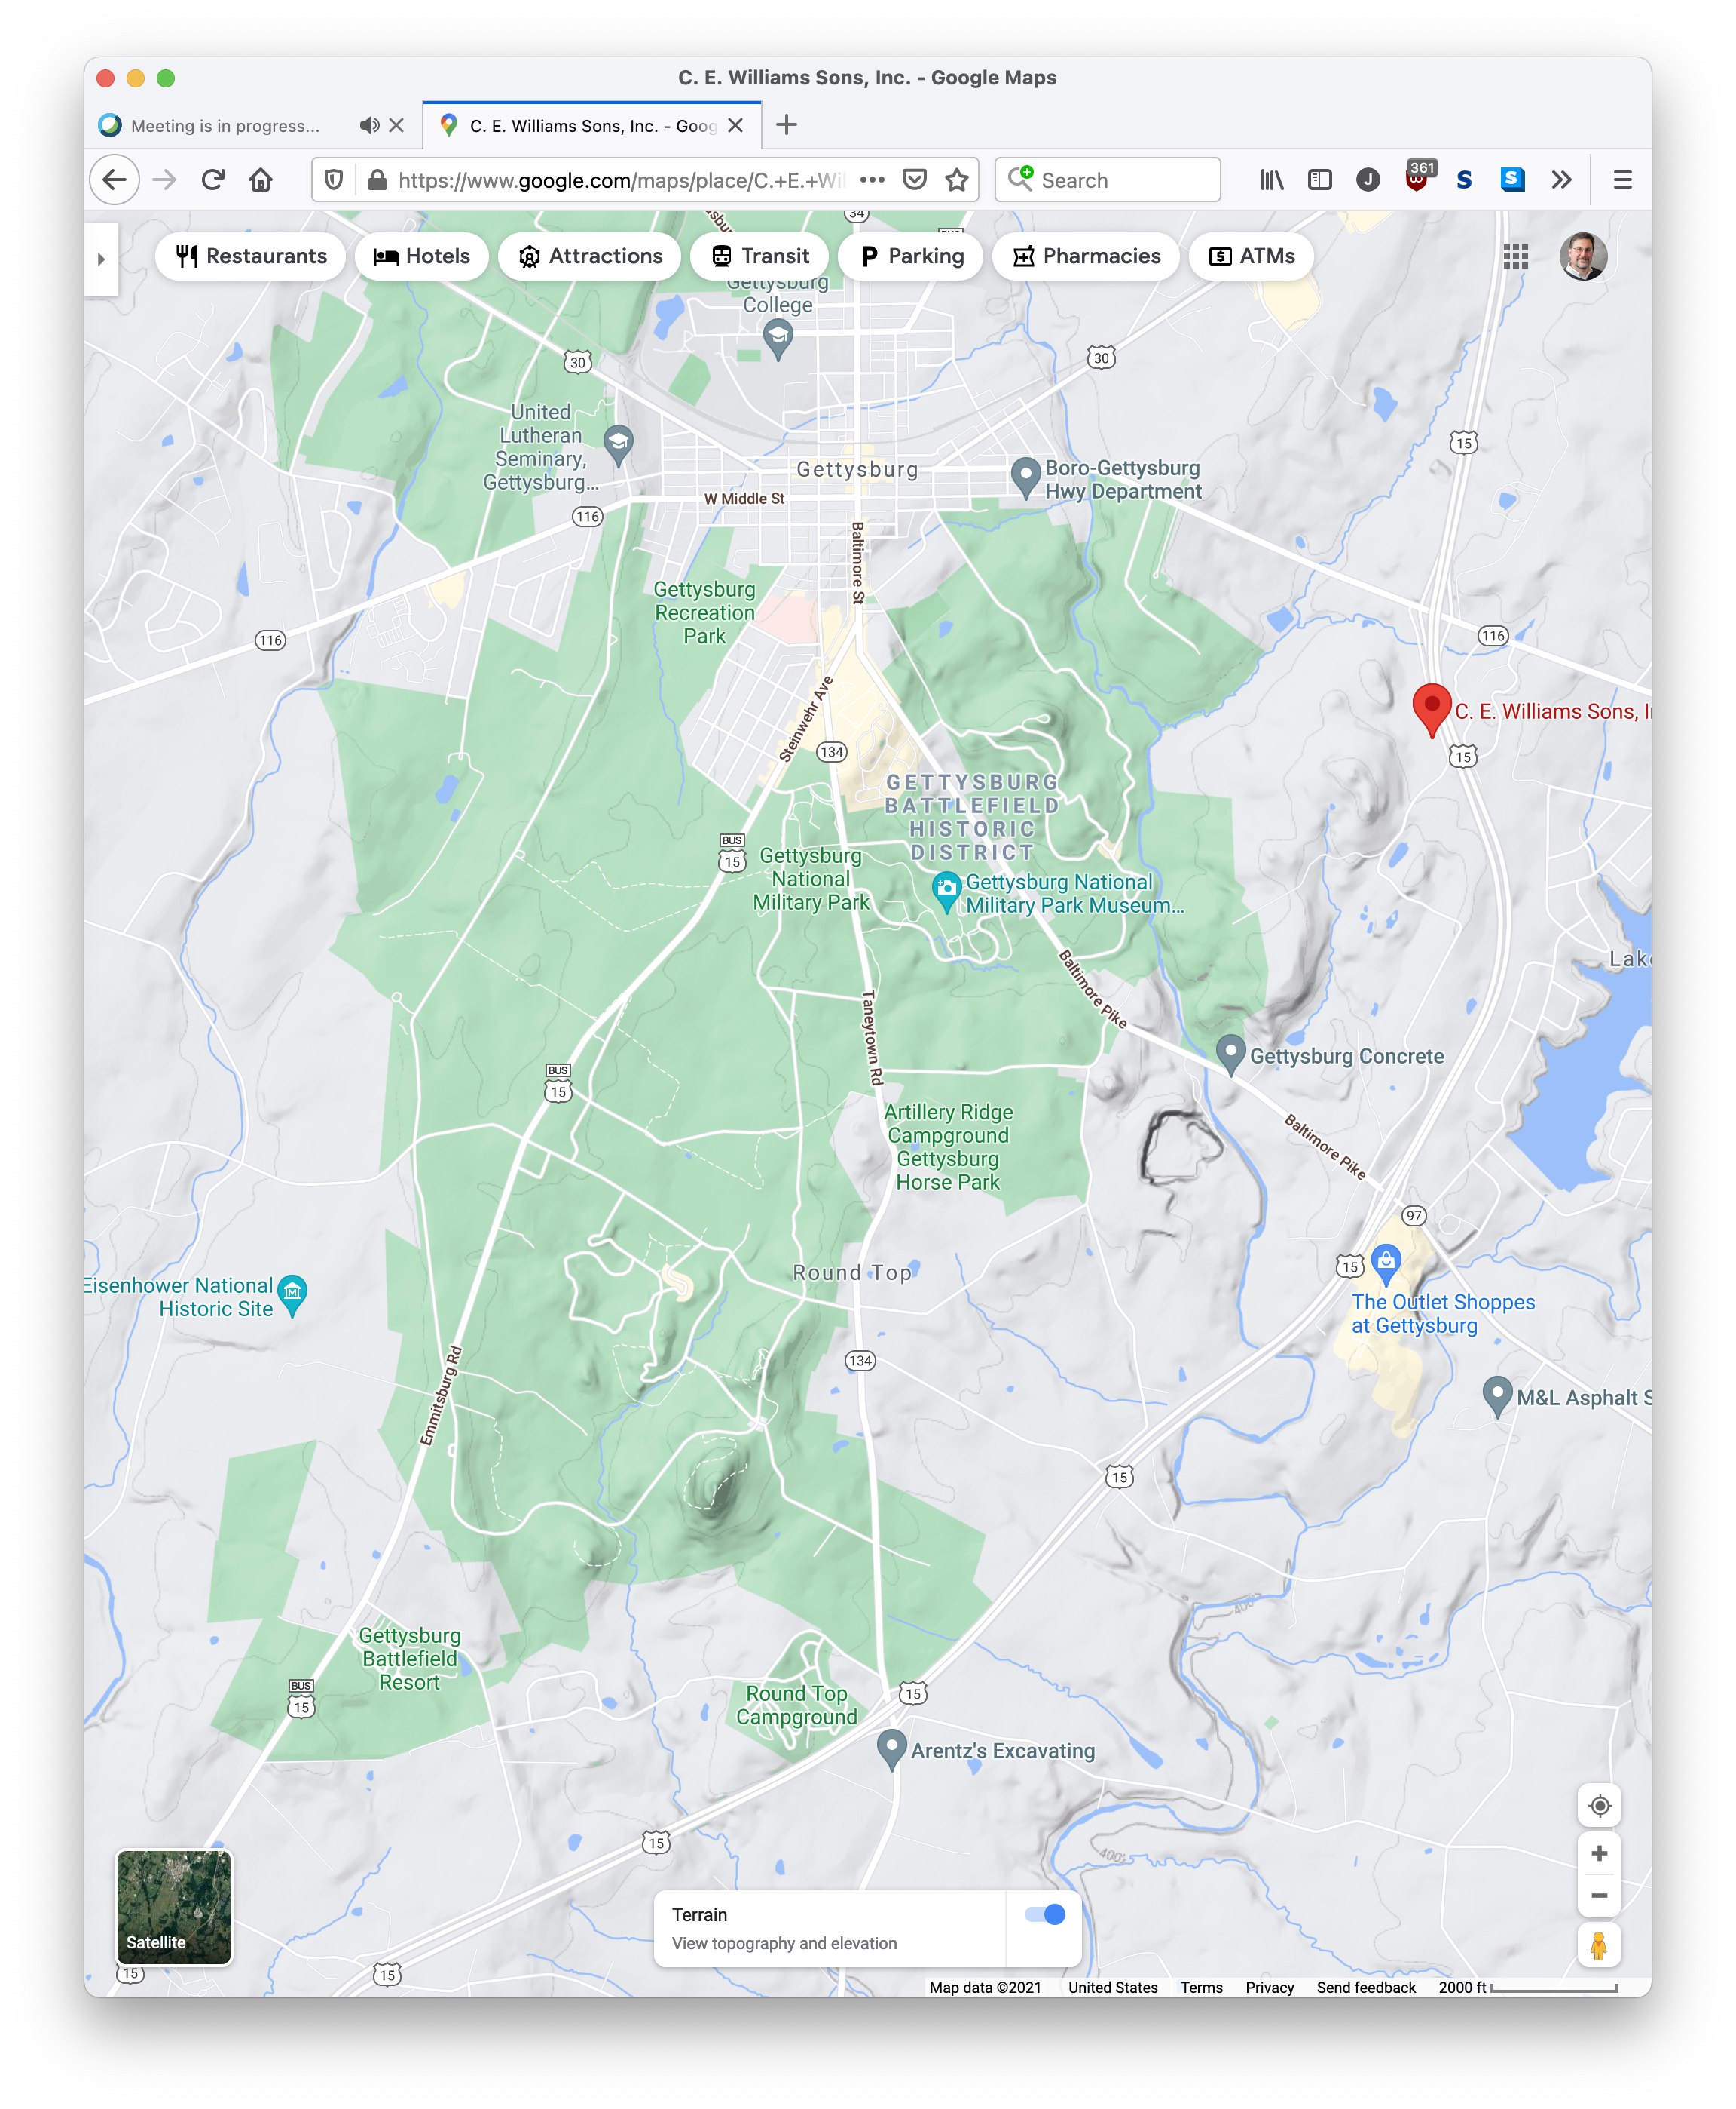
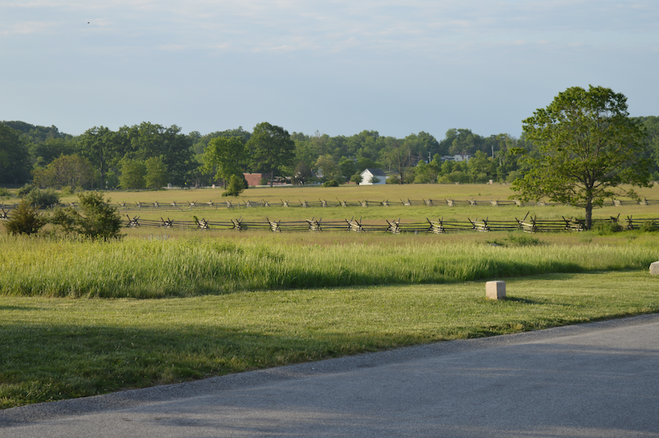
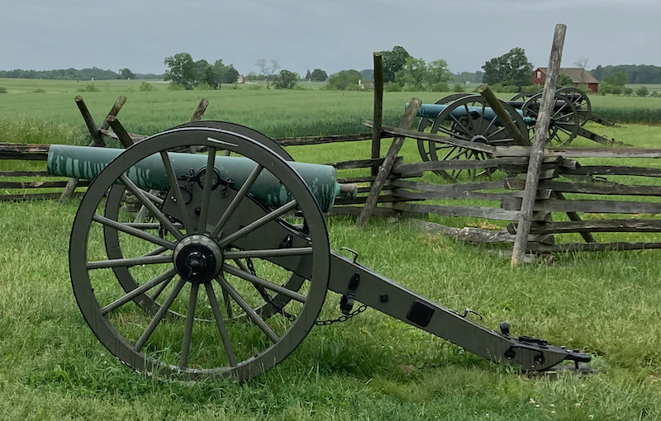
Battle of Gettysburg: July 1-3, 1863
Modern Map
Pickett’s Charge:
Day 3 of Battle of Gettysburg
July 3, 1863, about 2:30 PM
About one hour
JP Photos
Area of Interest

Slide 4
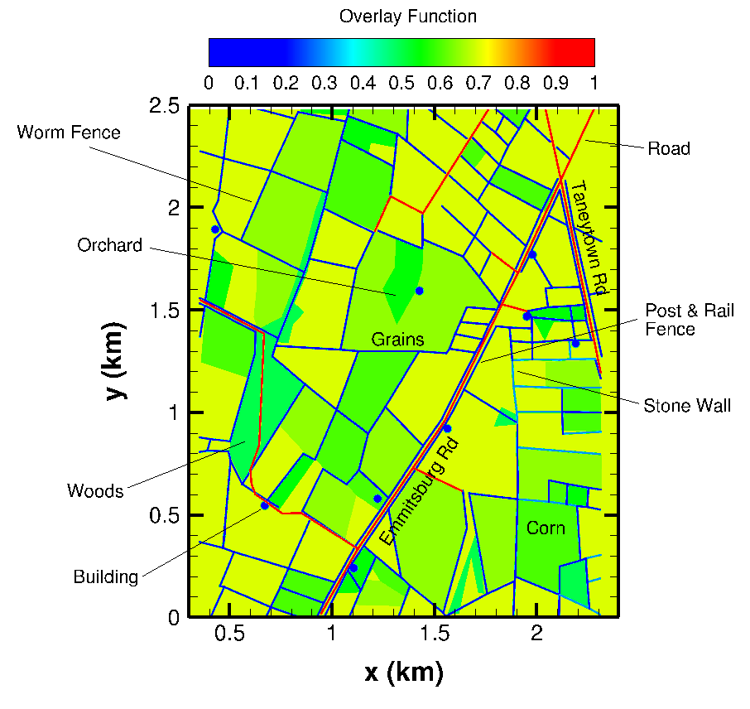
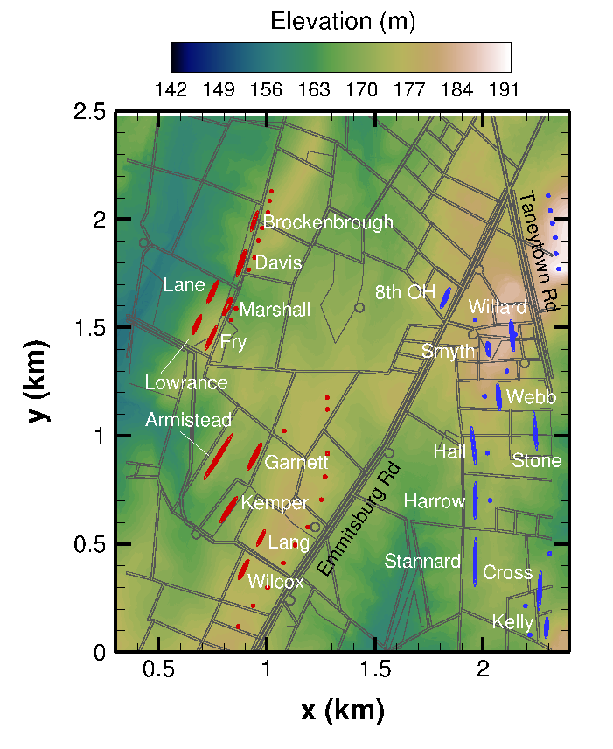
Overlay Layer and Contour Map
Collin Tofts (undergrad, CS)
Matthew Ellis (PhD student, Poli Sci)

Slide 5
Army Level of Aggregation
Elevation and Terrain Included
Perfectly Flat Landscape
https://engineering.purdue.edu/~jpoggie/battle_flow_model/armies.mp4
https://engineering.purdue.edu/~jpoggie/battle_flow_model/armies_no_terrain.mp4

Slide 6
Brigade Level of Aggregation
Continuous Agents
(Our Model)
Discrete Agents
(Traditional Model)
https://engineering.purdue.edu/~jpoggie/battle_flow_model/brigades_case0.mp4
https://engineering.purdue.edu/~jpoggie/battle_flow_model/brigades_case0_discrete.mp4

Slide 7
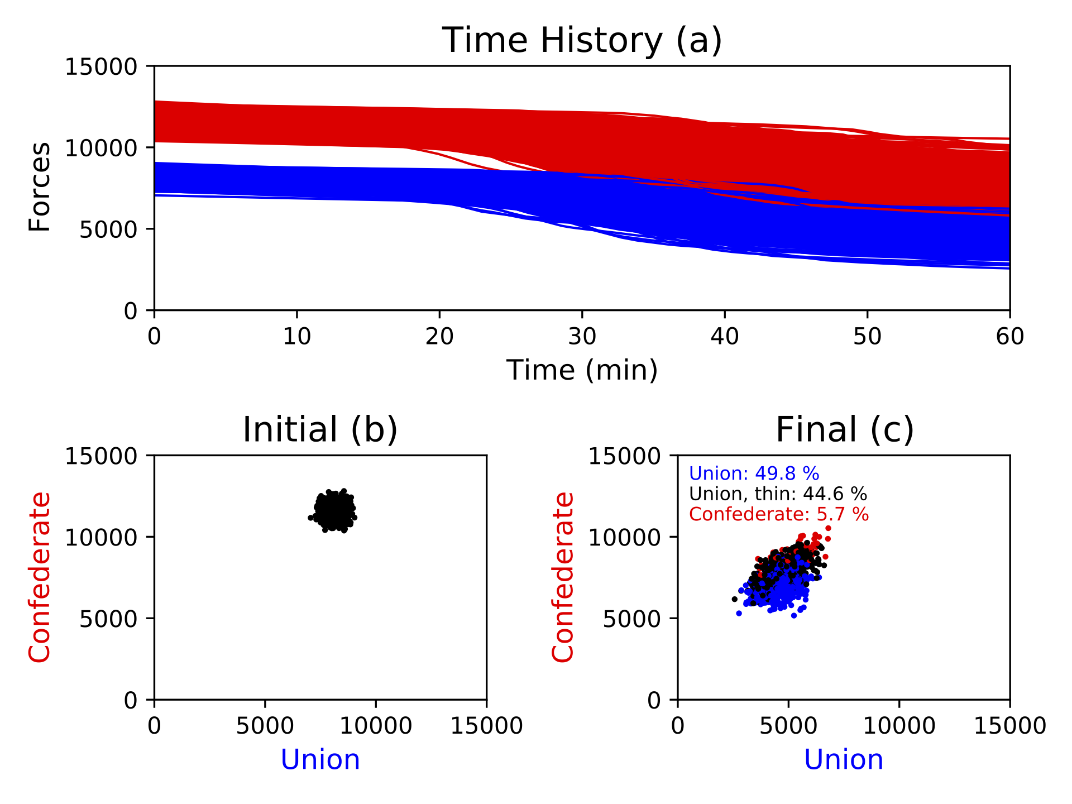
Statistical Analysis
Confederate
Union
Confederates win only 6% of cases
Random model perturbation
1000 cases

Slide 8
Take Away Points
Confederates cannot fire effectively while moving
Terrain slows pace of battle and favors defenders
Confederate victory in only 6% of cases
Insufficient Confederate force to break and hold Union lines

Slide 9
Thank You
Acknowldegements:
Matthew Ellis (grad student) helped with maps
Collin Tofts (undergrad) generated overlay layer
Prof. Carol Reardon provided historical context and tour
Dr. Anna Creese researched historical details, helpful discussions
Computer time on Purdue RCAC Halstead Cluster

