Slide 1
Distributed Solutions of Locally Coupled Convex Optimization Problems and Convex-Concave Games on Networks
Jianghai Hu
School of Electrical and Computer Engineering
Purdue University
Yingying Xiao, Xiaodong Hou (Purdue) and Ji Liu (Stony Brook)

Slide 2
Overview
Distributed Optimization Problem formulation
Synchronous and asynchronous distributed solution algorithms
Distributed convex-concave games and solution
Examples
Possible extensions

Slide 3
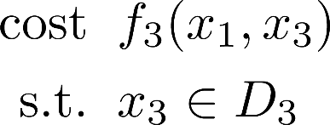
Optimization Problems on Agent Networks
A set of agents, each with a local variable and a local optimization problem
Local problems are coupled
dependency graph
Agent 1
Local variable $x_{1}$
In-neighbors
Out-neighbors
Agent 2
Agent 1
Global optimization problem
Agent 3
Notes:
Suppose there is a group of agents. Each agent has a local variable and tries to solve a local optimization problem.
Local problems are coupled, and the couplings can be modeled by a directed graph called the dependency graph
For example, there is a directed edge from agent 2 to agent 1 because….
Similarly we can define out-neighbors
The global optimization problem is to

Slide 4
Special Cases
Consensus optimization
Common feasibility problem
Hierarchical optimization
Notes:
Our problem formulation is general. They can have arbitrary coupling structures and arbitrary partition and distributed storage of state variables.
Another instance is the hierarchical optimization.
In the two-level case, a group of agents, …
While agent 0 is a coordinator, it does not have its variable and is in charge of minimizing some system-level cost.

Slide 5
Assumptions
Convexity:
$f_{i}$ are extended real-valued, closed, convex, proper (CCP) functions
$D_{i}$ are nonempty closed convex sets, with (convex) indicator function
Existence of solutions: global optimization problem has solutions
Communication: Neighboring agents can exchange information both ways
Agent 1
Agent 2
Notes:
First, we assume local problems are convex: ...
The indicator function of a set has the value …
By including the indicator functions of constraints into cost function, we can eliminate the constraint.
Second, we assume the overall optimization has at least one solution.
In the example problem, although…
Finally, although dependency edge has direction, we assume two neighboring agents can have two-way communications.

Slide 6
Relevant Approaches
Primal approaches
Subgradient descent plus consensus step (e.g. [Nedic et al’09&10], …)
Projected subgradient method (e.g. [Figueiredo et al’07], …)
Proximal subgradient method (e.g. [Nesterov’83&07],[Shi et al’15], …)
Primal-dual approaches
Dual decomposition (e.g. [Terelius et al’11] )
ADMM algorithms (e.g., [Gabay&Mercier’83],[Boyd et al’11],...)
Operator splitting techniques ([Bauschke&Combettes’16])
Notes:
Many approaches have been proposed to solve optimization problems on agent networks.
One important class is the subgradient-based approach, especially for solving consensus optimization problems. One issue is..
Operator splitting is another approach. We will some recent developments to propose our solution algorithms.

Slide 7
Overview of Our Approach
Find iteration algorithms for some operator $T$ such that
Fixed points of $T$are exactly the optimal solutions
Starting from any ,
Desired features:
Can handle arbitrary dependency graph and state partition
Can handle general convex cost function and constraints
Distributed implementation with minimal inter-agent communications
Can be adapted for random, asynchronous implementations
Notes:
In our proposed approach, we will look for iteration algorithms using properly designed operator T so that …
Our emphasis will be on finding T that can handle

Slide 8
Averaged Operators
An operator is nonexpansive if
May not converge to a fixed point, even if it exists (e.g. a rotation)
$T$ is averaged if for a nonexpansive $S$ and
Convergence to a fixed point (if exists) is guaranteed
For any fixed point (if exists) and any $x$

Slide 9
Monotone Operators
A monotone operator is a set-valued operator satisfying
Example: subdifferential operator of a convex function
For a monotone operator , its resolvent is
is nonexapansive; hence is averaged
Set of fixed points of is
Example: for CCP function , the resolvent of is the proximal operator
Proximal point algorithm ([Rockafellar’76], [Guler’91]):

Slide 10
Problem Reformulation
Augment agent $i$’s variable to where is a local copy of
Recast local cost as
Impose consensus constraint
Agent 2
Agent 1
Global optimization problem
Agent 3

Slide 11
Remark
Both and are “proximable”
is the projection onto
Proximal operator of is difficult to compute

Slide 12
Operator Splitting
Goal: find a minimizer of for proximable
Douglas-Rachford Splitting: [Douglas&Rachford’56]
Find a fixed point of the nonexpansive map
Output
Step 1 can be accomplished by iterating the averaged operator:
Roles of can be switched

Slide 13
Douglas-Rachford Algorithm
Goal: find a minimizer of
Algorithm: initialize
Output:
Theorem: converges to an optimal solution for any

Slide 14
Example
Agent 1
Agent 2
D-R algorithm with
is an optimal solution

Slide 15
Algorithm Complexity
Agent 2
Agent 1
In each round
Total number of one-way communications:
Total number of variables transmitted:
Total number of proximal evaluations: $m$
Agent 3
Notes:
All the interagent communications happen in the first step, while the second step is pure local.

Slide 16
Dual Douglas-Rachford Algorithm
Dual Problem: Let be the convex conjugate of
Moreau’s decomposition relates to
Algorithm: initialize .
Output:
Theorem: converges to a dual solution for any

Slide 17
Asynchrony in Agent Networks
Previous algorithms require multiple synchronized operations in a round
Full synchronization may be costly or unrealistic
No central agent coordinating the computation
Heterogeneous agent computation powers and proximability
Blackout of agents and communication links

Slide 18
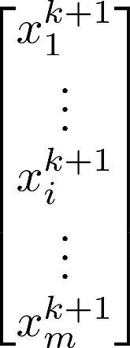
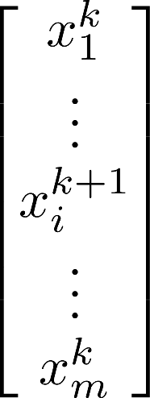
Asynchronous Implementation of Averaged Operators
Iteration using an averaged operator
Block coordinate decomposition:
Random coordinate update
At each round randomly activate a block $i$ with probability $p_{i}$ to update
Under some ergodicity assumption, the iteration converges to a fixed point of $T$ with probability one ([Wei&Ozdaglar’13] [Bianci et al’16])

Slide 19
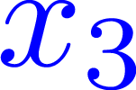
Asynchronous D-R Algorithm
At each round, activate an agent $i$ randomly with probability $p_{i}$ and do
Agent 2
Agent 1
Activated agent collects information from
Its out-neighbors
Its in-neighbors and their in-neighbors
Agent 3

Slide 20
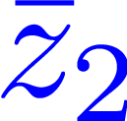
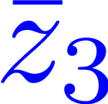
Modified Asynchronous D-R Algorithm
Each agent $i$ maintains an extra variable , the consensus value of
Activate randomly an agent $i$ at each round and do
Agent 2
At each round
Activated agent only communicates with in-neighbors
Expected number of transmissions:
Agent 3

Slide 21
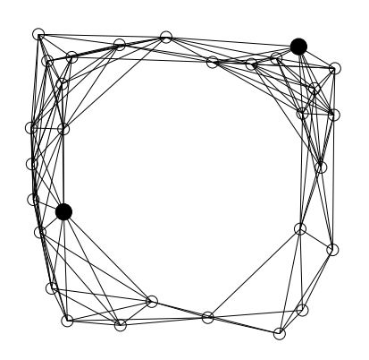
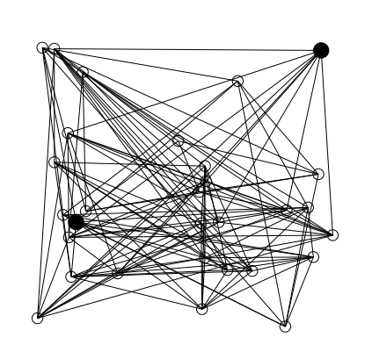
Example: Network Localization
28 agents with unknown positions and two anchors
Each edge is a constraint on the relative orientation of two agents
Ground Truth
Random Initial Guess

Slide 22
Example: Network Localization
Synchronous Algorithm
Asynchronous Algorithm

Slide 23
Locally Coupled Convex-Concave Games on Networks

Slide 24
Saddle Functions
Saddle function for Euclidean spaces :
is convex on for each fixed
is convex on for each fixed
Examples:
for convex
Lagrange function of constrained convex optimization problems
Given two subsets , the function :

Slide 25
Saddle Points
is a saddle point of if
Nash equilibrium of 2-player zero-sum game with payoff function
Existence conditions: von Neumann/Sion’s minimax theorems, strong convexity,…
To ensure , replace with

Slide 26
Saddle Differential Operator
For a saddle function , its saddle differential operator is
A (maximal) monotone operator if is closed and proper [Rockafellar’70]
Resolvent of :
Averaged operator whose fixed points are the saddle points of
Proximal Point Algorithm:

Slide 27
Operator Splitting
Goal: find a saddle point of
Assume are much easier to compute than
Douglas-Rachford Splitting:
Find a fixed point of the nonexpansive map
Output

Slide 28
Example: Sparse Bilinear Game
where is elementwise soft thresholding operator
is a affine map
For , has a unique saddle point
For , the converged saddle point is
For , the converged saddle point is

Slide 29
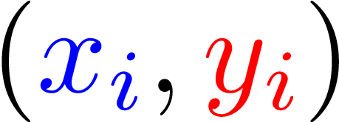
Convex-Concave Games on Agent Networks
Each agent has a local variable and a local saddle function
Local games are coupled
dependency graph
Agent 1
Local variable ${(x}_{1},y_{1})$
In-neighbors
Out-neighbors
Agent 2
Agent 1
Global convex-concave game
Agent 3
Notes:
Suppose there is a group of agents. Each agent has a local variable and tries to solve a local optimization problem.
Local problems are coupled, and the couplings can be modeled by a directed graph called the dependency graph
For example, there is a directed edge from agent 2 to agent 1 because….
Similarly we can define out-neighbors
The global optimization problem is to

Slide 30
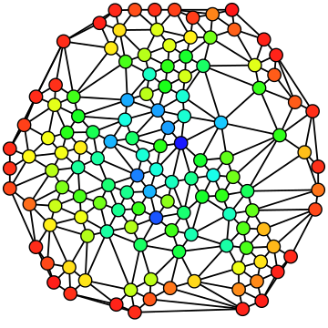
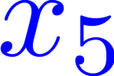
Convex-Concave Games on Agent Networks
Each agent’s local variable could be either or
Games played between two alliances of agents
(Wikipedia)

Slide 31
Reformulation of Games
Augment agent $i$’s variables to
Global saddle function becomes separable:
subject to consensus constraints
Goal: find a saddle point of
Douglas-Rachford algorithm

Slide 32
Example
Seven agents, five in blue team vs. two in red team
Randomly generated local quadratic saddle functions
No local saddle points
Unique global saddle point

Slide 33
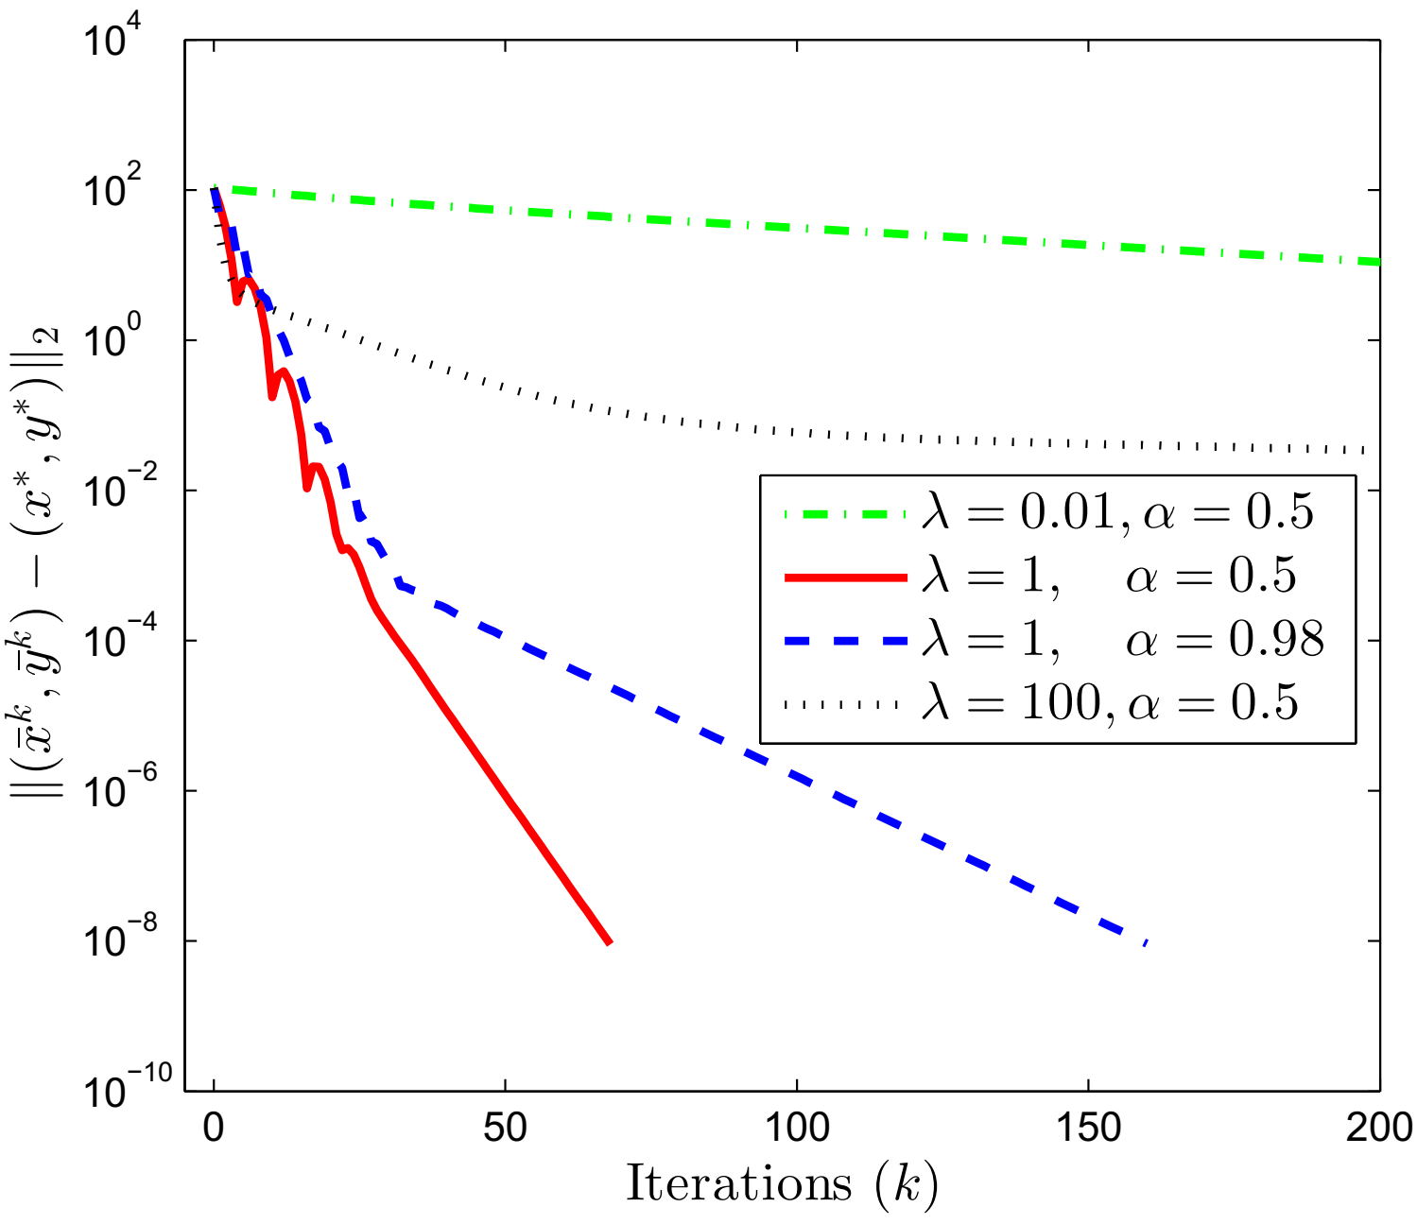
Example
Synchronous Algorithms

Slide 34
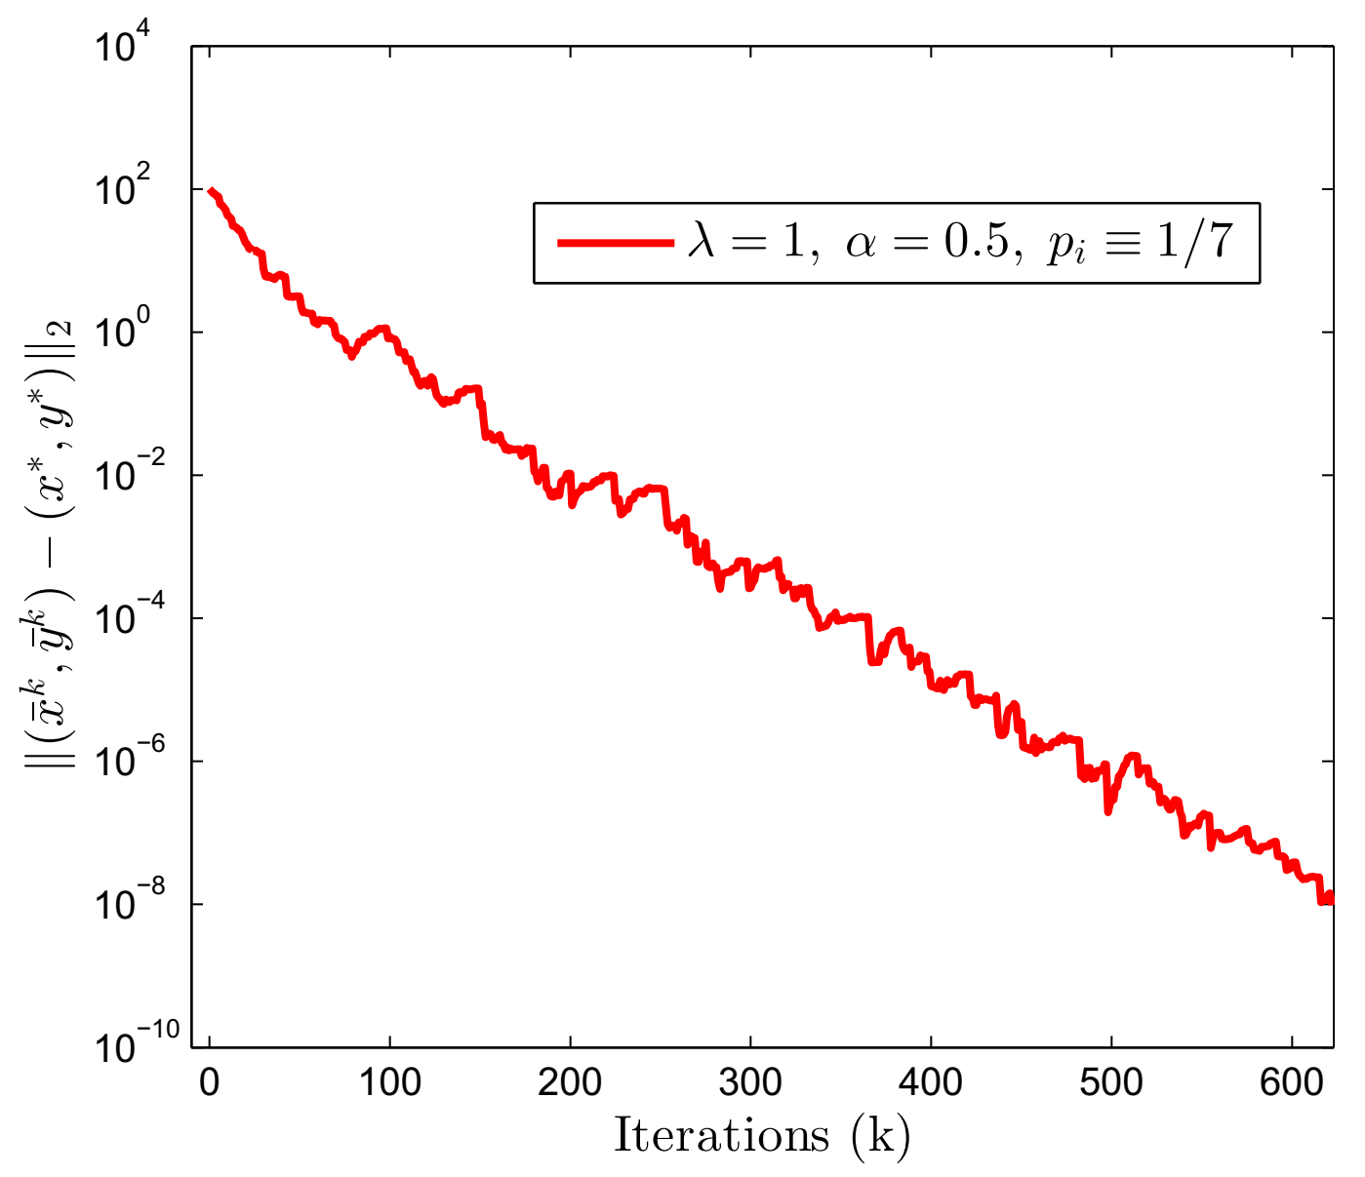
Example
Synchronous Algorithms
Asynchronous Algorithms

Slide 35
Extensions
Convergence rates
3-operator splitting [Davis&Yin’15],[Condat’13], [Vu’13]
Communication delays (e.g. ARock Algorithm [Peng et al’16])
Multi-player, non-zero-sum games on networks
Nonconvex problems

Slide 36
More details can be found in
“Distributed algorithms for solving locally coupled optimization problems on agent networks,” J. Hu, Y. Xiao, and J. Liu, 2018 IEEE Int. Conf. Decision and Control.
“Distributed solution of convex-concave games on networks,” Y. Xiao, X. Hou, and J. Hu, submitted to 2019 American Control Conference

