Slide 1
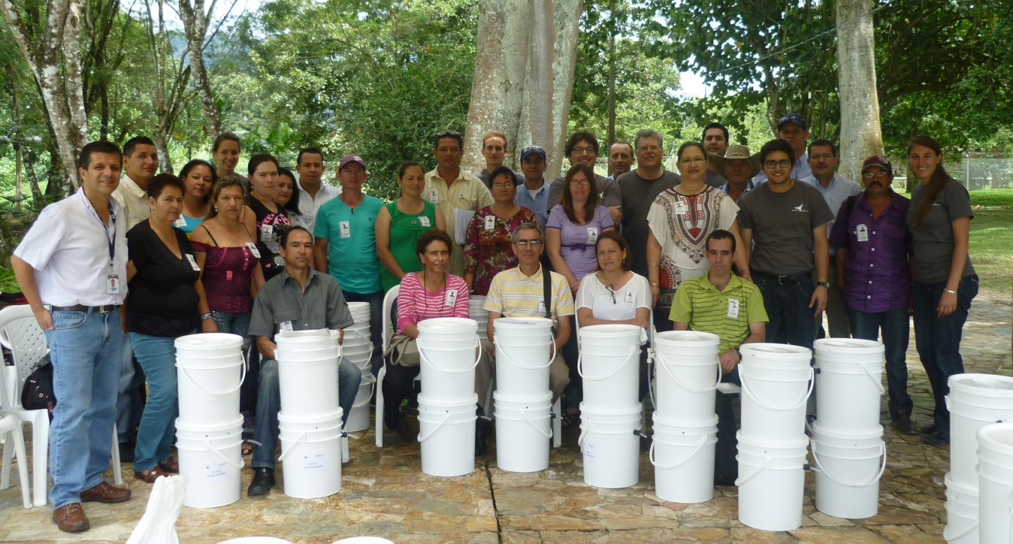
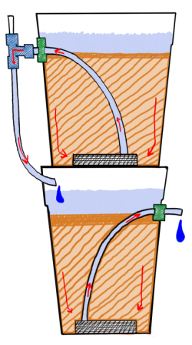
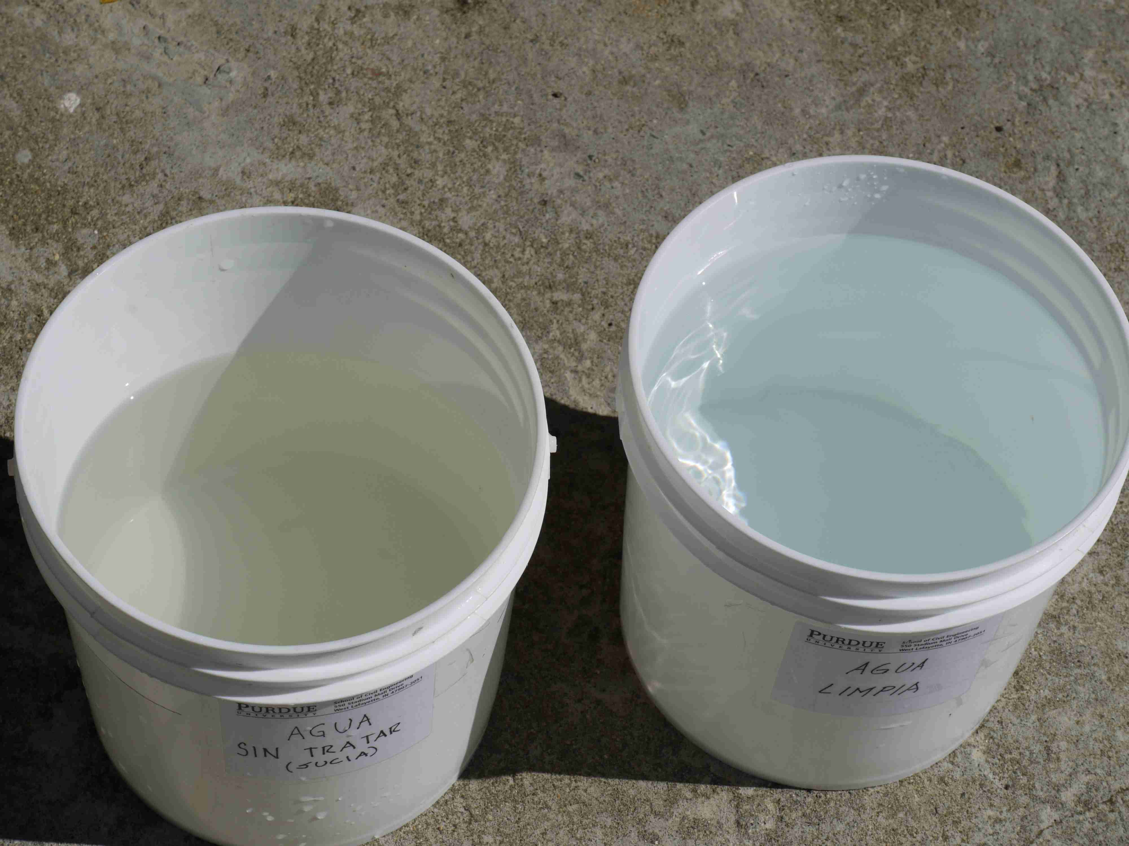
WATER TREATMENT IN RURAL AREAS
SLOW SAND FILTERS
This project aims to develop economical and effective drinking water treatment systems for rural communities in Colombia in response to Kimberly-Clark Corporation’s interest in improving drinking water quality in schools and homes of people rural areas.
In a slow sand filter (SSF), the water flows downward through a bed of sand placed over layered coarse sand and pea gravel, or other porous media. The sand filters out the solid organic matter (suspended particles) that cause the water to be turbid, and also provides a large surface area for attachment of “good” micro-organisms (bacteria and protozoa that do not cause disease) that mineralize (i.e., convert to carbon dioxide and water) the organic matter present in the water. Although these filters can also significantly reduce the number of pathogens (disease causing micro-organisms), it is critical that the filtered water be boiled, or treated with a disinfectant, such as chlorine and UV light, to inactivate any pathogens that do pass through the sand.
One SSF unit consist on:
2 5-gallon pails with lids
2 polypropylene porous plates + polypropylene mesh
Sand with diameter of ~0.25-1.0 mm
Accessories: tubing, tees, cord grips, etc.
Operational characteristics:
Required Retention Time: 8 hrs
Maximum Treatment capacity: 20 L / day per unit (2 units at each school)
untreated SSF treated water
water

