Slide 1
NEAR-THRESHOLD PERCEPTUAL DISTORTION PREDICTION BASED ON OPTIMAL STRUCTURE CLASSIFICATION
ICIP 2016
Yucheng Liu and Jan P. Allebach
School of ECE, Purdue University
09/26/2016
Presenter:
Jan P. Allebach
allebach@purdue.edu
Notes:
Send e-mail to “allebach@purdue.edu” to request a copy of Yucheng’s dissertation.
The method that we will be discussing is a full-reference method.
We train and test on the CISQ database developed by Damon Chandler and his group.

Slide 2
Outline
Introduction to near-threshold local distortion in natural images
Limitation of current methods
Probabilistic model for near-threshold distortion
Results
Contributions

Slide 3
Outline
Introduction to near-threshold local distortion in natural images
Limitation of current methods
Probabilistic model for near-threshold distortion
Results
Conclusion

Slide 4
Near-Threshold Local Image Quality
General-Purpose Image Quality Measure
Near-Threshold Local Image Quality Measure
    Potential applications: Image compression, digital watermarking
Reference
Image
Distortion is present at both near-threshold and (mostly) supra-threshold level
General-Purpose Image Quality
Measure
(SSIM, MS-SSIM, VIF, …)
Quality
Score
Reference
Image
Low Visibility
Visibility
Map
Distortion is present at below- and near-threshold level
Near-Threshold Local Distortion Measure
High Visibility
Notes:
Compare supra-threshold distortion and near-threshold distortion, and show metrics result.
Note that difference in distortion levels is most apparent in images row 2, columns 2 and 3.

Slide 5
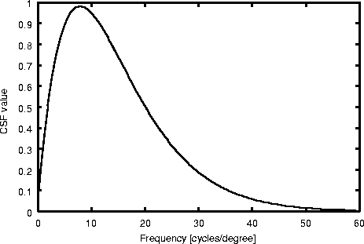
Problem Definition
Goal: For a given reference image and distortion, predict the distortion visibility threshold (in RMS contrast) at each local region.
Key properties of the HVS related to the near-threshold local distortion visibility:
    Multi-channel frequency response
    Contrast sensitivity
    Light Adaptation
    Contrast masking
    Structure familiarity
Perceptual
Model
Reference Image
Error Image
Ground Truth Threshold Map
(dB)
Contrast Sensitivity Function
[J. L. Mannos and D. J. Sakrison’1974]
Notes:
Determine the distortion visibility for near-threshold distortions in the image, state the challenges
See following slide for enlarged version of image and corresponding threshold map
Blue means low threshold, i.e. high visibility of distortion
Red means high threshold, i.e. low visibility of distortion

Slide 6
Detail From Previous Slide

Slide 7
Outline
Introduction to near-threshold local distortion in natural images
Limitation of current methods
Probabilistic model for near-threshold distortion
Results
Conclusion

Slide 8
Limitations of Gain-Control Based Models
Gain-control based models are usually optimized on unnatural mask images, it cannot adapt flexibly to complicated natural image structures
Mask Image
Ground-Truth
Threshold Map
Watson’s Model
Predicted
Threshold Map
(dB)
Notes:
Show examples that demonstrate the limitations of gain-control based models, underestimate thresholds for texture, and overestimate thresholds for edges and structures
Threshold of distortion visibility is underestimated in yellow circled regions, i.e. the distortion in these regions is less visible than predicted.
Threshold of distortion visibility is overestimated in red circled regions. i.e. the distortion in these regions is more visible than predicted.

Slide 9
Outline
Introduction to near-threshold local distortion in natural images
Limitation of current methods
Optimal classification based model for near-threshold distortion
Results
Conclusion

Slide 10
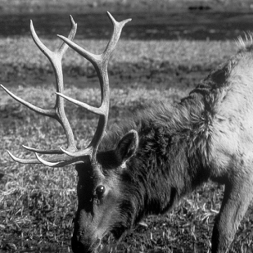
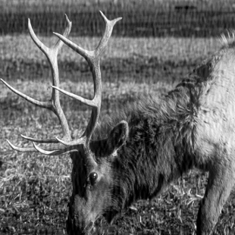
High Level Local Distortion Prediction Framework
8
8
Overlapping block
extraction
16x16
Sub-blocks
85x85
Perceptual
Distortion
Map
Reference
Patch
Reference
Sub-blocks
Reference
Image
Sub-block
Distortion
Model
Percent
Pooling
Predicted
Distortion
Distorted
Patch
Distorted
Sub-blocks
Distorted
Image
Notes:
Show figure, extract patch from image, divide patch into sub-blocks, prediction is made on each sub-block independently, and pool across the sub-block responses to generate the final patch-wise response
Subblocks are 16x16, and overlap by 8 pixels.

Slide 11
Probabilistic Problem Formulation
The perceived near-threshold distortion can be modeled as the probability that the local distortion is visible given the local distortion contrast, local lightness, and local structures
Model assumption:
Structure
Class Label
Local
Lightness
Distortion
Contrast Feature
Local Structure
Feature
Notes:
“y = 1” denotes event that distortion is visible.
K is number of subclasses.
Model assumptions:
Relative to the structure class label, the local structure feature fully accounts for dependency on local lightness and distortion contrast.
Relative to probability that distortion is visible (y = 1), the distortion class fully accounts for dependency on the local structure feature.

Slide 12

Local Structure Feature Extraction
Sub-block
Structure
Feature
log-Gabor
Filter
Bank
Nonlinearity
Feature
Pooling
Orientation
Rearrangement
Reference
Patch
Structure feature is rotation invariant (similar to SIFT).
Orientation rearrangement shifts the structure feature vector to prioritize the orientation component with strongest spectral energy magnitude at each radial frequency band.
At prediction stage, spatial consistency is enforced for each sub-block structure feature.
W/ Orientation
Rearrangement
W/O Orientation
Rearrangement
Notes:
There are four different orientations corresponding to edge normal at 0, 45, 90, and 135. This is how they are ordered in the sub-block structure feature vector.
Here, they are shown in the order 0, 90, 45, and 135.
Here I think that m is the index of the structure feature; and n is the index of the sub-block.

Slide 13
Distortion Contrast Feature Extraction
log-Gabor
Filter
Bank
Sub-block
Distortion Contrast
Feature
Reference
Patch
Divisive Adjacent
Band Inhibition
Nonlinearity
Feature
Pooling
log-Gabor
Filter
Bank
Distorted
Patch
The distortion contrast feature depicts the masked error contrast in each frequency band
The set of adjacent bands include subbands within 45 degrees, and 1.7 octaves of the center band.
Notes:
Here j is the index of the current frequency band.
N^j is the set of frequency bands{ n^j}_l adjacent to frequency band j.
c_{m,n}(j,l) is the distortion contrast in band j as masked by band l.
Here I think that m is the index of the structure feature; and n is the index of the sub-block.

Slide 14


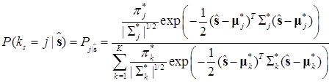
Structure Classification Model
The distribution of structure features is modeled by a Gaussian Mixture Model (GMM):
Parameters can be obtained by solving the following maximum likelihood problem on the training data using EM algorithm:
The classification probability can be computed as

Slide 15
Distortion Prediction Model
The perceptual distortion prediction probability given the distortion contrast, luminance, and local structure type is defined as
The light adaptation function is defined using a LUT with entries:
The final distortion prediction is made by combining the model responses weighted by the structure classification probabilities:

Slide 16
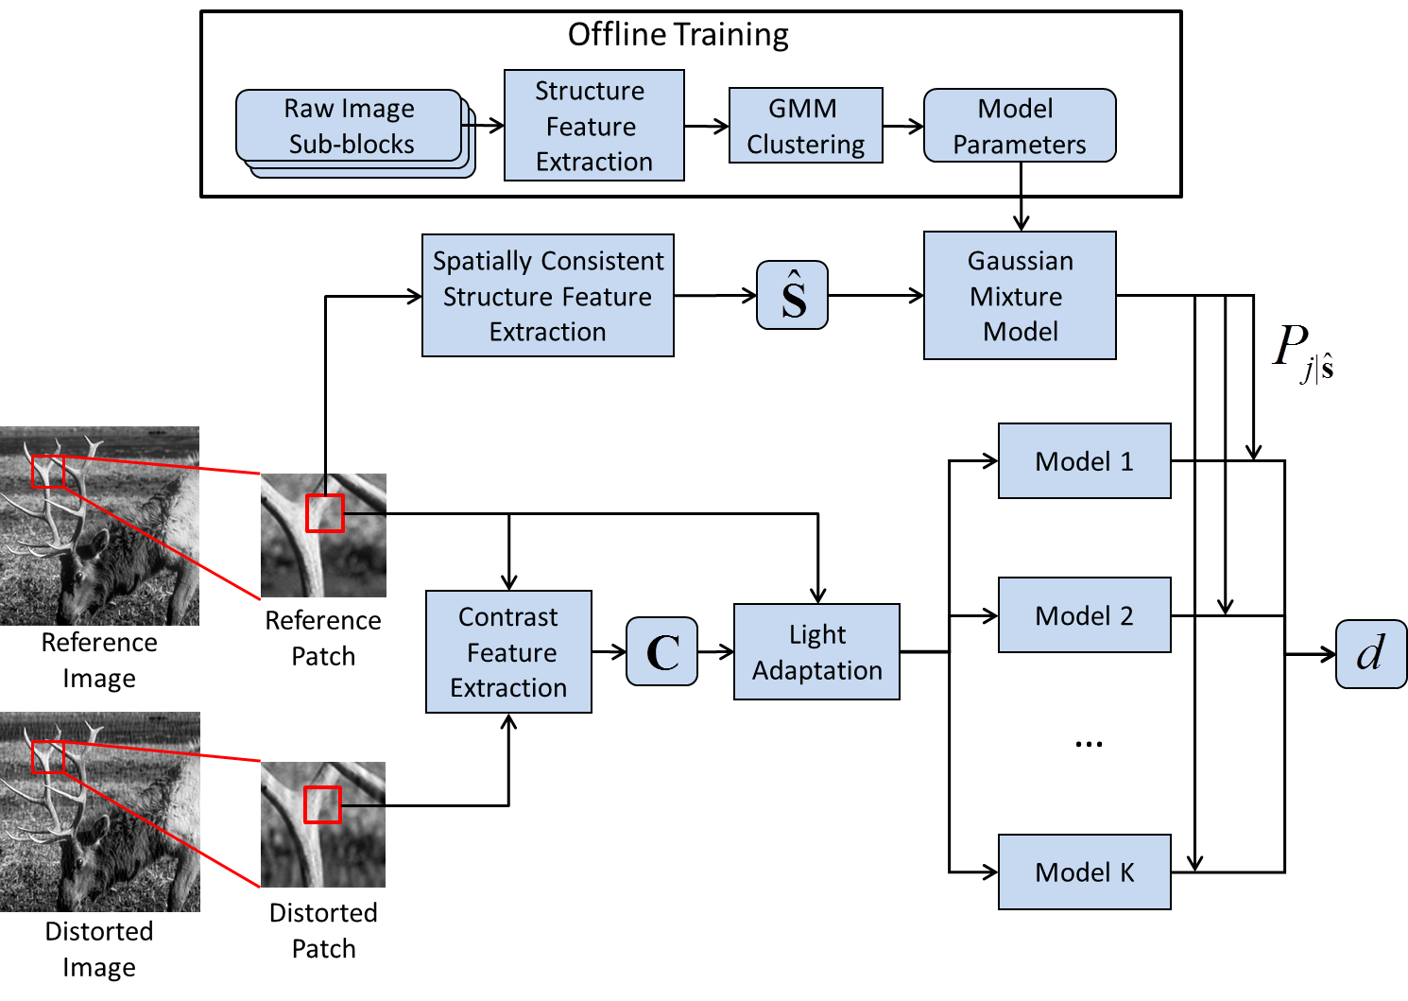
Sub-Block Distortion Prediction Framework Summary
Notes:
The K models are for the K different structure classes.

Slide 17
Outline
Introduction to near-threshold local distortion in natural images
Limitation of current methods
Optimal classification based model for near-threshold distortion
Results
Conclusion

Slide 18
Five-Fold Cross-Validation
We randomly divide the 1080 local patches extracted from the 30 images in the CSIQ* database into five subsets. Patches in different subsets are extracted from different images.
3 subsets are used as training set, 1 subset is used as validation set, and 1 subset is used as test set.
We perform five experiments to evaluate the model with each of the five subsets used as the test set exactly once. The average and standard deviation are recorded.
Training
Set
Parameter
Tuning
Validation
Set
Performance
Evaluation
Test
Set
*Alam et al, J. Vision (2014)

Slide 19
Model Evaluation
The ability of the model to predict near-threshold distortion is evaluated by the accuracy of distortion detection threshold prediction.
The distortion is deemed to be present at threshold level when the model gives response of 0.5.
The threshold prediction performance is quantified by the Pearson’s Correlation Coefficient (CC), Spearman’s Rank-Order Correlation Coefficient (SROCC), and RMSE between the predicted and ground-truth thresholds.
    Pearson’s Correlation Coefficient
    Spearman’s Rank-Order Correlation Coefficient
    RMSE

Slide 20
Benchmark
The structure classification based distortion prediction model (SC-PDP) is compared to other perceptual similarity (distortion) models including:
    Support vector regression using the 14 features suggested by the database owner (Alam et al.’14, very expensive and slow)
    Watson-Solomon Model (Watson et al.’97, gain-control based model)
    SSIM (Wang et al.’03, full-reference image quality metric)
    Multi-scale SSIM (Wang et al.’04, full-reference image quality metric)
All model parameters are optimized on the validation set before the performance is evaluated on the test set. (Optimal model parameter values are reported in the paper.)
Notes:
SC-PDP = Structure Classification Perceptual Distortion Prediction
Optimal number of structure classes K = 10
Optimal number of subbands J = 6x4 and optimal number of adjacent subbands L = 3

Slide 21
CC, SROCC and RMSE between Predicted Threshold and Ground-Truth Threshold
Notes:
In terms of RMSE, SC-PDP is 2-3 dB better than competing methods.
At ICIP-2015, Alam et al (Chandler’s group) reported an optimal gain-control and CNN-based models for predicting local distortion visibility. It would be interesting to compare their results with ours. In our paper, we do report RMSEs of 5.24 dB and 5.55 dB, respectively, for Alam’s two predictors, which is somewhat inferior to our result of 4.42 dB. Also, in his dissertation, Yucheng discusses a 2-stage model that reduces RMSE to around 3.5.

Slide 22
Predicted Threshold Map
Mask Image
Ground-Truth
Threshold Map
Watson’s Model
Predicted
Threshold Map
SC-PDP
Predicted
Threshold Map
(dB)
Notes:
Look only at Images in Columns 1-3
SC-PDP is generally closer to ground-truth than is Watson’s model. But there is still room for improvement!!

Slide 23
Outline
Introduction to near-threshold local distortion in natural images
Limitation of current methods
Optimal classification based model for near-threshold distortion
Results
Conclusion

Slide 24
Conclusion
We developed a probabilistic framework SC-PDP to better model the perception of near-threshold distortion of the HVS. The proposed model properly accounts for various aspects of the V1 response, including light adaptation, contrast sensitivity, and contrast masking of various kinds. The model achieves better threshold prediction performance than the conventional gain-control based methods and popular full-reference image quality measures.

Slide 25
Thank You!!

