Slide 1
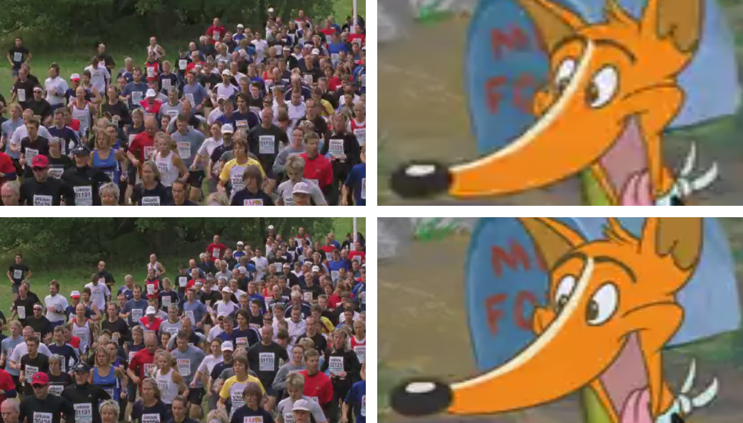
VMAF – Video Multi-Method Assessment Fusion
PSNR: 31
DMOS: 82
PSNR: 31
DMOS: 27
PSNR: 34
DMOS: 96
PSNR: 34
DMOS: 58
Notes:
One can barely notice the difference on the “crowd” videos, while the difference is much more clear on the two “fox” videos.
The scores from all observers were combined to generate a Differential Mean Opinion Score or DMOS for each distorted video and normalized in the range 0 to 100, with the score of 100 for the reference video.

Slide 2
About the author

Slide 3
Additional Resources
Here's a good tutorial,
https://netflixtechblog.com/toward-a-practical-perceptual-video-quality-metric-653f208b9652
The code repository,
https://github.com/Netflix/vmaf
Ioannis Katsavounidis, Liwei Guo, "Video codec comparison using the dynamic optimizer framework," Proc. SPIE 10752, Applications of Digital Image Processing XLI, 107520Q (17 September 2018); doi:
10.1117/12.2322118.
Joe Yuchieh Lin, Tsung-Jung Liu, Eddy Chi-Hao Wu, and C.-C Jay Kuo, “A Fusion-based Video QualityAssessment (FVQA) Index,”APSIPA 2014.
H. R. Sheikh and A. C. Bovik, “Image Information and Visual Quality,” IEEE Trans. Image Processing, Vol. 15, No. 2, pp. 430-444, February 2006.
Anne Aaron, Zhi Li, Megha Manohara, Joe Yuchieh Lin, Eddy Chi-Hao Wu, and C.-C Jay Kuo, “Challenges in Cloud Based Ingest and Encoding for High Quality Streaming Media,” IEEE International Conference on Image Processing, 2015.

Slide 4
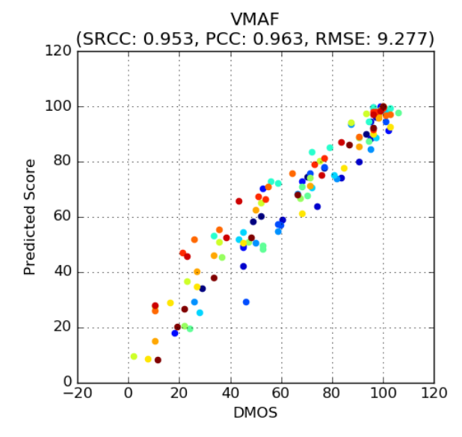
Why VMAF
Traditional Techniques:
Given a range of predicted scores, DMOS spread too broad
DMOS : Differential Mean Opinion Score

Slide 5
VMAF Overview
Predicts subjective quality by combining multiple elementary quality metrics
By ‘fusing’ elementary metrics into a final metric using a machine-learning algorithm - Support Vector Machine (SVM) regressor - which assigns weights to each elementary metric
Machine-learning model is trained and tested using the opinion scores obtained through a subjective experiment (NFLX Video Dataset)
https://github.com/Netflix/vmaf

Slide 6
VMAF
Elementary quality metrics
Visual Information Fidelity (VIF): quality is complementary to the measure of information fidelity loss
Detail Loss Metric (DLM): separately measure the loss of details which affects the content visibility, and the redundant impairment which distracts viewer attention
Motion: temporal difference between adjacent frames

Slide 7
Metric Comparison
https://www.streamingmedia.com/Articles/Editorial/Featured-Articles/Buyers-Guide-to-Video-Quality-Metrics-130675.aspx
Notes:
SSIMplus developer SSIMWave
ML methods may improve over time, but math model, static.
PSNR: Probably the most widely used metric, but also recognized as having the lowest predictive value. Still cited by Netflix, Facebook, and other companies in codec comparisons and similar applications but usage is declining.
SSIM: Slightly higher predictive value than PSNR, and less well-known, but favored by some codec researchers and compression engineers. Usage is declining.
SSIMplus: very functional and highly regarded metric but proprietary so not available in tools other than those from SSIMWave which start at around $995.
VMAF: Invented by Netflix and then open-sourced, VMAF is widely available. Designed for and tuned for use in evaluating streams encoded for multiple-resolution rungs on an encoding ladder, VMAF is the engine behind Netflix's highly-respected per-title and per-clip encoding stacks. Very functional and an up and comer.

Slide 8
About the author

Slide 9
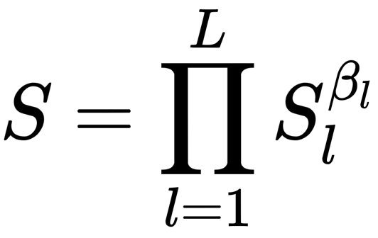
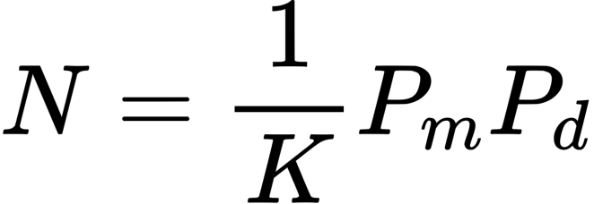
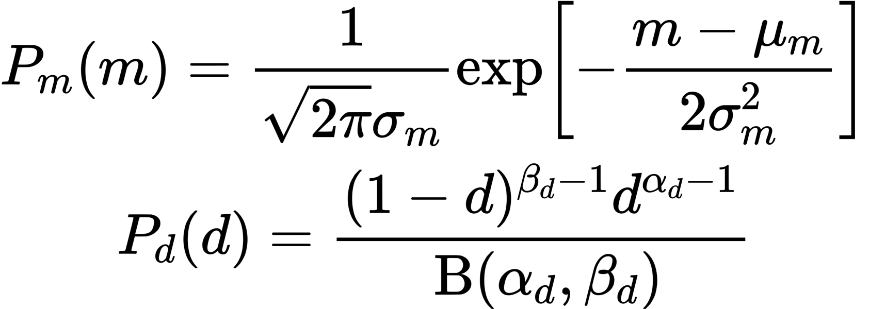
EXPERIMENT SETUP
Metrics
SSIM: Structural Similarity Index
PSNR: Peak Signal-to-Noise Ratio
LPIPS: Learned Perceptual Image Patch Similarity
Richard Zhang, Phillip Isola, Alexei A Efros, Eli Shechtman, and Oliver Wang. The unreasonable effectiveness of deep features as a perceptual metric. In CVPR, 2018.
TMQI: Tone-Mapping Quality Index
Hojatollah Yeganeh and Zhou Wang. Objective quality assessment of tone-mapped images.IEEE Transactions on Image Processing, 22(2):657–667, 2013.
Structural Fidelity
Statistical Naturalness
TMQI
L: number of scales
N_{l}: number of patches at a scale

Slide 10
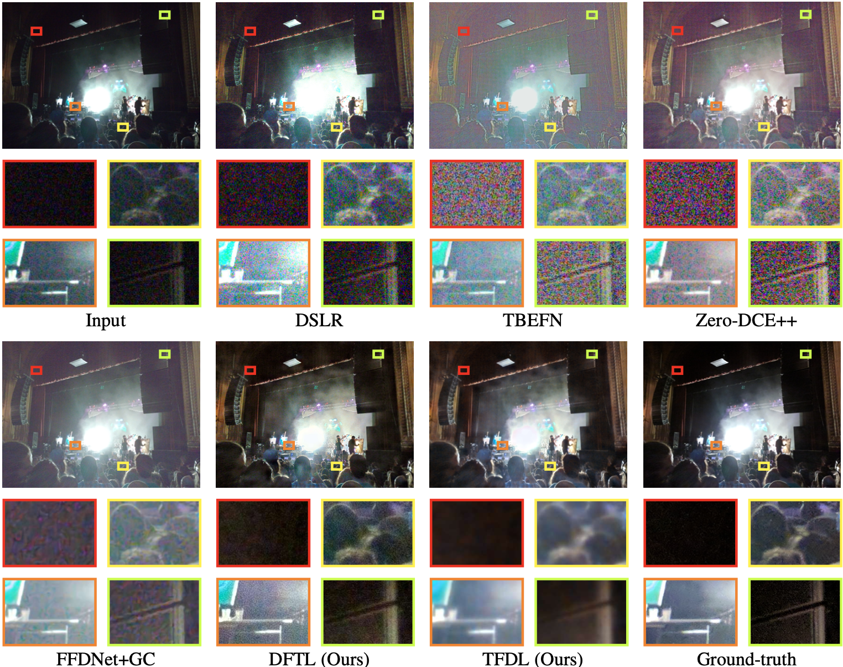
EXPERIMENT RESULTS
Quantitative & Qualitative Comparisons on HDR+ Testing Set
Quantitative comparison on the HDR+ testing set. The best results are printed in boldface. The second-best results are underlined.
Notes:
The quantitative result are shown on the left side, and an example from the dataset is shown on the right side. In the table, best results are printed in boldface, and the second-best are underlined. In the examples, the methods in the top row are mainly for comparing tone-mapping performance, since they don’t explicitly denoise the image, and the FFDNet method are mainly for comparing denoising performance.

