Slide 1
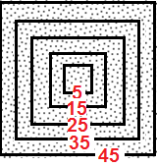
Do we need to consider a larger neighborhood than 5x5?
Measured central pixel absorptance as a function of neighborhood’s size
Dispersed-dot halftone
generated using DBS algorithm
Conclusion:
Neighborhood larger than 5x5 can strongly influence the central pixel absorptance
Portion of test page
Slide prepared by Yanling Ju
Notes:
larger 45x45 neighborhood that is intended to capture the effect of long-path scattering of light between the
point where it is incident on the surface of the printed media and where it finally exits, known as the Yule-Nielsen effect

