Slide 1
New results for aperiodic, dispersed-dot halftoning*
Jiayin Liuª , Altyngul Jumabayevaª, Yujian Xuª, Yin Wangª, Tal Frank^{b}, Shani Gat^{b},
Orel Bat Mor^{b}, Yotam Ben-Shoshan^{b}, Robert Ulichney^{c}, and Jan Allebachª
ªSchool of Electrical and Computer Engineering,
Purdue University, West Lafayette, IN 47907, U.S.A.;
^{b}Hewlett-Packard Indigo Division, Rehovot, Israel;
^{c}Hewlett-Packard Laboratories USA, Cambridge, MA 02142, U.S.A.
*This work was supported by HP Inc., Indigo Division, Israel

Slide 2
MS-MP-CLU-DBS Screen Design Using DBS

Slide 3
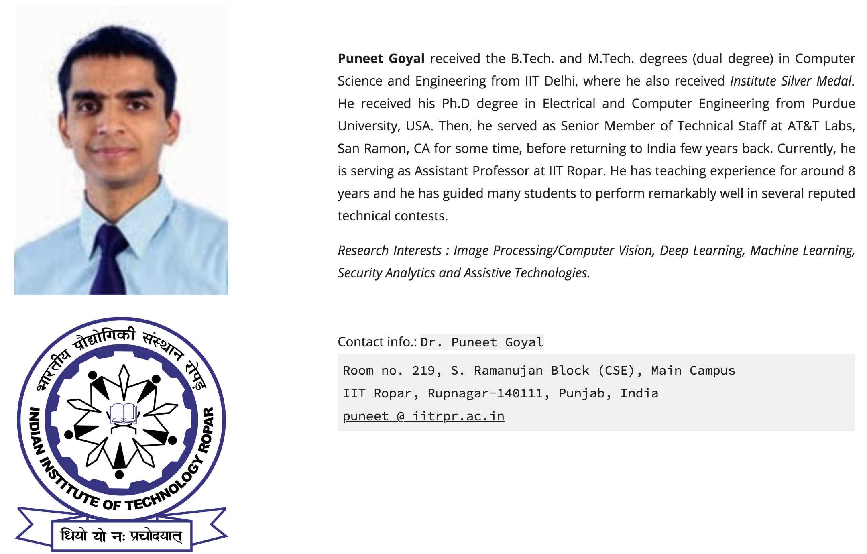
About the authors (1/3)

Slide 4
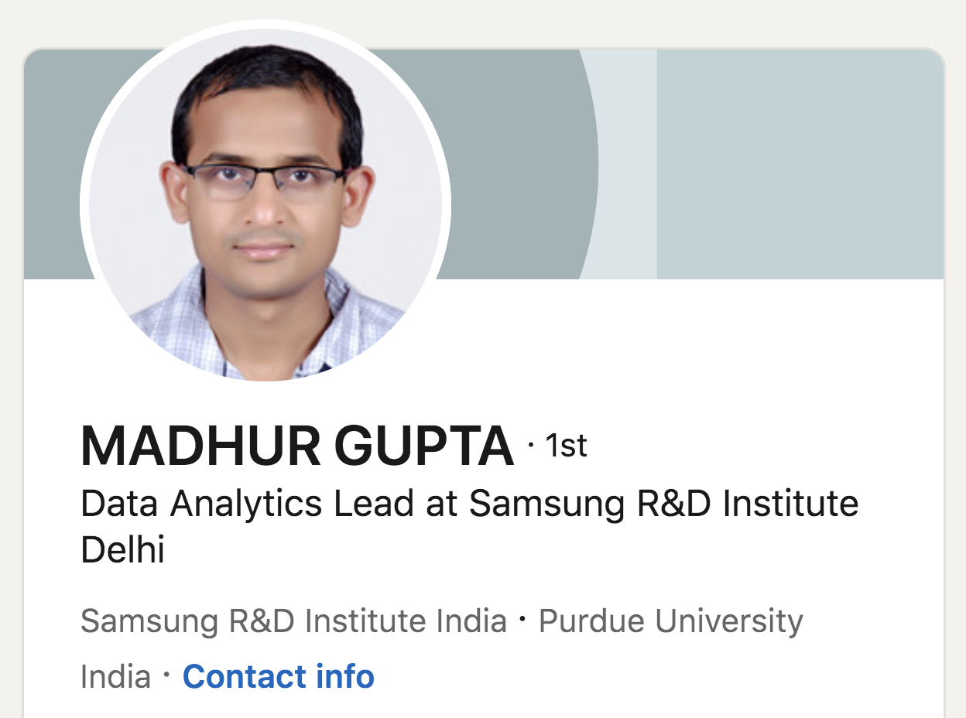
About the authors (2/3)
P. Goyal, M. Gupta, C. Staelin, M. Fischer, O. Shacham, J. Allebach, “Clustered-Dot Halftoning with Direct Binary Search,” IEEE Trans. on Image Processing, Vol. 22, pp. 473-487, February 2013.

Slide 5
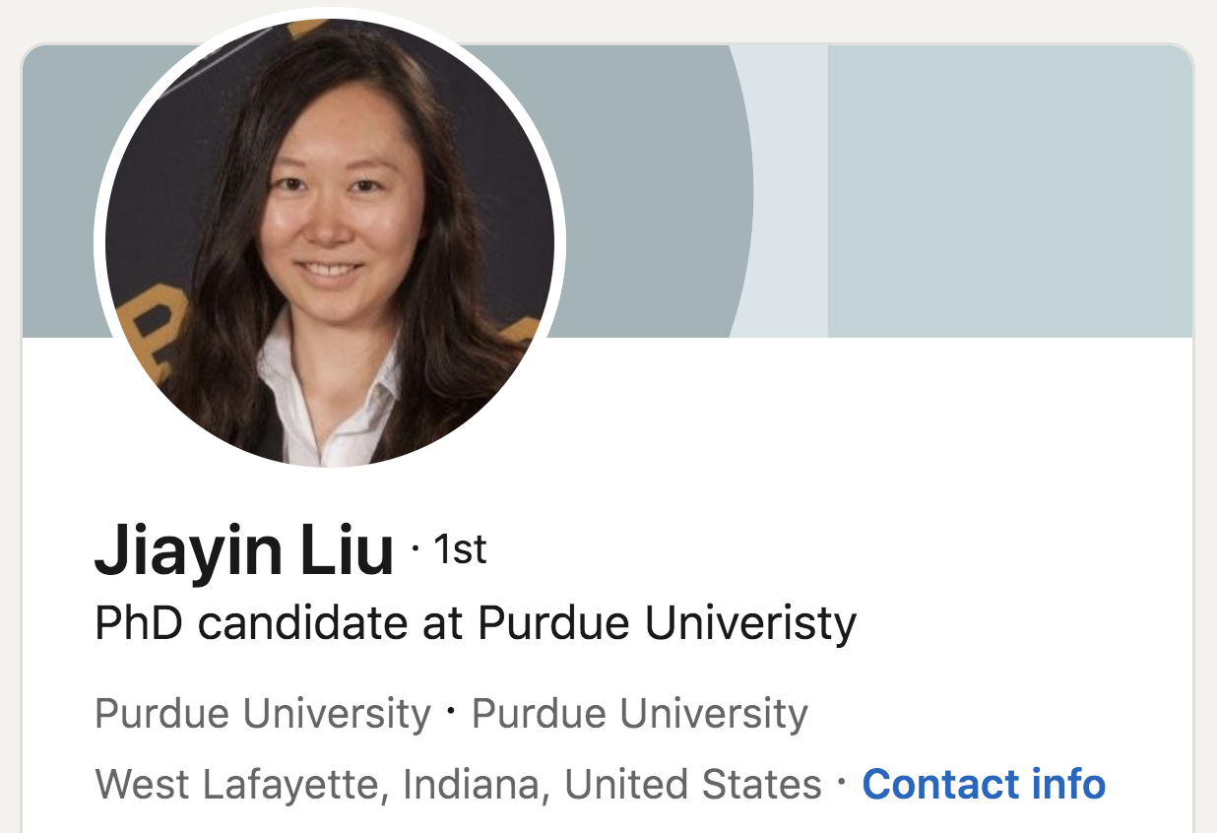
About the authors (3/3)
Liu, A. Jumabayeva, Y. Xu, Y. Wang, T. Frank, S. Gat, O. Bat Mor, Y. Ben-Shoshan, R. Ulichney, and J. Allebach, “New results for aperiodic, dispersed-dot halftoning,” Color Imaging XXV: Displaying, Processing, Hardcopy, and Applications, (Part of IS&T Electronic Imaging 2020), R. Eschbach, G. Marcu, and A. Rizzi, Eds., Burlingame, CA, 26 January - 30 January 2020.

Slide 6
Big picture
FM (Frequency modulation) halftoning (aperiodic and dispersed-dots) is increasingly popular with traditional analog offset lithographic printing.
There is a desire from customers in the commercial market to use this capability with high-end digital presses based on electrophotographic printing (EP) technologies.
However, the inherent instability of the EP process challenges the achievement of satisfactory print quality with dispersed-dot, aperiodic halftoning.
The direct binary search (DBS) algorithm is widely considered to represent the gold standard of dispersed-dot, aperiodic halftone image quality.
We continue our previous efforts to adapt DBS from dispersed-dots to clustered-dots to use with the Indigo liquid EP printing technology.

Slide 7
What we will specifically talk about today?
Overview of DBS and CLU-DBS
MS-MP-CLU-DBS Screen Design

Slide 8
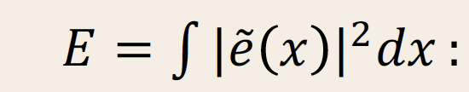
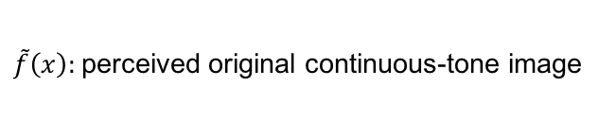
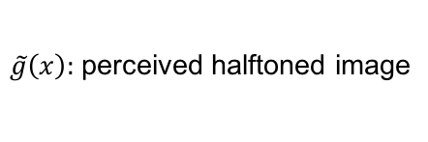

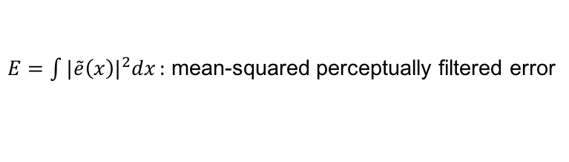
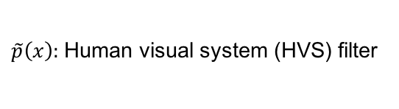
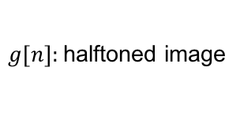
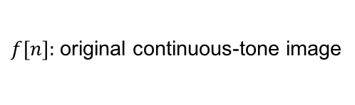
Direct Binary Search (DBS) Framework
$f[n]:$original continuous-tone image
$\tilde{p}\left(x\right):$Human visual system (HVS) filter
$\tilde{f}\left(x\right):$perceived original continuous-tone image
$\tilde{e}\left(x\right)=\tilde{f}\left(x\right)−\tilde{g}\left(x\right):$ perceptually filtered error
$g[n]:$halftoned image
$E=\int{{|\tilde{e}\left(x\right)|}^{2}dx}:$ mean-squared perceptually filtered error
$\tilde{g}\left(x\right):$perceived halftoned image

Slide 9
Dispersed-dots to clustered-dots
Since printers using electrophotographic (EP) technology cannot render isolated dots stably, what we found is that clustered-dots halftones would give us a better print quality without losing details in highlights or shadows.
The DBS optimization framework had been modified to design stochastic, clustered-dot texture, by using filters with different sizes in the initialization and update steps of the algorithm.

Slide 10
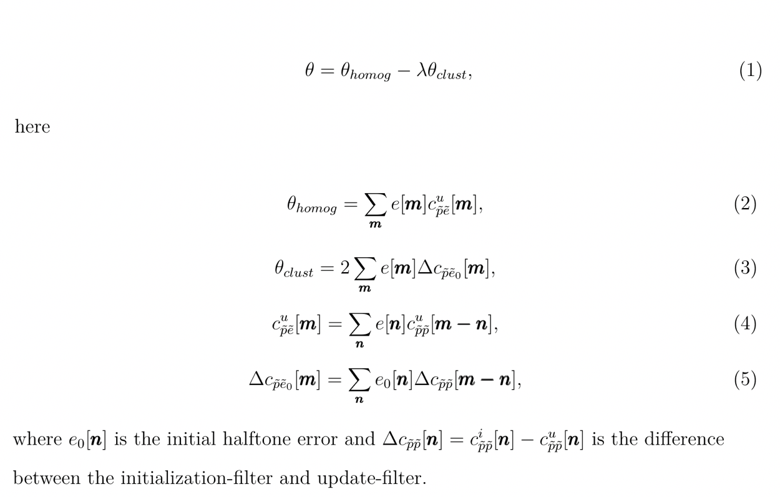
Cost metric for CLU-DBS*
* P. Goyal, M. Gupta, C.Staelin, M. Fischer, O. Shacham and J. Allebach “Clustered-Dot Halftoning With Direct Binary Search ”
IEEE Transactions on Image Processing, vol. 22, no.2, pp. 473–487, Feb. 2013.

Slide 11
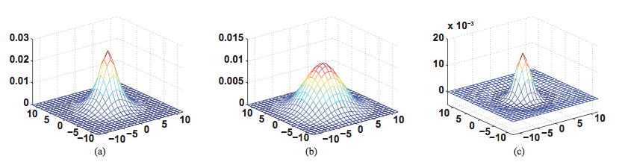


CLU-DBS
Difference between Conventional DBS and CLU-DBS
Initialization filter
Update filter
Difference
$$c_{\tilde{p}\tilde{p}}^{i}$$
$$c_{\tilde{p}\tilde{p}}^{u}$$

Slide 12
Factors influencing CLU-DBS halftone texture
Seed halftone
Filter type
Filter scale parameter
Relation between halftone frequency and filter size
Multi-Pass refinement
Multi-State refinement

Slide 13
MP-CLU-DBS
Multi-pass (MP) refinement
    Is used to refine the halftone texture.
    A pass is a complete refinement consisting of multiple iterations of the CLU-DBS algorithm.
Single pass:
Seed
Halftone
Iteration 1
Iteration 2
Iteration n
Final halftone
CLU-DBS
…...
DBS
Initialization
filter
Update
filter
Multi-pass:
Each re-optimization is carried out with the original filters, and this leads to a homogenous texture.
Seed
Halftone
CLU-DBS
CLU-DBS
…...
CLU-DBS
MP-CLU-DBS
Optimal
Halftone
From Pass 1
Optimal
Halftone
From Pass 2
Optimal
Halftone
From Pass n

Slide 14

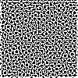
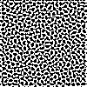
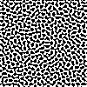
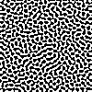
Halftone Result of MP-CLU-DBS
Original image
Gray level = 127/255
Halftone result based on MP-CLU-DBS
Pass 1
Pass 2
Pass 3
Pass n
……

Slide 15
MS-MP-CLU-DBS
Multi-stage (MS) optimization
    Is the core part of the algorithm.
    Starting with a seed halftone, the key idea is to build up the continuous-tone (CT) image stage-by-stage.
    The absorptance value of the continuous-tone image in each stage is controlled by attenuation factors.

Slide 16





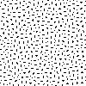
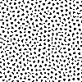
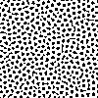
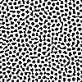
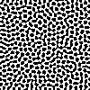
MS-MP-CLU-DBS
MS-MP-CLU-DBS:
Stage 1
continuous-
tone image
Stage 2
continuous-
tone image
Stage K
continuous-
tone image
Stage 1
Stage 2
Stage K
Seed
Halftone
MP-CLU-DBS
MP-CLU-DBS
…...
MP-CLU-DBS
Stage 1 halftone result
Stage 2 halftone result
Stage K halftone result
5 stages in all
attenuation factors: {0.2, 0.4, 0.6, 0.8, 1.0}
Original image
Stage 5
Stage 1
Stage 2
Stage 3
Stage 4
continuous-tone
image
Gray level = 127/255
Seed
Halftone
Halftone
result
Gray level = 7.5/255

Slide 17
MS-MP-CLU-DBS applied to a continuous-tone folded ramp
MS = 5; MP = 10

Slide 18
Outline
Overview of DBS and CLU-DBS
MS-MP-CLU-DBS Screen Design
    Screen design procedure
    Desired LPI (halftone frequency)
    Halftone quality and metrics

Slide 19
Screen Design
A screen is a threshold matrix that can be used to halftone any input image by pixel-wise comparison of the image with the screen. A screen is constructed by designing halftones for each gray-level in the tonal range in some specified sequence with stacking constraints applied.
Generating a halftone from a screen is much faster than generating a halftone by directly applying MS-MP-CLU-DBS.
Our goal of the screen is to generate a halftone that would have texture quality similar to that of direct MS-MP-CLU-DBS.

Slide 20
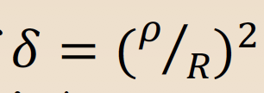
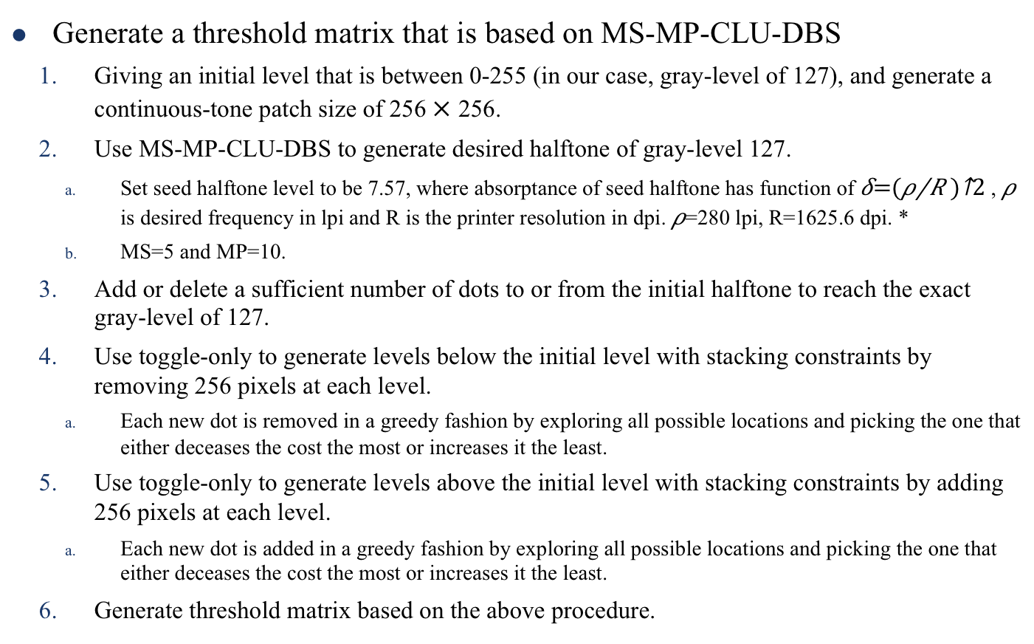
MS-MP-CLU-DBS based screen design
Generate a threshold matrix that is based on MS-MP-CLU-DBS
    Giving an initial level that is between 0-255 (in our case, gray-level of 127), and generate a continuous-tone patch size of 256 256.
    Use MS-MP-CLU-DBS to generate desired halftone of gray-level 127.
      Set seed halftone level to be 7.57, where absorptance of seed halftone has function of , is desired frequency in lpi and R is the printer resolution in dpi. =280 lpi, R=1625.6 dpi. *
      MS=5 and MP=10.
    Add or delete a sufficient number of dots to or from the initial halftone to reach the exact gray-level of 127.
    Use toggle-only to generate levels below the initial level with stacking constraints by removing 256 pixels at each level.
      Each new dot is removed in a greedy fashion by exploring all possible locations and picking the one that either deceases the cost the most or increases it the least.
    Use toggle-only to generate levels above the initial level with stacking constraints by adding 256 pixels at each level.
      Each new dot is added in a greedy fashion by exploring all possible locations and picking the one that either deceases the cost the most or increases it the least.
    Generate threshold matrix based on the above procedure.
* M. Gupta, PhD Dissertation, “Clustered-dot Halftoning with Direct Binary Search”, Jan. 2010

Slide 21
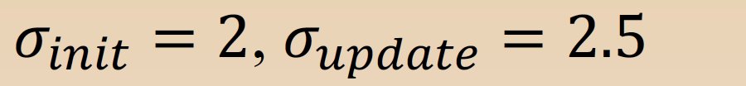


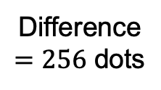
An example
Gaussian parameters: $σ_{init}=2$, $σ_{update}=2.5$
Screen size: 256 $×$ 256
Patch size: 256 $×$ 256
$$−$$
=
Initial level of 127
Level: 126
Generated from Initial level of 127
with stacking constraints by removing 256 dots
Difference
$=256$ dots

Slide 22
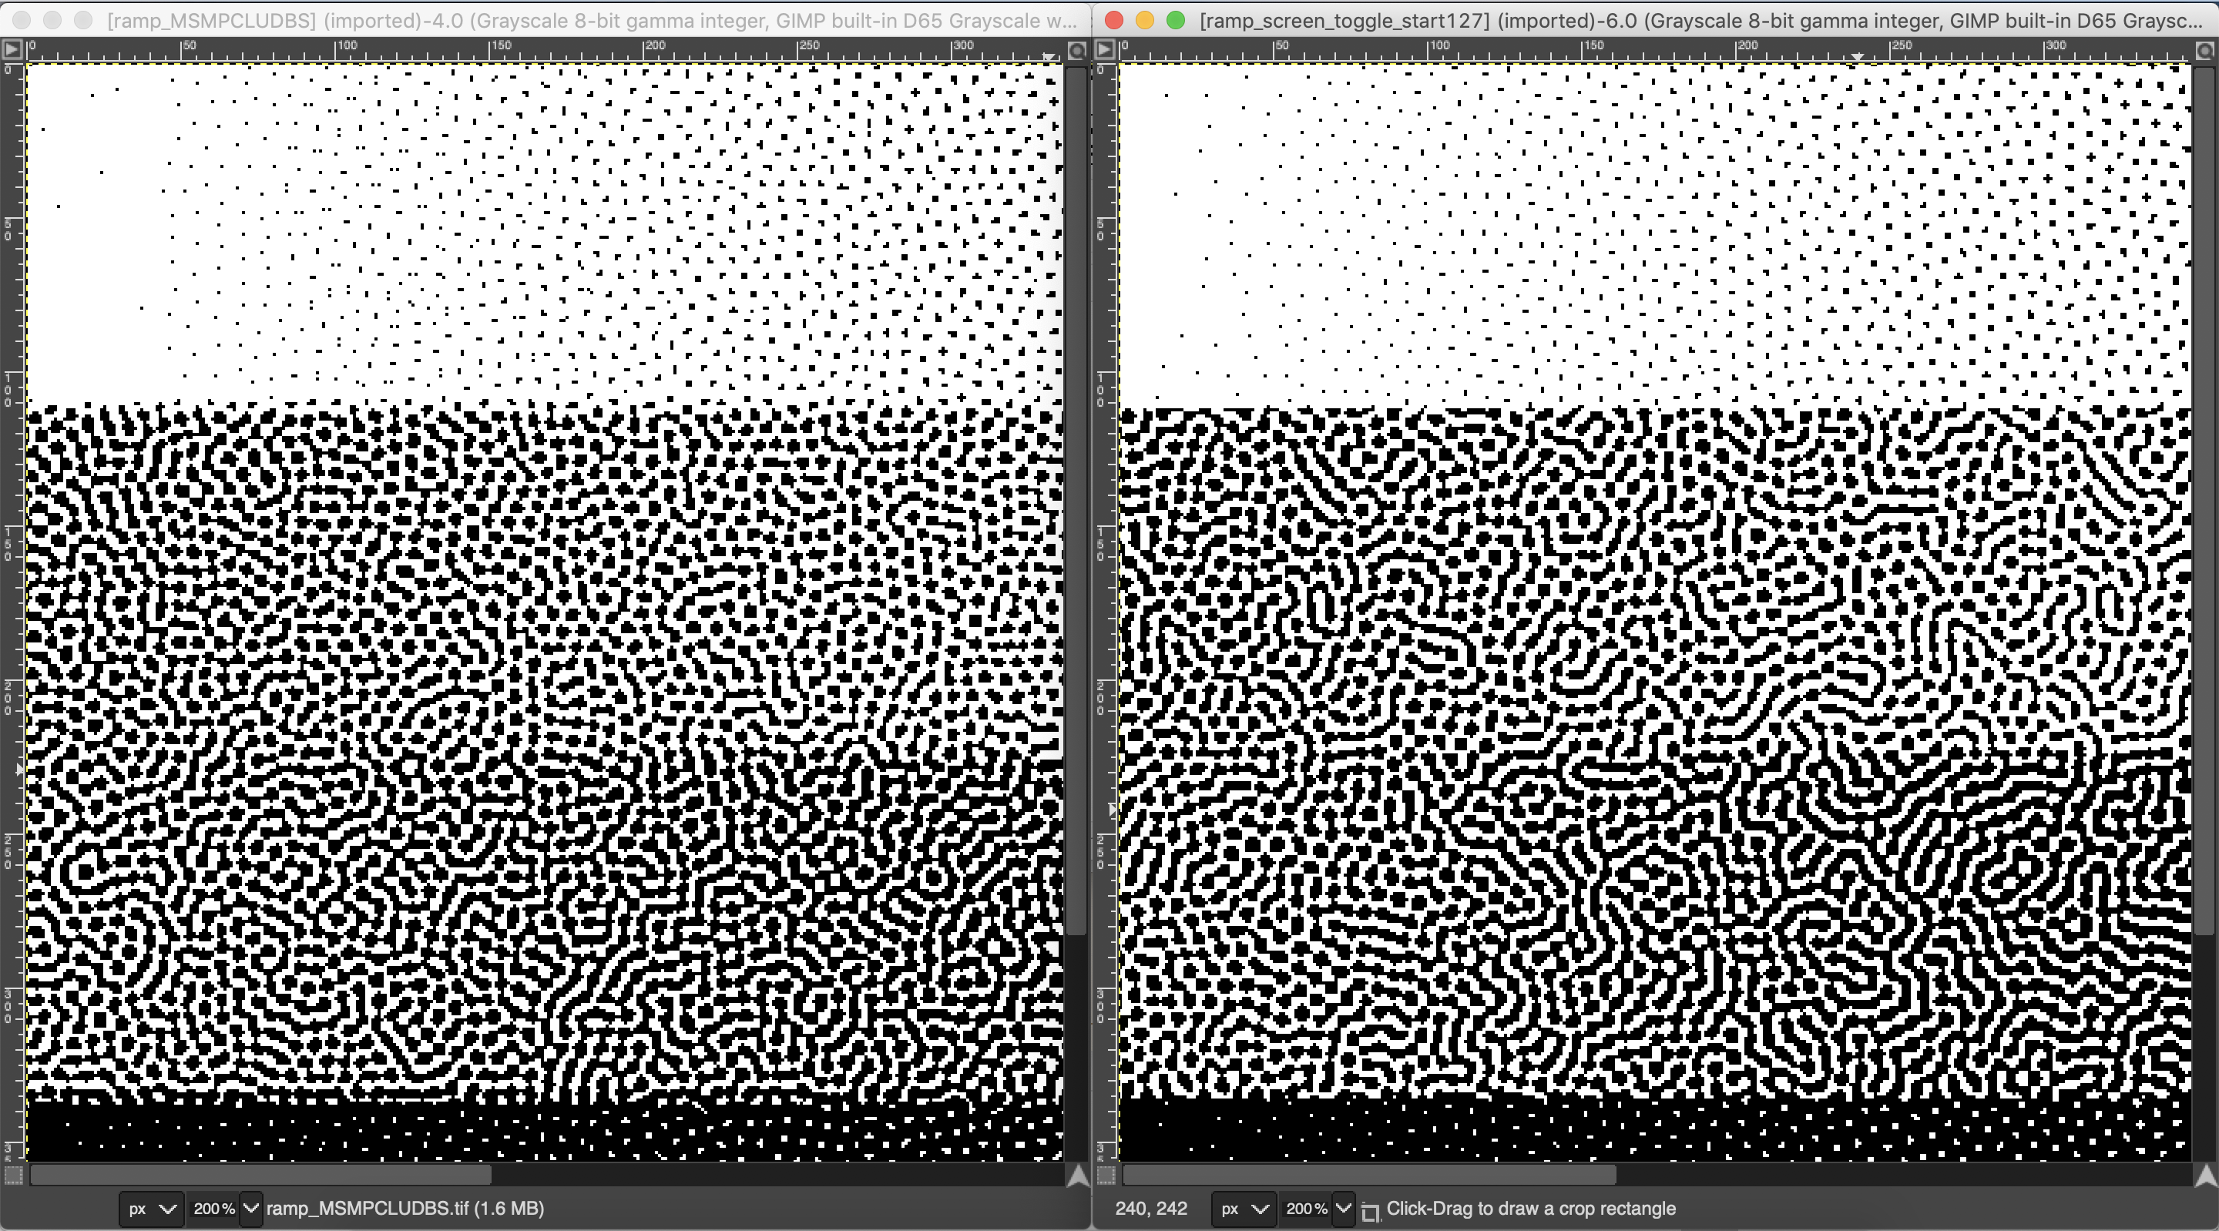

Comparison with direct MS-MP-CLU-DBS
Gaussian parameters: $σ_{init}=2$, $σ_{update}=2.5$
Screen size: 256 x 256
Generated from direct MS-MP-CLU-DBS
Generated from Screen
Seed halftone: 7.57

Slide 23
Outline
Overview of DBS and CLU-DBS
MS-MP-CLU-DBS Screen Design
    Screen design procedure
    Desired LPI (halftone frequency)
    Halftone quality and metrics

Slide 24

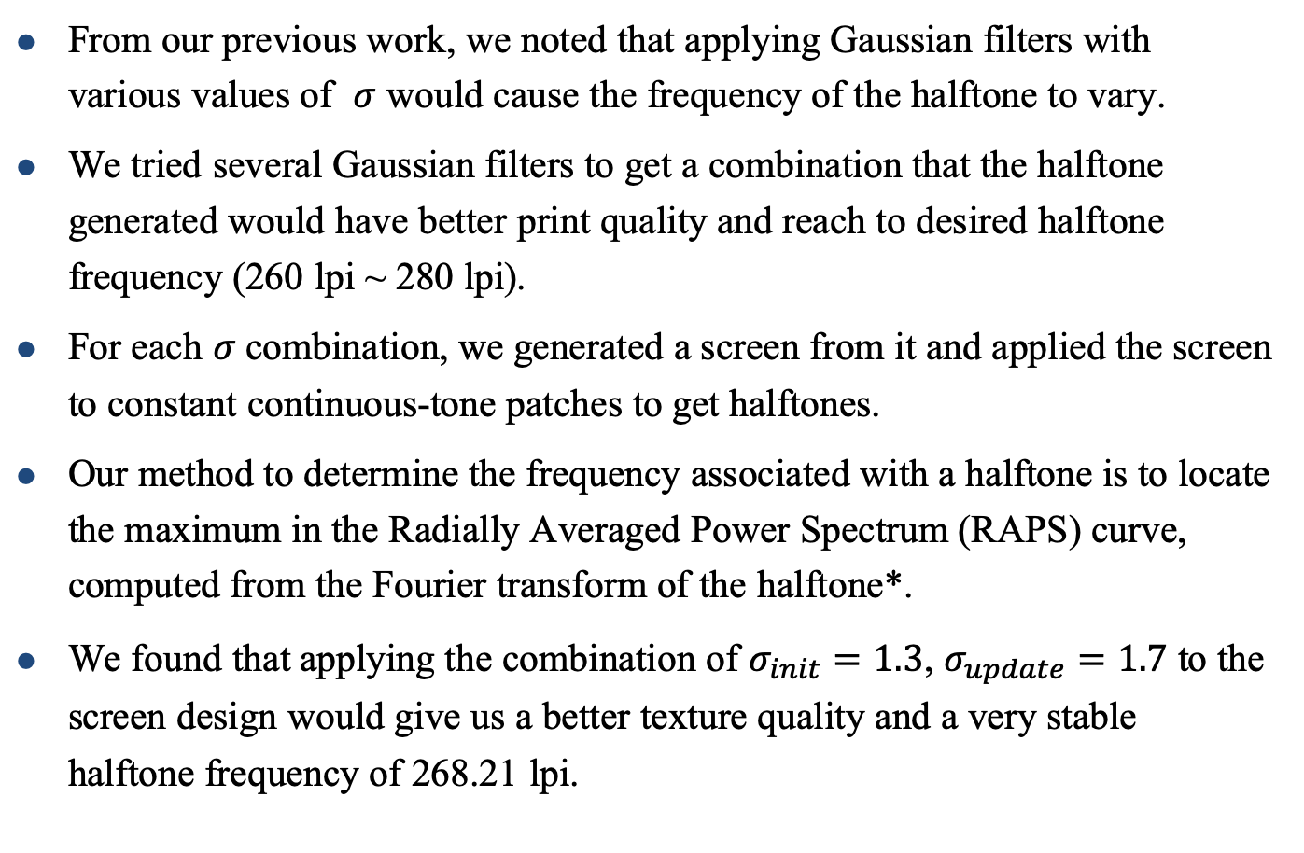
Desired LPI (halftone frequency)
From our previous work, we noted that applying Gaussian filters with various values of $σ$ would cause the frequency of the halftone to vary.
We tried several Gaussian filters to get a combination that the halftone generated would have better print quality and reach to desired halftone frequency (260 lpi ~ 280 lpi).
For each $σ$combination, we generated a screen from it and applied the screen to constant continuous-tone patches to get halftones.
Our method to determine the frequency associated with a halftone is to locate the maximum in the Radially Averaged Power Spectrum (RAPS) curve, computed from the Fourier transform of the halftone*.
We found that applying the combination of $σ_{init}=1.3$, $σ_{update}=1.7$ to the screen design would give us a better texture quality and a very stable halftone frequency of 268.21 lpi.
* R. Ulichney, “Dithering with blue noise,” Proc. IEEE, vol. 76, pp. 56–79, Jan. 1988.

Slide 25
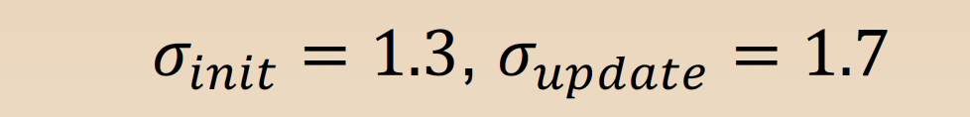

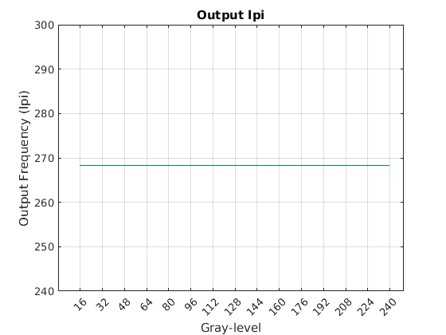
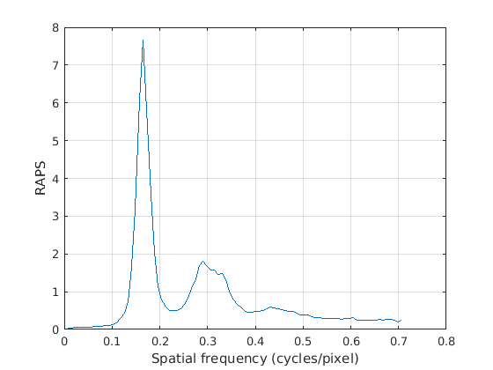

Level 16
Gaussian parameters: $σ_{init}=1.3$, $σ_{update}=1.7$
Screen size: 256 $×$ 256
$ρ_{RAPS}$: 268.21 lpi

Slide 26

Apply the new screen to a folded ramp
$σ_{init}=1.3$, $σ_{update}=1.7$

Slide 27
Outline
Overview of DBS and CLU-DBS
MS-MP-CLU-DBS Screen Design
    Screen design procedure
    Desired LPI (halftone frequency)
    Halftone quality and metrics

Slide 28
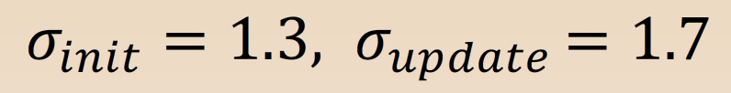
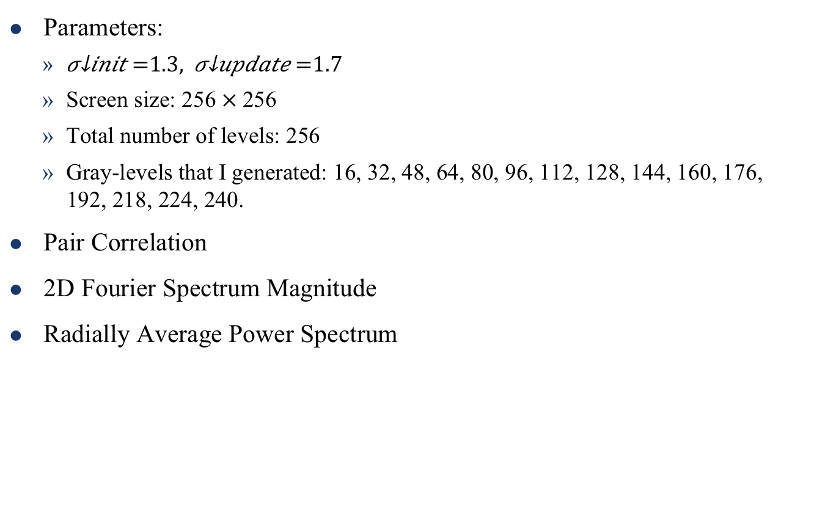
    Halftone quality and metrics
Parameters:
    $σ_{init}=1.3{, σ}_{update}=1.7$
    Screen size: 256$×$256
    Total number of levels: 256
    Gray-levels that I generated: 16, 32, 48, 64, 80, 96, 112, 128, 144, 160, 176, 192, 218, 224, 240.
Pair Correlation
2D Fourier Spectrum Magnitude
Radially Average Power Spectrum

Slide 29
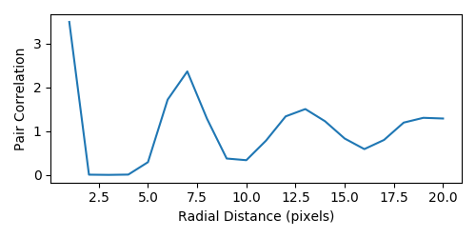
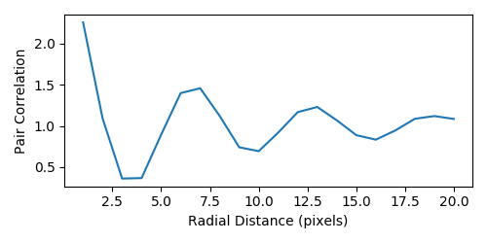
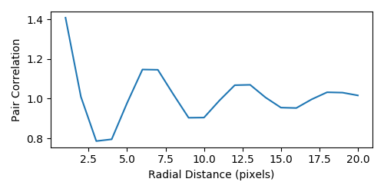
Pair Correlation
Level 16
Level 64
Level 128
D. L. Lau, G. R. Arce, and N. C. Gallagher, “Green-noise digital halftoning,”
Proc. IEEE, vol. 86, pp. 2424–2444, Dec. 1998.
Notes:
average separation of clusters

Slide 30
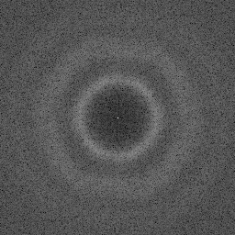
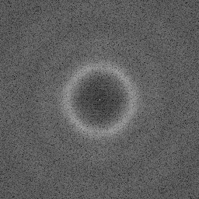
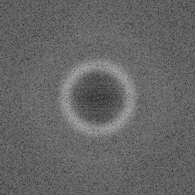
2D Fourier Spectrum Magnitude
Level 16
Level 64
Level 128

Slide 31

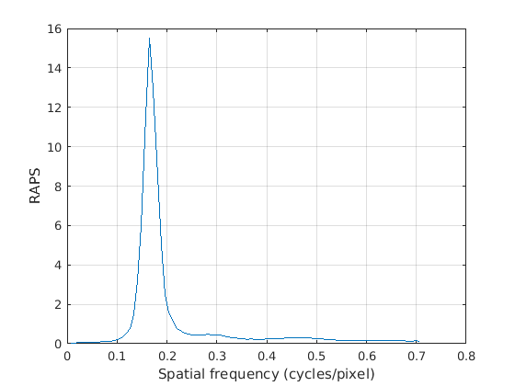
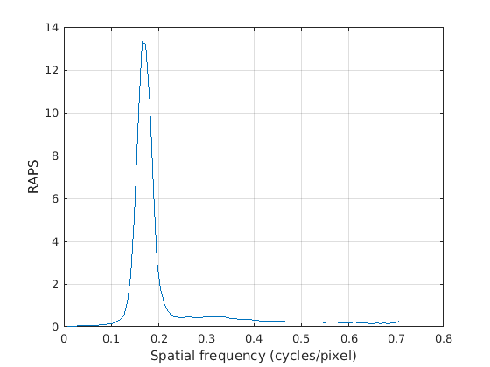



Radially Average Power Spectrum
Level 16
$ρ_{RAPS}$: 268.21 lpi
Level 64
$ρ_{RAPS}$: 268.21 lpi
$ρ_{RAPS}$: 268.21 lpi
Level 128
R. Ulichney, “Dithering with blue noise,” Proc. IEEE, vol. 76, pp. 56–79, Jan. 1988.

Slide 32
Conclusion
We have performed a screen design based on MS-MP-CLU-DBS to generate aperiodic clustered-dots halftones to use with the Indigo liquid EP printing technology.
We have explored a combination of Gaussian filters, and chose a combination that yields good halftone quality and the desired LPI based on the maximum in the Radially Averaged Power Spectrum (RAPS) curve.
We have shown that our screen design has a very stable LPI.
We have used several metrics to validate our screen-based halftone quality.

Slide 33
Thank you!

