Slide 1

Joint Design of CMY Screen Sets Using DBS

Slide 2

About the Author
Y. Yang and J. Allebach, “Joint Design of Plane-Dependent FM Screen Sets Using DBS Algorithm,” Proceedings of CIC27 – IS&T’s 27th Color Imaging Conference, 21-25 October 2019, Paris FRANCE.
This presentation is part of Yi Yang’s Preliminary Examination presentation – 10 July 2020.

Slide 3
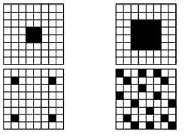
Background
2. Independent and Dependent²
Independent
AM
1. AM and FM¹
Dependent
FM
Method | Operation | Image Quality | Speed | Implementation Complexity
Screening | Pixel comparison | Good | Fast | Simple
DBS | Iterative search | Excellent | Slow | Complex
3. Screening and DBS
algorithm ³
Kang H R. Digital color halftoning[M]. SPIE press.
Lee J H, Allebach J P. Colorant-based direct binary search halftoning[J]. Journal of Electronic Imaging, 11(4): 517-528.
Allebach J P. DBS: retrospective and future directions[C],Color Imaging: Device-Independent Color, Color Hardcopy, and Graphic Arts VI. International Society for Optics and Photonics, 4300: 358-376.

Slide 4
Motivation
Keys:
  Color representation.
  High quality.
  Speed and complexity.
Our goal: Combine advantages of Screening and DBS
  Jointly design FM, dependent screens set for C, M and Y colorants.
  Using the DBS algorithm.
  Simple and fast to use.
  Great halftoned image quality.

Slide 5
Outline of Topic 1:
Background and Motivation
Color DBS Algorithm and Screens Design
Joint Design Algorithm
Implement and Results
Comparison Results
Conclusion

Slide 6
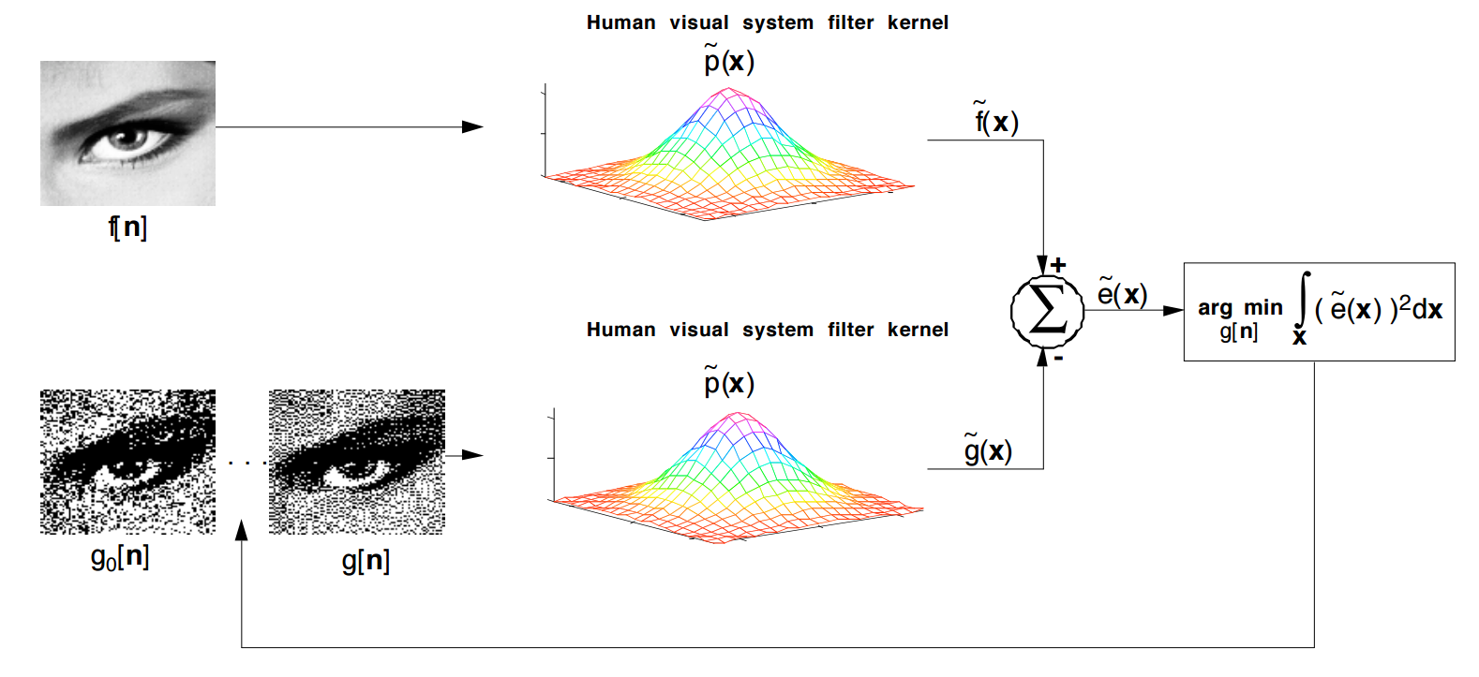
DBS Halftoning Algorithm
* Allebach J P. DBS: retrospective and future directions[C]//Color Imaging: Device-Independent Color, Color Hardcopy, and Graphic Arts VI. International Society for Optics and Photonics, 4300: 358-376.

Slide 7
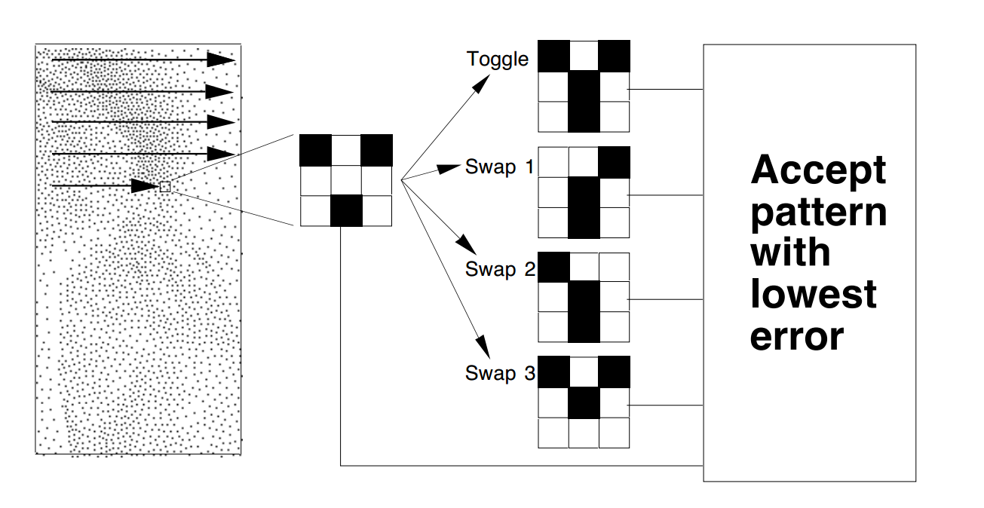
DBS Search Heuristic
the
* Allebach J P. DBS: retrospective and future directions, Color Imaging: Device-Independent Color, Color Hardcopy, and Graphic Arts VI. International Society for Optics and Photonics, 4300: 358-376.

Slide 8
Screening method
Screening is a Thresholding Process
  Simple point-to-point transformation of each pixel in the continuous-tone image to a binary value.
  Process requires no memory or neighborhood information.
The following are equivalent terms in Halftoning:
Threshold matrix, Screen, Dither matrix, Mask
* Allebach J P. Advanced topic in digital halftoning – 17-19 October 2016.

Slide 9
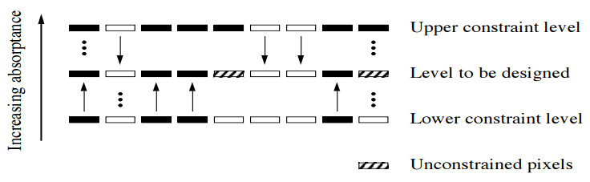
Screens Design -- Level-by-level design of the dot profile function
Dot profile function (halftone pattern) * :
Level-by-level design:
Design by generating uniform pattern for each gray level.
Must follow stacking constraint*.
Stacking constraint:
* Allebach J P. Advanced topic in digital halftoning – 17-19 October 2016.

Slide 10
Outline of Topic 1:
Background and Motivation
Color DBS Algorithm and Screens Design
Joint Design Algorithm
Implement and Results
Comparison Results
Conclusion

Slide 11
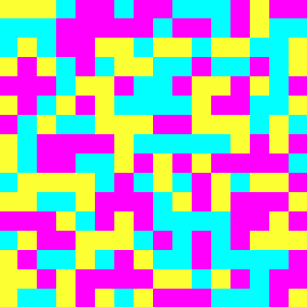
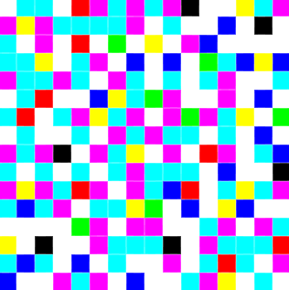
Quality Conditions for the Designed Screens Set
For obtaining homogeneous halftone images, all levels patterns of screens need to satisfy the following conditions*.
The pattern of each colorant (C, M, or Y) should be arranged as uniform as possible.
The overall composite pattern that consists of all three colorants should be as uniform as possible.
keep dot-off-dot as much as possible during the process of design screens.
Pattern has:
Secondary colors:
B = C + M
G = C + Y
R = M + Y
Tertiary Color:
K = C + M + Y
Pattern only has Primary Colors:
C, M, and Y
Fig 14-1. The zoomed-in details (16×16) of a dot-off-dot pattern.
Fig 14-2. The zoomed-in details (16×16) of a dot-on-dot pattern.
* Je H. Lee and Jan P. Allebach, “CMYK Halftoning Algorithm Based on Direct Binary Search". Color and Imaging Conference. Vol. 6.

Slide 12










Error Metrics for Joint Design Algorithm
Continuous-tone
Halftone
Spatial coordinates:
Discrete image:
HVS filter:
Perceived discrete image:
Error between original continuous-tone image and the halftone image is:
Perceived error through HVS is：
* Used Nasanan's HVS model

Slide 13
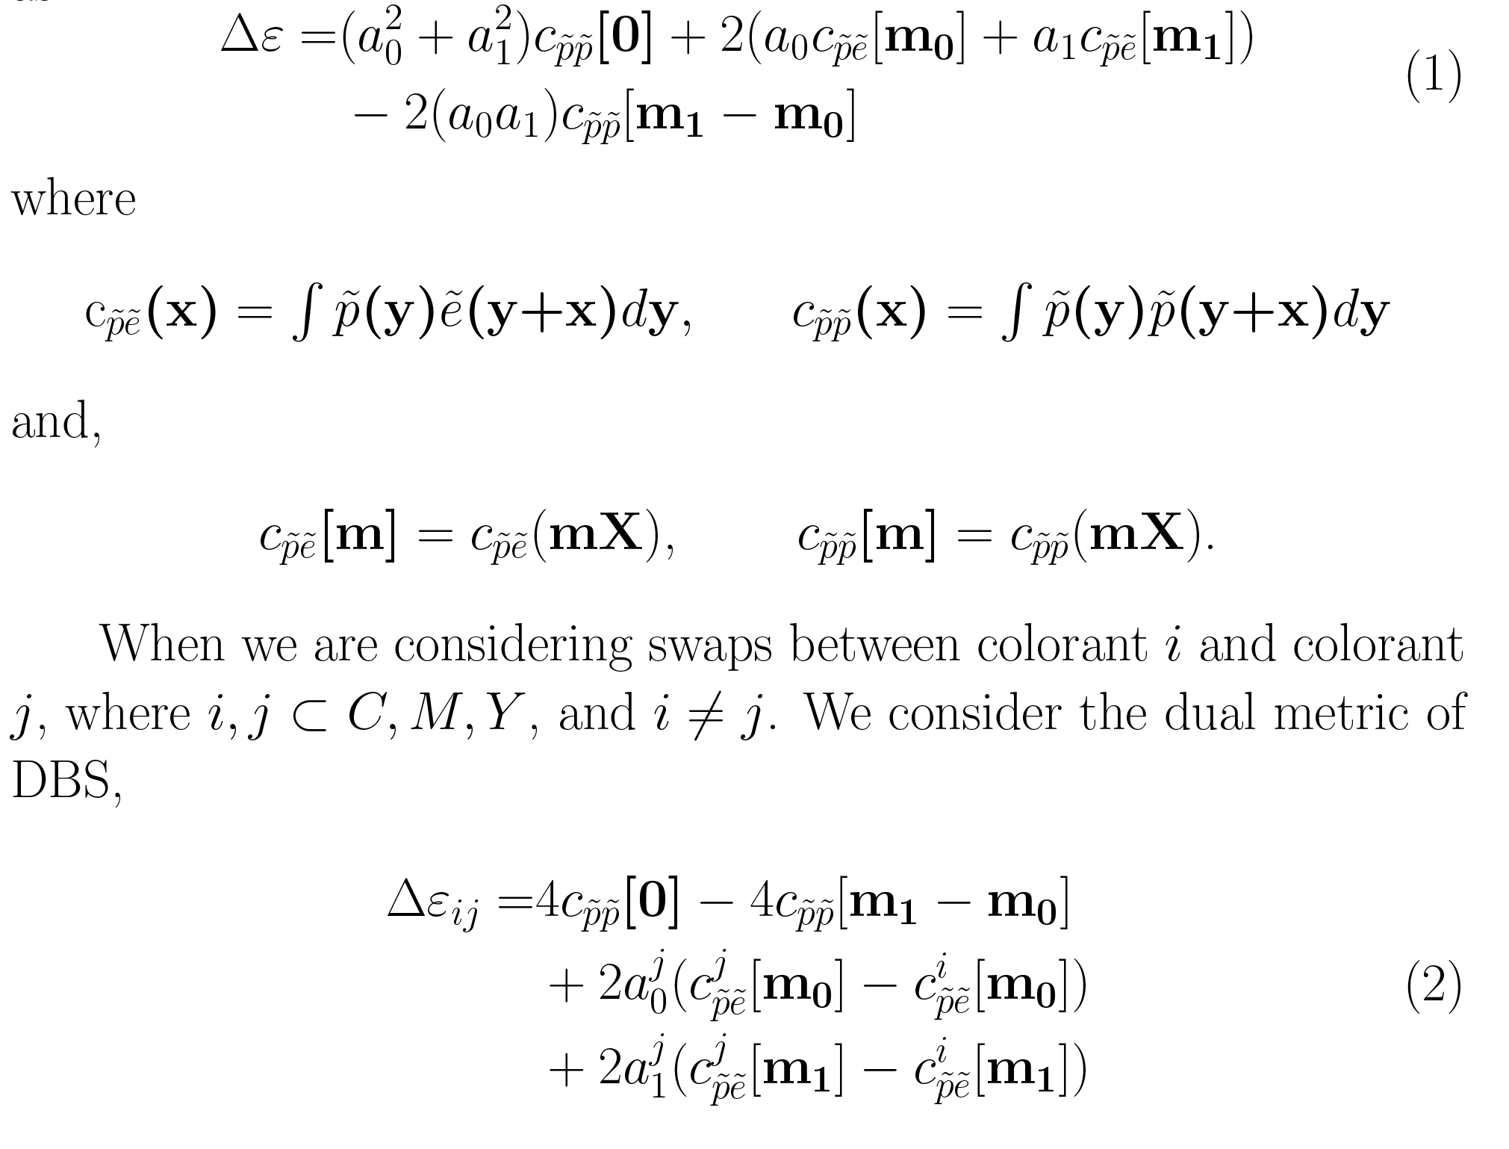
Error Metrics for Joint Design Algorithm
Monochrome Error Metric：
Dual Error Metric：

Slide 14
Pipeline of Joint Design Screens
Design the starting Level.
Select a certain level as the starting level.
Generate an initial pattern for this level.
Optimize the initial pattern by reducing error metric to obtain a homogeneous pattern for this level.
Level-by-Level design of darker levels below and lighter levels above the starting Level.
Add/ Remove certain number of dots from previous level pattern to get an initial pattern.
Optimize the initial pattern by reducing error metric to obtain a homogeneous pattern.
Apply color control for each level.

Slide 15
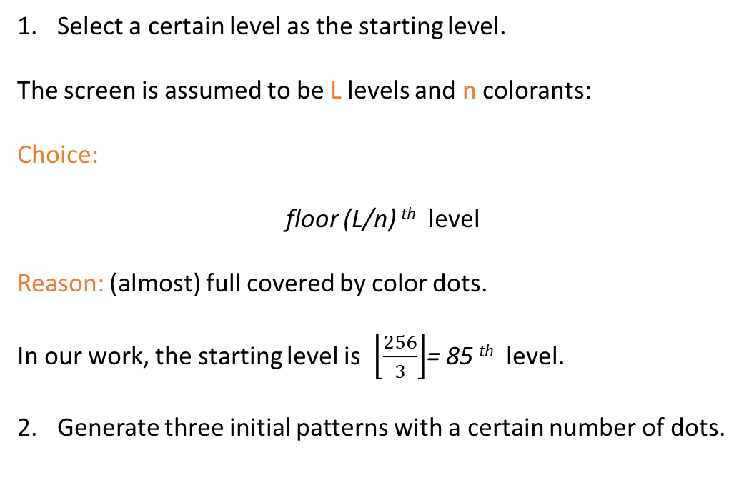
Designing the starting Level
Select a certain level as the starting level.
The screen is assumed to be L levels and n colorants:
Choice:
floor (L/n) ^{th} level
Reason: (almost) full covered by color dots.
In our work, the starting level is $\left\lfloor \frac{256}{3}\right\rfloor$= 85 ^{th} level.
Generate three initial patterns with a certain number of dots.
Fig 16-1. A CMY color pattern as a combination of three different C, M and Y patterns.

Slide 16
Designing the starting Level
3. Optimize the initial patterns to obtain a homogeneous pattern.
Apply swap-only DBS algorithm to iteratively compute the Dual Error Metric between two different colorants.
swap1
Current pixel
swap2
Iteration:
swap3
error not converges || (# iterations < threshold)
C with M
C with Y
M with Y
Fig 17-1. Possible swap trials between two colorants.

Slide 17
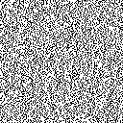
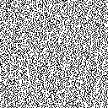
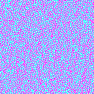
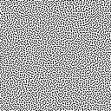
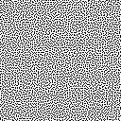
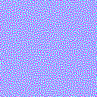
Uniform combination pattern
Initial
Initial pattern of Cyan
Initial pattern of Magenta
The initial pattern of combination of Cyan and Magenta.
Optimized
Optimized pattern of Cyan
Optimized pattern of Magenta
The optimized pattern of combination of Cyan and Magenta.

Slide 18
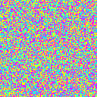

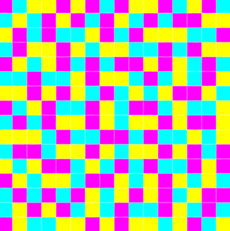
Uniform pattern of starting level
Fig 21-1. The initial and optimized pattern of combination of Cyan, Magenta and Yellow.

Slide 19
Level-by-level Design Method
The screen is assumed to be MxM pixels; and L is the number of levels in the screen.
Lighter levels:
Randomly remove M²/L dots from C, M and Y starting pattern respectively to get the pattern of the next lighter level.
Perform trial swaps between newly removed dots with existing dots to reduce the Monochrome Error Metric(Eq.1) of each pattern independently.
Apply constraints to guarantee the composite pattern is totally dot-off-dot.
Darker levels:
Randomly add M²/L dots into the C, M and Y starting pattern respectively to get the new pattern of the next darker level.
Perform trial swaps between newly added dots of different colorants to reduce the Dual Error Metric(Eq.2 ).
Apply several constraints to control the appearance of secondary colors.

Slide 20
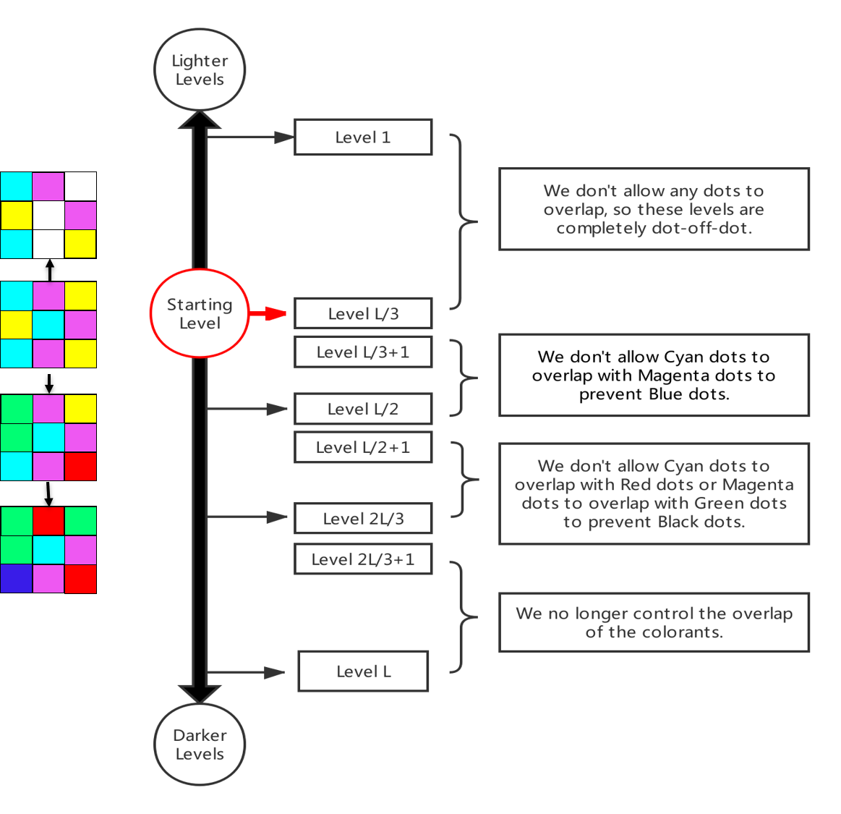
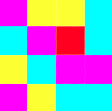
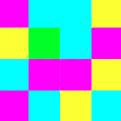
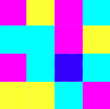
Apply color control.
Reasons
Steps
Secondary colors:
Red
Green
Blue
Tertiary color:
Black

Slide 21
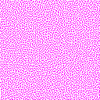
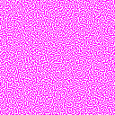
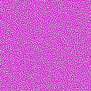
Uniform patterns for lighter/ darker levels
Magenta colorant
Figure 24-1. The patterns for Magenta colorant in the 1st, 2nd, and 3rd levels.
Figure 24-2. The patterns for the Magenta colorant in the 85th, 130th and 160th levels

Slide 22
Outline of Topic 1:
Background and Motivation
Color DBS Algorithm and Screens Design
Joint Design Algorithm
Implement and Results
Comparison Results
Conclusion

Slide 23
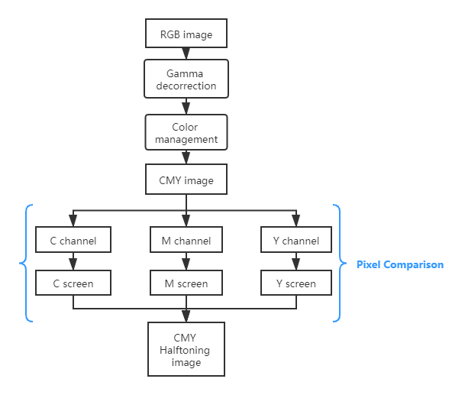
CMY joint screens set implement
Separate a color image into R, G and B channels
Apply gamma de-correction to each channel
Convert components of RGB to CMY color space.
The halftoning rule is:
If C_channel[i,j] < C_screen[i,j], print a cyan dot at [i,j];
If M_ channel[i,j] < M_screen[i,j], print a magenta dot at [i,j];
If Y_ channel[i,j] < Y_screen[i,j], print a yellow dot at [i,j].
Where C, M and Y screens are jointly designed screens for cyan, magenta and yellow.

Slide 24



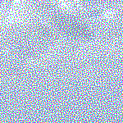
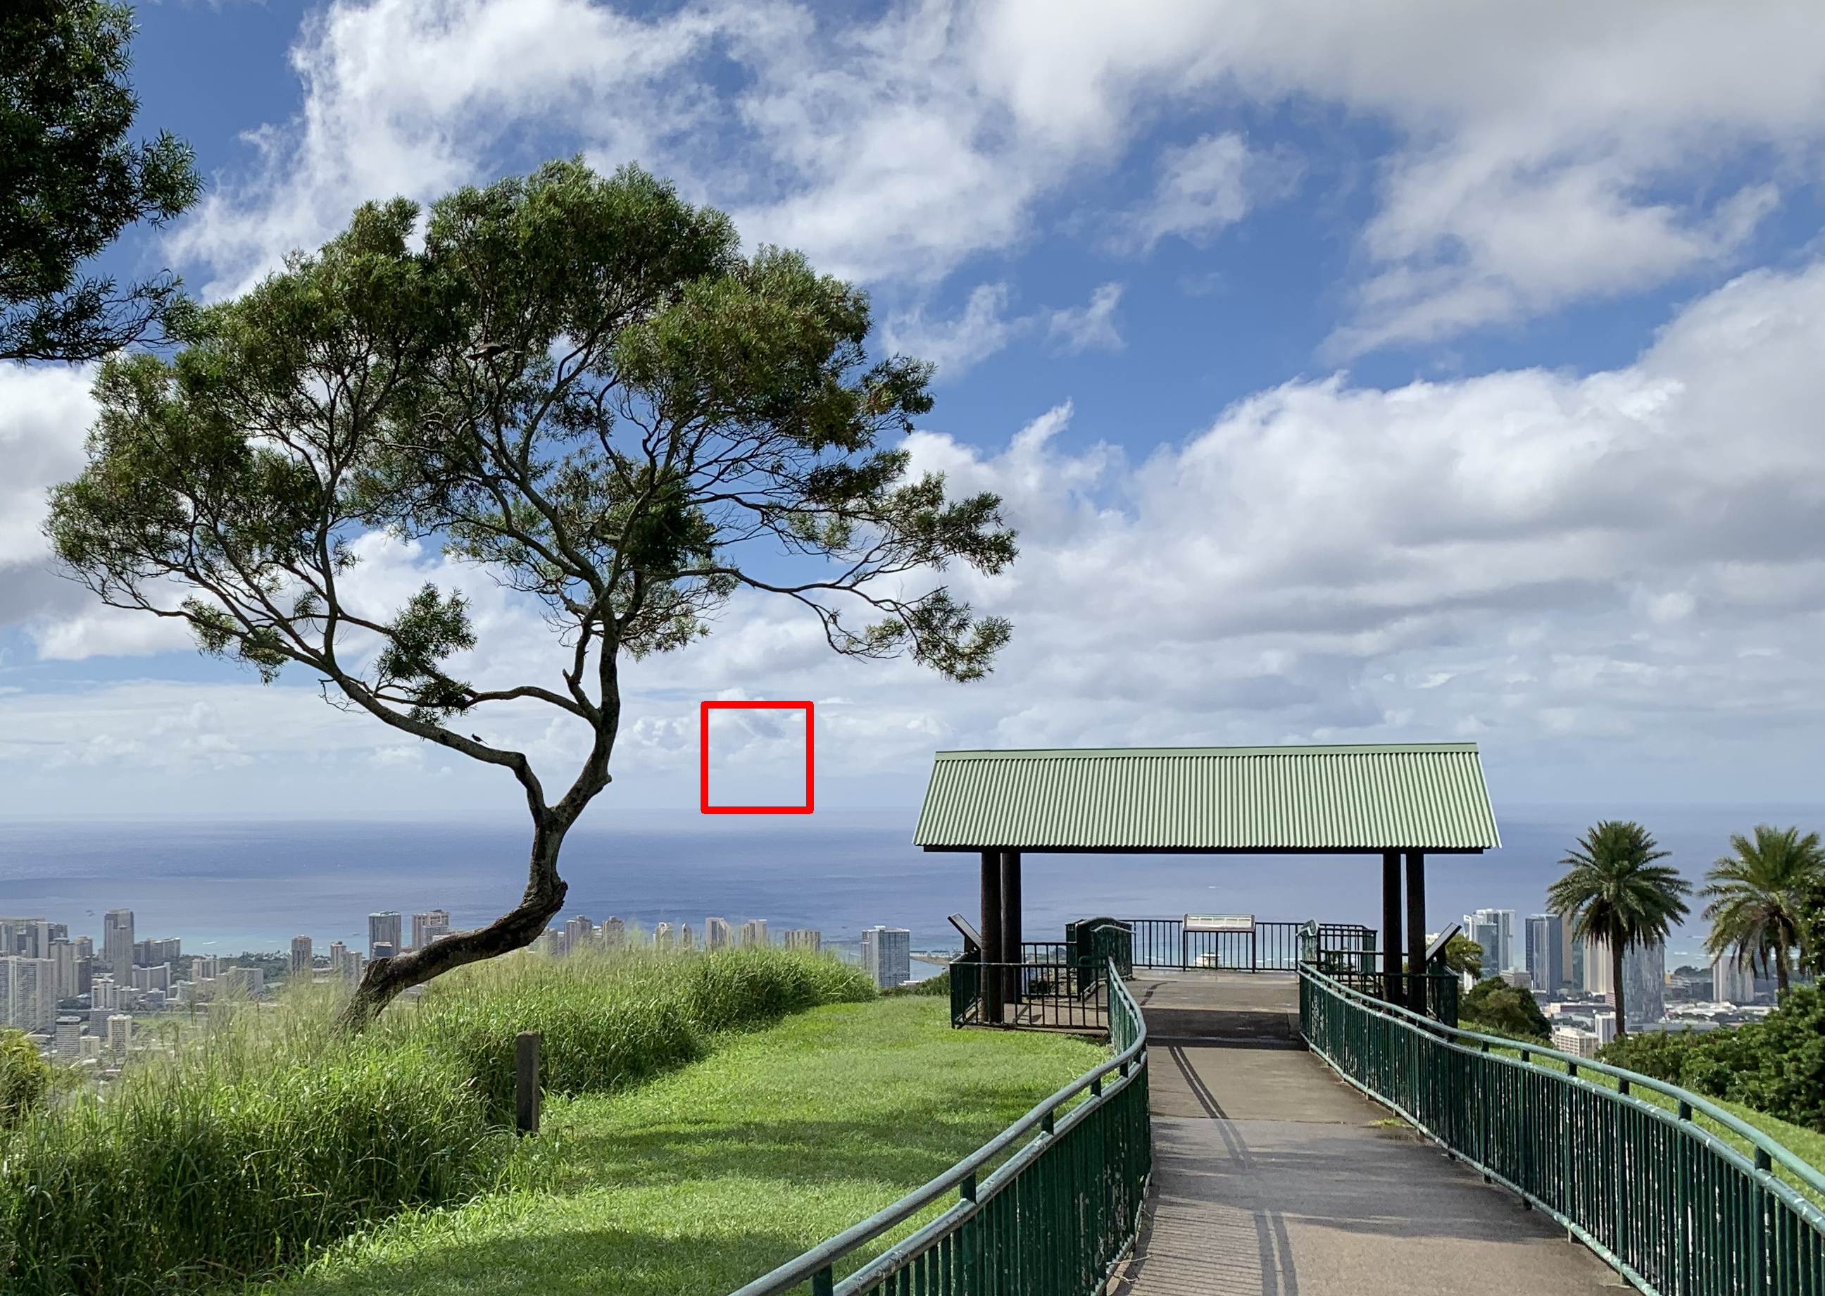
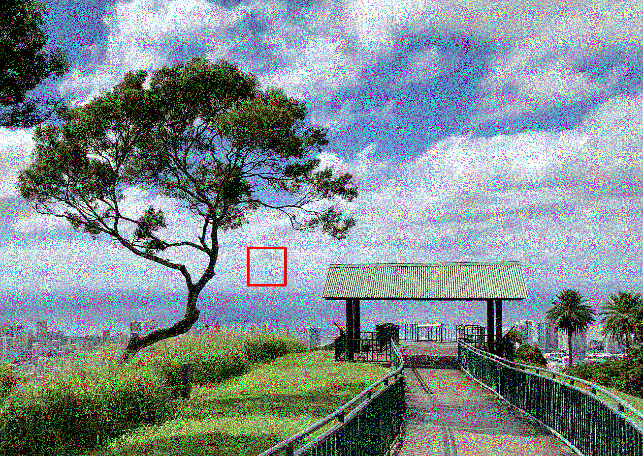
Halftoning results
Figure 27-1. Continuous-tone color image
Figure 27-2. Image halftoned using jointly designed screen set.

Slide 25
Outline of Topic 1:
Background and Motivation
Color DBS Algorithm and Screens Design
Joint Design Algorithm
Implement and Results
Comparison Results
Conclusion

Slide 26
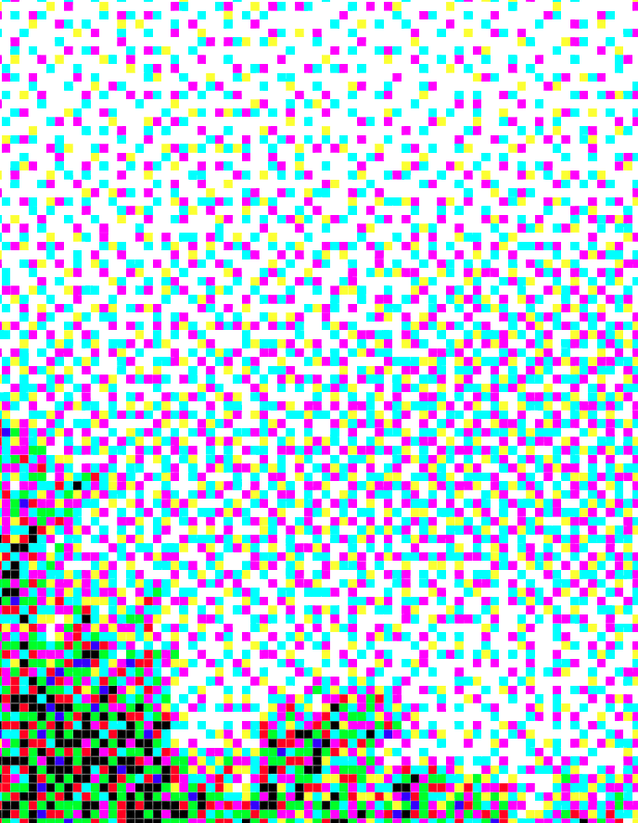
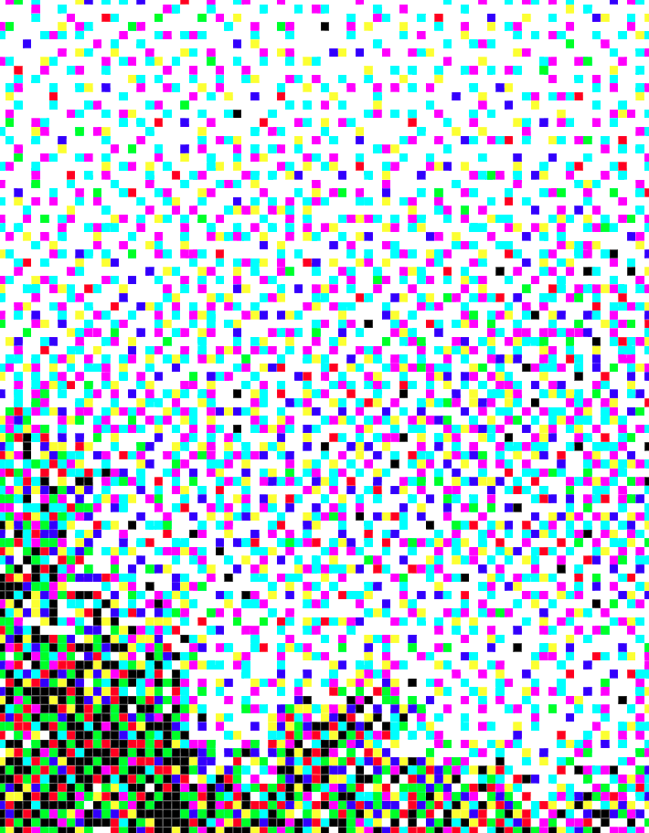
Comparison
Image halftoned by jointly designed screens.
Image halftoned by independently designed screens.
Lighter tone
No secondary colors:
(red, green, blue).
Has secondary colors:
(red, green, blue).
Mid tone
Has secondary colors and tertiary color :
(red, green, blue, black).
No secondary colors:
(red, green, blue).
Darker tone
Has secondary color, and a small amount of tertiary color.
Has a lot of tertiary color.
Figure 29-1. Comparison of the zoomed-in detail of same regions in the two halftone images.

Slide 27
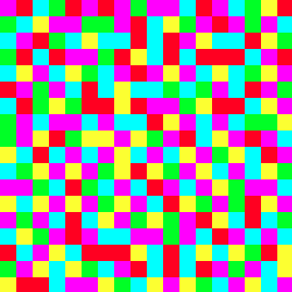
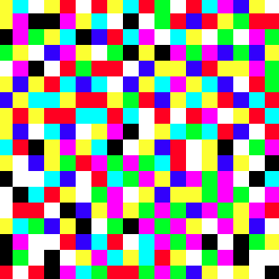
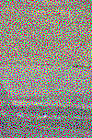
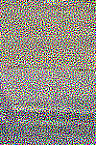
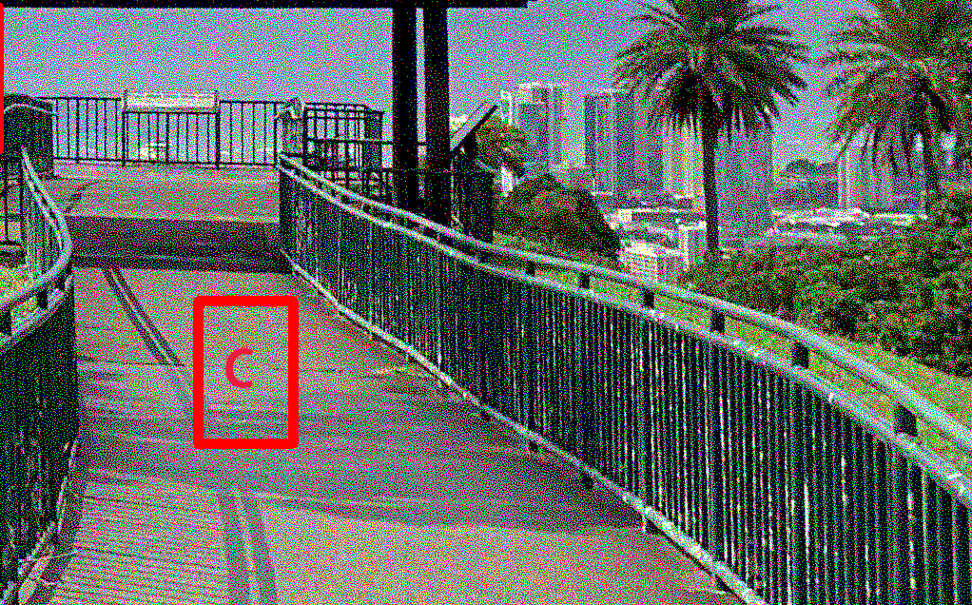

Comparison
Image halftoned by jointly designed screens.
Image halftoned by independently designed screens.
Dot profile.
This pattern has fewer secondary colors, does not have tertiary color or white holes.
Therefore, the overall image appears more uniform.
This pattern has numerous secondary colors, tertiary color and white holes.
Therefore, the overall image appears grainy.
Figure 30-1. Comparison of the zoomed-in detail of same regions in the two halftone images.

Slide 28
Outline of Topic 1:
Background and Motivation
Color DBS Algorithm and Screens Design
Joint Design Algorithm
Implement and Results
Comparison Results
Conclusion

Slide 29



Conclusion
We investigated the advantages and disadvantages of the main color halftoning algorithms and proposed a method that can combine the Screening and the DBS.
We showed our results having better quality than regular Screening halftoning, and simpler to use than the color DBS halftoning.
We designed joint screens sets for Cyan, Magenta, and Yellow colorants, which can be used to halftone color images directly by pixel comparison.
It is convenient to store and simple to use, which is suitable for generating various color halftone images.

