Slide 1
EE 638: Principles of Digital Color Imaging Systems
Lecture 22: Display and Printing
Notes partially prepared by Sirui Hu

Slide 2
Synopsis
General Model for Display and Printing Processes
Line-Continuous Scanning Systems
Matrix-Addressable Systems
General Model
Ideal Reconstruction
Zero Order Hold Reconstruction
Aliasing Artifacts

Slide 3
Line-Continuous Scanning Systems
-- reconstructed (displayed, printed, or written) image
-- write spot
-- scan signal

Slide 4
Recall
– read spot function

Slide 5
Note that the term inside the curly brackets above is
The product of and is

Slide 6
Matrix-Addressable Systems
Recall

Slide 7
By applying the sifting property of the impulse to the line below, we get the above equation
Note that the term inside the curly brackets above is again

Slide 8
The product of and is

Slide 9
General Model

Slide 10
Ideal Reconstruction

Slide 11
Spatial domain interpretation

Slide 12
If Nyquist conditions are satisfied,
i.e. then

Slide 13
1-D illustration of reconstruction process

Slide 14
Zero Order Hold Reconstruction

Slide 15
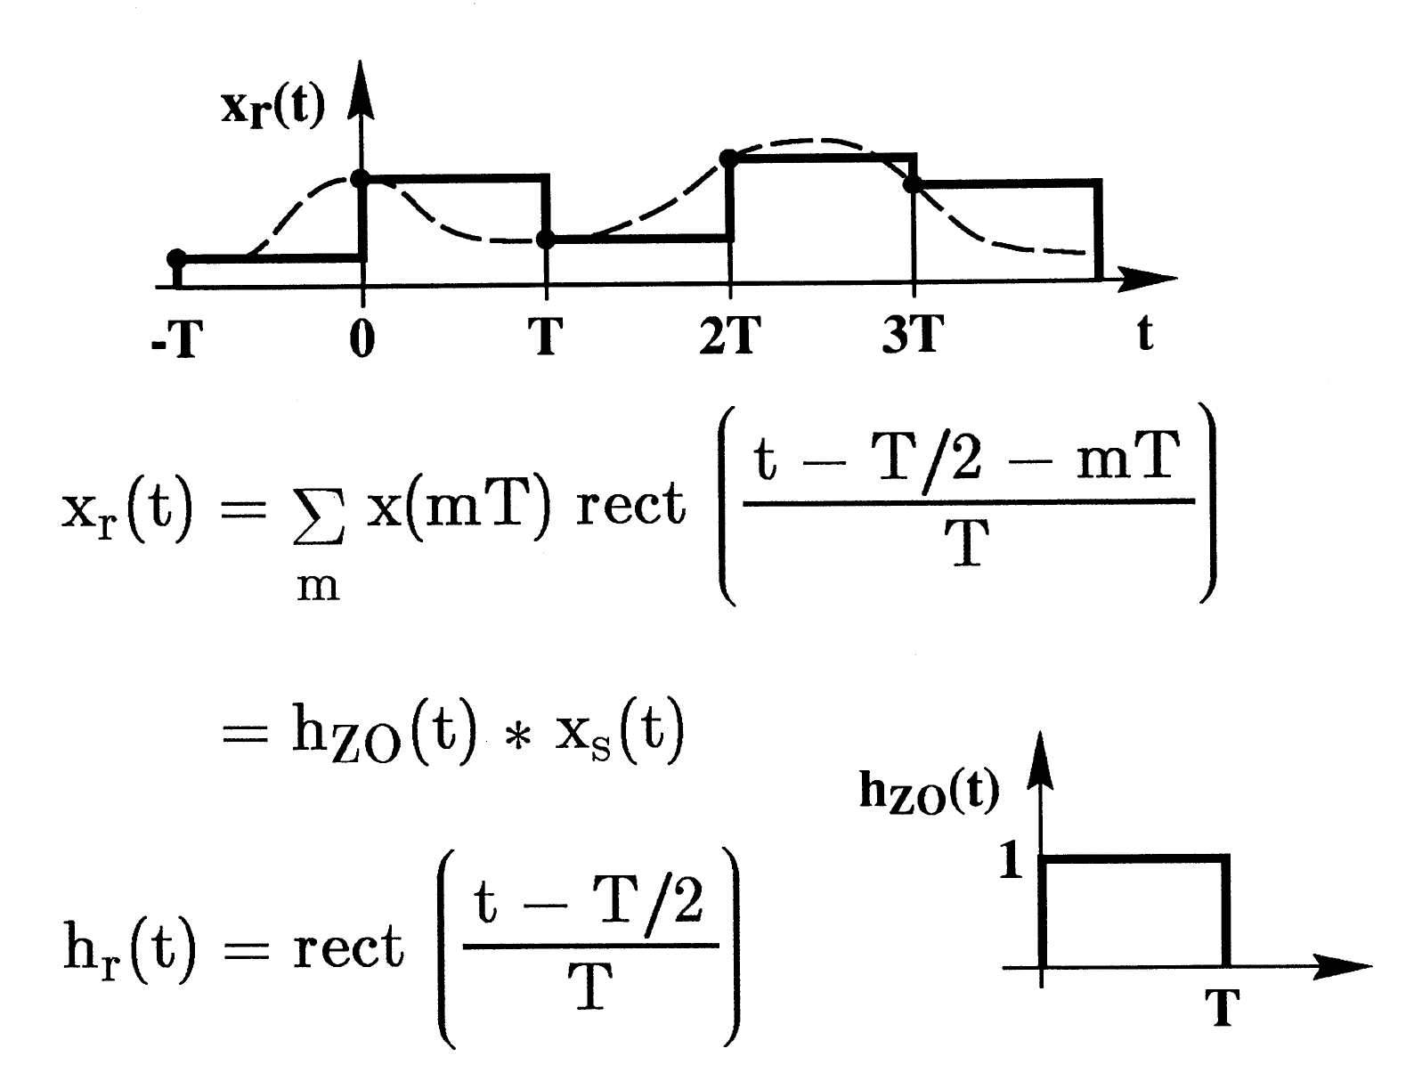
Zero Order Hold Reconstruction (1-D Analysis) in Time Domain

Slide 16
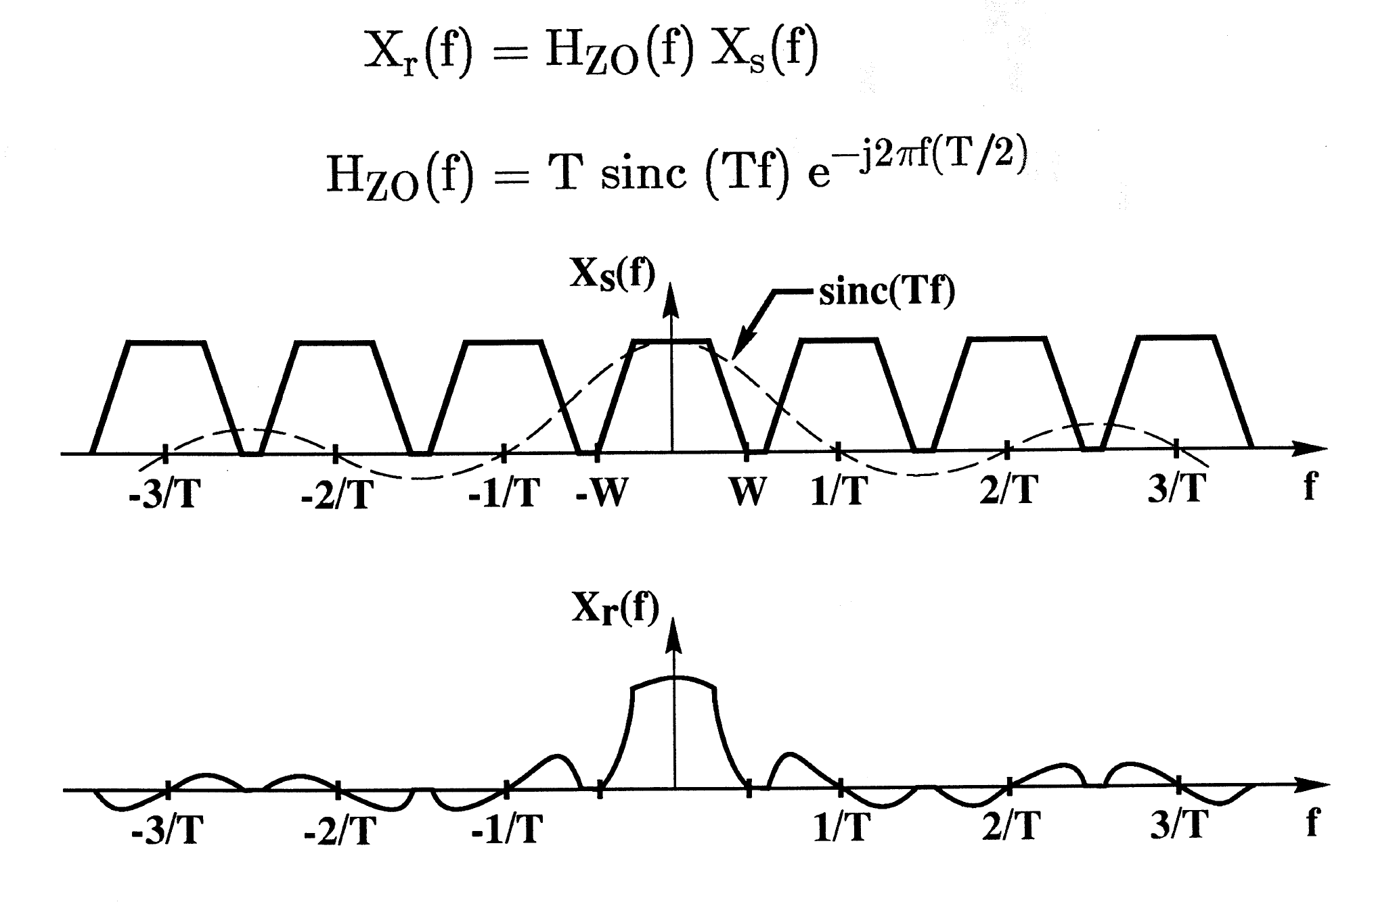
Zero Order Hold Reconstruction (1-D Analysis) in Frequency Domain

Slide 17
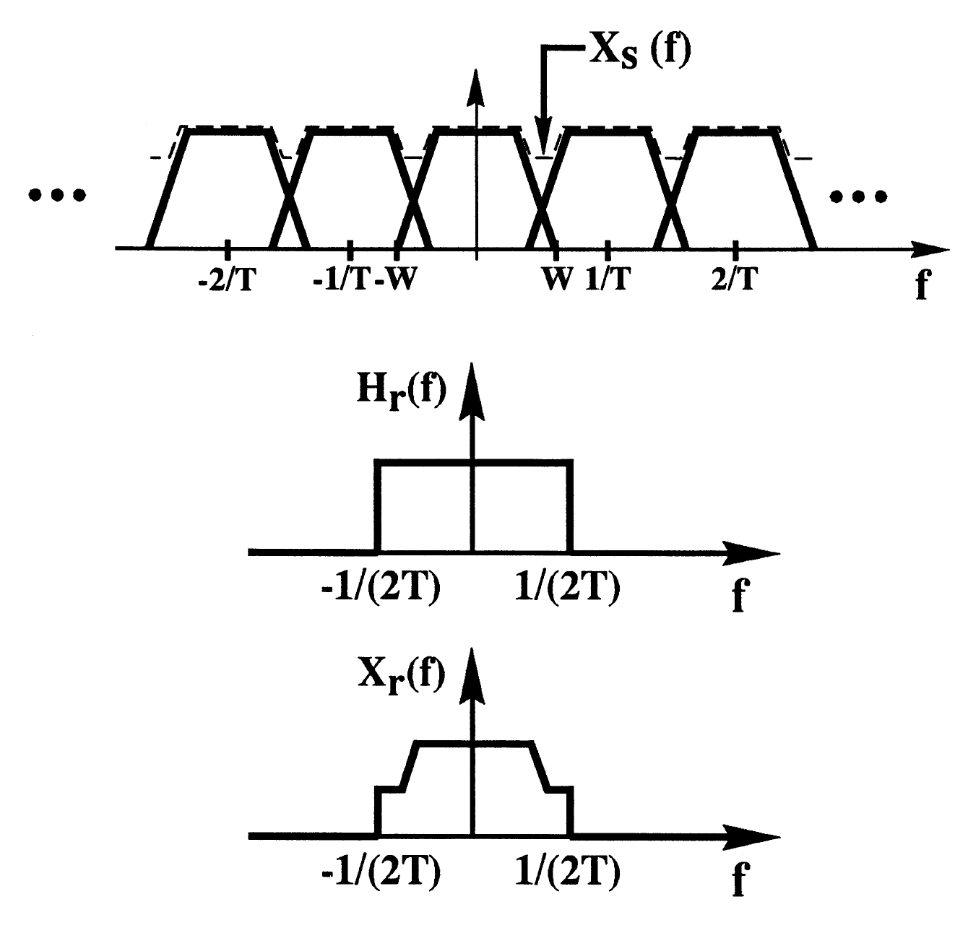
Effect of Undersampling (1-D Analysis) in Frequency Domain (W > 1/(2T)

Slide 18
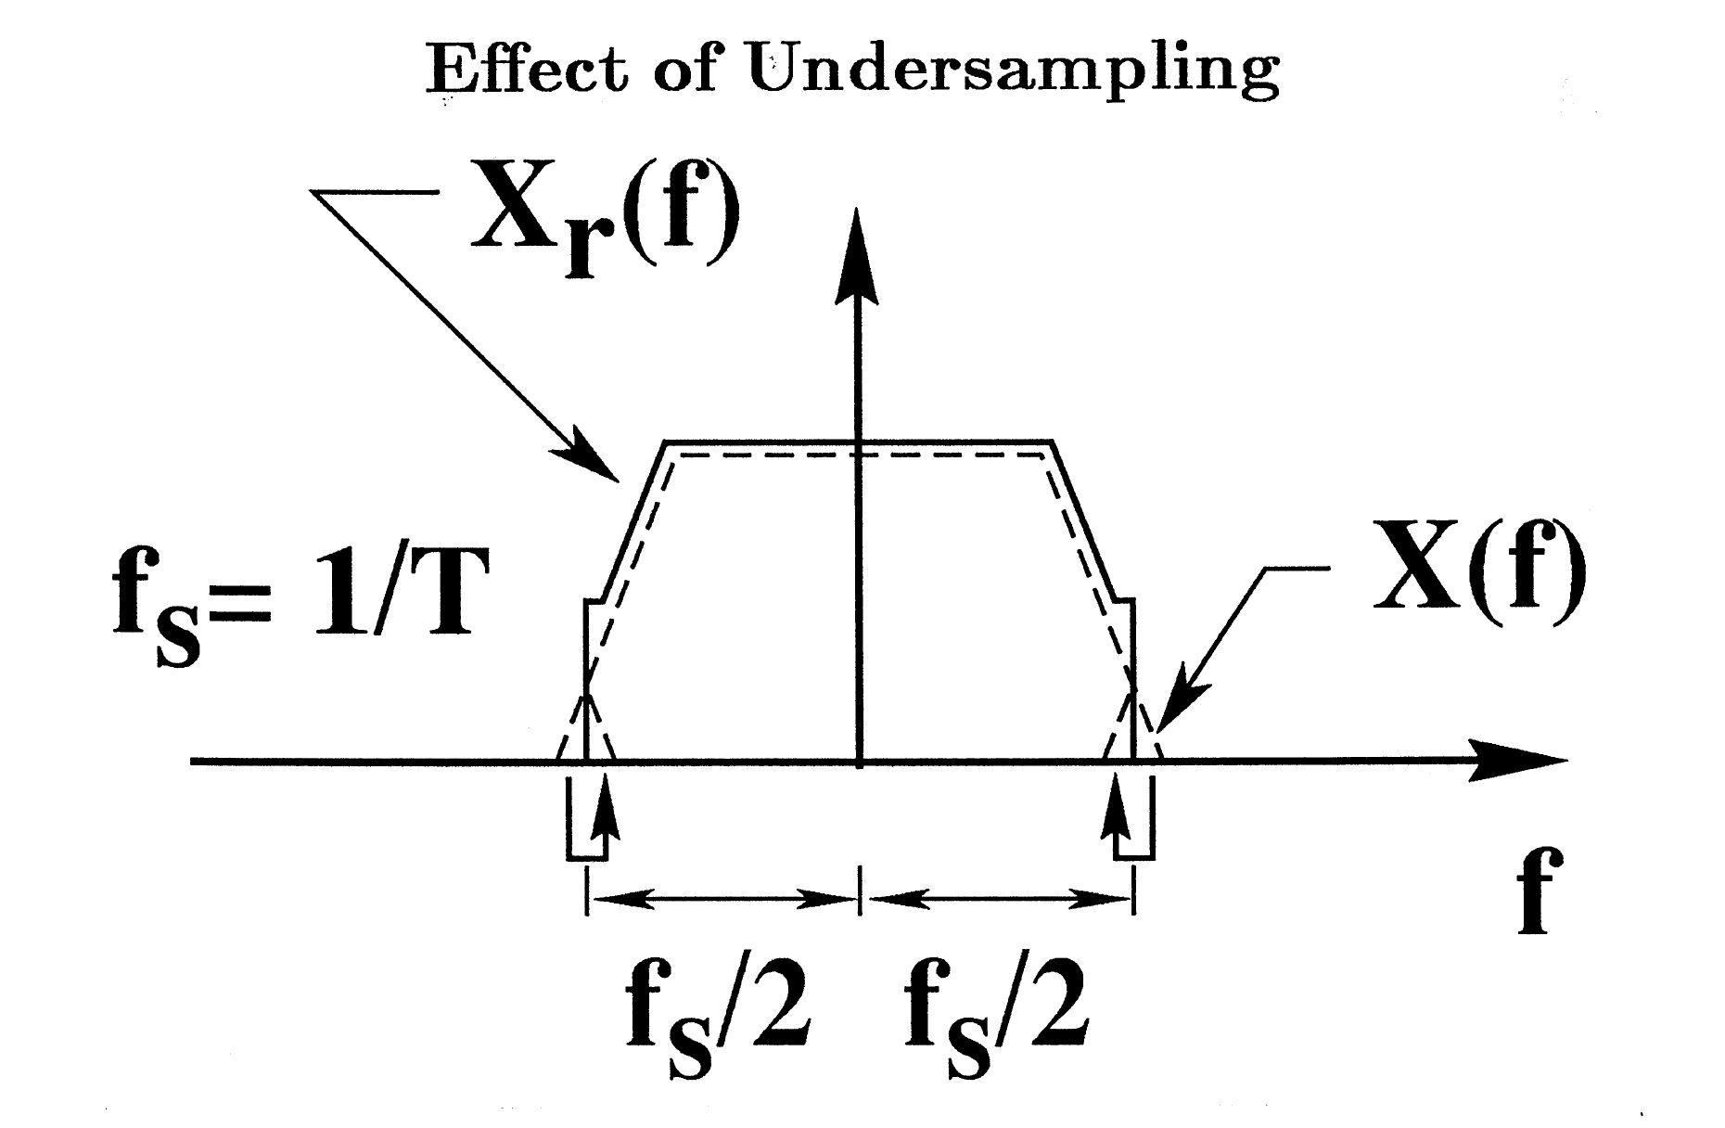
Effect of Undersampling (1-D Analysis) in Frequency Domain (Detail view)
Frequency truncation
Aliasing

Slide 19
Aliasing Artifacts
Due to presence of replications for which
in spectrum of displayed or printed (written) image
Results in spurious low frequency patterns in displayed or printed image:
Moiré Patterns
Jagged rendition of straight edges

Slide 20
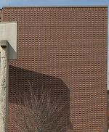
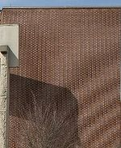
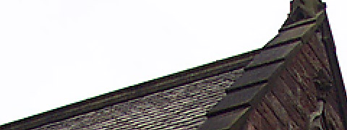
Aliasing Artifacts in Image (2 Examples)
1) Moiré pattern
Original image Moiré pattern formed by down-sampling
2) Jaggies (staircase effect)

Slide 21
Example illustrating Moiré formation during sampling of a sine wave grating
Spatial domain
Frequency domain

Slide 22
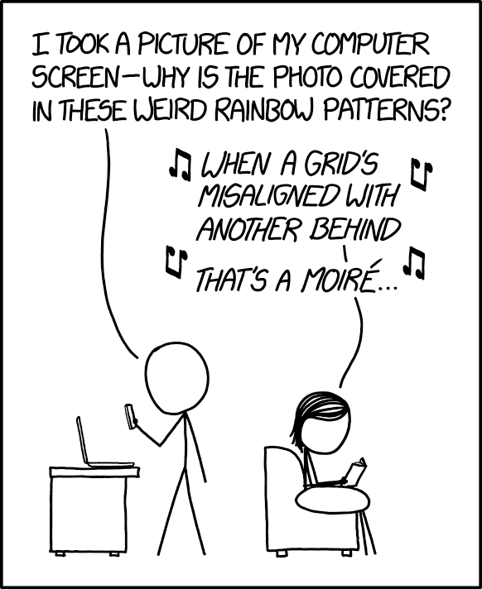
More about Moiré

Slide 23
https://youtube/OnFlx2Lnr9Q

Slide 24
Web comic and song lead provided by Mai Seto

