Slide 1
EE 638: Principles of Digital Color Imaging Systems
Lecture 21: Sampling and Scanning
Notes partially prepared by Sirui Hu

Slide 2
Synopsis
Scanning Technologies
Development of a general model
Analysis sampling
Sampling on arbitrary lattices
Analysis of scanning
Terminology:
Sampling -- mapping from continuous-parameter
to discrete-parameter
Scanning – mapping from 2-D or 3-D to 1-D

Slide 3
1. Scanning Technologies
1) Flying Spot
Mechanisms:
Electron beam Analog TV camera
Electromechanical Drum scanner
Diffractive Supermarket scanner
Phased array Radar
Aperture effects: illuminating spot
read spot
dwell time

Slide 4
2) Focal Plane Arrays
Mechanisms:
1D array with electromechanical scan (desktop scanners are an example)
2D staring mosaic (digital cameras are an example)
CCD, CID and CMOS
Aperture effects:
size of photosensitive cells
dwell time

Slide 5
2. Line-Continuous Flying Spot Process
Line-continuous Flying Spot Process
Combine illuminating and read spot profiles as one function (the aperture):
- Illuminating spot profile
Show diagram to illustrate this.
- Read spot profile
- Scan trajectory
- Continuous-space still image
- Scan signal

Slide 6
1) Integration over Aperture
define
then

Slide 7
2) Sampling
define
then let
This signal embodies all the effects due to the fact that we only see along the locus of points
With regard to these sampling effects, it is unimportant how we map the signal information into a 1-D function of time.

Slide 8
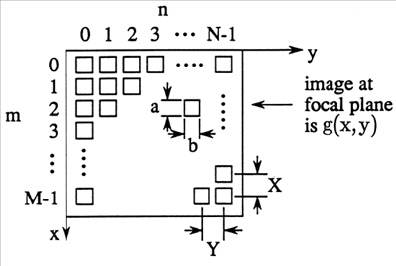
3. Focal Plane Array Scan Process
How can we represent this process using our tools for 2D linear systems and signal analysis?
Note difference between this scenario and that analyzed previously where we looked at the image through an aperture grille
Integral within the window

Slide 9
1) Integration over Aperture
let
define
then
Blurred image
Samples of blurred image

Slide 10
2) Sampling
define
then let
Again, this signal embodies all the effects due to the fact that we observe only at locations

Slide 11
4. General Model for Scanning & Sampling
1) Aperture effects
Aperture acts as a filter
As spreads out, contracts resulting in attenuation of the higher frequency components of the image .

Slide 12
2) Sampling effects
Since generally contains periodic structures,
will consist of an array of impulses.
Convolution of with will result in replications of located at the coordinates of each impulse in .

Slide 13
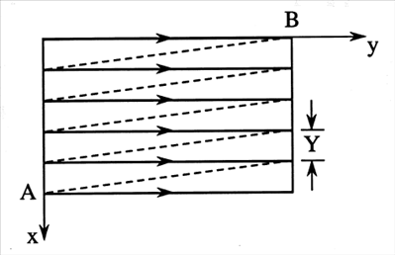
5. Analysis of Sampling
Note the “Matlabian” orientation of the axes.
1) Line-continuous scanning

Slide 14
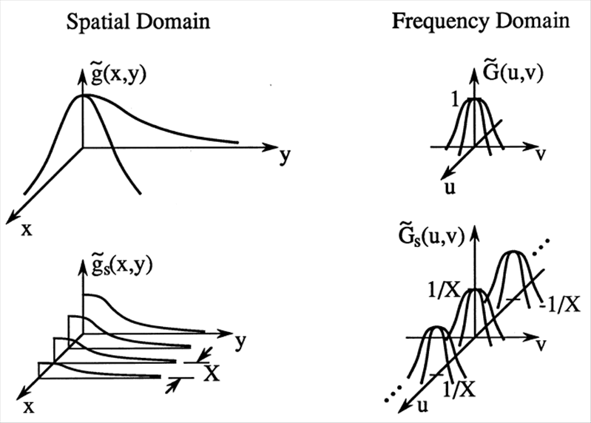
Note: the tildes “~” below denote the fact that the image has already been blurred by convolution with the doubly reflected aperture function.

Slide 15
Nyquist condition for line-continuous scanning
The aperture smoothed image may be uniquely reconstructed from its line-continuous scanned version
provided
Note that this condition is sufficient but not necessary for perfect reconstruction.

Slide 16
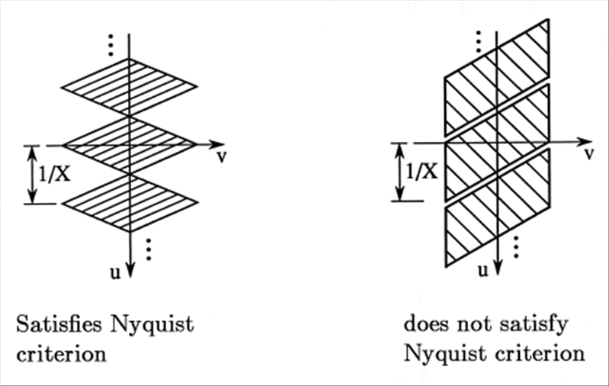
Perfect reconstruction is possible in both cases shown below.

Slide 17
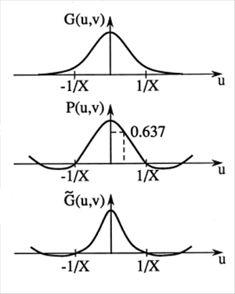
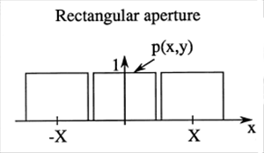
Pre-scan Band-limiting Effect of Aperture

Slide 18
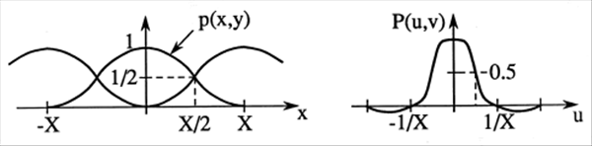
Raised cosine aperture
Analyzing the frequency domain effect of the raised cosine aperture would be a good homework problem. Look for it on HW No. 4

Slide 19
2) Sampling Effects with Focal Plane Array

Slide 20
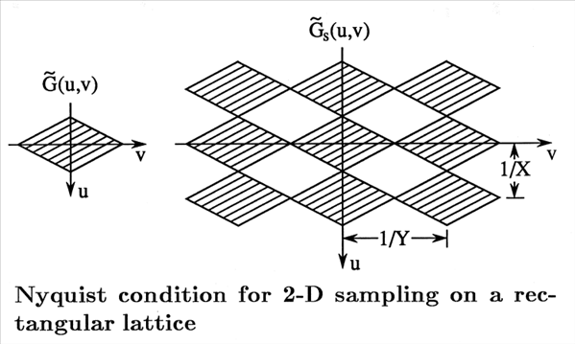
The aperture smoothed image may be uniquely reconstructed from its sampled version provided
Again, condition is sufficient but not necessary.

Slide 21
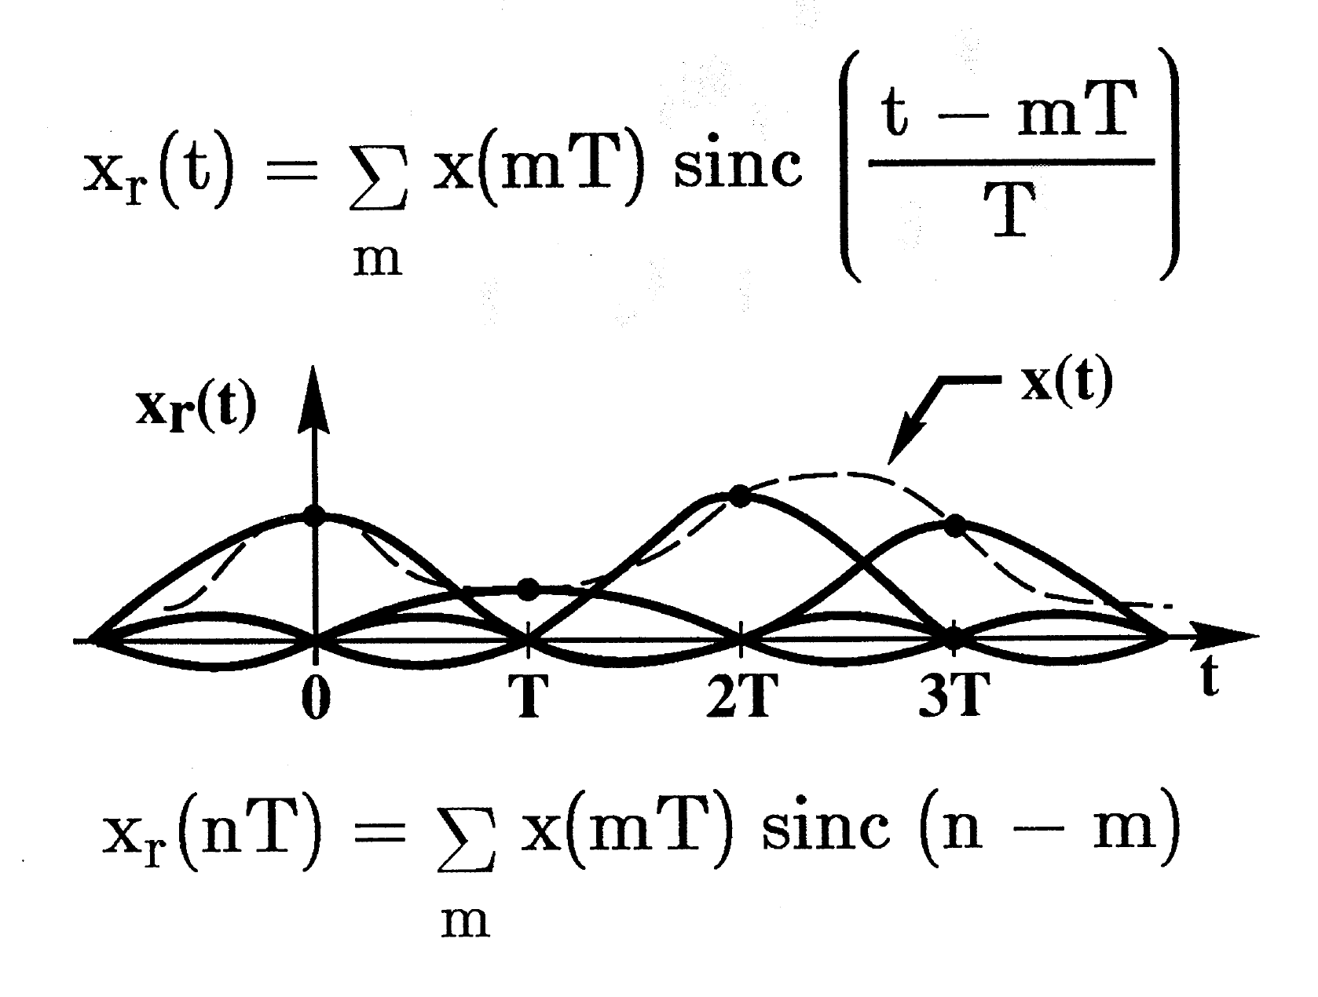
1-D illustration of reconstruction with sinc function interpolation

Slide 22
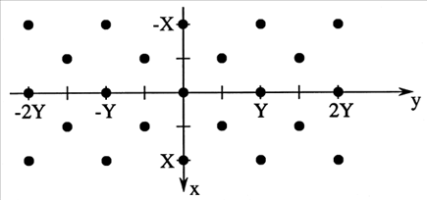
6. Sampling on non-rectangular lattices
Consider lattice structure of following form:
Represent as two interlaced rectangular lattices

Slide 23
(see note below.)
Note that
Reciprocal lattice has same structure as spatial lattice.
Note: During the remainder of this lecture, we neglect aperture smoothing effect; so we replace by

Slide 24
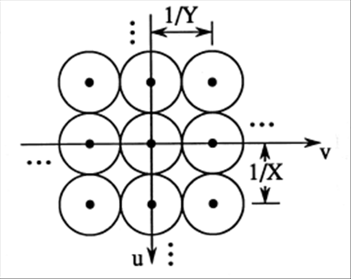
Sampling of Circularly Band-limited Signals
Rectangular Lattice
Sampling density:
samples/unit area

Slide 25
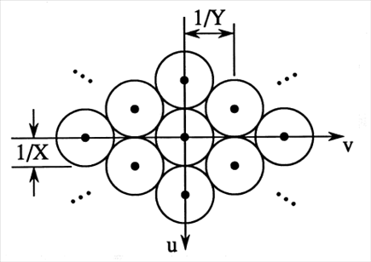
Non-rectangular (hexagonal) lattice
Sampling density:
Savings:
samples/unit area

Slide 26



Slide 27
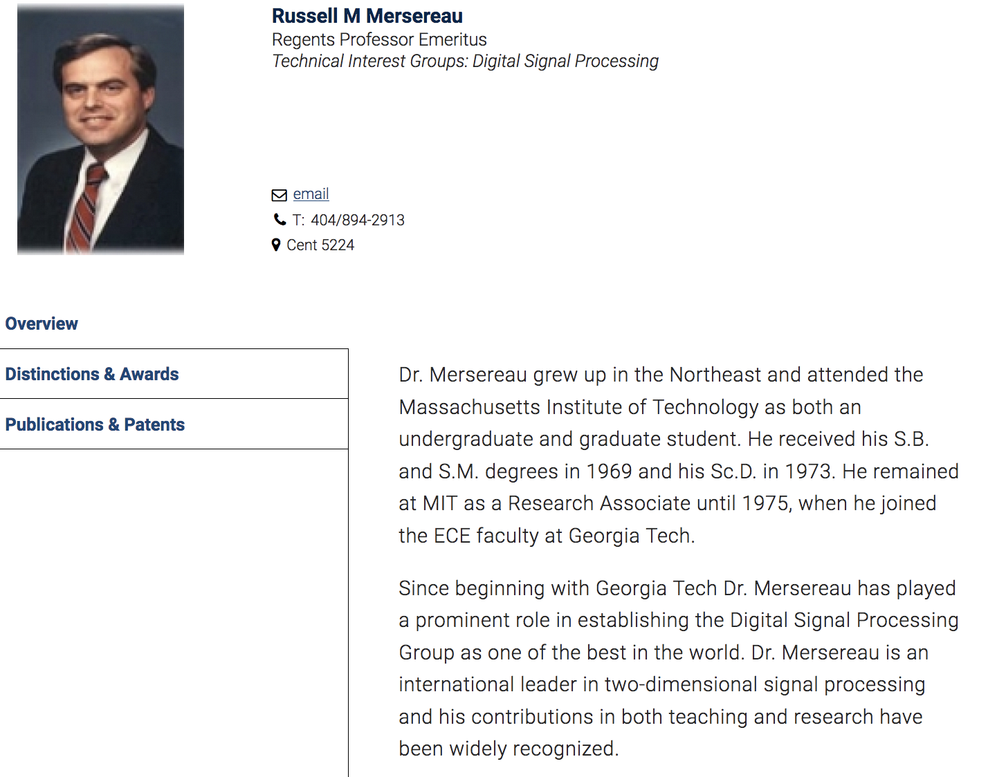

Slide 28
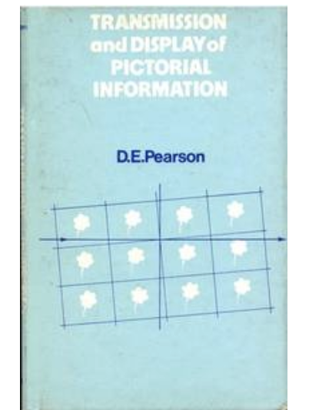
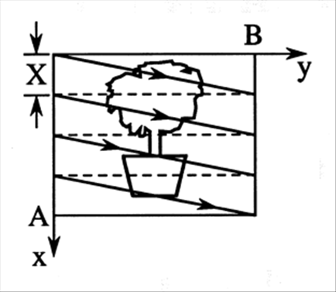
7. Analysis of Line-continuous Scanning
Line-Continuous Scanning:
Consider lexicographic scanning of a still image
This material is from D. E. Pearson’s textbook

Slide 29
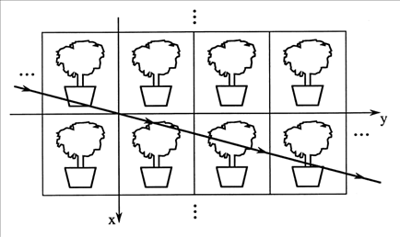
Assume: scan lines have slope
line retrace is horizontal
an integer (number of scan lines)
During scanning of a single frame, scan line passes back and forth across field of view (FOV).
Achieve same effect by replicating he FOV and scanning along a straight line.

Slide 30
Replicated image
Equation of scan line
Sampled image
Projection of sampled image onto x-axis
Conversion to function of time
V= velocity of scan beam along x axis

Slide 31
Fourier Analysis of Line-Continuous Scanning

Slide 33
constant

Slide 35
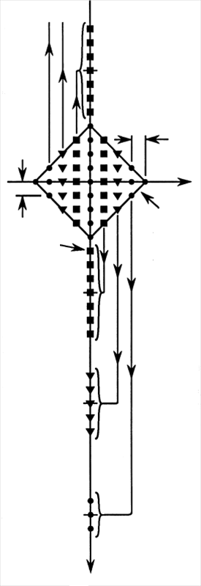
Interpretation
Spectral groups will not overlap
provided
This is the Nyquist condition that was
derived earlier.

Slide 36
Spectrum of Scanned Signal
Recall identity
Recall:

Slide 37
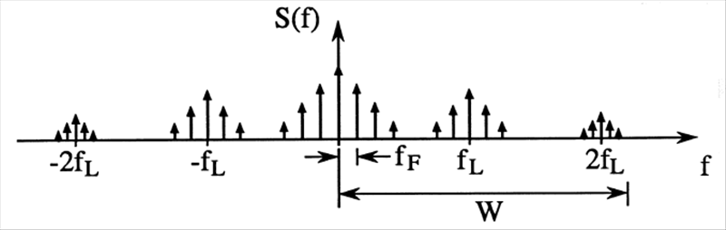
Frame period
Line period
Example (NTSC Video)
Maximum spatial frequency along y axis
Assume equal resolution along y axis, which implies M samples per B units of width. Thus the maximum spatial frequency in the horizontal direction would be M/(2B) cycles per unit distance. Thus, G(u,v) = 0 for |v| > M/(2B). This means that we have M/2 groups along the f axis in the spectrum for S(f). Since the groups are spaced f_{L} apart, we get W = Mf_{L}/2.

Slide 38
Spectral Mappings
High horizontal spatial frequencies (large values of u) in are mapped to edge of each spectral group.
High vertical spatial frequencies (large values of v) in are mapped to the higher index spectral groups.

