Slide 1
EE 638: Principles of Digital Color Imaging Systems
Lecture 20: 2-D Linear Systems
and Spectral Analysis
Presentation partially prepared by Sirui Hu

Slide 2
Synopsis
Special 2-D Signals
2-D Continuous-space Fourier Transform (CSFT)
Linear, Shift-invariant Imaging Systems
Periodic Structures
Resources:
My ECE 438 course materials (https://engineering.purdue.edu/~ece438/ – see lecture notes, both legacy and published versions)
Prof. Bouman’s ECE 637 course materials

Slide 3
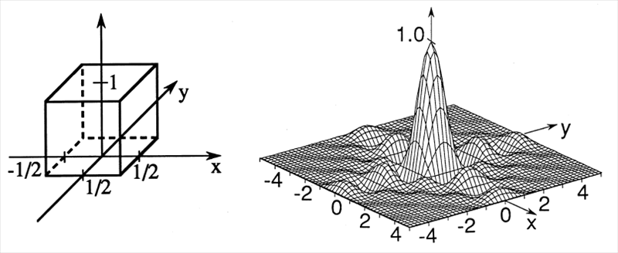
Special 2-D Signals

Slide 4
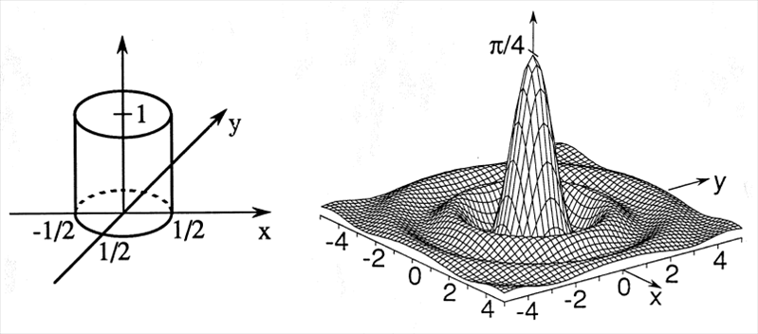
(Bessel function of 1st kind order 1)

Slide 5
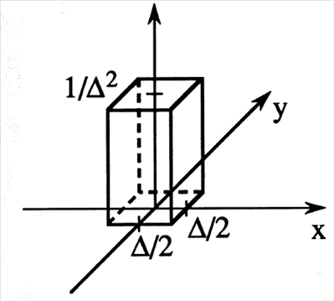
2-D Impulse Function

Slide 6
Sifting Property

Slide 7
Spatial Frequency Components

Slide 8
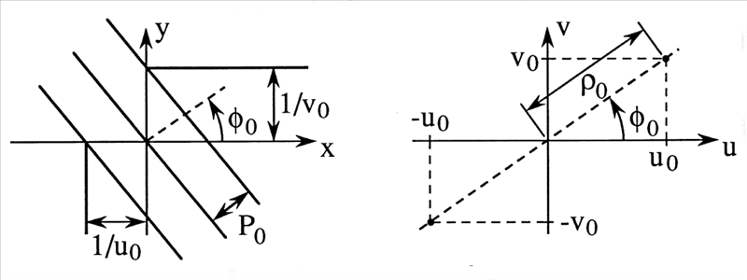
Spatial Domain
Frequency Domain

Slide 9
2-D CSFT
Forward Transform:
Inverse Transform:

Slide 10
Hermitian Symmetry for Real Signals
Let
If f(x,y) is real,
In this case, the inverse transform may be written as

Slide 11
2-D Transform Relations
1. linearity
2. Scaling and shifting
3. Modulation
4. Reciprocity
5. Parseval’s Relation

Slide 12
6. Initial value
7. Let
then
(Separability)

Slide 13
Separability
A function is separable if it factors as:
Some important separable functions:

Slide 14
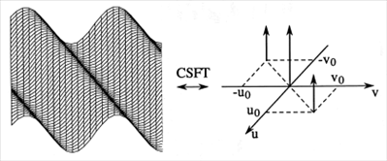
Important Transform Pairs
1.
2.
3.
4.
5.
6.
(by sifting property)
(by reciprocity)
(by modulation property)

Slide 15
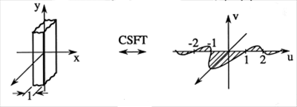
7.
8.
Impulse sheets

Slide 16
Linear, Shift-invariant(LSIV) Imaging System

Slide 17
Imaging an Extended Object
Imaging
System
Imaging
System
(by homogeneity)

Slide 18
By superposition,
This type of analysis extends to a very large class of imaging systems.
diffraction
limited image
Image predicted by
geometrical optics
2-D convolution
integral

Slide 19
CSFT and LSIV Imaging Systems Convolution Theorem
As in the 1-D case, we have the following identity for any functions and ,
Consider the image of a complex exponential object:
Imaging
System
is an eigenfunction of the system

Slide 20
Now consider again the extended object:
By linearity:
Imaging
System

Slide 21
Convolution & Product Theorem
Since and are arbitrary signals, we have the following Fourier transform relation
or
By reciprocity, we also have the following result
Convolution Theorem
ProductTheorem

Slide 22
Impulse Function
Impulse function is separable:
Shifting property for impulses

Slide 23
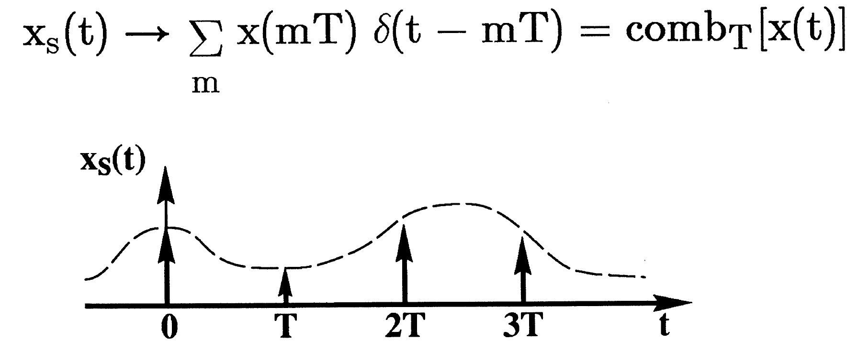
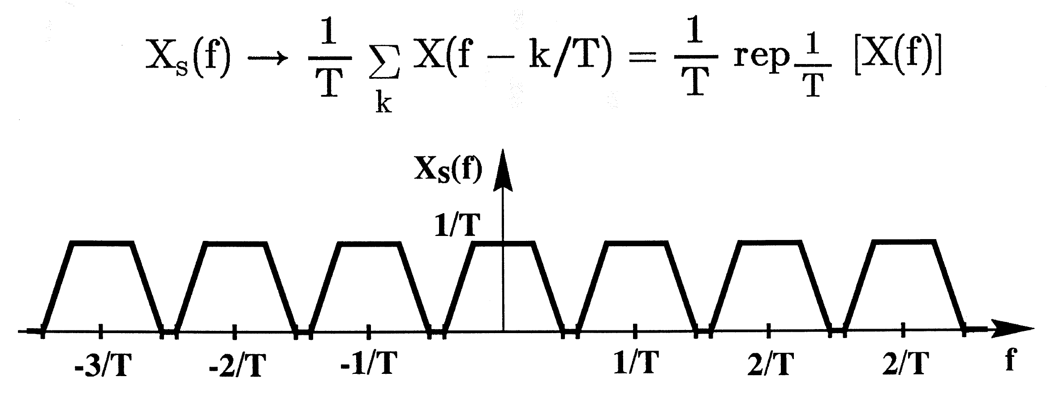
Comb and Rep Functions
This is a definition

Slide 24
Comb and Replication Operators
1-D: ,
2-D:
Transform relation

Slide 25
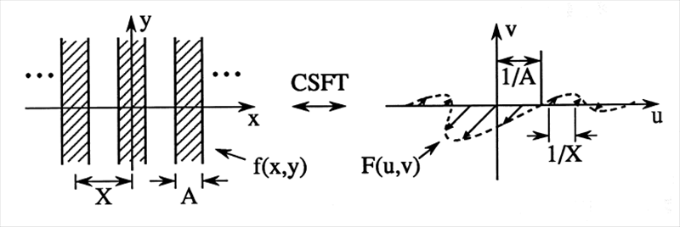
Periodic Structures – Example 1
Notes:
Zero crossing point at 1/A
Impulse sheet like function

Slide 26
Periodic Structures – Example 2
Note:

Slide 27
Periodic Structures – Example 3

Slide 28
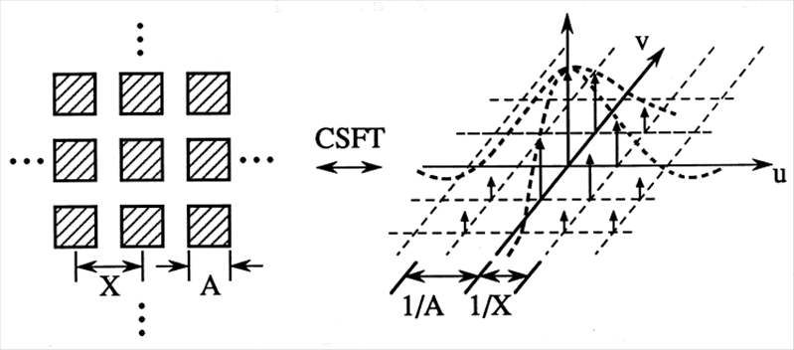
Periodic Structures – Example 4

Slide 29
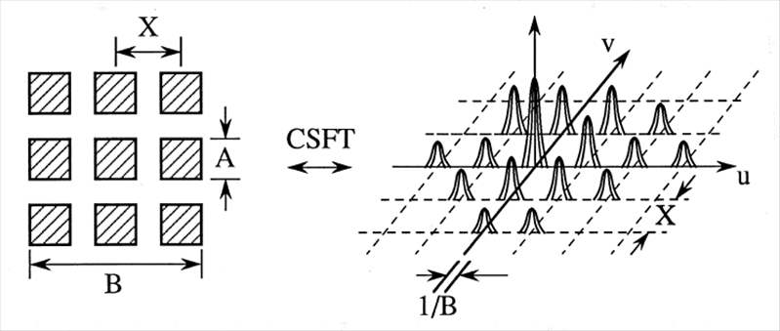
Periodic Structures – Example 5
By the product theorem

Slide 30
Example: Digital Camera
Input image:
Output image
(looking at through
a mesh ):
Each aperture is A x A in size and they are located on a grid with spacing X x X
Sensing area
arbitrary

Slide 31
How to reconstruct the image?
constant
Notes:
Interchange summation and convolution → convolution with impulse → shifting I to (k/X, l/X)

Slide 32
Use low-pass filter with cut-off frequency of
Note that for
in frequency domain
Low-pass Filter
CSFT
Inv-CSFT
Reconstructed
Image

