Slide 1
ECE 638: Principles of Digital Color Imaging Systems Lecture 14: L*a*b* Plots for Scitex Solid Colors
Prepared by Wanling Jiang
05/25/2017

Slide 2
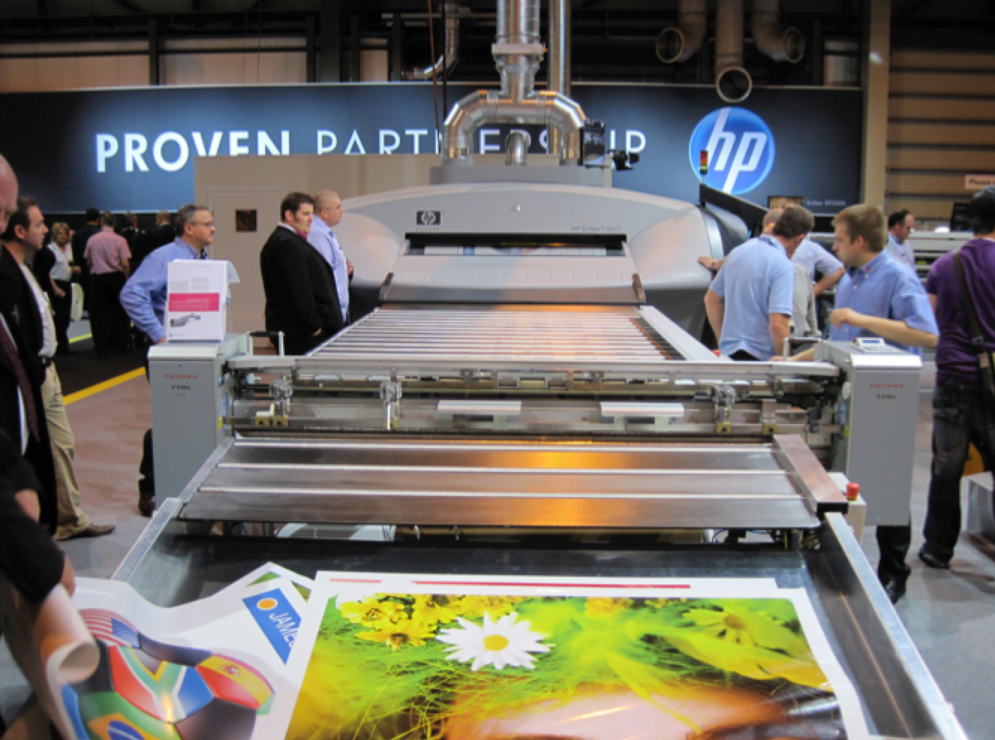
Typical HP Scitex Product

Slide 3
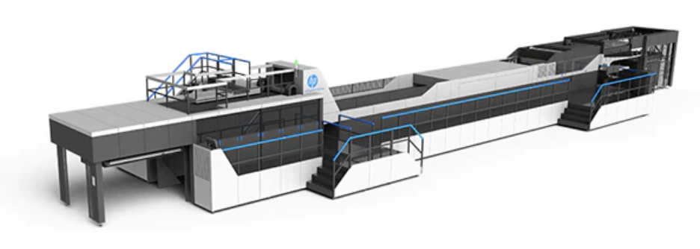
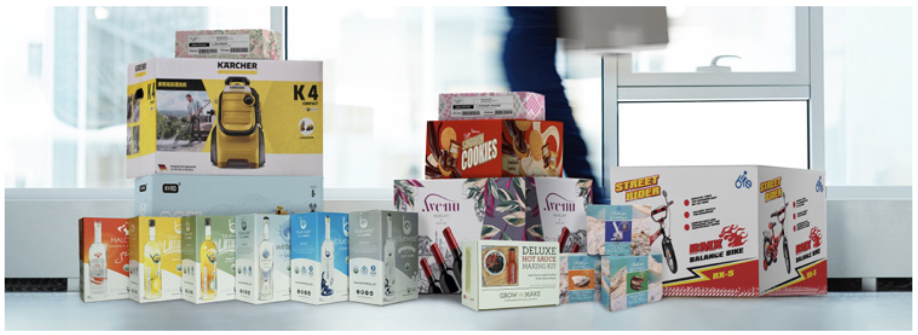
HP C500 Digital Press – A Current Scitex Product
Offset quality on corrugated cardboard
Speed: 75 linear meters/minute

Slide 4
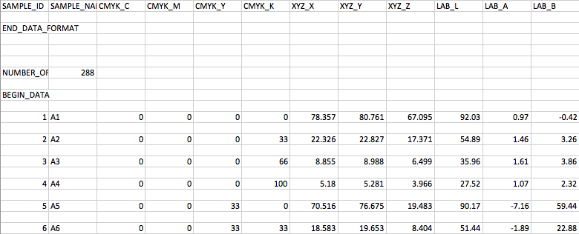
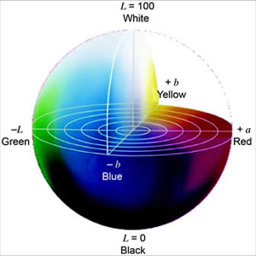
Visualization (Sample color in sRGB)
L*a*b* color space
(We observe the color space in L*a*b*)
Directly use this
L*a*b* Coordinates:
X
Y
Z
Transform from XYZ to sRGB to show the color of sampled points:
Note that these are linear RGB values. They must be gamma corrected before they can be displayed.
RGB values outside range are clipped.

Slide 5
Observing the data samples
Only Mondi_1_M0 sample points are plotted.
Case No. 9 -- C= 0%, M = 66%, Y = 0%,
Case No. 10 -- C= 33%, M = 66%, Y = 0%,
Case No. 11 -- C= 66%, M = 66%, Y = 0%,
Case No. 12 -- C= 100%, M = 66%, Y = 0%,
Case No. 13 -- C= 0%, M = 100%, Y = 0%,
Case No. 14 -- C= 33%, M = 100%, Y = 0%,
Case No. 15 -- C= 66%, M = 100%, Y = 0%,
Case No. 16 -- C= 100%, M = 100%, Y = 0%,
Case No. 1 -- C= 0%, M = 0%, Y = 0%,
Case No. 2 -- C= 33%, M = 0%, Y = 0%,
Case No. 3 -- C= 66%, M = 0%, Y = 0%,
Case No. 4 -- C= 100%, M = 0%, Y = 0%,
Case No. 5 -- C= 0%, M = 33%, Y = 0%,
Case No. 6 -- C= 33%, M = 33%, Y = 0%,
Case No. 7 -- C= 66%, M = 33%, Y = 0%,
Case No. 8 -- C= 100%, M = 33%, Y = 0%,
Now, EACH of these 16 cases, can be expanding to a line consisting of 4 points, by plotting the results for the fixed CMY values, when we use 0%, 33%, 66%, and 100% K.
Note that units for amount of colorant are percent of full colorant, which may be translated to number of drops as follows: 0 drops = 0%, 1 drop = 33% 2 drops = 66%, and 3 drops = 100%

Slide 6
Observing the data samples
We group the cases together and plot them in the same graph.
Set 1. cases: 1,5,9,13, C=Y=0, M,K varies
Set 2. cases: 1,5,6,7,8, Y=0, M=33, C,K varies
Set 3. cases: 1,9,10,11,12, Y=0, M=66, C,K varies
Set 4. cases: 1,13,14,15, Y=0, M=100, C,K varies
Note that Case No. 1 is included in every plot.

Slide 7
Set 1. cases: 1,5,9,13, C=Y=0, M,K varies (L* vs. a*)
Each curve is fixed M
Note that color of each dot is a rendering of what that colorant combination would look like according to the equations for conversion to RGB at the bottom of Slide 3.
No M
No colorant; so color is that of media
1 drop of M
One drop of K
2 drop of M
Two drops of K
3 drop of M
Go out of presentation mode, and zoom in to more clearly see the color of each dot.

Slide 8
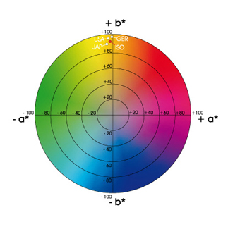
Set 1. cases: 1,5,9,13, C=Y=0, M,K varies (a* vs. b*)
3 drop of M
2 drop of M
Two drops of M
1 drop of M
Color of media
Use case 5
(1 drop of M)
No M

Slide 9
Set 1. cases: 1,5,9,13, C=Y=0, M,K varies (L* vs. b*)
No M
1 drop of M
2 drop of M
3 drop of M

Slide 10
Set 2. cases: 1,5,6,7,8, Y=0, M=33, C,K varies (L* vs. a*)
No C
No C
1 drop of C
2 drops of C
3 drops of C

Slide 11
Set 2. cases: 1,5,6,7,8, Y=0, M=33, C,K varies(a* vs. b*)
No C
1 drop of C
2 drops of C
No C
3 drops of C

Slide 12
Set 2. cases: 1,5,6,7,8, Y=0, M=33, C,K varies(L* vs. b*)
No C
No C
1 drop of C
2 drops of C
3 drops of C

Slide 13
Set 3. cases: 1,9,10,11,12, Y=0, M=66, C,K varies (L* vs. a*)
No C
No C
1 drop of C
2 drops of C
3 drops of C

Slide 14
Set 3. cases: 1,9,10,11,12, Y=0, M=66, C,K varies (a* vs. b*)
No C
1 drop of C
2 drops of C
3 drops of C
No C

Slide 15
Set 3. cases: 1,9,10,11,12, Y=0, M=66, C,K varies (L* vs. b*)
No C
No C
1 drop of C
2 drops of C
3 drops of C

Slide 16
Set 4. cases: 1,13,14,15, Y=0, M=100, C,K varies (L* vs. a*)
No C
No C
1 drop of C
2 drops of C

Slide 17
Set 4. cases: 1,13,14,15, Y=0, M=100, C,K varies (a* vs. b*)
No C
1 drop of C
2 drops of C
No C

Slide 18
Set 4. cases: 1,13,14,15, Y=0, M=100, C,K varies (L* vs. b*)
No C
No C
1 drop of C
2 drops of C

