Slide 1
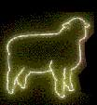
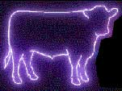

Understanding Animal and Livestock Production
Notes:
You are here today because you have or are contemplating having domestic livestock on your property. We will cover topics that will help us understand the reasons people own animals, including the land, work and money that is required to maintain them. Questions we will address include:
What legal considerations should we know about before keeping animals?
Why have animals in the first place?
What inputs of resources (both time and money) will be needed?
What are the needs of different types of animals?
What is your land’s capability to support and/or maintain them?

Slide 2
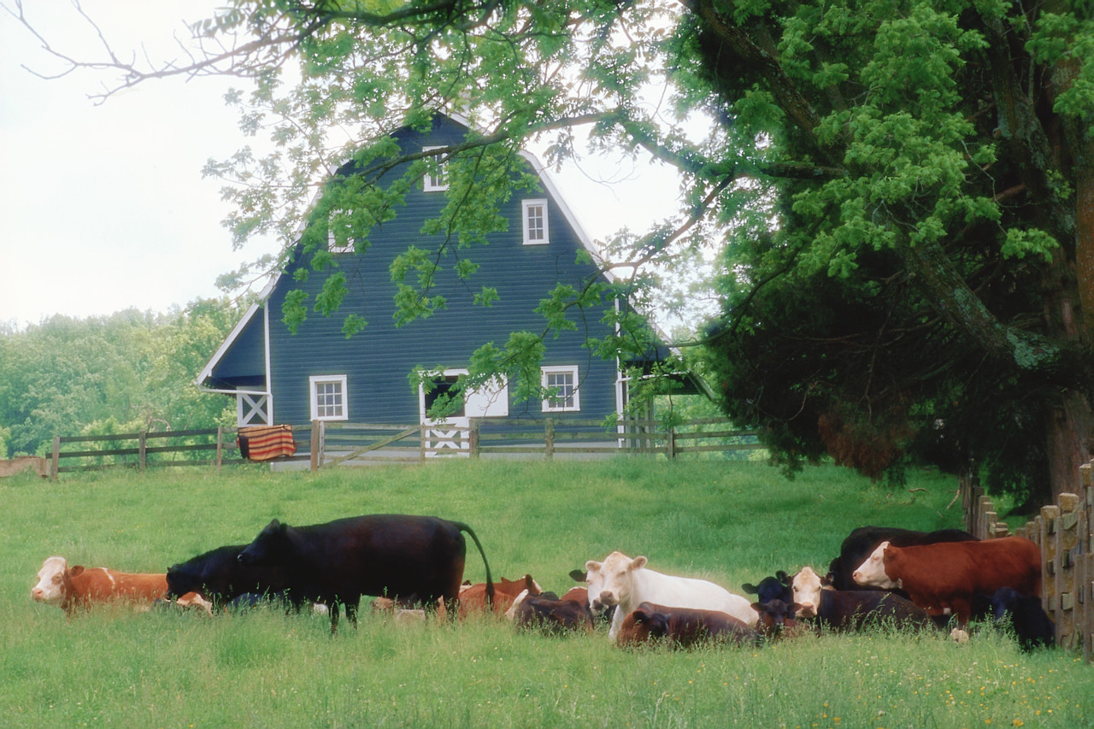
Matching Your Farm with the Animal
Notes:
When going into livestock production the important question is how we are best going to utilize our resources for this enterprise. Does our farm land lend itself to forage production and those animal that utilize these forages. Do we have small acreage in which we will need to purchase feeds. In general grains can be stored more easily than forages. Do we have or our we willing to build forage storage facilities. Grains can be purchase more easily and uniformly at local elevators. Forages must be bought from individuals and they are more variable in their nutrient content.
Do I have the facilities to handle this enterprise?

Slide 3
Zoning
Imposed by local government
Agricultural, urban, rural, commercial
Each zone has regulations on animals
Some may require a permit
Notes:
One of the most important regulatory mechanisms is zoning. Zoning is a classification system imposed on all lands by government. Lands may be zoned agricultural, urban, rural, commercial or many others. Each zone has regulations concerning keeping animals and specifies whether a special permit is required to do so. Many zones may not allow domestic livestock.

Slide 4
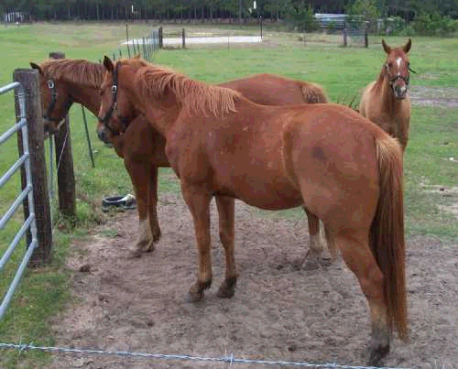
Why have animals?
www.farmphoto.com
Notes:
Animals offer many rewards, but can be time-consuming and expensive. Why do you think you want to own livestock?
Take a few minutes to discuss the Pros And Cons Of Animal Ownership. If you currently own livestock, write down the pros and cons as you experience them. If you are just thinking about owning livestock, write down the pros and cons that you imagine would apply to you once you acquire those animals. When we’re done, we’ll go around the room and ask you to share your pros and cons with the group.
Instructor: Give attendees a few minutes to capture their ideas.
Now that you’ve finished your lists, let’s go around the room and have each person tell the group one of your reasons. Let’s start with the pros and then list our cons.

Slide 5
Animal ownership Pros Cons
Relaxing | Time-consuming
Close to nature | Hard to get away
Teaches children skills | Costly
Fun family activity | Middle of night work
Supplemental income | May be dangerous
Notes:
Below are some examples of pros and cons of animal ownership.
Pros:
Being with animals can be relaxing
Provides closeness to other creatures
Strengthens families, since children and adults can participate together
Teaches children many skills, including:
Responsibility
Self-confidence and personal discipline
How to budget time and resources
Coordination, strength and agility
Can provide supplemental income
Cons:
Can be very time-consuming
Can be difficult to go on vacation
Is costly
May contend with bad weather
May require care in middle of night
May be dangerous
Presents liability issues
Instructor: Write participants’ reasons in two columns (pros and cons.) Once the list is complete, review it with the group and summarize it briefly. If any important reasons are missing, add them to the list.

Slide 6
Balancing pros and cons
Notes:
Instructor: Often, the list of negatives is longer than that of benefits, leading participants to wonder if animal ownership makes sense for them.

Slide 7
Nutrient Needs
Fiber (Forages)
Protein
Energy- can come from Fiber, Grains and Protein
Vitamin
Mineral
Water
Notes:
The selection of the enterprise should relate to the feed that these animals need.
Swine and Poultry have diets that are high in energy(mostly coming from grains), low in fiber and high or very high in protein.
Horses and Rabbits utilize a high fiber low energy and low protein diets for their unique digestive systems.

Slide 8
Digestive tract capacities
Animal | Gallons
Cattle | 94
Sheep or goat | 12
Horse | 56
Pig | 7.2
Humans | 1.6
Notes:
This table shows the differences in digestive-tract capacities of a number of common farm animals and humans. Animals with rumens have much larger digestive tract capacities than animals without rumens.
Data from Feeds & Nutrition Digest, 1990, Enminger, Oldfield, Heinemann.

Slide 9
Digestive Systems
Cattle, Sheep and Goats—Ruminants
Prefer high forage diets of grass or legumes
Goats are browsers and not good grass eaters
Cattle and Sheep will eat grass and legumes
All diet changes must be gradual.
Notes:
A lot depends on the type of digestive system these animal have.
Cattle, sheep and goats are know as ruminants. They have a stomach that is designed to be efficient converters of forages. Therefore they will have diets high in fiber, Lower in protein and depending on what stage they are in life generally lower in grains. Farms that are more rolling are suited for this type of production. These farms will be found in areas with similar farms and people with experience in this area.

Slide 10
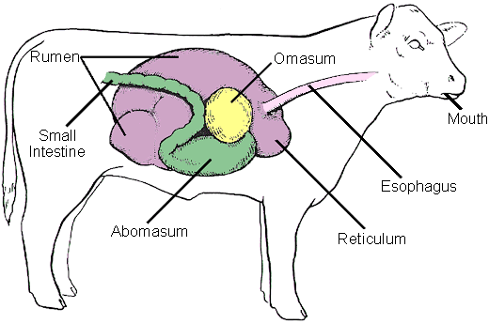
Notes:
This is the digestive tract of cattle, goats and sheep. They are animals made to eat high fiber diets and have the large rumen to help them do just that.

Slide 11
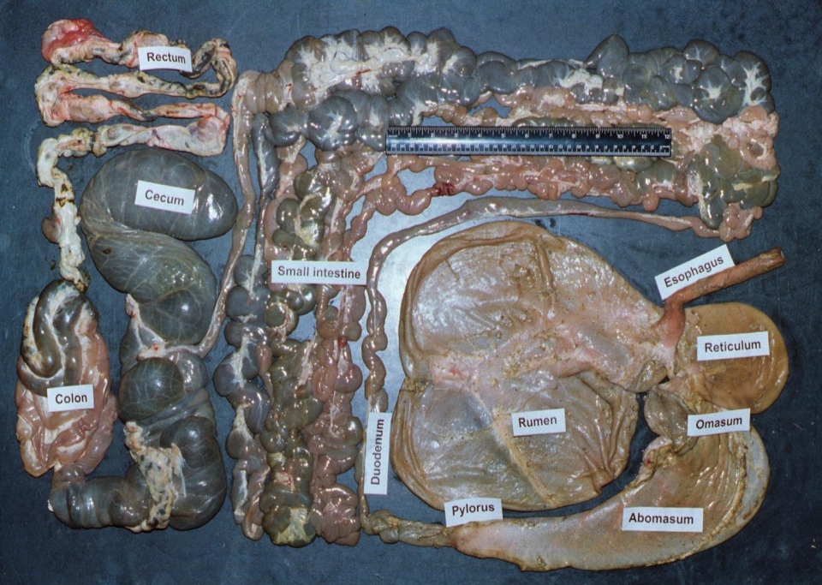

Slide 12
Feed Needs- Beef Cattle
A Beef cow will consume about 5 ton of forages per year. Over one half a square bale per day.
This cow would be expected to produce a 550 pound weaned calf.
550 – 1300 market animal would consume around 4500 pounds of feed. (most of it generally as grain)
Notes:
Total consumption is around 2%of body weight

Slide 13
Beef cattle
Water | 1.5 gallons per each 100 pounds of body weight
Protein | 8 to 16% of their diet
Energy | 22 to 28 pounds of dry matter per day (or equivalent fresh material) with a fiber level of 30 to 70%
Vitamins | Generally must supplement A and E
Minerals | Ca to P ratios of 1.5:1 to 2:1; salt with trace minerals
Fats | Less than 5%; fats interfere with rumen function
Notes:
Younger animals would need higher protein diets. Adults would need the lower energy, lower protein diet.

Slide 14
Grass Fed Beef
Lower in fat
Higher in conjugated linoleic acid
Environmentally friendly?
E-coli?
Notes:
Some claims are that because they are raised on pastures this means the land is taken out of row crops so there is less erosion.
Because they are not on a grain based died and therefore the rumen ph is not as low they theoretically would have less chance of spreading e-coli.
Grass-fed beef is normally leaner, both externally and within the muscle (marbling) and has less saturated fat and cholesterol, resulting in a more heart-healthy product than commodity grain-fed beef

Slide 15
Feed Needs--- Goats
A 150 pound Dairy goat will consume around 3200 pounds of feed per year. Most as forages.
Meat goats will consume less
Notes:
Dairy goats are good eaters and can consume from 4 to 7% dry matter (DM) per 100 lbs body weight as compared to 3-4% DM consumption for dairy cows. This high level of intake allows the dairy goat to have an abundance of nutrients readily available for the synthesis of milk. Overall, the efficiency of milk production by the dairy goat is quite similar to that of the dairy cow.

Slide 16
Meat goats
Water | 1 to 1.5 gallons per day average, double for lactating females
Protein | 10 to 14% of their diet
Energy | 2 to 4% of body weight. Need a minimum of 0.5 to 1.0 pound of roughage per day to keep rumen functioning. Can add grain as supplement.
Vitamins | May need to supplement A and E
Minerals | Ca to P ratios of 2:1; copper, zinc, and selenium are likely to be low
Fats | Less than 5%; fats interfere with rumen function
Notes:
Water: Water needs are dependent on the weather. Ideally, water temperatures should be between 45 to 55 degrees F. Water needs will more than double in weather hotter than 70 degrees F. Cold water requires additional energy to maintain body temperature. Locating water in the shade in summer and using water heaters in the winter will help keep water consumption at optimum levels.
Protein: Like all ruminants, the quantity of protein is more important than the quality. The rumen will break down protein and synthesize the amino acids needed for growth, milk, maintenance, etc. In young animals, when the rumen in not yet functioning to full potential, quality protein must be provided.
Energy: To keep the rumen functioning, all ruminants should receive a minimum amount of roughage in their diet. For goats, this minimum is 0.5 to 1.0 pounds of roughage per day. They should receive 2 to 4 percent of their body weight in energy or carbohydrates.
Vitamins: Goats are ruminants and can synthesize vitamin C and all the B vitamins they need. Vitamin D is generally produced if the animals have access to sunlight. Vitamins A and E are present in fresh, leafy green forages. If the animals are fed a diet of stored forages, they should receive supplements containing vitamins A and E.
Minerals: Too much phosphorus can cause urinary stones in males. Too little or too much calcium can cause milk fever. General requirements for calcium are 0.4 to 0.6 percent of body weight, and phosphorus requirements are half that amount. Ideal Ca:P ratio is 2:1. Goats can maintain health at ratios up to 7:1 as long a P levels are adequate. Goats are susceptible to copper deficiency and, unlike sheep, are resistant to copper toxicity. Use a trace mineral supplement block formulated for cattle or goats rather than sheep to ensure adequate copper levels.

Slide 17
Sheep
Prefer grass pastures with some forages mixed in.
Lambs are usually finished on mostly grain diets
Look out for a condition called Urinary calculi
Notes:
Urinary calculi, or water belly, a common disease of
male sheep, is caused by the formation of small
stones, called calculi, in the urinary tract that cause
retention of urine and rupture of the urinary bladder or
urethra.

Slide 18
Sheep
Water | 1 to 1.5 gallons per day average, double for lactating females
Protein | 10 to 14% of their diet
Energy | 2 to 4% of body weight. Need a minimum of 0.5 to 1.0 pound of roughage per day to keep rumen functioning. Can add grain as supplement.
Vitamins | May need to supplement A and E
Minerals | Ca to P ratios of 2:1; zinc and selenium are likely to be low. Copper levels must be monitored as sheep are susceptible to copper toxicity.
Fats | Less than 5%; fats interfere with rumen function
Notes:
Water: Water needs are dependent on the weather. Ideally, water temperatures should be between 45 and 55 degrees F. Water needs will more than double in weather hotter than 70 degrees F. Cold water requires additional energy to maintain body temperature. Locating water in the shade in summer and using water heaters in the winter will help keep water consumption at optimum levels.
Protein: Like all ruminants, the quantity of protein is more important than the quality. The rumen will break down protein and synthesize the amino acids needed for growth, milk, maintenance, etc. In young animals, when the rumen in not yet functioning to full potential, quality protein must be provided.
Energy: To keep the rumen functioning, all ruminants should receive a minimum amount of roughage in their diet. For sheep, as with goats, goats, this minimum is 0.5 to 1.0 pounds of roughage per day. They should receive 2 to 4 percent of their body weight in energy or carbohydrates. Supplement with grain as needed.
Vitamins: Sheep are ruminants and can synthesize vitamin C and all the B vitamins they need. Vitamin D is generally produced if the animals have access to sunlight. Vitamins A and E are present in fresh, leafy green forages. If the animals are fed stored forages they should receive supplements containing vitamins A and E.
Minerals: Too much phosphorus can cause urinary stones in males. Too little or too much calcium can cause milk fever. General requirements for calcium are 0.4 to 0.6 percent of body weight, and phosphorus requirements are half that amount. Ideal Ca:P ratio is 2:1. Sheep can maintain health at ratios up to 7:1 as long a P levels are adequate. Sheep are susceptible to copper toxicity. Use a trace mineral supplement block formulated for sheep, not for cattle or goats, to ensure low levels of copper.

Slide 19
Swine and Poultry
Prefer high energy low fiber diets
Diets will be high in protein
Manure will be higher in Nitrogen
Notes:
Swine and Poultry have diets that are high in energy(mostly coming from grains), low in fiber and high or very high in protein. The main component of protein is nitrogen. Therefore the manure from these animals will be higher in nitrogen. Swine protein requirements range from 14 to 21%. Chicken protein requirements are from 16 to 22%. Turkey rations may begin with starters that are 28% protein.

Slide 20
Feed Needs- Swine
It takes about 10 bushels of corn and 90 pounds of Soybean meal to raise and finish a hog to market.
Pasture pork---One acre of good pasture can accommodate up to 8 sows for a season.
Under 100 pounds --- 15–30 pigs per acre
Over 100 pounds----10-20 pigs per acre
Notes:
Due to high fiber content and low energy density, forages have only limited use for young pigs (especially those weighing less than 40 pounds) and lactating sows.
Available recommendations on stocking rates for grow-finish hogs on pasture vary considerably with soil fertility, pasture species, rainfall, and season impacting forage availability and quality. Available recommendations for pigs weighing less than 100 pounds are 15–30 pigs per acre and 10–20 pigs per acre for pigs weighing over 100 pounds. These numbers can be increased significantly with more intensive management such as rotational grazing. Grow-finish pigs on pasture are full-fed in most instances. However, some observations suggest limit feeding can be practiced with sufficient nutrient contributions coming from the pasture.

Slide 21
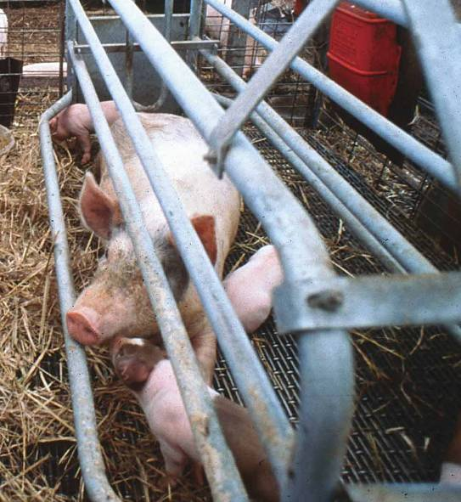
Swine
Water | 1 to 5 gallons per day
Protein | 12 to 18% of their diet
Energy | 3 to 6% of body weight per day
Vitamins | Make vitamin C and some of the B vitamins; will need to supplement A, D, E, K, B-series, and other water soluble vitamins
Minerals | Sodium & chloride (salt), calcium, phosphorus, copper, iron, zinc, iodine, selenium
USDA NRCS
Notes:
Water: 1 to 5 gallons per day. As always, these needs will more than double in warmer weather.
Protein: Swine are monogastric and cannot synthesize amino acids. There are 10 essential amino acids swine require. Lysine is the limiting amino acid for swine. Many swine feeds and feeding programs report total available lysine, rather than crude protein. Many swine diets contain a mix of grains for energy and soybeans for protein. Neither grain nor soybeans contain the vitamins and minerals needed for swine. Vitamin and mineral supplements are required.
Energy: Swine cannot handle the roughage-based diets of ruminants. Most swine feed is based on grains such as corn, wheat, barley, oats, etc. Fat should comprise 10 percent or less of the ration.
Vitamins: Swine make their own vitamin C and some B vitamins. However, early-weaned pigs may need C and B-series supplement. Supplementation of the fat-soluble vitamins A, D, E and K and the water-soluble B vitamins, choline, folic acid and panthothenic acid will probably be necessary.
Minerals: Salt is a required portion of the feed and is generally 0.25 percent of the ration. Calcium and phosphorus should be present at a ratio of 1.1:1 to 1.5:1. Copper, iron, zinc, iodine, and selenium should also be supplemented.

Slide 22
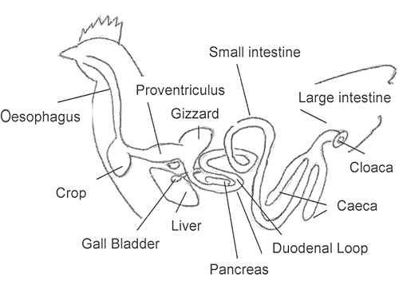
Poultry Digestive Tract
Notes:
The crop is a storage structure and the Proventriculus is more like we think of a stomach where the acids are mixed with the food.

Slide 23
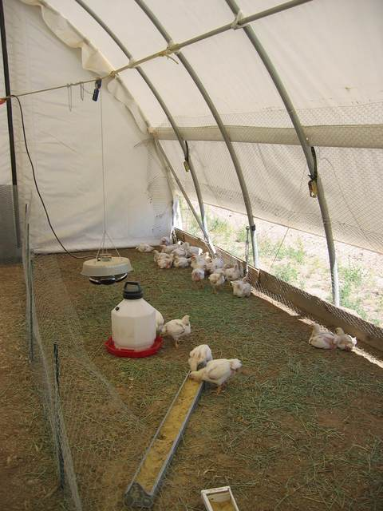
Poultry: for meat or eggs?
A laying ration provides two times more vitamin A, 2½ times more vitamin D and at least 3 times more calcium
A mature, lightweight bird will eat about 1/4 pound of feed daily, or 90 lbs/year, while producing about 240+ eggs each year
Broilers can gain 2 pounds for each pound of feed eaten
L. Allen, Nev.
Notes:
Be sure to read feed tags and match nutritional needs of the animals with the content of the feed. When pullet chicks first begin to lay, they should be switched from a growing ration to a laying ration to compensate for the nutrients used in egg production.

Slide 24
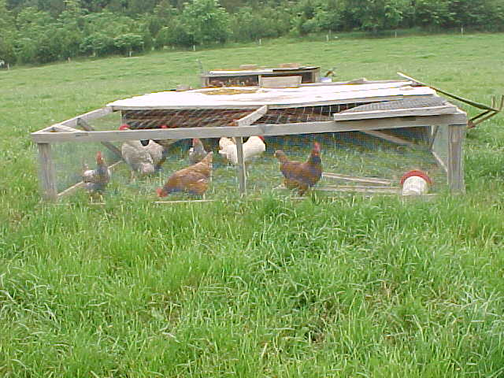
Pasture Poultry
Notes:
Pastured poultry is a niche market in which some consumers are willing to pay more for what many of them consider to be tastier, healthier and more humanely grown chicken. The poultry industry in the U.S. was pasture based until the 1950s when confinement housing became the norm. Small, independent producers have been replaced by highly integrated companies. Today there are many consumers interested in "natural" poultry products. Consumers have different interpretations of the term "natural" but it usually includes flocks of chickens that roam on grassy pasture and eat only non-medicated feeds that do not contain unappealing by-products. Some consumers want certified organic products or gourmet products, believing that pastured poultry delivers better nutrition and taste.

Slide 25
Pasture poultry
Meat type poultry raised on pasture during warm weather.
Chicks brooded and move to pasture at 3 weeks.
Harvested at 8 weeks.
Notes:
The chickens receive exercise and fresh air while foraging for plants and insects, and their manure adds fertility to the pasture. They are fed a supplemental feed concentrate, usually without routine medications such as antibiotics. Feed costs are reduced by keeping birds on pasture.
Production is usually seasonal-participants order day-old chicks from early April to October from hatcheries. Chicks are brooded and moved onto pasture at about 2- 3 weeks - when they are feathered out and when weather permits.
Birds are usually slaughtered on-farm at about 8 weeks of age and customers come directly to the farm to pick up their chicken. Although marketing is usually word-of-mouth, producers put significant effort into planning sales, reminding customers of pick-up dates, and having the birds ready on time.

Slide 26
Free Range Eggs
Yokes are darker and more flavorful.
Many different types of housing-chicken tractors
Predators
Notes:
The U.S. Department of Agriculture (USDA) does not currently have specific regulatory definitions for “free-range,” although the term is allowed on label under certain circumstances.
The main difference between free range and factory farmed eggs is that the birds are permitted to roam freely within the farmyard and only kept in sheds or henhouses at night.

Slide 27
Poultry
Water | 1 gallon per 10 chickens per day
Protein | 16 to 22% of their diet
Energy | Needs vary with age; layer hens require 1/4 pound of complete ration per day. Chickens can not digest cellulose.
Vitamins | Need A, E, K, B series, C, choline, folic acid, biotin, pantothenic acid; most are included in balanced ration. Vitamin D is produced in the skin if the birds have access to sunlight.
Minerals | Ca:P ratios of 2:1 for meat birds and 8:1 for laying hens; also require salt and trace amounts of iodine, iron, manganese and zinc
Notes:
Water: 1 gallon per 10 chickens per day. Water is the most important nutrient for chickens, since water makes up 55 to 75 percent of the bird’s body and 65 percent of each egg. Like most animals, water is required to digest feed. Chickens will generally drink 2 to 3 times as much water by weight as they eat in feed. If water supplies are inadequate, they will not eat. Laying hens drink 25 percent of their daily water intake during the two hours prior to darkness in the evening. It is important to check the water supply for chickens both morning and evening.
Protein: Chickens can make some of required amino acids if the other amino acids are in adequate supply. Chickens are omnivores, and it is not unusual for some feed ration ingredients to be animal-based proteins such as fish meal, bone meal or other meat by-products. If you are raising other livestock, it is important to segregate chicken feeds, both in storage and in feeders.
Energy : Needs vary with age. Layer hens require one-quarter pound of complete ration per day. Chicken can not digest cellulose, so the bulk of their ration is seed or grain-based plant products, such as corn, wheat and milo.
Vitamins: Chickens need vitamins A, E, K, B series, C, choline, folic acid, biotin, and pantothenic acid. Most of these nutrients are included in a balanced ration. Vitamin D is produced in the skin if the birds have access to sunlight.
Minerals: Ca:P ratios of 2:1 for meat birds; 8:1 for laying hens. Chickens also require salt and trace amounts of iodine, iron, manganese and zinc.

Slide 28
Reproduction Replacement rate
Animal Yearly repro rate Time to next Gen
Swine 20 10 months
Cattle 1 2 years
Sheep and Goats 1-3 1 year
Horse < 1 3 years
Poultry Many 7 months
Notes:
This is the amount of animals and the time need to turnover a generation. To go from birth to giving birth.

Slide 29
Fencing considerations
Balance looks, functionality and economics
Safety of animals and people
Installed or do-it-yourself
Life expectancy
Annual maintenance costs
Notes:
Before investing in fencing, ask yourself the following questions:
Will the fence meet my needs?
Can I afford the style of fence?
Is it safe for people and animals?
Can I install it myself?
How long will it last?
How much maintenance will it require?

Slide 30
What kind of shelter do my animals need? What kind of shelter do I want for my animals?

Slide 31
Considerations for shelter
Needs to provide adequate shelter for local weather conditions
summer
winter
Durable
Reasonable maintenance costs
Visually appealing
COSTS
Notes:
Questions to ask yourself:
Will the structure you’ve selected provide adequate shelter year-round?
Will it provide enough shade in the summer and enough protection during winter storms?
How long will it last?
How much will it cost to maintain, both in terms of time and money?
Do you like the way it looks?
Will it mesh with your property?
Is it visible from the street, and is this acceptable considering your CC&Rs, neighbors, etc.?
And, of course, HOW MUCH WILL THIS COST?

Slide 32
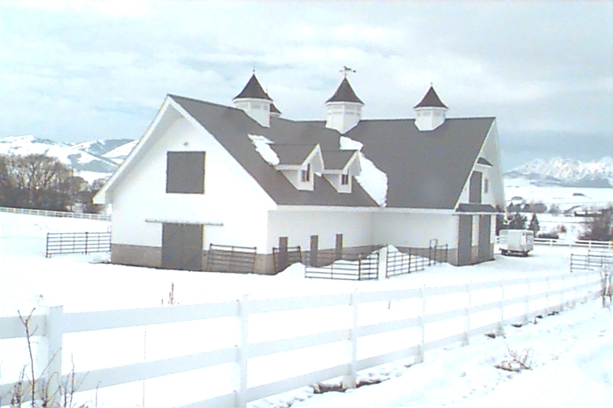
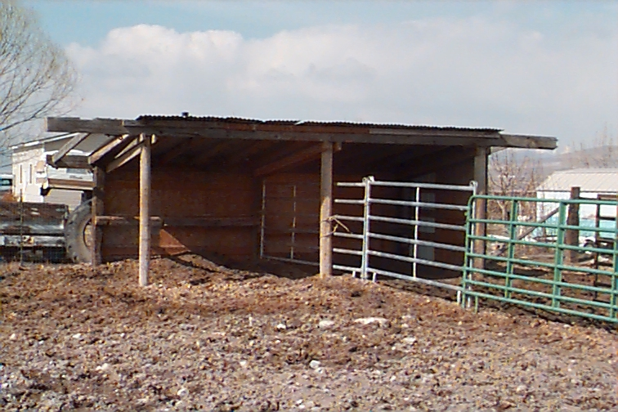
Shelter
Can be simple or elaborate
Costs vary widely
The Ritz
No Tell Motel
USU, Logan, UT
USU, Logan, UT
Notes:
Costs for shelters vary widely, from $8 per square foot to more than $275 per square foot, depending on type of shelter, the weather conditions, the location, etc.

Slide 33
Nutrition and Health
Well-fed animals in good condition are healthier and more resistant to disease
Two categories of disease:
Infectious (“to put into”)- caused by parasites, fungi, bacteria, viruses, protozoa
Noninfectious – results from issues such as nutritional deficiencies, metabolic disorders, trauma, congenital defects & toxic materials
Notes:
An animal health and disease prevention program is integrally linked to proper nutrition. Proper nutrition is an essential step in maintaining an animal’s defense system against disease and parasites. Mucous membranes and the skin provide the first line of defense against diseases. Vitamins A, B₂, and niacin are necessary to keep the skin’s surfaces in a healthy state. Protein and several of the B vitamins are needed for antibody production. Proper nutrition plays a vital role in keeping an animal’s resistance at the maximum level. It also enables an animal to respond properly to vaccinations. The effects of disease, in most cases, increase the nutritive requirements of the affected animals.
There are two main categories of disease:
Infectious diseases result from the entrance, growth and activity of disease-causing organisms in or on the animal’s body. Infectious diseases may or may not be contagious. Most infectious diseases are rather easily transmitted by direct contact. However, some are not passed from animal to animal. For example, tetanus is an infectious, noncontagious disease.
Noninfectious diseases are caused by nonliving agents, and result from such things as a nutritional deficiency, metabolic disorders, trauma, toxic materials, and congenital defects. These are also classified as noncontagious, since they don’t spread from animal to animal by direct or indirect contact.

Slide 34
Preventive healthcare for animals
Consult a local veterinarian
Maintain schedules of vaccinations
Keep complete records
Quarantine new animals
Notes:
Along with good nutrition, preventive healthcare for animals is an important consideration. A preventive healthcare program for your animals should take into account the following factors:
Consult a local veterinarian: Find out about the prevalence of diseases in your area. Ask about required and recommended vaccinations. If animals will be traveling interstate, you may be required to have veterinarian checks. This is especially true of horses.
Maintain vaccinations schedules: Most vaccines are given on an annual or biannual basis for adult animals. Vaccines are most effective when given at the appropriate time. Give vaccinations during other stock-handling times to reduce animal stress and your labor. If your animals are being raised for meat, check on the required withdrawal time from some drugs or vaccines. If you are attempting to raise animals naturally or organically, check on requirements relative to vaccinations. If you are selling the animals for meat, vaccinations may be required.
Record-keeping is a must: It is imperative that records be kept of vaccinations and checkups. Additional records of births, illnesses and injuries may prove helpful. Document the mode of administration of the vaccines or drugs (intravenous, subcutaneous, intramuscular) to determine if a withdrawal period is required before slaughter.
Quarantine new animals: Quarantine of new animals from other animals for a transition time period can help reduce infection and disease in your animals.
Instructor: Hand out local basic schedules for vaccinations for species of interest, if available. Vaccination schedules are different for each species and for each area. For this reason, vaccine schedules are not included in this lesson.

Slide 35
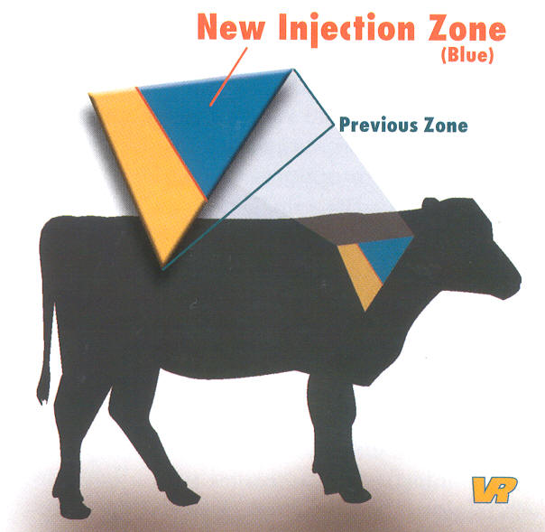
Injection Site
Notes:
Injections need to be made in the places on the animal where there are the least valuable cuts of meat.

Slide 36
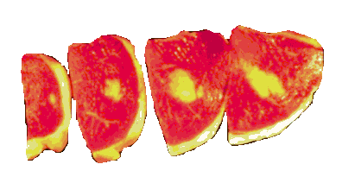
Injection Site Lesion
Notes:
Would you like this steak?

Slide 37
What to look for in a Healthy Animal
Shiny coat
Bright eyes
Good breathing
Body condition
Sound feet and legs
Genetics
Manure consistency

Slide 38
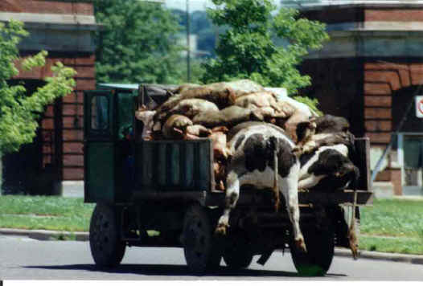
Dispose of dead animals properly
http://defendingfarmanimals

Slide 39
Wellbeing
Producer-originated animal suffering :
Neglect -- failing to provide an animal with a vital requirement such as food, water, or shelter.
Abuse -- striking or willfully harming an animal with a club or instrument of harm.
Notes:
Working with animals can be very frustrating and expensive. These can lead to Neglect or Abuse.

Slide 40
Safety Animals to watch
New moms
Males
Scared or cornered
Separated from the herd
Animals raised as pets
Notes:
People who work with animals recognize the ability of animals to communicate despite an inability to speak. Most species have and display characteristic signs of fear, aggression, and contentment. Astute handlers are sensitive to warnings evidenced by:
raised or pinned ears,
raised tail,
raised back hair,
barred teeth,
pawing the ground, and/or
snorting.

Slide 41
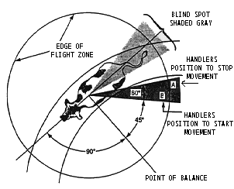
Flight zone
Notes:
A key aspect when working with cattle is to know and respect their
danger zone. With eyes on the side of the head, cattle have a wide range
of vision. However, there is a blind zone in their immediate hindquarter
area. Approaching from this direction can startle the animal. If you are
behind an animal and must move forward, move off somewhat to the side
and advance from a safer angle.
Kick Zone
When startled, cattle may respond defensively by kicking. The rear leg
will kick forward and out to the side. This may also be the case if an
animal experiences pain from injury or inflammation. For example, a cow
with mastitis in a left quarter may kick from the left side. In this instance,
approach or examine the cow from the
opposite side whenever possible.

