Slide 1
Presenter : Tzu-Chun Tseng Date: 2017/01/30
Tutorial to SAP2000 for CE470

Slide 2
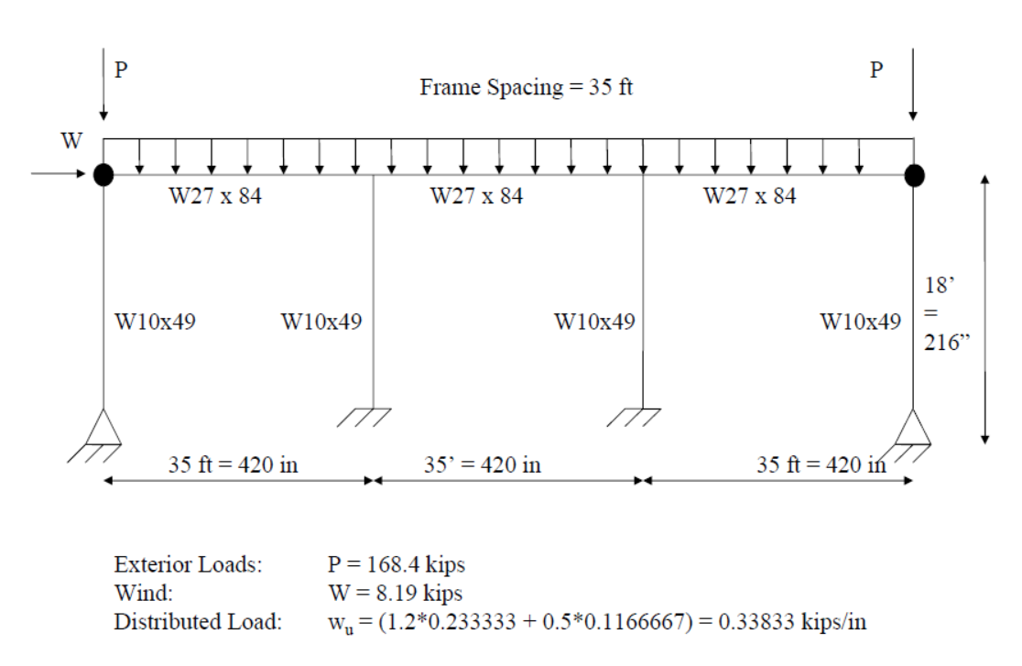
Frame and Loading Condition
A992Gr50 Steel, assume unfactored loads and 0.8 reduced stiffness.

Slide 3
Loading Condition
Wind load equals to 8.19 kips.
Notional load equals to 0.2% of total gravity load.
Case1: 1.2DL+1.6LL+Notional load
Case2: 1.2DL+1.0WL

Slide 4
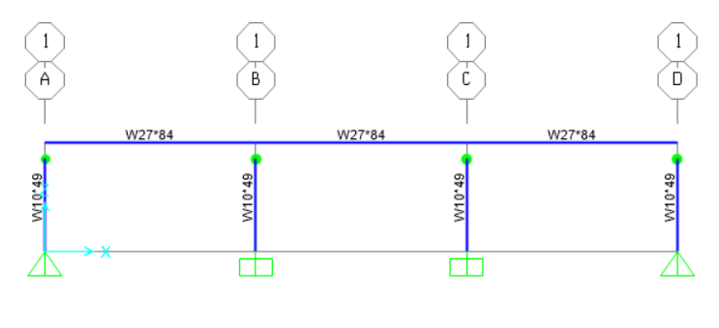
Employing The Previous Model

Slide 5
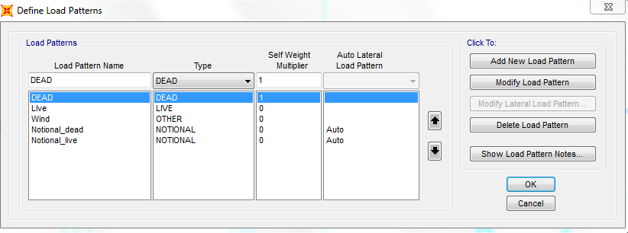
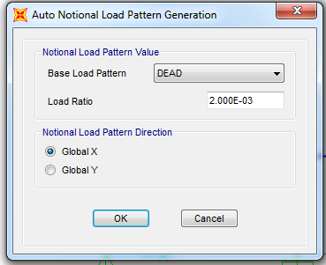
Define Load Patterns
Click on “Define-Load Patterns”.
Create new load patterns “Dead”, “Live”, ”Wind”, “Notional_dead” and “Notional_live”.
Click on “Modify Lateral Load Pattern” and set the notional load as 0.2% of the gravity load.

Slide 6
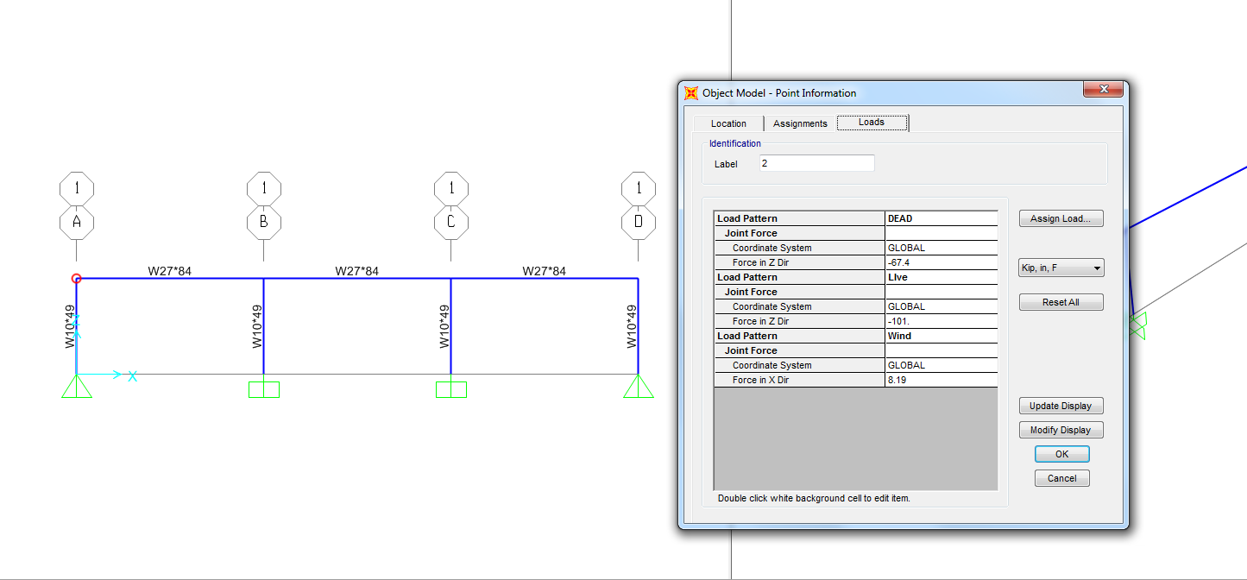
Assign Loads
Assign the dead load, the live load and wind load separately.
The notional load would be assigned automatically by the program.

Slide 7
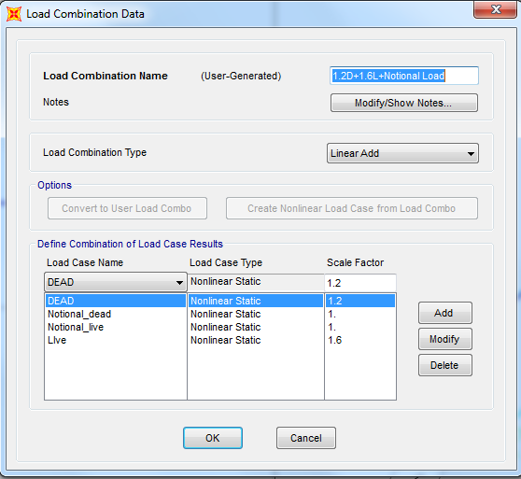
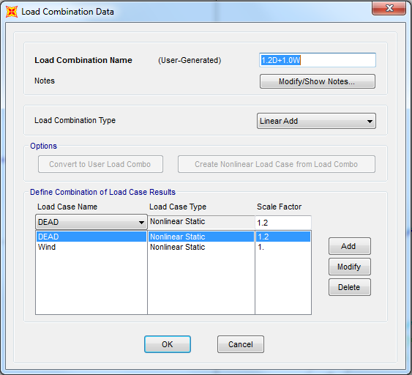
Define Load Combination
Click on “Define-Load Combinations-Add New Combo”.
Input proper scale factors and load cases.

Slide 8
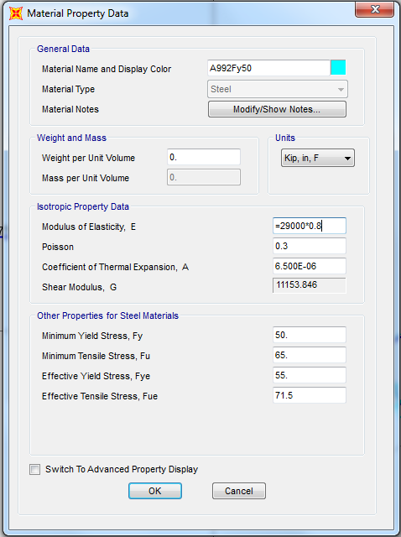
Reduce to The 0.8 Stiffness
You can adjust stiffness by changing the E value of material.

Slide 9
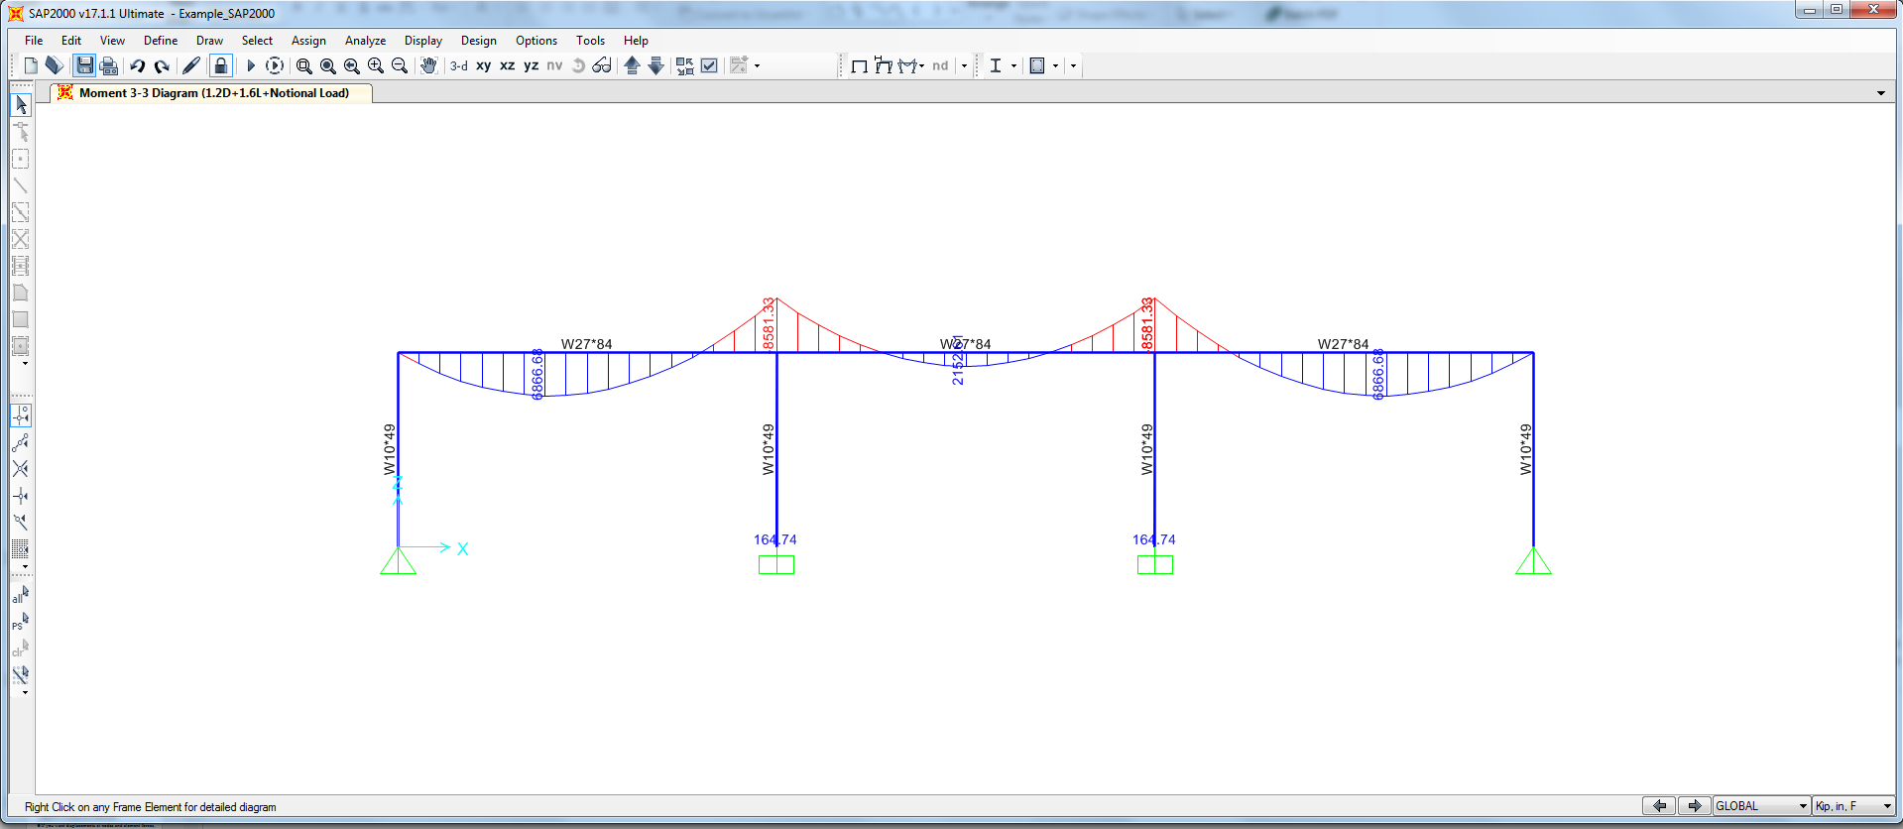
Run Analysis
Set all the cases as nonlinear cases and consider P-delta effect.
Click ”Analyze-Run Analysis-Run Now”.
You should get results as below.

Slide 10
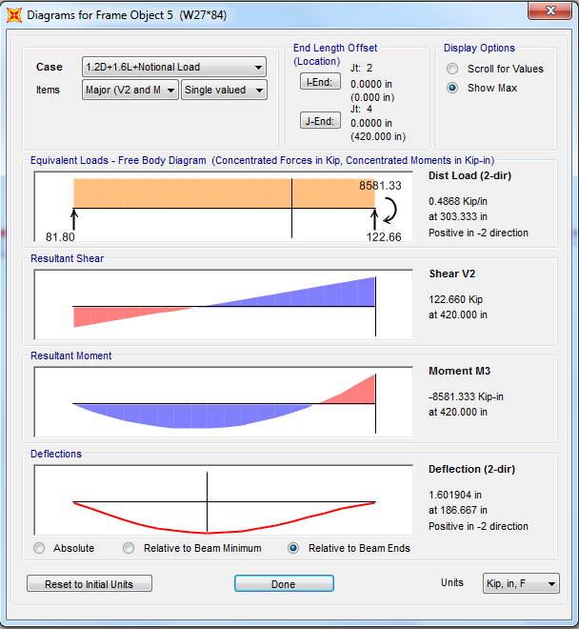
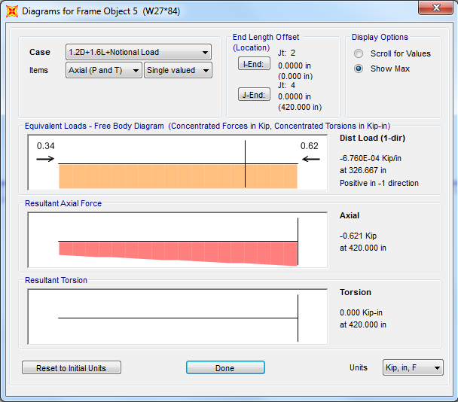
Analytical Results
You can see maximum shear forces, bending moments and axial forces for different load combinations as below.

Slide 11
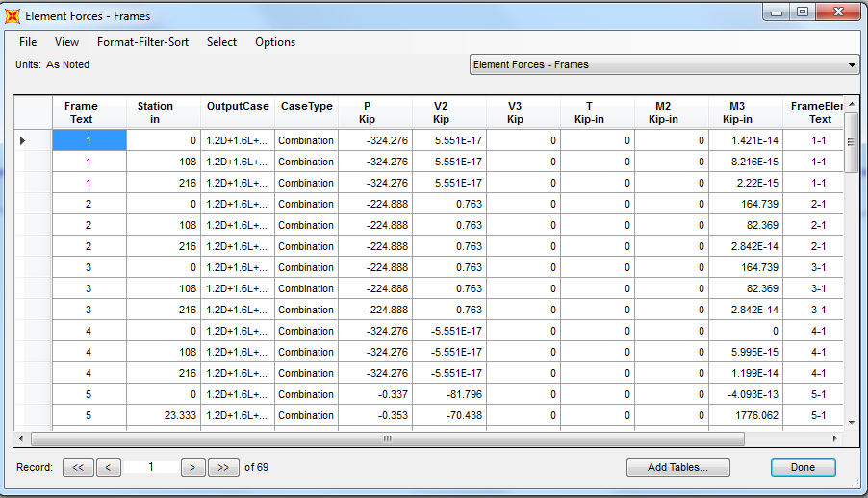
Analytical Results
The results can also be showed as tables.

Slide 12
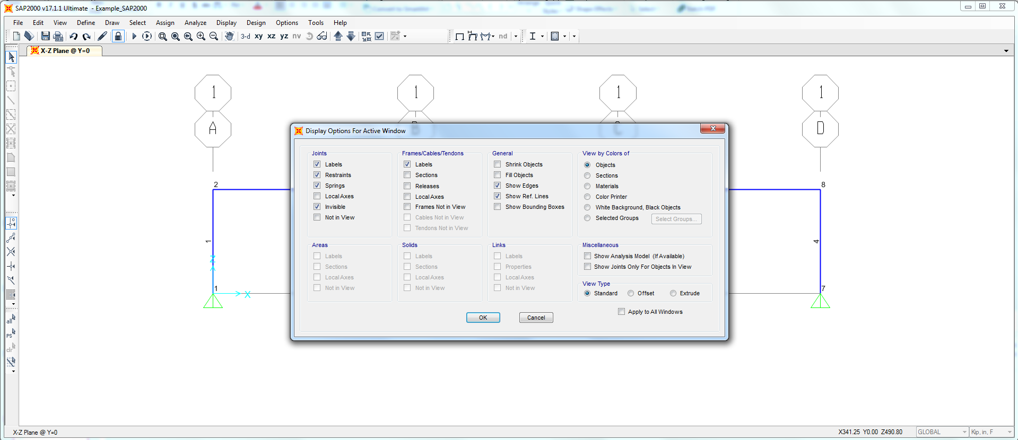
Reminder
Please indicate the labels of each member and joint, or I can hardly figure out your answers.

