Slide 1
Quantum Theory of Light
Cross disciplinary research is difficult

Slide 2
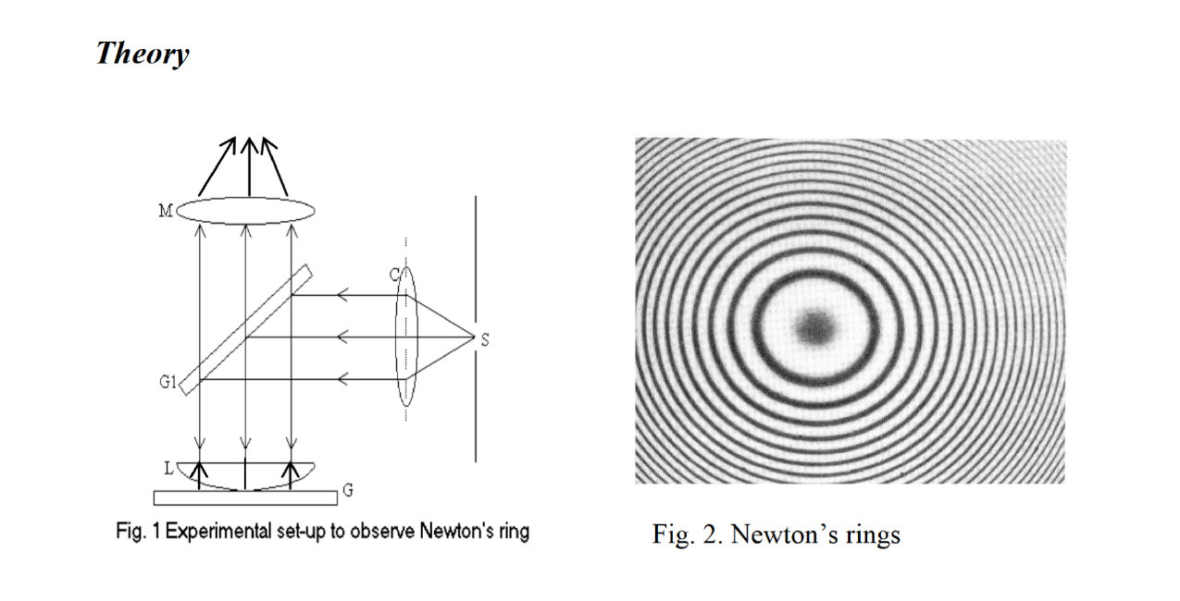

Slide 3
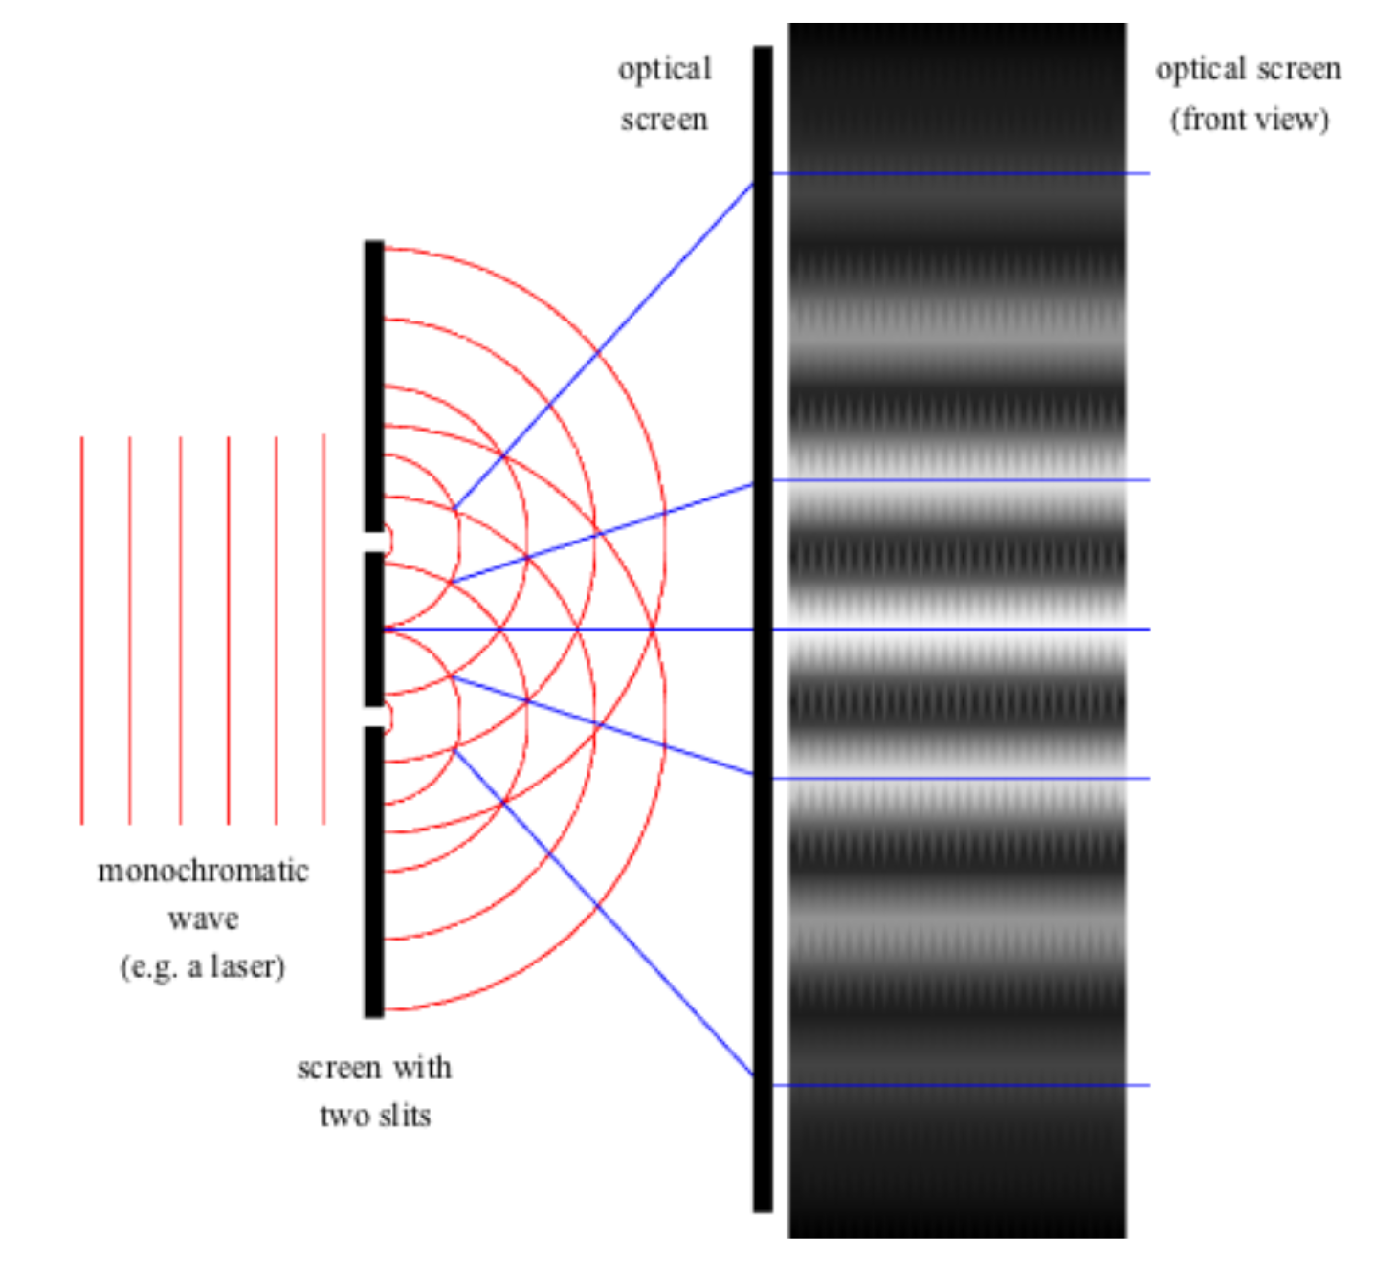

Slide 7
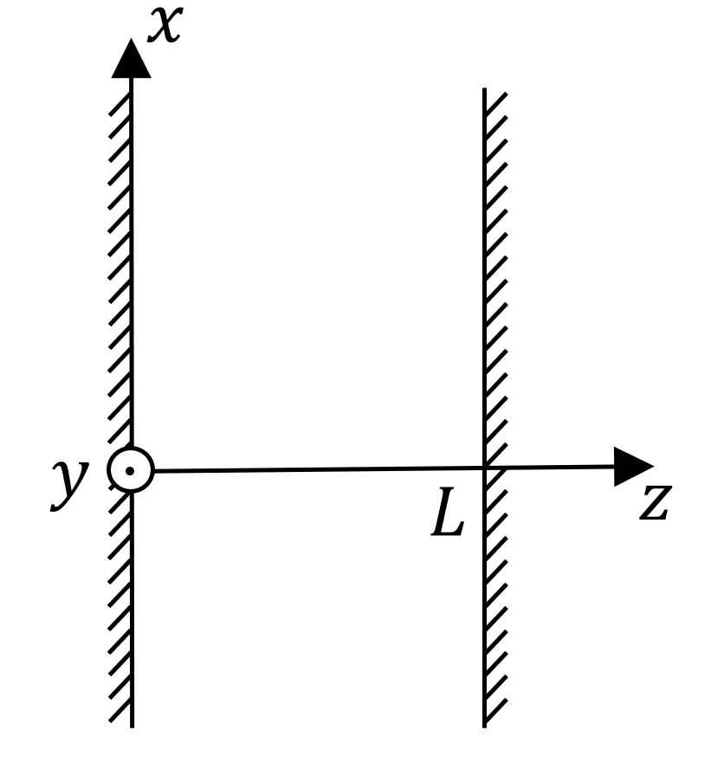

Slide 8
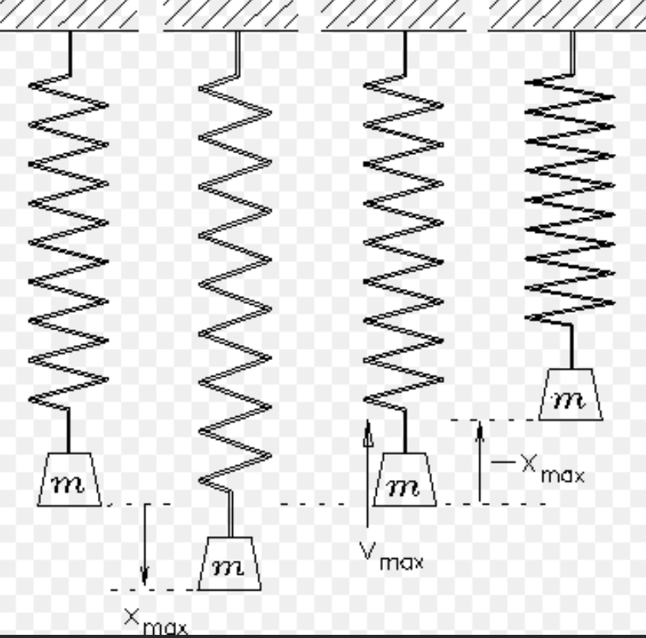
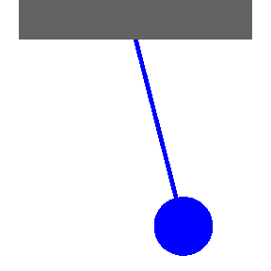
Electromagnetic Mode Oscillation
An electromagnetic mode oscillating is similar to a simple pendulum.
If we can connect a simple pendulm to a quantum pendulum, we can understand the quantization of electromagnetic field.
Notes:
電磁模式振盪類似于一個簡單的鐘擺; 如果我們能把一個簡單的鐘擺連接到量子擺, 我們就能理解電磁場的量子化。

Slide 15
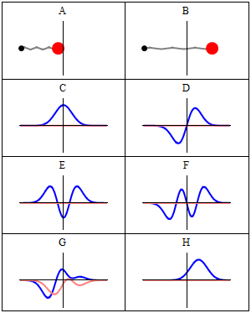
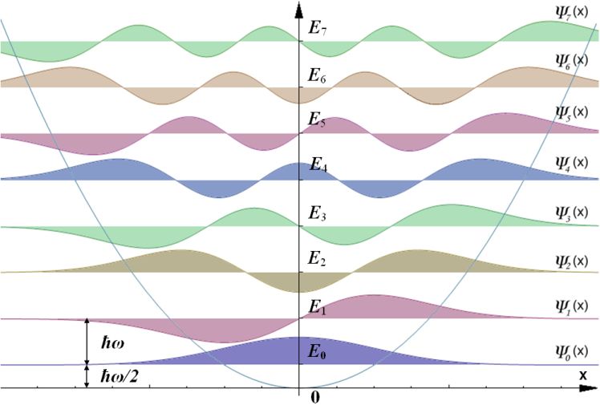
Electromagnetic Oscillation as a Quantum Pendulum
Courtesy of Wiki
Classical harmonic oscillator
Wave-Particle Duality
x²potential
Quantum harmonic oscillator
Photon-Number State
Quantum State Eigenequation
Wave mechanics
Zero point energy
Vacuum state
Potential Well
Notes:
二象性. 狀態。波動力學。真空；

Slide 18
