Slide 4
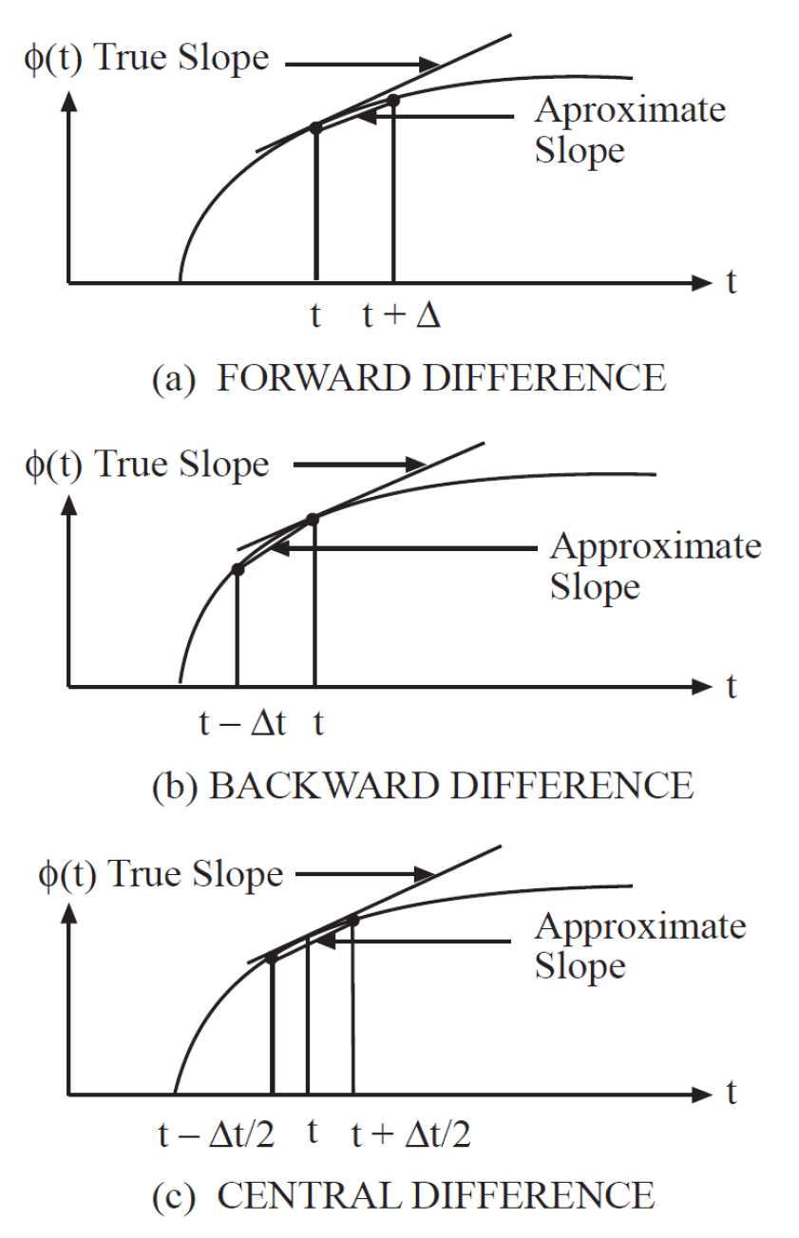

Slide 5
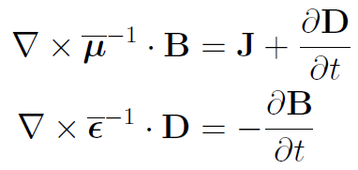
Convert ME into Matrix Eqns—CEM Made Simple
Finite Difference Time Domain Method （Yee （余）Algorithm, 1966):
Stability:
There ain’t such thing as a free lunch。

Slide 11
