Slide 2
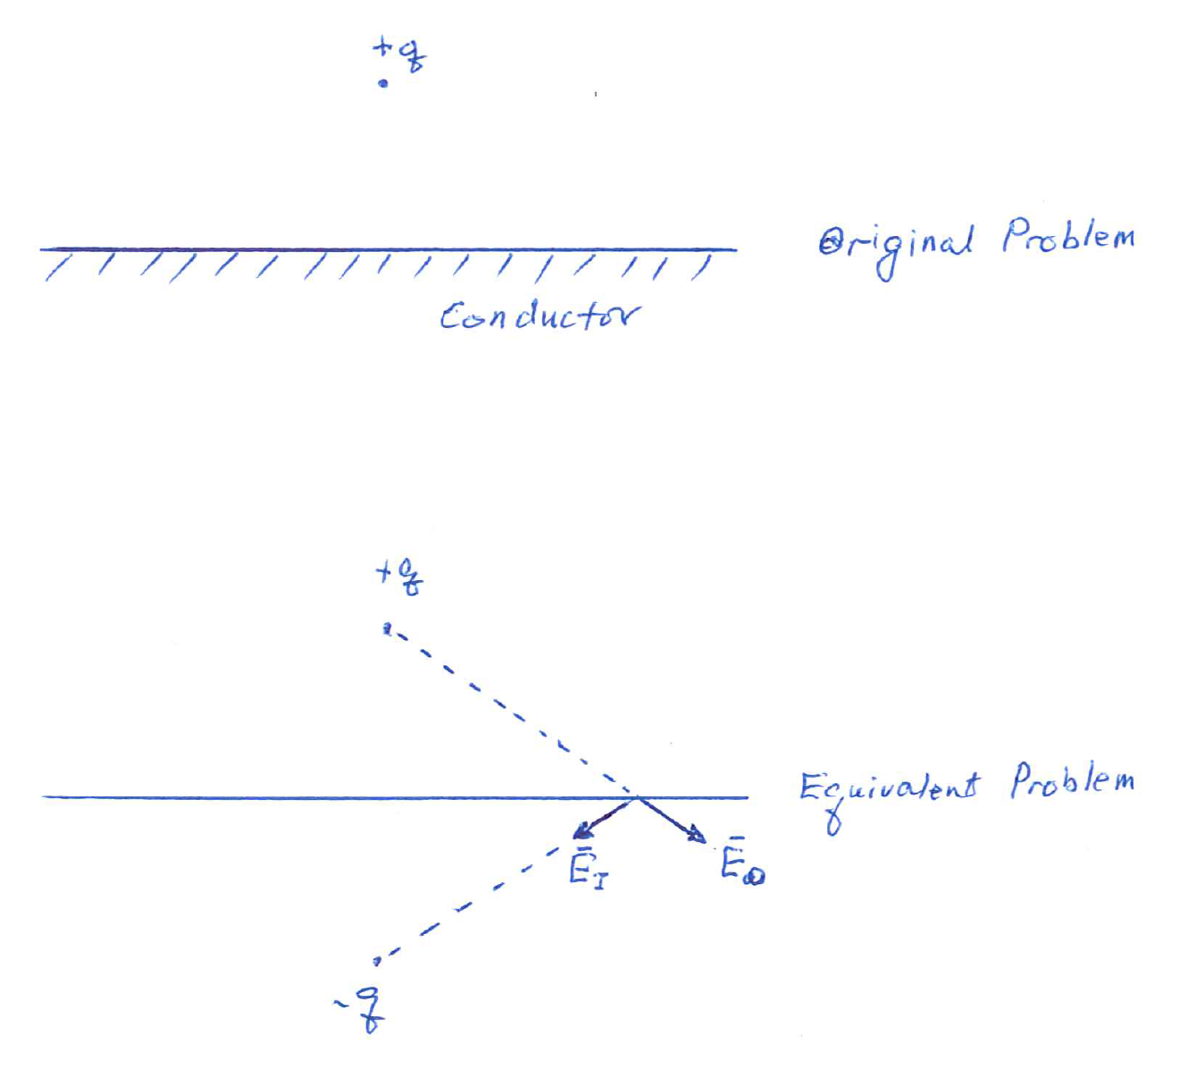

Slide 3
Image Theorem

Slide 4
Conductor Surface

Slide 5
Conductor Shielding

Slide 6
Relaxation Time in Shielding

Slide 7
Magnetic Monopole above PEC

Slide 9
Meissner Effect

Slide 11
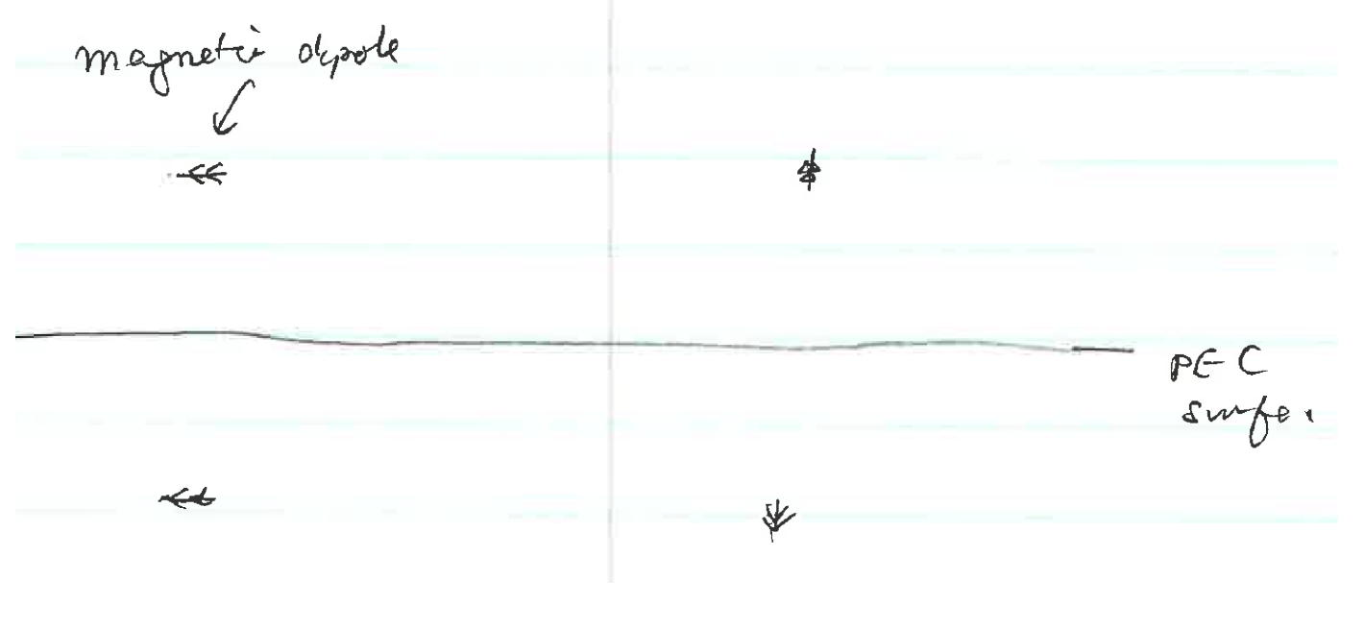

Slide 12
