Slide 1
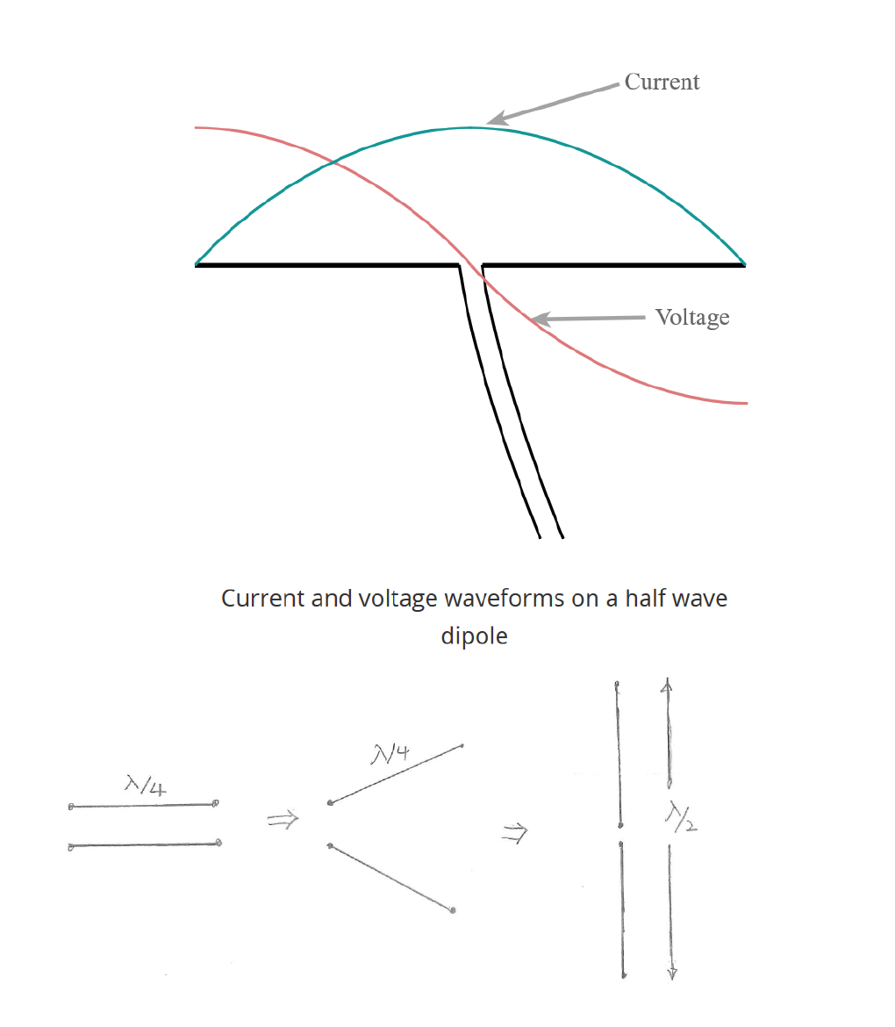

Slide 2
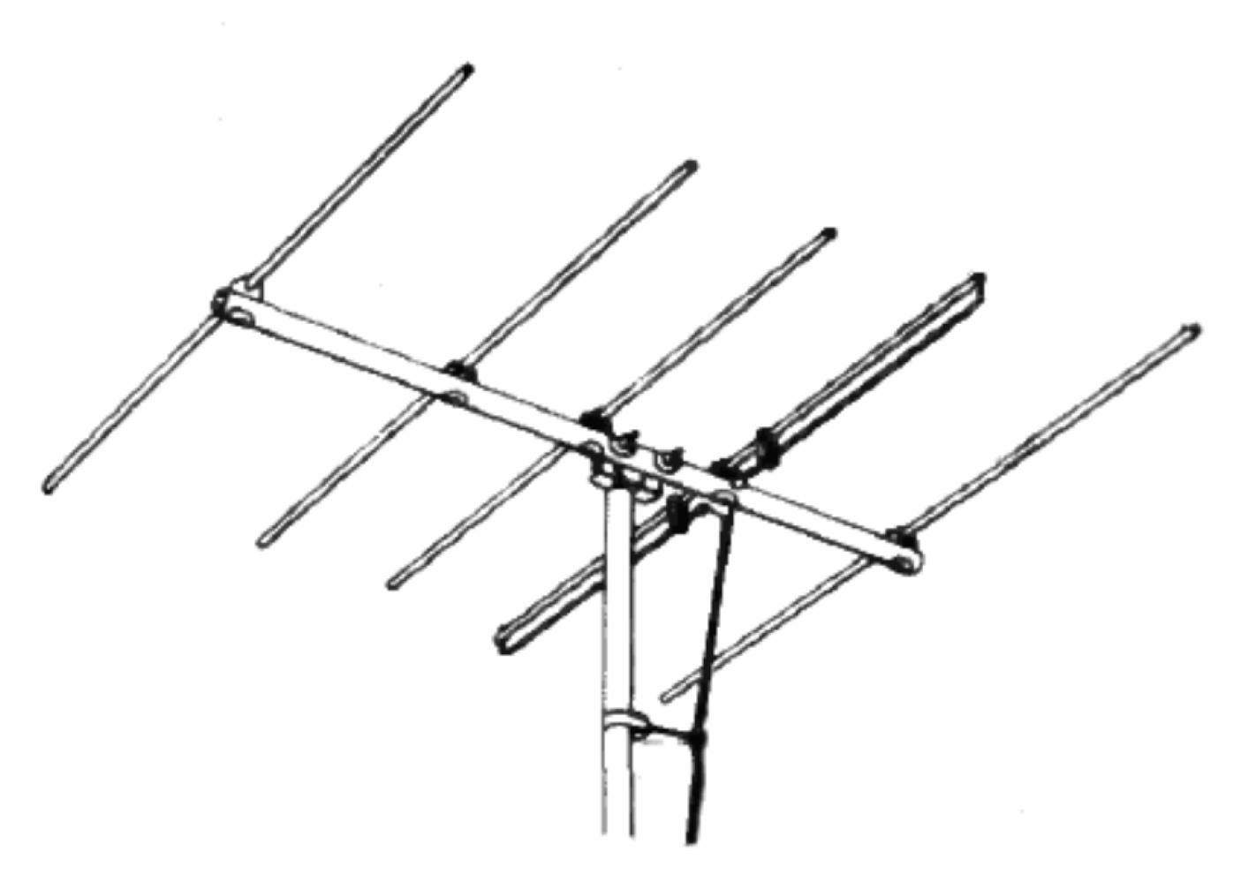

Slide 3
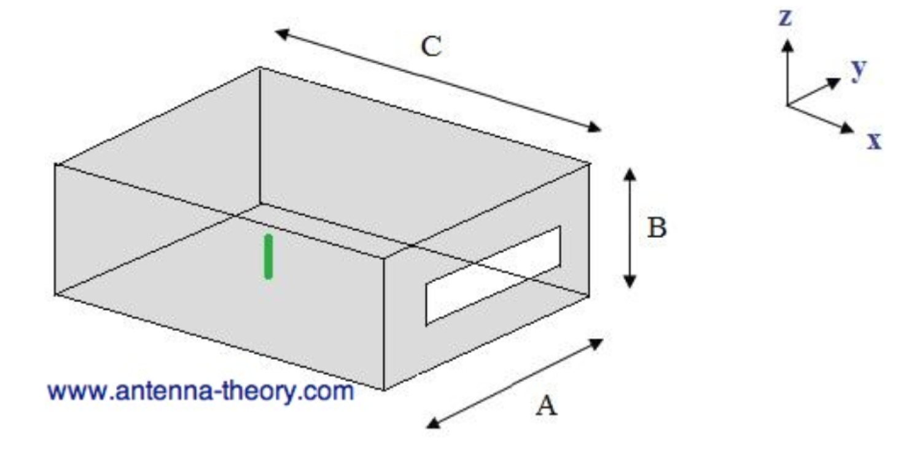
Cavity backed slot antenna

Slide 4
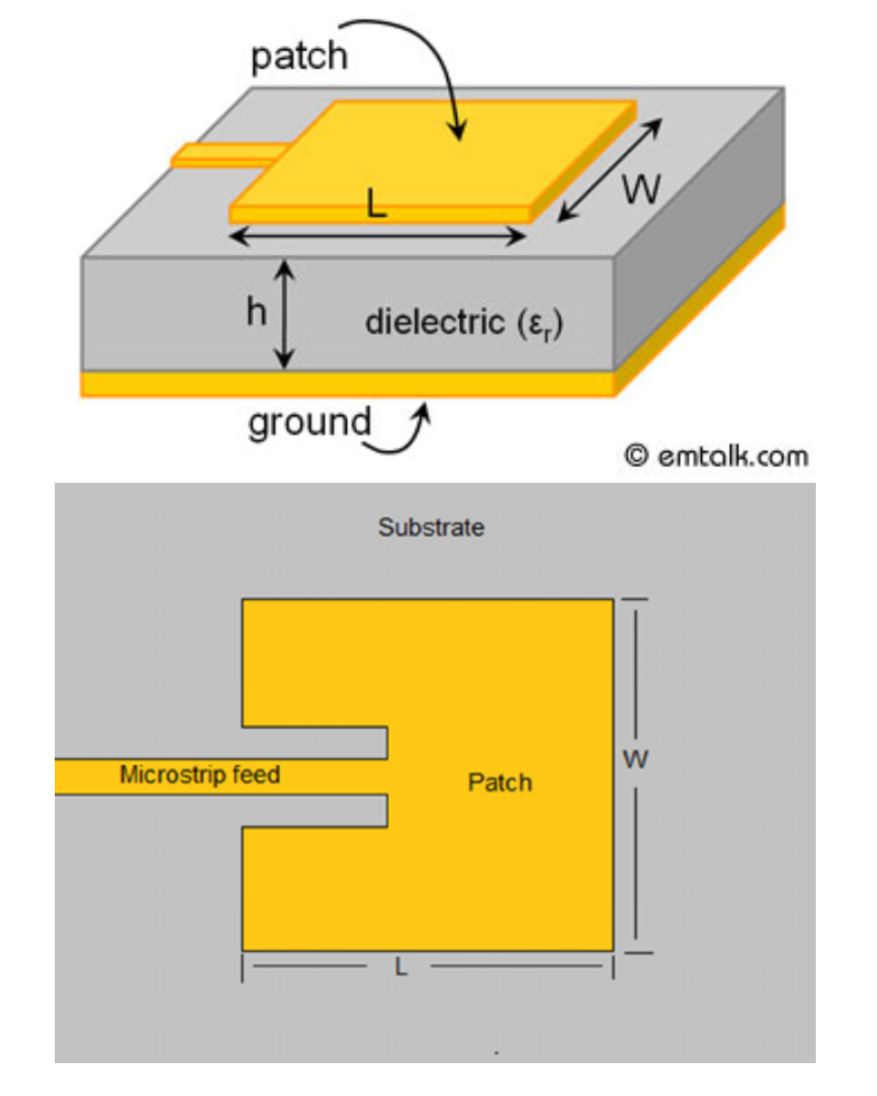
Microstrip patch antennas

Slide 5
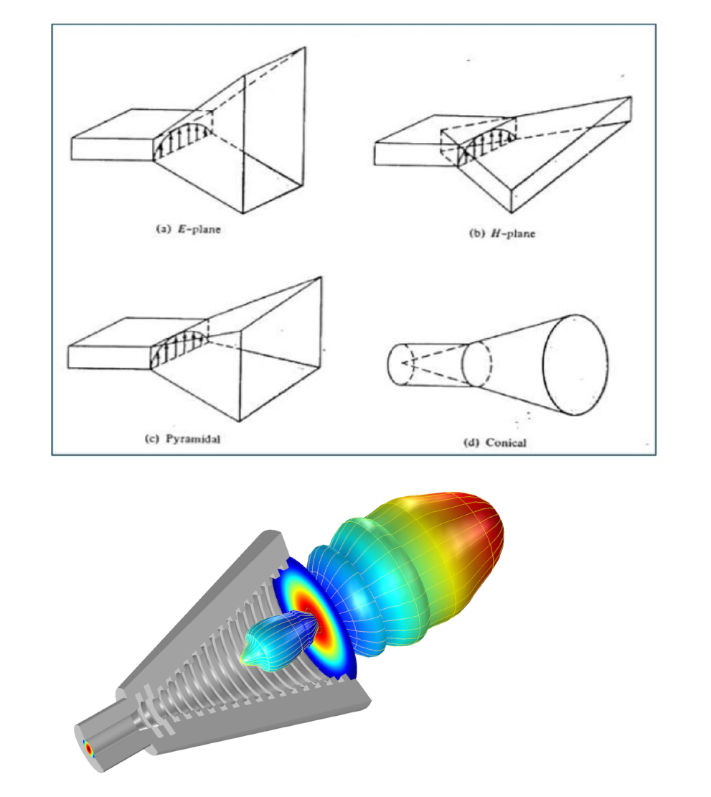
Horn antennas

Slide 6
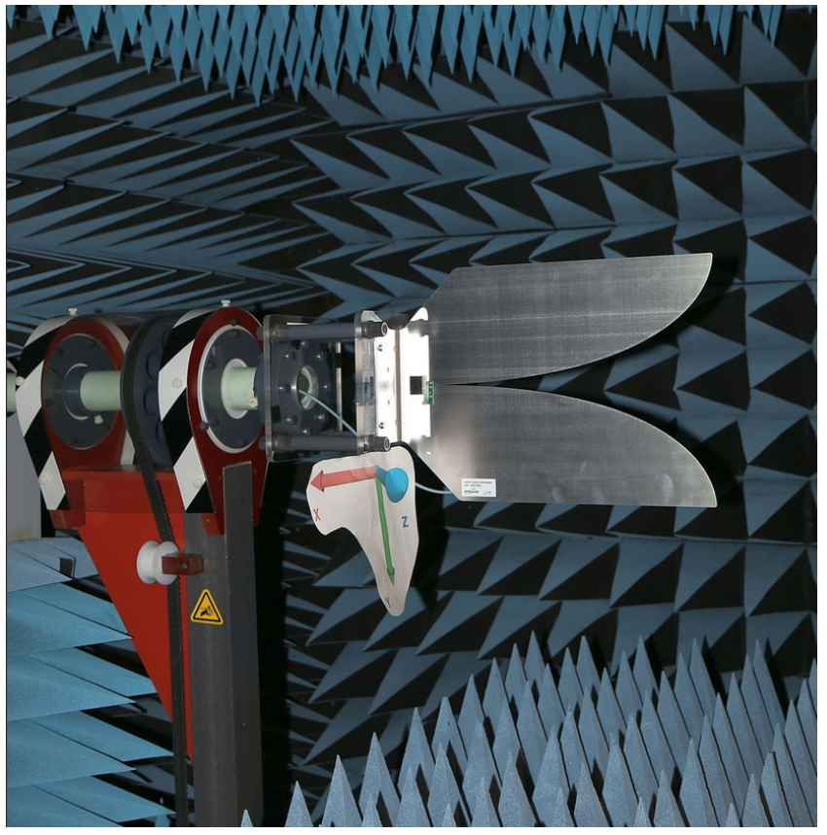
Vivaldi antenna

Slide 7
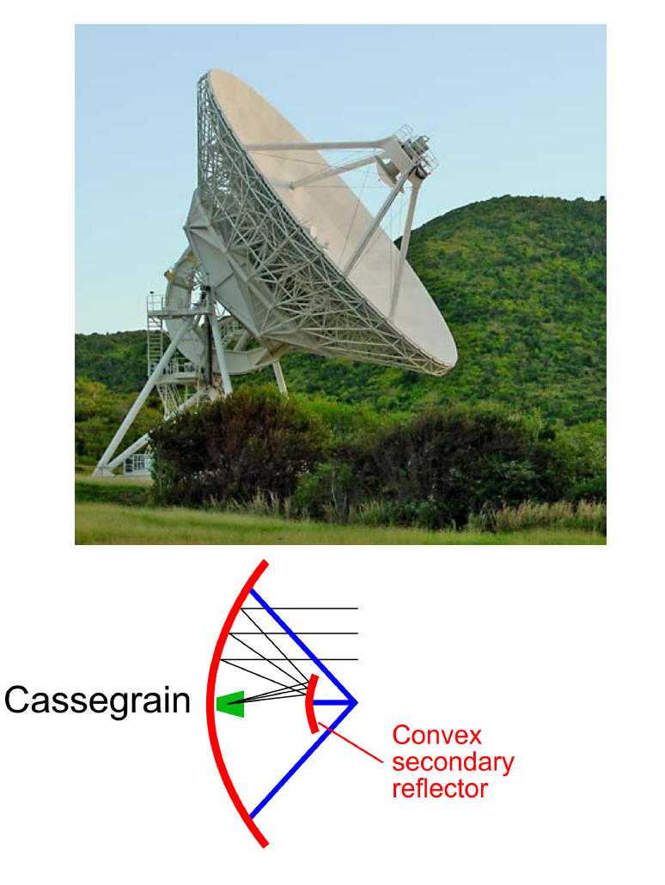
Parabolic reflector antenna

Slide 8
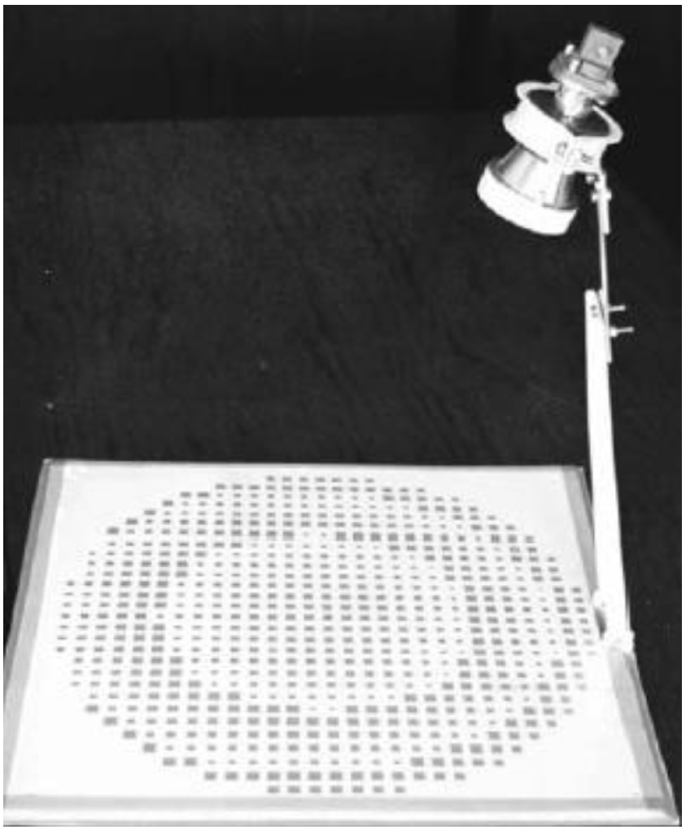
Reflectarray

Slide 9
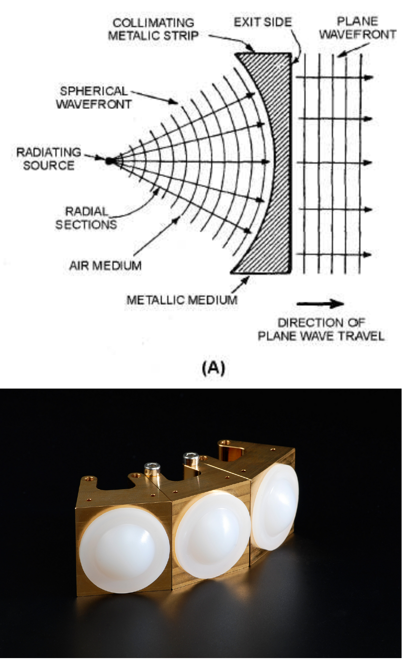
Lens antenna

Slide 10
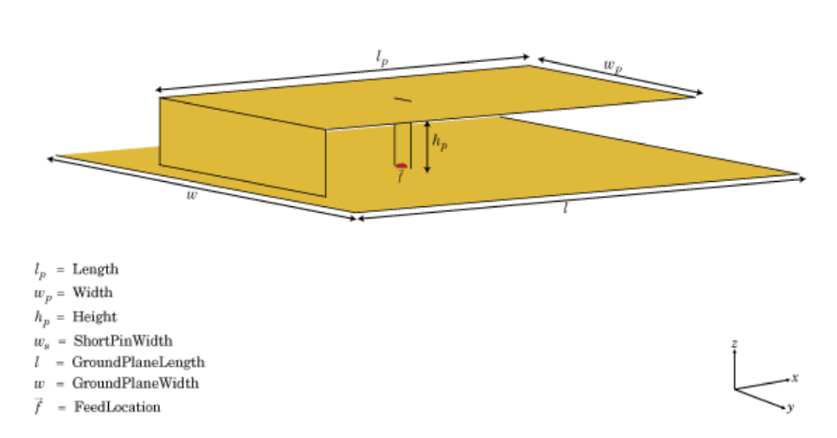
Small antenna-PIFA, planar inverted F antenna

Slide 11
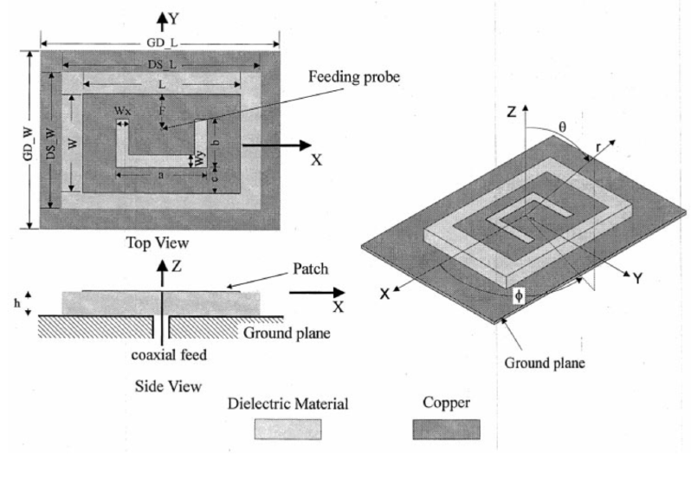
Small antenna-U Slot antenna

Slide 12










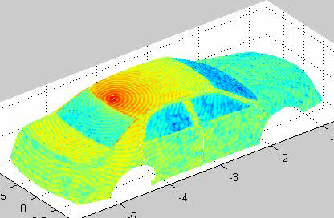
Animation of Current Distribution on Car (2005)
I.T. Chiang
A.J. Hesford
L.J. Jiang
M.K. Li
M.S. Tong
K. Pirapa
M. Delaquil
G. Sorenson
S. Ohnuki
J. Xiong
Antenna generates a circularly polarized field and current on rooftop of the car.
2 GHz antenna on a 4.25 m size car is equivalent to 100 GHz on a 8 cm board
Note also works by Zhen Peng and Z.P. Nie’s group.

Slide 13
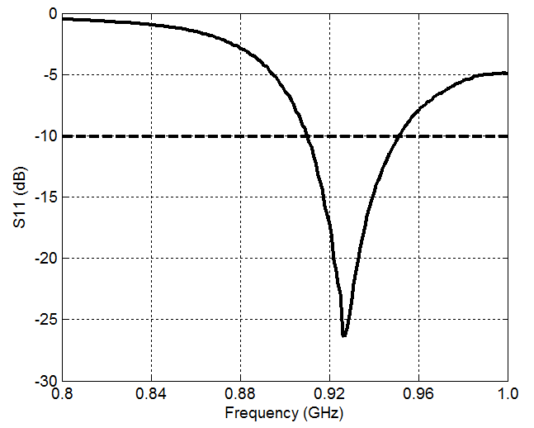
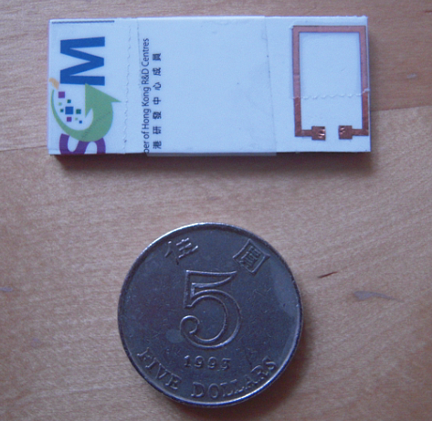
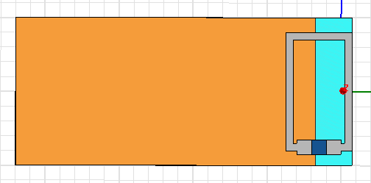
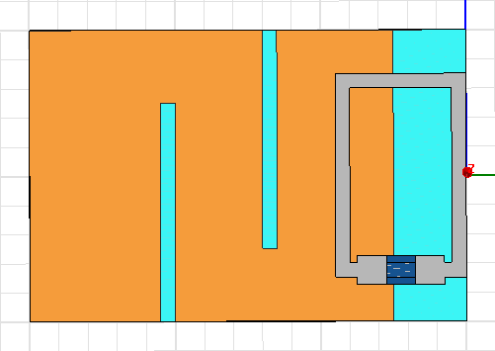
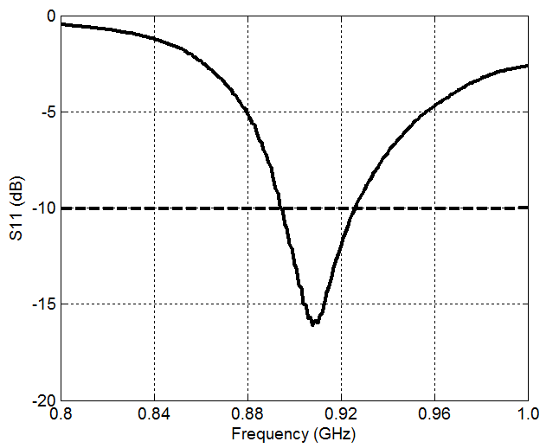
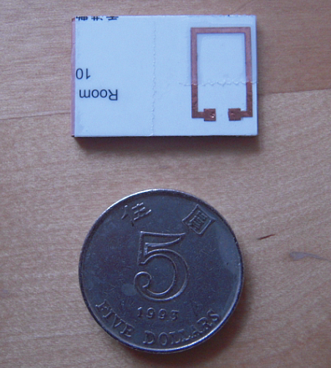
Size Reduction (YANG Peng, LI Yan, HUANG Jun, HE Shiquan, JIANG Lijun, Terry YE)
short
short
86*25*2mm
Read range:>5m
short
45*20*2mm
Read range:>2.5m
short
30*20*2mm
Read range:1m

Slide 14
Square Segmented Loop
See also: Daniel M. Dobkin, Steven M. Weigand and Nathan Iye, Microwave Journal, vol.50 , no. 6, 2007.
By CHEN Zhi Ning, from ASTAR, Singapore, 2009

Slide 16
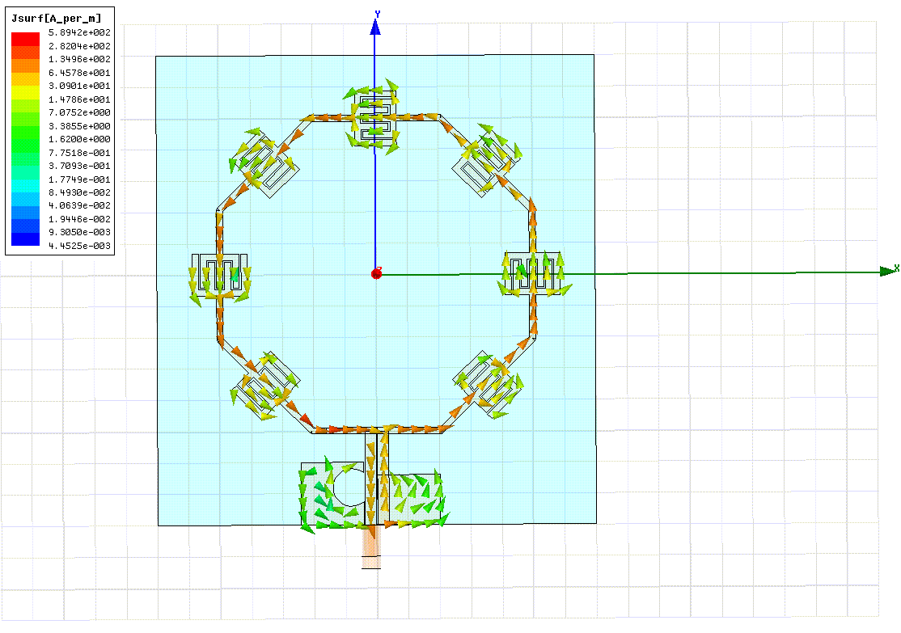
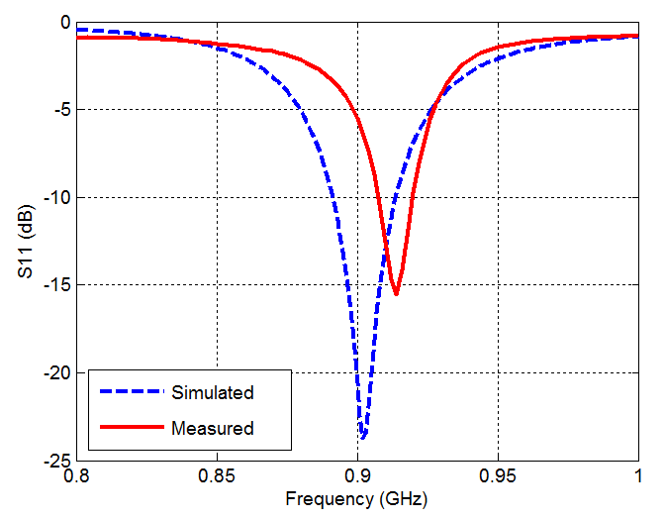
Current Distribution and Measured S11 (YANG Peng, LI Yan, HUANG Jun, HE Shiquan, JIANG Lijun, Terry YE)

