Slide 5
J. Xiong

Slide 6
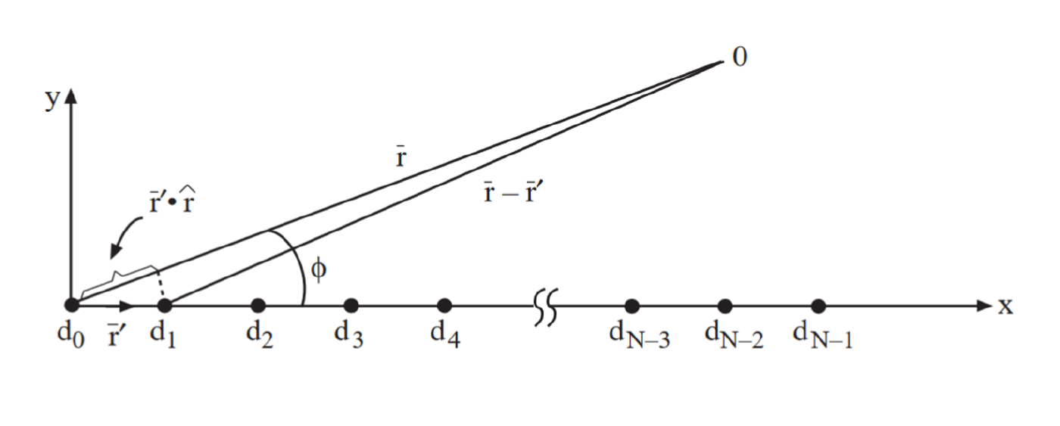

Slide 11
Cavity backed slot antenna

Slide 12
Microstrip patch antennas

Slide 13
Horn antennas

Slide 14
Vivaldi antenna

Slide 15
Parabolic reflector antenna

Slide 16
Reflectarray

Slide 17
Lens antenna

Slide 18
Small antenna-PIFA, planar inverted F antenna

Slide 19
Small antenna-U Slot antenna

